Slide 1
Sustainable Concepts and Technologies
Workpackage Meeting
iFAST 2nd Annual Meeting, April 18, 2023
Mike Seidel, PSI/EPFL

Slide 2
Agenda for today, April 18
1) | Welcome and Introduction, M.Seidel (PSI)
2) | Update on CERN activities, N.Catalan-Lasheras (CERN)
3) | Plans at ESS after change of coordinator, A.Sunesson (ESS)
4) | Update workshop on HTS applications and GSI activities on energy efficiency, P.Spiller, J.Stadlmann (GSI)
5) | Lessons of workshop on critical materials and plans for DESY activities, D.Völker (DESY)
6) | Update on PM combined function magnets and plans for STFC, A.Hinton, B.Shepherd (STFC)
7) | Discussion, all: Support of ESSRI workshop Madrid, 2024 Ideas for additional activities of WP11 in remaining time till 4/2025, e.g. topical workshops A.O.B.
8) | Review of decisions and conclusion (all)

Slide 3
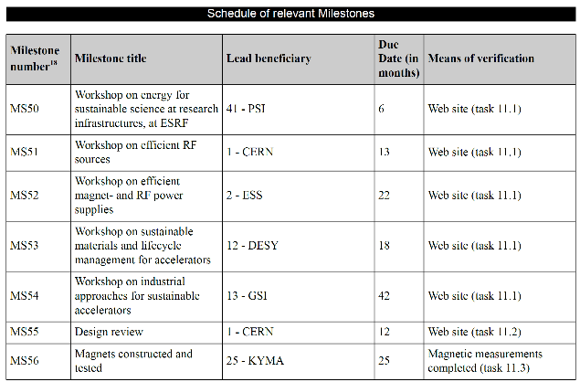
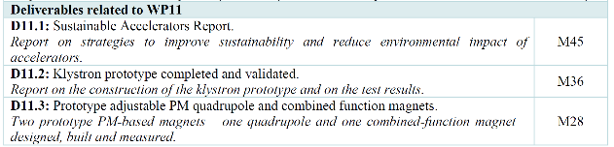
Appendix: Milestones & Deliverables
September 2022, done
July 2022, done
Delayed to 2024
February 2023, done
December 2023 (HTS topic)
June 2022, done
July 2023

