Slide 1
ESS in iFAST
Anders Sunesson WP 17
Marko Kalafatic WP 17 leader
Mamad Eshraqi Beam Physics GL
www.europeanspallationsource.se
April 2023

Slide 2
Summary
Sustainability in accelerator operation:
    PV installation to supplement the grid – considerable savings possible
    More efficient DC/DC converter to directly power equipment (in fact, most electronics is powered by DC!), for example to 1.1 kV voltage, which would allow direct powering of HV modulators with higher efficiency
Improved power converters in general using active frontends – less need for compensation for flicker etc
Workshop 2023 moved to 2024. Suggested focus Efficient Power converters and solar power generation optimization
ESS co-applicant to HORIZON 2023 program FlexRICAN geared towards sustainability and flexibility in how you power facilities

Slide 3
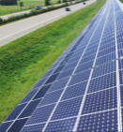
Alternatives
Alternative 1:
PV injected into the AC grid (4 stages)
Alternative 2:
PV injected into power converters (2 stages)
Power Converter
load
(magnets, RF amp’s)
load
(magnets, RF amp’s)
Power Converter
AC grid
AC
AC grid
DC
DC
~
~
DC
DC
DC
AFE: Active Front End
η_{PV}≈0.98x0.97x0.97x0.95 = 87.6%
η_{PV}≈0.98x0.95 = 93.1%
AC
DC
For P=0.5MW ->
savings ≈ 20k€/year
DC
DC
DC
DC

Slide 4
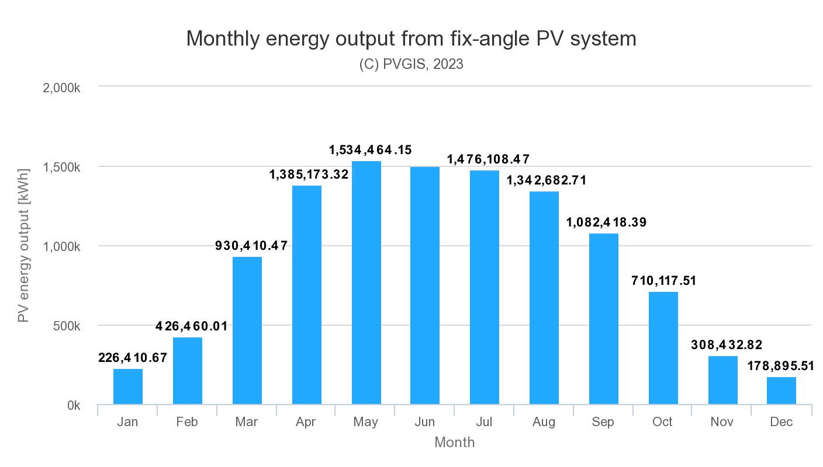
Possible power savings using PV
Using public websites, ESS can quite easily cover enough ground on the site to install more than 10 MW of solar power
From PVGIS, this area would allow generation of 11 GWh per year
Combining with HV Power need for ESS 2 MW linac, savings of ca 1 M€/year possible
DC/DC feeding would add ca 50 kEuro

Slide 5
FlexRICAN application highlights
Flexibility in powering Research Infrastructures
Optimising solar power set-ups
    Validate models for solar irradiation and how they work over time in a pilot set-up
    Actually design DC/DC converters and the system to employ them
Develop efficient energy storage systems
    Employ batteries to ”even out” variations in sustainable sources power delivery and stabilise the grid
Recover excess heat
    Use warm cooling water in district heating that otherwise would have gone to waste
    Use also lower grade water (possible for some installations)

Slide 6
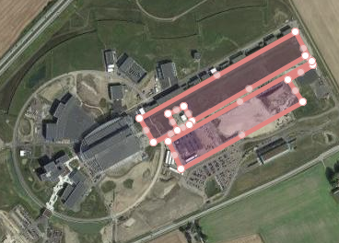
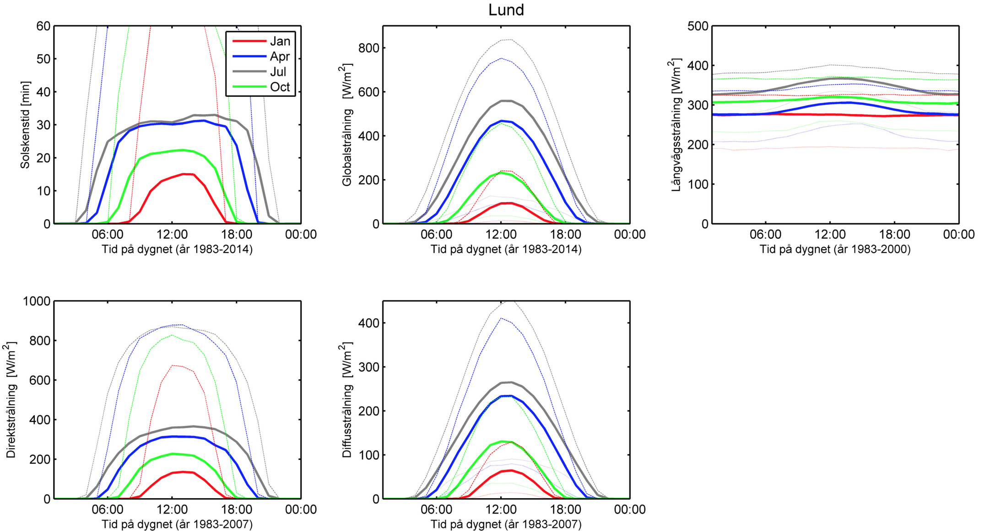
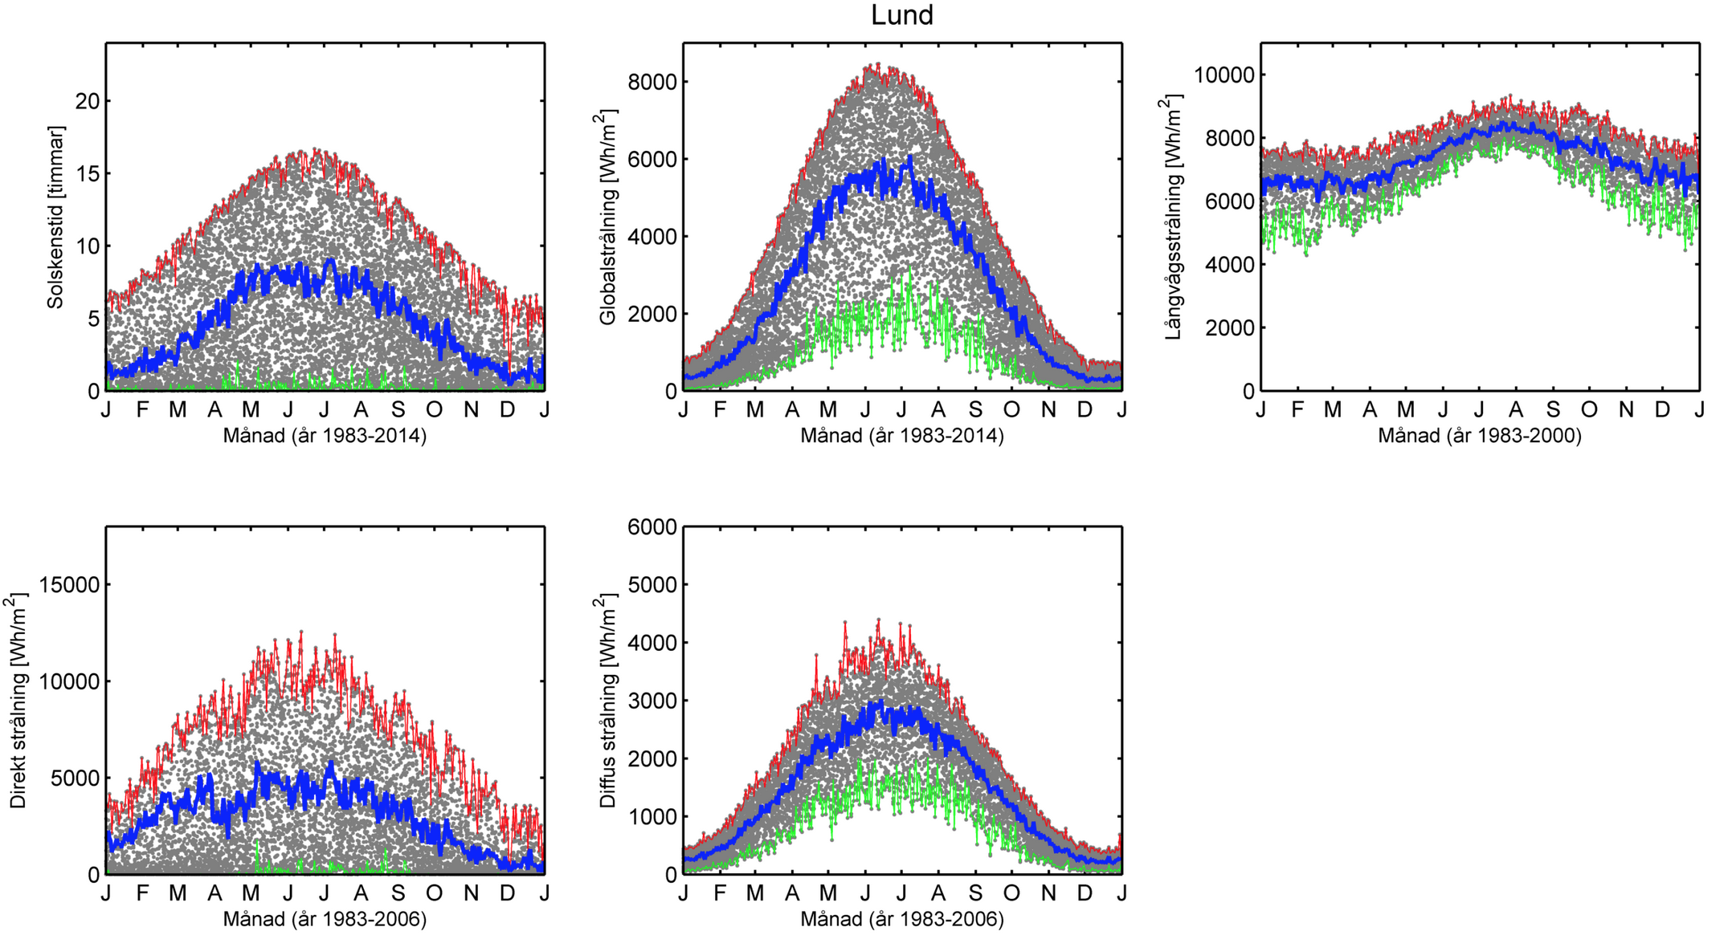
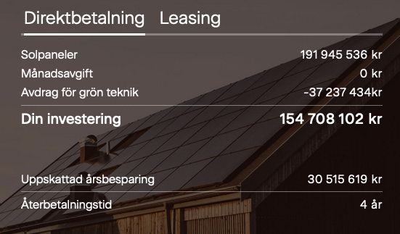
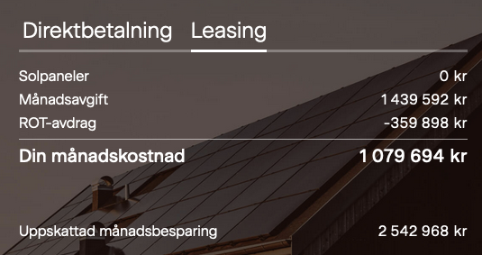
Solar Neutrons
Solar cells powering the neutron source
Panels are 1.1 x 1.75 m, each rated at 410 W
  With ~34k panels the installed capacity is ~14 MW, total cost (incl VAT): 154 MSEK
  Daily variations
  Annual variations
https://www.smhi.se/kunskapsbanken/meteorologi/stralning/solstralning-i-sverige-1.89984

