Slide 1
Energy Efficiency and Sustainability
Accelerator Research and Development
Peter Spiller
Subproject SIS100/SIS18
GSI Task Force Energy
02.02.2023

Slide 2
Energy Efficiency - Topics
Energy Saving HTS Magnet
KI based Power Grid Monitoring
Sensor Based Power Monitoring
Watchdog for Accelerator Devices
Development of a HTS Nuclotron Cable
FAIR Energy Consumption Forecast
Cooling Water Flow Control
Energy Efficient Design of SIS100 Cooling System
Energy Efficient beam Transport by High Current Pulsed Magnets

Slide 3
Campus Studies C. Ripp
Masterthesis C. Ripp
Multi energy web platform and monitoring at TUD "EnEff Campus Lichtwiese“, based on the concept of digital twins.
Transparent time-dependent, consumption-related CO2 emissions of all of the campus' buildings over all energy forms.
Data monitoring - Sensor system approach

Slide 4
Campus StudieS
GSI – Load Curves and Electrical Power
Masterthesis C. Ripp
Energy Consumption: 55 GWh
(Electrical) Energy Cost: 7.6 M€ (2012)
Max. peak: 12 MW (incl. accel. operation)
Min. load: 2.2 MW (e,g. holiday period)

Slide 5
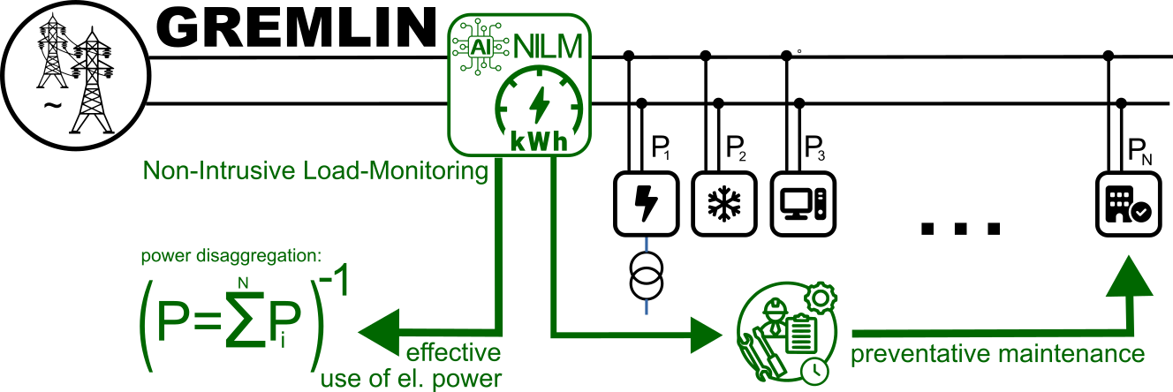
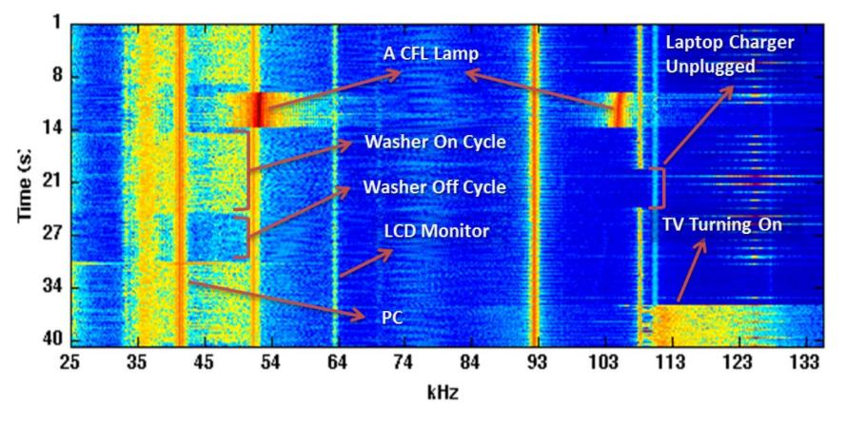
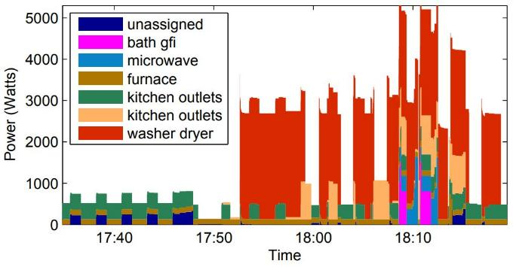
aka. load disaggregation
Non-Intrusive Load Monitoring
EMI Device Fingerprints
AI-based classification of facility’s effective energy consumption at the device level without the need for direct instrumentation of each device (N.B. “big brother” of domestic smart-meters)
  N.B. identification via unique electromagnetic interference (EMI) emissions devices generate on the network (aka. 'Van Eck phreaking' or 'TEMPEST')
  Opportunities:
  monitor effective energy use on a sub-component level
  → detect unused or unnecessarily powered devices
  identify malfunctioning, degrading, or inefficient equipment
  → schedule preventative maintenance or mitigation measures.
Extended Domestic Application beyond FAIR:
source [1]
[1] Sidhant Gupta, "ElectriSense: Single-Point Sensing using EMI for Electrical Event Detection and Classification [..]",PhD thesis, U-Washington, 2014

Slide 6

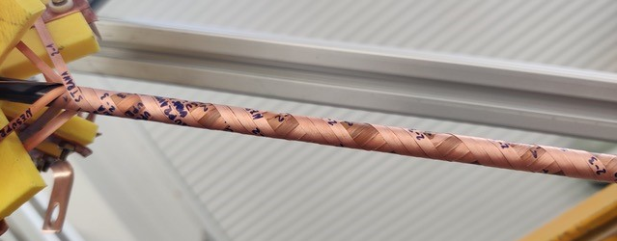
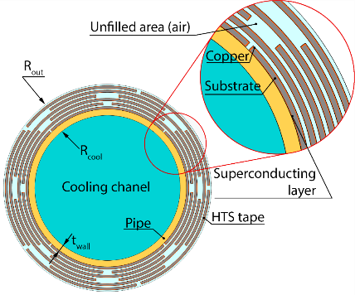


HTS ReBCO Cable
B_{ac}
_{(80 mT,}
_{50 Hz)}
HTS Nuklotron cable sample
Transposition= 22 mm
COLLAGE: A.-S. MÜLLER, FOTO : M. BREIG/KIT
Design Parameters for a round, high current, low ac loss HTS ReBCO cable defined
Good direct cooling properties, and windability of FAIR SIS100 cable and apply it to HTS
Application: fast ramped, high field accelerator magnets
EU IFAST work packages members:
  Institute of Electrical Engineering (IEE), Slovak Academy of Sciences, Slovakia
  ILK Dresden, Germany
  GSI, Germany
  EMS Chair, University of Twente (UT), Netherlands
I.FAST
Innovation Fostering in Accelerator Science and Technology
Horizon 2020 Research Infrastructures GA n° 101004730
Notes:
Mo 26.9. 14:00 – Giovanni de Carne – Investigating energy futures: The KITTEN test facility for sustainable research infrastructures
Mo 26.9. 14:50 – Samira Fatehi – High temperature superconductors and magnet technologies
Mo 26.9. 15:05 – Tiemo Winkler – Development of a new HTS Nuklotron cable for fast ramped S.C. magnets
Mo 27.9. 14:35 – Jens Völker – Permanent magnet design for BESSY II and BESSY III

Slide 7
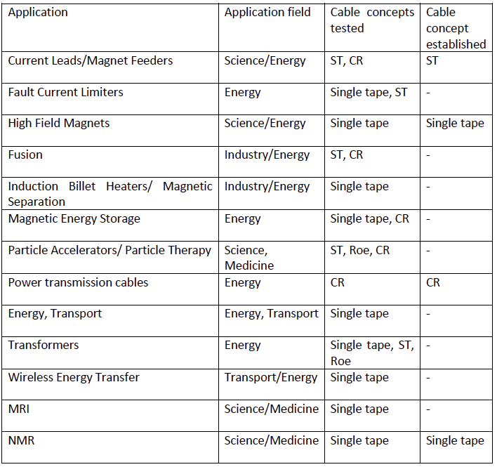
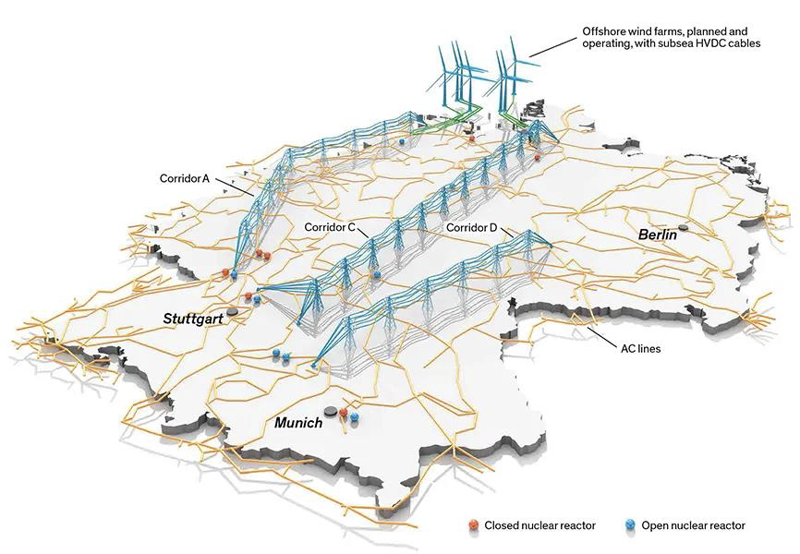
Applications of HTS Cable in Energy System
Possible Applications of HTS Cables for Fast Ramped Synchrotrons
in Energy Systems
Two studies on Application in Energy Systems performed with IEE Bratislava
SUPERCONDUCTING FAULT CURRENT LIMITER FROM CORT
Evaluated cable options
  Stacked tapes cable (ST)
  Roebel cable (Roe)
  CORC/CORT (Conductor on Round Tube) (CR)
FCL has been studied for CORC/CORT type cable
  Advantages:
    Easily adjustable transport capacity by varying coolant temperature
    Parallel paths in CORT makes tapes requirements less stict
    Round shape gives flexibitly for winding

Slide 8
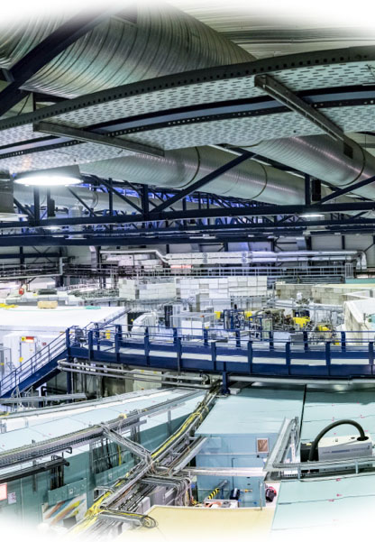
R&D for energy efficient accelerators

Slide 9
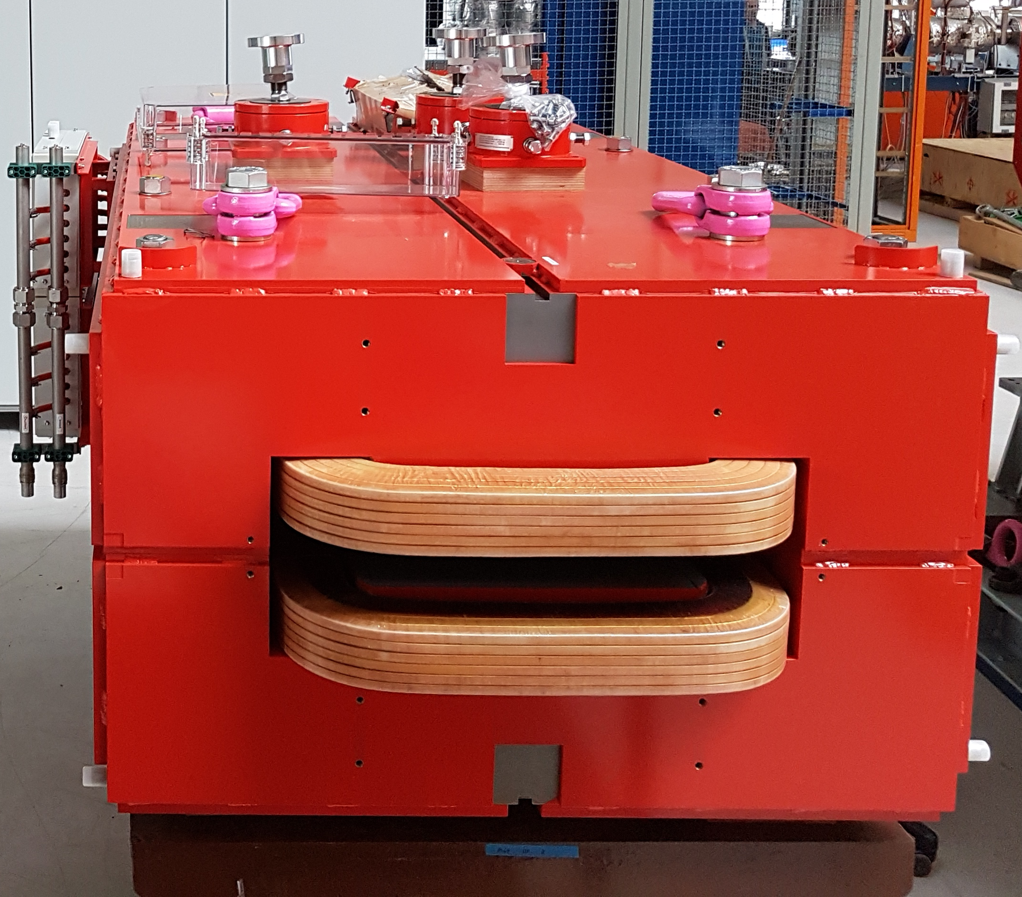
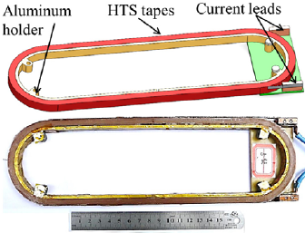
Energy Saving HTS Magnet
Replacing copper coils in HEST magnets by cryostat containing an HTS Coil
56 % of overall GSI energy consumption is made by accelerator operation (assuming 6-7 kh)
UNILAC: 4,5 MW, SIS: 3 MW,
HEST: 1,4 MW, ESR: 2 MW
Energy dissipation im magnet: 97 % in water 3 % in air
Maintaining number of windings
Cold heat cooled 20-40 K
(no large infrastructure)
Potential saving: 10% of overall GSI consumption
HTS pancake coil
Next steps:
Calculation of AC loss (IEE Bratislave)
Calculation of hot spot temperature
Engineering design and prototyping

Slide 10
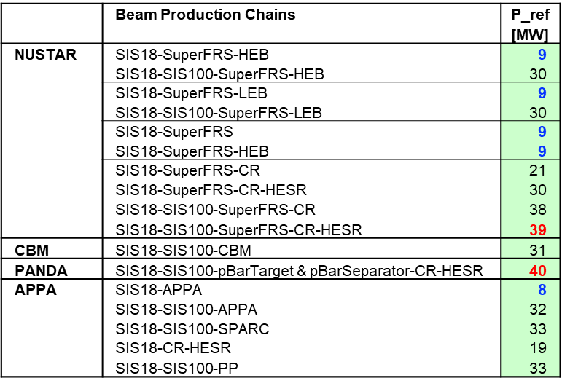
Prediction of Acceleartor Power ConsuMption
We are able to predict the energy consumption (and energy costs) for each operation mode (single and parallel operation) and experiment/user.
Cycling of SIS100 and beamlines
Calculation of dissipated power
Phase | Stage of Realization | Power Loss
IBN Kryoanlage |  | 4.4 MW
Early Science | SIS18 – Super-FRS | 10.2 MW
First Science | SIS100 – Super-FRS | 24.1 MW
First Science+ | SIS100 – Super-FRS + CBM | 34.0 MW
First Science++ | SIS100 – Super-FRS + CBM + APPA | 35.9 MW
The knowledge of power dissipation enables an intelligent control of the technical infrastructure and of the cryogenic plant.

Slide 11
Cooling Water Flow Control for Magnets
Controled cooling water flow rather than constant flow.
The pumps in these systems consume a lot of electrical energy and generate corresponding costs.
The total flow rate in the full version of the FAIR cooling system is approx. 3000 m³/h.
Cooling water quantity magnets approx. 1800 m³/h at 10bar differential
pressure
The power requirement for pumping this flow rate is approx. 900 kW. If you reduce
this flow to 20%, e.g. during shutdown, you only need approx. 180 kW. 720 kW = 17.280 kWh/d = 3110 €/d*
Two options:
On-off (full flow/minimum flow rate) according to magnet usage
Controled flow rate according to magnet power consumption

Slide 12
Other Topics
Provision of controlling power by e.g. operation of cryoplant.
Provision of controlling power by computing power (green IT cube).

Slide 13
Energy Efficiency Programs
EU IFAST „Sustainable Concepts for Accelerator driven Research Infrastructures“
( PSI, CERN, ESS, DESY, GSI )
Paticipation in future EU CARAT program „Green Energy Monitoring for Large-scale Infrastructures (GREMLIN)“
GSI hosts a Joint Workshop – Industry (Connectus) meets Accelerator in 2023
Sustainability INNOVEA in M&T ARD

