Slide 1

I.FAST 2nd Annual Meeting– Task 11.3 Permanent Magnet Quadrupoles & Combined Function Magnets for Ultra Low-Emittance Rings
Alex Hinton, ASTeC, STFC Daresbury Laboratory
I.FAST 2nd Annual Meeting, Trieste
20/04/2023

Slide 2
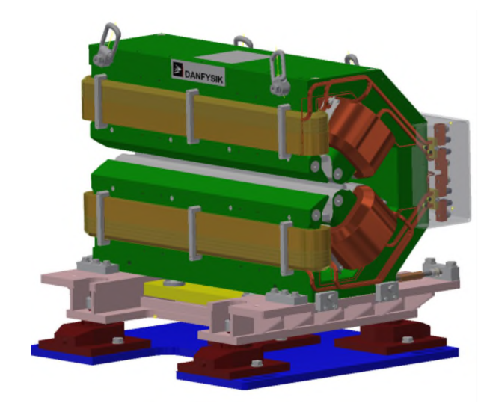
Introduction
Fourth generation synchrotron light sources make use of multi-bend achromat lattices to reduce beam emittance and increase radiation brightness.
Lattices require combined function dipole-quadrupole (DQ) magnets.
Diamond-II upgrade will require 48 DQ magnets drawing 2.3 kW each.
Can permanent magnets achieve the same purpose with negligible power?

Slide 3
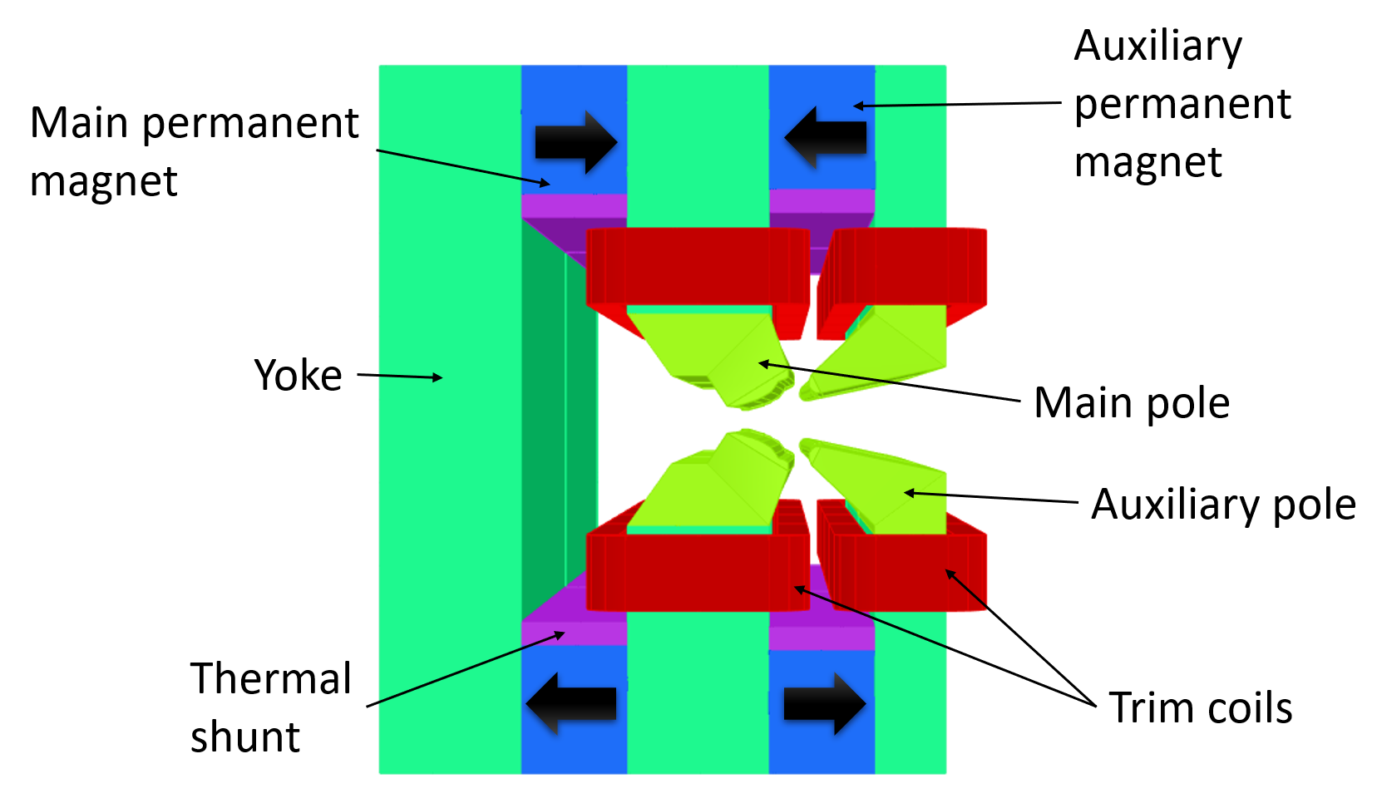
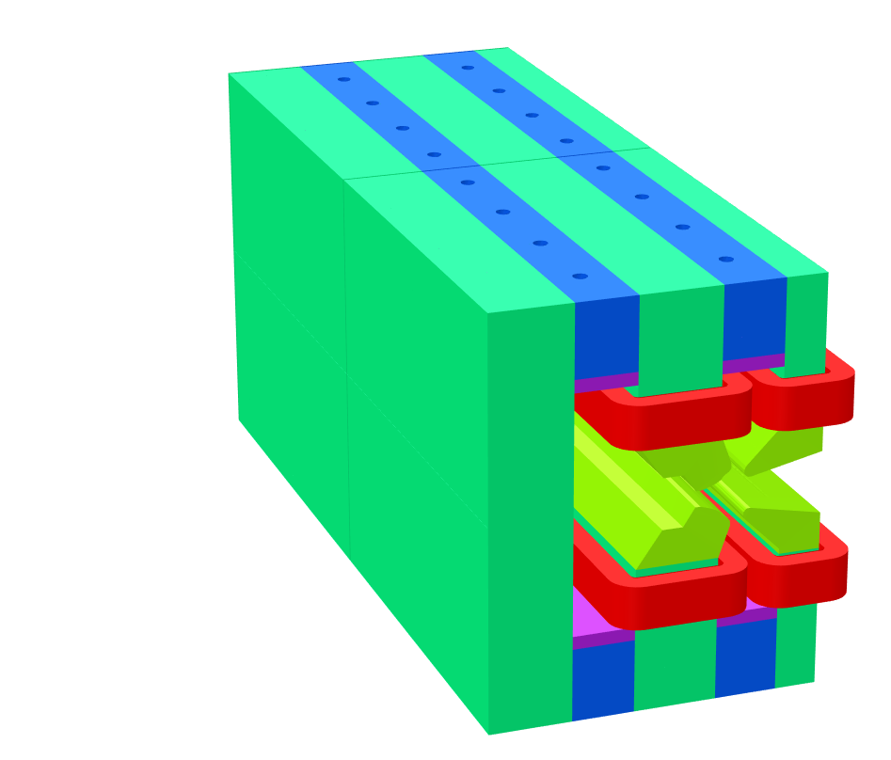
Design Overview
Hybrid Electromagnet-Permanent Magnet Tuneable Optics (HEPTO).
Dipole = 0.7 T, Gradient = 33 T/m.
Effective length = 0.870 m.
Main source of field = NdFeB permanent magnet blocks
Dipole and gradient fields require independent tuning of ±2.5% for commissioning purposes.
Field tuning achieved by air-cooled trim coils.
Yoke and poles made from XC06 low-carbon steel.
400 mm
831 mm
320 mm

Slide 4
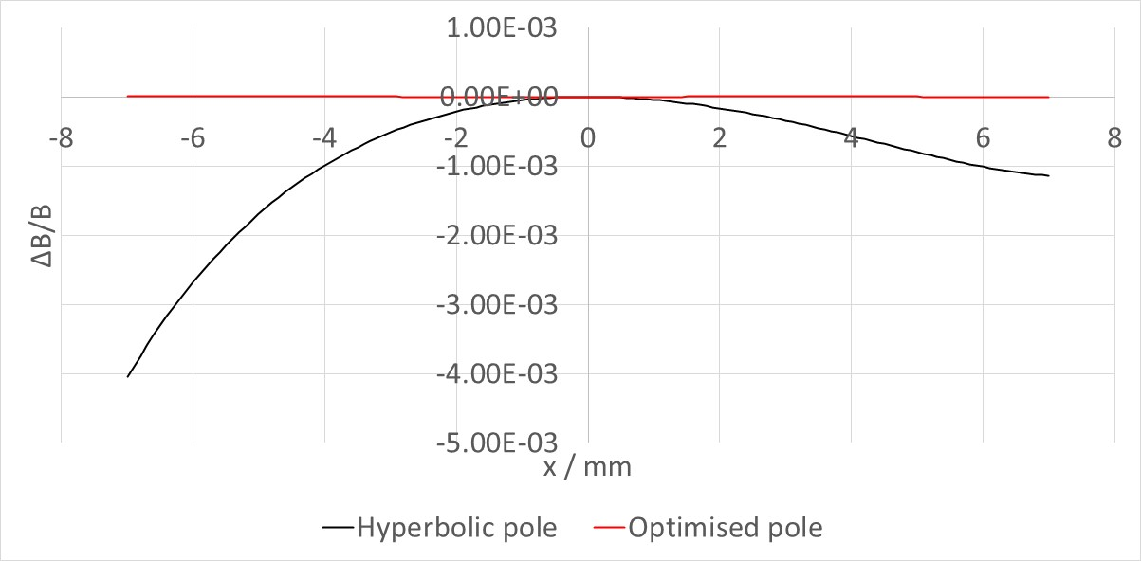
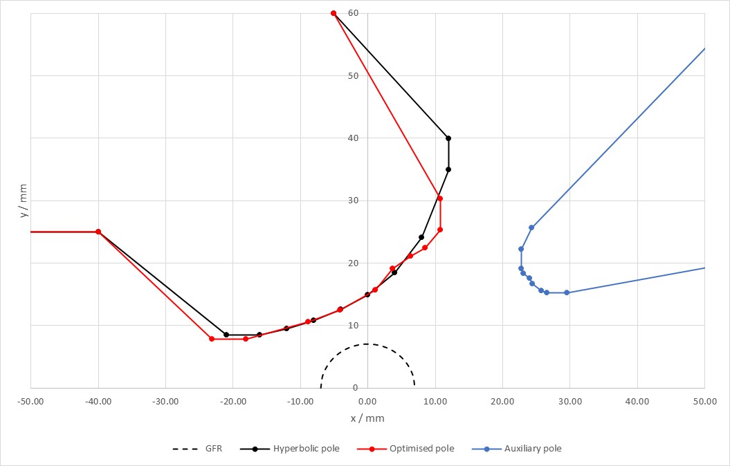
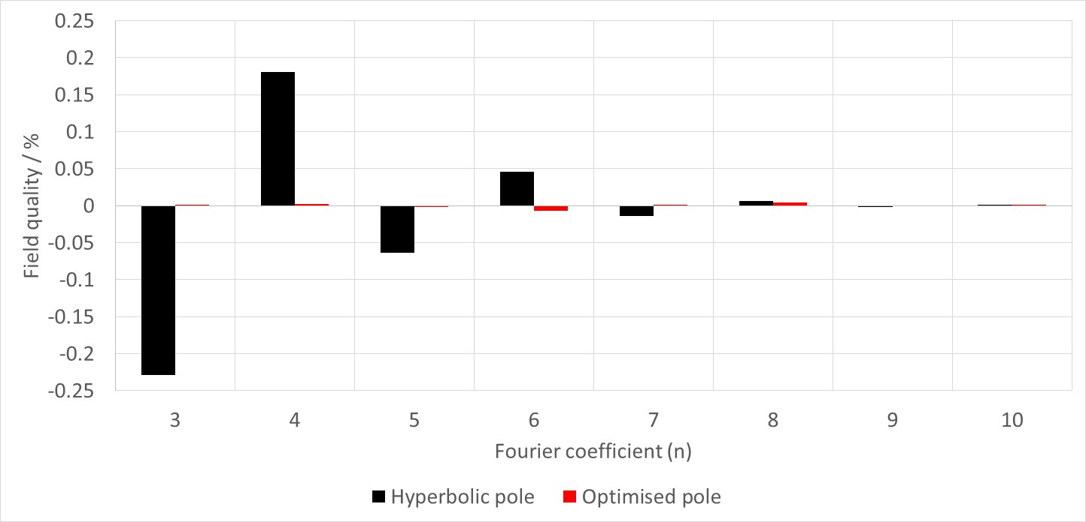
Pole Shape Optimisation
Pole tip design optimised in Opera 2D.
Pole shaping algorithm used to minimise multipole errors [1].
Required field quality ΔB/B < 5x10⁻⁴.
[1] G. Le Be, J. Chavanne and P. N'gotta, “Shape optimization for the ESRF II magnets,” in IPAC 2014: Proceedings of the 5th International Particle Accelerator Conference, 2014.

Slide 5
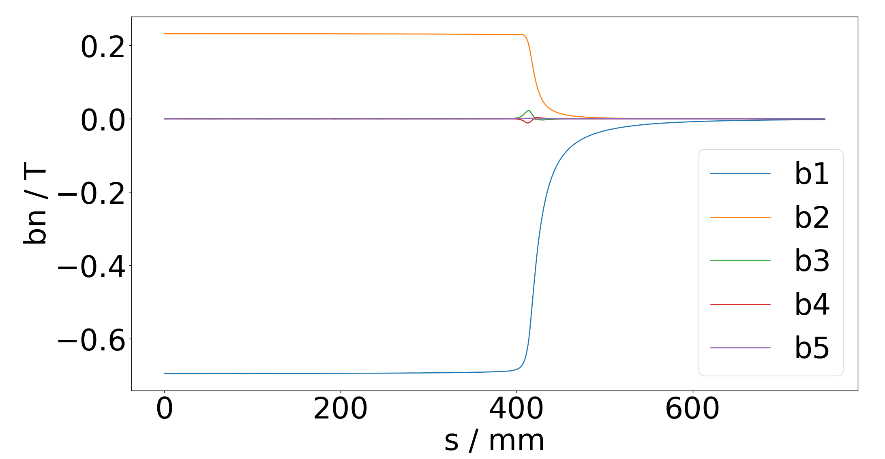
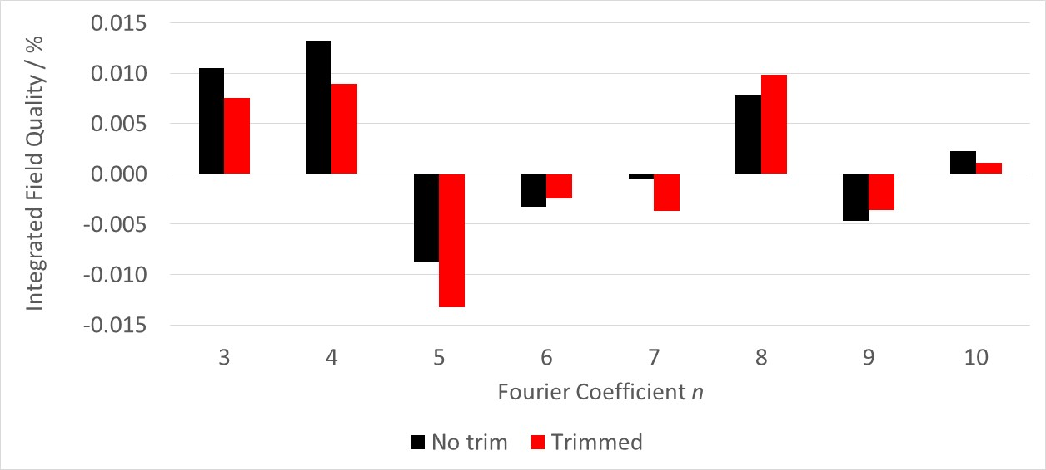
3D Field Quality
Integrated field quality assessed in Opera 3D.
Pole tips curved to follow beam trajectory and give constant dipole field.
Effective length of quadrupole shorter than dipole.
Central gradient increased and pole profile adjusted slightly to give target field integrals.
Trim coils reduce integrated sextupole, octupole terms.

Slide 6
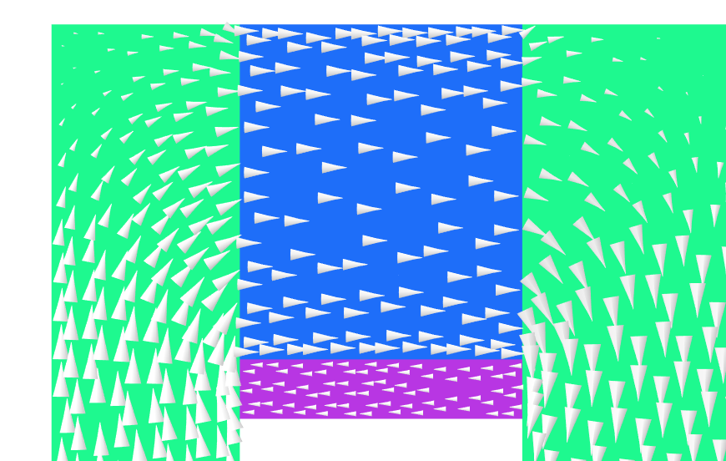
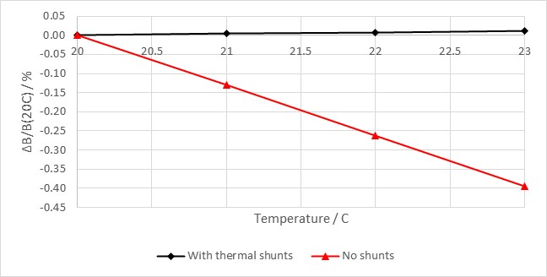
Permanent magnet
Steel yoke
Thermal stability
Flux vectors
Permanent magnet strength decreases with increased temperature.
FeNi shunts used to provide improved thermal stability.
Shunt has negative temperature coefficient; as temperature increases, saturation polarisation decreases.
Dipole thermal stability from -0.131% / degree without shunt to +0.004% / degree with shunt
0.01% variation typical due to power supply fluctuation in electromagnets.
FeNi shunt

Slide 7

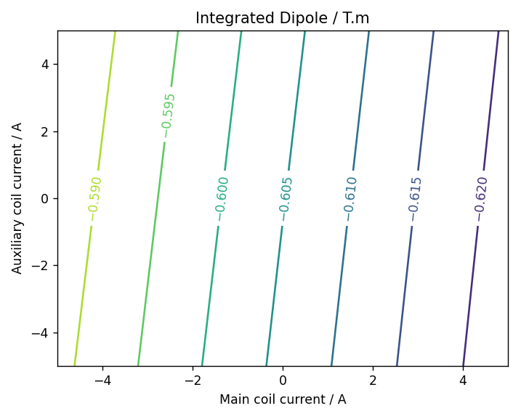
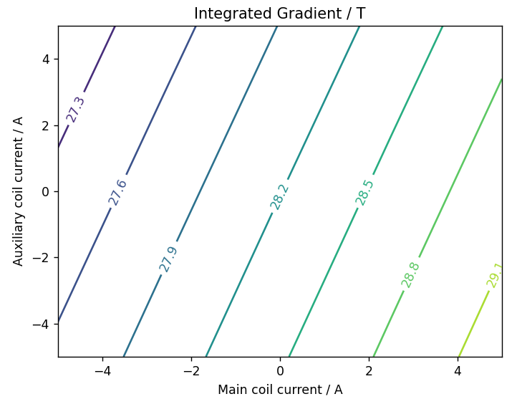
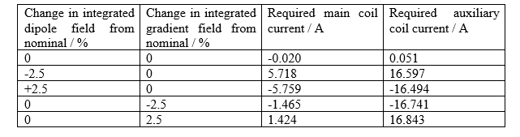
Tuning Range
Main coil
Auxiliary coil
Air cooled coils used to independently trim dipole and quadrupole fields by ±2.5%.
Currents limited to 5 A to allow air cooling.
Tuning is inefficient due to permanent magnets in magnetic circuit.
Required tuning range cannot be achieved with air-cooled coils.

Slide 8
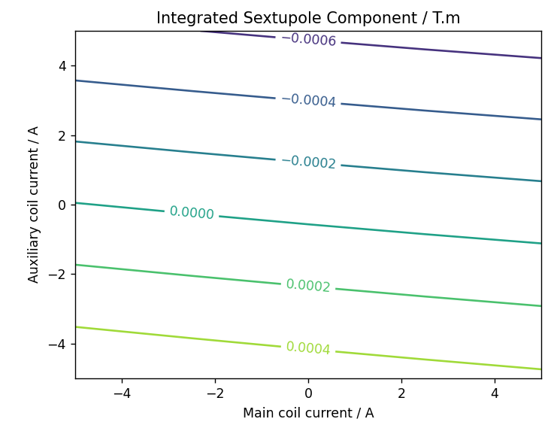
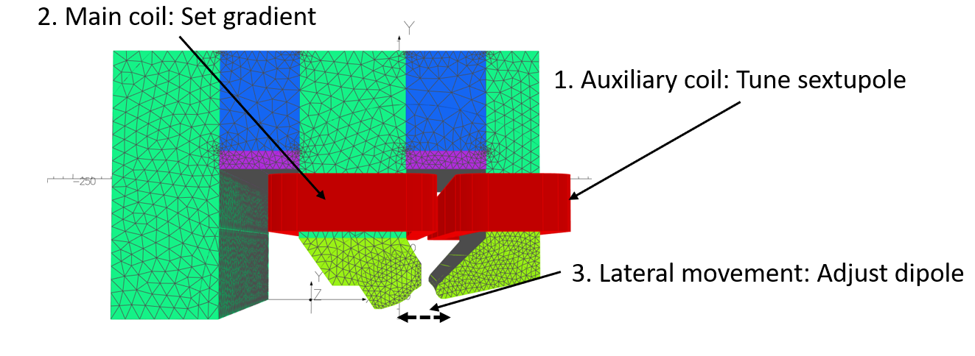
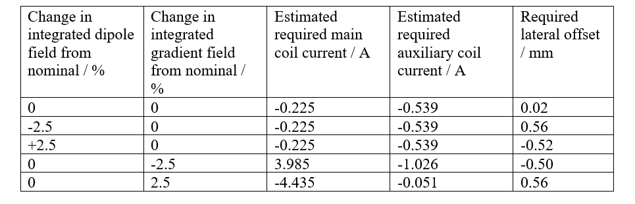
Mechanical Tuning
Main and auxiliary coils cannot achieve independent field tuning in isolation.
Lateral movement of magnet can tune on-axis dipole independent of gradient without coil currents.
Auxiliary coil used to tune sextupole field component.
Main coil used to tune gradient.
With ±1mm lateral movement of magnet in-situ, required tuning can be achieved with air-cooled coils.

Slide 9
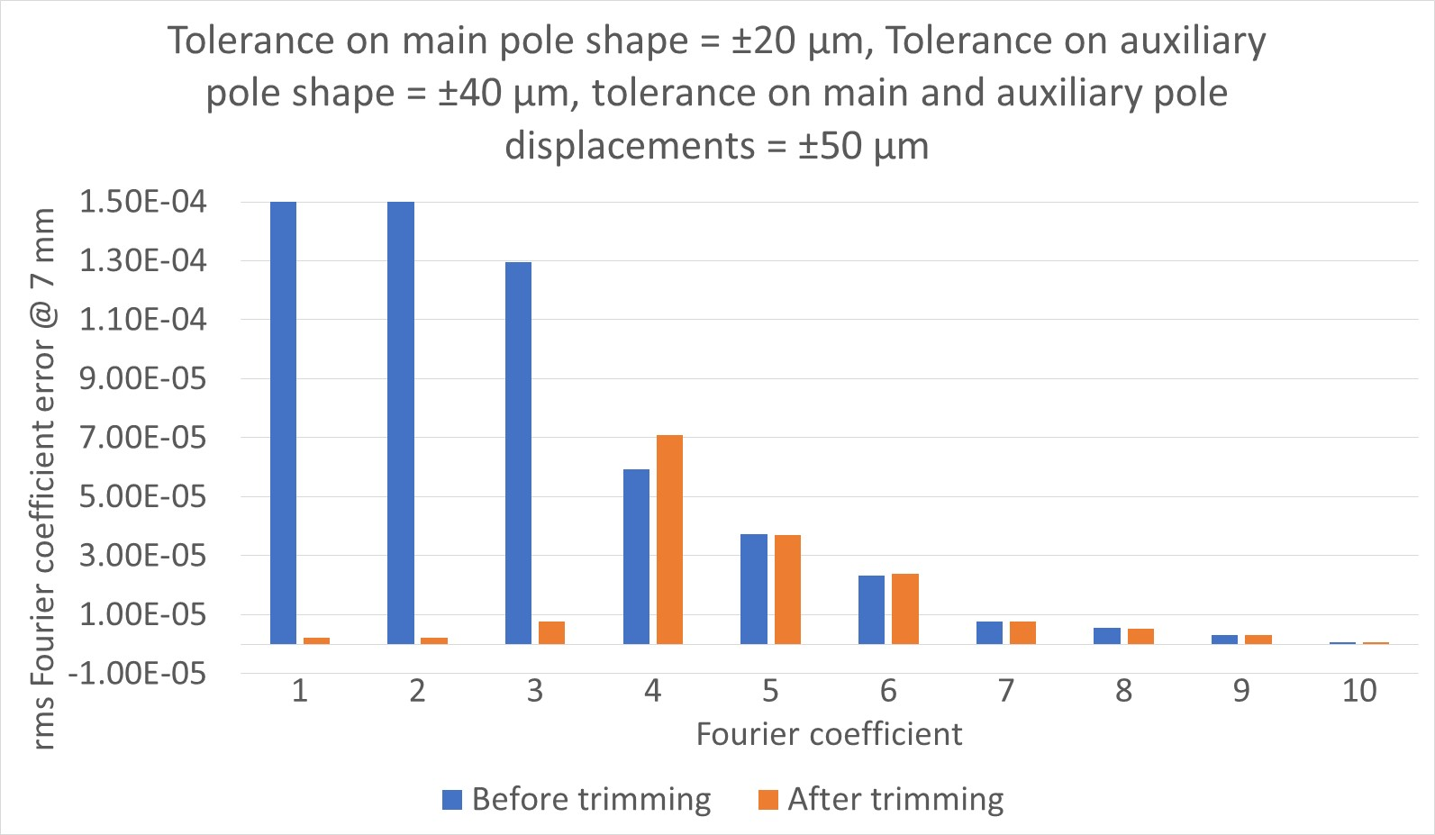
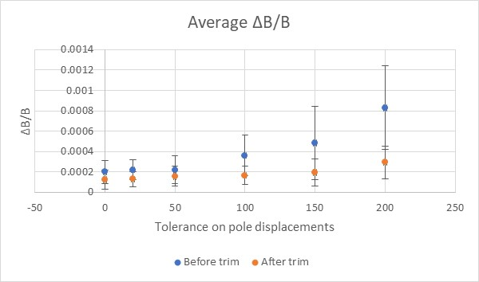
Tolerance Studies
Required field quality ΔB/B < 5x10⁻⁴.
Sextupole component < 10⁻³.
Machining and assembly tolerances will negatively impact field quality compared to nominal magnetic design.
Auxiliary coil can trim undesired sextupole component introduced by tolerances.
Modelling shows required machining tolerances of ±20 μm on main pole, ±40 μm on auxiliary pole.
Displacement tolerances < 200 μm.

Slide 10
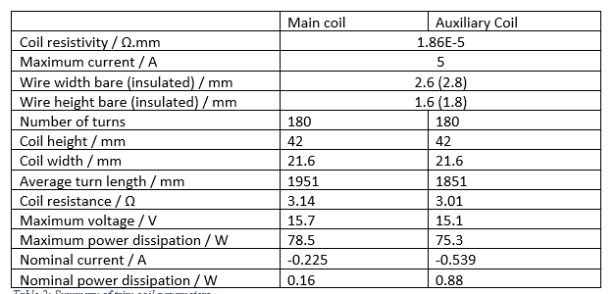
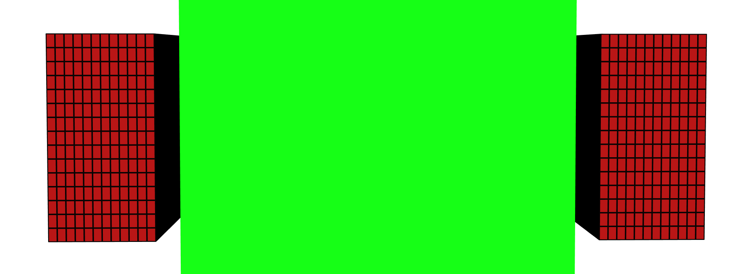
Final Coil Design
Coils wound from solid insulated copper wire.
Air cooled coils – no need for water cooling infrastructure.
Some current expected at nominal operation to trim fields (account for magnetisation and machining tolerances).
Nominal power dissipation of equivalent electromagnet = 2.3 kW.
Bipolar power supply required for field tuning.
Coil cross-section
Yoke

Slide 11

Assembly and Forces
Large attractive magnetic forces between permanent magnet blocks and steel yoke.
Forces need to be considered during assembly of magnet to prevent injury or damage to the magnet.
Forces between poles in assembled magnet could cause deformation and hence reduced field quality.
Movement of components must be prohibited.
0.7 kN
40 kN
30 kN
5 kN
0.3 kN
30 kN

Slide 12
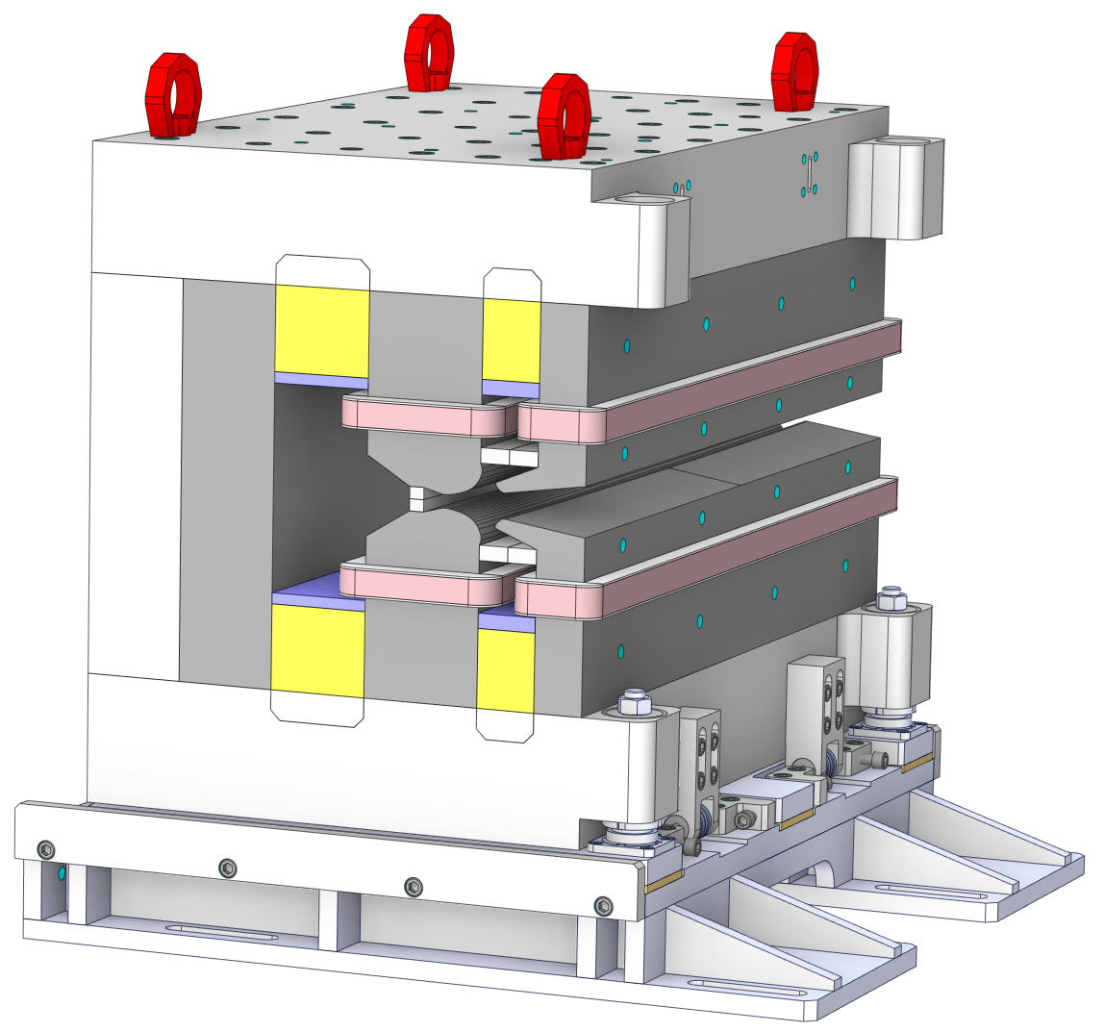
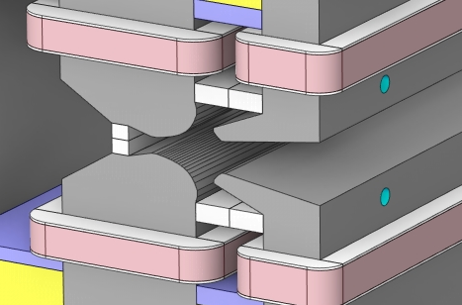
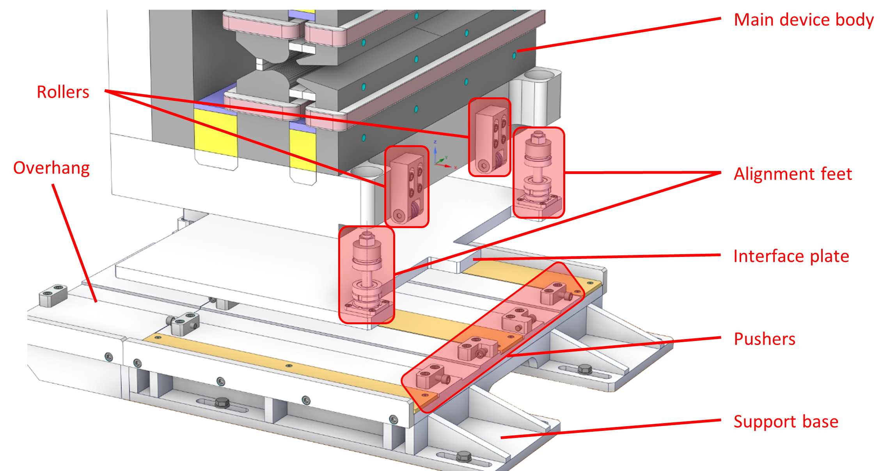

Mechanical Design Overview
Conceptual mechanical design for assembling and mounting magnet produced by Kyma.
Aluminium C-shape support frame.
Device can be inserted around vacuum chamber.
Gap spacers control separation of poles subject to attractive forces.
Support base allows adjustment of displacement and angular alignment.
Can in-situ lateral adjustment be achieved?

Slide 13
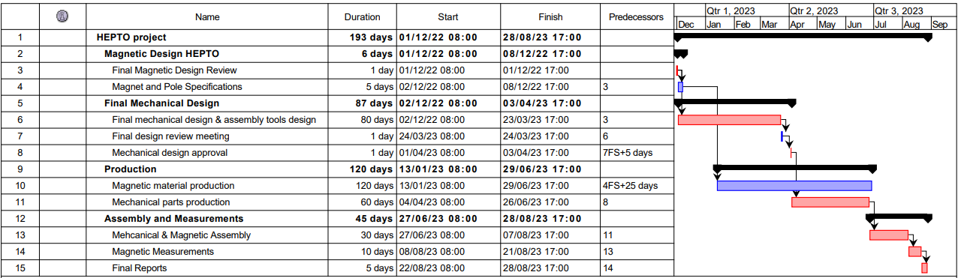
Future Planning
Time plan correct as of 12/01/2023.
Delays in procurement of permanent magnet and thermal shunt materials due to high prices.

Slide 14
Conclusions and Future Planning
Magnetic design is complete.
Mechanical design being finalised.
Nominal power requirement per magnet (for field trimming) < 2 W.
Maximum power requirement per magnet (5 A per coil) = 150 W.
Equivalent electromagnet requires 2.3 kW + water cooling.
Next steps: procurement of materials for building prototype magnet.
Some delays due to prices and availability of permanent magnet and thermal shunt material.
Plan is to construct and test prototype by end of August 2023.

Slide 15

Thank you
Acknowledgements:
Ben Shepherd (STFC)
Tadej Milharcic and Mirko Kokole (Kyma), Mechanical Design
Alfie Shahveh (Diamond Light Source)
Facebook: Science and Technology Facilities Council
Twitter:@STFC_matters
YouTube: Science and Technology Facilities Council

