Slide 1

WP5 progress report
ITS3
Tuesday 18th April 2022
WP5 collaboration

Slide 2
Detector layout: tolerances
Next wind-tunnel tests

Slide 3
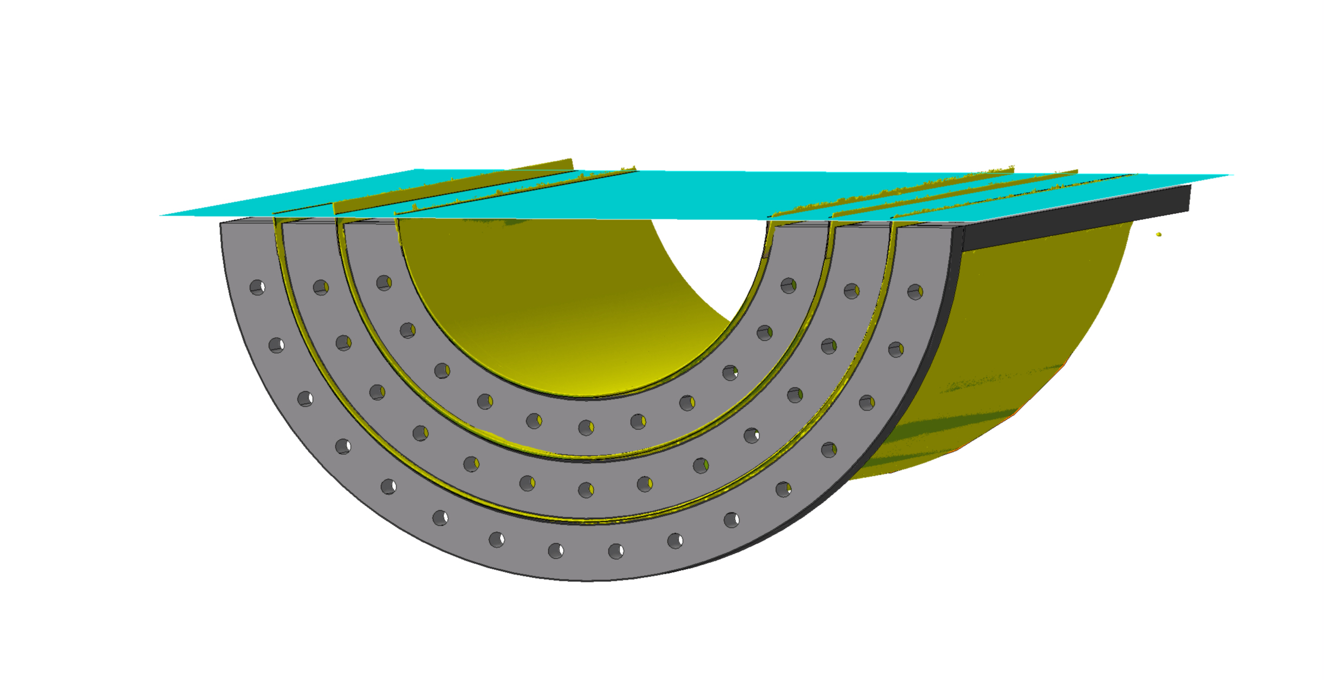
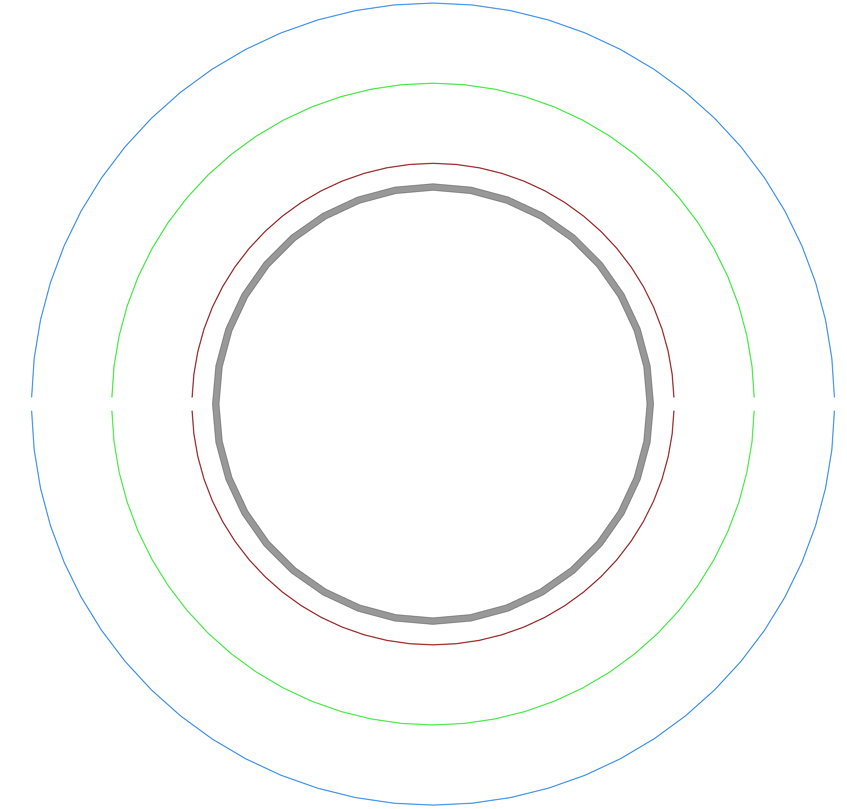
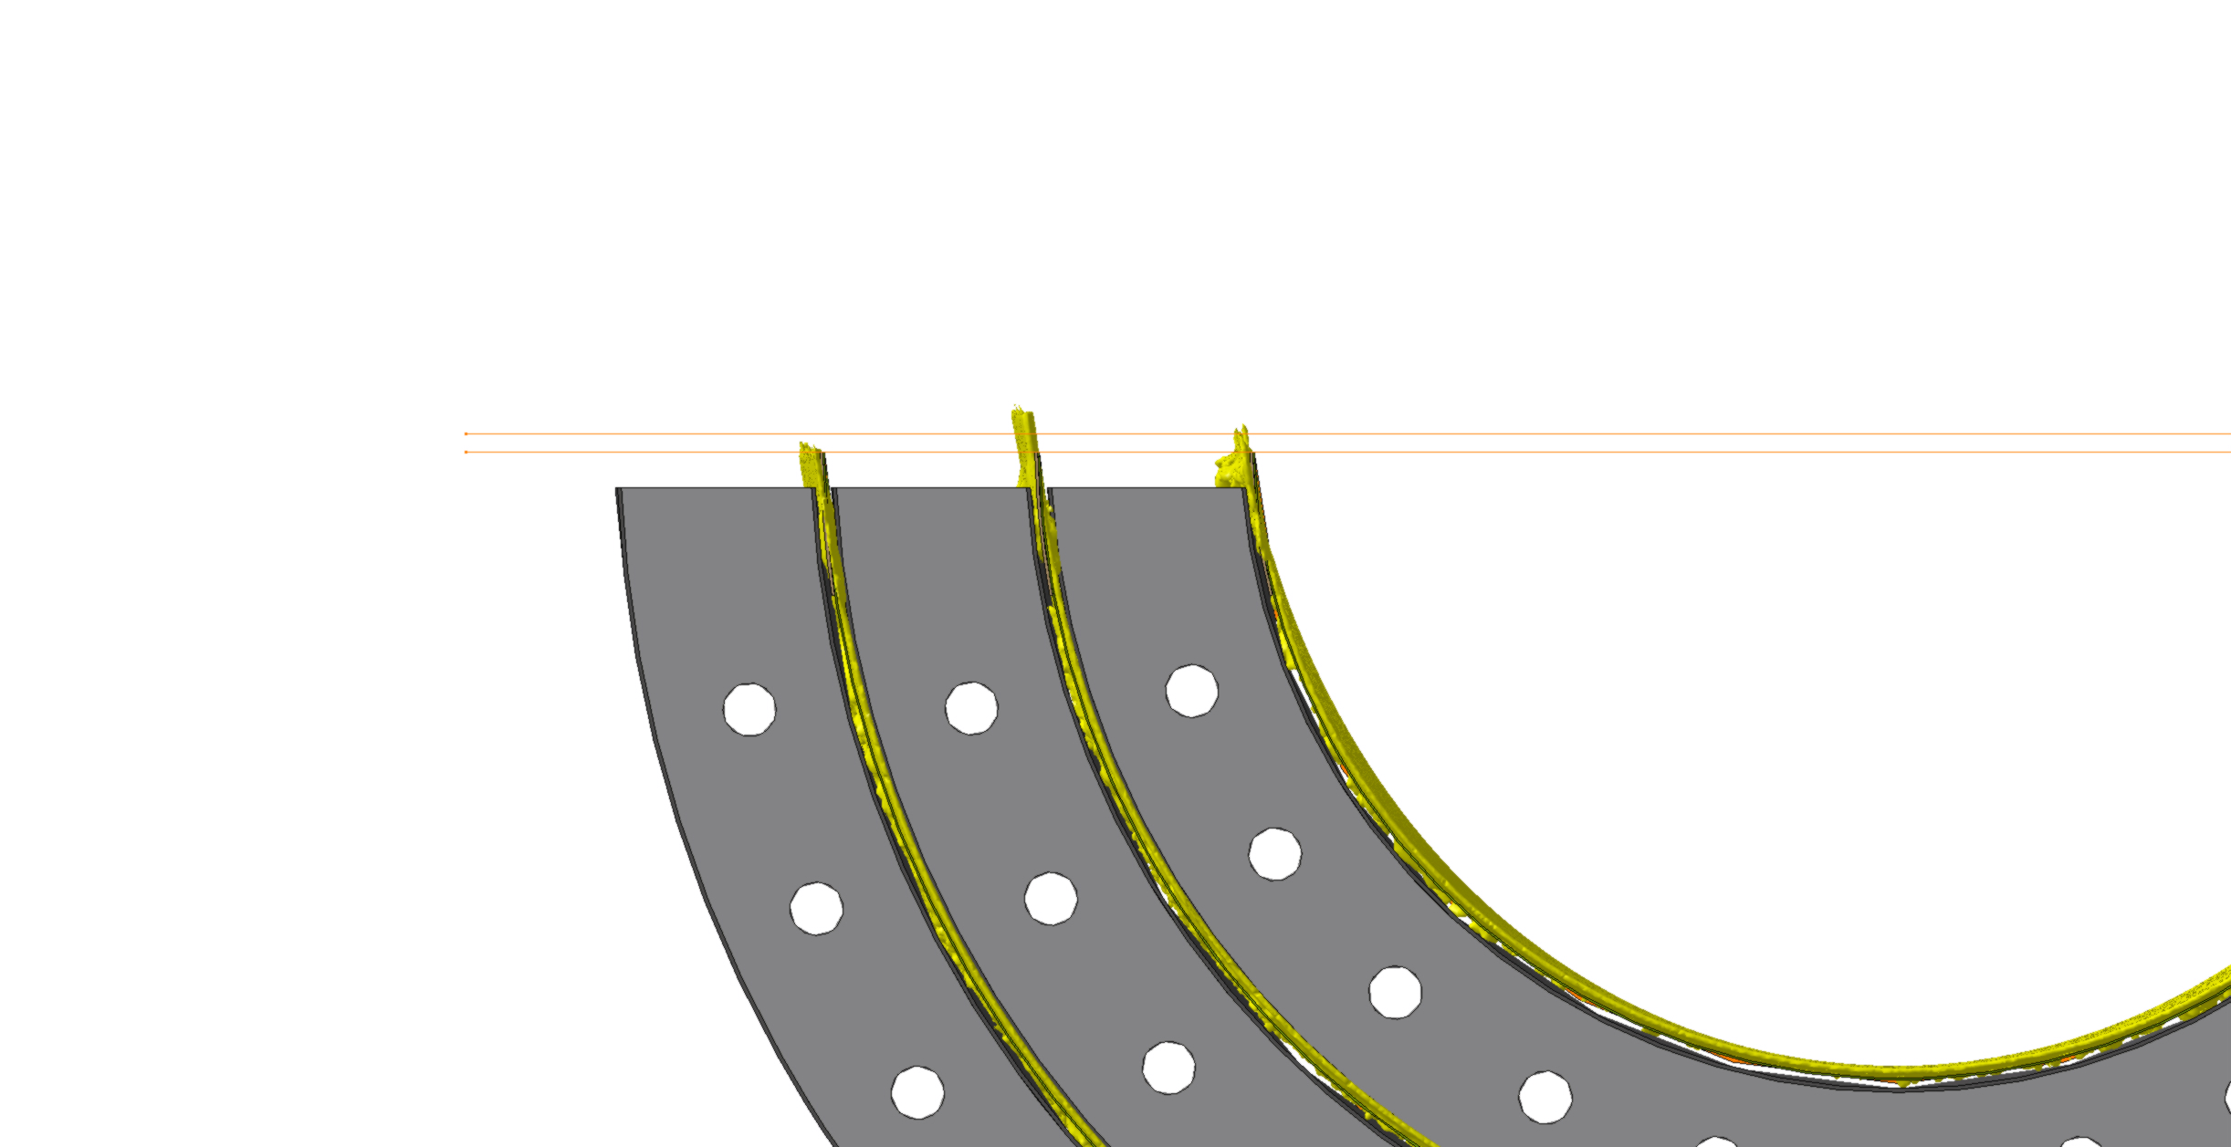
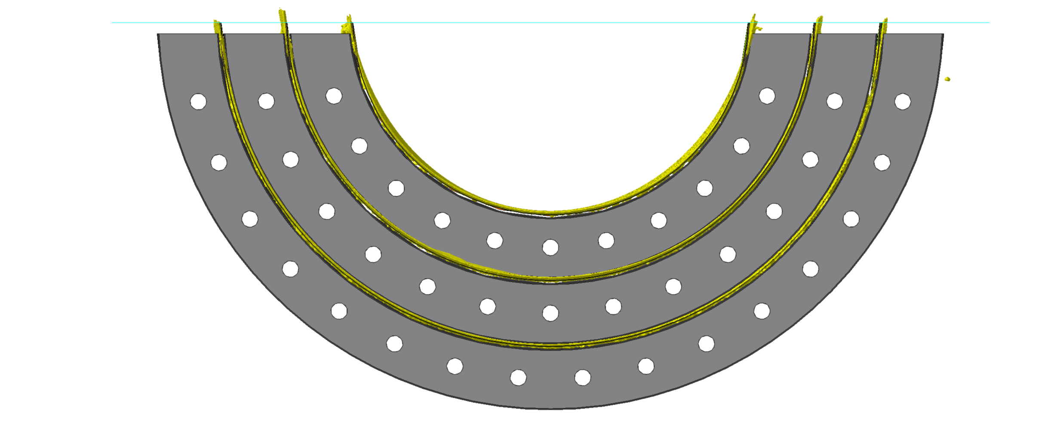
Detector layout: tolerances at equatorial gap
30
EM2:
Blank silicon h-layers
24
18
16.5
1
1.5
Equatorial plane
-0.5 mm
R nominal
Kapton tape, larger
Within 0.5mm, if Kapton tape cut is improved

Slide 4
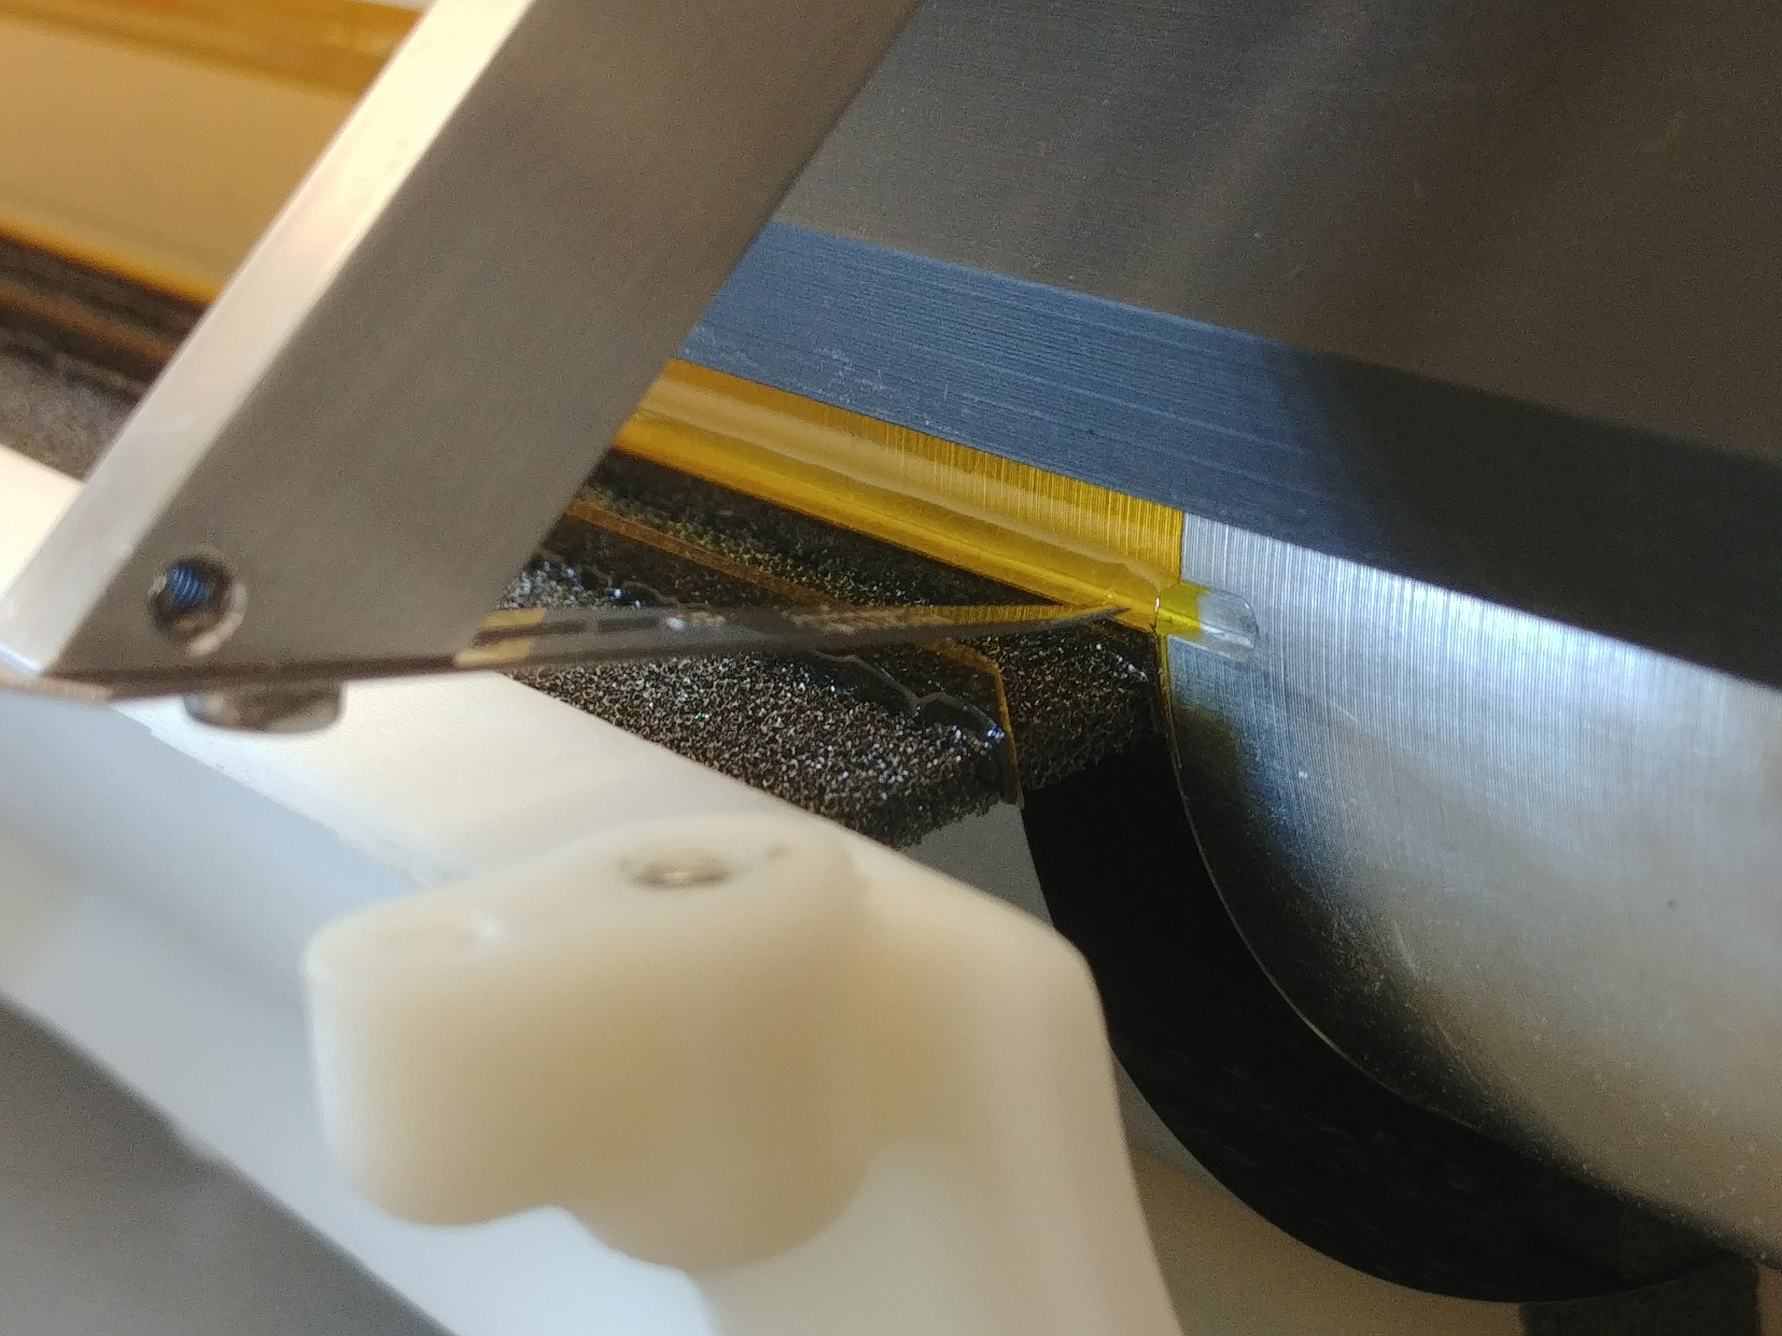
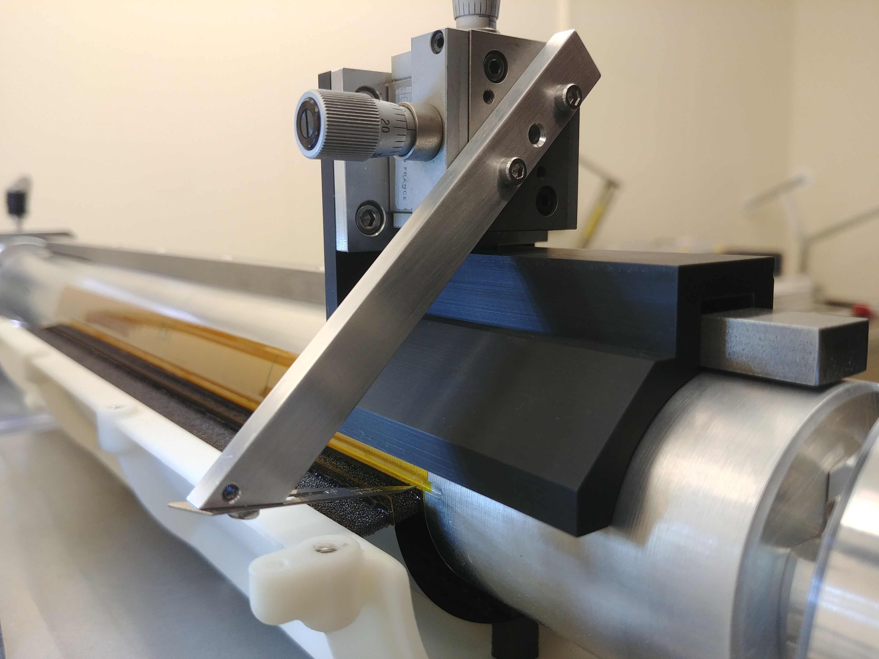
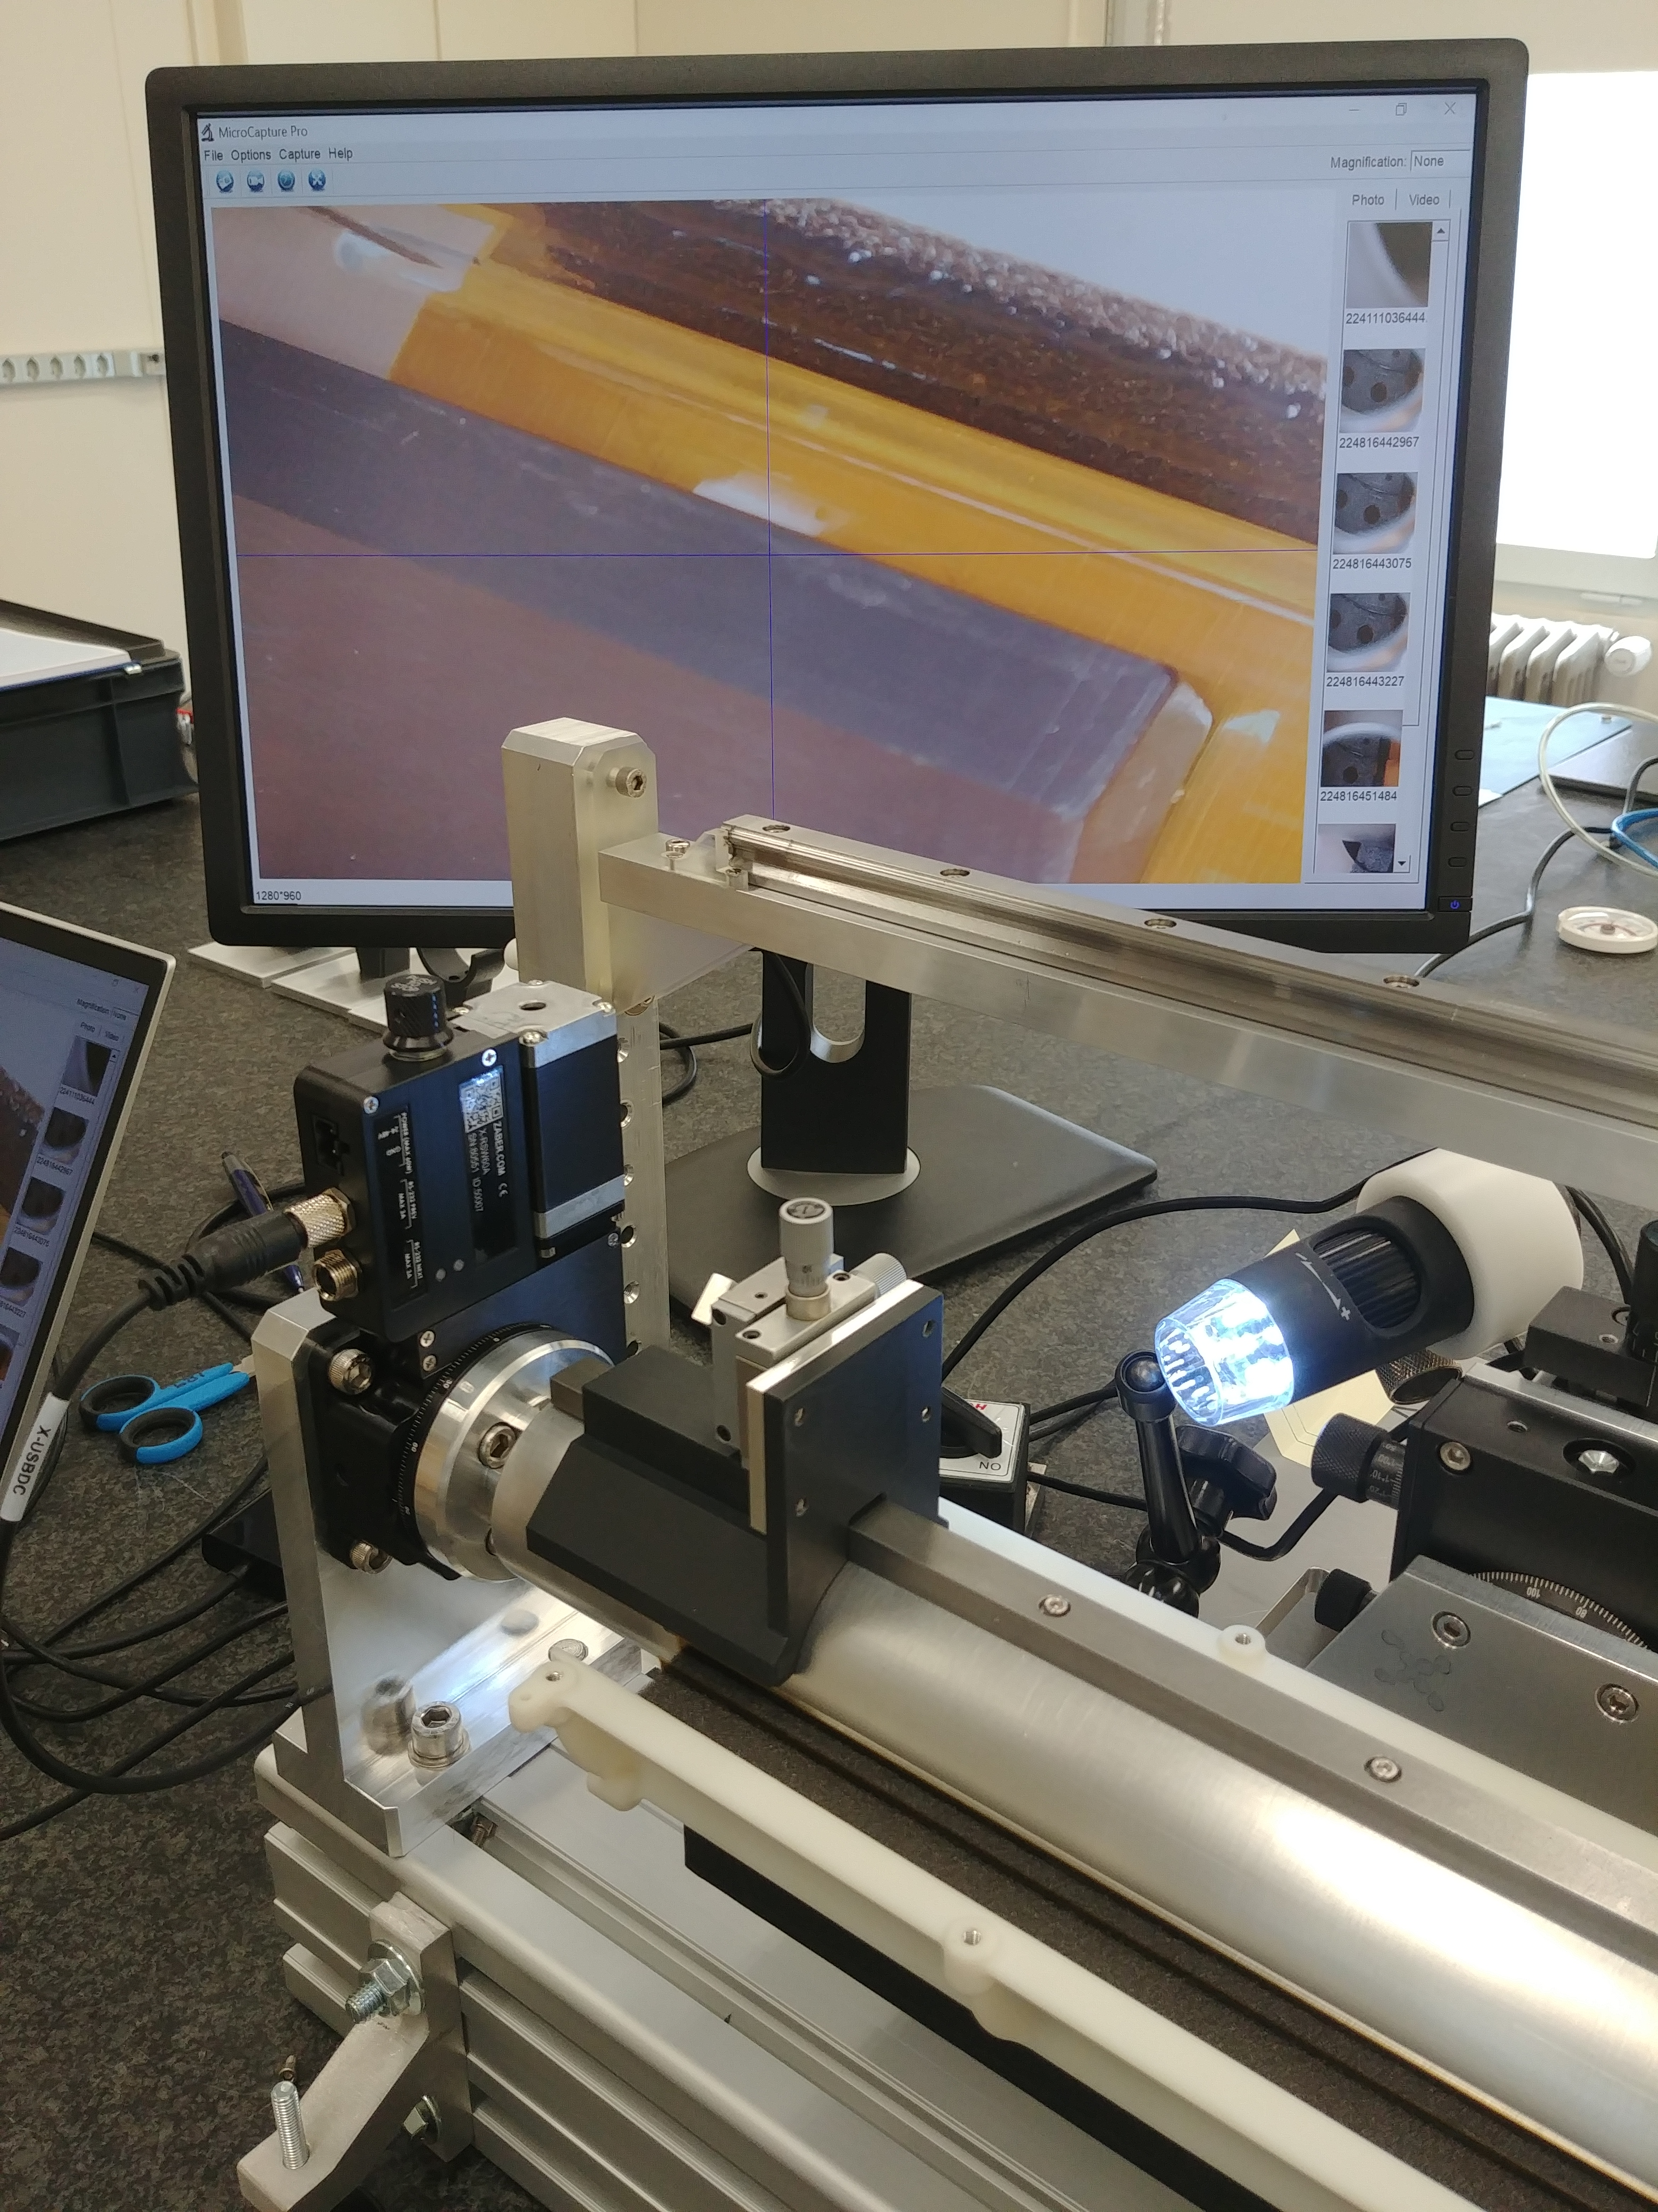
Detector layout: Kapton tape
Improvement of the cut of the Kapton tape: NEXT, Pieter
Target: fine cut +- 0.1 mm accuracy over 270 mm length, reasonable?
Target: Distance from the Silicon as small as possible according to the above target
  Define procedure
  Improvement:
    Alignment (mandrel and cutter)
    Fine cut
      Surgery knife ? (Diamond knives for eyes surgery)
      Laser cut? (FS laser , other ..)
      Any suggestions?
EM2 , L1 during Kapton cut

Slide 5
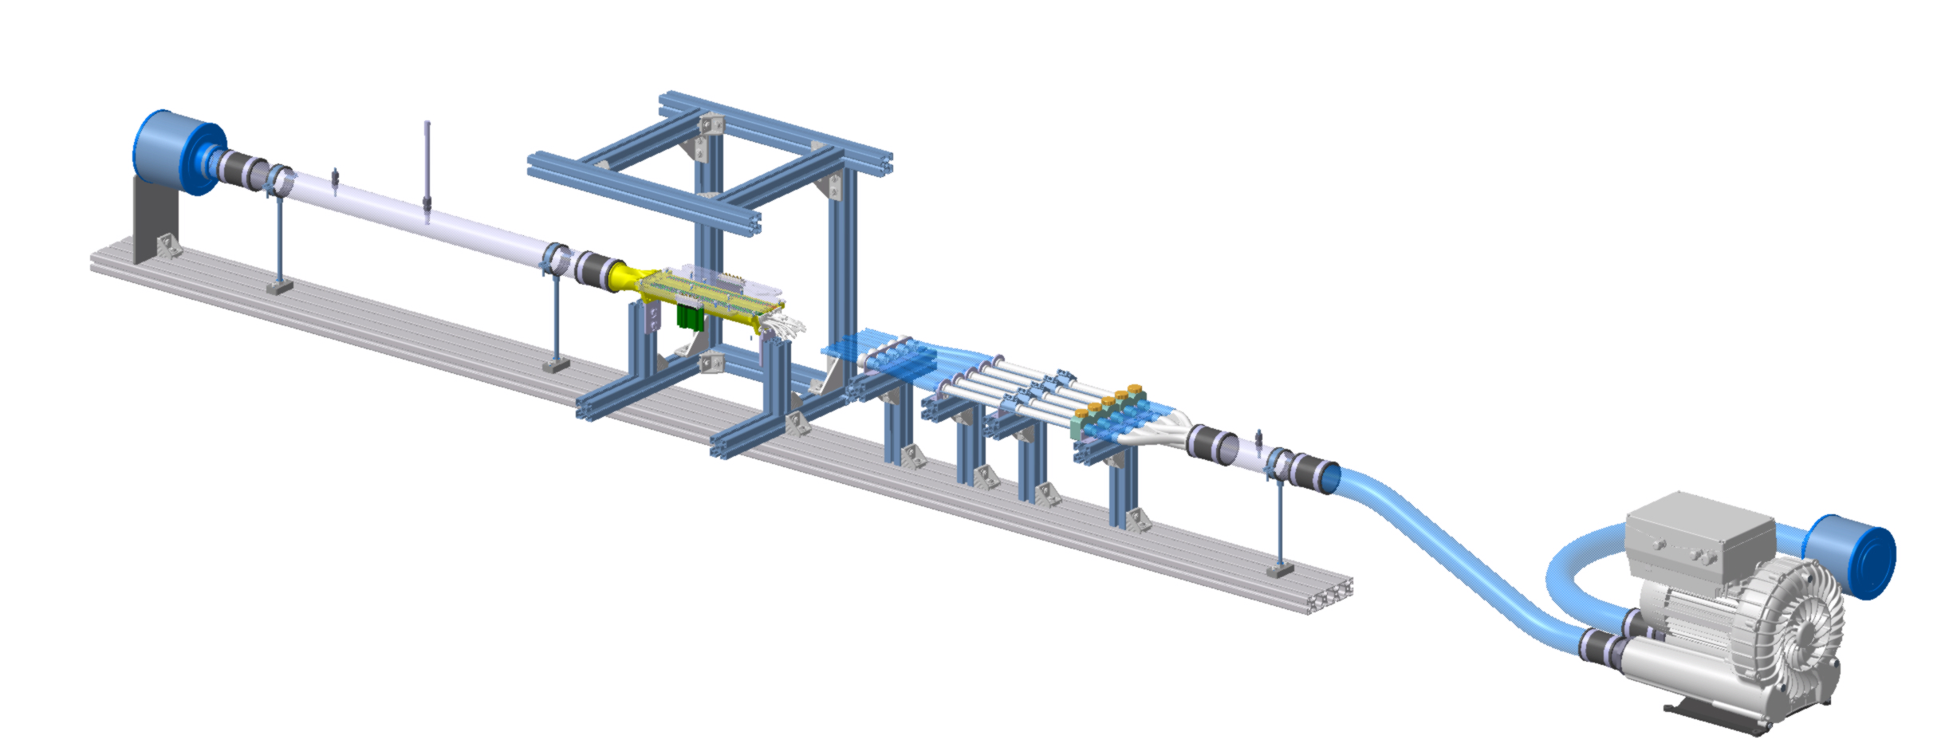
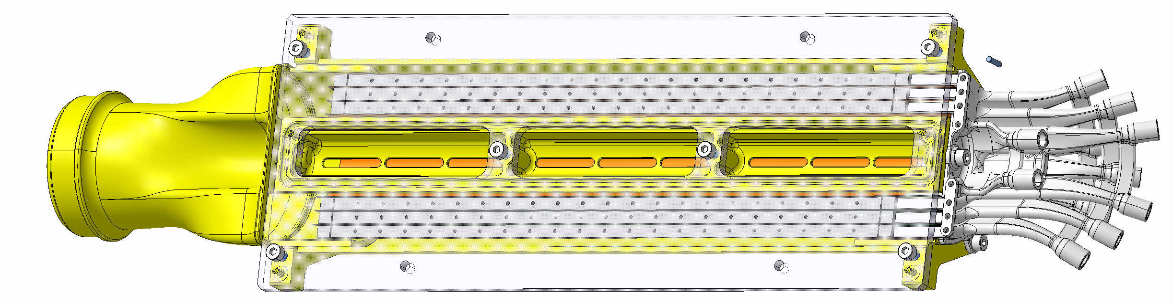
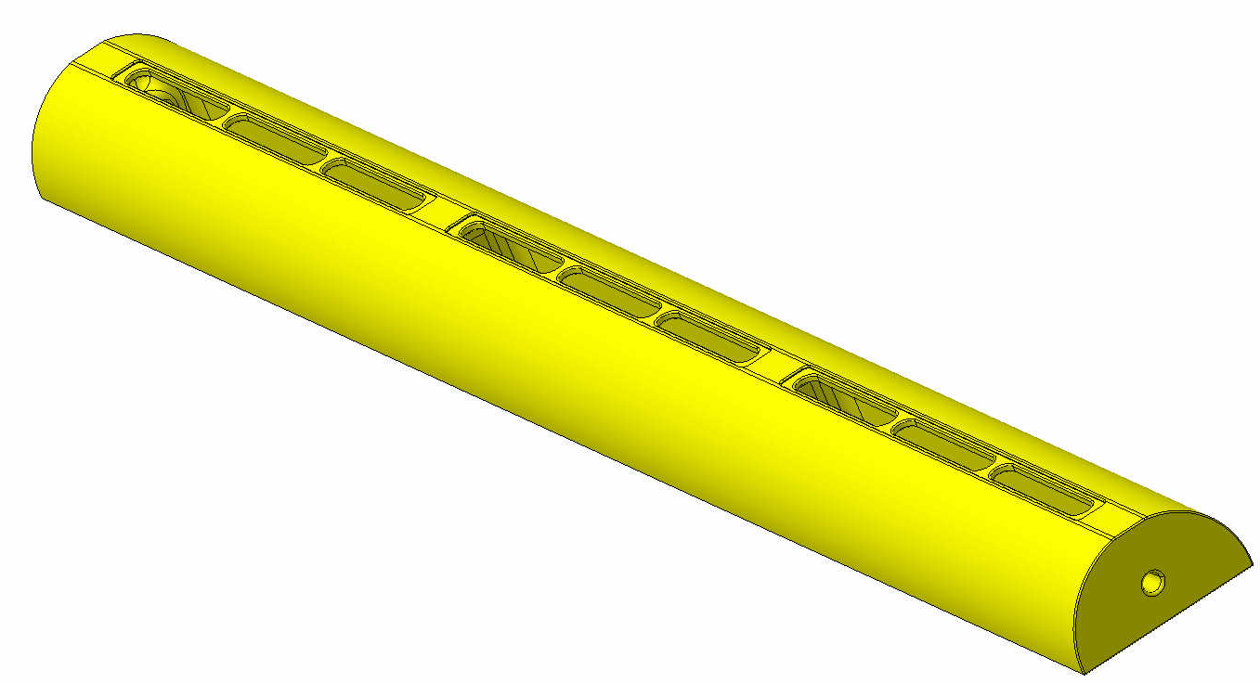
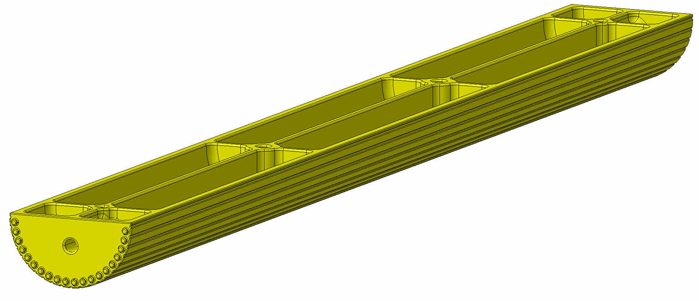
Next wind-tunnel tests
First vibration campaign conclude
NEXT:
Reverse flow direction
Thermal test (similar to previous one).
Vibrational tests
Upgrade of the prototype (target in 2 weeks)
Thermal test and vibrational tests
both air flow direction
Improvement of the test set-up
Blowing air
3D printing parts:
Production on going
in Grenoble
Resistive wire
BP with window for the
displacement sensor,
For vibration measuring of layer0
BP with integrated heater for additional
thermal test considering heat coming from BP

