Slide 1
Computing Feynman Parton Distributions on Lattice through
Large-momentum effective theory
Xiangdong Ji, University of Maryland
50 years of QCD symposium, UCLA
Sept 14, 2023

Slide 2
Outline
Power of partons
A brief history of partons from light-cone correlator
Partons in Feynman’s way: Euclidean formulation
Large momentum expansion (or EFT)
Applications
  Gluon polarization
  PDFs
  GPDs
  TMDPDFs
  LFWFs
Outlook

Slide 3
Power of partons

Slide 4
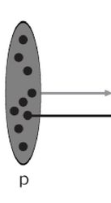
Feynman’s parton model
In high-energy scattering, proton travels at v∼c, one can assume the proton travels exactly at v=c, or the proton momentum is
p=E=∞
(Infinite momentum frame, IMF)
Proton may be considered as a collection of interaction-free particles: partons
A picture of proton here

Slide 5
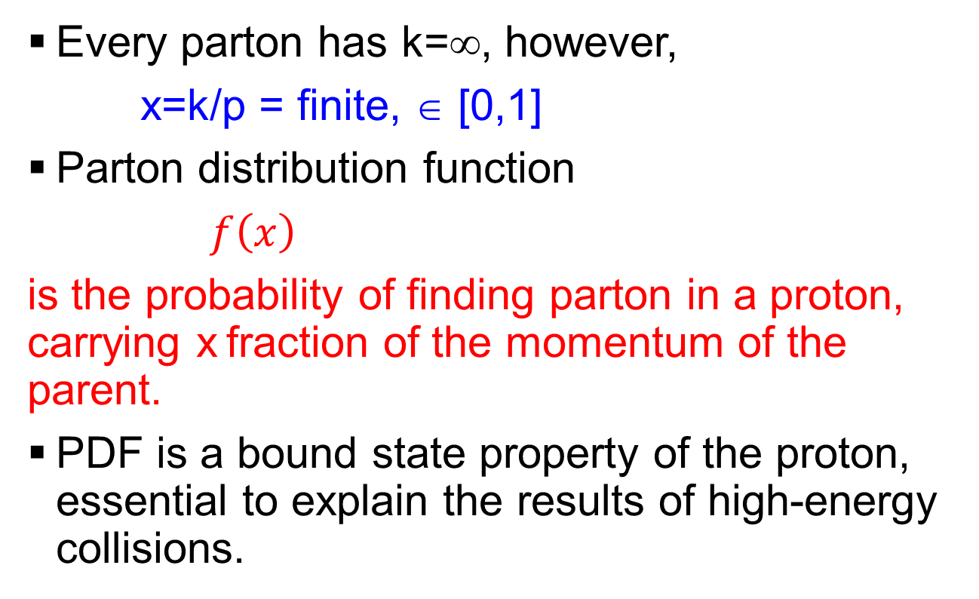
Parton distribution functions (PDF)
Every parton has k=∞, however,
x=k/p = finite, ∈ [0,1]
Parton distribution function
$f\left(x\right)$
is the probability of finding parton in a proton, carrying x fraction of the momentum of the parent.
PDF is a bound state property of the proton, essential to explain the results of high-energy collisions.

Slide 6
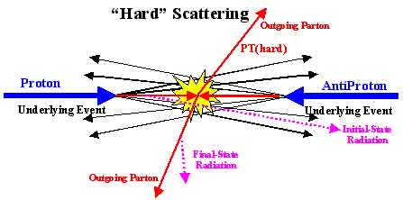


Hard scattering & factorization
Factorization: The scattering cross sections are factorized in terms of PDFs and parton x-section.
$σ=∫dx_{a}dx_{b}f_{a/A}\left(x_{a}\right)f_{b/B}\left(x_{b}\right)\hat{σ}$

Slide 7
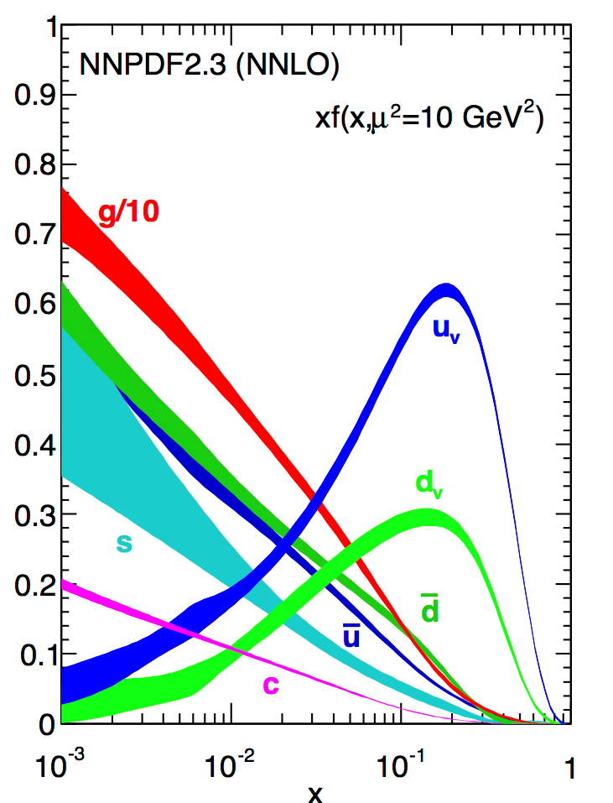
Phenomenological PDFs
Use experimental data (50+ yrs) to extract PDFs
J. Gao, et al,
Phys. Rept. 742 (2018) 1-121

Slide 8
Exp. data vs. Standard Model theory

Slide 9
A brief history of partons from light-cone correlator

Slide 10
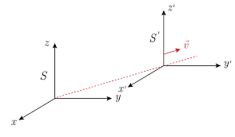
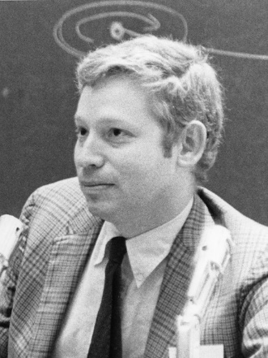
Weinberg’s rules
What does an object look like when travelling at infinite momentum or speed of light?
S. Weinberg (scalar QFT)
Dynamics at infinite momentum
Phys. Rev. 150 (1966) 1313-1318
All kinematic infinities can be removed from the calculations, resulting a set of rules for perturbation theory (“old-fashioned p.t.”)
The result is similar to a “non-relativistic” theory.

Slide 11
More Weinberg’s rules…
L. Susskind, K. Bardakci, and M. B.Halpern,…
S. J. Chang and S. K. Ma (1969)
Feynman rules and quantum electrodynamics at infinite momentum,
Phys. Rev. 180 (1969) 1506-1513
J. Kogut and D. Soper
Quantum Electrodynamics in the Infinite Momentum Frame, Phys.Rev.D 1 (1970) 2901-2913

Slide 12
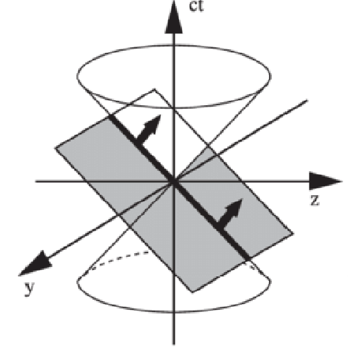

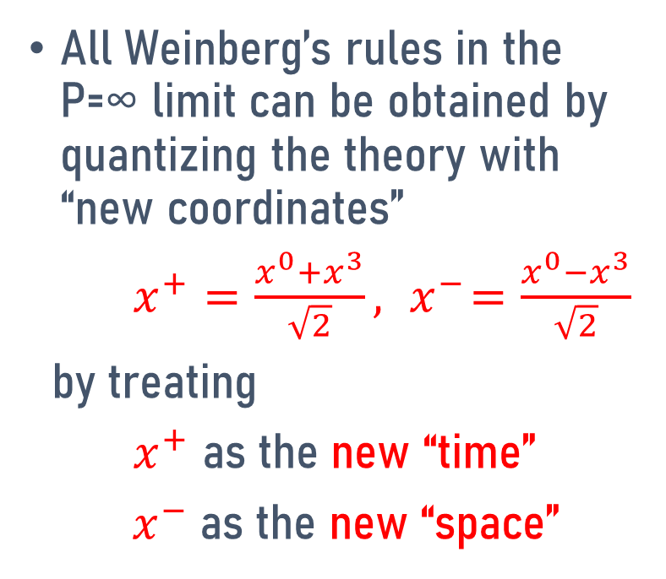

Chang and Ma’s discovery
All Weinberg’s rules in the P=∞ limit can be obtained by quantizing the theory with “new coordinates”
$x^{+}=\frac{x^{0}+x^{3}}{\sqrt{2}}, { x}^{−}=\frac{x^{0}−x^{3}}{\sqrt{2}}$
by treating
$x^{+}$ as the new “time”
${ x}^{−}$ as the new “space”
$$x^{−}$$
$$x^{+}$$

Slide 13
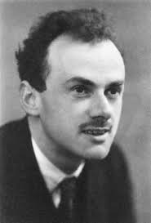
Dirac’s form of dynamics
The Weinberg’s rules exactly correspond to what Dirac proposed in 1949.
Paul A.M. Dirac,
Forms of Relativistic Dynamics,
Rev. Mod. Phys. 21 (1949) 392-399.
“Front form”
or Light-front quantization (LFQ)

Slide 14
Light-cone dominance
In DIS, it was realized the process is dominated by light-cone correlations
In Feynman’s parton model, the worldline of the final state parton goes along the lightcone
The light-cone correlation is captured by light-front quantization

Slide 15
Feynman’s parton & LF wave functions
Feynman’s parton are Fock components in the light-front wave function
And parton density is just the particle number distribution

Slide 16
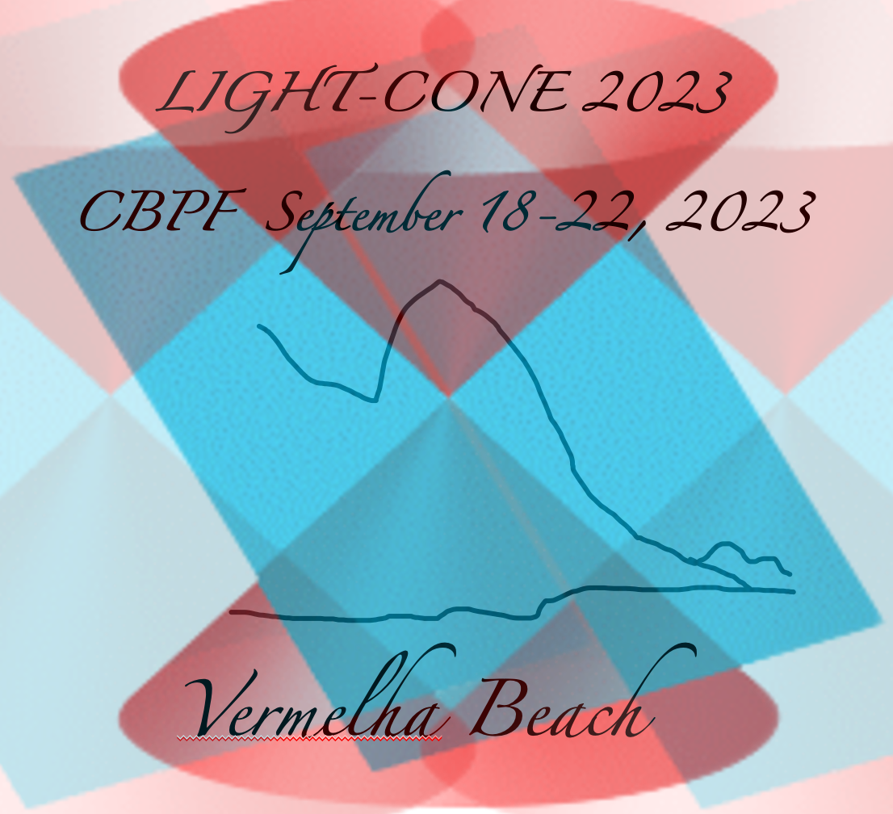
It is hard to solve LF wave functions
LF QCD is still a strong-coupling problem! there is no demonstration that the weak coupling expansion actually works for QCD.
K. Wilson et. al. Phys. Rev. D49 (1994)
LF breaks various symmetries that make renormalization difficult (infinite number of renormalization constant)
Difficulty with vacuum zero-modes.

Slide 17
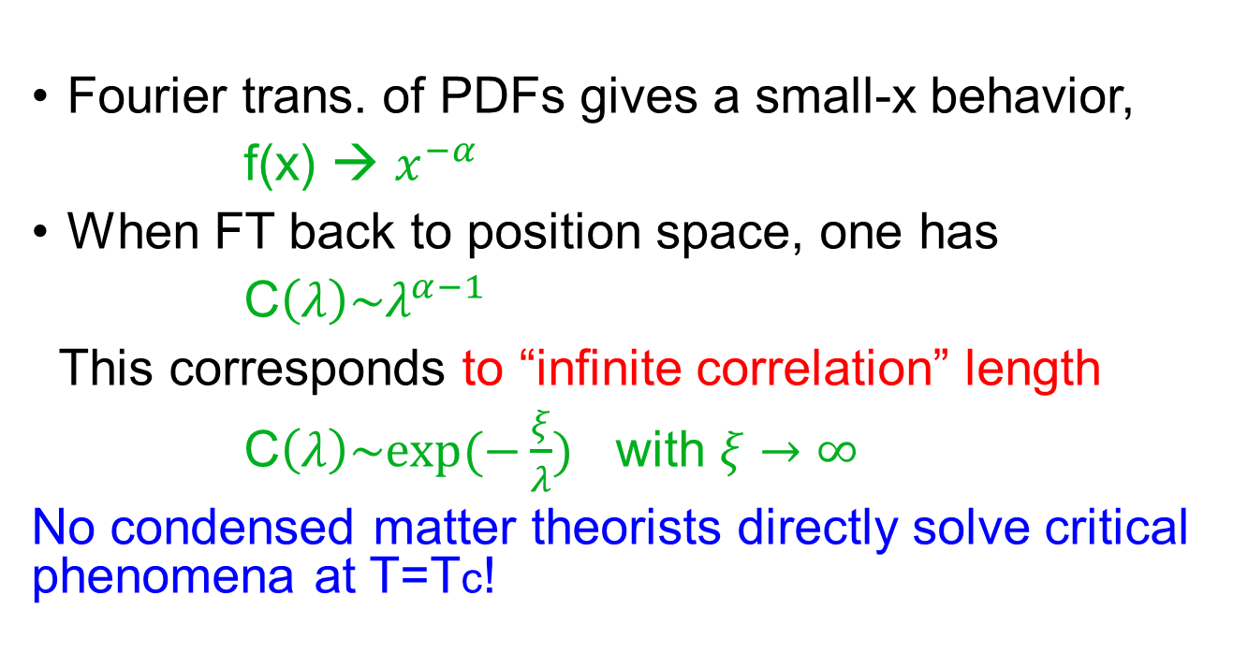
Partons and critical phenomena
Fourier trans. of PDFs gives a small-x behavior,
f(x) → $x^{−α}$
When FT back to position space, one has
C$\left(λ\right)\sim λ^{α−1}$
This corresponds to “infinite correlation” length
C$\left(λ\right)\sim exp(−\frac{ξ}{λ})$ with $ξ→∞$
No condensed matter theorists directly solve critical phenomena at T=Tc!

Slide 18
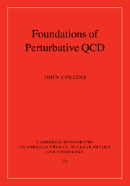
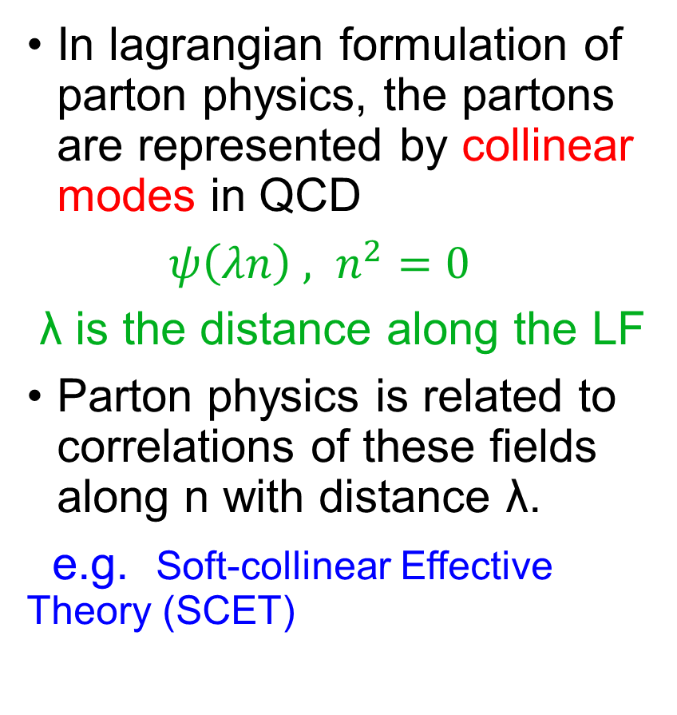
Factorization & collinear modes
In lagrangian formulation of parton physics, the partons are represented by collinear modes in QCD
$ψ\left(λn\right) , n^{2}=0$
λ is the distance along the LF
Parton physics is related to correlations of these fields along n with distance λ.
e.g. Soft-collinear Effective Theory (SCET)

Slide 19
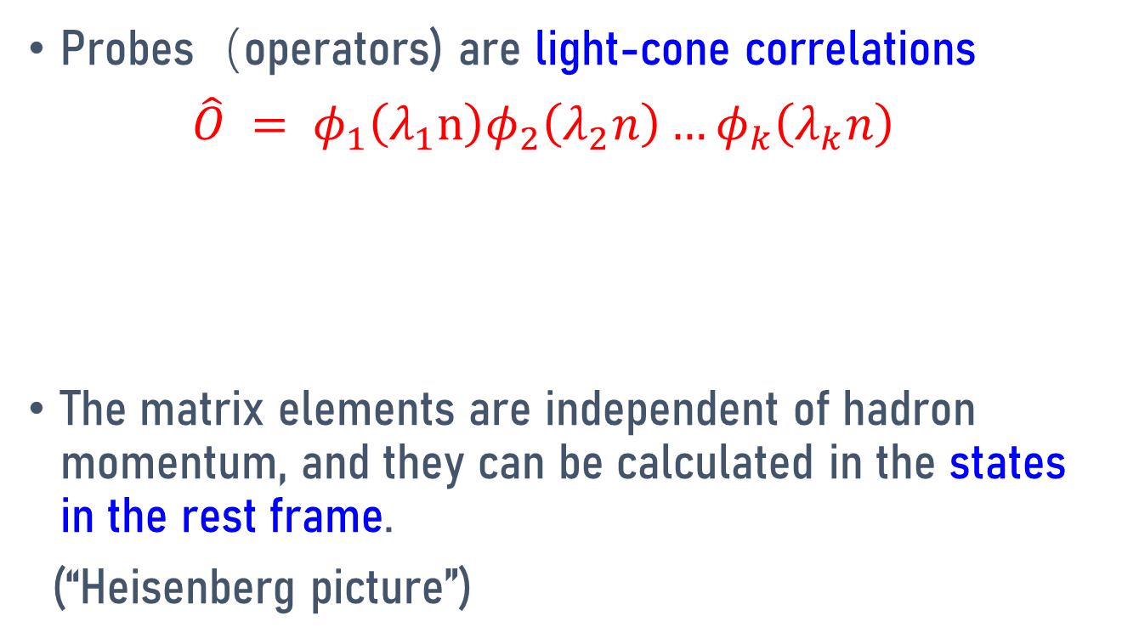
Partons as LF correlations
Probes（operators) are light-cone correlations
$\hat{O} = φ_{1}\left(λ_{1}n\right)φ_{2}\left(λ_{2}n\right)…φ_{k}\left(λ_{k}n\right)$
The matrix elements are independent of hadron momentum, and they can be calculated in the states in the rest frame.
(“Heisenberg picture”)
^{n}
^{p}

Slide 20
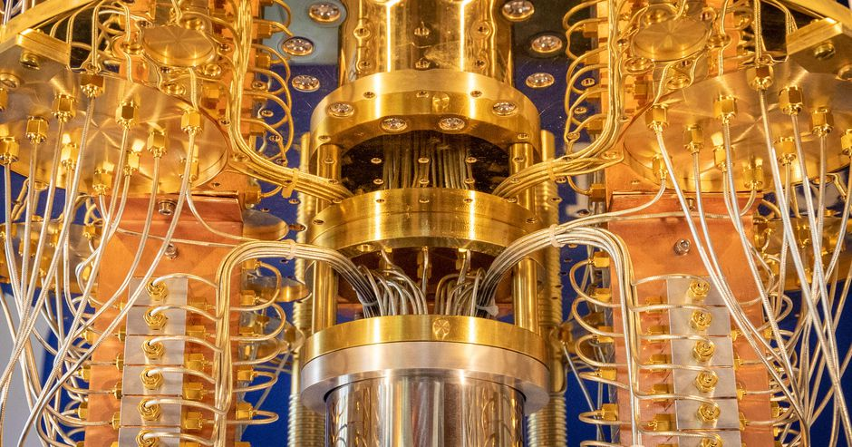
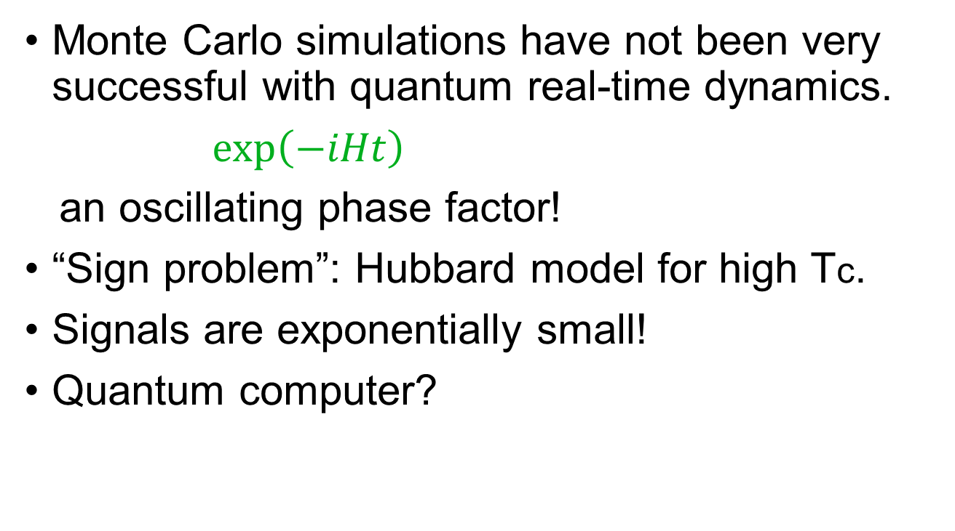
Real-time Monte Carlo in path integrals?
Monte Carlo simulations have not been very successful with quantum real-time dynamics.
$\exp\left(−iHt\right)$
an oscillating phase factor!
“Sign problem”: Hubbard model for high Tc.
Signals are exponentially small!
Quantum computer?

Slide 21
Partons in Feynman’s way: a Euclidean formulation

Slide 22
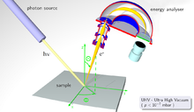
Origin of Parton Model
Electron-proton deep-inelastic scattering (DIS)
Knock out scattering in NR systems
  e-scattering on atoms
  ARPES in CM systems
  Neutron scattering on liquid He
  …

Slide 23
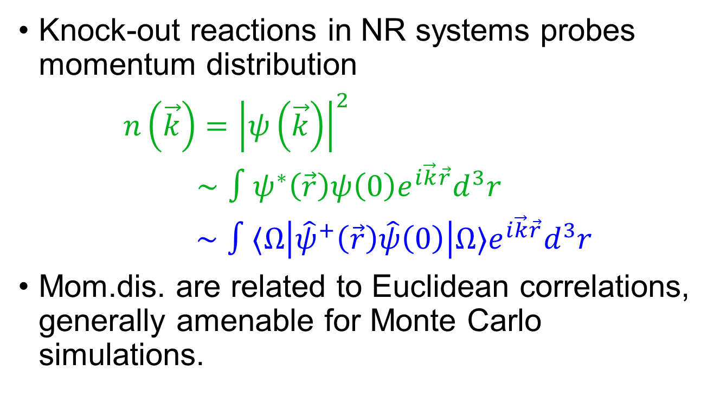
Momentum distribution in NR systems
Knock-out reactions in NR systems probes momentum distribution
$n\left(\vec{k}\right)={\left|ψ\left(\vec{k}\right)\right|}^{2}$
$∼∫ψ^{∗}\left(\vec{r}\right)ψ\left(0\right)e^{i\vec{k}\vec{r}}d^{3}r$
$∼∫⟨Ω\left|{\hat{ψ}}^{+}\left(\vec{r}\right)\hat{ψ}\left(0\right)\right|Ω⟩e^{i\vec{k}\vec{r}}d^{3}r$
Mom.dis. are related to Euclidean correlations, generally amenable for Monte Carlo simulations.

Slide 24
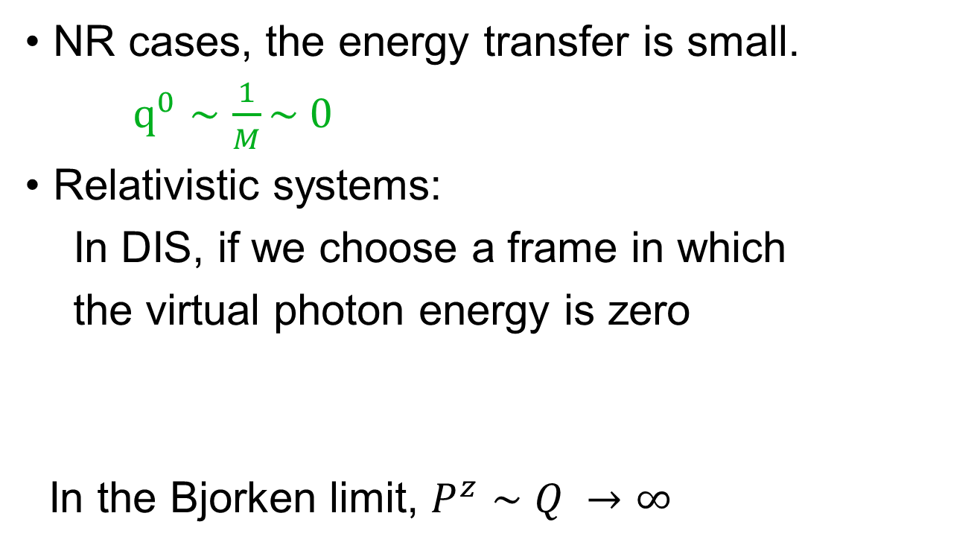
Difference between relativistic and NR systems
NR cases, the energy transfer is small.
$q^{0}∼\frac{1}{M}\sim 0$
Relativistic systems:
In DIS, if we choose a frame in which
the virtual photon energy is zero
In the Bjorken limit, $P^{z}∼Q →∞$

Slide 25
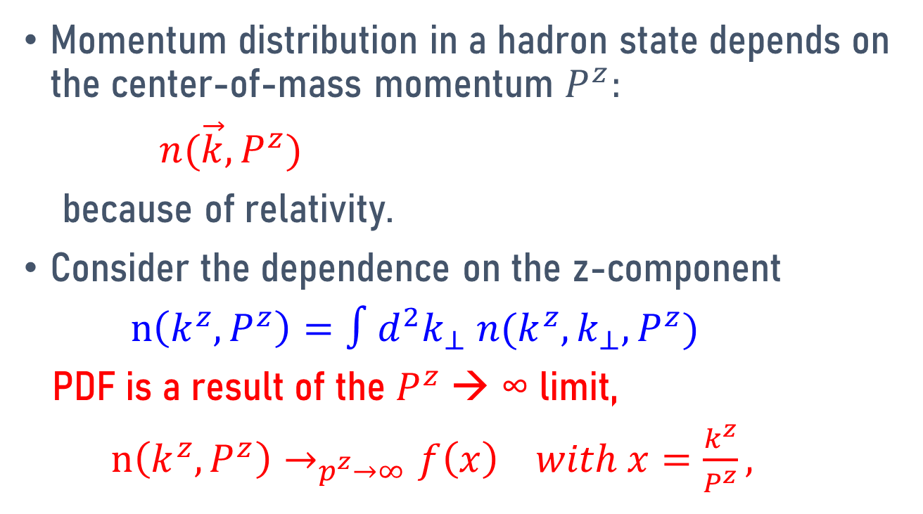
Feynman’s partons
Momentum distribution in a hadron state depends on the center-of-mass momentum $P^{z}:$
$n(\vec{k},P^{z})$
because of relativity.
Consider the dependence on the z-component
$n\left(k^{z}, P^{z}\right)=∫d^{2}k_{⊥} n(k^{z},k_{⊥},P^{z})$
PDF is a result of the $P^{z}$→ ∞ limit,
$n\left(k^{z}, P^{z}\right)→_{p^{z}→∞}f\left(x\right) with x=\frac{k^{z}}{P^{z}},$

Slide 26
Partons in Euclidean formulation
Calculate the Euclidean correlation
Parton distribution

Slide 27
Relation between two parton formalisms
Partons as light-front field correlations
  Use LF collinear field operators
  Parton physics as LF correlations
  Independent of external state momentum
Partons as mom. distribution in infinite-P hadrons
  Use infinite-momentum states to select parton modes
  Euclidean correlations
  Can select with different operators: universality class

Slide 28
Large-momentum expansion

Slide 29
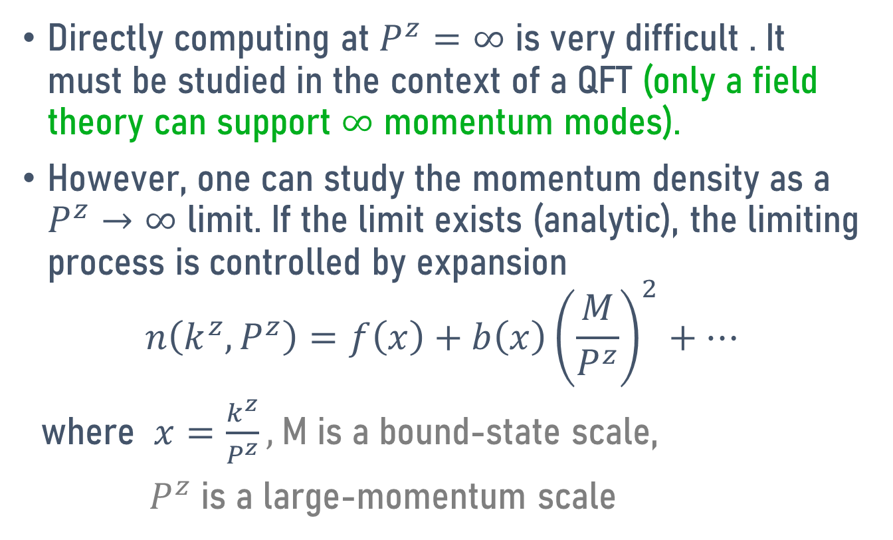
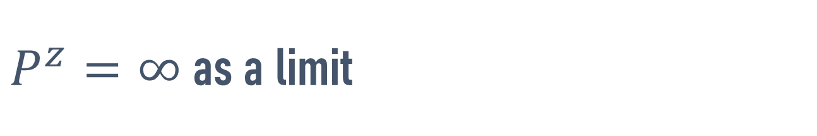
$P^{z}=∞$ as a limit
Directly computing at $P^{z}=∞$ is very difficult . It must be studied in the context of a QFT (only a field theory can support $∞$ momentum modes).
However, one can study the momentum density as a $P^{z}→∞$ limit. If the limit exists (analytic), the limiting process is controlled by expansion
$$n\left(k^{z}, P^{z}\right)=f\left(x\right)+b\left(x\right){\left(\frac{M}{P^{z}}\right)}^{2}+…$$
where $x=\frac{k^{z}}{P^{z}},$M is a bound-state scale,
$P^{z}$is a large-momentum scale

Slide 30
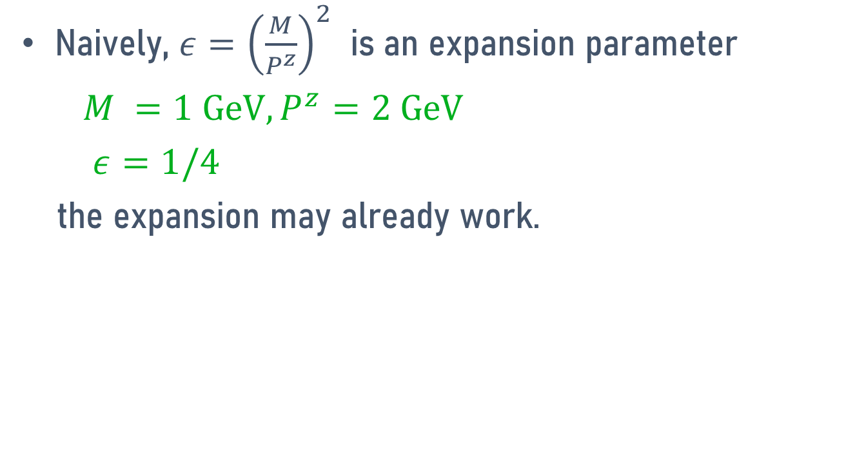

Convergence of the $P^{z}=∞$expansion
Naively, $ε={\left(\frac{M}{P^{z}}\right)}^{2}$ is an expansion parameter
$M =1 GeV, P^{z}=2 GeV$
$ε=1/4$
the expansion may already work.

Slide 31
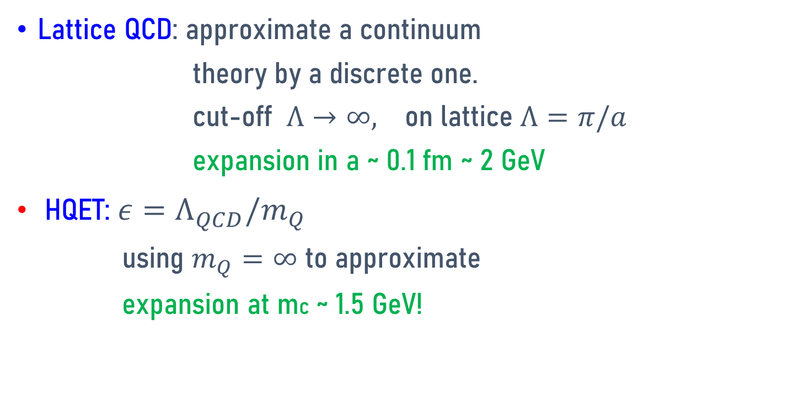
Similar to other expansions in QCD
Lattice QCD: approximate a continuum
theory by a discrete one.
cut-off $Λ→∞,$ on lattice $Λ=π/a$
expansion in a ~ 0.1 fm ~ 2 GeV
HQET: $ε=Λ_{QCD}^{}/m_{Q}$
using $m_{Q}=∞$ to approximate
expansion at mc ~ 1.5 GeV!

Slide 32
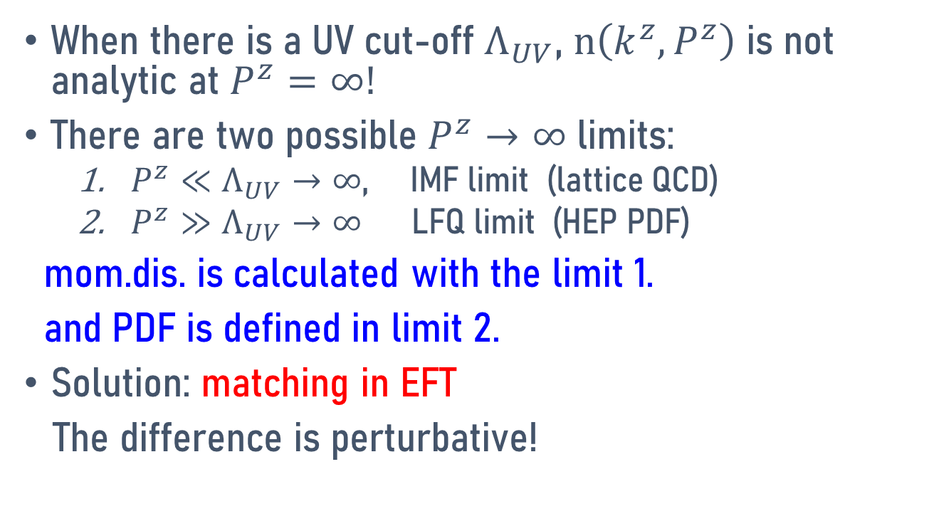
QFT subtleties
When there is a UV cut-off $Λ_{UV}$, $n\left(k^{z},P^{z}\right)$ is not analytic at $P^{z}=∞!$
There are two possible $P^{z}→∞$ limits:
  $P^{z}≪Λ_{UV}→∞$, IMF limit (lattice QCD)
  $P^{z}≫Λ_{UV}→∞$ LFQ limit (HEP PDF)
mom.dis. is calculated with the limit 1.
and PDF is defined in limit 2.
Solution: matching in EFT
The difference is perturbative!

Slide 33
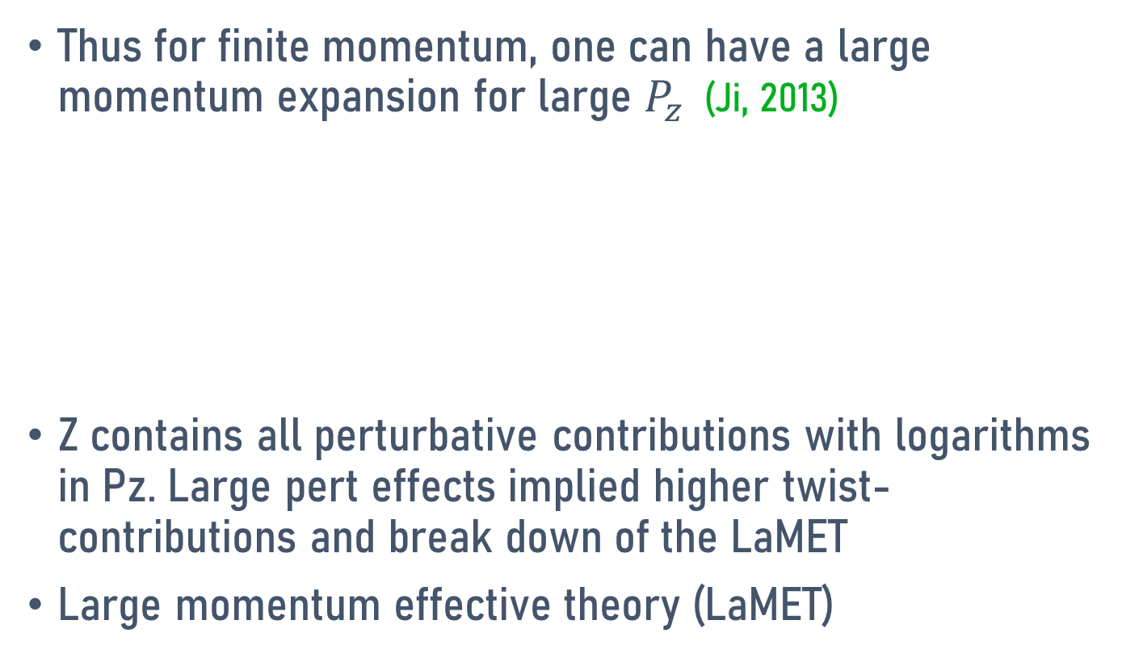
Large momentum expansion
Thus for finite momentum, one can have a large momentum expansion for large $P_{z}$ (Ji, 2013)
Z contains all perturbative contributions with logarithms in Pz. Large pert effects implied higher twist-contributions and break down of the LaMET
Large momentum effective theory (LaMET)

Slide 34
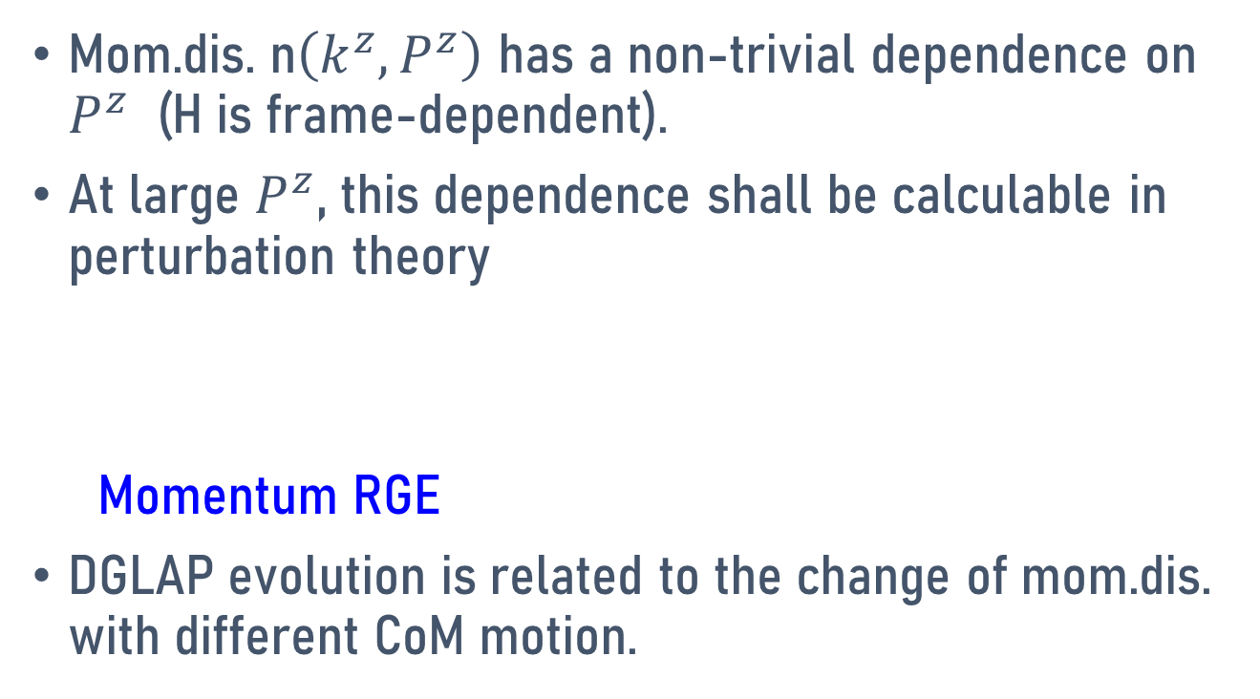
Momentum renormalization group equation
Mom.dis. n$\left(k^{z},P^{z}\right)$ has a non-trivial dependence on $P^{z}$ (H is frame-dependent).
At large $P^{z}$, this dependence shall be calculable in perturbation theory
Momentum RGE
DGLAP evolution is related to the change of mom.dis. with different CoM motion.

Slide 35
Universality
One can practically choose ANY composite operator, so long as Pz large enough, they give the same collinear or soft physics.
For different operators, flowing into the fixed point of large momentum will have different rates (which is faster?), but the limit is the same.

Slide 36
Applications

Slide 37
App1: Gluon total helicity ΔG
In QCD factorization, one can show that the gluon polarization is a matrix element of non-local light-cone correlation.
A. Manohar,Phys. Rev. Lett. 66 (1991) 2684
No one knows how to calculate this for a long time.

Slide 38
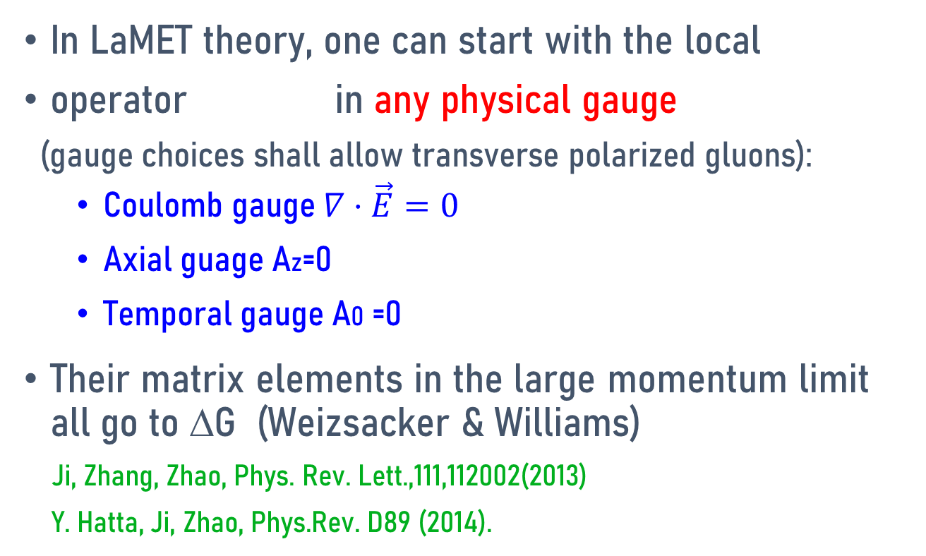
LaMET calculations
In LaMET theory, one can start with the local
operator in any physical gauge
(gauge choices shall allow transverse polarized gluons):
  Coulomb gauge $∇⋅\vec{E}=0$
  Axial guage Az=0
  Temporal gauge A0 =0
Their matrix elements in the large momentum limit all go to ΔG (Weizsacker & Williams)
Ji, Zhang, Zhao, Phys. Rev. Lett.,111,112002(2013)
Y. Hatta, Ji, Zhao, Phys.Rev. D89 (2014).

Slide 39
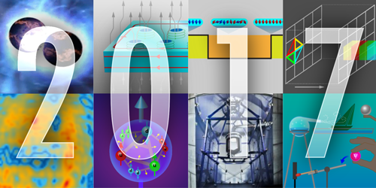
First calculation (Y. Yang et al, PRL(2017))
Gluons Provide Half of the Proton’s Spin
The gluons that bind quarks together in nucleons provide a considerable chunk of the proton’s total spin. That was the conclusion reached by Yi-Bo Yang from the University of Kentucky, Lexington, and colleagues (see Viewpoint: Spinning Gluons in the Proton). By running state-of-the-art computer simulations of quark-gluon dynamics on a so-called spacetime lattice, the researchers found that 50% of the proton’s spin comes from its gluons. The result is in agreement with recent experiments and shows how such lattice simulations can now accurately predict an increasing number of particle properties. The simulations also indicate that, despite being substantial, the gluon spin contribution is too small to play a major part in “screening” the quark spin contribution—which according to experiments is only 30%—through a quantum effect called the axial anomaly. The remaining 20% of the proton spin is thought to come from the orbital angular momentum of quarks and gluons.
Need more controlled calculations

Slide 40
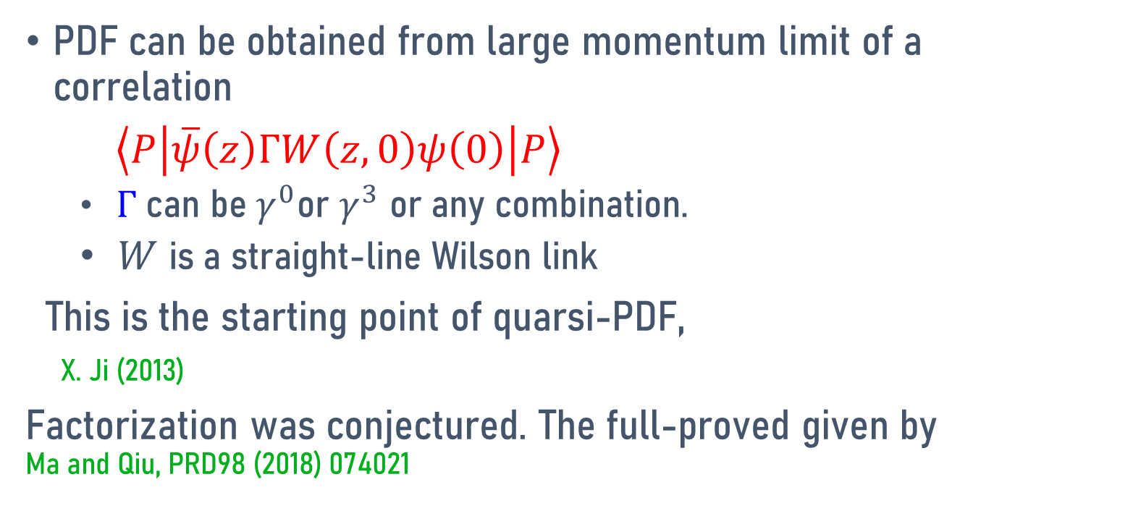
App2: Feynman PDF
PDF can be obtained from large momentum limit of a correlation
$\left\langle P\left|\overline{ψ}\left(z\right)ΓW\left(z,0\right)ψ\left(0\right)\right|P\right\rangle$
  $Γ$ can be $γ^{0}$or $γ^{3}$ or any combination.
  $W$ is a straight-line Wilson link
This is the starting point of quarsi-PDF,
X. Ji (2013)
Factorization was conjectured. The full-proved given by Ma and Qiu, PRD98 (2018) 074021

Slide 41
Pion PDF (BNL/ANL, X. Gao et al, PRL, 2022)
LaMET is only approach to predict x dependence

Slide 42
Universality

Slide 43
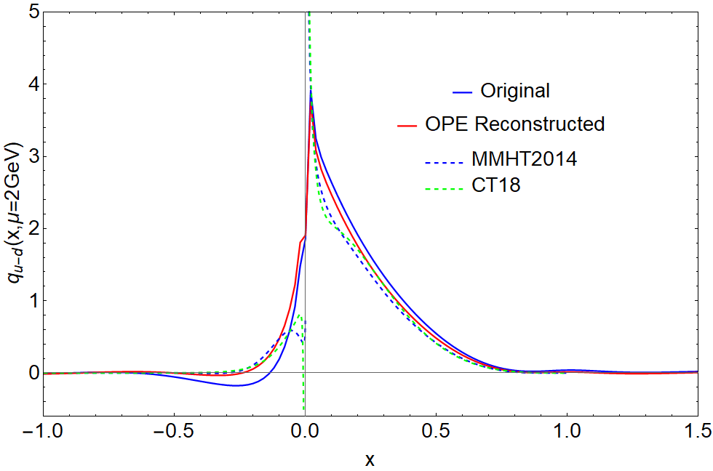
Proton u(x)-d(x) PDF (LPC, unpublished)

Slide 44
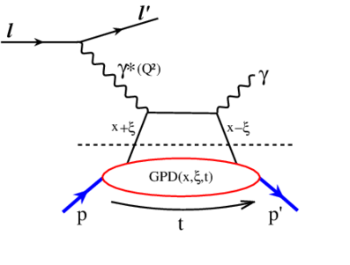
App3: Generalized parton distributions (GPD)
GPD are form factors of parton distributions, providing coordinate space distribution and angular momentum of partons.
An experimental process that was proposed to measure GPD: Deeply virtual Compton scattering (Ji, 1996). Other experiments including meson productions have also been studied (talk by J. W. Qiu)
Kinematic variables: x, ξ, t

Slide 45
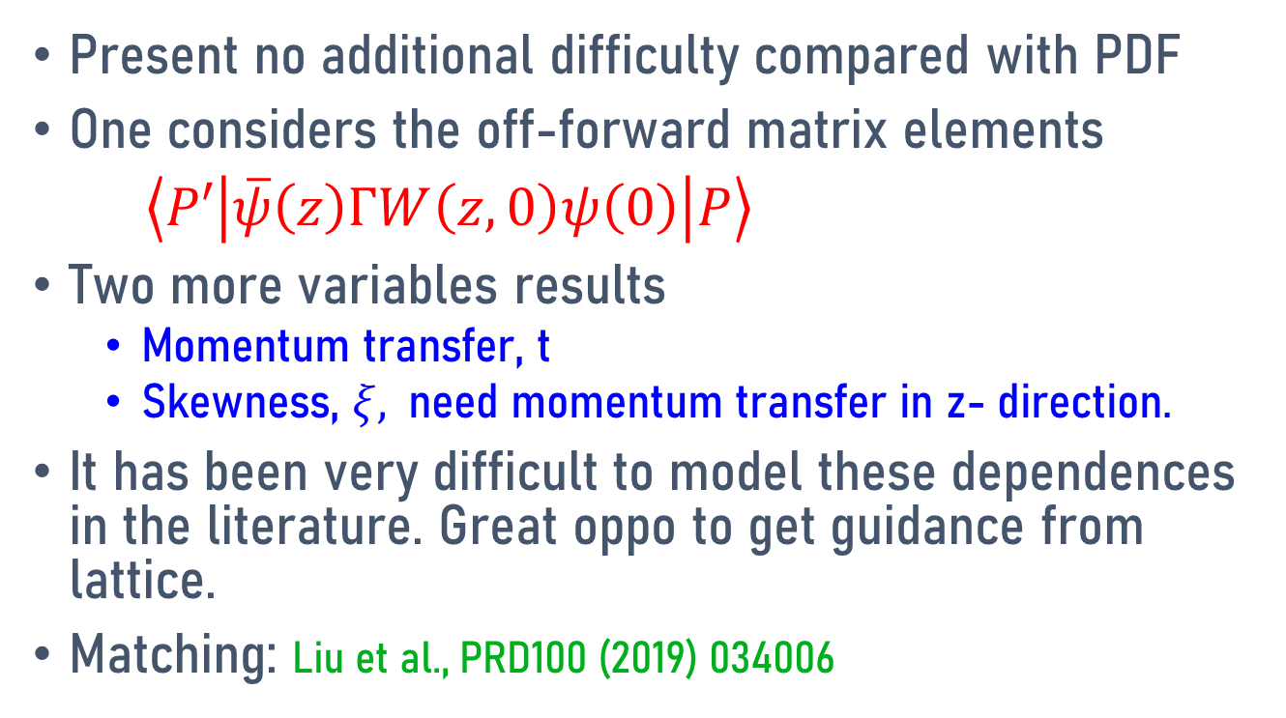
GPD on lattice
Present no additional difficulty compared with PDF
One considers the off-forward matrix elements
$\left\langle P′\left|\overline{ψ}\left(z\right)ΓW\left(z,0\right)ψ\left(0\right)\right|P\right\rangle$
Two more variables results
  Momentum transfer, t
  Skewness, $ξ,$need momentum transfer in z- direction.
It has been very difficult to model these dependences in the literature. Great oppo to get guidance from lattice.
Matching: Liu et al., PRD100 (2019) 034006

Slide 46
Quark transverse-plan distributions in the proton from lattice (H.W.Lin, PRL2021)
MILC configurations
a = 0.09 fm, m_{π} = 140 MeV
Pz = 2.2 GeV

Slide 47
App4: Transverse-momentum-dependent PDFs
Important nucleon observable, many phenomenology related to spin physics (Sivers effect etc).
TMD HANDBOOK, R. Boussarie et al, e-Print: 2304.03302

Slide 52
TMDPDF
LPC (J.C.He et al, 2211.02340)

Slide 53
App 5 : Light-Front Wave Function
Light-front quantized theory is formal (undefined!) and cannot be solved without regularizing light-cone singularities.
If the regularization breaks Lorentz symmetry (almost all regulators in the LFQ literature do), theory ends up non-renormalizable.
LFQ can be defined through large-momentum effective theories, including wave functions.
(X. Ji & Y. Liu, 2022)

Slide 55
Lowest Fock state LFWF

Slide 57
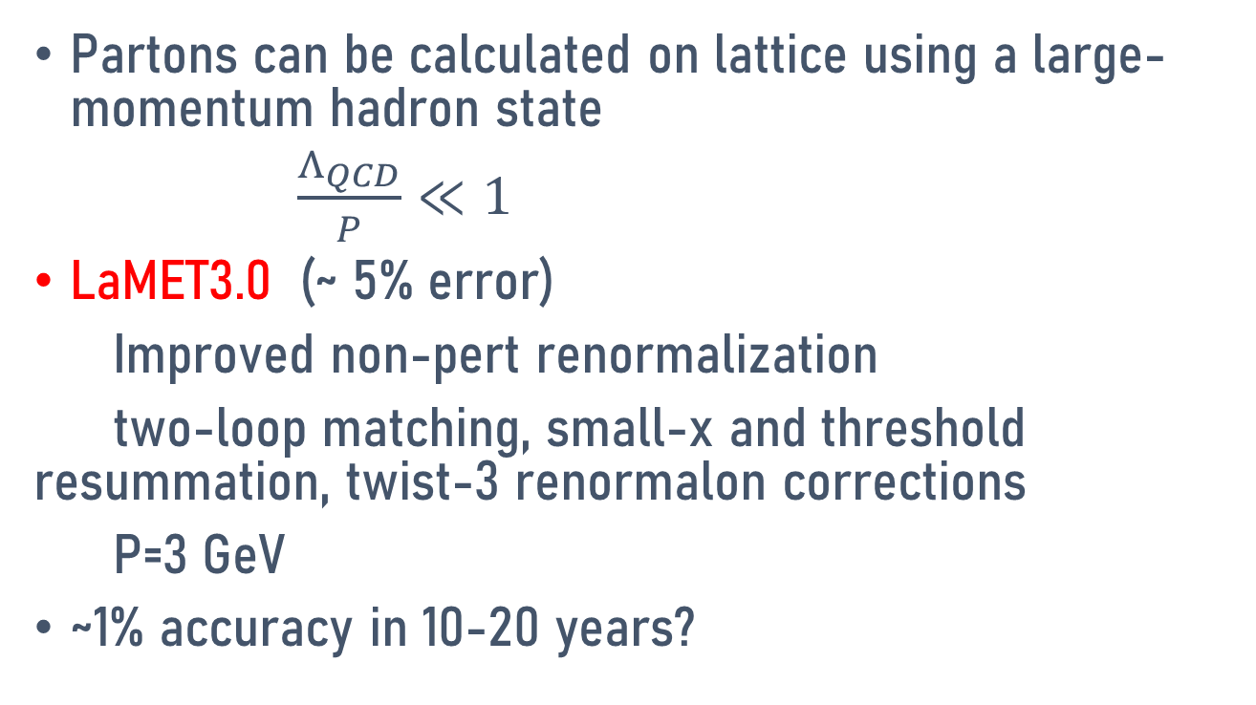
Outlook
Partons can be calculated on lattice using a large-momentum hadron state
$\frac{Λ_{QCD}}{P}≪1$
LaMET3.0 (~ 5% error)
Improved non-pert renormalization
two-loop matching, small-x and threshold resummation, twist-3 renormalon corrections
P=3 GeV
~1% accuracy in 10-20 years?

