Slide 1
Business Continuity/Disaster Recovery/Enterprise Architecture
IT Department Status
Tim Bell
IT BC/DR Lead
5 May 2023

Slide 2
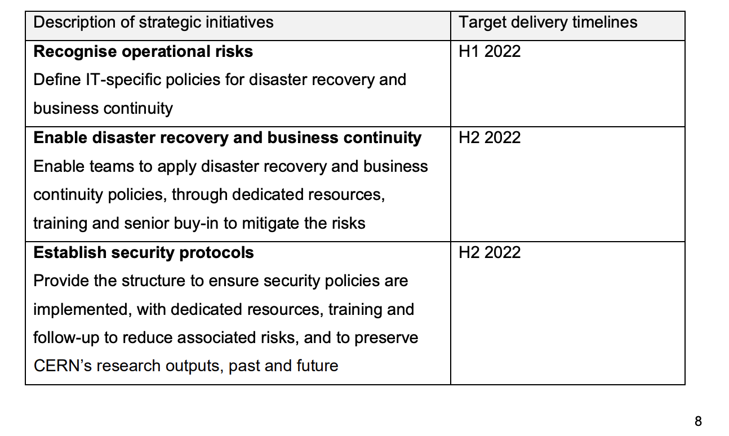

IT strategy 2022-2025
Includes as a provider,
AS-IS
External
Assessment
Recognise operational risks
Today: IT disaster recovery and business continuity procedures are not adequate. Although failures are limited, the risk is significant to ongoing operations
‘We don’t have a proper disaster recovery and business continuity plan’
Full IT Strategy document

Slide 3
Governance bodies in the project/service lifecycle
Project Initiation
Development
Operation
Project Portfolio Review
Oversees the resources, costs, and progress of ongoing projects
PIM/C5
Problem and Incident Management
Engagement Channels:
ATS, FHR, RCS
user & business development needs from Org. sectors
Technical Enhancement
optimizations from service delivery
Innovation Review Board
proposals & requirements from innovation activities
Architecture Review Board
Review proposed implementation
Change and Release Management Board
Review service changes/deployment plan
Operation Review Board
Service operation
Ideation meetings
Demand Management Review Board
Review objectives against department strategy
Assign resources

Slide 4
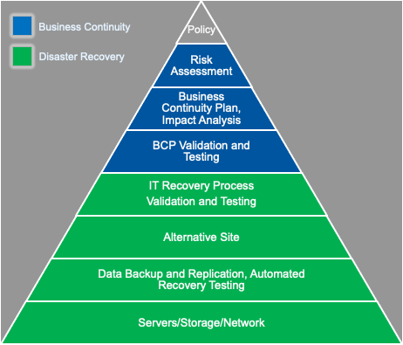
BC/DR problem statement
Risk of significant incident remains
  IT has tried several initiatives (2012, 2016, 2019)
IT BC/DR project established in 2022 until end 2024 but mismatch between our targets and our current capacity
  Estimated 14 person years effort over 2 years, current outlook is around 4 person years spread over 8 people given departures
  Is budget available? (estimated 1.2M CHF needed for PDC capacity and public cloud)
Underlying complex multi-department computing landscape (even more with the experiment workflows)
  Each consuming services from others, including external SaaS
  Service attributes such as responsibilities, recovery times and availabilities are not always clearly understood
  Personas, processes, systems are often not documented and maintained
Notes:
‘not always’ is an understatement ☺

Slide 5
Goal #1: Business Continuity focus
Not an IT only problem - need an organisation network to evaluate key processes
Prepare business impact analysis
  What happens if a process cannot be executed ?
  How can the incident be mitigated ?
  What are the desired recovery objectives (RPO/RTO) ?
  What is the maximum tolerable downtime (MTD) ?
  Needs an end-to-end view of how CERN’s critical process are delivered (see #3)
Would MTD cut-off reduce effort ?
  ~ Only (enviromental|safety|financial|recovery) – mitigations needed for others as significant downtime

Slide 6
Goal #2: Disaster Recovery focus
Highest priority is basic building blocks needed by low RTO
  Cloud and Storage for services
  Kubernetes / Openshift
  Authentication / Authorisation
  Databases
Perform as-is assessment to understand where we are currently (Q2 2023)
Prepare architecture proposals based on PDC availability and external cloud frameworks with the ARB (Q3 2023)
  Balance of up-front purchase cost for active-passive compared to cost only if we need it at the expense of higher recovery times
Update DR project plan based on available resources and required tasks (Q3 2023)

Slide 7

Goal #3: Enterprise Architecture (strictly not BC/DR)
Understand, document and maintain the multi-department computing landscape
  Persona, Processes, Applications, IT Services, IT Functions and the inter-dependencies
  Service lifecycle roadmap (e.g. pilot, production, maintenance, end of life of service and ensure end user actions aligned)
  Common vocabulary for computing architectures
How
  FHR started 18 months ago and IT input is needed
  ATS-IT Steering Committee endorsed the EA approach in December 2022
  Tweak ARB processes and checklists – TOGAF was already selected from the start “What is Architecture?” (LIVE IT)
  IT plan to be prepared in 2H 2023 and embedded into sector-IT planning, Service Catalog/Levels and BC/DR in 2H 2023 (as per goal defined in the IT Strategy 2022-2025)
Who – mirror FHR project structure with experts and ambassadors
  Train ARB members as Enterprise Architects,
  Extended ARB contribute to the EA repository which is aiming to be organisation-wide
  Service managers will be asked to provide input on current architecture along with updates for ARB and CMRB gates
IT Department Strategy 2022-2025
Notes:
EA is not directly related to BC/DR but a robust EA does help defining the service parameters like Recovery Times.

Slide 8

Mini Business Impact Analysis
Identify key processes
Interviews with business
Define impact if process not performed
Financial, Reputation, Scientific Program
Identify business applications needed
Enterprise architecture
Derive IT service elements needed
Define supporting IT functional elements
Iterate on FE dependencies
Service catalog
Calculate recovery objective for an FE
Enterprise architecture
Service catalog
Goal is to map from CERN key processes to recovery objectives of IT service
  Approach
  Raw data
Metric | Count
Business Processes | 46
Business Applications | 223
IT Service Elements | 118
IT Functional Elements | 187
IT SE on FE Dependencies | 1111
IT FE on FE Dependencoes | 468

Slide 9
Business Continuity Next Steps
FAP-BC have run a procurement for “Impact Analysis on Business of Business Computing Downtime” (DO-33582)
  Consultancy to determine the recovery objectives and maximum tolerable downtime for FHR services
  Consultants will also report on their assessment of CERN’s maturity levels
  Aim to start in Q2 2023
Similar analysis was done in 2016
We can expect a follow up discussion on service levels
This could potentially act as a template for other sectors

Slide 10
Disaster Recovery
Focus of IT efforts in 2023 is establishing a cross-group project team (initially with IT-FA, IT-CD, IT-SD, IT-DA and IT-PW) (DROIT details)
  Evaluate plans and tasks in their group’s areas of expertise
  Act as point of contact for their group members to the BC/DR project lead for as-is analysis, service enhancements and test plans
  Communicate concepts, what’s needed and status to their groups
Currently performing as-is assessment to identify, for each service (Draft)
  Current status of service resilience
  Functionality to support recovery of other services
  Upcoming improvements

Slide 11
Disaster Recovery Maturity KPI
  As part of the new operating model, a set of KPIs are being defined to show the current status and track the benefits of the changes going forward.
  Proposed criteria are as follows
    Data source: An annual self assessment is performed by the disaster recovery operations in IT (DROIT) team. The 2023 report is in preparation here. This operation will be repeated each year in Q1.
    Collection method : BC/DR lead will perform the CobiT analysis following the annual as-is self assessment. This will produce a value in the range 0-5 based on the average CobiT level for the FEs with a recovery time objective of <= 1 day
    Detailed criteria in slides #18 (Backups)
    Reporting: Using spreadsheet at https://cernbox.cern.ch/s/PBAlUp6avpICUcP
    Current baseline (2023): 0.95 (“Incomplete process”)
  Note: it is not a criticism if a service has a lower rating, it reflects previous priorities. The key aspect is the delta as we go forward.

Slide 12
Self Assessment Criteria (CobiT)
Level | CobiT Maturity | CobiT Description | DR Description
0 | Incomplete process | The process is not placed or it cannot reach its objective. At this level the process has no objective to achieve. For this reason this level has no attribute. | Limited or no DR capability
1 | Performed process | Performed process. The process is in place and achieves its own purpose. This level has only “Process Performance” as process attribute. | Occasional testing and informal estimation of recovery objectives.
2 | Repeatable but intuitive | The process is implemented following a series of activities such as planning, monitoring and adjusting activities. The outcomes are established, controlled and maintained. This level has “Performance Management” and “Work Product Management” as process attributes | Resiliency architecture available describing the implementation of the disaster recovery process, RTO/RPOs shared with business, dependencies agreed with associated objectives.
3 | Established process | The previous level is now implemented following a defined process that allows the achievement of the process outcomes. This level has “Process Definition” and “Process Deployment” as process attributes. | Success criteria defined. Manually tested confirming correct recovery within RTO/RPO. Test results documented and published.
4 | Predictable process | This level implements processes within a defined boundary that allows the achievement of the processes outcomes. This level has “Process Management” and “Process Control” as process attributes. | Process description for how to execute the disaster recovery process documented, qualified staff defined, and DR Test executed, and results validated.
5 | Optimising process | This level implements processes in the way that makes it possible to achieve relevant, current and projected business goals. This level has “Process Innovation” and “Process Optimisation” as process attributes. | DR Test part of the standard operational procedures of the service with regular testing of backups and DR steps. RTO/RPO are agreed with the business and documented in the IT service level description.

Slide 13
Using the IT operating model to deliver BC/DR
With Architecture, Demand management and Change/Release boards
  Define criteria for assessment of operational resilience
  Best practices defined for backup/restore, resource placement and DR testing
  Reference industry standard DR architecture patterns for service managers
  Implement the critical improvements for the highest risks within the IT budget
AWS
Cold | Pilot Light | Warm Standby | Multi Site Active-Active
RTO/RPO : hours / days | RTO/RPO : 10s of minutes | RTO/RPO : minutes | RTO/RPO : seconds
Less critical systems Classic restore from backup Prevision and restore after the event Cost $ | Data live, minimal capacity Scale out after the event Cost $$ | Business critical Initially running at degraded capacity but usable Scale to full capacity after the event Cost $$$ | Minimal downtime Near zero data loss Mission critical services Can be complex and potential production impact Cost $$$$

Slide 14
Disaster Recovery Next Steps
PDC – Building – Infrastructure-as-a-Service
  Procurement of the initial Infrastucture-as-a-Service resources for the PDC UPS racks (Q2 order, ~Q4 delivery)
    Capacity for services with a recovery objective < 1 day based off mini impact analysis and cloud resource report
    O(1.5M) CHF orders in preparation for fast recovery such as Active-Active or Active-Passive
  Define architecture for independent cloud region in PDC
    Test bed in B513 already available to help bootstrap (e.g. burn-in) and test
    IT Architecture Review Board scheduled in May to review the IaaS proposal
    Test plan development with DROIT (Q3)
  Full disconnect test in planning for start / end of LS3
Public cloud contracts
  For services with a recovery objective > 1 day
  Low running costs (testing) but could be scaled as needed
  Some testing with Oracle cloud but will need Public Cloud Framework (in preparation) and budget

Slide 15
Enterprise Architecture Motivations
Complex relationships between different CERN departments computing activities are not documented (and often not understood)
Computing evolution is hampered by difficulty of impact analysis and integrating multiple component plans
Result is
  “Don’t change anything because you’ll break something”
  “This service needs to be kept running just in case even though there is a high cost”
  “Service levels are difficult to define as lower layer dependencies unknown”
  “There is no common place to plan change and end of life so surprises occur”
  “Defining downtime impact requires many meetings”
IT Department Strategy 2022-2025

Slide 16
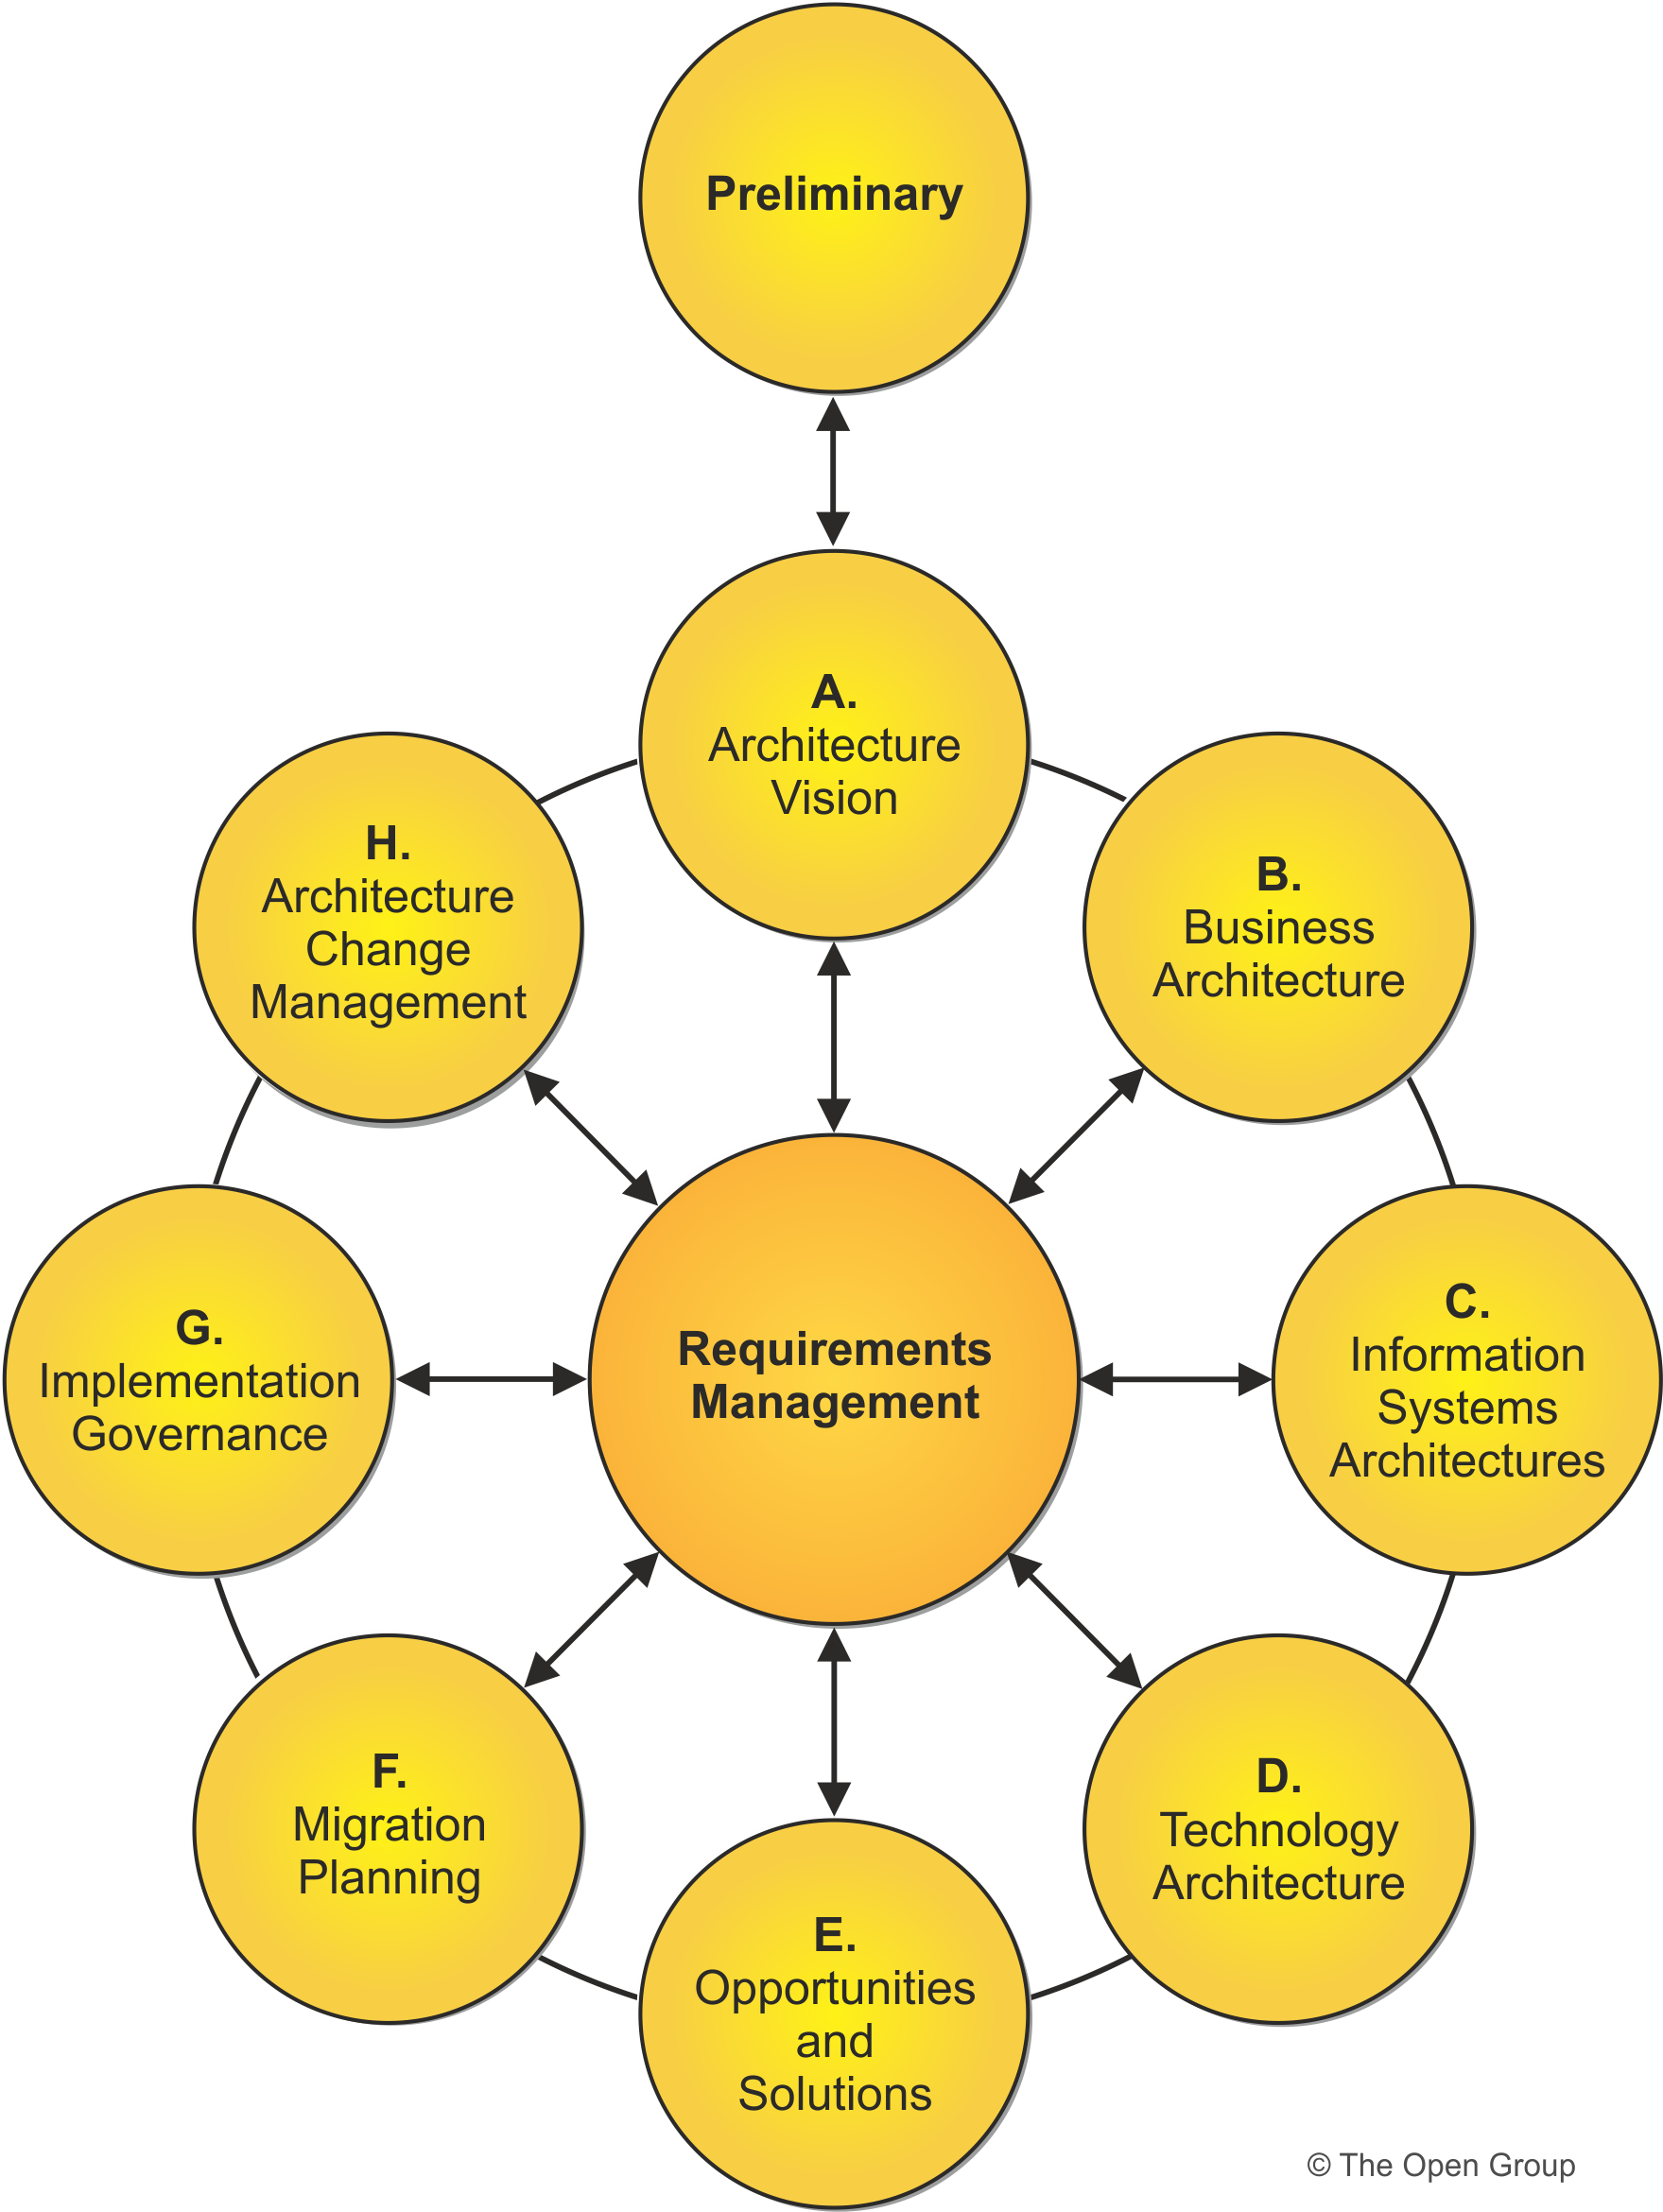
TOGAF : An opengroup Standard for EA
‘The TOGAF Standard is used by small, medium, and large commercial businesses, as well as government departments, non-government public organizations, and defense agencies
With greatly expanded guidance and how-to material, it enables organizations to operate in an efficient and effective way across a broad range of use-cases, including agile enterprises and Digital Transformation
The TOGAF Standard is designed for the dichotomy of common universal concepts and variable detailed configuration
The structure focuses on what most architects want – more, better, and topical guidance on how to deliver the best Enterprise Architecture that supports their stakeholders and their organization”
Source: https://www.opengroup.org/togaf

Slide 17
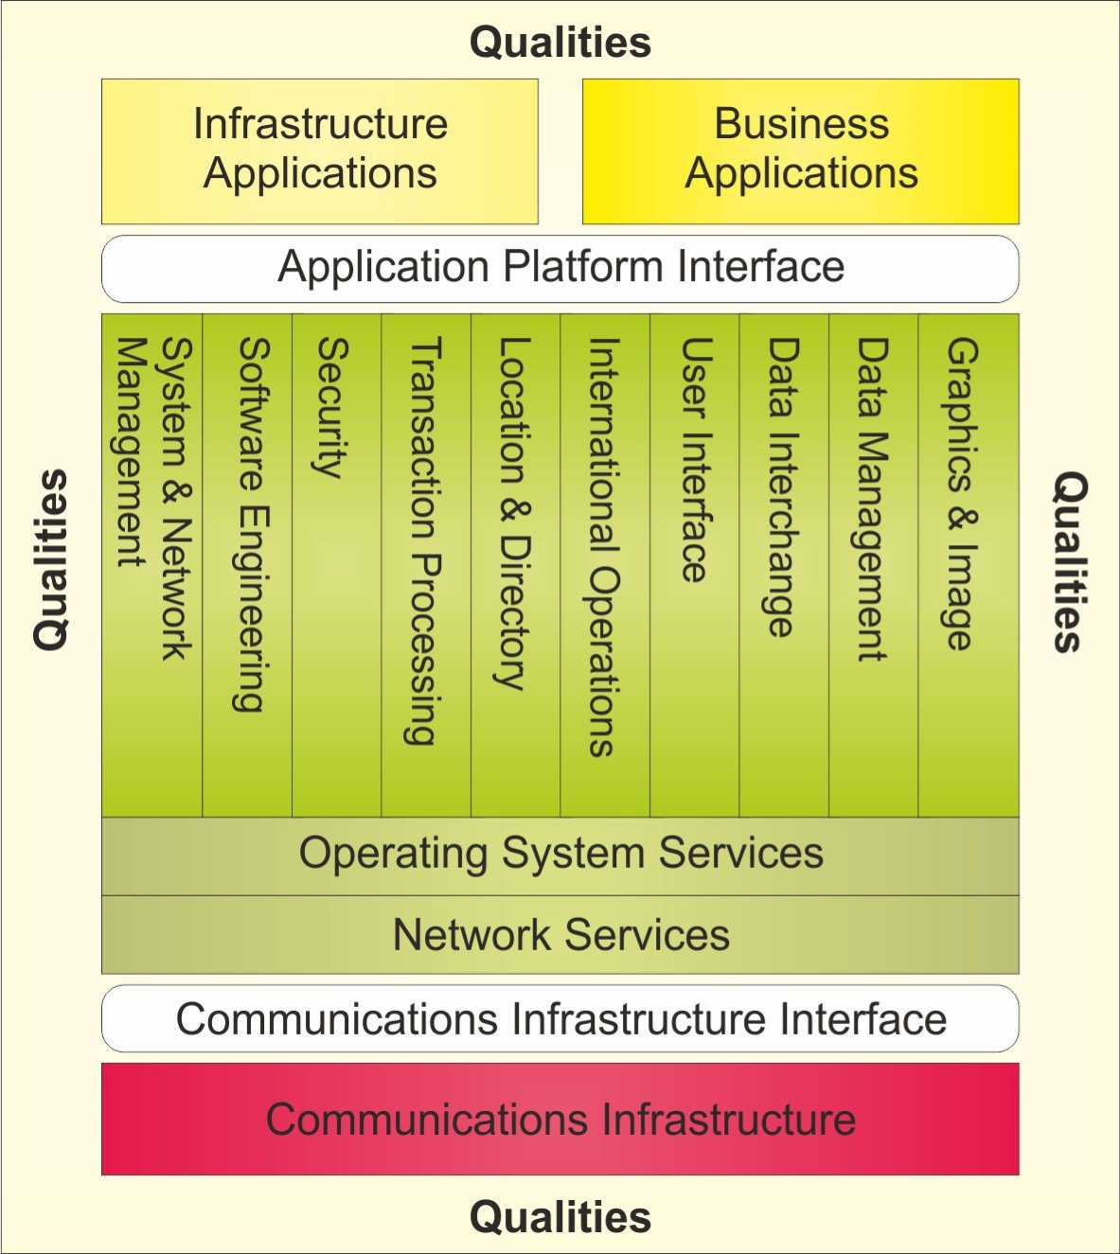
TOGAF Technical Reference Model (TRM)
“The objective of the TOGAF TRM is to provide a widely accepted core taxonomy, and an appropriate visual representation of that taxonomy.”
A common ontology for how the organisations computing activities fit together
Source: https://pubs.opengroup.org/togaf-standard/reference-models/trm.html

Slide 18
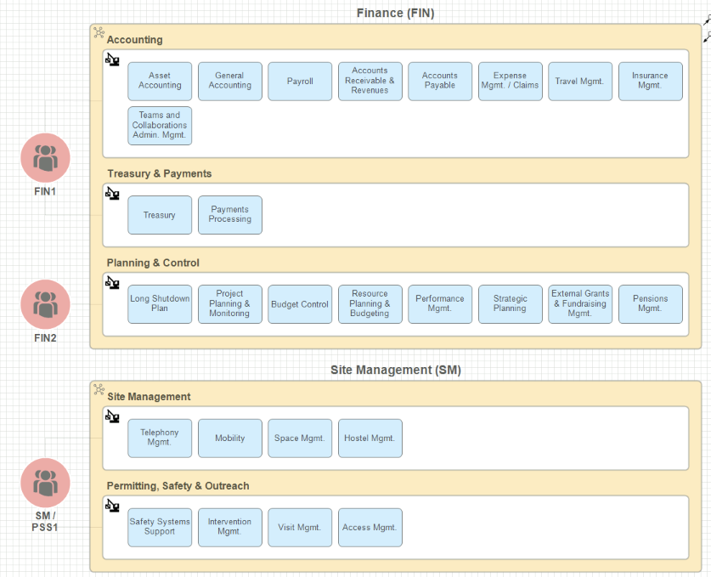
FHR Analysis : Capabilities

Slide 19
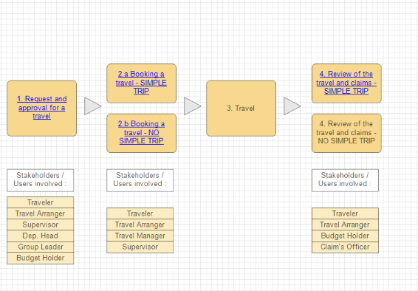
FHR Analysis : Sample Process

Slide 20
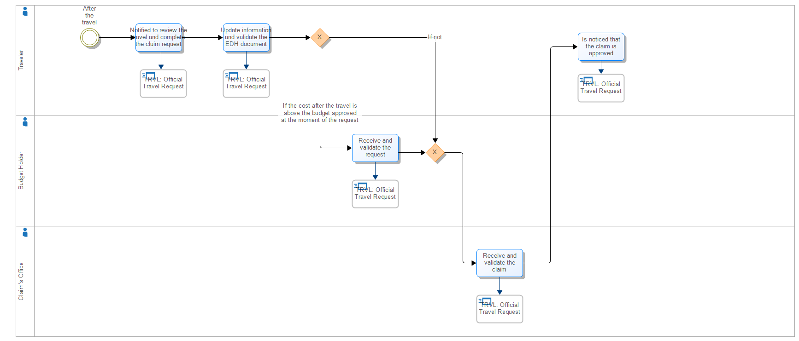
FHR Analysis : Process to Application

Slide 21
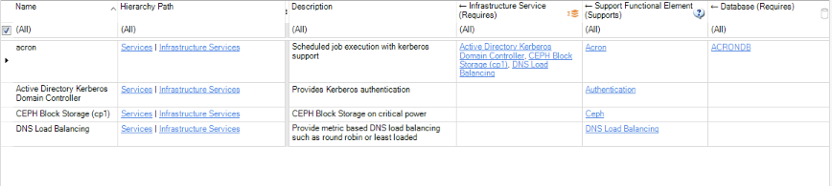
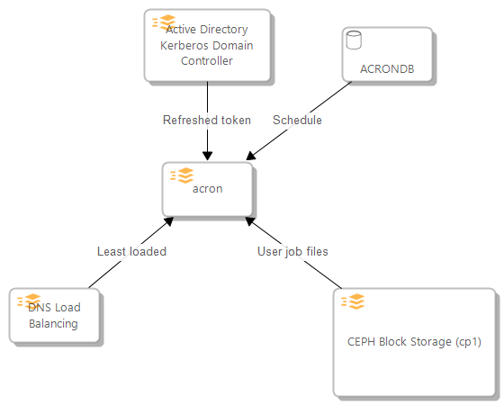
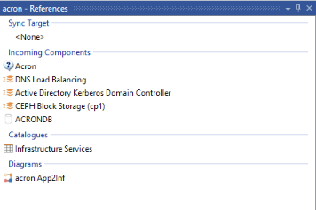
Sample Infrastructure Application : acron
Catalogs contain properties (e.g. Description) and constraints (with the connection type, e.g. Requires)
Diagrams
References

Slide 22
Enterprise Architecture : Next Few Months (Q2/3)
Working with FHR and ATS on a roadmap
  Plan to submit Purpose-Scope-Objective (PSO) initiatives for both FHR-IT and ATS-IT along with the IT DMRB (Draft)
  Establish a CERN wide forum to share experiences and manage common EA repository
An IT Architecture Review Board workplan (Q3)
  However, with significant implications on BC/DR e.g. business impact analysis
  Need to get the organisation computing engineers on board
IT Modeling of TOGAF Technical Reference Model (TRM) in Abacus
  Map IT services and components to the TOGAF model
  Define properties / dependencies
  Investigate diagramming, import processes and built in reports (e.g. availability, performance, …)
The SNOW service catalog will initially be used as-is
  Many potential evolutions but could lead to pleasing nobody
  Catalog changes have a significant cost

Slide 23
BC/DR/EA Further Concerns
Not all critical services will be resilient and tested until LS3
  Cause
    IT Technical Delivery resource availability
    Departure of BC/DR team member
    Related activities needed to improve maturity such as Enterprise Architecture / Service Levels
  Proposed actions
    Target PDC first 6 months window for initial DR testing and full disconnect test requested at start/end LS3
    DMRB allocation of a share of new fellows in Infrastructure-as-a-Service layers
Dispersed activities around BC/DR across the organisation
  Cause
    Complex computing services organisation and responsibilities
    Limited service level agreements between parties
    No agreement on CERN wide governance structure yet
  Proposed actions
    Maintain informal contacts such as EA and power cut preparation team

Slide 24
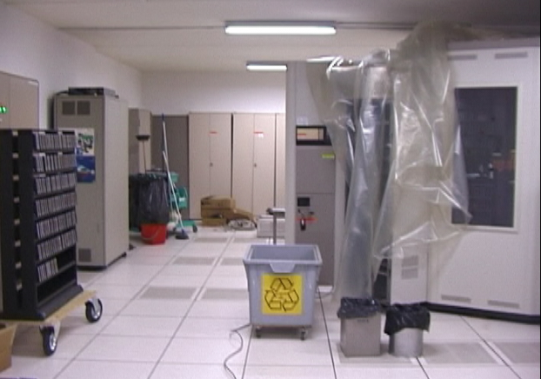
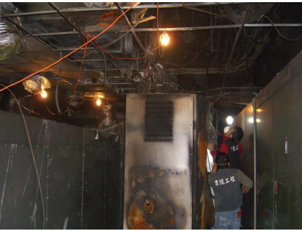
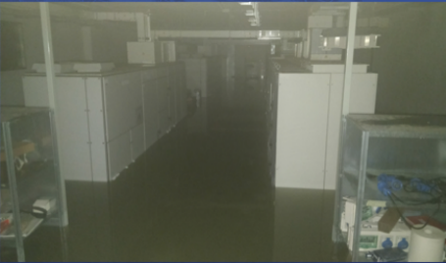
Incidents : some High Energy Physics examples
Incident | When | Site | Details
Tapes ‘dampened’ due to plumbing mistake | 2004 | CERN | HEPiX
Tree cuts all power | 2005 | SLAC | HEPiX
Power outage | 2006 | CERN | Report
EDH down for 3 days due to RAID failure | 2007 | CERN | HEPiX
UPS Fire | 2009 | ASGC/Sineca | Details
20,000 tape files unintentionally deleted | 2010 | CERN | Details
Site wide power outage | 2010 | SLAC | HEPiX
Power outage | 2014 | CERN | Details
Flood of computer centre | 2018 | INFN | CHEP
Power outage during power test | 2021 | CERN | ASDF

Slide 25
Additional Material
IT BC/DR Project in Indico
  https://indico.cern.ch/event/1276940/
IT Disaster Recovery Web Site
  https://disaster-recovery.web.cern.ch/
Draft IT Project Description for BC/DR
  https://cernbox.cern.ch/s/ElLIpYoVJpKBjZI
If there are any permission errors, please get in touch

Slide 26
Backups

Slide 27
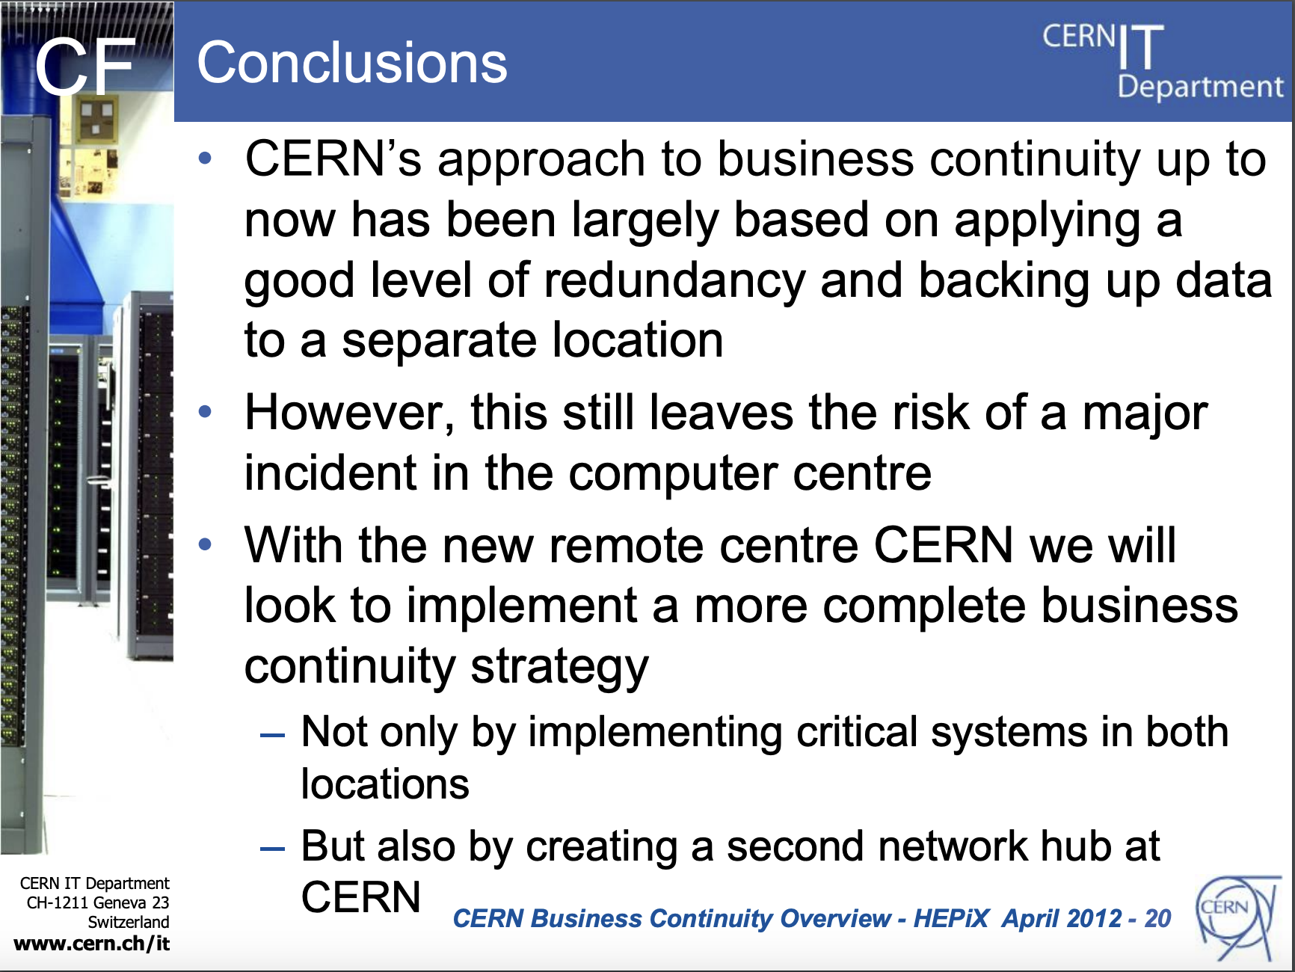
Wayne Salter
HEPiX 2012

Slide 28
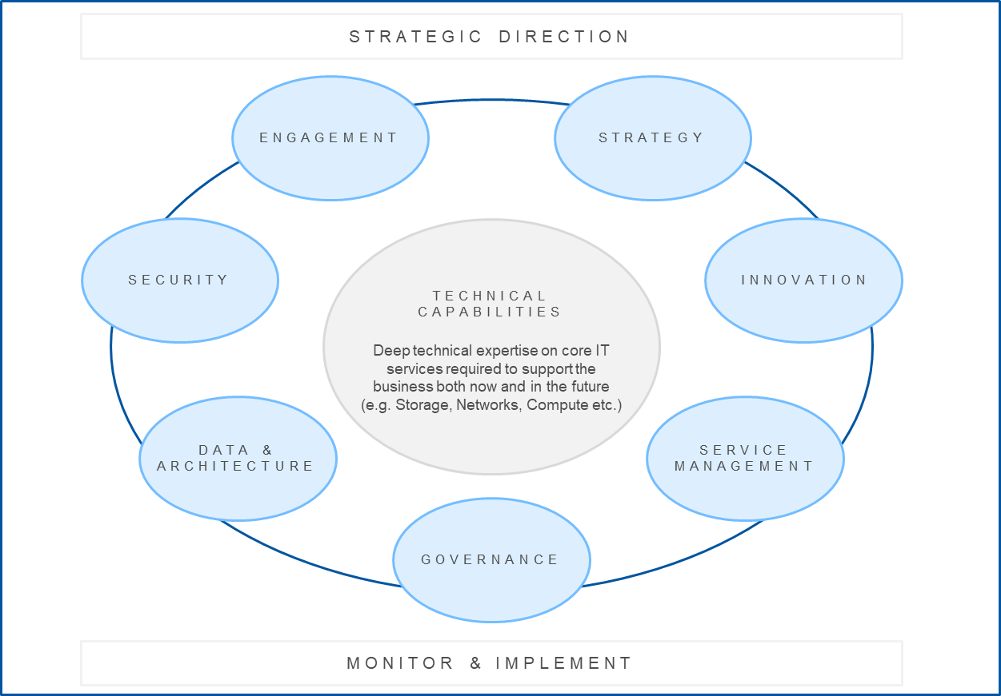
2022 – transformation
2023 – consolidation and evolution

Slide 29
Disaster Recovery 1st Wave
Need to do a full business impact analysis but..
These are likely to be amongst the first ones
  Authentication (AD, SSO, e-groups, Grappa, …)
  Safety (CSAM, RAMSES, …)
  Access Control (SUSI, ZORA, …)
  SCADA, Cooling/Ventilation + Controls
  Communication tools
    E-Mail, Chat, Phone, …
  Application servers
    Foundation, Qualiac, Payroll, IMPACT, HRT, EDH, EDMS, INFOR, …
  Core Web services

Slide 30
Disaster Recovery ‘Easy’ Ones
The (relatively) easy IT ones will also be good to do early
  Mkdocs (!)
  Gitlab, …
  Opendcim, …
  aiadm-homeless
  Puppet et al
  Linuxsoft
  Indico

Slide 31
Summary of Status Based on Live-IT Plans
Area | Milestone | Target | Status
BC | Business Impact Analysis with at least one sector | Q3 2023 | On track (Mini)
 | Update DMRB with refined resource plan and schedule | Q3 2023 | On track
DR | Establish IT cross group co-ordination team | Q1 2023 | Done
 | Prepare as-is assessment on current capability | Q2 2023 | On track (Draft)
 | In collaboration with TD, refine implementation to support rapid recovery from incidents for IT critical services, including PCC and public cloud resources as needed | Q4 2023 | On track
EA | Evaluate industry standard approach for personas, products, applications, services and ontology with FHR, IT, ATS | Q2 2023 | Tight (Draft)
 | Prepare project proposal for DMRB | Q3 2023 | On track
 | Adapt processes with ARB and TD for implementation & maintenance | Q4 2023 | Delayed to Q1 2024

