Slide 1
Continued ADC Chip Study
Greg Powers
May the 4th, 2023

Slide 2
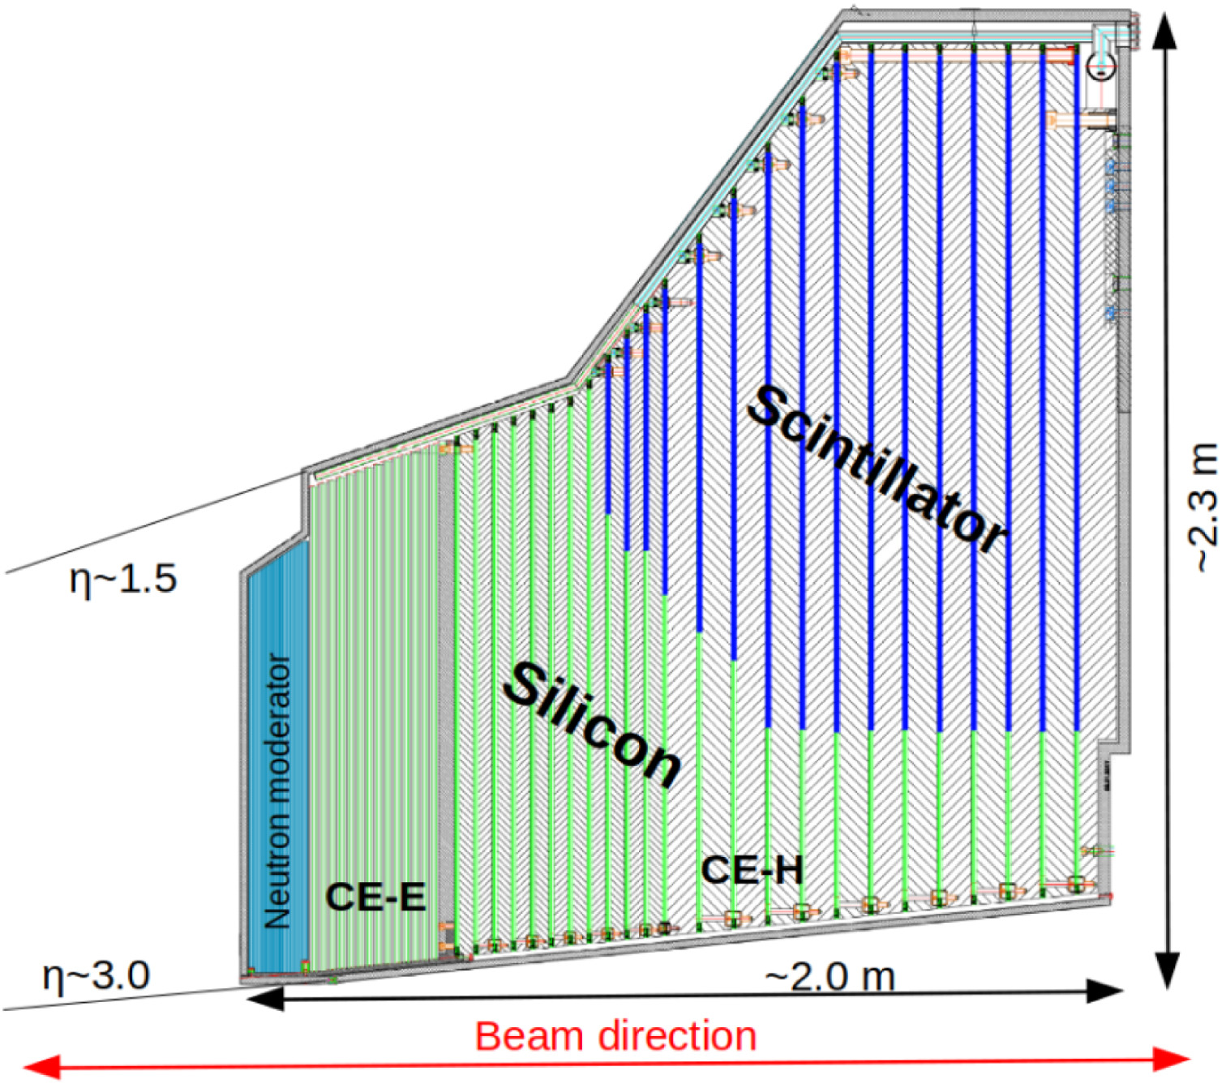
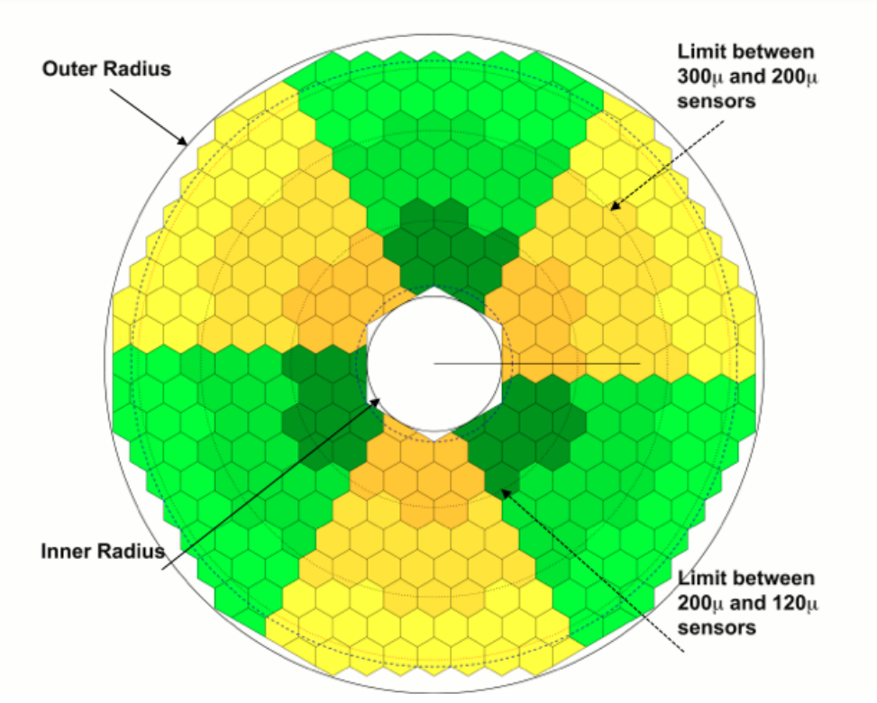
HGCAL Overview
https://cds.cern.ch/record/2293646/files/CMS-TDR-019.pdf

Slide 3
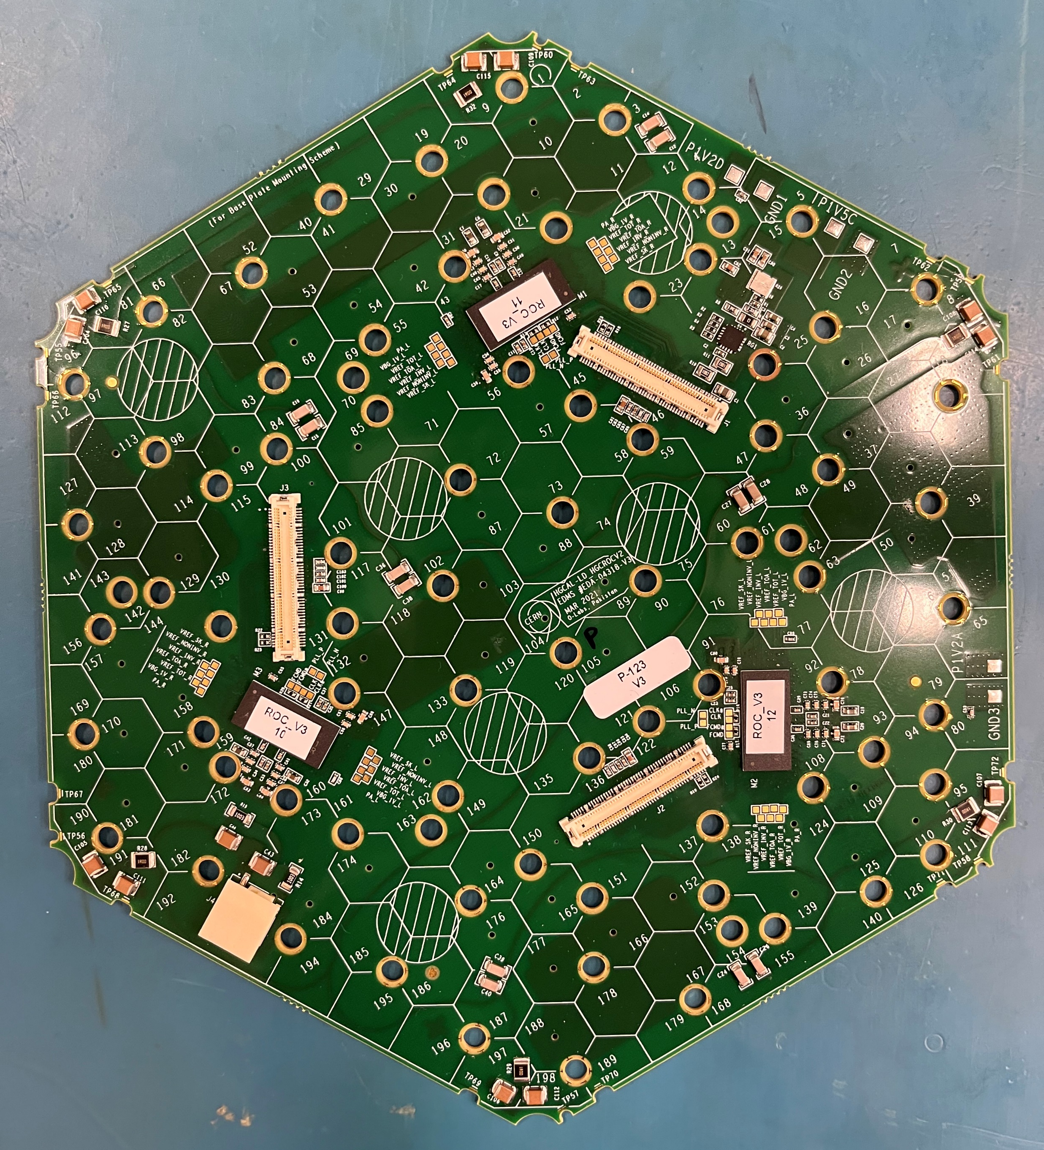
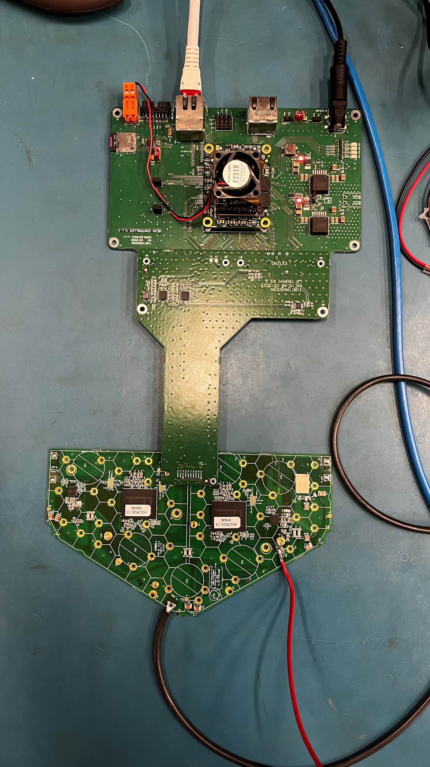
Chips
Semi-Board
Low Density Full Board

Slide 4
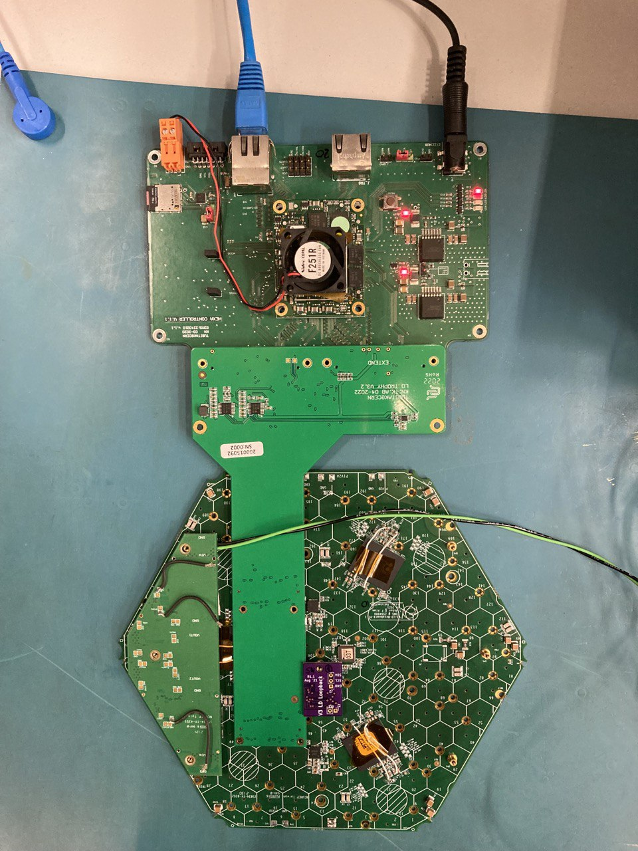
Testing Setup
FPGA
ADCs
Trophy Board
Power
ROCs
Loop Back
Hexaboard

Slide 5
Semi-Board Testing

Slide 6
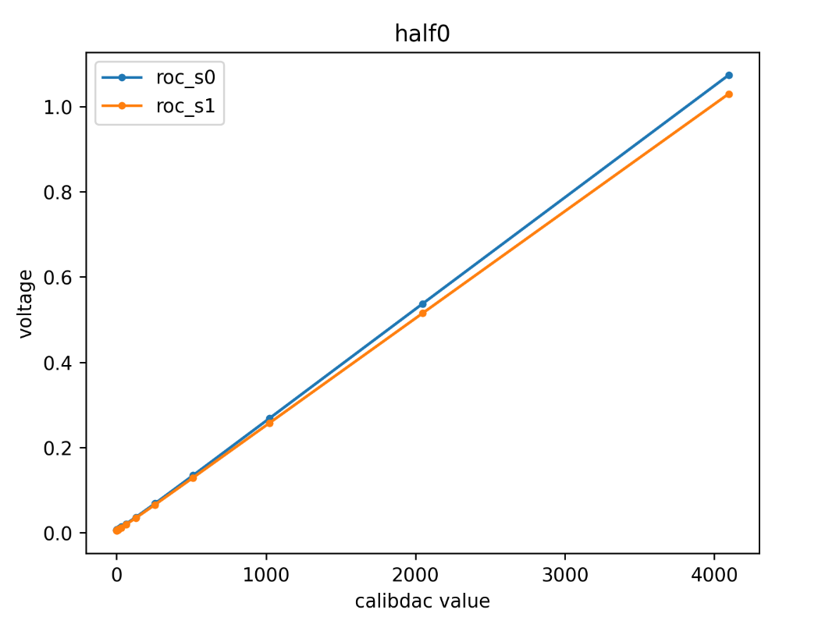
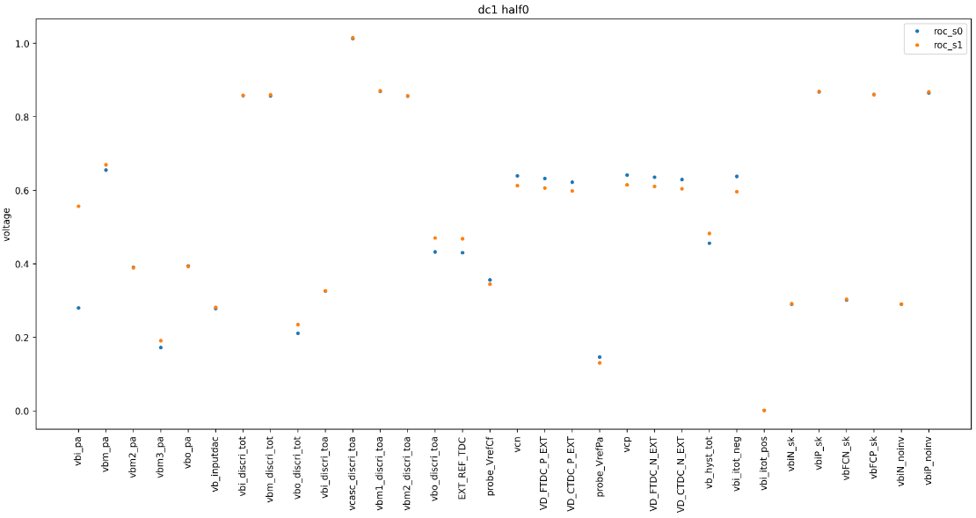
Semi-Board Calibration Plots

Slide 7
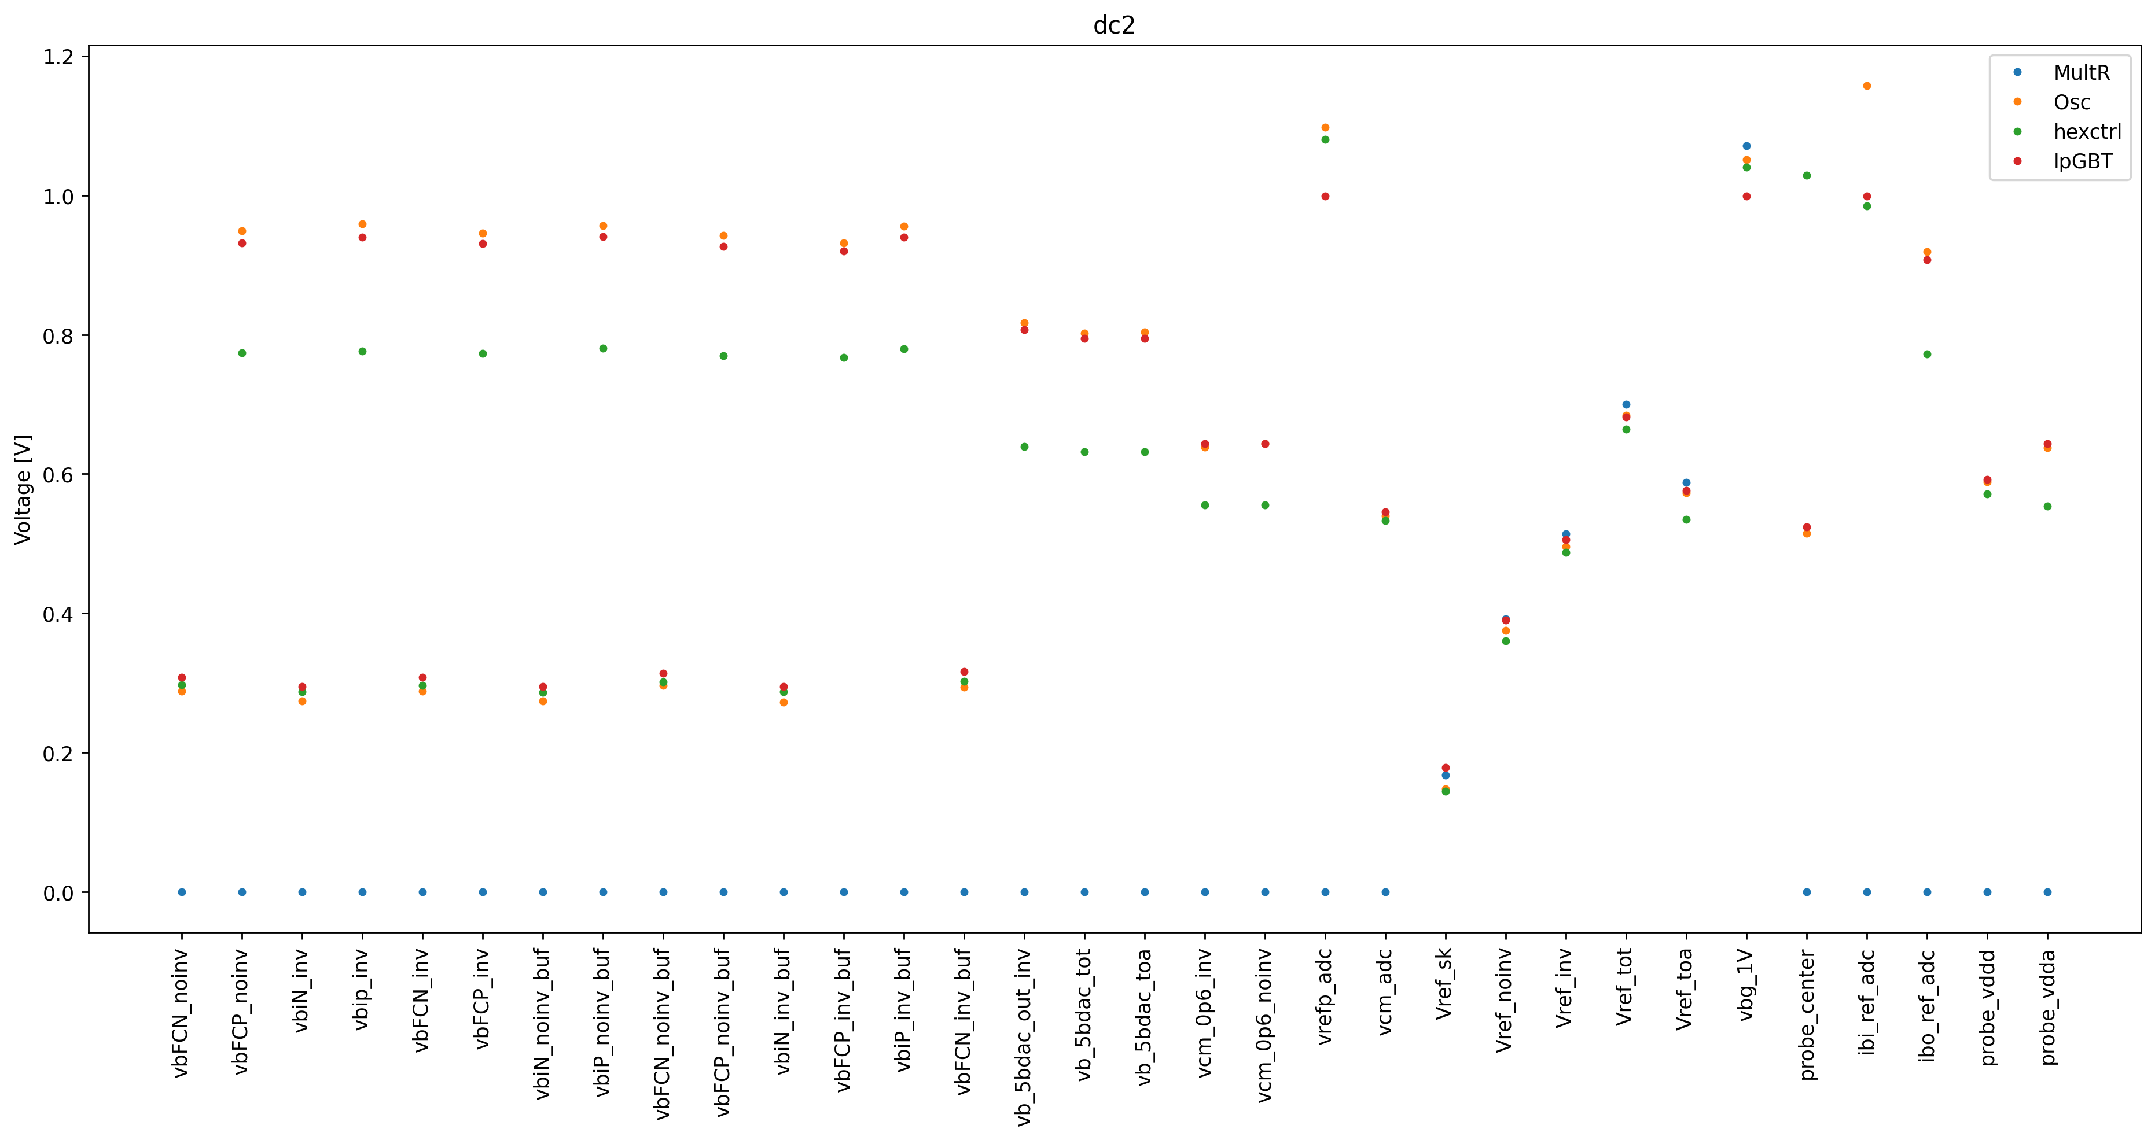
Comparing Measurement Techniques: Insignificant

Slide 8
Temperature Measurement
Started implementing, but was delayed due to new board testing
Relatively low priority

Slide 9
(Maybe) Next: Laser Beam Detection Testing

