Slide 1
Simulating Cosmic Ray Collisions With Pythia8-Angantyr
Jake McCool
04 May 2023

Slide 2
Presentation Structure
Reminder of what I am doing
Goals from last presentation
What I will do next
Troubleshooting/Progress

Slide 3
Presentation Structure
Reminder of what I am doing
Goals from last presentation
What I will do next
Troubleshooting/Progress

Slide 4
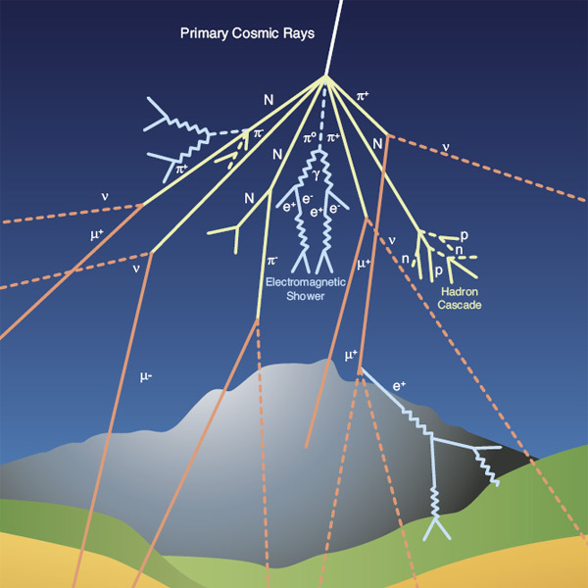
As a Reminder about Cosmic Rays…
Generally, Protons or light atomic nuclei
  Accelerated in supernovae or our sun (solar wind) for example
Collide with our atmosphere and create a particle shower
  ~ 10 billion particles, ~20 km2 for UHECR
We put detectors on satellites above the atmosphere
Not enough data for higher energies
  lower flux at high energies
So, we use the atmosphere as a detector
  And Monte Carlo Generators

Slide 5
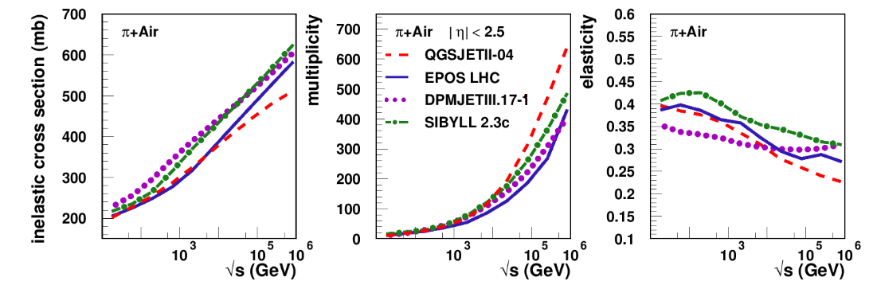
The Kind of Graphs We Would Like

Slide 6
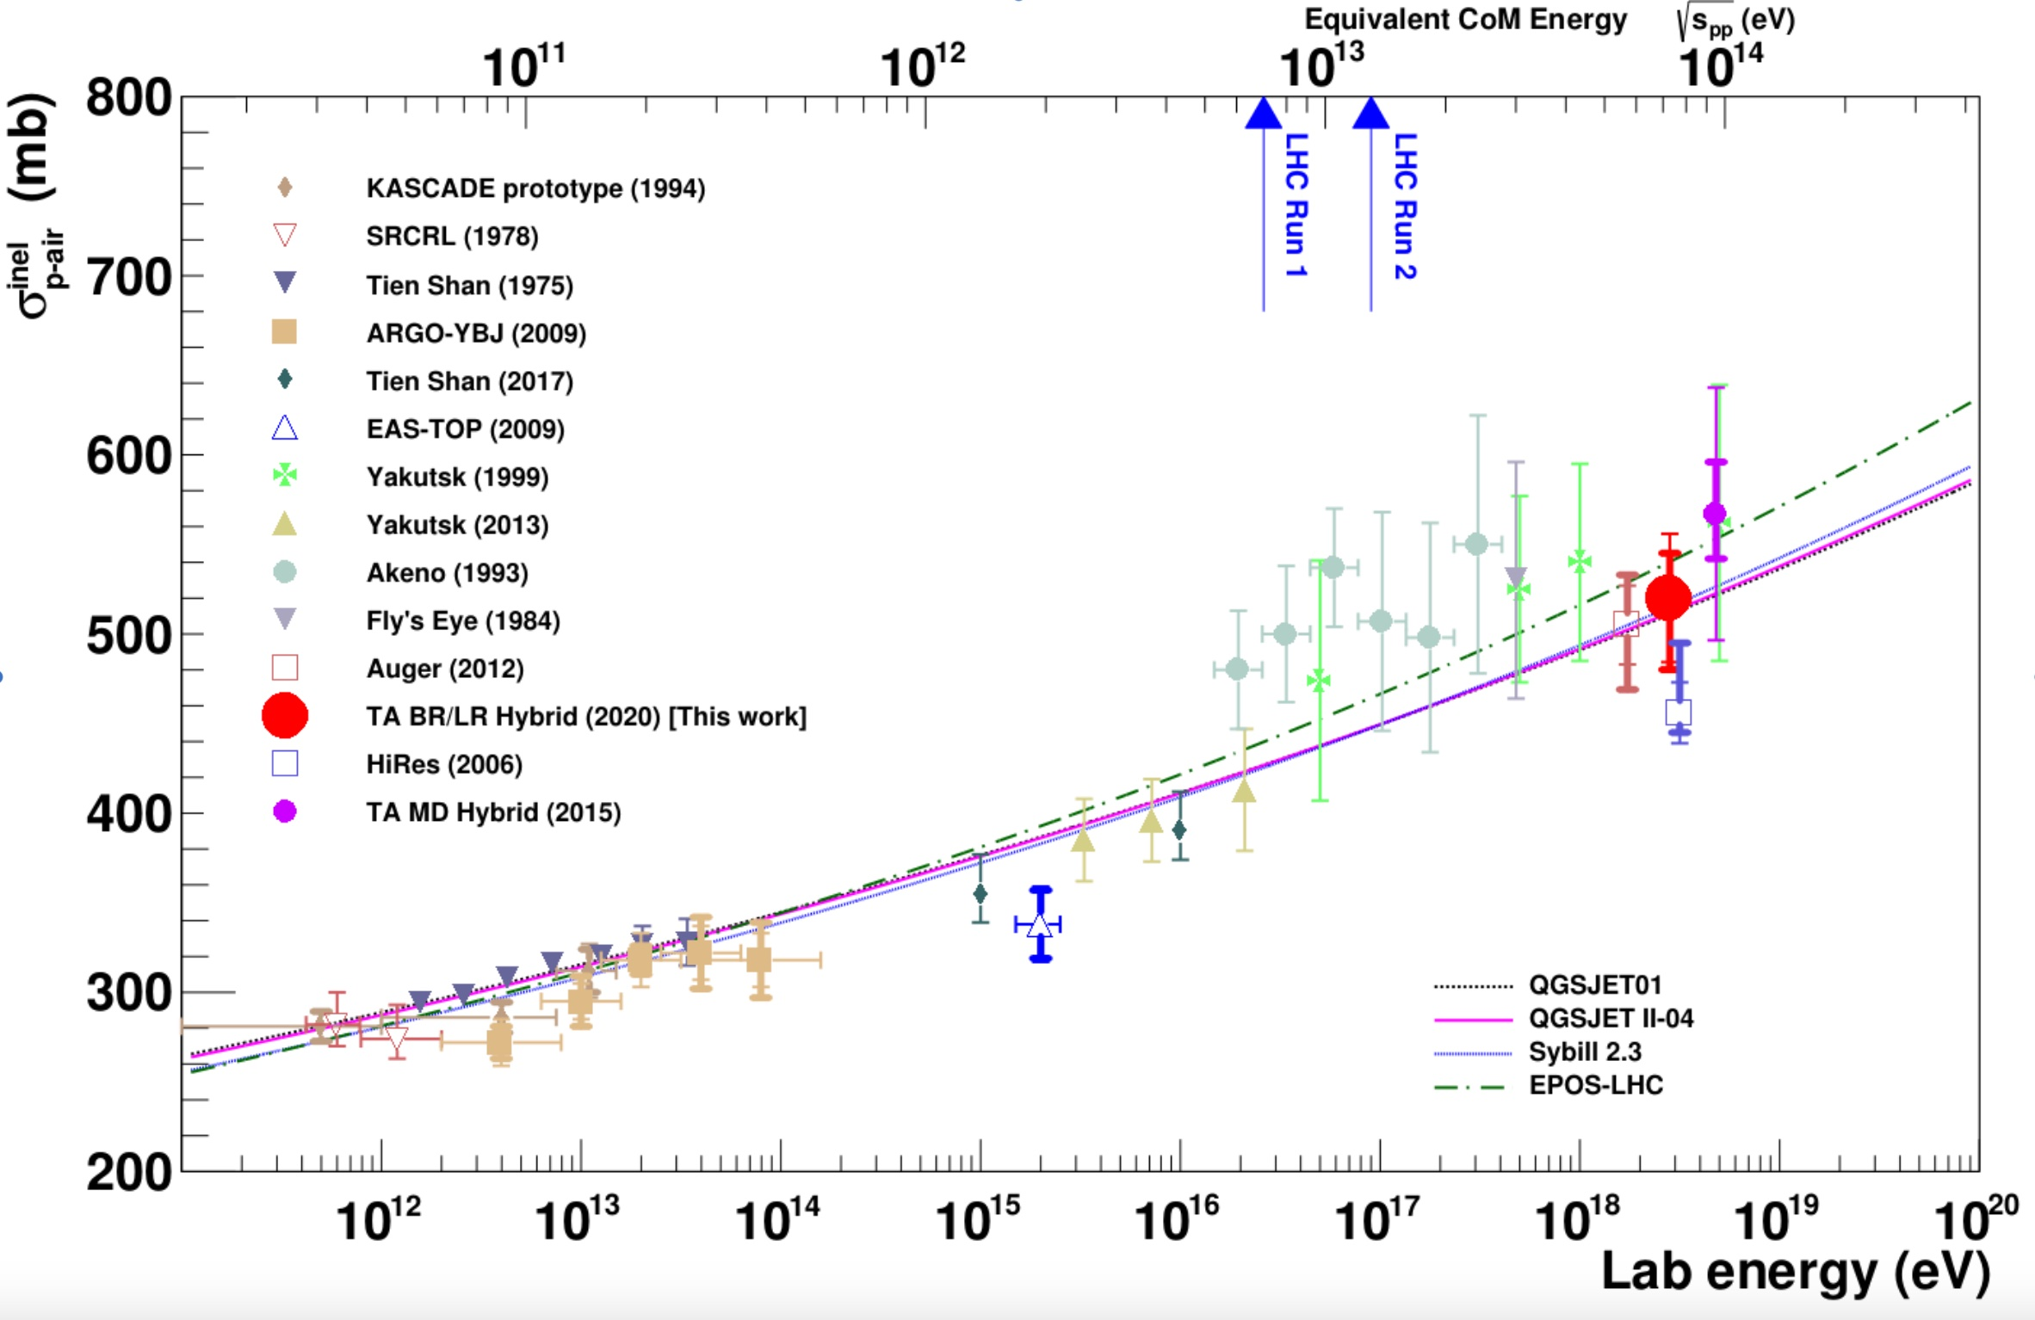

Slide 7
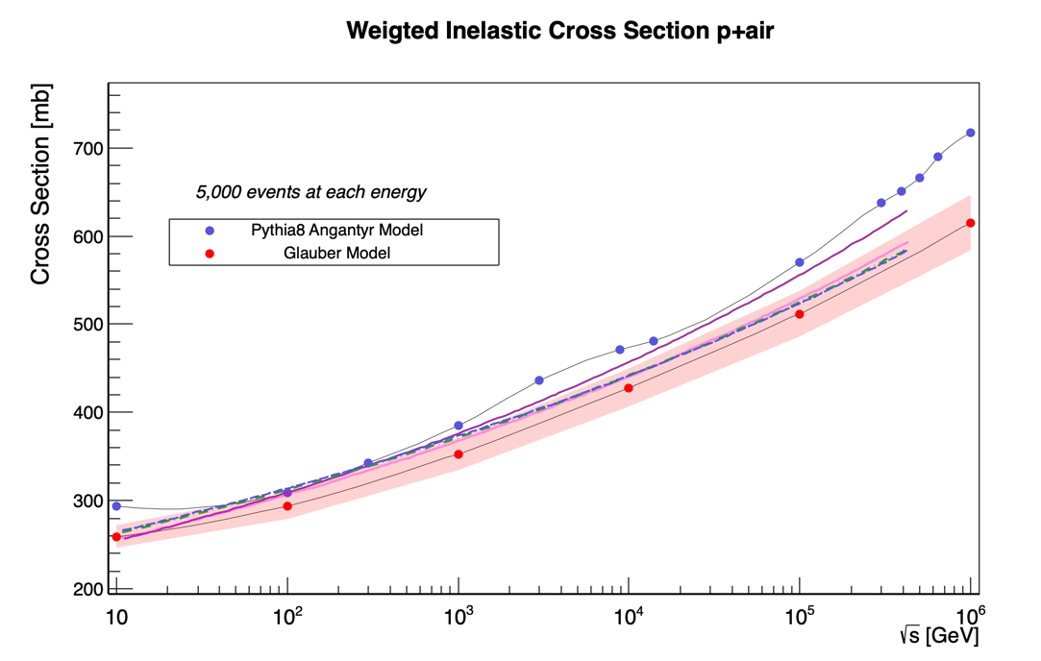
Previously…

Slide 8
Presentation Structure
Reminder of what I am doing
Goals from last presentation
What I will do next
Troubleshooting/Progress

Slide 9
What Were My Goals?
Add experimental data to master graph
Produce the same plot but for Pion-Air
Then Graph Multiplicity for both
Graph p-p cross section vs p-air cross section

Slide 10
Presentation Structure
Reminder of what I am doing
Goals from last presentation
What I will do next
Troubleshooting/Progress

Slide 11
Whoops…All Errors
Root stopped working, and I am trying again to recompile from source with Pythia-8

Slide 12
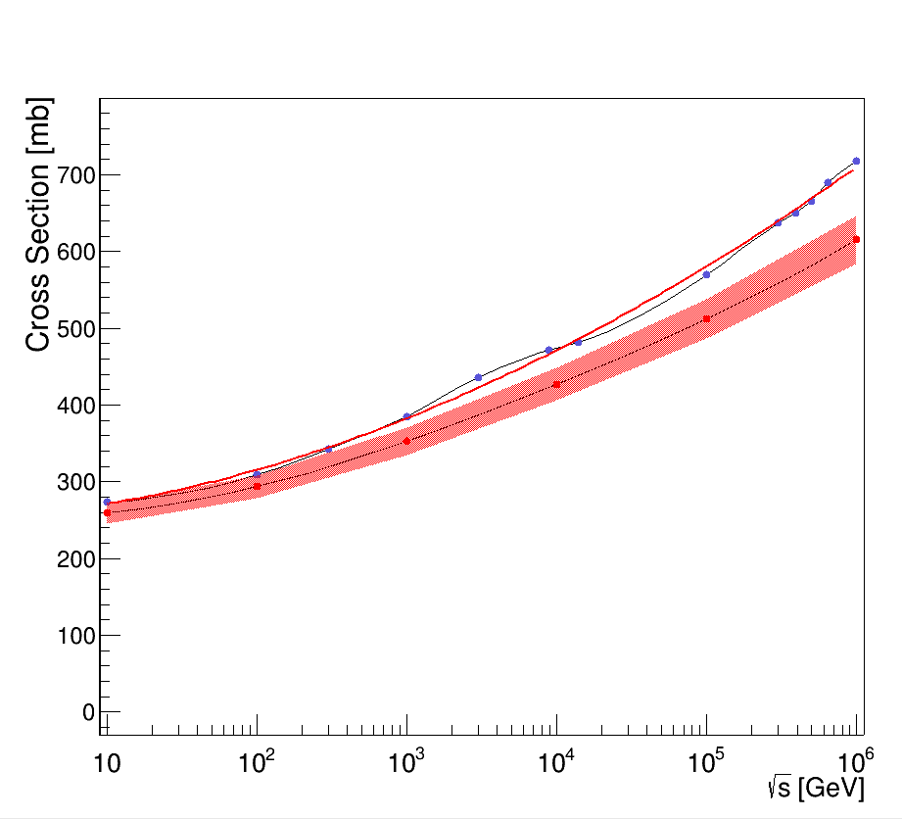
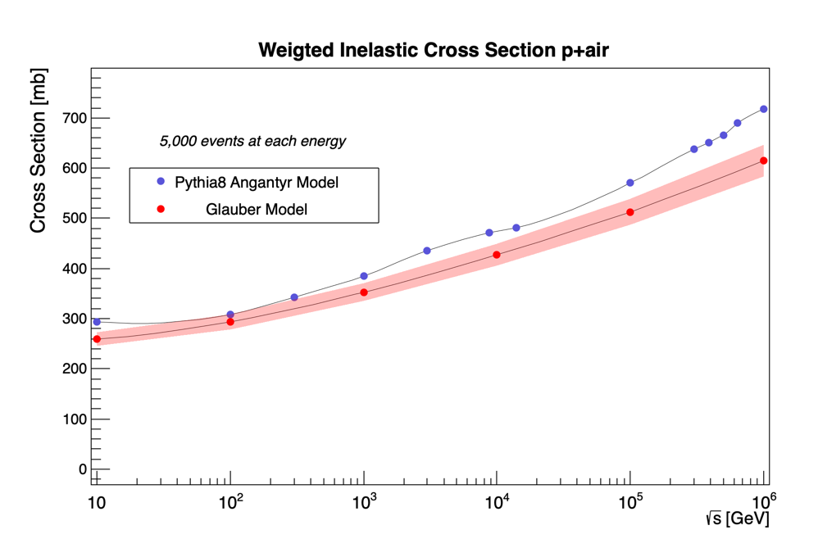
First point was way off
•Incorrect Elastic x-section was a significant amount of sum

Slide 13
Master
Cosmic
Ray Graph

Slide 14
Before ROOT stopped working, we had another idea
Plot sigma p-p vs sigma p-air
Fit this, and find a function that describes their relation
Grab sigma p-air off master cosmic ray graph
Find sigma p-p for energies much greater than ecom of LHC

Slide 15
With Fits

Slide 16
P-air vs P-P

Slide 17
Presentation Structure
Reminder of what I am doing
Goals from last presentation
What I will do next
Troubleshooting/Progress

Slide 18
Next steps
Get ROOT to work again :((
Find corresponding values of p-p x-section for real cosmic ray data
Compile LHAPDF with Pythia8
  This has more up to date parton density functions for muons
Run Pion-Air collisions and create similar graphs with x-section
Graph multiplicity for both proton-air and pion-air

Slide 19
Thank you :)

