Slide 1
4D Tracking Updates
Camille Mauceri

Slide 2
Overview
Preparation for updates to the LHC
Hypothetical detector technology could measure time and position of hit with high precision
Tracking software needs to be updated to include this capability
Tracking algorithms tested using simulated data on different detector geometries
Long term goal: include timing info in hit-track and track-vertex association

Slide 3
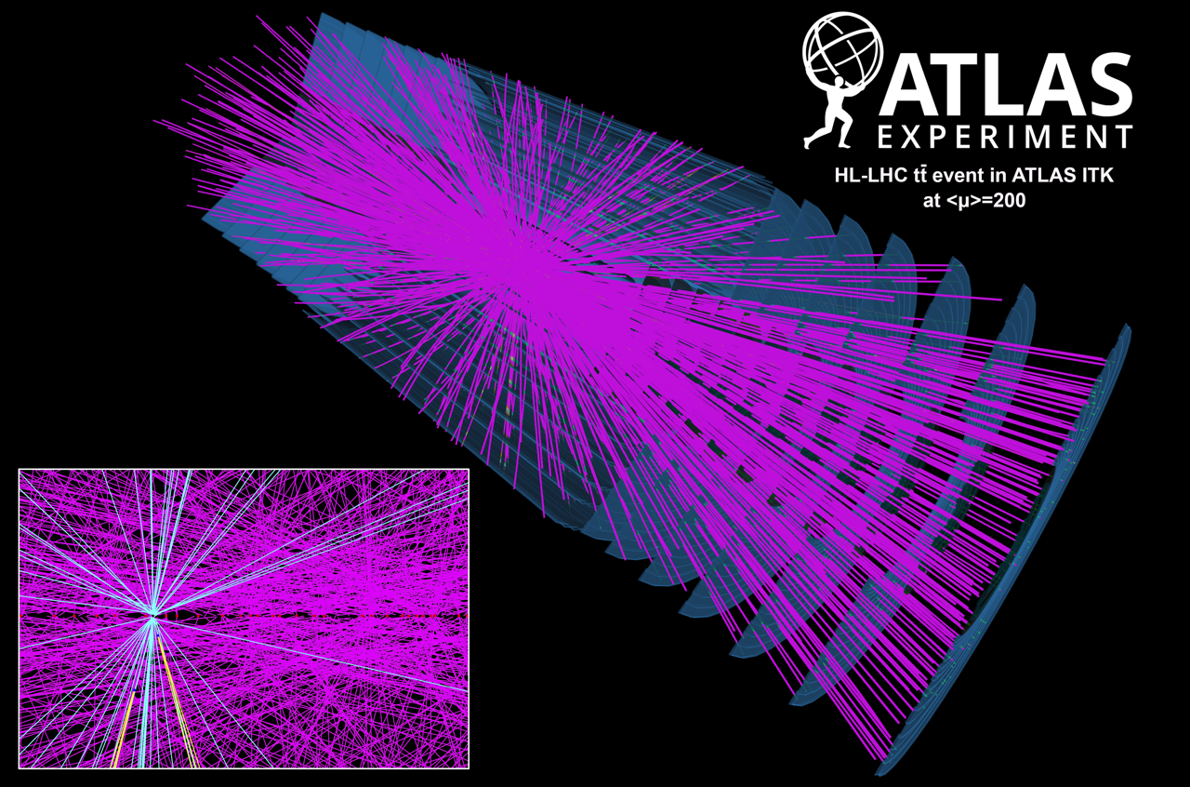
Basics of track reconstruction
Proton beam collisions
Hard scattering (primary vertex)
Pile up scattering
Hits detected on pixel and strip detectors
Charged particle trajectory reconstruction from hits
Vertex reconstruction from tracks

Slide 4
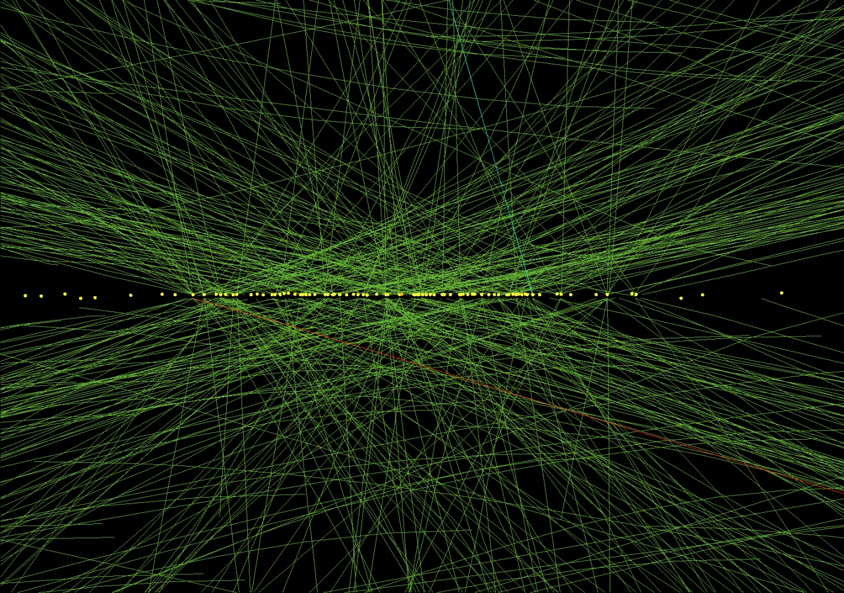
Why 4d?
Pile-up and hard scattering events occur at different times
Eliminating pile-up allows for more accurate track reconstruction of hard scattering events

Slide 5
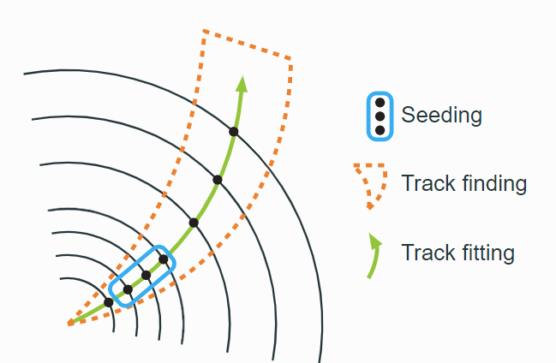
Track reconstruction process
Hits are detected on the pixel detectors in the inner tracker as well as outer strip detectors
Seed tracks from hit triplets
Full track reconstruction based on Combinatorial Kalman Filter Algorithm (CKF)

Slide 6

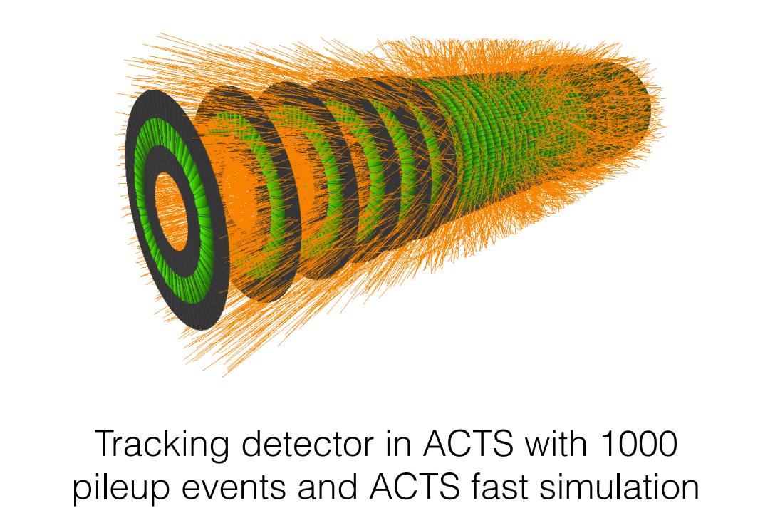
Acts
A Common Tracking Software
  Open source library for track reconstruction
Simulates collision events and reconstructs particle trajectories
Versatility – in principle can be used on any detector geometry.
  We concentrate on the provided Open Data Detector – similar geometry to ATLAS

Slide 7

Track parameter studies review
Goal: Run full chain track reconstruction and vertexing using Open Data Detector
  Support already available in the ACTS library, but not fully validated yet
Concentrated on validating reconstruction chain with by focusing on track fit quality results
  Checked track parameters at the interaction point and compared with truth particles
  Studied track parameter pulls to validate correctness of fit and proper estimation of track covariance matrix
  Pulls are expected to be normally distributed with width 1
I generated multiple samples for my studies
  Muon and pion particle gun
  Ttbar using pythia8 interface
Studied approximated (FATRAS) and full (Geant4) detector simulations to validate particle-matter interaction
$pull=\frac{τ^{reco}−τ^{truth}}{σ_{τ}}$,
where $τ=(d0,z0,θ,φ,\frac{q}{p},t)$

Slide 8
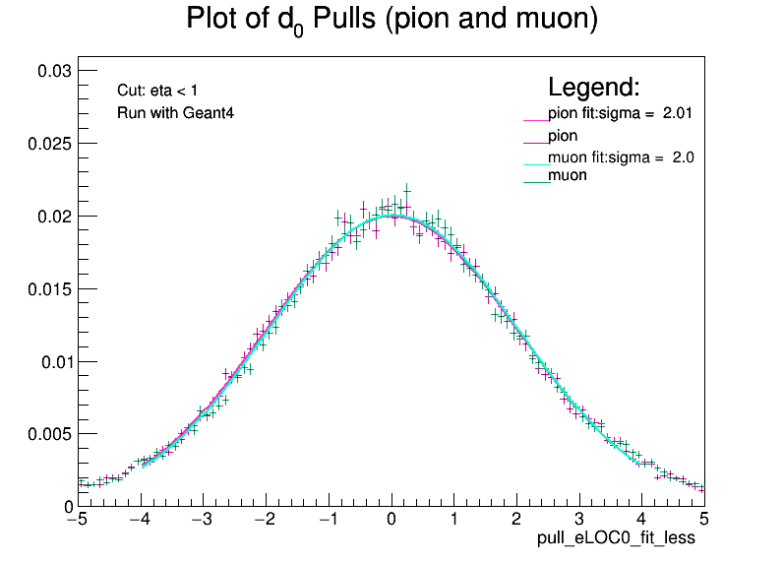
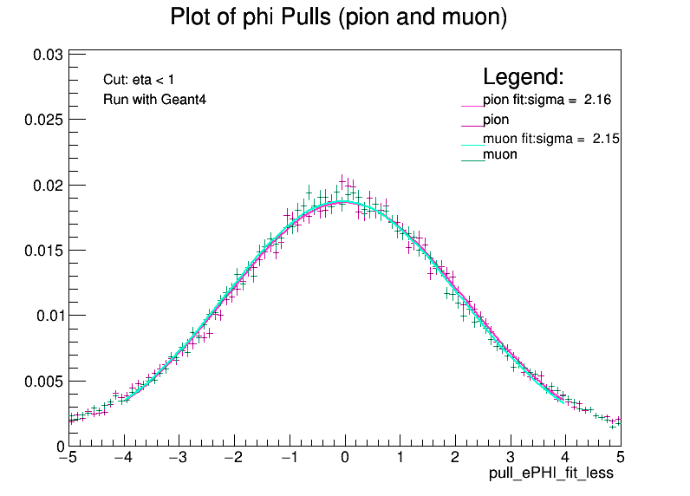
Acts follow up
Found that track parameter pulls did not have gaussian distributions with width of 1
  True for all configurations (muons, ttbar events, run with FATRAS or Geant4, etc.)

Slide 9
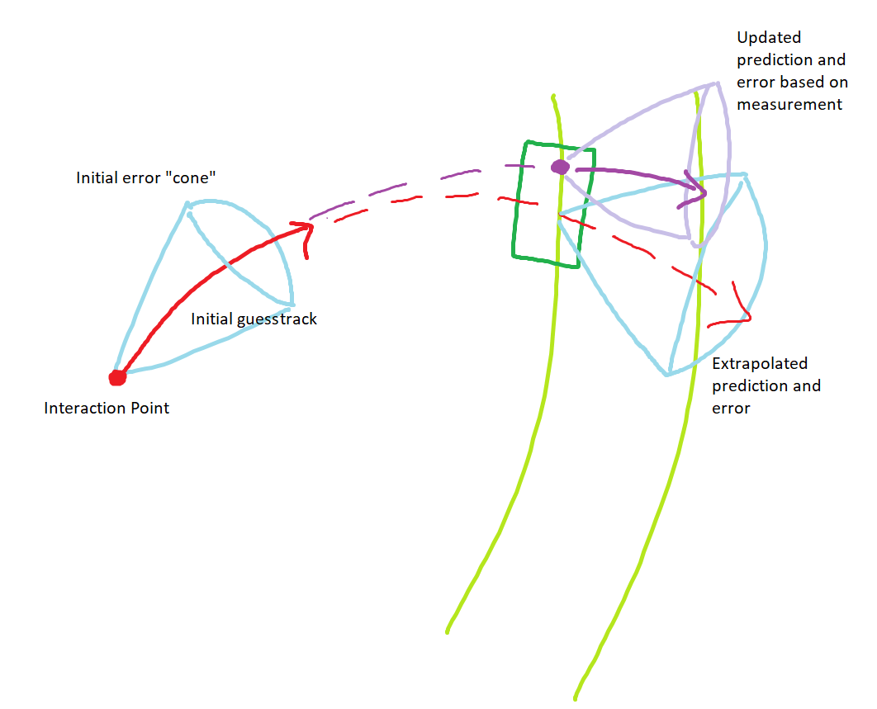
seeding
Tested many different reconstruction configurations and found that the problem was related to the seeding strategy
CKF is given an initial seed and initial covariance matrix
It is important to provide a large initial estimate of the covariance matrix to avoid biases in error estimation
  Initial cov. Matrix was wrongly set to expected detector resolution: too tight
  Decided to inflate initial cov. Matrix by factor of 100

Slide 10
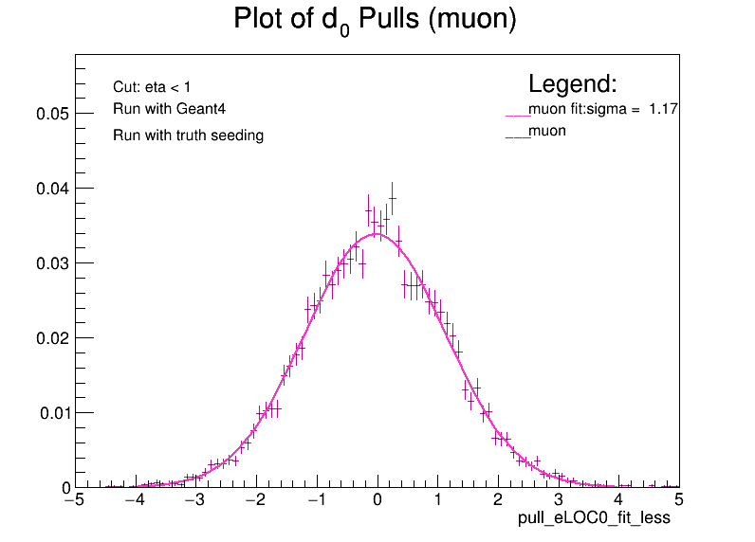
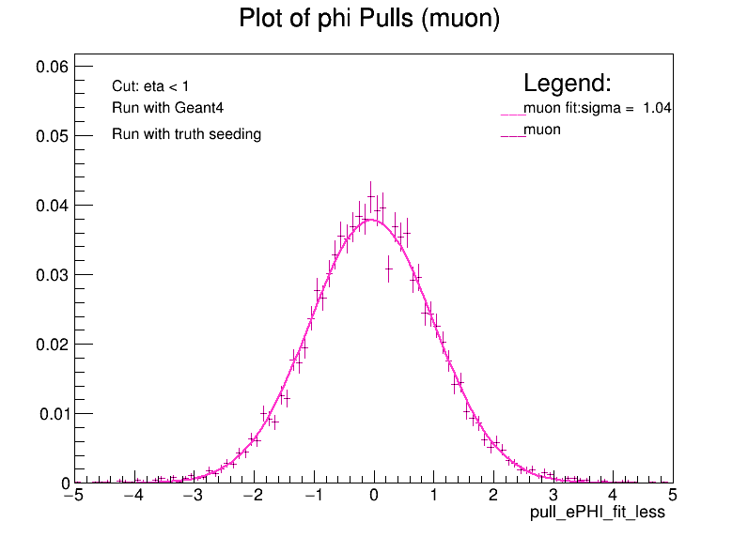
CORRECTED COVARIANCE RUN

Slide 11
Summary and next steps
Successfully ran full reconstruction chain on the ODD
Wrote monitoring code to visualize quality results for fitted track parameters
  Performed simple cut-based analysis to select tracks in the different regions of the detector or with various numbers of associated measurements
Found issue with seeding strategy for CKF filter, corrected by adjusting initial covariance matrix
Next steps
  Produce standard set of plots showing improved results
  Move forward to validate vertexing and track to vertex association using time information

