Slide 1
4D Tracking Updates
Camille Mauceri
25 May 2023

Slide 2
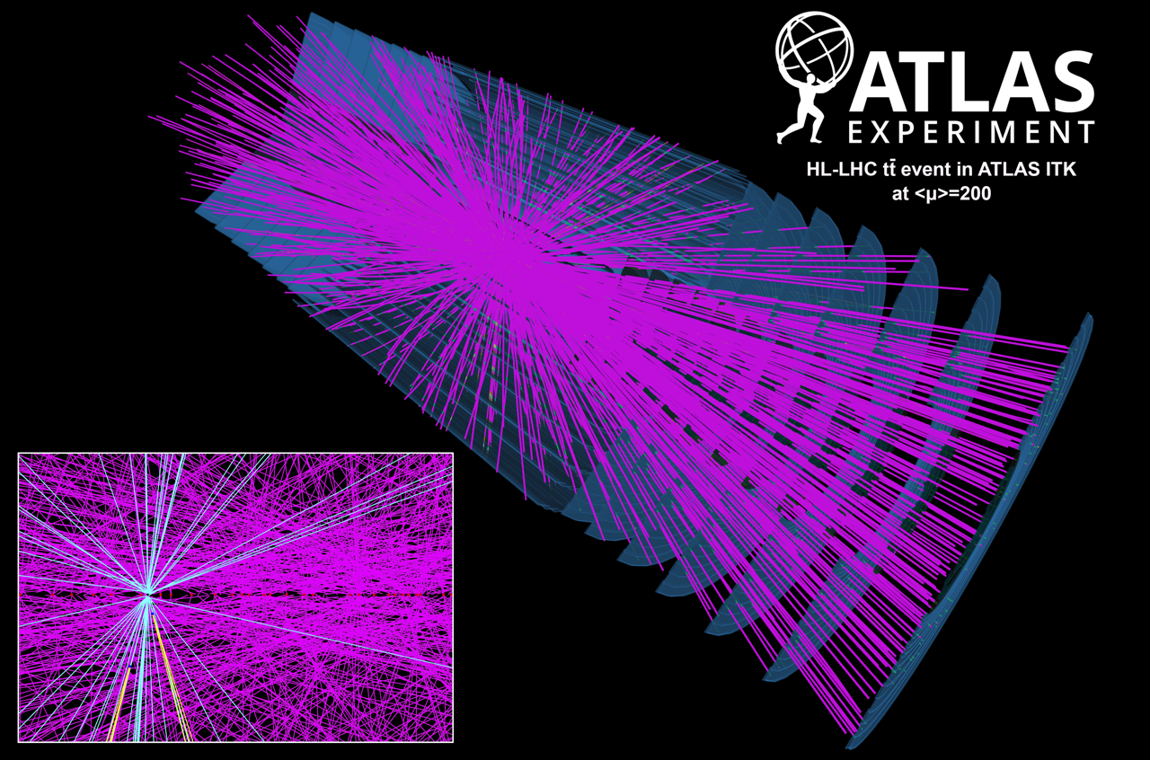
Overview
Preparation for updates to the LHC
Hypothetical detector technology could measure time and position of hit with high precision
Tracking software needs to be updated to include this capability
Tracking algorithms tested using simulated data on different detector geometries
Long term goal: include timing info in hit-track and track-vertex association

Slide 3
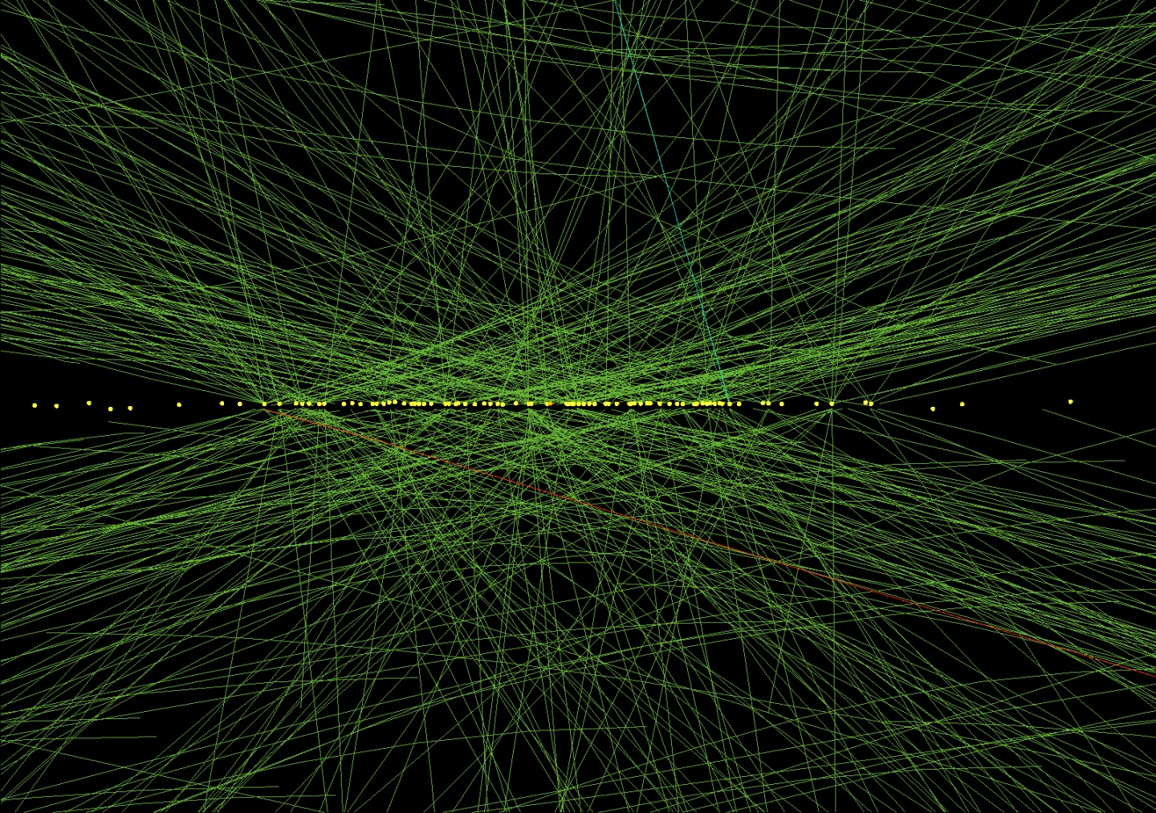
Why 4d?
Pile-up vs. hard scatter
Pile-up and hard scattering events occur at different times
Eliminating pile-up allows for more accurate track reconstruction of hard scattering events and identification of hard scattering vertices

Slide 4

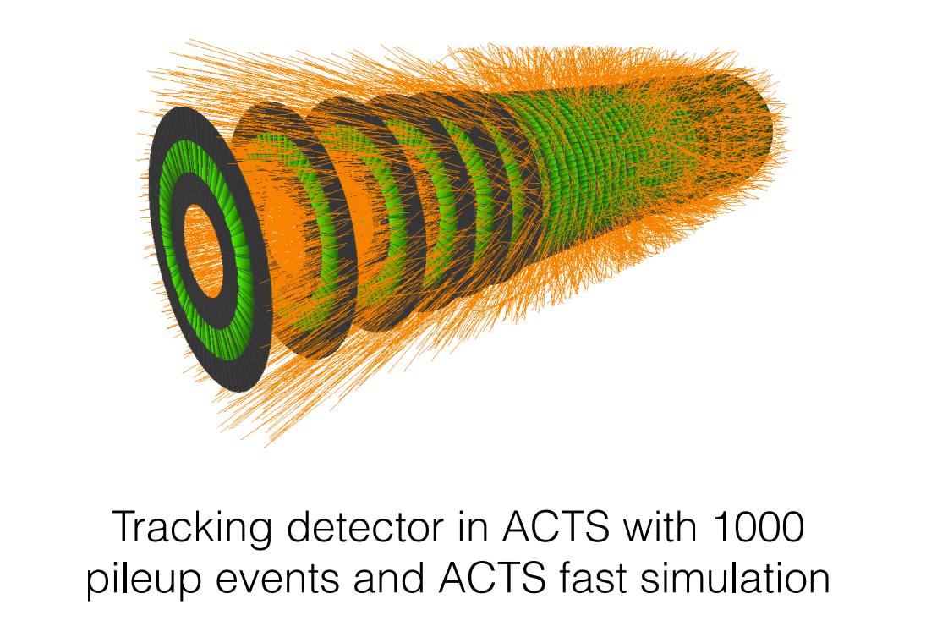
Acts
A Common Tracking Software
  Open source library for track reconstruction
Simulates collision events and reconstructs particle trajectories
Versatility – in principle can be used on any detector geometry.
  We concentrate on the provided Open Data Detector – similar geometry to ATLAS

Slide 5
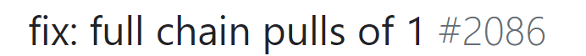
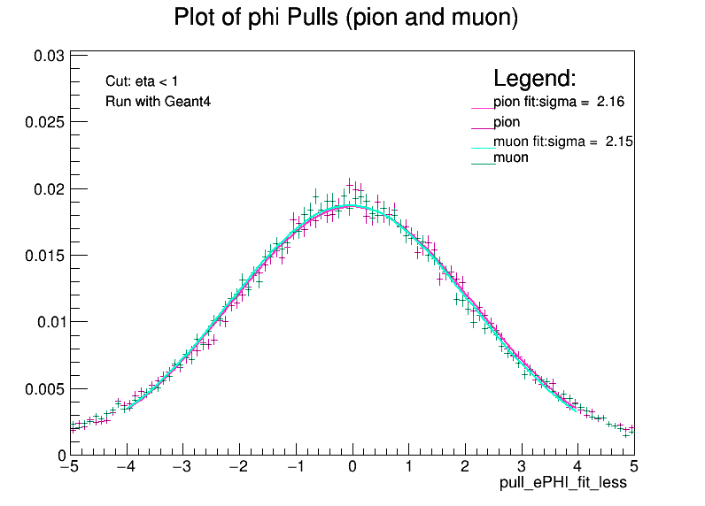
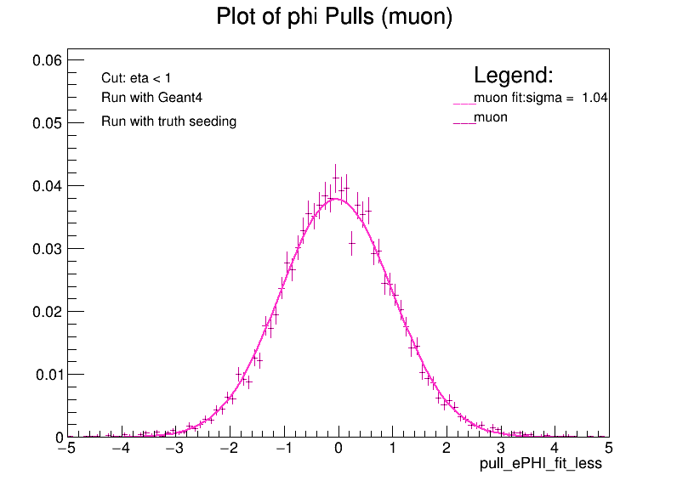




Track parameter studies
$pull=\frac{τ^{reco}−τ^{truth}}{σ_{τ}}$,
where $τ=(d0,z0,θ,φ,\frac{q}{p},t)$
Goal: Run full chain track reconstruction and vertexing using Open Data Detector
Studied track parameter pulls for various regions, detector simulations, and collision types
Pulls should be normally distributed with width 1, but I found they were too wide
Temporary fix: scaling covariance matrix
Pull request submitted to the ACTS developers
Phi pulls before changes
Phi pulls after changes

Slide 6
Vertexing

Slide 7
Vertexing Basics
  Identifying the hard scatter vertex
    Hard scatter (hs) : the proton-proton collision that transfers the most momentum
    On average only one hard scatter per event
  We are interested in the vertex that produces tracks with high transverse momentum
    To find the hs vertex, need to reconstruct tracks, associate them to vertices, and then choose the right vertex
HS: _____
Pileup: _____

Slide 8
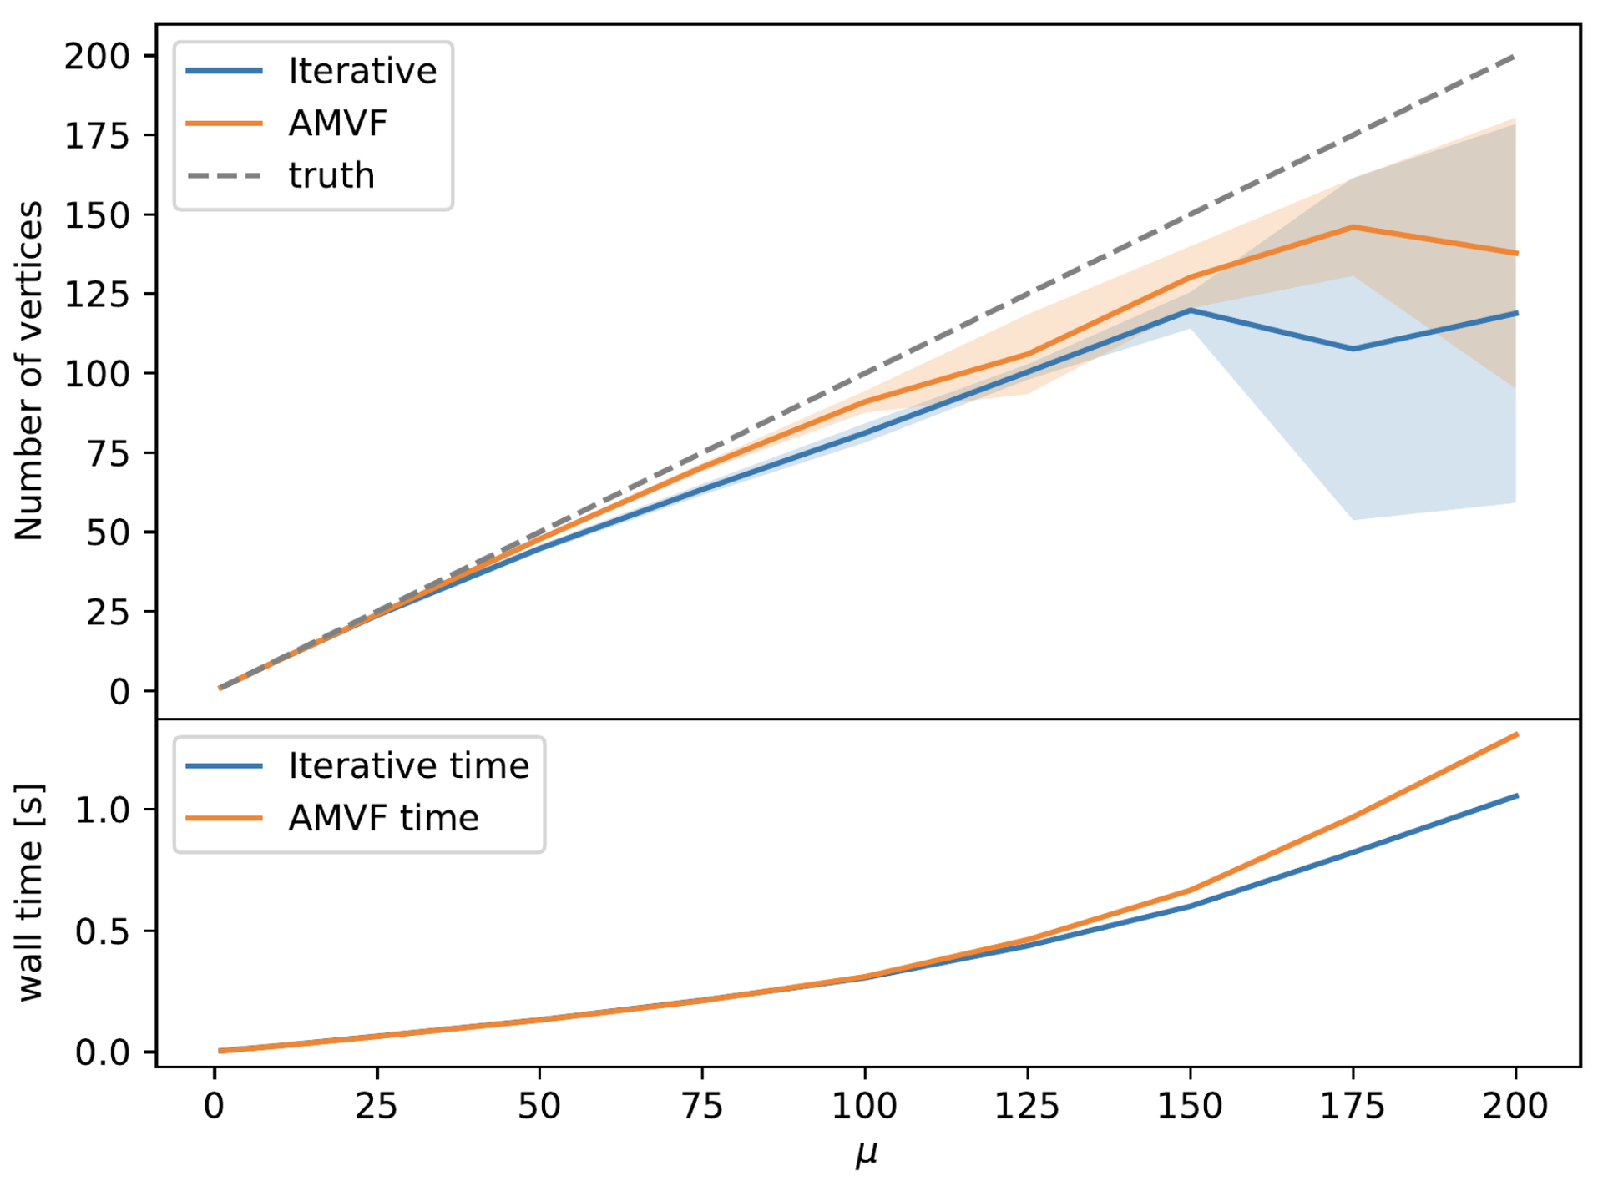
Vertex performance Studies
ACTS Plot for different vertexing algorithms, efficiency ~ 60-75%
Investigating how many vertices are being reconstructed as compared to the truth
Since there is only one hard scatter vertex, this is equivalent to looking at reconstructed vertices vs. pileup

Slide 9
Primary vertex identification
Developing an algorithm to determine which vertex is the hard scatter
  Currently implemented steps:
    Takes in a vector of vertices with associated tracks
    Finds the p_{T}² for each track, sums the track for each vertex
    Compares the p_{T}²s and finds the maximum
    Finds the vertex associated to those tracks
  Next: compare with truth to determine how many primary vertices we are identifying

Slide 10

Looking Forward
While it is generally true that tracks from the HS vertex have the highest pt, this is not always true
This is where adapting my algorithms to include timing will be useful
HS: _____
Pileup: _____
Pileup Misidentified as HS: ______

Slide 11
Project Timeline
Familiarization with Track Reconstruction and ACTS Library
Track Parameter studies and validation on Open Data Detector
Hard Scatter vertex selection algorithm
Jet track characterization for different jet flavour
Incorporate timing to track-to-vertex association

Slide 12
backup

Slide 13
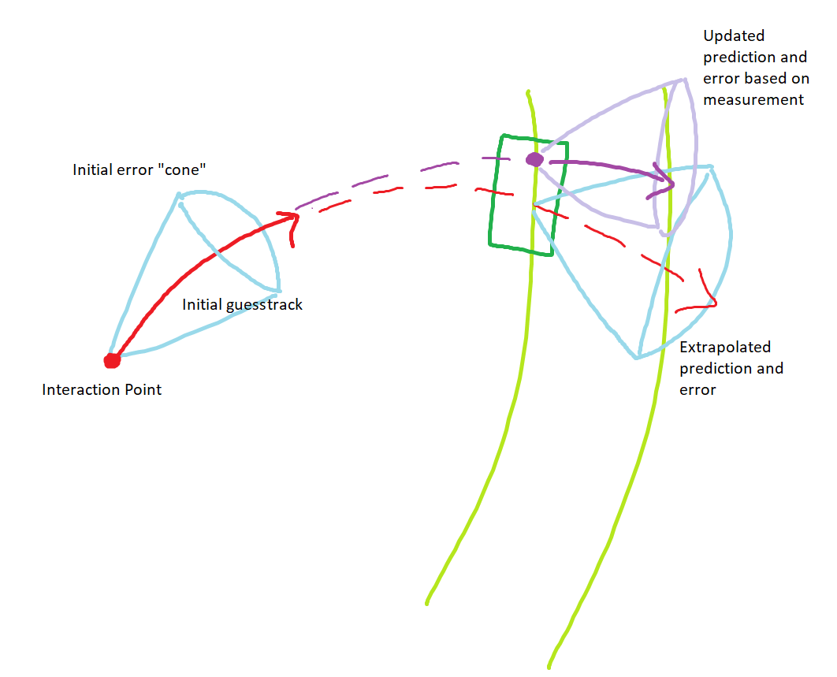
Covariance matrix fix
If the error cone (covariance matrix) is too small, we don’t allow enough error to find hits and form tracks
Temporary fix: Inflated covariance matrix by factor of 100
ACTS Developers are currently working on fixing the covariance matrix

Slide 14
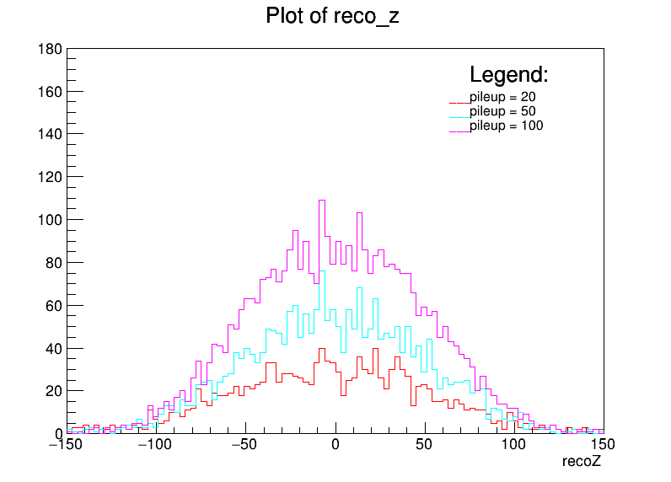
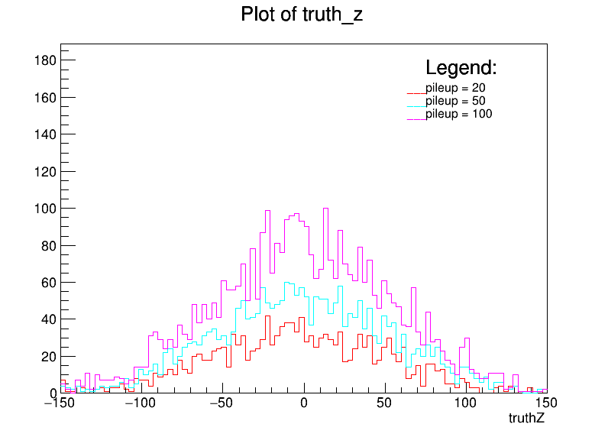
Vertex performance

Slide 15
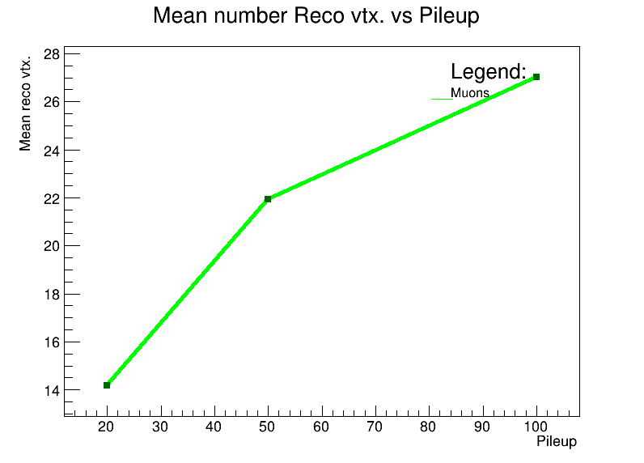
Reco vertices vs. truth vertices
As we increase pileup, the number of reconstructed vertices does not increase linearly
Even with the updated covariance matrix, we are not reconstructing as many vertices as expected
I compared the full chain code with the physics monitoring code that produces expected results and have not determined the cause.
ACTS development team is looking into this further

