Slide 1
Simulating Cosmic Ray Collisions With Pythia8-Angantyr
Jake McCool
25 May 2023

Slide 2
Presentation Structure
Reminder of what I am doing
Goals from last presentation
What I will do next
Troubleshooting/Progress

Slide 3
Presentation Structure
Reminder of what I am doing
Goals from last presentation
What I will do next
Troubleshooting/Progress

Slide 4
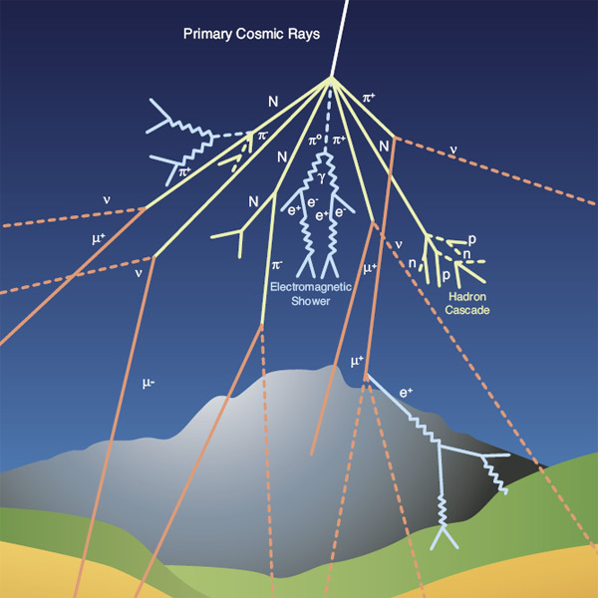
As a Reminder about Cosmic Rays…
Generally, Protons or light atomic nuclei
  Accelerated in supernovae or our sun (solar wind) for example
Collide with our atmosphere and create a particle shower
  ~ 10 billion particles, ~20 km2 for UHECR
We put detectors on satellites above the atmosphere
Not enough data for higher energies
  lower flux at high energies
So, we use the atmosphere as a detector
  And Monte Carlo Generators

Slide 5
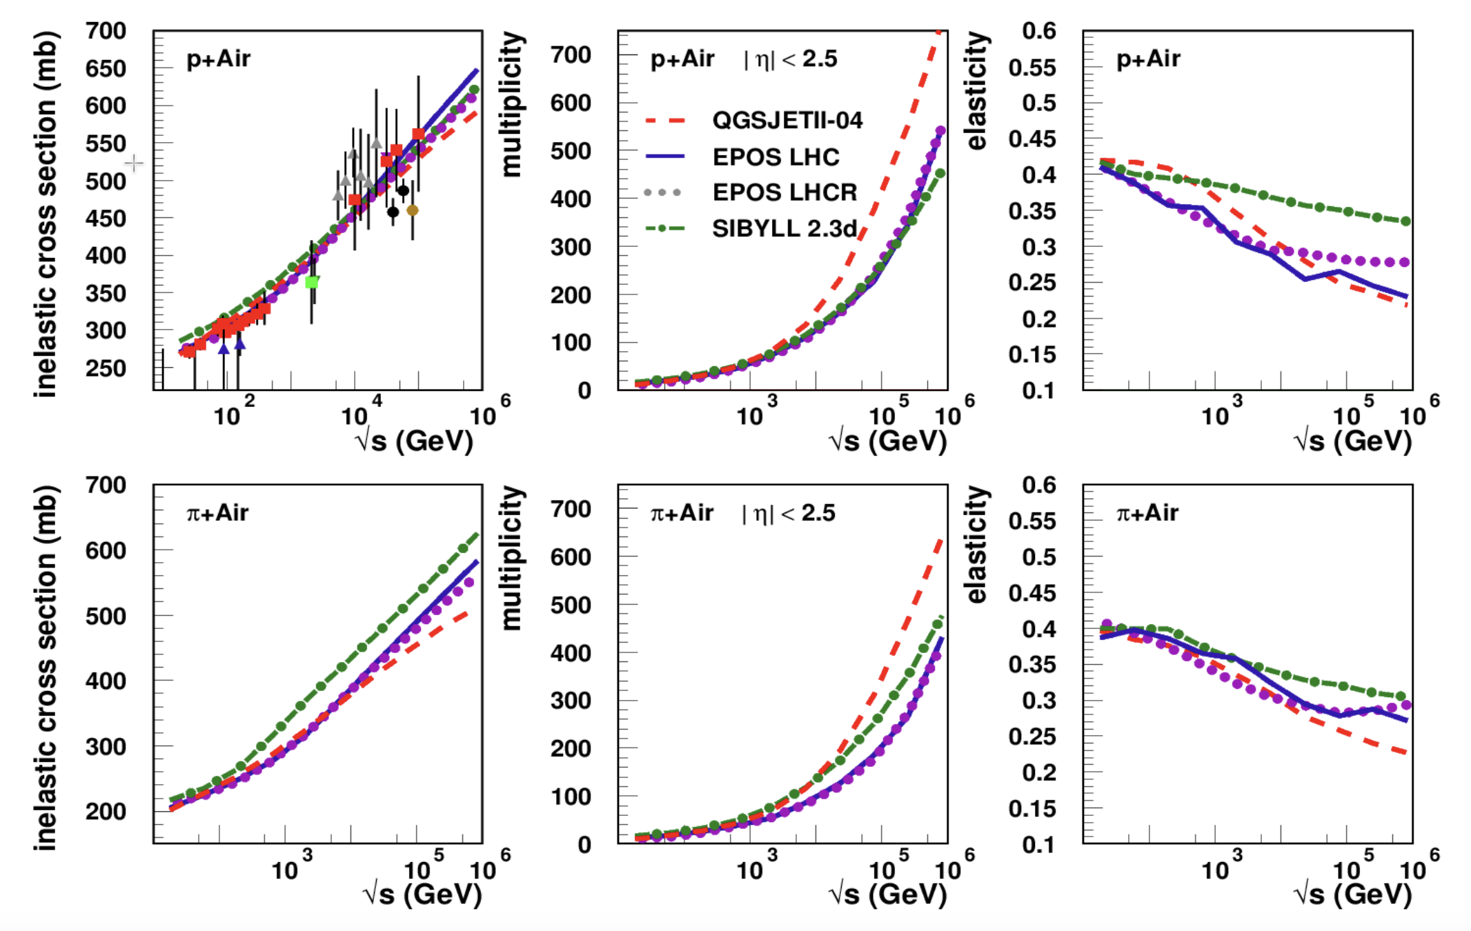
The Kind of Graphs We Would Like
Hadronic Interactions Studies at LHC,
Tanguy Pierog

Slide 6
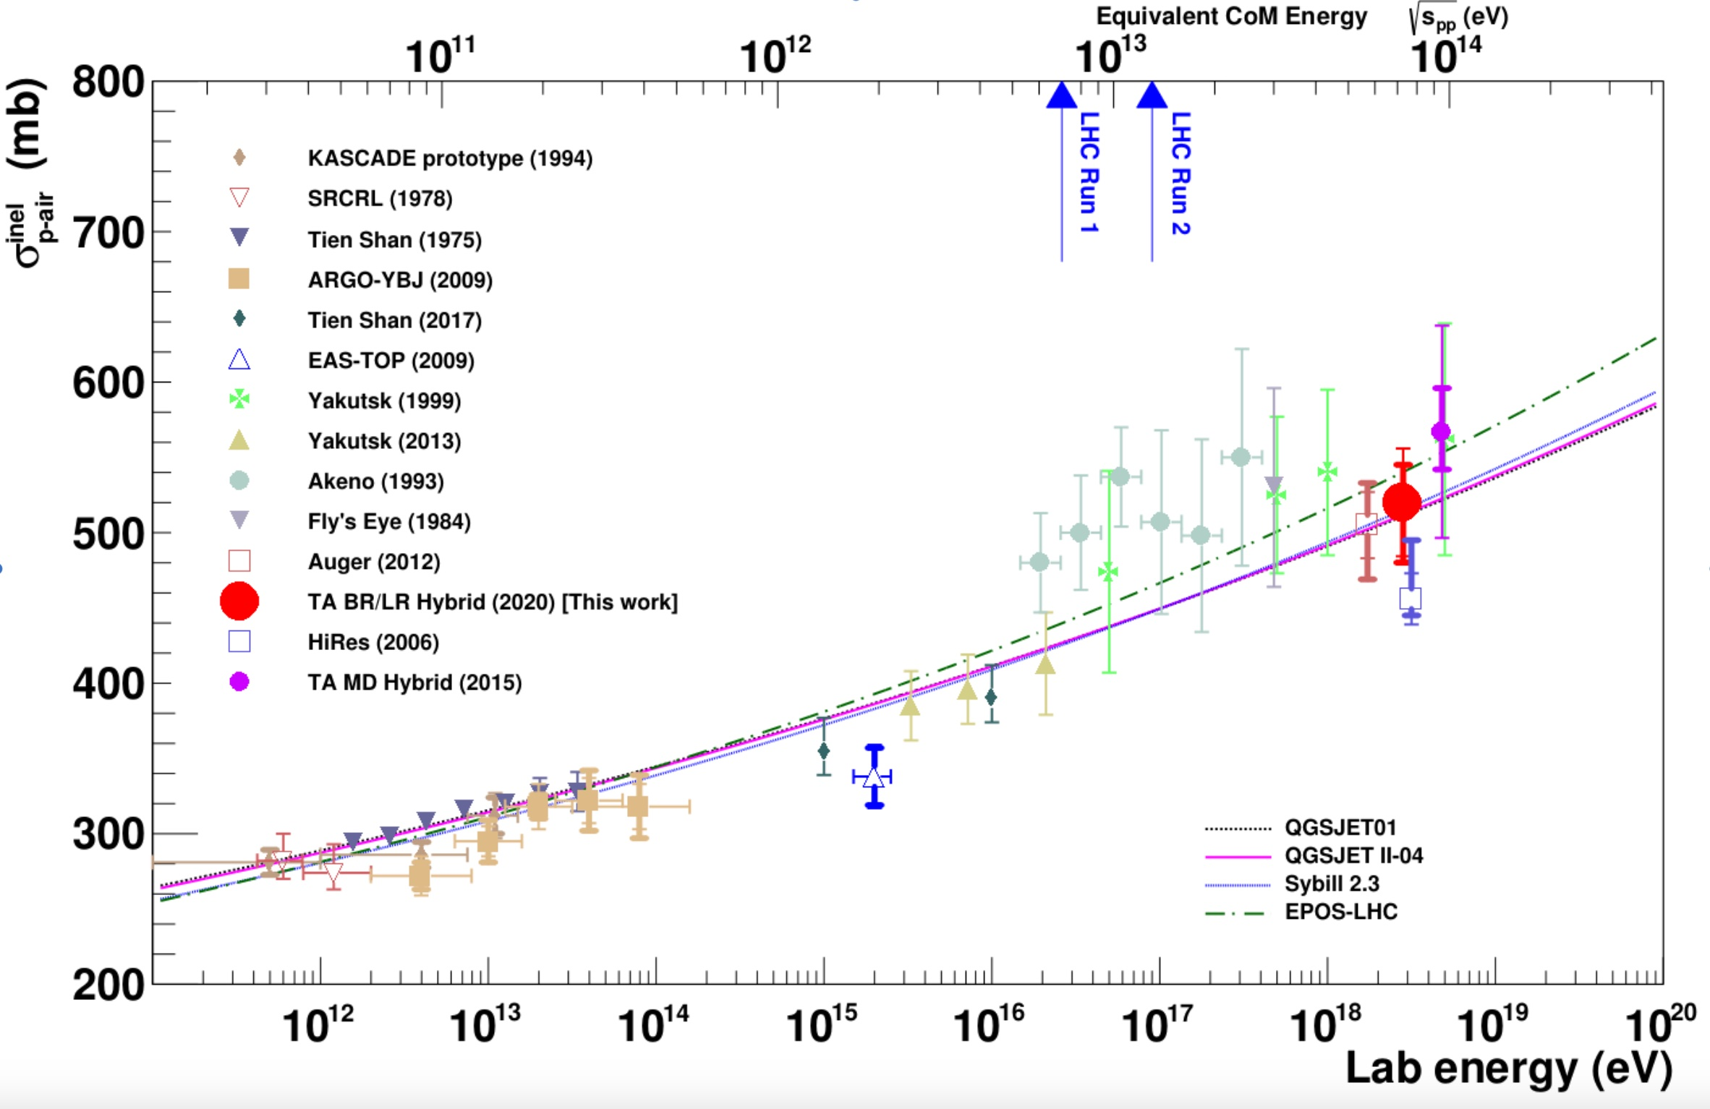
Measurement of the Proton-Air Cross Section with Telescope Array’s Black Rock Mesa and Long Ridge Fluorescence Detectors, and Surface Array in Hybrid Mode, Abbasi Et al.

Slide 7
Presentation Structure
Reminder of what I am doing
Goals from last presentation
What I will do next
Troubleshooting/Progress

Slide 8
Goals from last time
Get ROOT to work again :((
Find corresponding values of p-p x-section for real cosmic ray data
Compile LHAPDF with Pythia8
  This has more up to date parton distribution functions for muons
Run Pion-Air collisions and create similar graphs with x-section
Graph multiplicity for both proton-air and pion-air

Slide 9
Presentation Structure
Reminder of what I am doing
Goals from last presentation
What I will do next
Troubleshooting/Progress

Slide 10
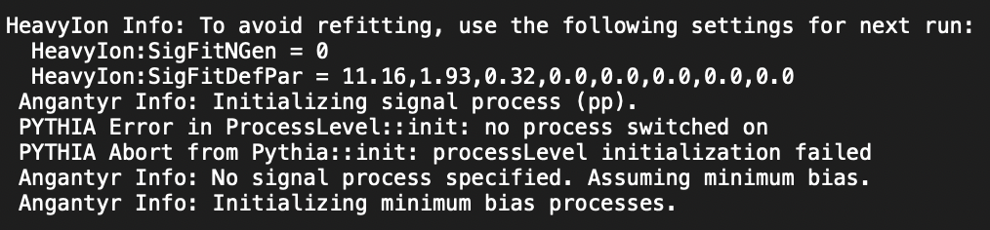
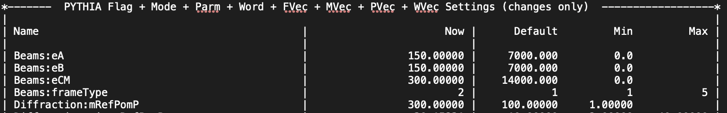
Oddities with Angantyr
Failed to initiate any process?? Seems sketch
  Angantyr author says it’s a bug
Auto switching to frame 2 >:(

Slide 11
Confusion about multiplicity
That’s no good
  Realized that was initializing variable in wrong loop

Slide 12
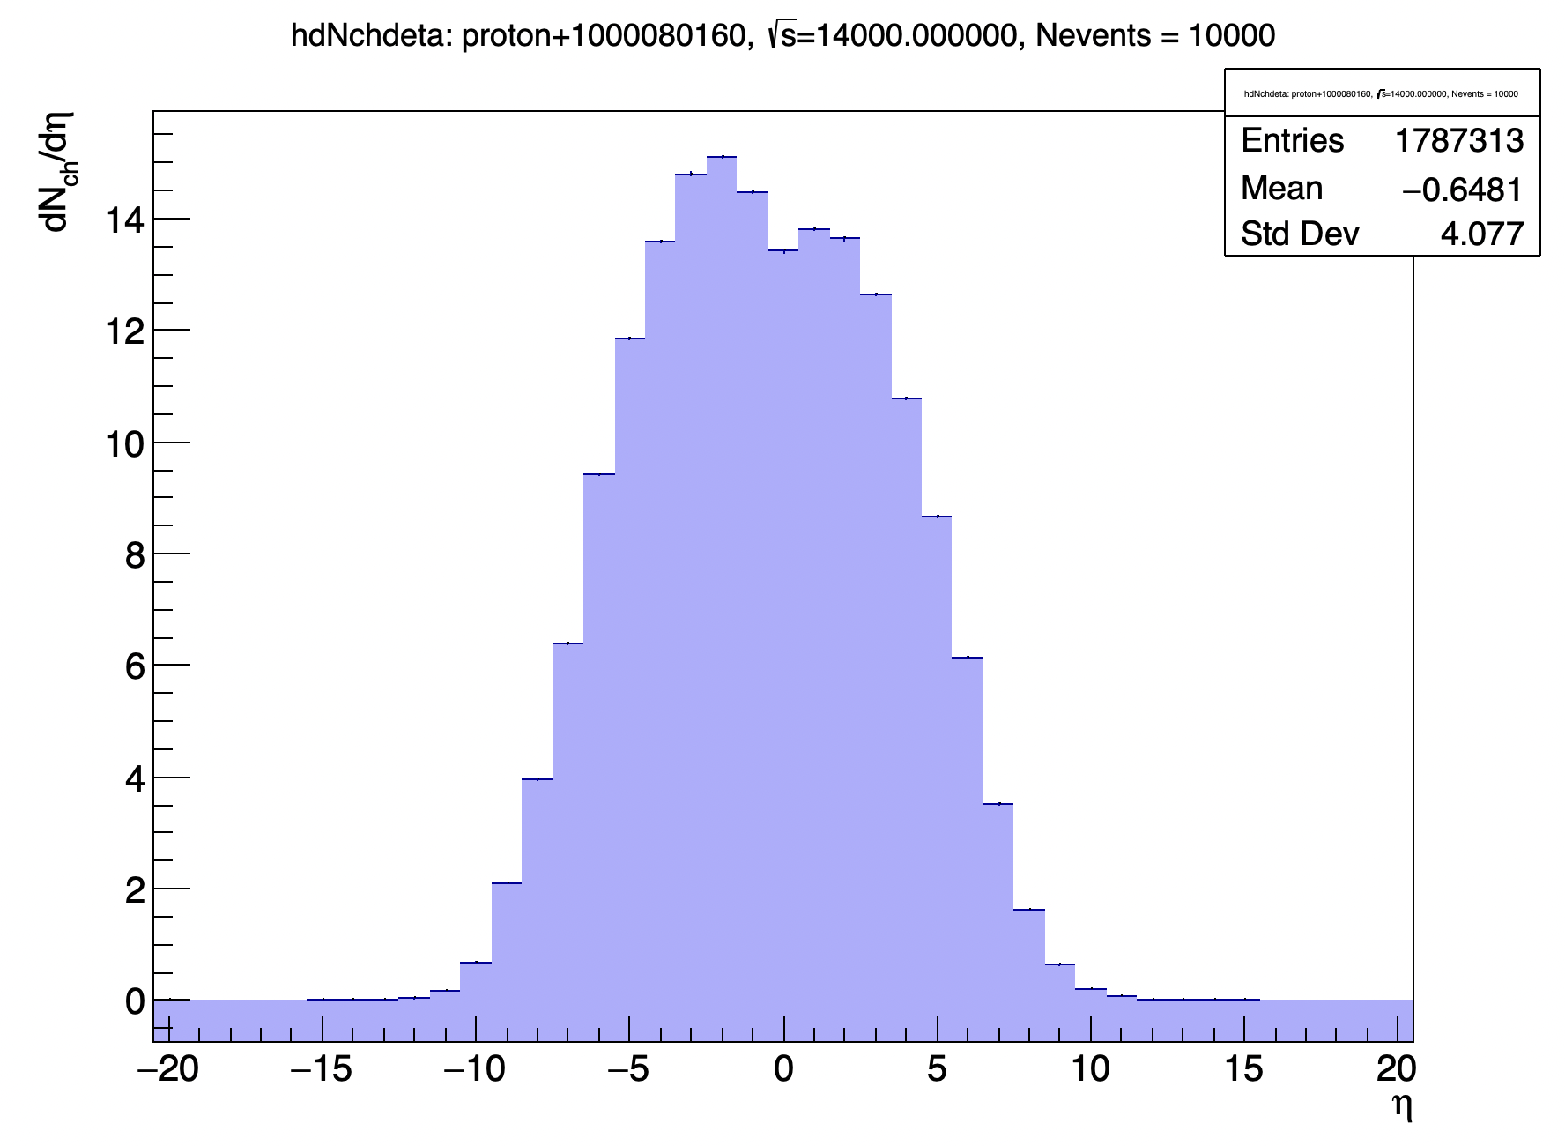
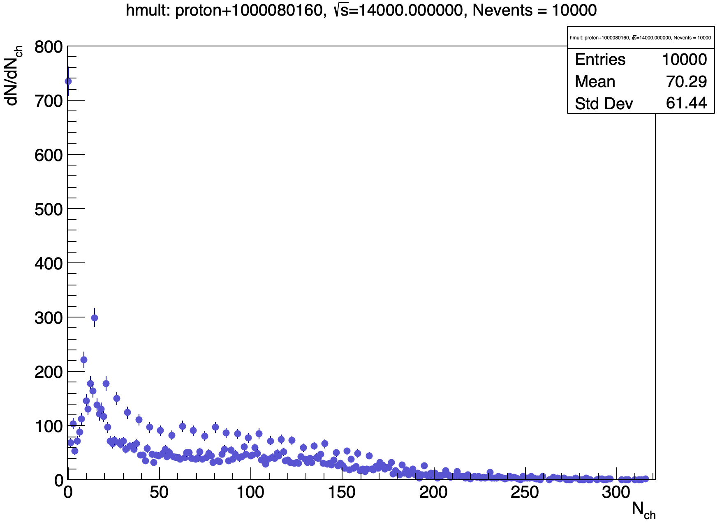
Better...

Slide 13
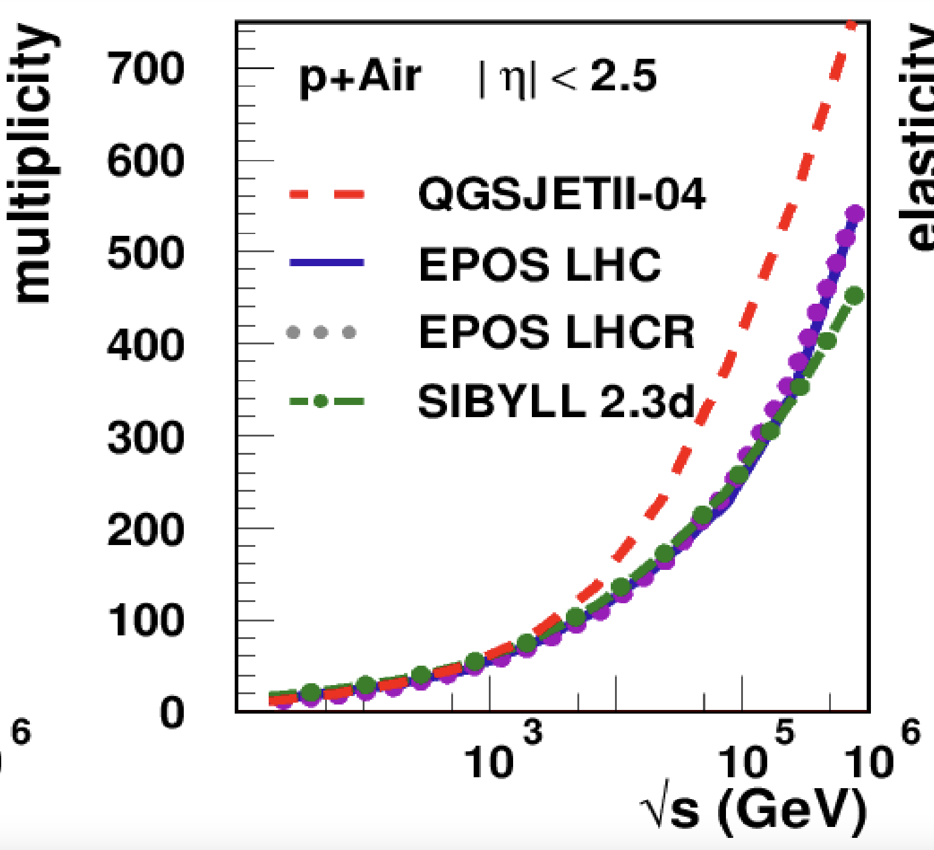
Still low ~half of other models

Slide 14
Original thoughts
Bin with highest count
Elastic/diffractive events
  Oxygen and proton survive -> multiplicity of ~0
    This would bring down the average multiplicity per event
• It actually turns out that these are just other heavy ions

Slide 15
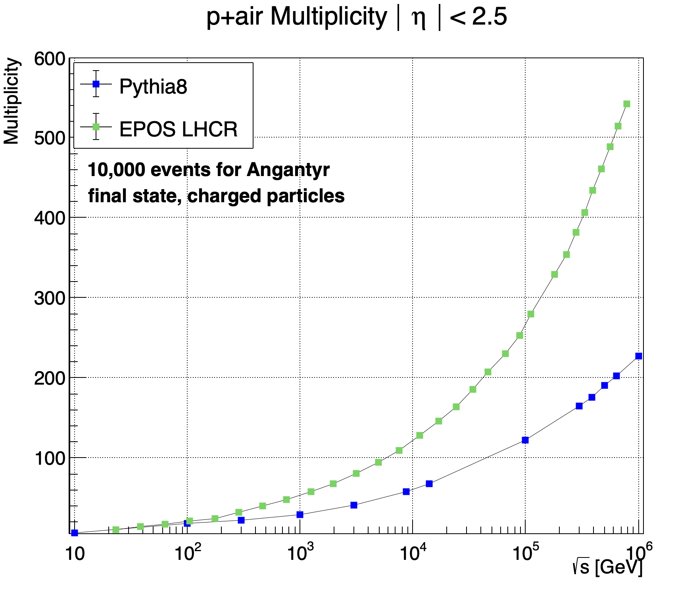
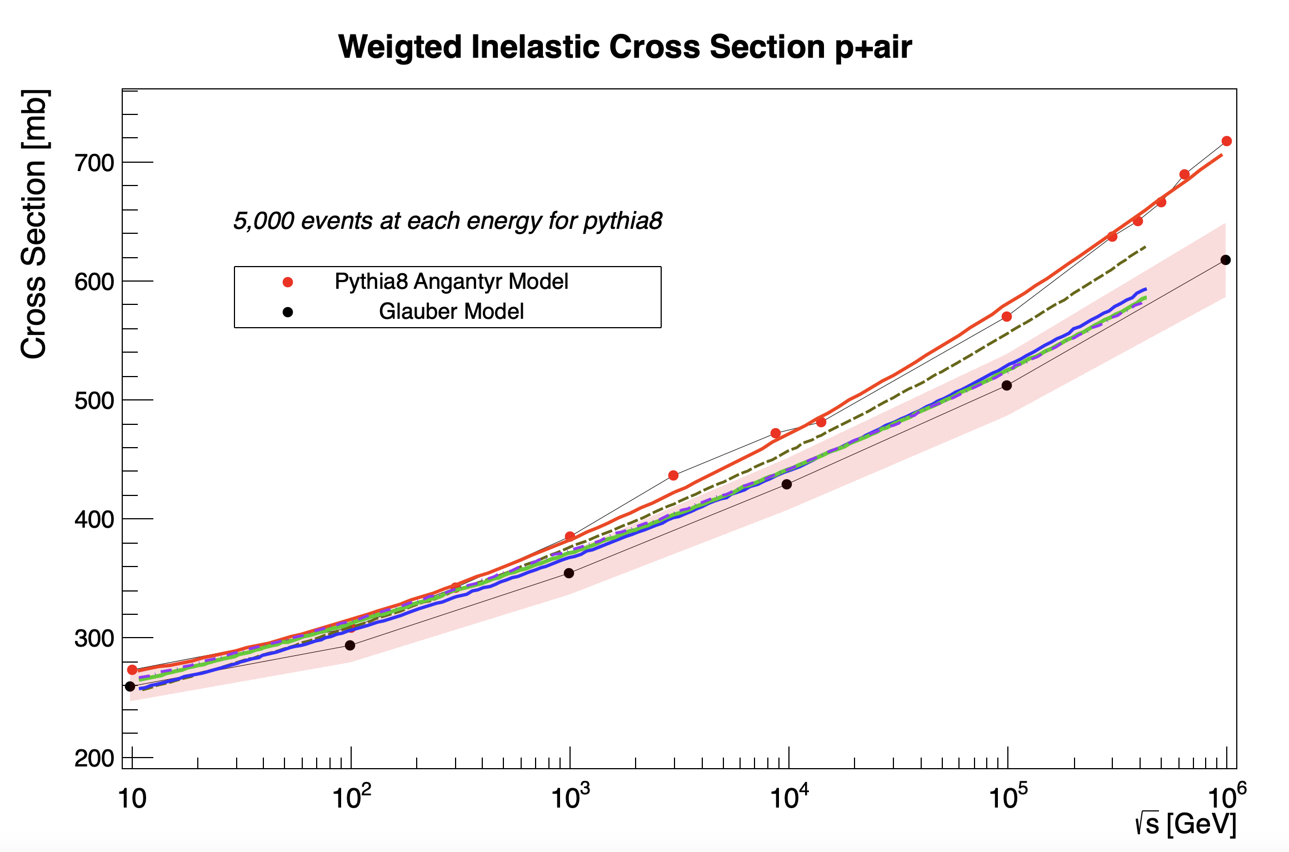
Low multiplicity, higher cross section

Slide 16
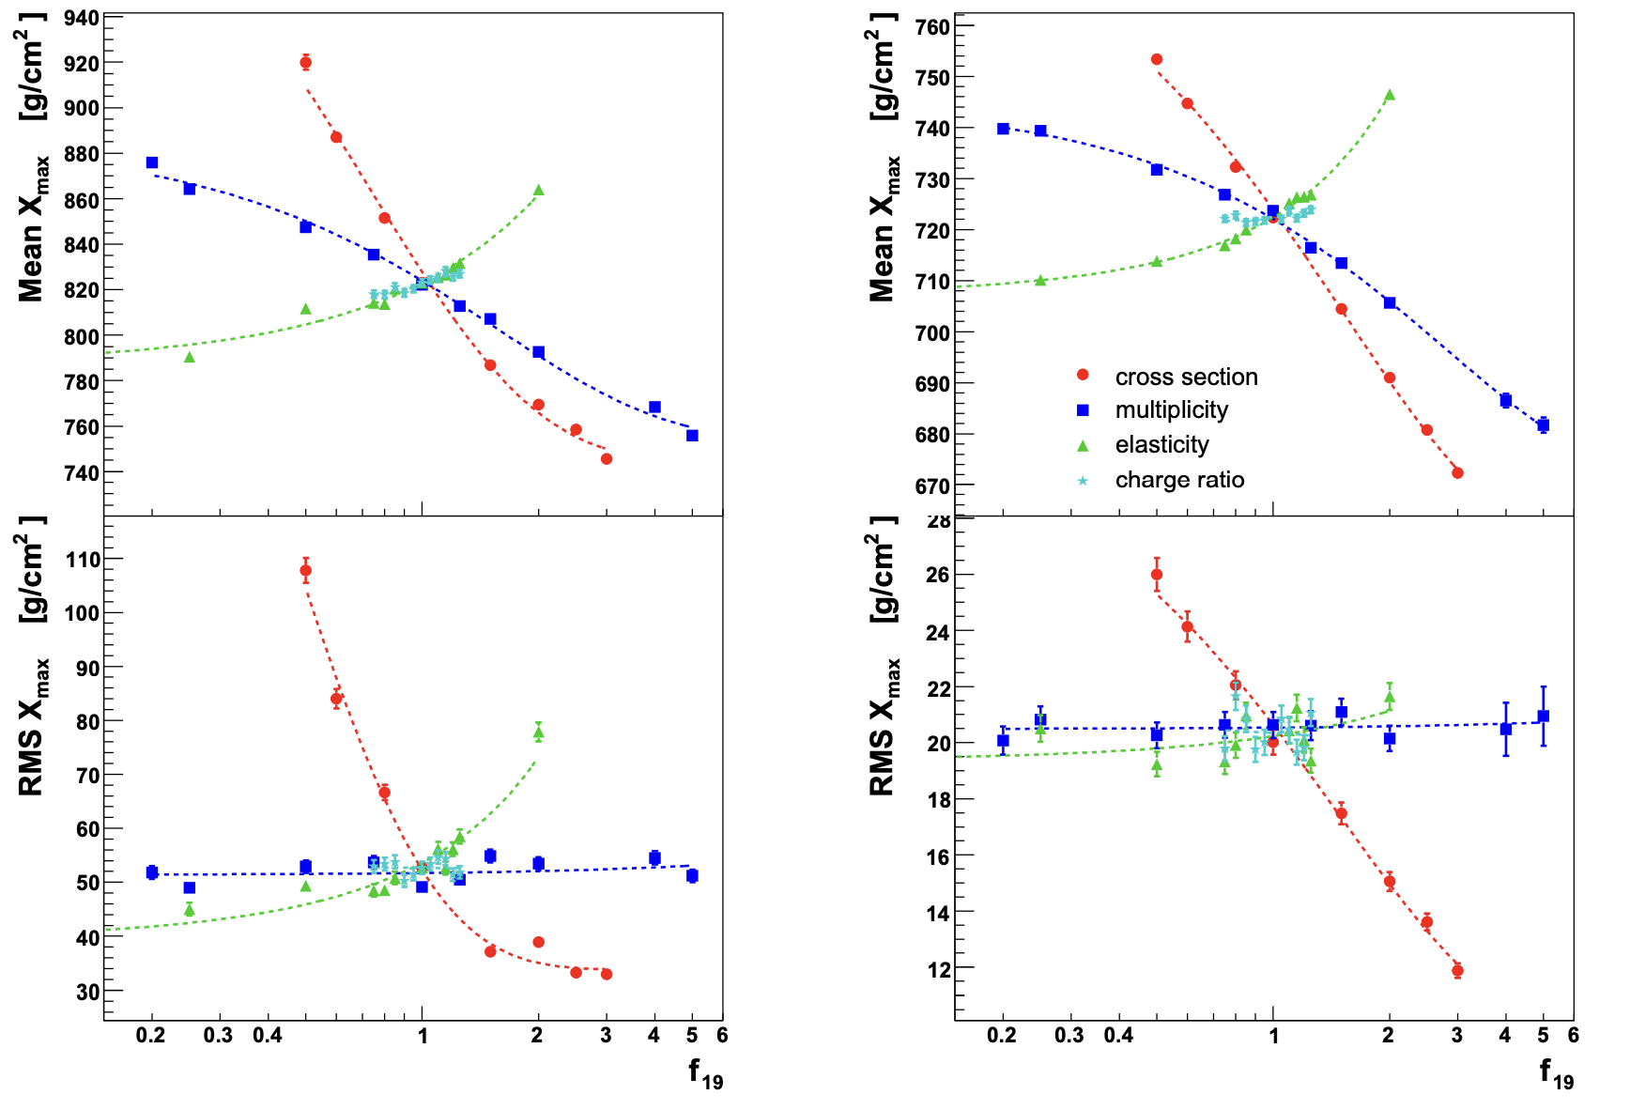
How does this affect cosmic ray data?
Hadronic Multiparticle Production at Ultra-High Energies and Extensive Air Showers
Ralf Ulrich, Ralph Engel, Michael Unger

Slide 17
Presentation Structure
Reminder of what I am doing
Goals from last presentation
What I will do next
Troubleshooting/Progress

Slide 18
Next Steps
Probably email Angantyr authors
Plot pion-air cross sections with other MC data
Make graphs of elasticity for pythia8 and compare with other MC generators

Slide 19
Thank you :)

