Slide 1

Spring at ISOLTRAP
2023/6/1
Roy Ramzi Bualuan
/ɹɔɪ ˈɹæm.zi bo.ɒl.ˈwɒn/

Slide 2
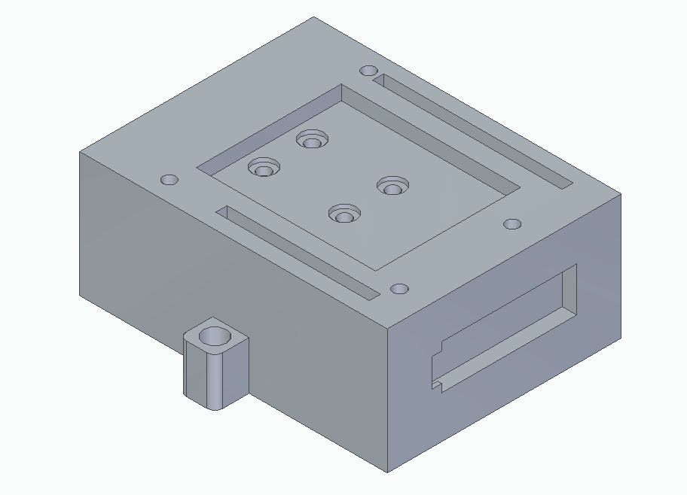
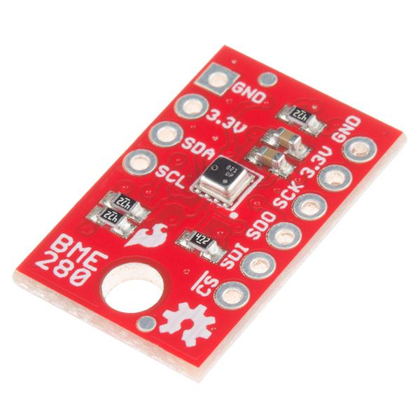
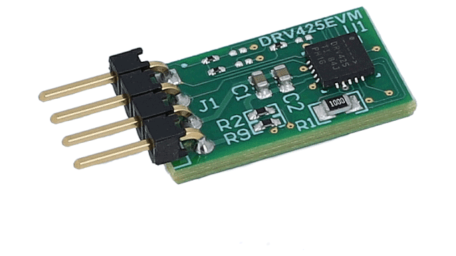
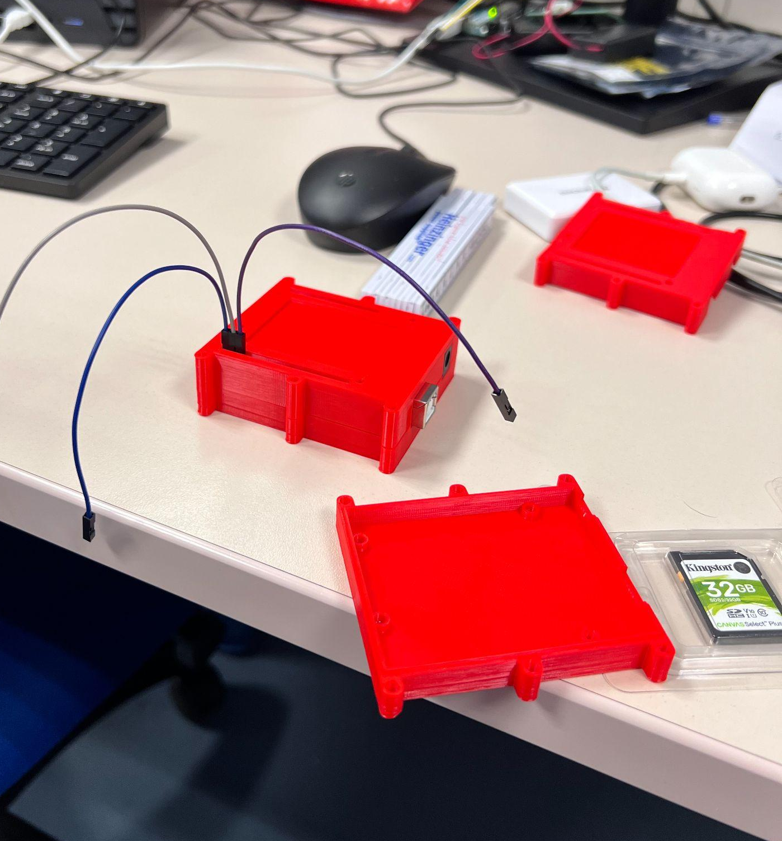
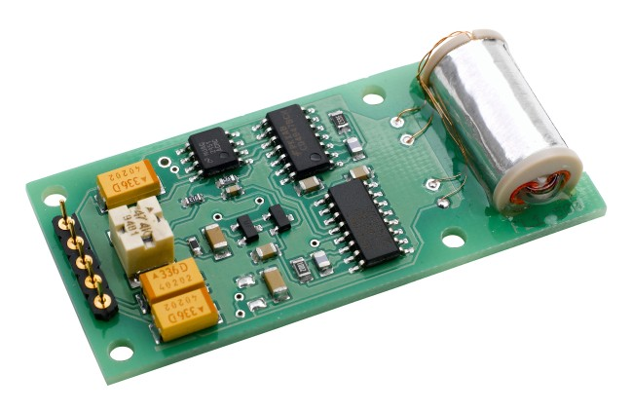
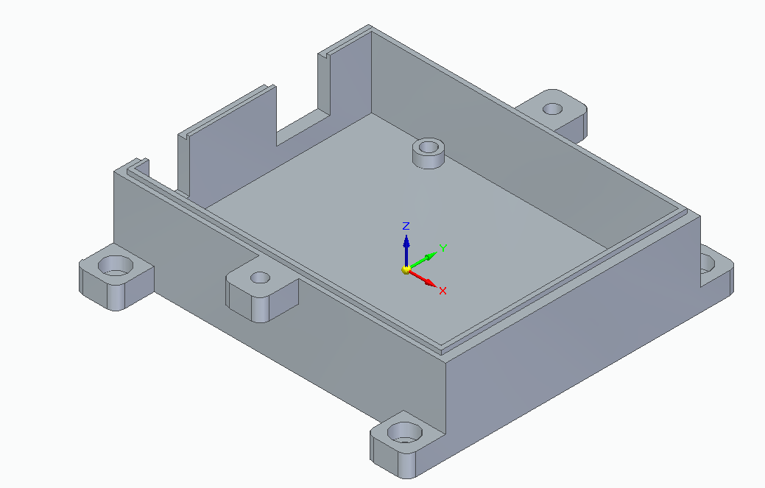
Where we last left off…

Slide 3
What’s new?

Slide 4
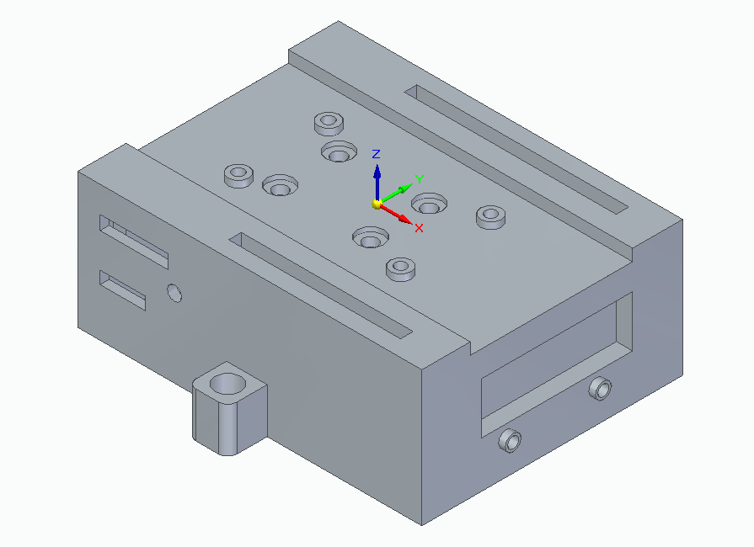
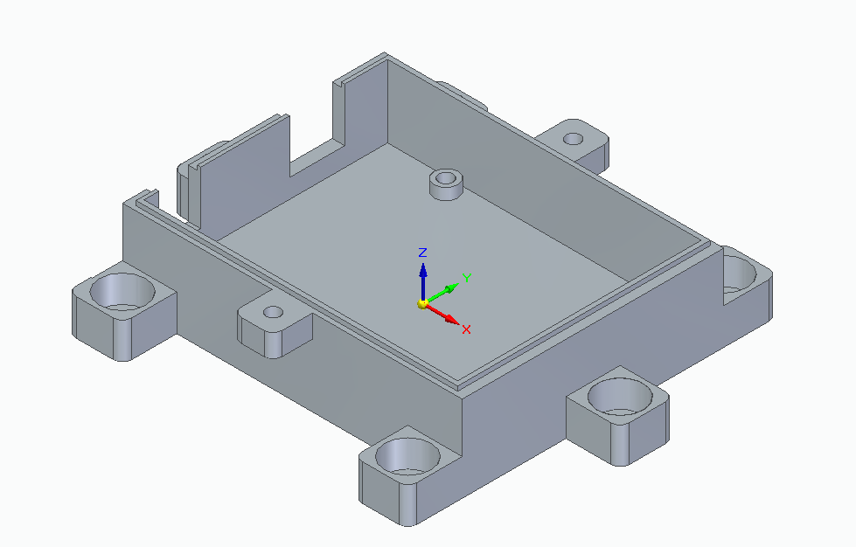
3D modeling ESUs
ESU v6
Multiple mounting positions
Modular sensor equipment
Final version?

Slide 5
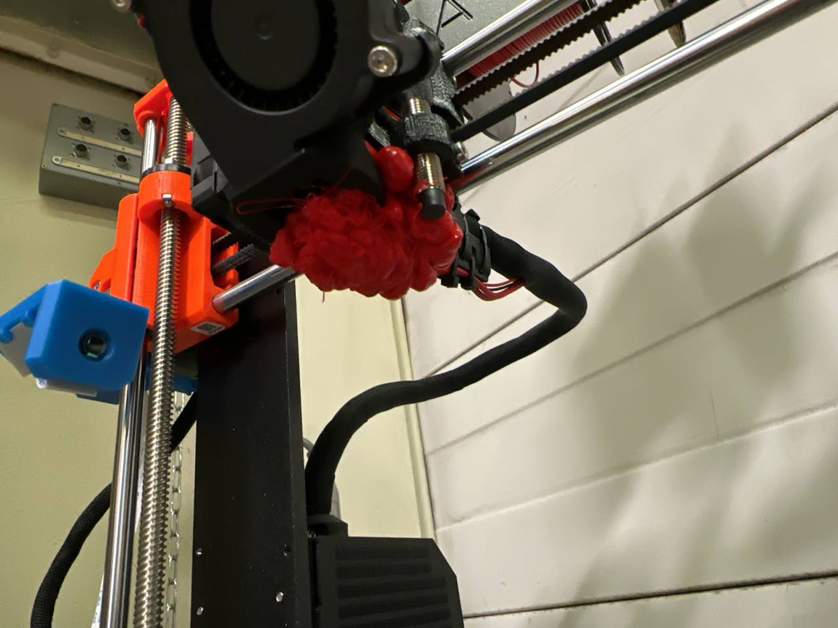
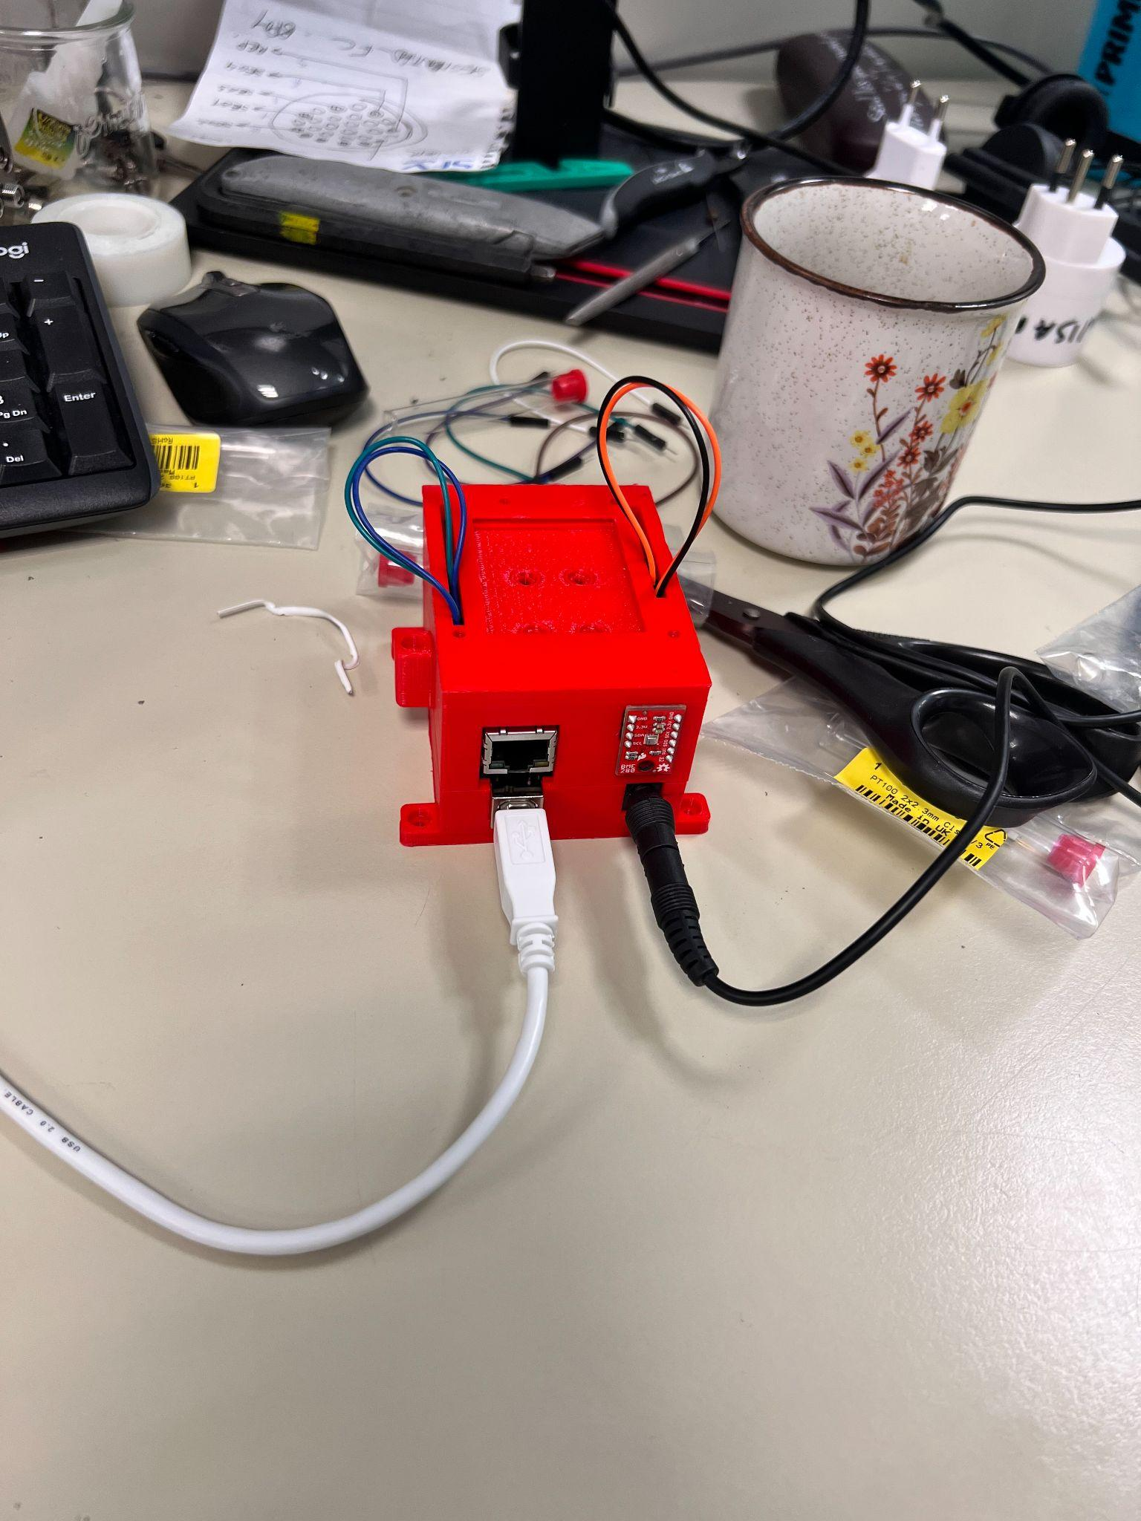
Oops

Slide 6
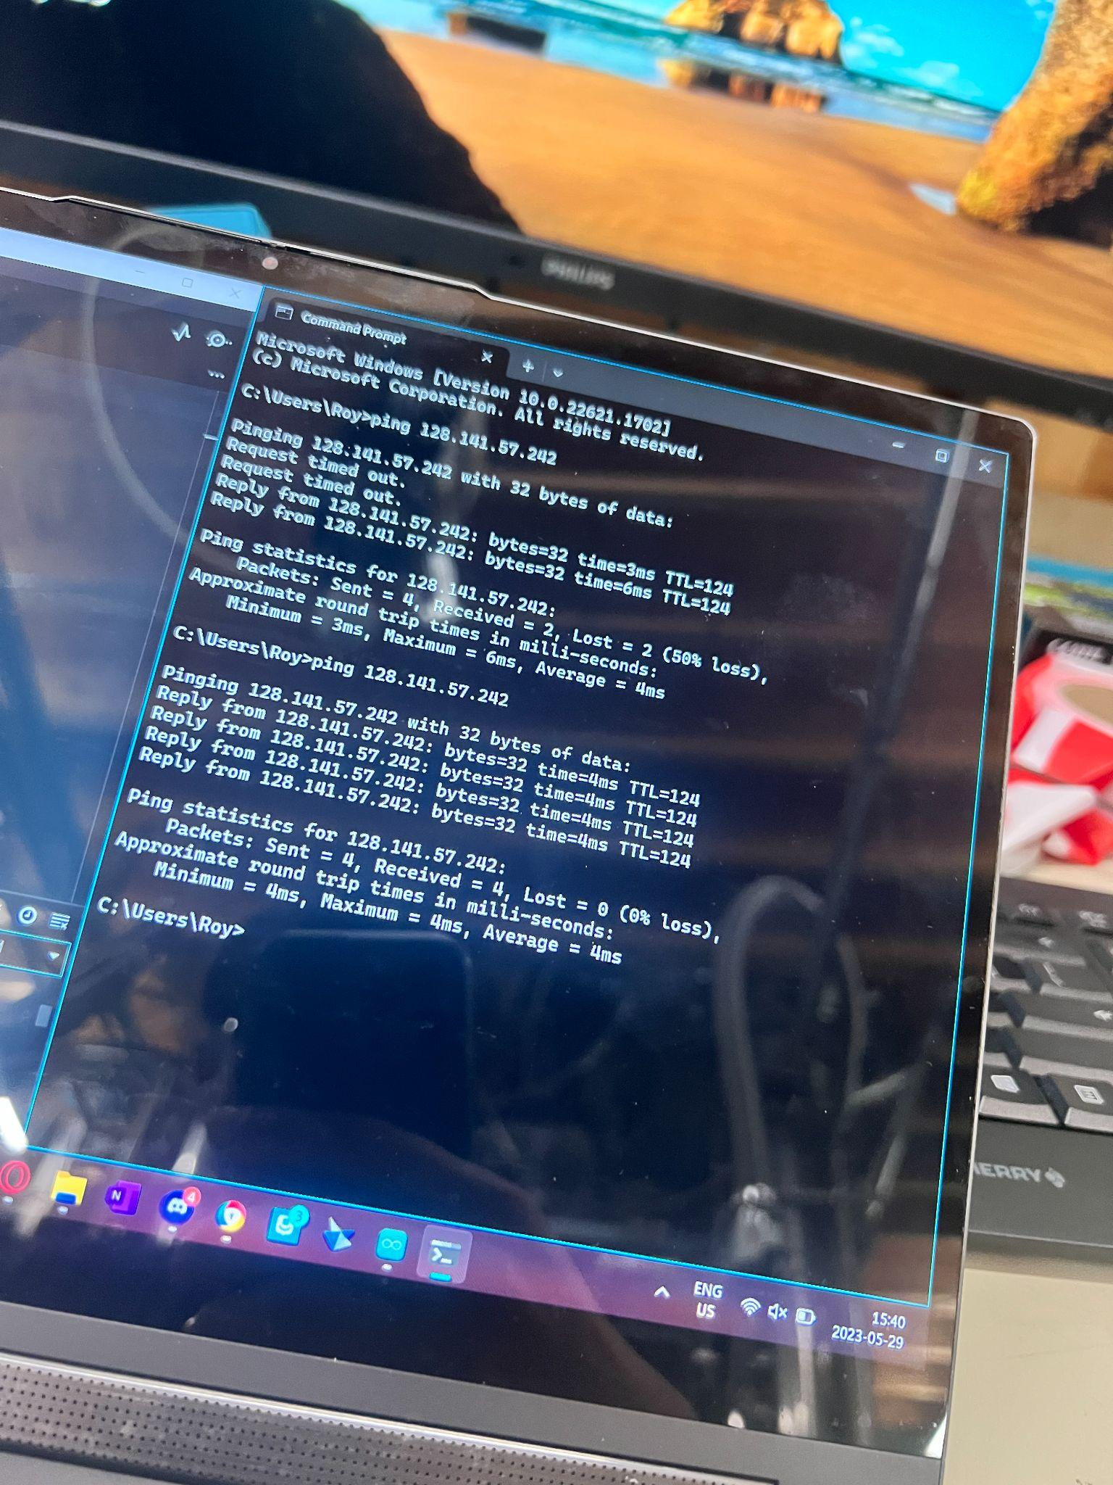
2. Ethernet Communication
Ethernet Registration
Rewrite Arduino Code
Set up device
Rewrite Python code
  Serial: ❌
  Pyvisa: ❌
  Socket:❓

Slide 7
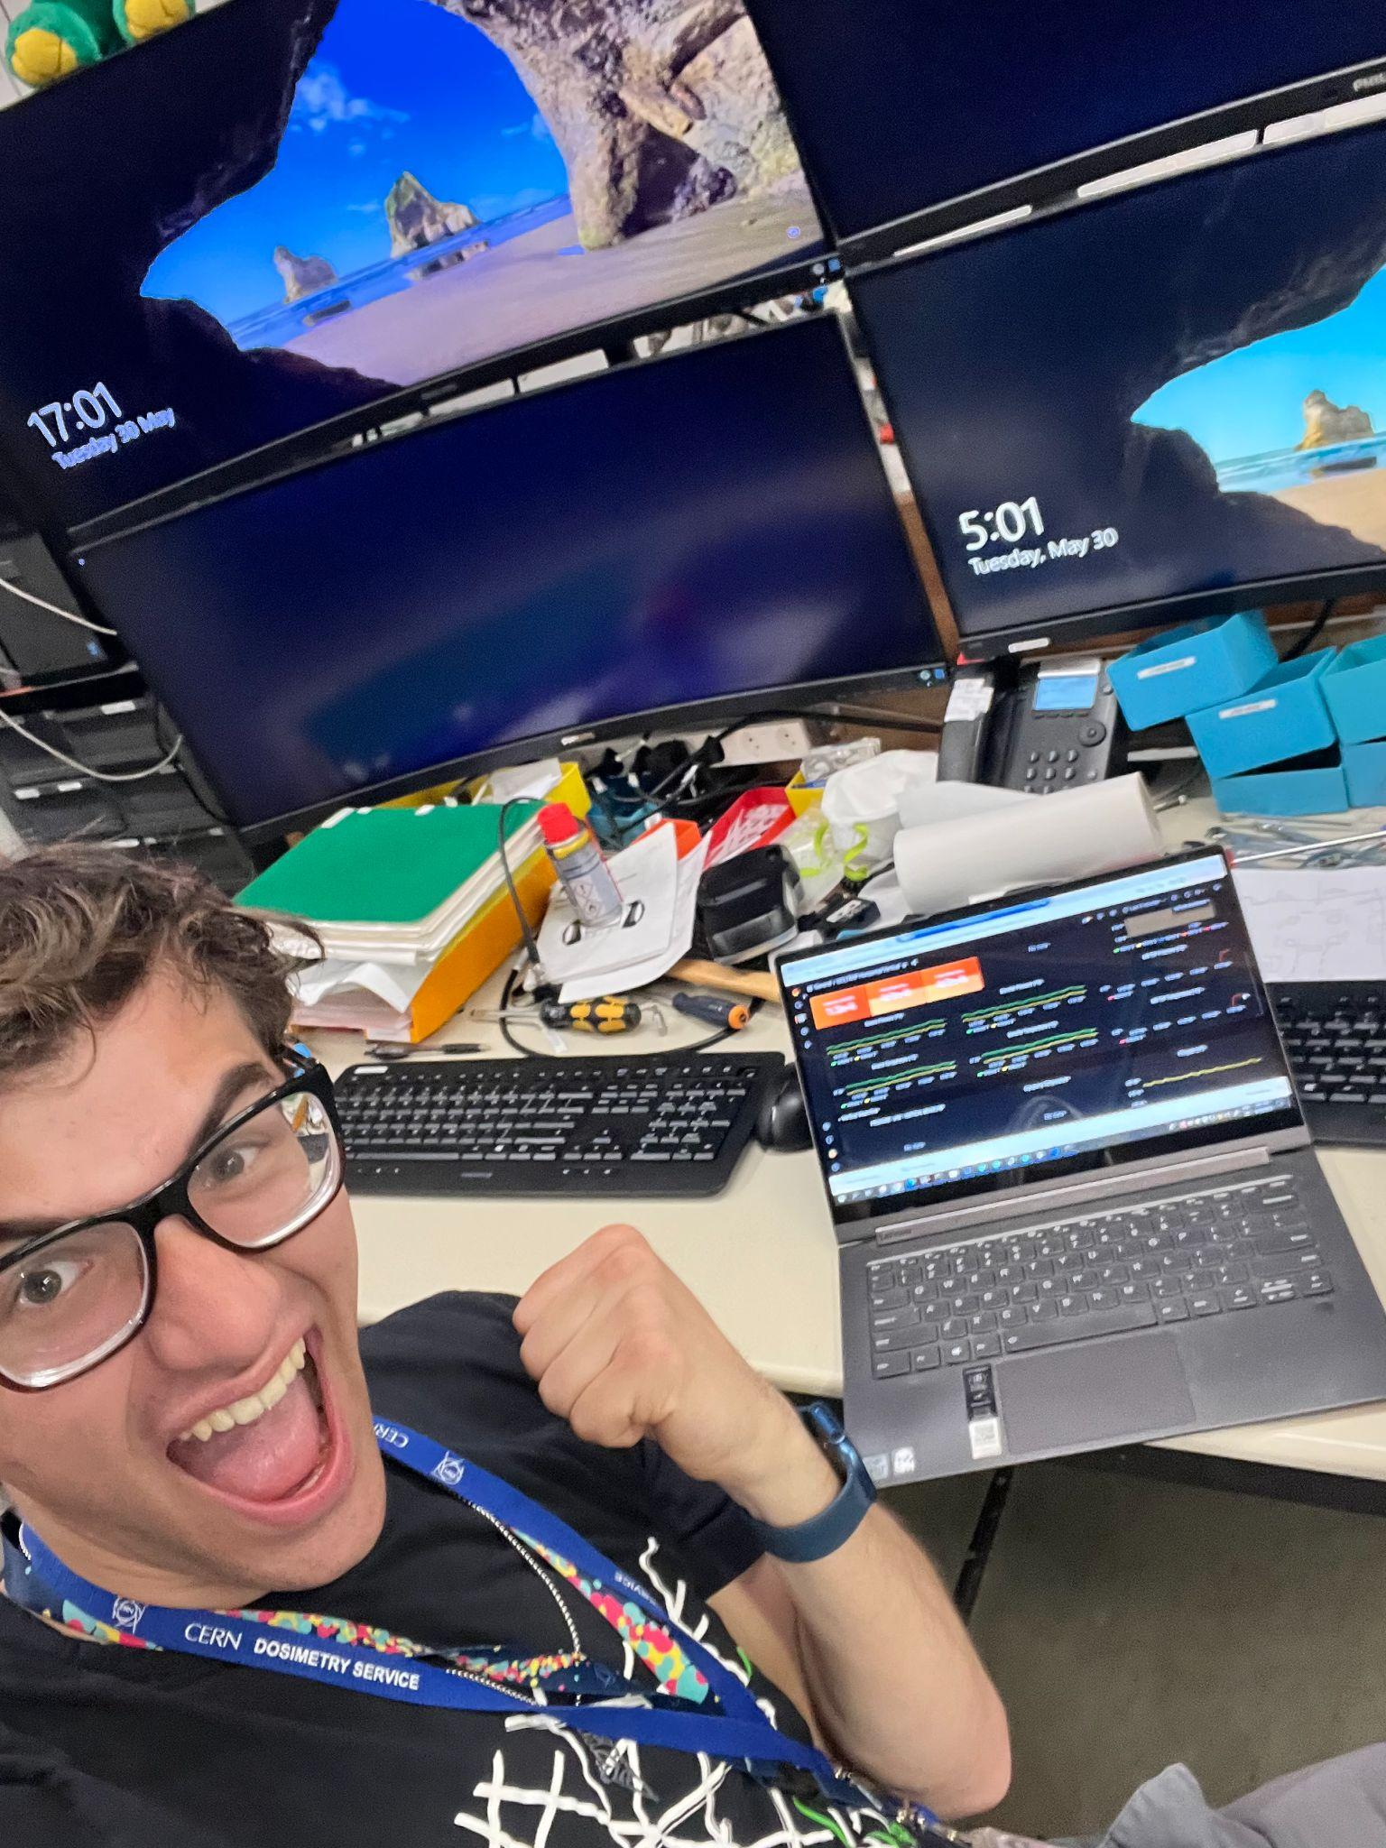
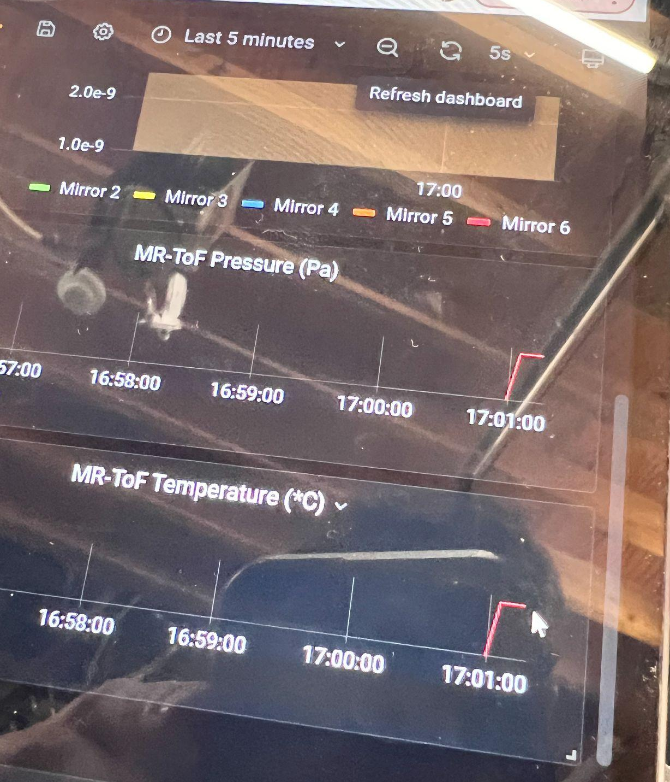
Success!

Slide 8
What’s next?

Slide 9
A lot…
BEAMTIME! 🥳
Finalize ESU 3D model 😅
  Waiting on 3D printer 👉👈
Fix minor (major) bugs in code 😵‍💫
Universalize code 🤓
Documentation 😬
Paper 🫠

