Slide 1
SPS status
Arthur Spierer for the SPS team
20th of april 2022, PS-SPS users meeting

Slide 2
SPS this week
  Coordinator next week: Carlo Zannini
  Coordination meeting on Monday 11.30
  SFTPRO
    Spill defined by beam line commissioning coordinator, 5e12 p/spill (single injection)
    Foils irradiation when smoothly, offline analysis ongoing
    Supercycles without NA timings are tripping NA power converters -> historical behaviour of converters
    100 Hz optimization will be running continuously next week
      Waiting NA62 for feedback
    Main stops due to SPS interlock system fault on Tuesday and investigation on ZS in the evening, long access on Wednesday until Thursday morning
      Compressed air leak in Prevessin (SPS+NA) started at 13h50, noticed Wed. evening, not found in SPS tunnel; Thu. BA80 : nothing, then TCC8 -> blocking NA extraction
    When is the second injection required? Need some time to setup, Spill deteriorated with LHC in the Supercycle
    Let us know when we can ramp up intensity (25-30 units for T2 currently) and adjust sharing
  HiRadMat (Week 21)
    Measured Eh = 2.66um Ev = 2.17um at the PSB, expected 2.5um from PS
    Spot size adjusted by SPS optics on the fly (not possible to measure without wire scanners)
    Requested bunch rotation will impact beam spot size (increased dp/p, dispersive optic)
  Next week: Start of NA Physics EHN1 + Beam Commissioning, SPS parallel MD on Wed.

Slide 3
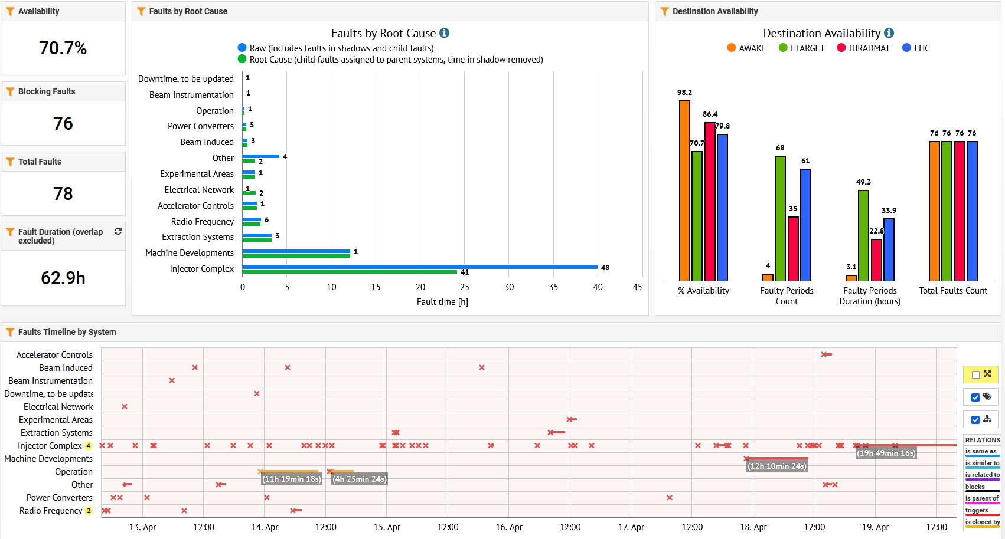
SPS availability overview

