Slide 1
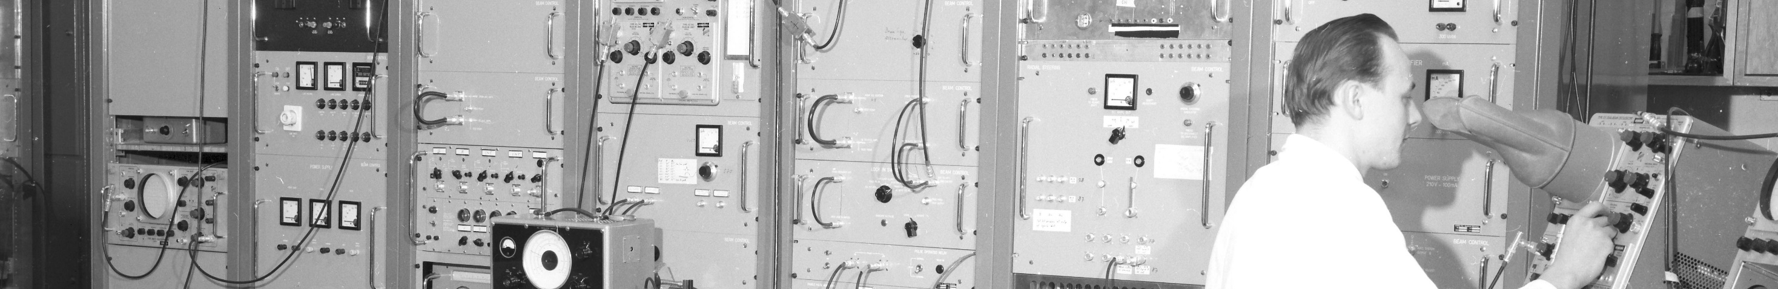
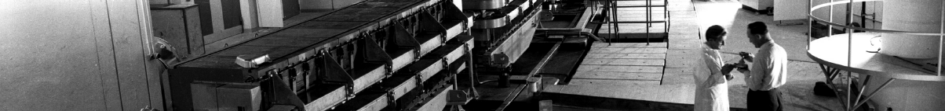
PS Report week 16
Many thanks
to the PS OP and coordination teams as well as all equipment experts and support teams!
A. Lasheen SY-RF-BR

Slide 2
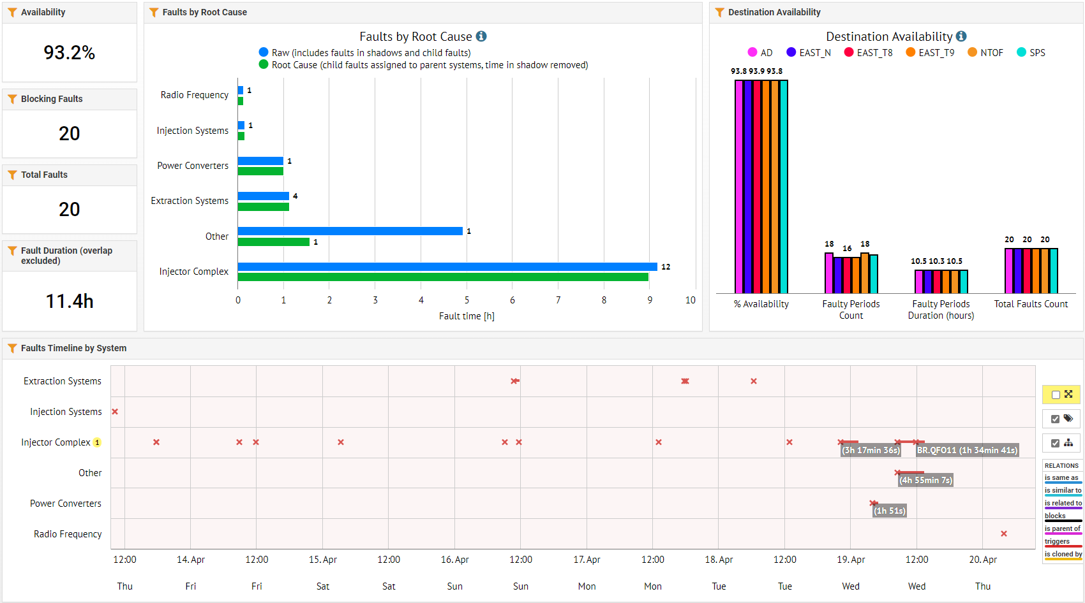
Beam availability W16
Beam stop for access L4/PSB/PS
L4 PLC issue
PSB magnet water leak
A. Lasheen SY-RF-BR

Slide 3
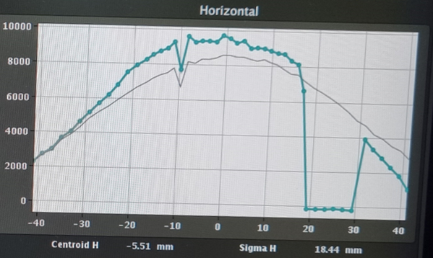
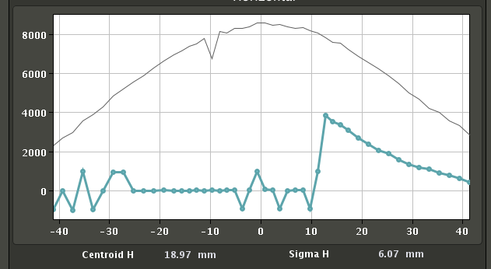
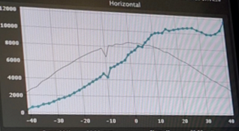
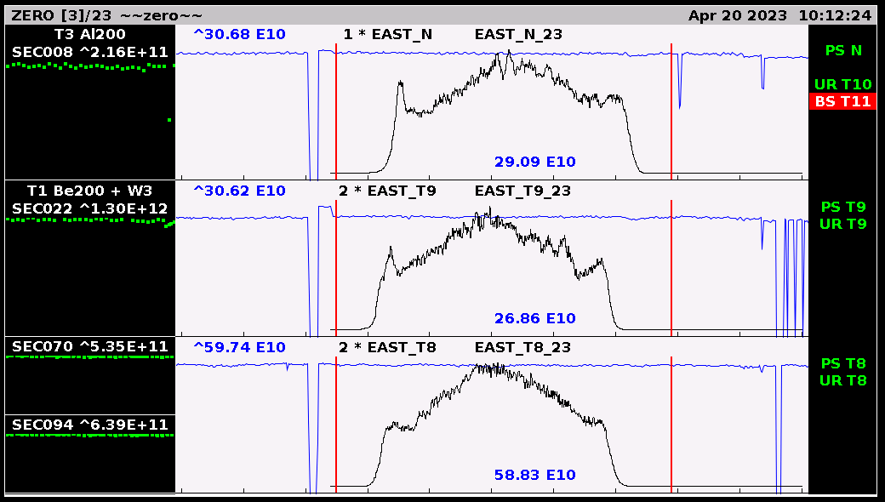
Main issues and activities
SEM grid data?
PS is now in full operation
TOF
  Investigations on the bad shots intermittently triggering the SIS and stopping the beam. No clear indication on extraction elements, BI expert contacted.
  Changed working point to improve vertical tune before extraction, reduced vertical beam size on SEM grids.
EAST
  Delivering spills to all EAST destinations including parasitic TOF.
  Work started for a high intensity parasitic TOF.
SFTPRO
  Optimization at PS-SPS transfer (energy matching with SPS, trajectory correction done by reducing extraction bump by 1 mm and adjusting DFAs)
HiRadMat/AWAKE
  Setting up of an AWAKE like bunch for HiRadMat, present performance in emittance@FT:
  ~2.7 um (H), 2.2 um (V)
Extraction element not pulsing?
A. Lasheen SY-RF-BR

Slide 4
Status of operational beams
Fixed target beams | Status | Comment
SFTPRO (core only) | Operational | Sent to SPS at 50 ∙ 10¹⁰ p/p
SFTPRO (5 turn extraction) | Operational | Available up to 1.5 ∙ 10¹³ p/p
AD | Operational | Available up to 1.5 ∙ 10¹³ p/p ; FTA line commissioned
TOF | Operational | 850 ∙ 10¹⁰ p/p and (28-)40 ns bunch length at extraction
EAST | Operational | Beam slow extracted to T9, N targets and to IRRAD, Fast extraction and parasitic TOF
LHC-type beams | Status | Comment
LHCPILOT, LHCINDIV | Operational
LHC25 (3bp, 72b) | Operational | Sent to SPS at 2.4 ∙ 10¹¹ p/b; Pushed up to 2.6 ∙ 10¹¹ p/b
LHC25 (2bp, 12b to 48b) | Operational | Sent to SPS at 1.9 ∙ 10¹¹ p/b; Pushed up to 2.6 ∙ 10¹¹ p/b
LHC25 BCMS (48b) | On hold | OK at 1.4 ∙ 10¹¹ p/b; Pushed up to 2.3 ∙ 10¹¹ p/b
LHC25 8b4e (56b) | Operational | Pushed up to 2.1 ∙ 10¹¹ p/b
AWAKE | Operational
HiRadMat | Operational | Single bunch AWAKE-like prepared at 2um transverse emittance
ILHC (1b), ILHC (4b)
A. Lasheen SY-RF-BR

Slide 5

PS Coordinator for week 16 – Alexandre Lasheen
PS Coordinator for week 17 – Matthew Fraser
Questions and Comments
9:00 live meeting at the CCC on Tuesday/Wednesday/Thursday/Friday
Zoom link to follow the meeting on remote: https://cern.zoom.us/j/9372114100?pwd=L29BcmlHUENCdFBRSytXYVcrM1B4Zz09
Meeting ID : 937 211 4100
Passcode: 525463
A. Lasheen SY-RF-BR

