Slide 1


A Possible Concept for a 40 T HTS Solenoid
A. Bertarelli on behalf of EN-MME

Slide 2
Outline
Introduction
Analytical Calculations
Finite Element Simulations
What’s Next?

Slide 3
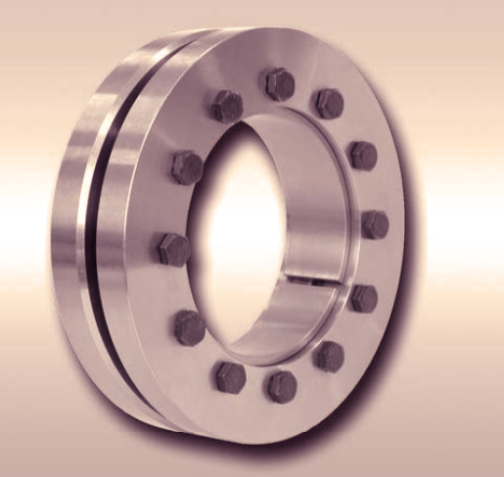
Basics
Introduction
A high radial compression is necessary to reduce hoop stresses and prevent tensile radial stresses on the HTS coil
Baseline concept is based on encapsulating all HTS coils in a thick cylindrical shell, relying on thermally-induced shrink fitting
  This concept is very simple and effective, but requires tight tolerances (~ 2 MPa/µm) and cannot be adjusted
A possible alternative may rely on shrink-discs with conical surfaces
  Pros:
    Easily adjustable
    Tolerances less critical (though still important),
    Thicker coils packs can be assembled (up to 8 x 12 mm coils)
  Cons:
    Control of friction coefficient between conical surfaces is critical ⇒ if lubrication not admissible, hard coatings likely required
    On thicker coil packs, boundary conditions induce some shear stresses

Slide 4
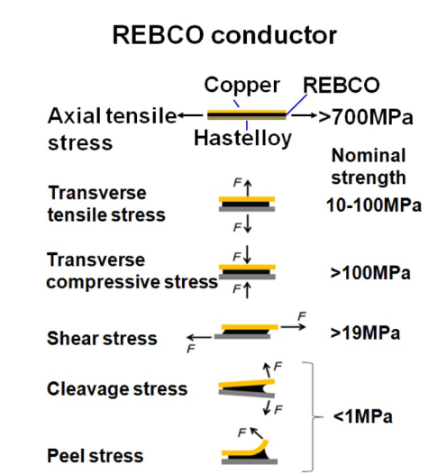
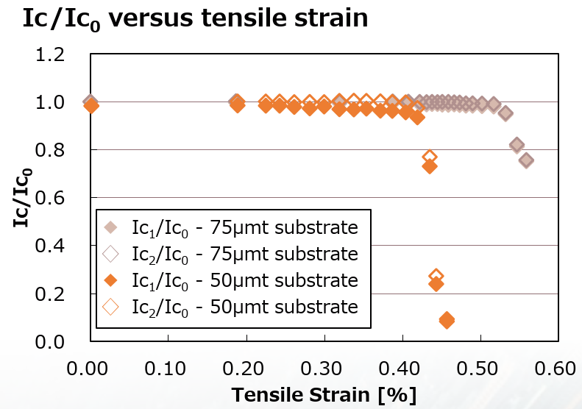
HTS Admissible Stresses
Introduction
Anistropic nature of HTS tape complicates stress analysis and assessment
Based on (incomplete) literature review, main assumptions are:
  In-plane tension limit is high ( > 700 MPa)
  Hoop tensile strain limit is ~0.4%
  In-plane compression limit is not known (recent paper by Gupta seems to imply - 167 MPa is acceptable)
  Radial tensile stress components to be avoided (what about 10-100 MPa limit?)
  Shear stress limit is low but not zero (> 19 MPa)
Hideaki Maeda and Yoshinori Yanagisawa IEEE TAS, VOL. 24, NO. 3, JUNE 2014

Slide 5
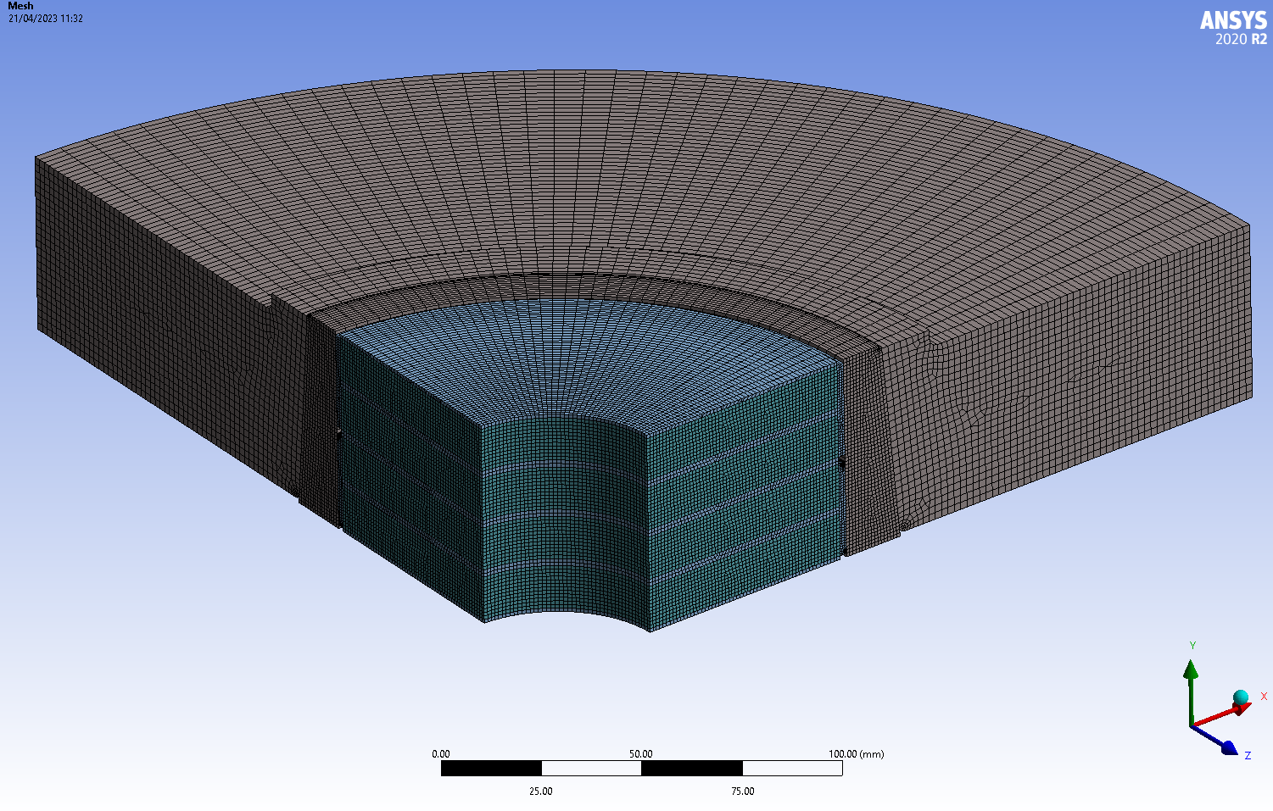
16 x M16x1.5 High Strength Bolts (not shown)
High Strength Inconel 718 Disk and Wedge
2 x 4 HTS Coils
(12 mm tape)
Symmetry Plane (XZ)

Slide 6
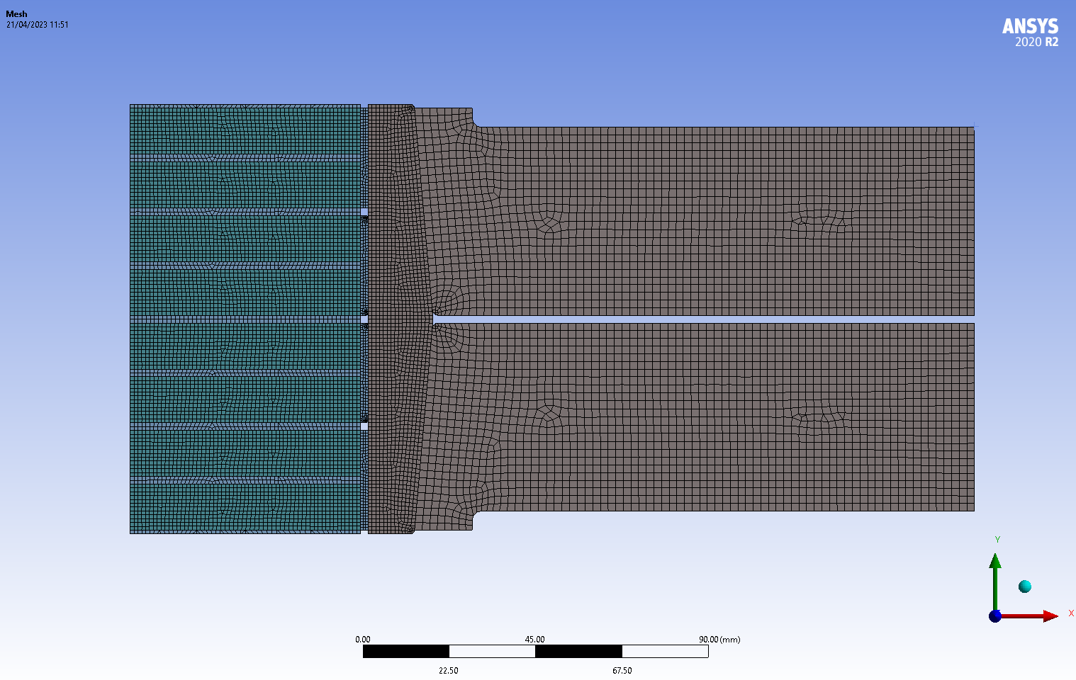
Main Dimensions
Coil IR 30 mm
Coil OR 90 mm
Outer Disc Dia 500 mm
Coil Pack Height 112 mm
Inner Coil Splices

Slide 7
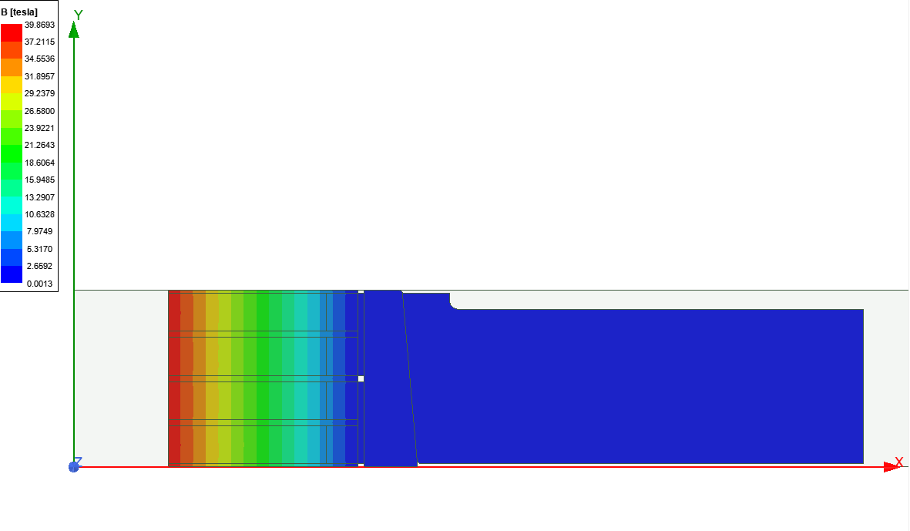
Magnetic Field with Double Symmetry BC (Long Solenoid)
Results

Slide 8
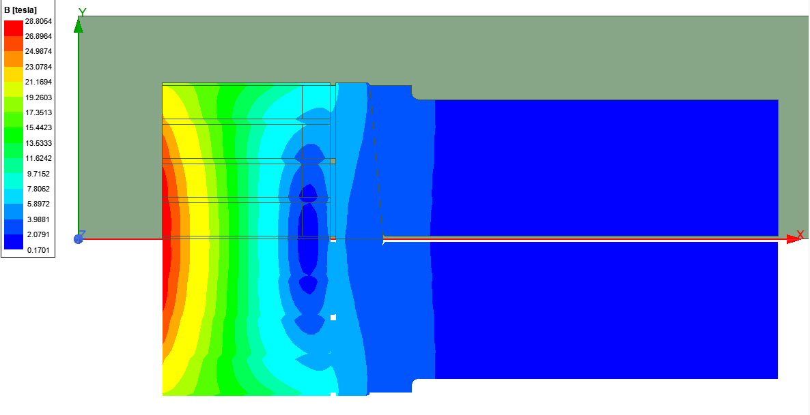
Magnetic Field with Single Symmetry BC (Short Solenoid)
Results

Slide 9
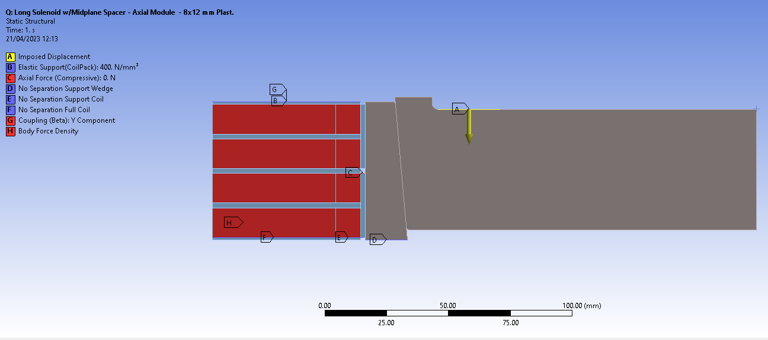
Mechanical Analysis Boundary Conditions
Results

Slide 10
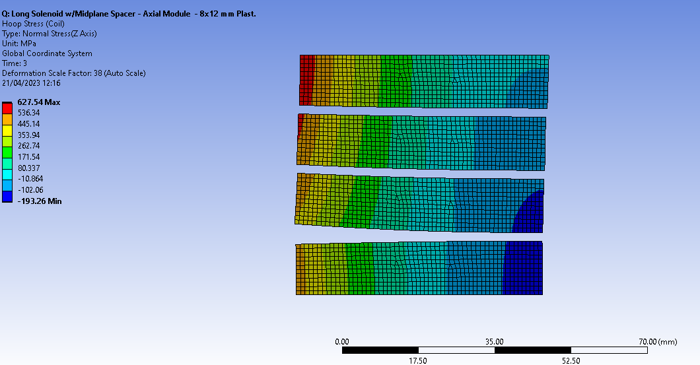
Mechanical Analysis: Coil Hoop Stresses
Results

Slide 11
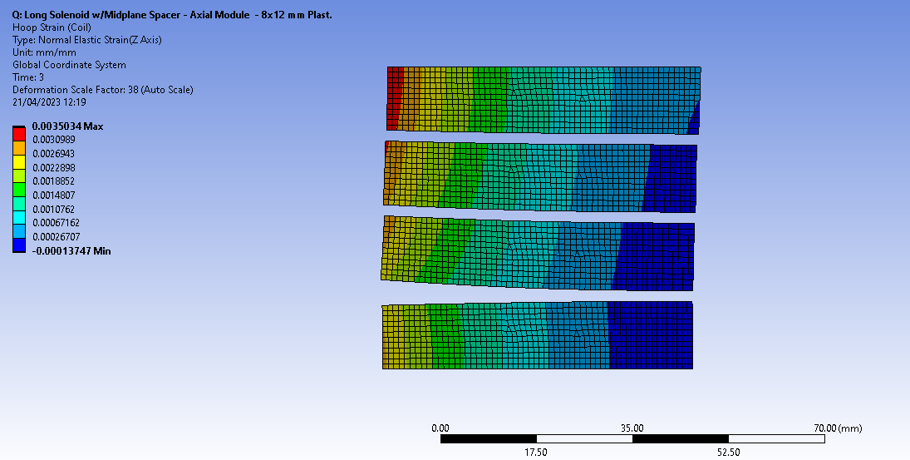
Mechanical Analysis: Coil Hoop Strains
Results

Slide 12
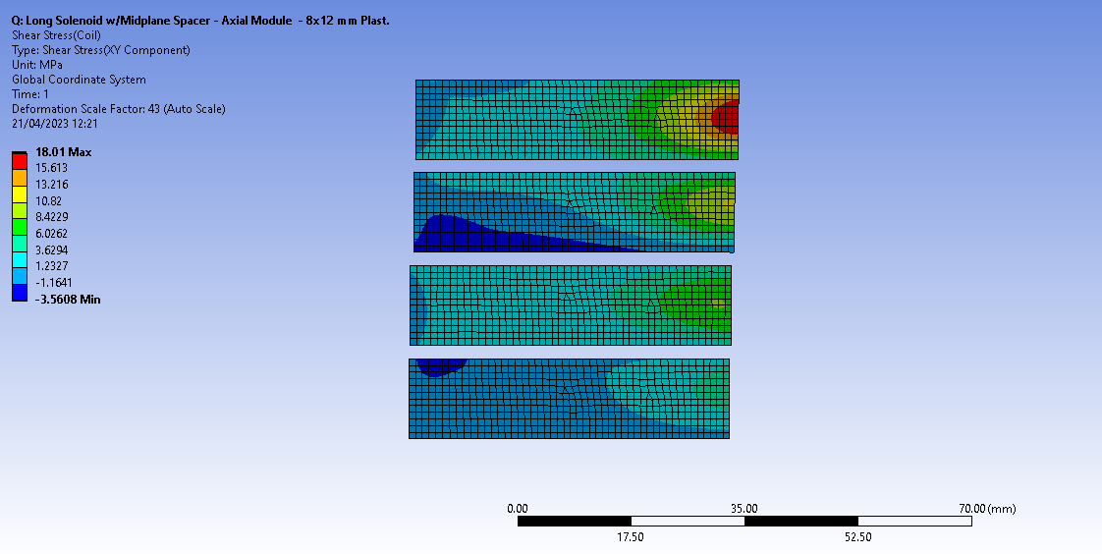
Mechanical Analysis: Coil Shear Stresses
Results

Slide 13
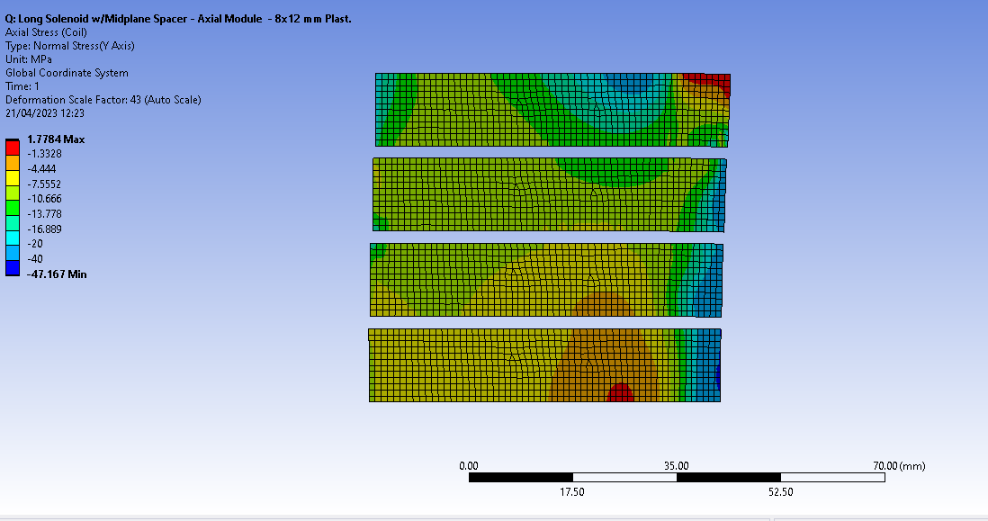
Mechanical Analysis: Coil Axial Stresses
Results

Slide 14
What’s next?
Proposal

