Slide 1
Task 2.3 Incoherent Effects
G. Sterbini on behalf of the team
BB DA studies (S. Kostoglou, C. Droin)
Luminosity model/performance (I. Efthymiopoulos)
Noise studies (S. Kostoglou, A. Radoslavova, A. Fornara [Manchester])
Wire studies (G. Sterbini, P. Belanger/D. Kaltchev [TRIUMF] )
With the invaluable support of
other WP2 members
G. Iadarola and the Xsuite community
E. Lamb (BB and beam profile evolution)
M. Rufolo (luminosity: filling schemes and heavy tails)

Slide 2
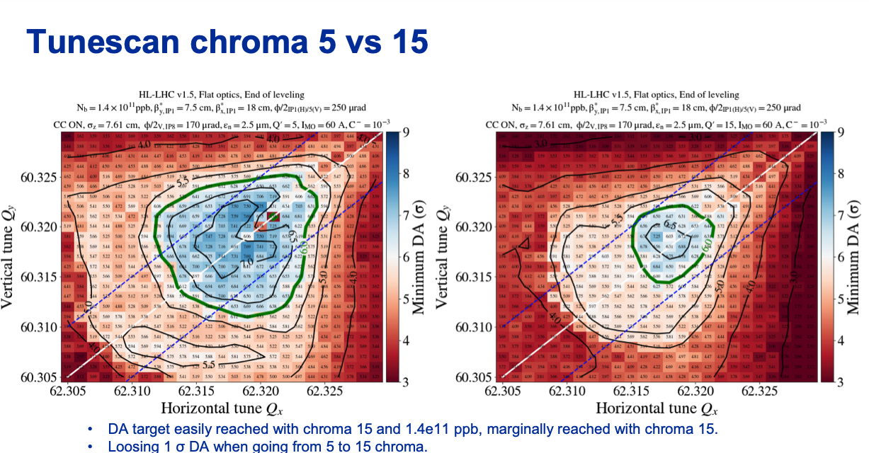
Main focus: flat optics scenarios
Contributing in defining/consolidating the new Run 4 baseline
Considering for the moment EOL (7.5/18 cm) and SOL (50/100 cm)
Focusing on the 8b4e (specific action to test the BCMS and the hybrid)
Chromaticity in the 5-15 range, clearly crucial parameter
S. Kostoglou

Slide 3
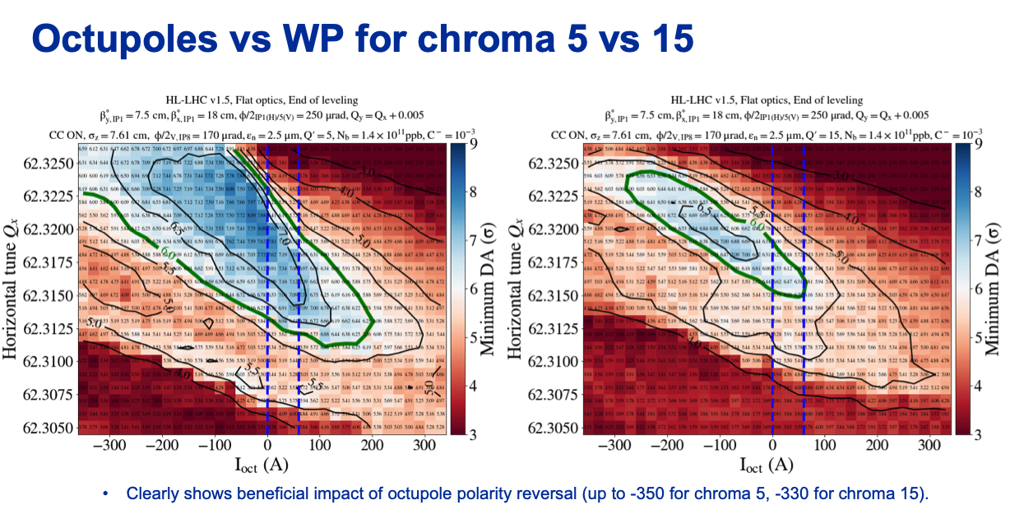
EOL: Benefit of negative octupoles on DA
S. Kostoglou

Slide 4
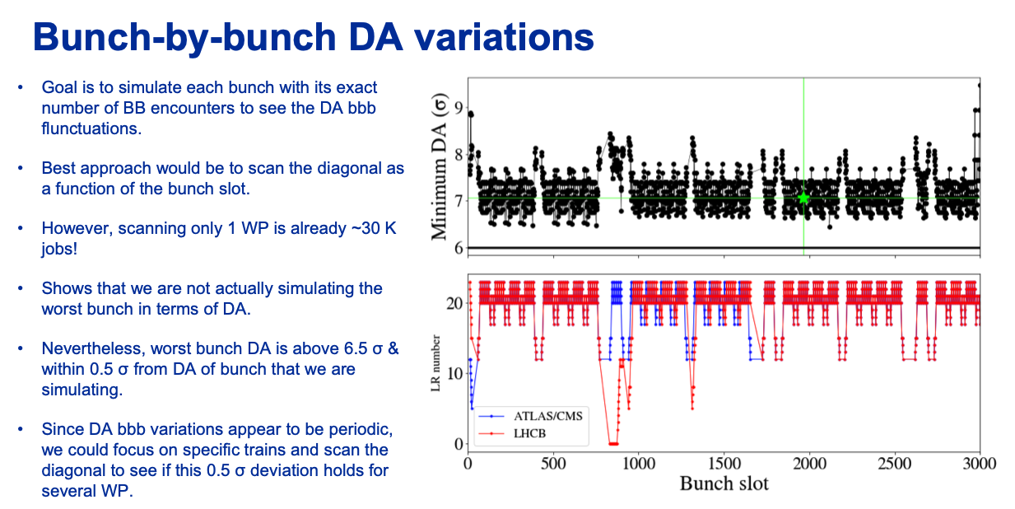
EOL: BB variation
S. Kostoglou

Slide 5
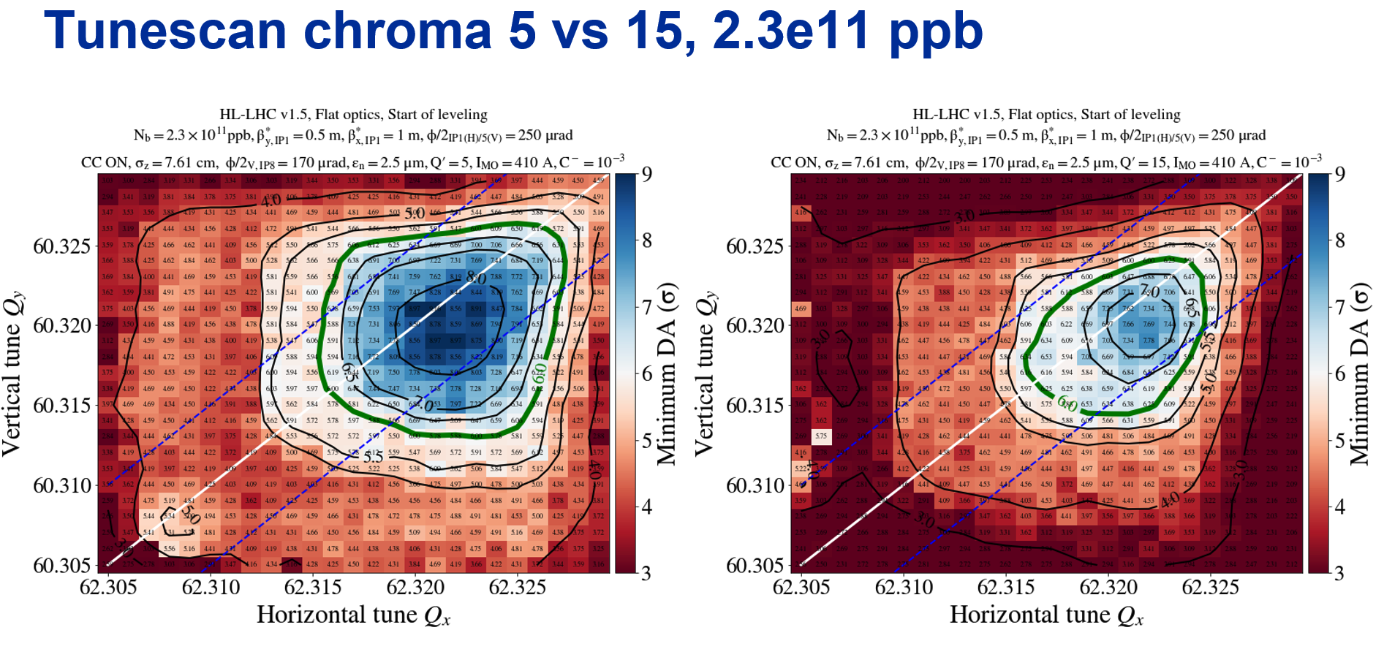
SOL 50/100 cm (work on going, preliminary)
S. Kostoglou

Slide 6
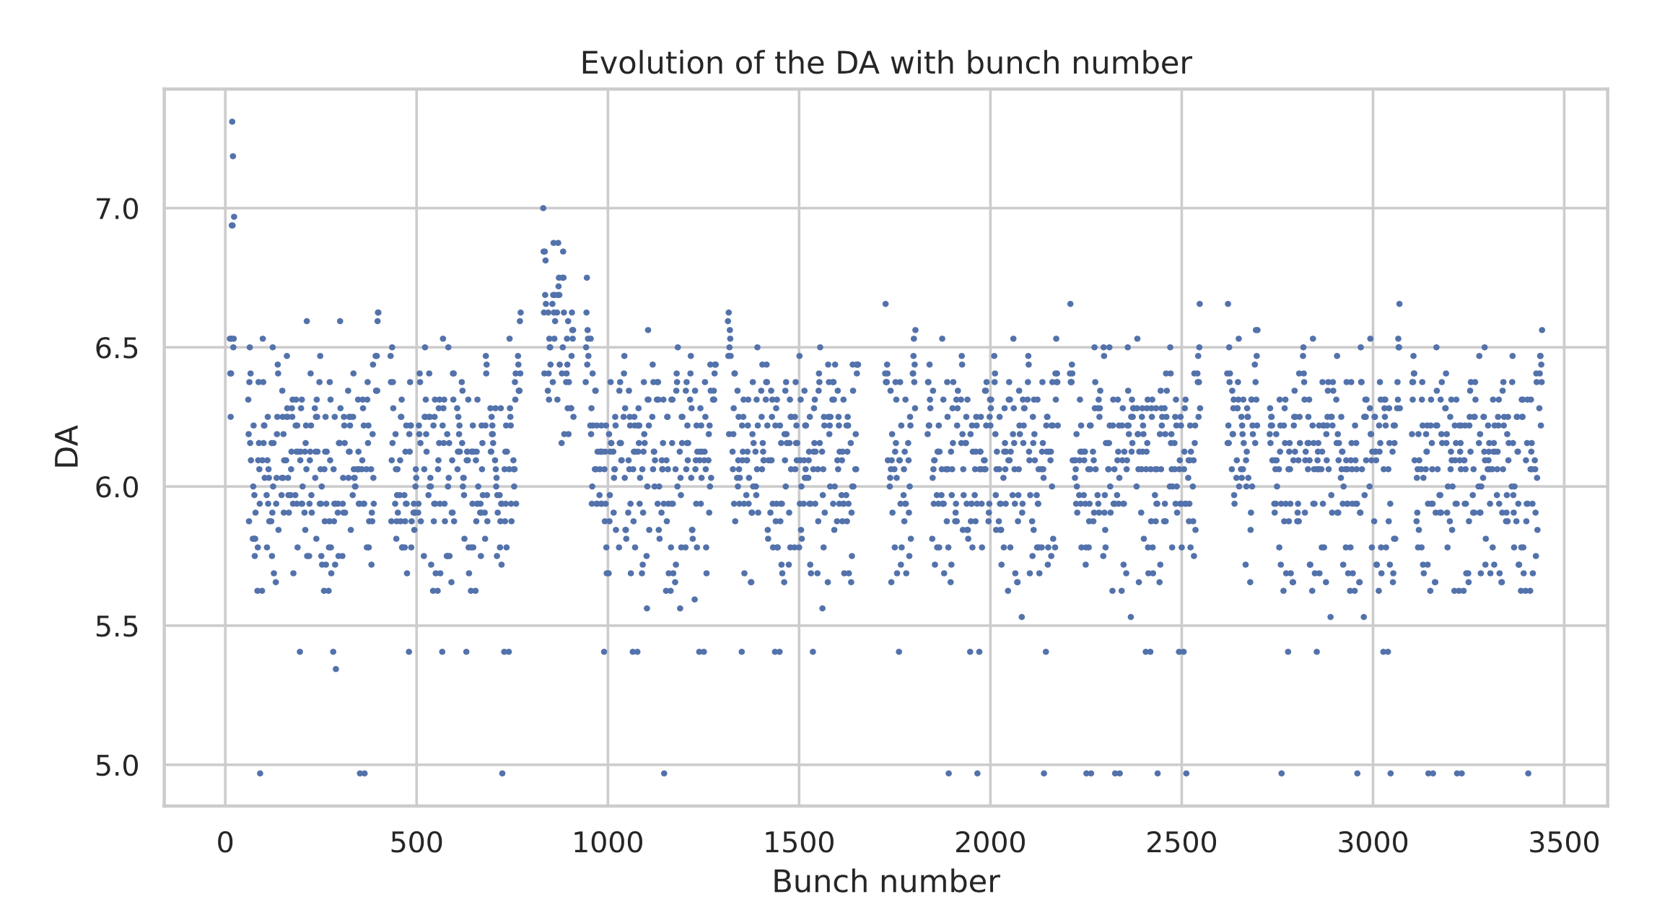
On going effort/studies on DA
Introducing Colas (arrived on January) to the team workflow: ready to contribute on DA studies
Code refactorization: migrating the DA studies from pymask to xmask (specifically luminosity leveling and bbb DA simulations). Great support from Gianni, as usual!
E.g. EOL bbb as done by Sofia but from Q’=5 to 15.
C. Droin

Slide 7
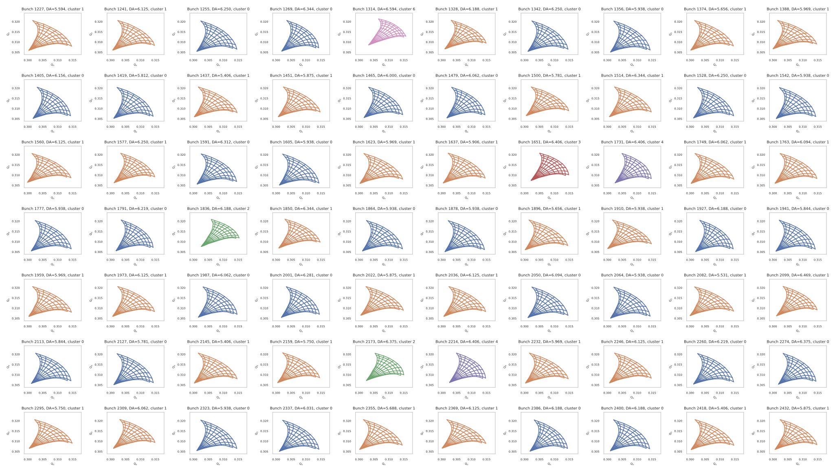
PRELIMINARY: DA clustering vs Q footprint
C. Droin
Can we establish a link between Q-footprint and DA to choose a subset of bunches for DA sudies?

Slide 8
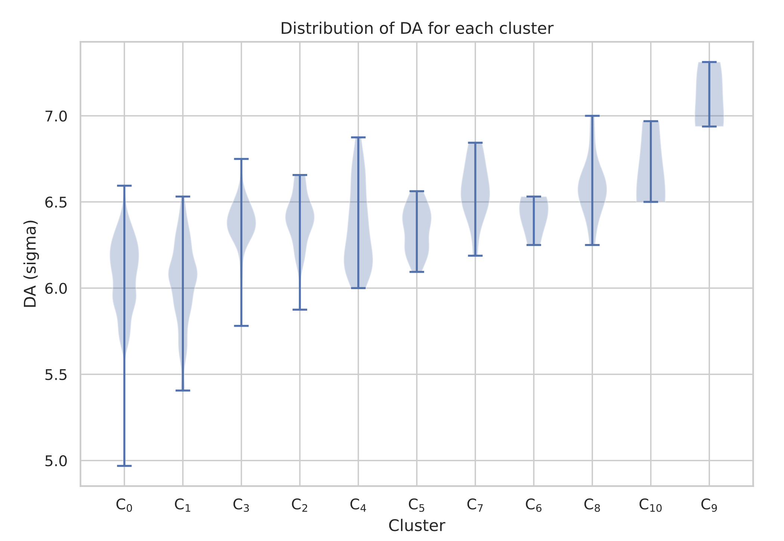
PRELIMINARY: DA clustering vs Q footprint
C. Droin
Just starting: perhaps Q-FP clustering (or other precursors) has some potential.

Slide 9
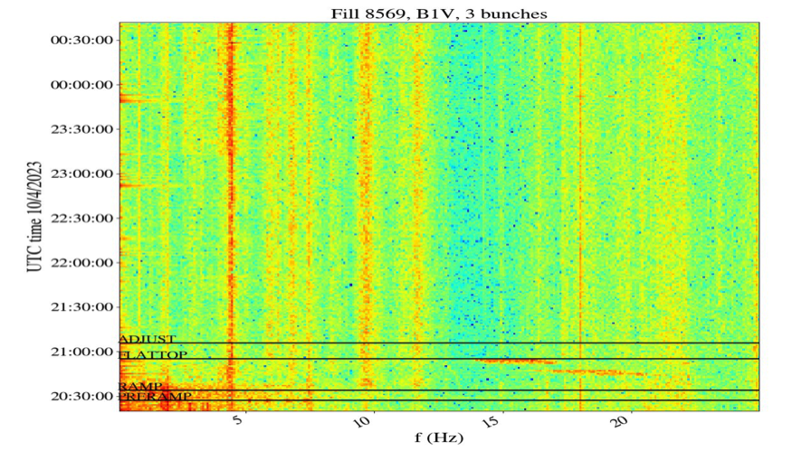
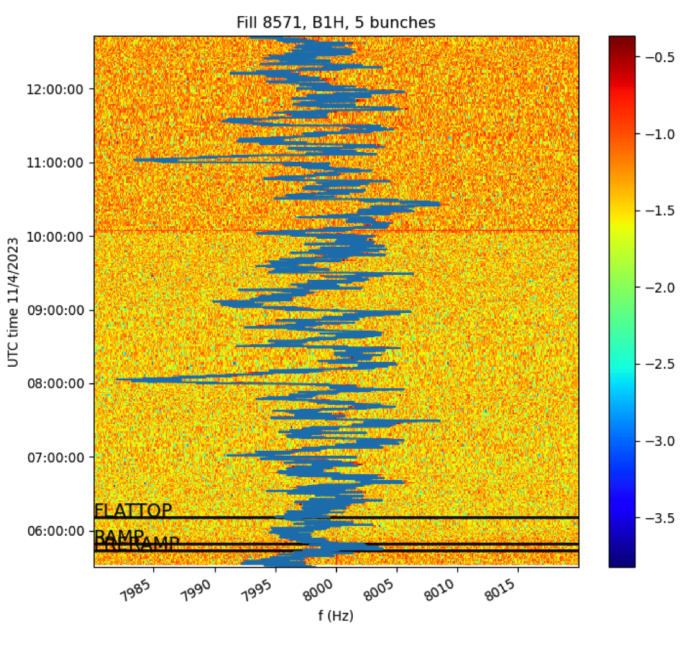
Noise studies
Following closely the 2023 start up to get an insight of the possible LHC noise sources.
An MD in the MD1 request on the noise (with Xavier): effect on the ADT gain on the 8 kHz.
A. Radoslavova
BB and Lumi, 19 April 2023

Slide 10
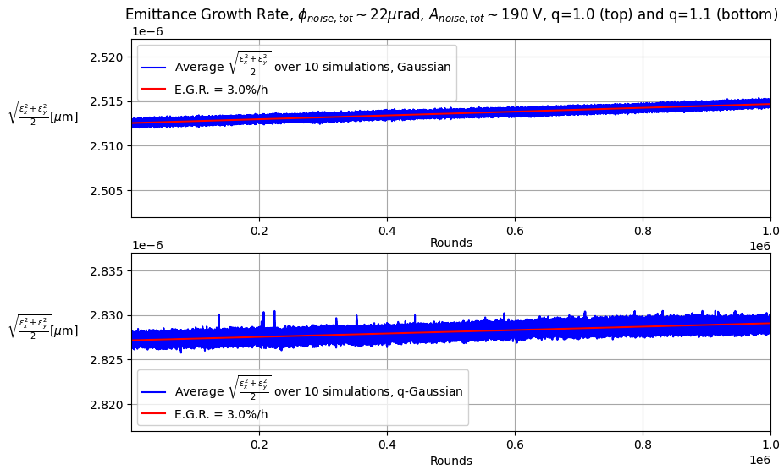
SIMULATION on CC and noise (BB+ heavy tails)
A. Fornara
Andrea arrived on 1st March and will spend 18 months at CERN
He will also contribute to the next SPS CC MD.

Slide 11
Wire Compensation
Waiting for Management mandate for the Review (we prepared a proposal and submitted).
For 2023, only LHC B2 wires will be available: included in the beam commissioning and in the intensity ramp-up.
The wire simulations for flat optics is still outstanding. As soon the xmask will be completed I will attack it.
An important MD test for 2023 is the wire compensation during the beta-levelling (2/3 steps)
Philippe will visit CERN for 1.5 months (coming the 2 May)

Slide 12
Summary
Studies priorities driven by the WP2 Actions
Filling scheme
DA vs intensity
Coupling of the strong beam
Effort put in the code/simulatin interface is paying off.
The bbb DA studies very demanding
Moving on the next stage of the analysis (linking precursors-DA for bbb clustering)
As complement of simulations studies, effort in preparing the 2023 MDs (noise [MD1], wire[MD2] and BB [MD2]).

