Slide 1
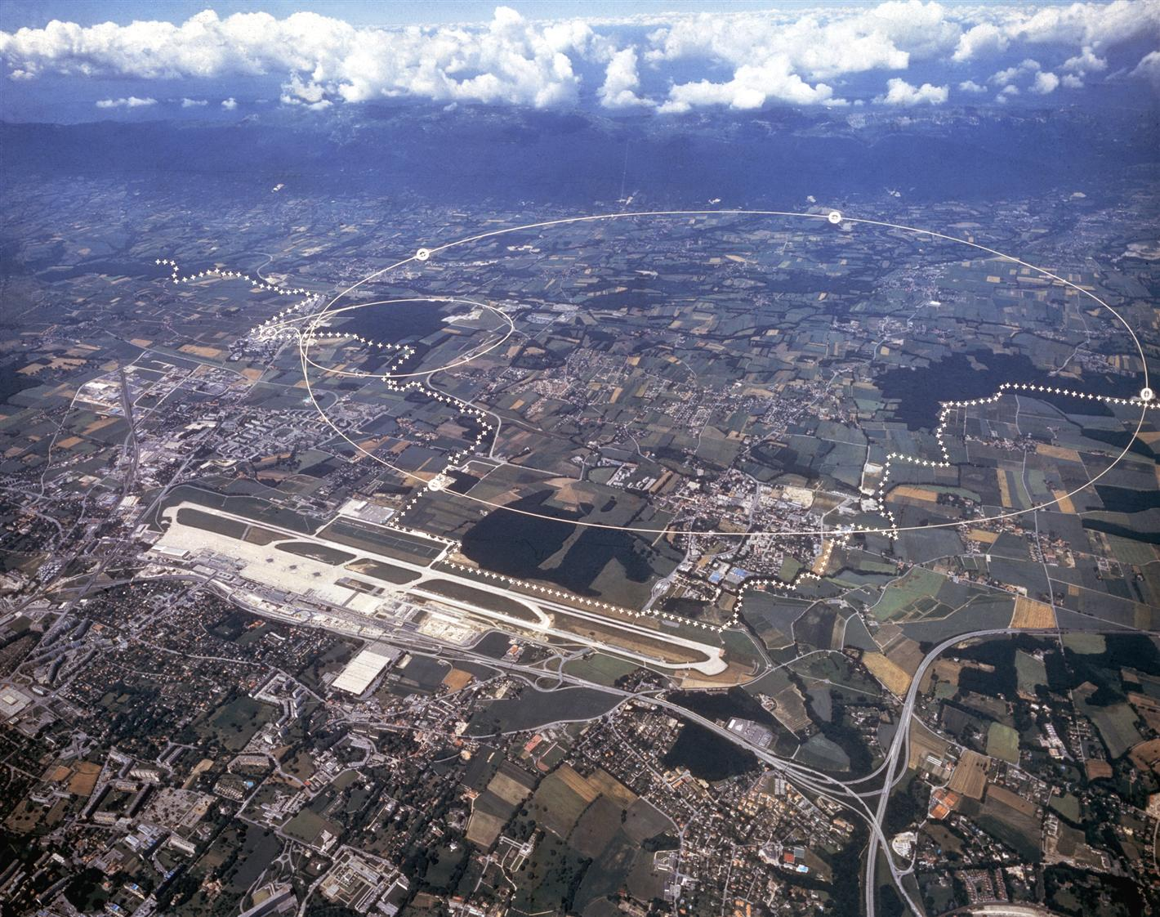
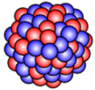
Updates on ion studies
R. Bruce et al.

Slide 2
Status of ion studies
Reminder: All HL-LHC upgrades for ions are already implemented – aim for HL-LHC performance already this year!
  Present work aims at preparing the 2023 run
2022 heavy-ion physics run postponed, short test scheduled on November 17-19, 2022
The test was very successful, in spite of several problems along the way - all main goals achieved in the 2-day test
  At some level, tested all new upgrades and ingredients for Run 3 / HL-LHC Pb-Pb operation

Slide 3
Main outcome of 2022 ion test
Tests of slip-stacked beams
  Could inject, ramp and collide 50 ns 8-bunch Pb trains for the first time
  Had very good beam characteristics from injectors (beam quality to be seen for longer trains)
First Pb-Pb collisions to experiments at record energy of 6.8 Z TeV
  About 0.1 – 0.3 μb⁻¹ collected during two stable beam-fills
Crystal collimation tests
  Channeling found with all crystals, including the ones installed in LS2
  Demonstrated up to factor 6 improvement in cleaning efficiency w.r.t. standard collimation system
Dispersion suppressor collimation test in IR2
  Demonstrated principle of collisional loss mitigation with new dispersion suppressor collimators and orbit bump
ALICE ZDC acceptance tested for new larger 100 μrad net half crossing angle

Slide 4
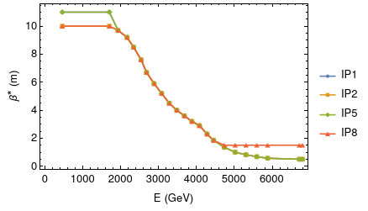
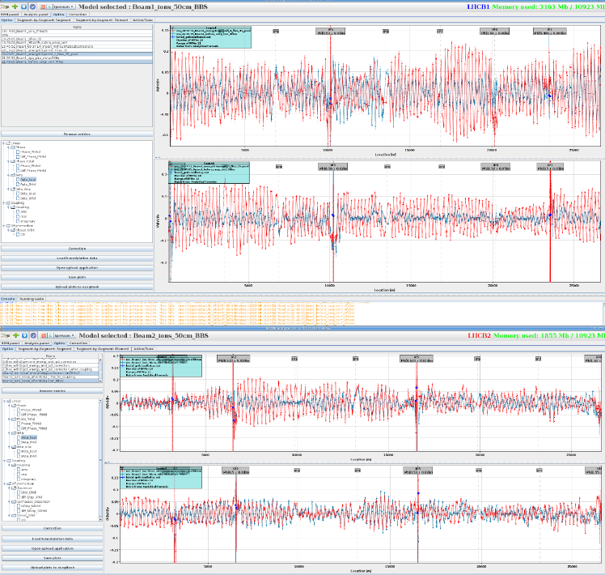
Ion cycle
Studied and consolidated proposal of shorter cycle, doing the full squeeze to 0.5m in the ramp
  See LBOC talk
OK for power converters and aperture
Main commissioning of ion optics done already, squeezed in during proton commissioning

Slide 5
Other updates
Matteo R and Guido studying ion filling schemes
B1H crystal collimator had problem, taken out, to be re-installed in TS1
Working group on studies of lighter ions beyond Run 4 started (chaired by Reyes, focus on injector complex)
  PhD student (Elias W) setting up simulation models of the machines
  Started comparing IBS models

