Slide 1






MuCol WP6:
RadioFrequency Systems
(CEA, INFN, UROS, Uni. Lancaster,
CERN, Uni. Strathclyde)
Claude Marchand – CEA Paris-Saclay
WP6 coordination meeting #1, May 10, 2023
Funded by the European Union under
Grant Agreement n. 101094300

Slide 2
MUCOL technical discussion
(slide of D. Schulte at 1st MUCOL management meeting April 26)
Need to have a coherent roadmap for all the WP’s
  How many people will you hire and for doing what
  What is the workplan
  How do you connect to the other WPs and to the IMCC
  How do we setup the parameters table, which spec do you need etc…

Slide 3
MUCOL Annual report
(slide of D. Schulte at 1st MUCOL management meeting April 26)
Information that will be in the report:
  Technical progress
  Milestones and Deliverables achieved (no milestones for WP6)
  Hiring stats
  List of publications
  Dissemination (conferences, presentations etc…)
  Public events
  Gender dimension actions

Slide 4
MUCOL Workpackages
Coordination and Communication: CERN
Physics and Detector Requirements: UNIPD, INFN, CEA, DESY, UOS, LIP, CERN
Accelerator chain:
Proton Complex: ESS, UU, CERN
Muon Production and Cooling: UKRI, Imperial, UWAR, CERN
High-energy Complex: CEA, INFN, CERN
Critical technologies:
RF Systems: CEA, ULA, UROS, INFN, CERN, Strathclyde
Magnet Systems: CERN, CEA, INFN, SOTON, TUDa, UTWENTE, UMIL
Cooling Cell Integration: UMIL, INFN, Imperial, UKRI, CERN
4

Slide 5
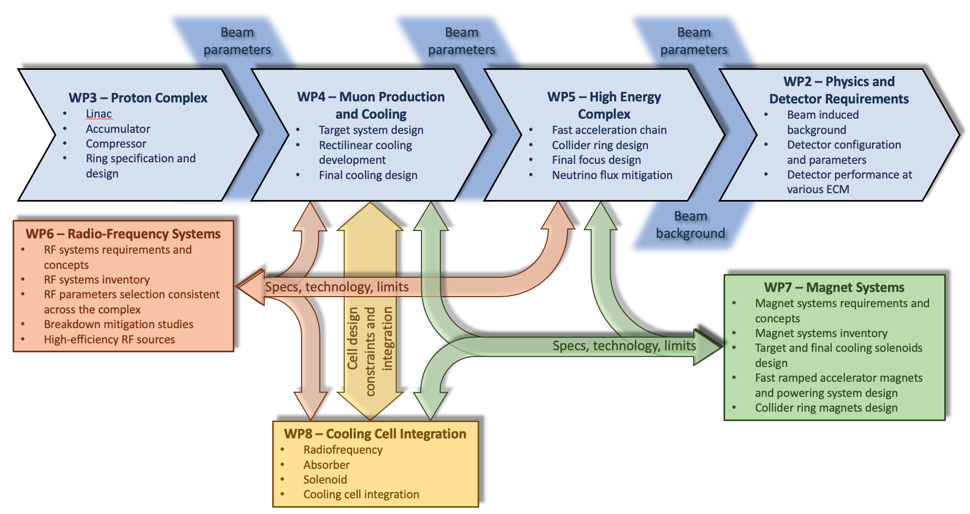
Interfaces between MUCOL WP’s
5

Slide 6
  WP6 objectives:
  The objective of this work package is to assess crucial feasibility issues and technological challenges of the RF systems. The study will concentrate on the two most challenging sections, the Muon Cooling Complex (MCC), and the muon acceleration stage of the High Energy Complex (HEC), for which a baseline concept of most critical RF components will be outlined based on inputs from WP4, WP5 and WP8.
  WP6 tasks :
  Task 6.1: Baseline concept of the RF system for acceleration to the High Energy Complex
  Task 6.2: Baseline concept of the RF system for the Muon Cooling Complex
  Task 6.3: Break down mitigation studies for cavities of the muon cooling cells
  Task 6.4: Baseline concept of high efficiency and high-power RF sources for the muon collider

Slide 7
Table 3.1c : List of Deliverables
Deliverable (number) | Deliverable name | Work package number | Short name of lead participant | Type | Dissemination level | Delivery date (in months)
6.1 | Consolidated report on baseline concept of high efficiency and high-power RF sources (task 6.4) | 6 | Uni. Lancaster | R | Public | 42
6.2 | Consolidated report on baseline concepts of the RF systems for the MCC and HEC complexes, including breakdown mitigation studies for MCC cavities (tasks 6.1,6.2,6.3) | 6 | CEA, INFN, UROS | R | Public | 45

Slide 8
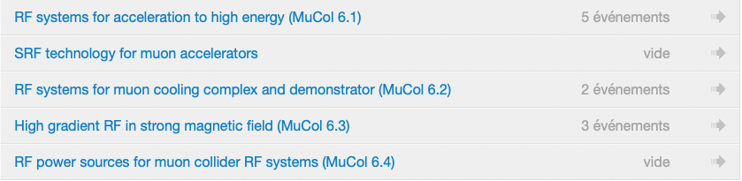
Coordination of work for WP6
  Regular Task meetings to coordinate work for each task https://indico.cern.ch/category/12831/
  WP6 coordination meetings on a bi-monthly basis:
    determine the overall work plan for WP6
    coordinate with other WP’s (e.g. parameters table, specs, etc.)
    evaluate global advance of work in WP6
    keep record of assigned manpower
    discuss publications and presentation at conferences, report to IMCC
    prepare input for MUCOL annual reports
8

Slide 9
Task 6.1: Concept of RF systems for acceleration to HEC (RCS’s)
(UROS, INFN, CERN, CEA)
Task objectives:
  by iterating with WP5, determine a full set of parameters for all cavities addressing longitudinal beam dynamics and stability (f, R/Q, Vmax, Q_{L},…)
  provide a conceptual design of cavities (eg: RCS-HE)
Challenges:
  Short muon lifetime
    -> huge RF voltages = need for high gradients (SRF cavities, eg XFEL like)
  Optimize distribution of RF cavities along the cyclotron circumference
  High intensity of muon bunches
  -> strong beam loading & wake field effects
  -> high induced voltage and high HOM power loss

Slide 10
Task 6.2: Concept of RF systems for the muon cooling complex
(INFN, CEA, CERN)
Task objectives:
  by iterating with WP4, determine a full set of parameters for all cavities
  provide a conceptual design of cavities (6D cooling)
Challenges:
  High beam loading -> mitigate energy spread
  Breakdown in high magnetic field needs to be mitigated (task 6.3 + WP8)

Slide 11
Task 6.3: Break-down mitigation studies for muon cooling cell cavities
(CEA, INFN, Strathclyde)
Task objectives:
  define cavities parameters & RF properties to minimize BD due to HG in high magnetic field
  (strong connection with task 6.2 and WP8)
Methodology:
  Enhance breakdown theory models in B field (like done in US beamlet approach)
  Define (and conduct some) experimental tests (DC and RF) to study influence of maximum number of parameters on BD rates:
    RF frequency, E field, RF pulse length, B field, material (Cu, Be, Al), temperature, surface preparation, conditioning algorithms, …
  Provide design and cost of few RF test stands for above tests to be included in LDG roadmap (CEA, INFN, Daresbury, CERN)

Slide 12
Task 6.4: Concept of high efficiency and high power RF sources
(Uni. Lancaster, CERN)
Task objectives:
  collect requirements for all RF power sources of the muon collider (f, peak power, efficiency) and identify the most challenging ones (wrt to commercially available RF sources)
  provide a conceptual design for those, in particular for the muon cooling section that may be used for the muon cooling demonstrator, with emphasis on high efficiency to ensure sustainability
Methodology:
  build upon experience acquired in the HEIKA collaboration on CLIC, combining novel designs
  possibly scale over the range of frequencies

Slide 13
WP6: preliminary assignment of tasks and manpower
(as defined in October 2022)
CERN (0 m.m EU, 41 m.m IK):
  Baseline concept for RF for MCC (task 6.2), 41 m.m IK
CEA (22 m.m EU, 16 m.m IK):
  Coordination WP6, 6 m.m IK
  Baseline concept for RF for HEC (task 6.1), 4 m.m IK
  Baseline concept for RF for MCC (task 6.2), 8 m.m EU + 2 m.m IK
  Coordination: Break-down mitigation studies and tests (task 6.3), 14 m.m EU + 4 m.m IK
INFN (36 m.m EU, 34 m.m IK):
  Deputy coordination WP6, 4 m.m IK
  Baseline concept for RF for HEC (task 6.1), 12 m.m EU + 10 m.m IK (Milano)
  Coordination: Baseline concept for RF for MCC (task 6.2), 12 m.m EU + 10 m.m IK (Milano+LNL)
  Break-down mitigation studies and tests (task 6.3), 12 m.m EU + 10 m.m IK (Milano, LNL, Naples,LNS)
UROS (12 m.m EU, 12 m.m IK):
  Coordination: Baseline concept for RF for HEC (task 6.1), 12 m.m EU + 12 m.m IK
Uni. Lancaster (36 m.m EU, 2 m.m IK):
  Coordination: Baseline concept for high efficiency RF (task 6.4), 36 m.m EU + 2 m.m IK
UKRI + Strathclyde (0 m.m EU, 48 m.m IK):
  Break-down mitigation studies and tests (task 6.3), 48 m.m IK Sthrathclyde-Rutheford

Slide 14
Thank you
for your attention

