Slide 1



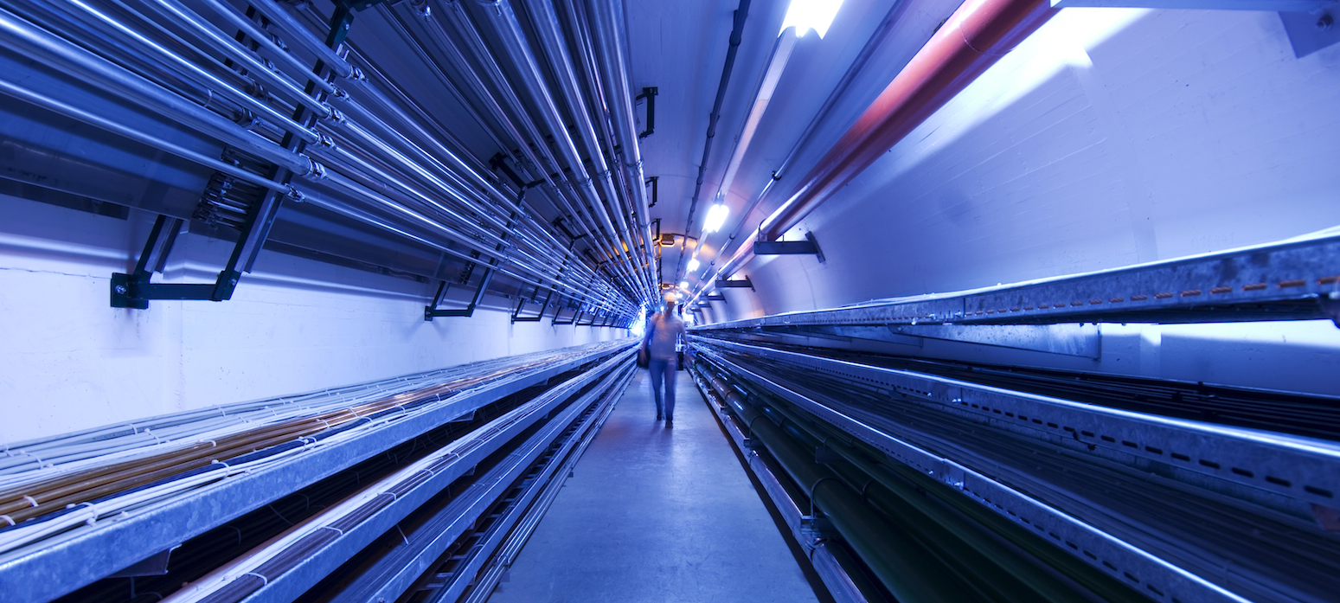
Workplan for RF WP6 Task 3:
Break-down mitigation studies
Guillaume Ferrand
CEA Paris-Saclay
WP6 coordination meeting #1
May 10, 2023

Slide 2
Outline
Problematic of NC RF cavities for the muon cooling complex in high magnetic fields:
  Cavity parameters (f,E,… ) and magnetic field
  Breakdown issues in magnetic field
  Previous experimental tests of cavity prototypes in high B field: MICE (201 MHz), MUCOOL (805 MHz)
Further tests are needed to test new/different BD mitigation solutions:
  Cavity shape, frequency, max RF power, magnet configuration and max B field, material (inc. temperature), accelerating gradient, pulse length…
Claude Marchand / MC collaboration meeting

Slide 3
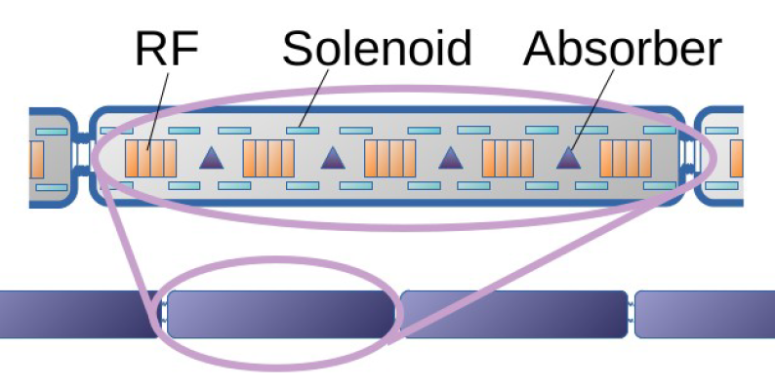
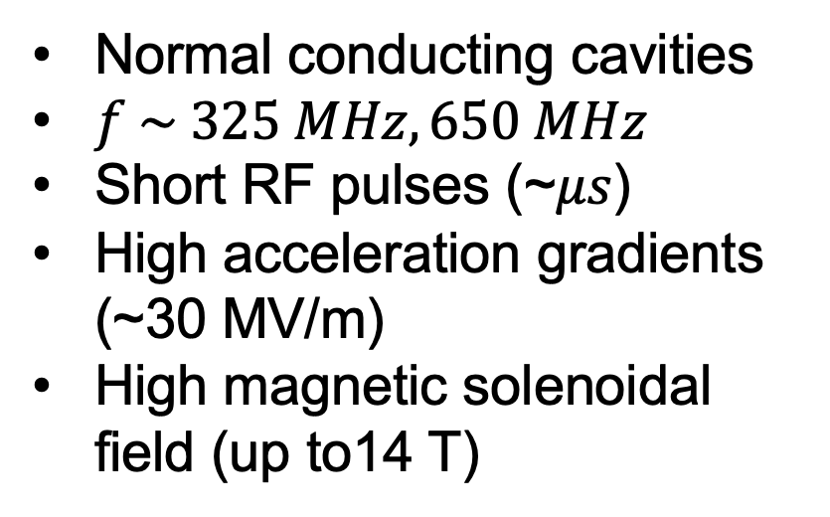
RF cavities for muon cooling cells
Normal conducting cavities
$f \sim 325 MHz, 650 MHz$
Short RF pulses (~𝜇𝑠)
High acceleration gradients (~30 MV/m)
High magnetic solenoidal field (up to14 T)
Creates problematics of break-down that needs to be mitigated
Claude Marchand / MC collaboration meeting

Slide 4
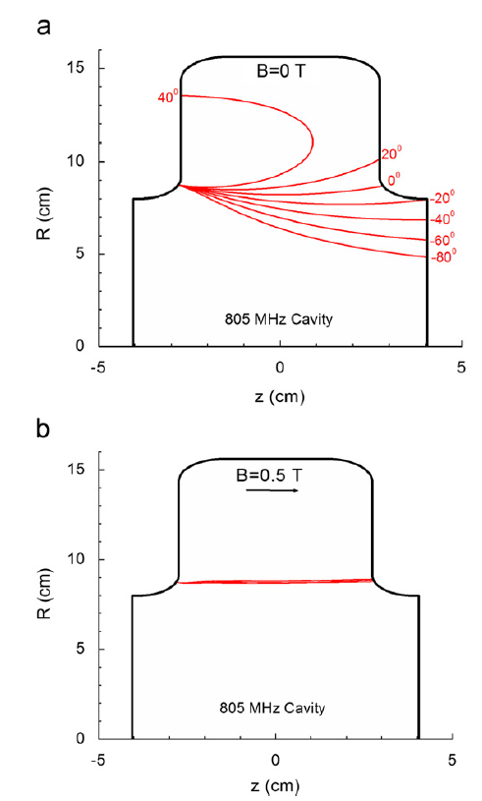
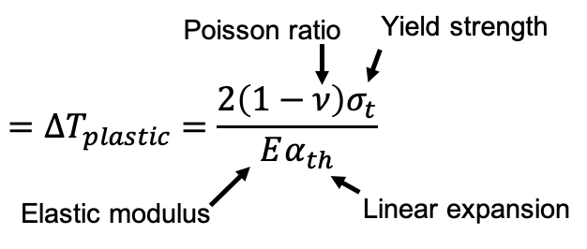
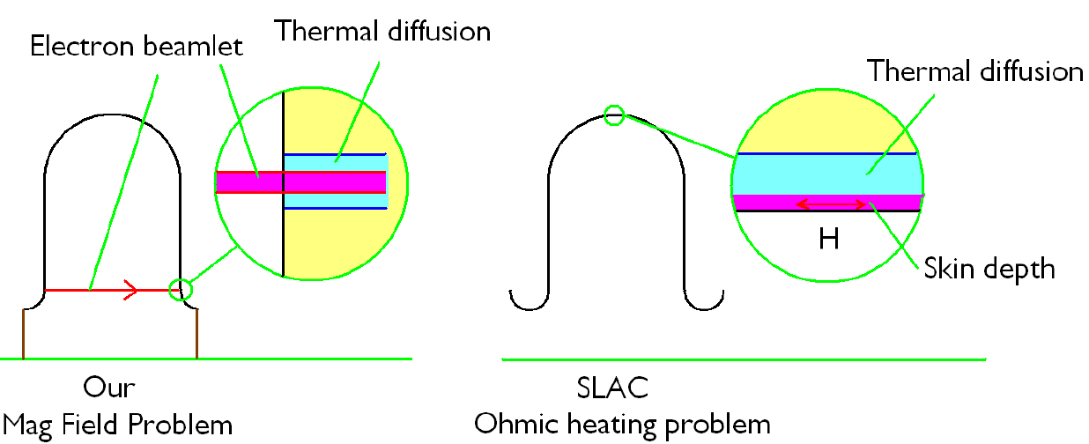

Breakdown model: beamlet focused by magnetic field
Numerical simulations conducted by SLAC collaborators showed trajectories of beamlets in the presence of the 805 MHz pillbox cavity
Model developed by US labs, checked against measurements in high $B$. papers: Palmer et.al PRAB 2009, Stratakis et.al NIMPR 2010, Bowring et.al PRAB 2020
Model predicts local temperature rise $∆T$ due to electron bombardment
Breakdown occurs when $∆T>∆T_{plastic}$
Electron beamlet
Thermal diffusion
Heating due to electron bombardment
$∆T_{plastic}$: 38 °C for Cu, 129 °C for Be, 224 °C for Al
Claude Marchand / MC collaboration meeting

Slide 5
6.3: Break-down mitigation studies
Task objectives:
  Find best cavities and RF properties to minimize breakdown due to high accelerating gradients under high magnetic field. (Material, gas, temperature, pulse length,…)
  For now, experiments about the effect of magnetic field have mainly been done by Bowring et al. at FNAL.
This plot is not intended to give absolute values for breakdown threshold, but only a feeling of which solutions can be more promising. We scale curves from MUCOOL cavity study.
Benefits of short pulse and aluminum multiply

Slide 6
Proposed methodology
Simulating/Understanding « beamlet » models:
  electron tracking under RF + magnetic field,
  different pulse lengths in a pillbox cavity,
  thermal studies.
Proposing RF test benches with existing components + some additions.
  Would certainly require to move some components from one laboratory to another one.
  Design a test bench and estimate costs.

Slide 7
What would we need in RF test stand to validate simulations?
Different cavities:
  Different frequencies: 325/650 MHz, materials: copper/aluminium/beryllium, shapes: pillbox/elliptic/QWR/HWR?
One magnet:
  Ideally that could go up to 4 T? Where we would put a cavity, ideally in different positions?
One or more amplifiers:
  Capable to go up to xx MW? Pulsed amplifier, which duty cycle? With pulse compressor?
  One or more frequencies? Which LLRF to drive it?
Eventually a cryostat to cool down the cavity? A cryogenic plant?
A bunker to protect during the test against X-Ray?

Slide 8
RF test stand under study
  RF test stand at 704 MHz at CEA Saclay
  RF power test station at INFN (200 sqm bunker)
  RF test stand at Cockcroft Institute (3 GHz)
  RF test station at CERN (12 GHz)

Slide 9
CEA Contribution – Study and simulation
Studying/simulating breakdown models:
  electron tracking under RF + magnetic field,
  different pulse lengths,
  different materials,
  thermal studies,
  scaling laws,
  Pillbox cavity + other geometries.

Slide 10
CEA Contribution – RF Test bench
Study/simulation of a test bench:
  that validates/invalidates the simulations,
  that allows tuning the parameters of the simulations,
  that validates/invalidates the proposed cavity designs (in relation to other tasks of WP6).
Feasibility with CEA klystrons.
Study of a pulse compressor @ 704 MHz.
Estimating costs.
Open position to hire postdoc on EU funds for 22 months

Slide 11
Example of CEA RF test stand
To build
Already exists
Bunker (radiation and B shielded)
Magnet
(MICE 4T)
Klystrons (f=704 MHz)
6m+4m
Thales 2182A 1.6 MW peak
2.8 MW
magic tee
cavity
CPI VKP7952A 1.2 MW peak
pulse compressor
7m

Slide 12
INFN Contribution:
Toward a proposal for a Cooling Channel Test Station
Dario Giove
on behalf of the INFN RF Group
for the Muon Collider Project
Design a compact multiple-cavity module, with efficient frequency tuning and RF power feeding systems. In order to have strong solenoid fields, the cavity design should be as compact as possible in the transverse direction.
Study the possibilities offered by improved copper surface qualities, new copper based alloys or low Z materials as Beryllium to improve the breakdown properties of a NC cavity.
Look into a suitable RF frequency choice (in the range 805 to 325 MHz) to define a trade off between the above discussed phenomena and the magnet design. This will contribute to the proposal of a demonstrator of a cooling channel section.

Slide 13
INFN Contribution
Dario Giove
on behalf of the INFN RF Group
for the Muon Collider Project
For 2023 INFN put a small amount of money to evaluate the possibility to carry out some tests on selected materials and polishing technologies on a DC HV test set up in magnetic field (1 T) @ LASA.
The setup may reach fields up to 30 MV/m but must be carefully designed due to the limited space in the magnet (120mm). A good starting point is represented by the work reported in the NIM 2018 paper from S.Lebedynskyi et al (N. Shipman PhD Thesis 2014). DC and pulsed HV regimes.
A more ambitious program may arise from these tests:.
study of innovative materials to create electrodes to be tested with a high DC static field in the presence of a magnetic field of at least 1 T or higher
study of surface finishing, coating and cleaning techniques for the above materials
DC high static field test in the presence of a magnetic field of at least 1 T or higher
design of single cells at different frequencies in the 650-3000 Ghz range to verify the feasibility of structures with a reduced number of brazing (against joining techniques that allow the parts to be removed)
low frequency test
high power tests
test in magnetic fields of at least 5 T of single cells with RF power.

Slide 14
INFN Contribution
Dario Giove
on behalf of the INFN RF Group
for the Muon Collider Project
In the context of these activities, a common laboratory (at LASA ?) could be thought of for the low-power qualification of these cavities. If this laboratory could count on a new and dedicated staff resource, it could also take care of transferring and increasing the know-how available in the context of LLRF systems and integrate with similar national and international initiatives.
A relevant new is the fact that INFN funded officially in January 2023 the construction of a 500 sqm bunker (walls 2 meters thick and completely underground) at LASA devoted to accelerator applications. The facility is foreseen to be ready by middle 2025.

Slide 15

Strathclyde Contribution to WP6.3
Contribute to RF breakdown theory models and simulation:
  The effect frequency, duty pattern/pulse duration and magnetic field has on breakdown probability
Contribute to DC breakdown studies at Strathclyde:
  Study the evolution of breakdown
  Influence of pulse duration;
  Surface preparation;
  Choice of materials for “stressed” walls.
Opportunity for collaboration
  Including opportunities for PhD student to assist with experiments using test stands at Saclay, Daresbury and INFN
    Dependent on future research funding for RF activity at
      Saclay,
      Daresbury,
      INFN….
Hiring of student on UK funds in process (->end Mucol)

