Slide 1
UK Advanced Instrumentation Training
Circuit Design 3 & 4
Simulation LTspice 1 & 2
Dr Weida Zhang
@physics.ox.ac.uk
2022 Apr 19

Slide 2
Circuit Design, Noise, Grounding
Workflow
  Analyze -> Block Diagram, Specs
  Schematic -> Circuit topology, Constraints
  Layout -> GERBER, BOM, Assembly-files
  Manufacturing (fabrication, population, assembly)
  Debug, Characterization -> Reports
  (Revision)
Simulation

Slide 3
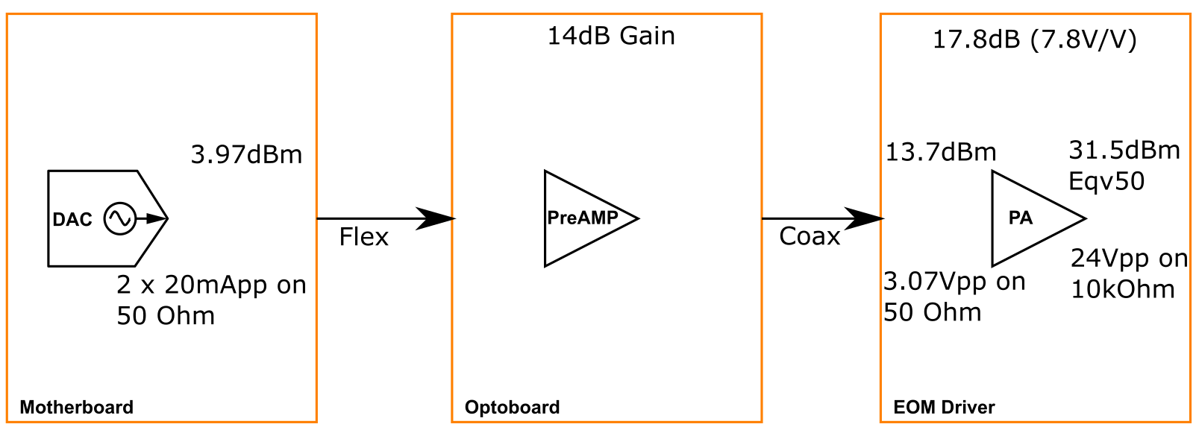
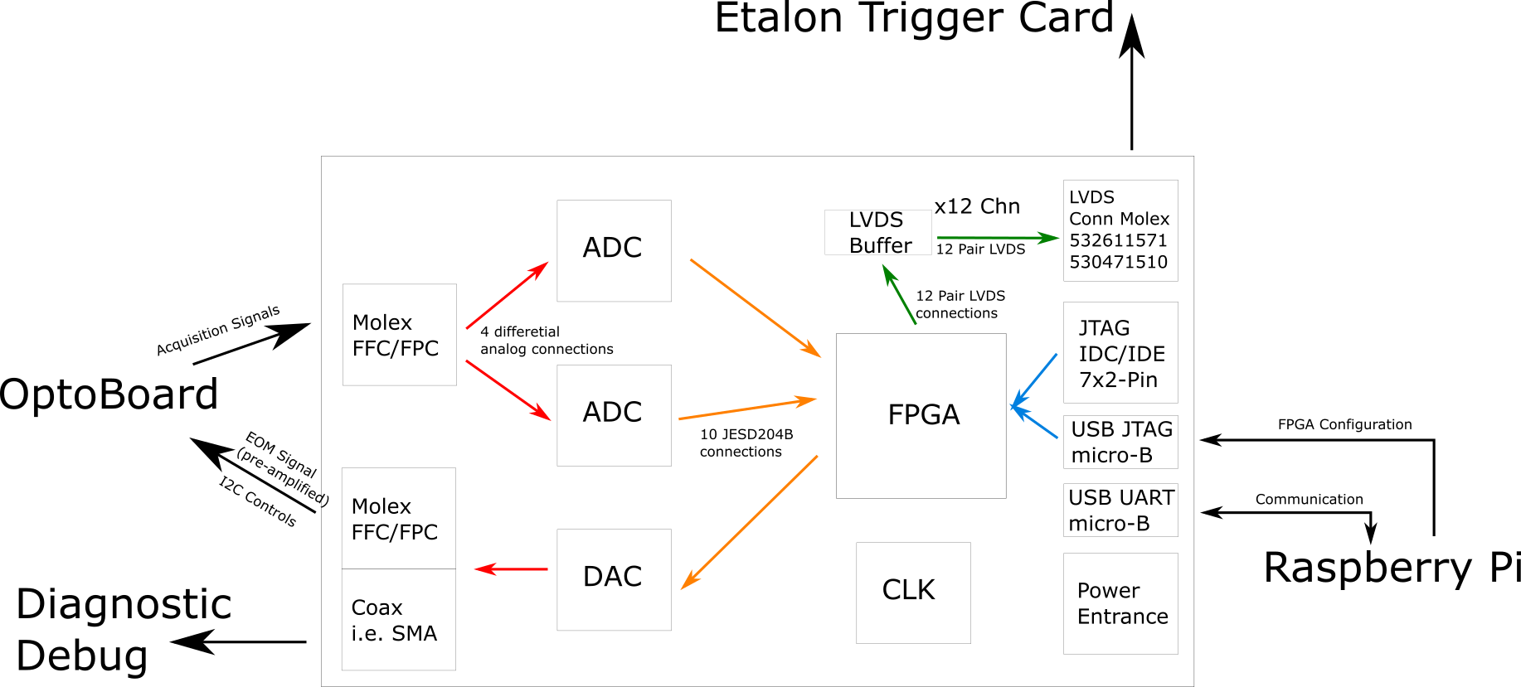
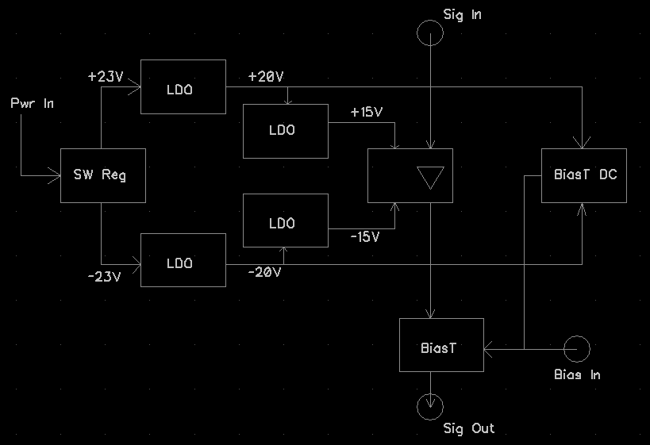
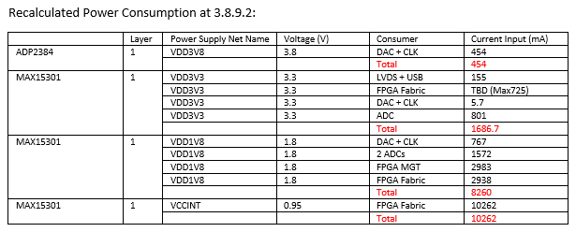
Circuit Design, Noise, Grounding
Workflow
  Analyze -> Block Diagram, Specs

Slide 4
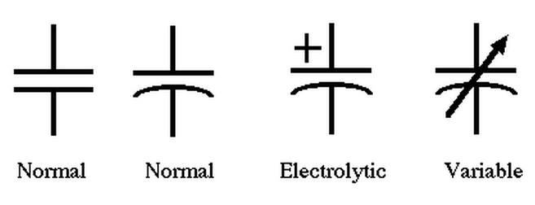
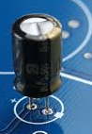
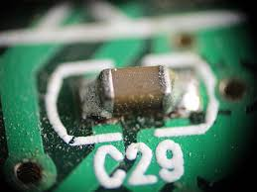
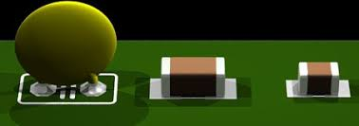
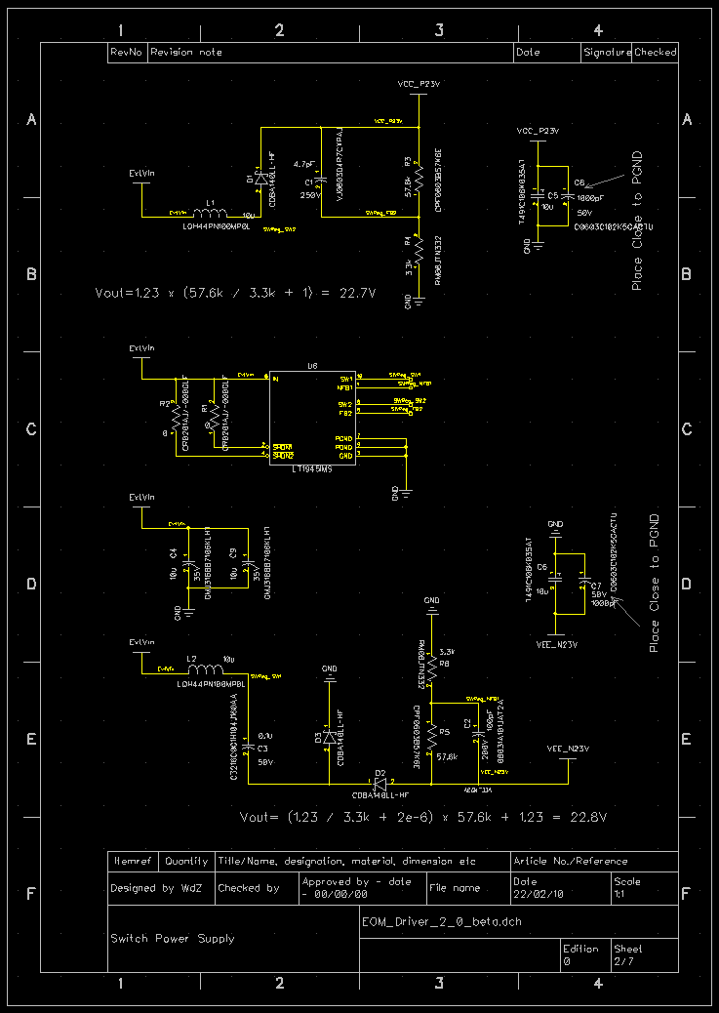
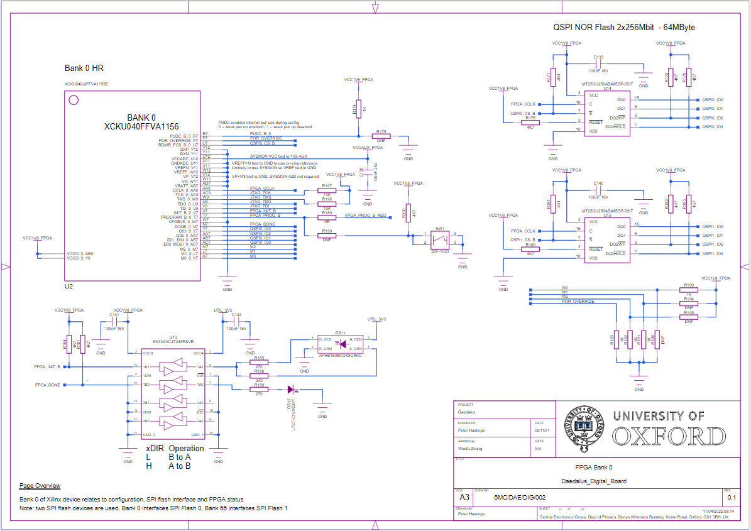
Circuit Design, Noise, Grounding
Workflow
  Schematic -> Circuit topology, Constraints

Slide 5
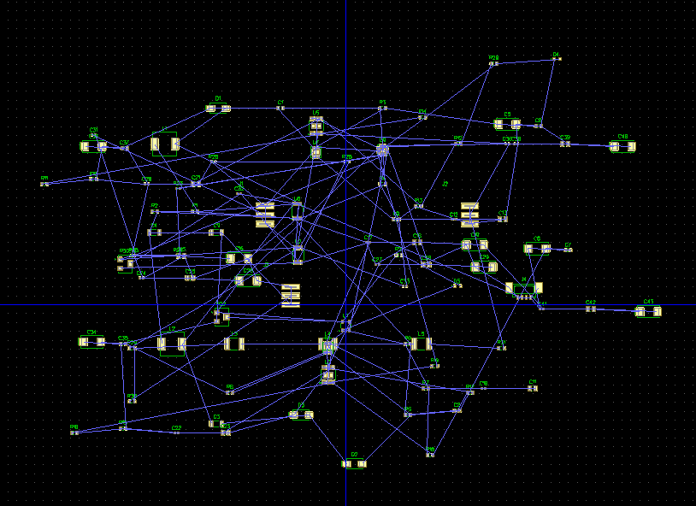
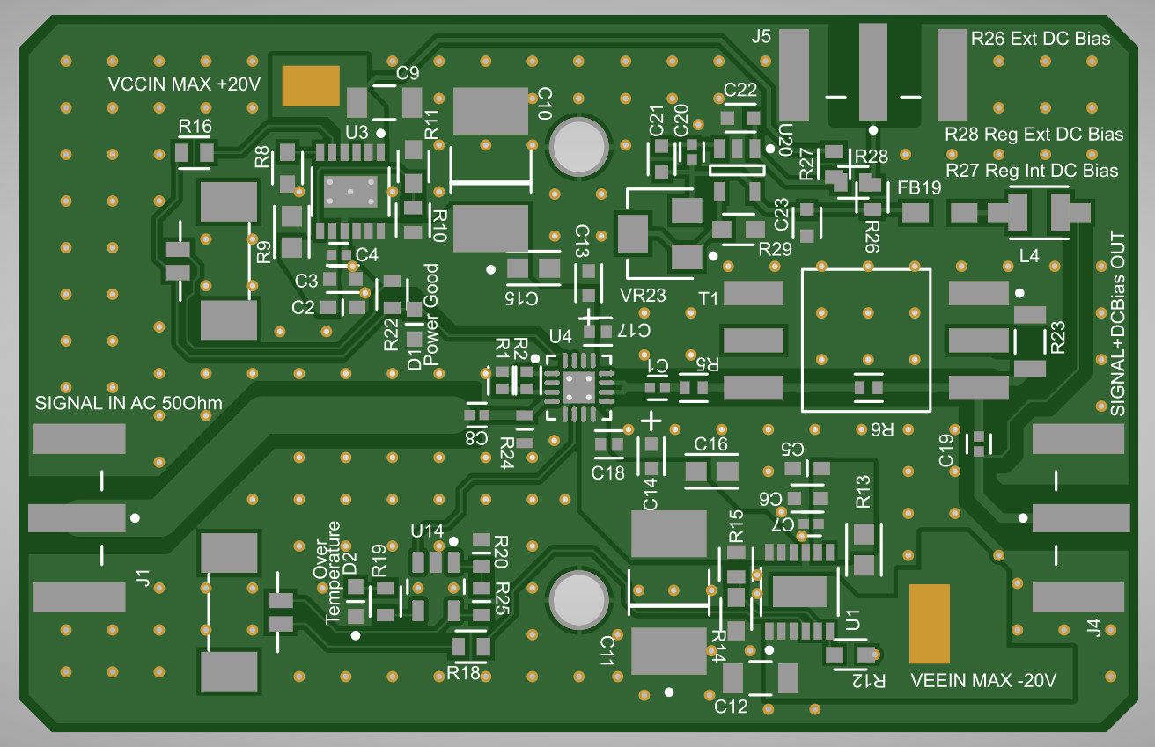
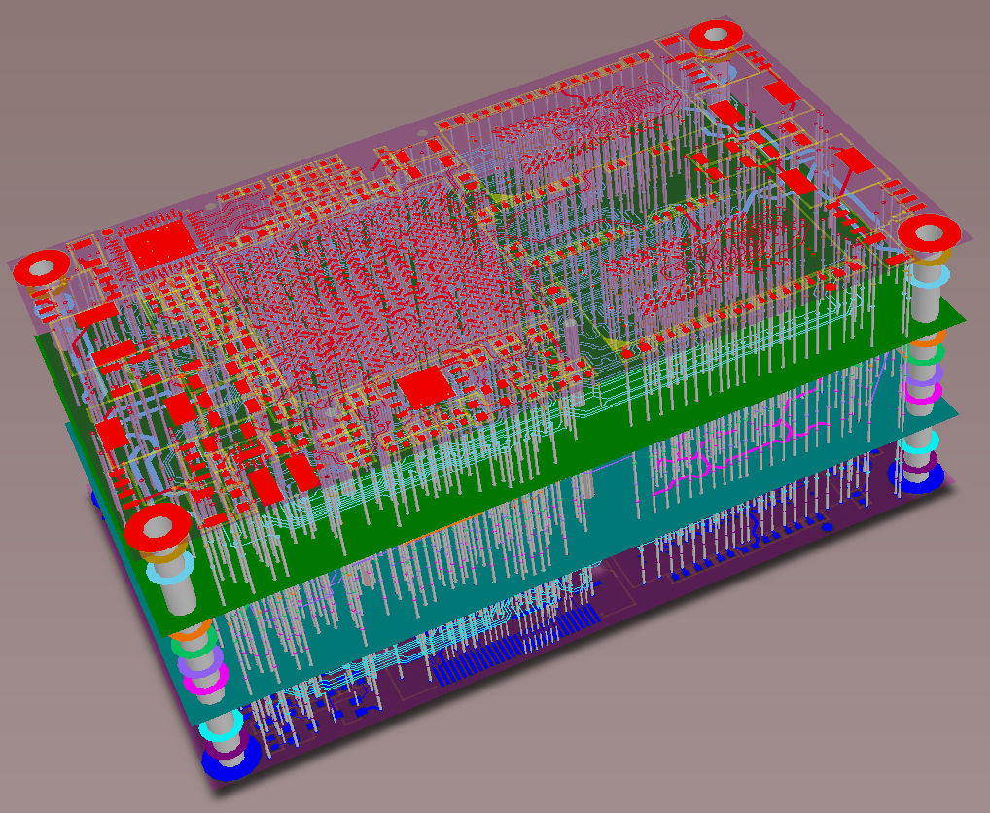
Circuit Design, Noise, Grounding
Workflow
  Layout -> GERBER, BOM, Assembly-files
Source: https://www.wellpcb.com/

Slide 6
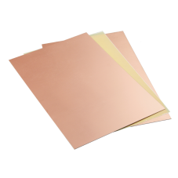
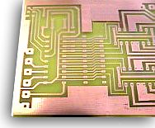
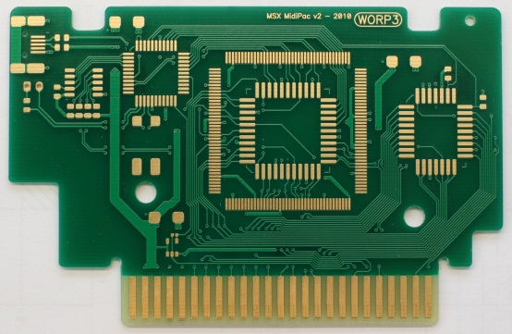
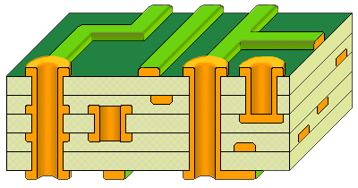
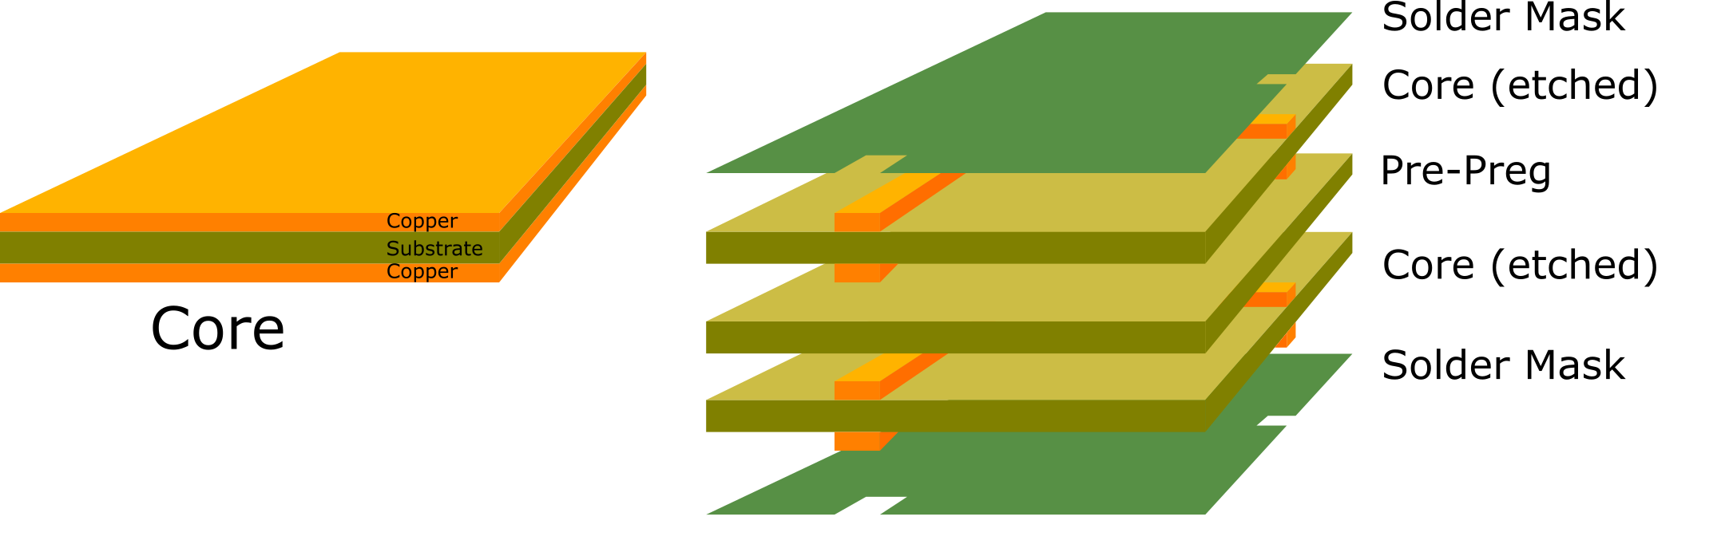
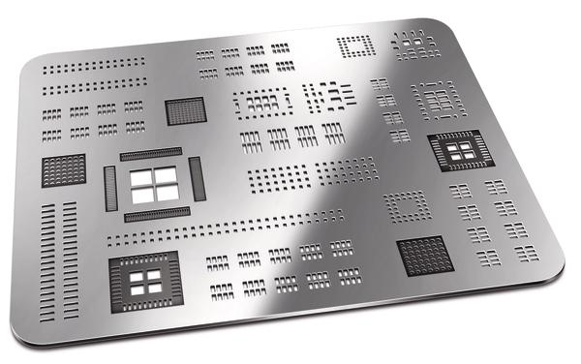
Circuit Design, Noise, Grounding
Workflow
  Manufacturing (fabrication, population, assembly)

Slide 7
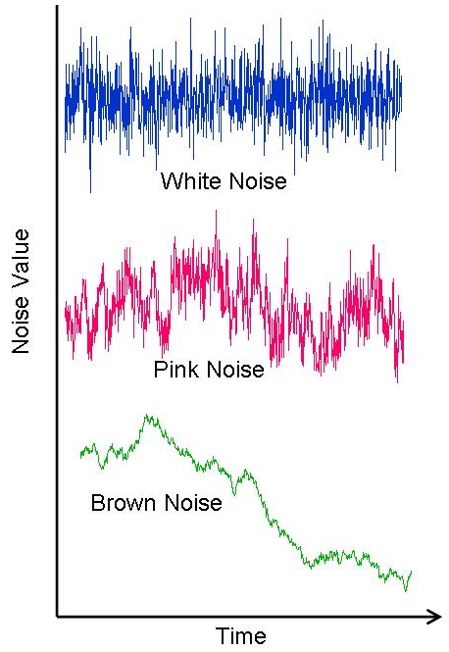
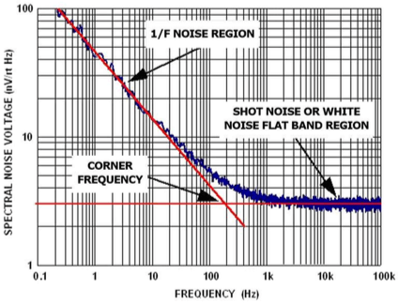
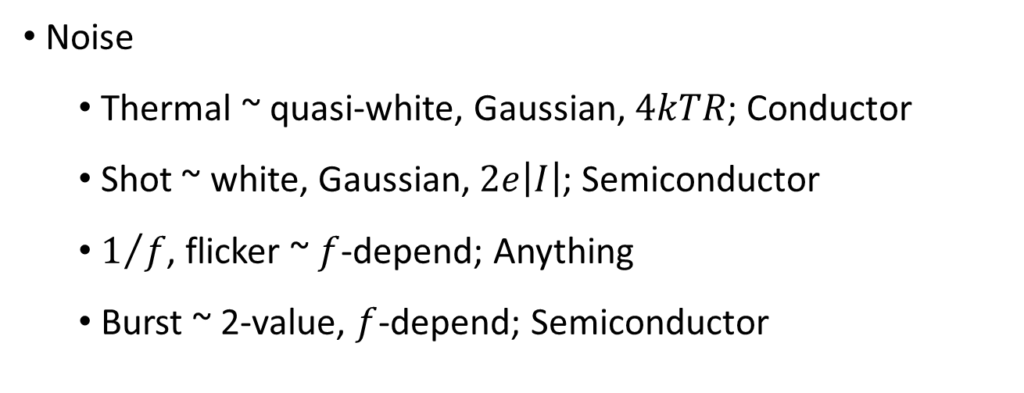
Circuit Design, Noise, Grounding
Noise
  Thermal ~ quasi-white, Gaussian, $4kTR$; Conductor
  Shot ~ white, Gaussian, $2e\left|I\right|$; Semiconductor
  $1/f$, flicker ~ $f$-depend; Anything
  Burst ~ 2-value, $f$-depend; Semiconductor

Slide 8
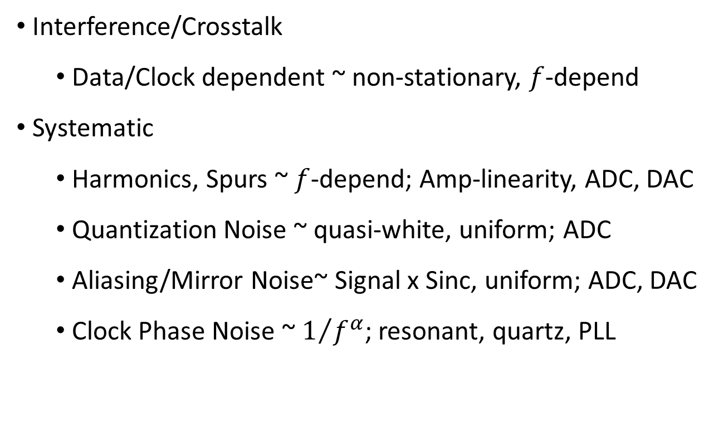
Circuit Design, Noise, Grounding
Interference/Crosstalk
  Data/Clock dependent ~ non-stationary, $f$-depend
Systematic
  Harmonics, Spurs ~ $f$-depend; Amp-linearity, ADC, DAC
  Quantization Noise ~ quasi-white, uniform; ADC
  Aliasing/Mirror Noise~ Signal x Sinc, uniform; ADC, DAC
  Clock Phase Noise ~ $1/{f^{α}}$; resonant, quartz, PLL

Slide 9
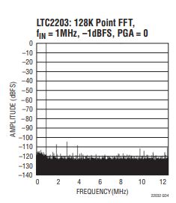
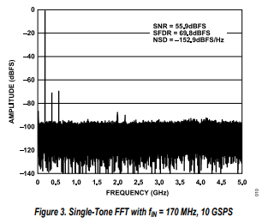
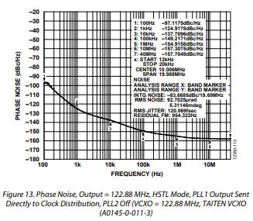
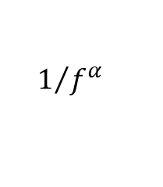
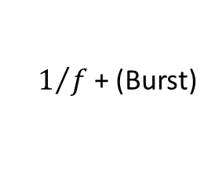
Circuit Design, Noise, Grounding
Harmonics
Spurs/Crosstalk
Thermal + Shot + Quantization
$$1/{f^{α}}$$
$1/f$+ (Burst)

Slide 10

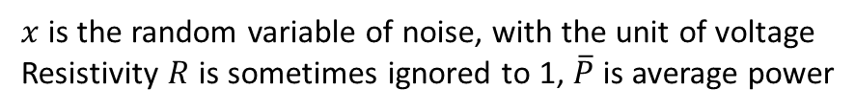
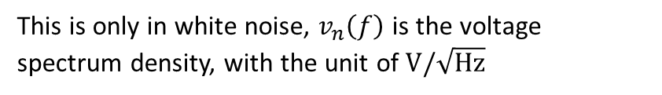
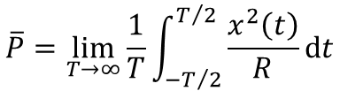
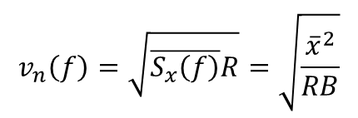
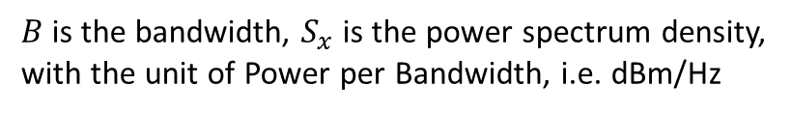

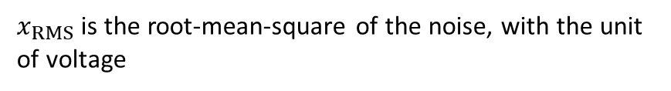
Circuit Design, Noise, Grounding
Noise
  Units PSD vs PSD
$$\overline{P}=\lim_{T→∞}{\frac{1}{T}\int_{−T/2}^{T/2}{\frac{x^{2}\left(t\right)}{R}dt}}$$
$x$ is the random variable of noise, with the unit of voltage
Resistivity $R$ is sometimes ignored to 1, $\overline{P}$ is average power
$$\overline{P}=\int_{0}^{B}{S_{x}\left(f\right)df}$$
$B$ is the bandwidth, $S_{x}$ is the power spectrum density,
with the unit of Power per Bandwidth, i.e. dBm/Hz
$$x_{RMS}=\sqrt{\overline{P}R}$$
$x_{RMS}$ is the root-mean-square of the noise, with the unit of voltage
$$v_{n}\left(f\right)=\sqrt{\overline{S_{x}\left(f\right)}R}=\sqrt{\frac{{\overline{x}}^{2}}{RB}}$$
This is only in white noise, $v_{n}\left(f\right)$ is the voltage spectrum density, with the unit of $V/\sqrt{Hz}$

Slide 11
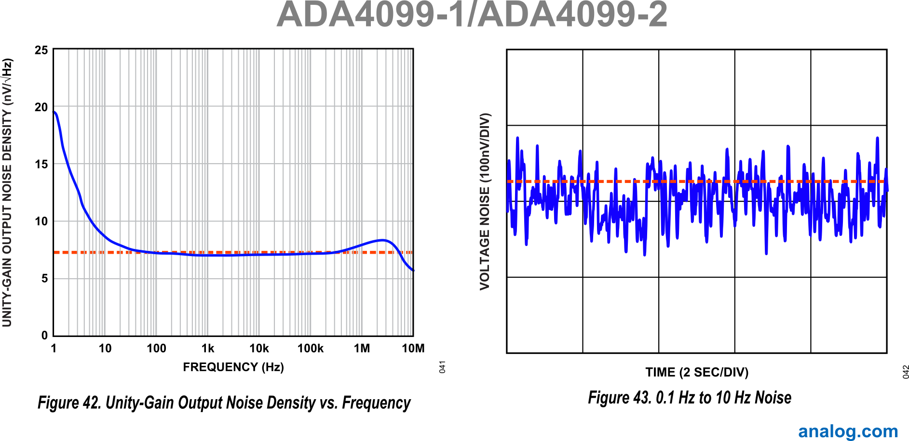
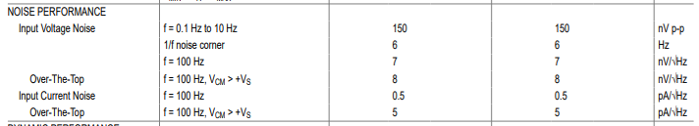


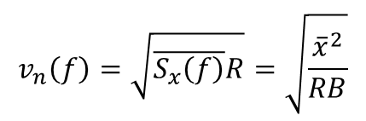


Circuit Design, Noise, Grounding
Noise
  Conversion
    0dBm = 0.632V_{PP} = 0.233 V_{RMS}
  Quantify and Comparison
$$x_{RMS}$$
$$v_{n}\left(f\right)$$
$v_{n}$ as a number gives floor
$x_{RMS}$ at low frequency tells flicker
$$x_{RMS}=\sqrt{\overline{P}R}$$
$$v_{n}\left(f\right)=\sqrt{\overline{S_{x}\left(f\right)}R}=\sqrt{\frac{{\overline{x}}^{2}}{RB}}$$

Slide 12
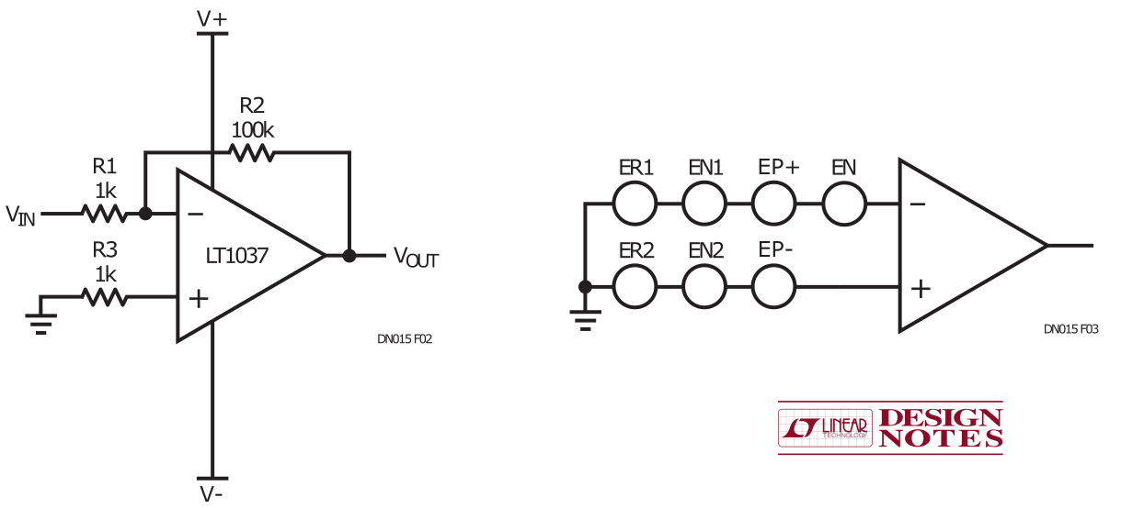
Circuit Design, Noise, Grounding
Noise
  Paths
    Signal Input
    Resistive Components
    Semiconductor Devices
    Non-Linear (not LTI)
    Power Supplies
    Indirect Coupling

Slide 13
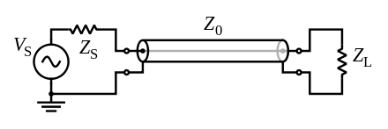
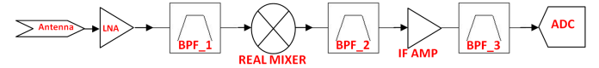
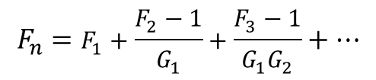
Circuit Design, Noise, Grounding
Noise
  Paths
    Signal Input
      Antenna, transducer -> matching network
      Previous Stage of Amps -> termination
Source: Texas Instruments
$$F_{n}=F_{1}+\frac{F_{2}−1}{G_{1}}+\frac{F_{3}−1}{G_{1}G_{2}}+…$$

Slide 14
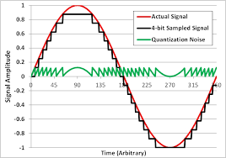
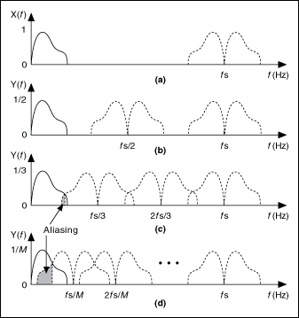
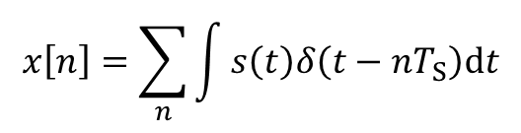
Circuit Design, Noise, Grounding
Noise
  Paths
    Signal Input
      ADC
        Quantization ENOB
        Aliasing
$$x\left[n\right]=\sum_{n}{\int{s\left(t\right)δ\left(t−nT_{S}\right)dt}}$$

Slide 15
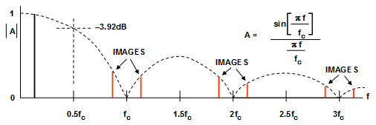
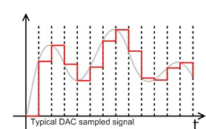
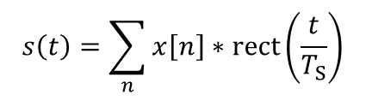
Circuit Design, Noise, Grounding
Noise
  Paths
    Signal Input
      DAC
        Quantization ENOB
        Mirror/Image
$$s\left(t\right)=\sum_{n}{x\left[n\right]∗rect\left(\frac{t}{T_{S}}\right)}$$

Slide 16
Circuit Design, Noise, Grounding
Noise
  Paths
    Resistive Components
    Semiconductor Devices

Slide 17
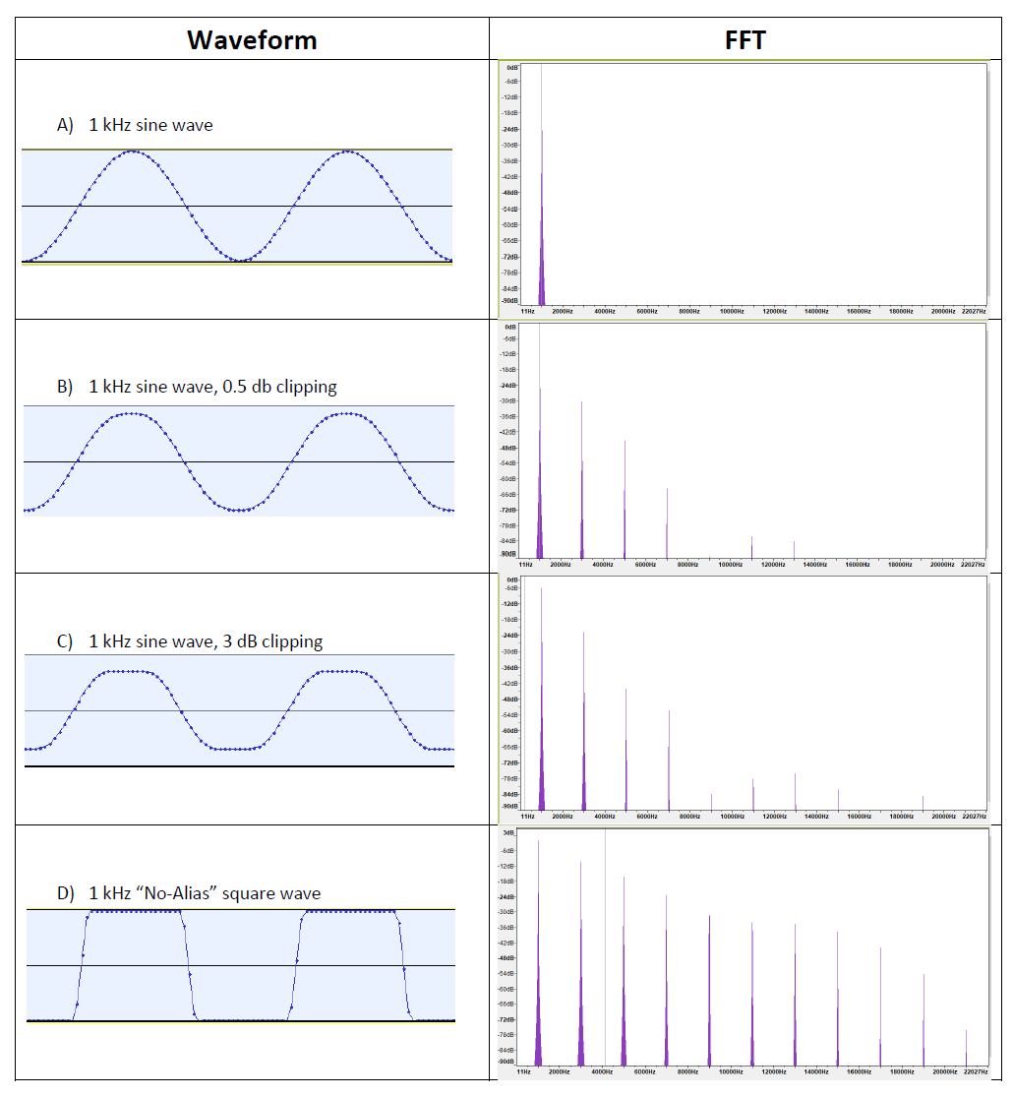
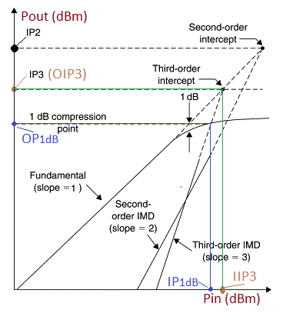
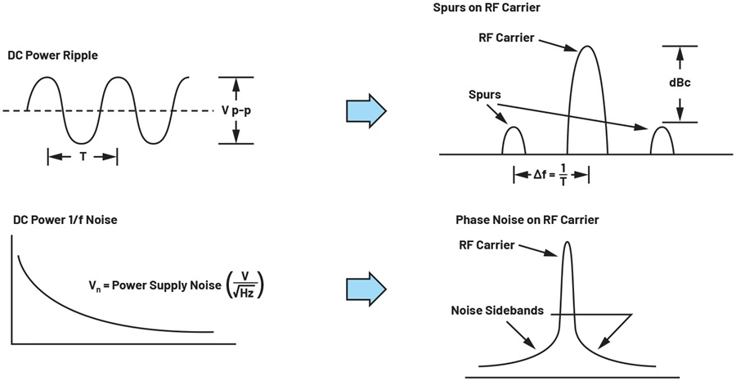
Circuit Design, Noise, Grounding
Noise
  Paths
    Non-Linear (not LTI)

Slide 18

Circuit Design, Noise, Grounding
Noise
  Paths
    Power Supplies
    Indirect Coupling
    Power integrity

Slide 19



Circuit Design, Noise, Grounding
Noise
  Paths
    Power Supplies
    Indirect Coupling

Slide 20

Circuit Design, Noise, Grounding
Grounding
weida.zhang@physics.ox.ac.uk

Slide 21













Circuit Design, Amplifier, Clock
Transmission Line Theory

Slide 22

Circuit Design, Amplifier, Clock
Signal Integrity
  Designing and Maintaining Trace Structure
  Termination
Source: Keysight

Slide 23



Circuit Design, Amplifier, Clock
Scattering Parameter (S-Parameter)

Slide 24




Circuit Design, Amplifier, Clock
Scattering Parameter (S-Parameter)

Slide 25




Circuit Design, Amplifier, Clock
Matching Network
$$S_{22}$$
$$S_{11}$$
Source: SiLabs

Slide 26

Circuit Design, Amplifier, Clock
Simulation of Amplifier Design
S12
S12

Slide 27


Circuit Design, Amplifier, Clock
Clock Jitter/Phase noise in Digital System/Comms

Slide 28

Circuit Design, Amplifier, Clock
Clock Jitter/Phase noise in DAQ

Slide 29


Circuit Design, Amplifier, Clock
Clock Jitter/Phase noise
Source: NIST

Slide 30


Circuit Design, Amplifier, Clock
Phase Locked Loop

Slide 31







Circuit Design, Amplifier, Clock
How to read datasheet
weida.zhang@physics.ox.ac.uk

Slide 32


Simulation - LTspice
Schematic Level
Layout Level
Structural model – SPICE
Behavioral model – IBIS
Scattering model – S-parameter

Slide 33




Simulation - LTspice
ADS by Keysight
Electronics Desktop by Ansys
LTspice by Analog Devices
Qucs (under GPL license)

Slide 34




Simulation - LTspice
Transient
AC
DC Sweep
Noise

Slide 35

Simulation - LTspice
Layout Level - SIwave

Slide 36

Simulation - LTspice
Transient
AC
Noise
Simulation – Qucs – Match Circuit

