Slide 1
B163 facility upgrade
Fabrication Qualification and R&D on Superconducting Cables
Protection jumper FRESCA 2
Smarteam reference: ST1701342_01
N.Joannon_20230406_edms #1797908

Slide 2
General view
Fresca 1
Frame +
Cu block
Fresca 2
Protection jumper
Satellite valvebox Fresca 2
Digital mock-up state on 06/04/2023

Slide 3
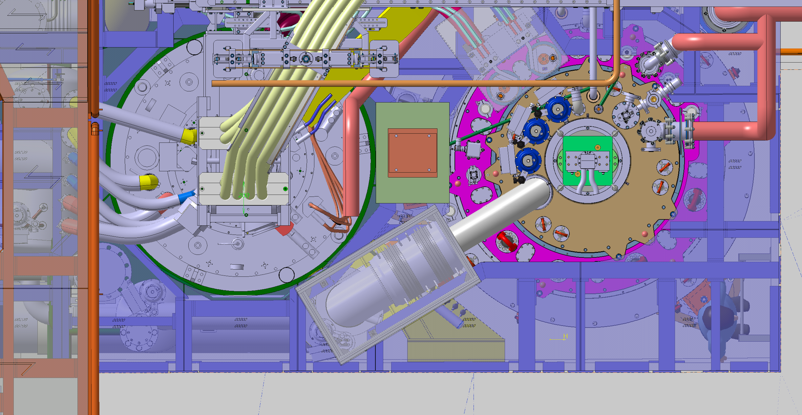
Top view
Fresca 1
Frame +
Cu block
Fresca 2
(255)
(295)
Protection jumper
Satellite valvebox Fresca 2
(230)
Digital mock-up state on 06/04/2023

Slide 4
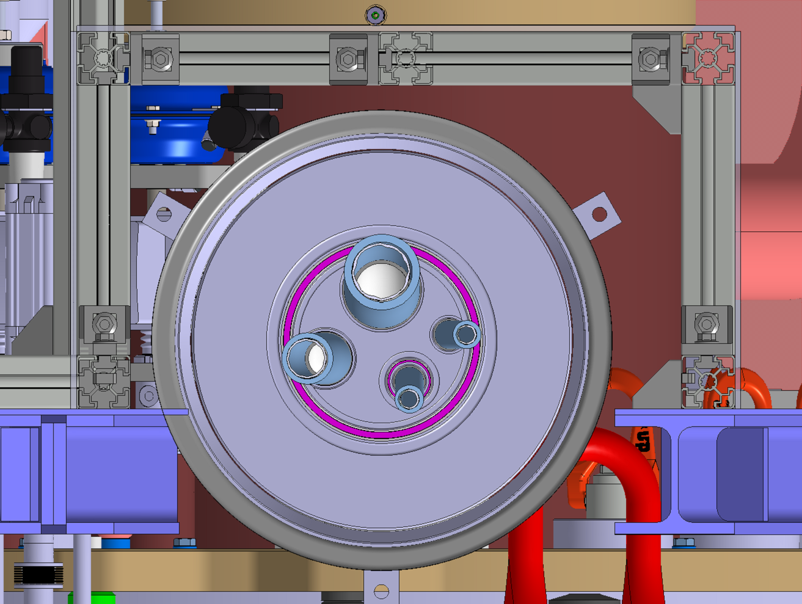
Section A-A
A
(65.5)
(20.5)
A
Digital mock-up state on 06/04/2023

Slide 5
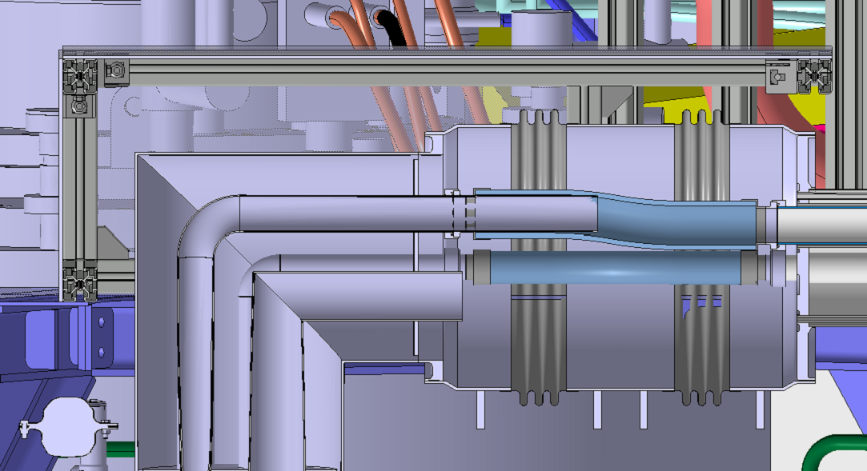
Section B-B
B
B
(48.5)
Digital mock-up state on 06/04/2023

Slide 6
Squares Bosch profile 45
Profiles Bosch 45x45
700
320
1000
550
Smarteam reference: ST1701342_01
Chequered sheets anticorodal
SCEM: 44.02.25.057.3
Digital mock-up state on 06/04/2023

