Slide 2
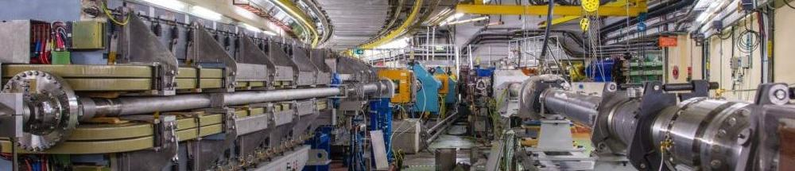
Automated scheduling optimisation
Development status of the “Supercycle Optimiser” program
Sandy Easton (BE-OP-PS)

Slide 3
Acknowledgements
Sandy Easton (BE-OP-PS)

Slide 4
Special thanks to
Hannes Pahl (BE-OP-PS)
  Made the whole program apart from the computation backend
    PyQt UI for inputting scheduling requests
    Interfaced program to Timing Server using LIC API (from BE-CSS)
    Launching the Java algorithm and displaying the results
  Excellent help and support
Sandy Easton (BE-OP-PS)

Slide 5
And also thanks to
Tibor Bukovics (BE-OP-PSB) & Andrea Callia (BE-OP-LHC)
  Software engineering support
Jean-Charles Tournier (ICS) & Bertrand Lefort (BE-OP-AD)
  Useful algorithm-whiteboard sessions
George Melvin & Alex Paulin (UC Berkeley), Spencer Gessner (SLAC) & Solve Slettebak (ESS)
  Theoretical discussions and encouragement
Alex Scheinker (LANL), Andrew Wooff (Napier), & Mike McKerns (Caltech/LANL)
  Broader scope of algorithms, and uniqueness of new functionality
Nico Madysa, Greg Kruk, Verena Kain, Zsolt Kovari & Andrejz Dvorak (BE-CSS)
  Programming assistance and raising project visibility
Sandy Easton (BE-OP-PS)

Slide 6
And also thanks to
Bettina Mikulecs (BE-OP-PS) & Frank Tecker (CAS)
  Long suffering supervisors ☺
Eva Maria Gonzalez Garcia (BE-OP-PS)
  Technical student assisting project 2020-2021
Prof. Andrew Ranicki (1948-2018) (Edinburgh)
  Former advisor and supervisor
and too many operators to mention!
Sandy Easton (BE-OP-PS)

Slide 7
Sandy Easton (BE-OP-PS)

Slide 8
Overview
Sandy Easton (BE-OP-PS)

Slide 9
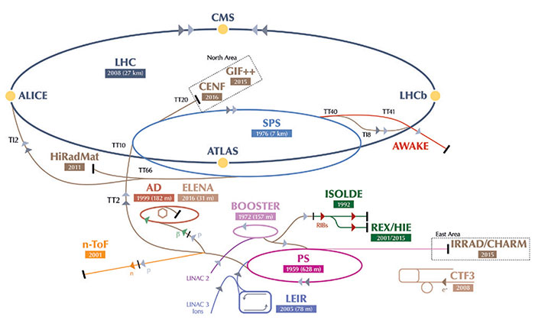
Scheduling beams
CERN’s accelerators are a chain
  Beams come from only two sources
Trafficing beams inefficiently wastes experiment-time
  Geneva traffic vs. Geneva airport….
  Scheduling bottlenecks -> Fewer beams/minute
  Not an insignifcant loss
The schedule is adjusted during real-time operations
  Every time an experiment’s requirement changes
  20 – 80 times per day
At any given time, this scheduling task is handled by the accelerator operators in the CCC
  Knowledge of which beams are to be taken
  Knowledge of all scheduling constraints
    How many to whom?
    User requirements, hardware constraints, etc.
  Knowledge of which users are given highest priorities
The operators agree upon a new schedule at every change
  A.k.a. “change the * Supercycle”
This schedule is used until the next change in a user requirement
* “Supercycle” = the schedule of beams to be created by the accelerator chain
Sandy Easton (BE-OP-PS)

Slide 10
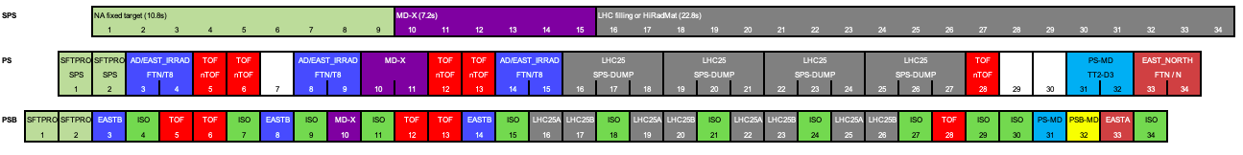
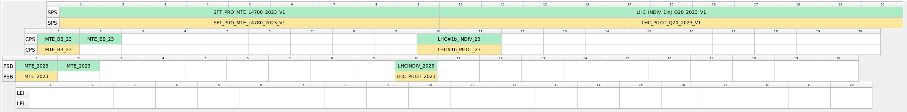
The Supercycle
Observe
  Green beams only using the booster (PSB user)
  Red blue and brown beams to PS users
    Pass through PSB & PS
  Teal, Purple and Grey to SPS users
    PSB, PS & SPS
  And this still omits the LEIR…!
  Behold, a real supercycle from the Timing App Suite (existing Supercycle edition software)
Sandy Easton (BE-OP-PS)

Slide 11
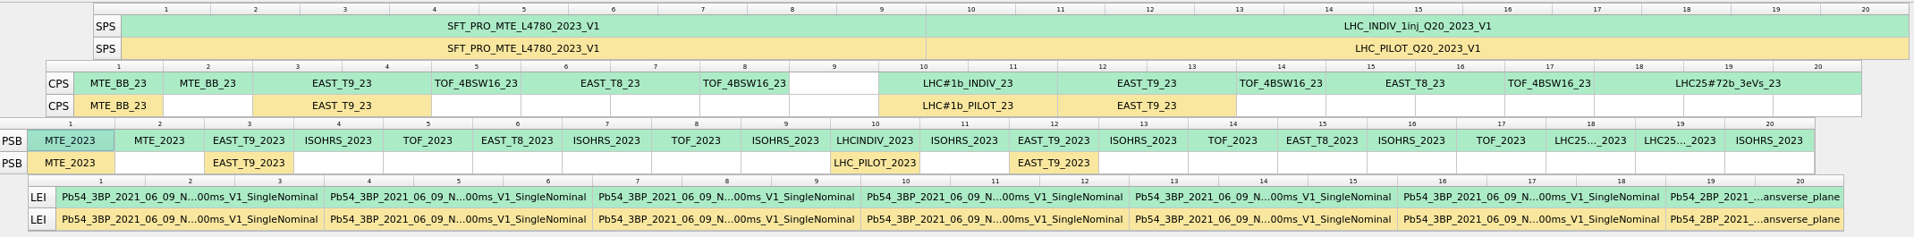
The Supercycle
Indeed, this is the skeleton when making a supercycle
  The beams to the SPS users
CPS beams are then placed in the available white space
  ISOLDE, EAST, AD, TOF
  MD users
  Beams under adjustment
The individual beams are hard to make outthere, don’t worry it’s just
Sandy Easton (BE-OP-PS)

Slide 12
Changing the supercycle
This schedule creation is performed manually by the CPS operators
  It takes 1-5 minutes to edit a sequence, depending on complexity
  All operators should verify it
  20-80 times per day
Which users in each accelerator?
Positioning constraints?
Who has priority
for free space?
Hardware constraints?
How many should there be of each user?
Repetition
rates?
Sandy Easton (BE-OP-PS)

Slide 13
Scheduling
Typically supercycles range from 20-40 blocks* long
  Occasionally higher
  As high as 80 BPs!
The supercycle is “cyclic”
  It repeats cyclically until changed
  This is surprisingly tricky for algorithms to deal with…!
Beams can each take up between 1-3 blocks in the CPS accelerators
  Beams can fit under each other
  Parallel scheduling
      Baby Terrapin
      Similarities to other scheduling problems (KT plug)
Beams can need to be regularly spaced etc. (a.k.a. “Constraints”)
This presents a sizable scheduling challenge!
* The supercycle is quantised into blocks of 1.2 seconds, a.k.a. “basic periods” or BPs
Sandy Easton (BE-OP-PS)

Slide 14
Why is automation necessary
  This task takes up considerable operator time
    CPS operators put most time into this task
    Considerable distraction for administrative task
  Estimated 30 minutes to 3 hours cumulative operator time per day
    Requires communal input from operators of all accelerators
  Existing system is effective for manual scheduling like this
    Manually edit schedules and send it to Timing hardware
    ”Locking” system to prevent concurrency mistakes
    Requires plenty communication and good timing
  However, manual scheduling itself is
    Laborious
    At least occasionally sub-optimal
    Open to some errors
Sandy Easton (BE-OP-PS)

Slide 15
Why is optimisation important?
  Example
    Suppose it is found that a rearrangement of the Supercycle can allow an extra instance to a user
    This user had two instances, but now gets three
    50% increase in rate of data taking for that user
  Example
    Consider a Supercycle of length 25 BP
    It is found to be suboptimal by a single BP in one accelerator going unnecessarily unused
    Akin to a 4% loss in that accelerator’s uptime
      AFT….? ☺
    2% for a 50 BP supercycle
  Small scheduling inefficiencies are a serious bottleneck for operations
    Small oversights can cost a lot
Sandy Easton (BE-OP-PS)

Slide 16
Schedule boundaries
  Suppose the SPS changes its skeleton request from
  To
  The PS, booster and LEIR operators must all now fill this space
    … in ”the same way” they did before
    obey all their previous constraints and requests
  This task must be performed whenever any operator has to change their request
Sandy Easton (BE-OP-PS)

Slide 17
Project aims
  Automate the task of building supercycles
  Explore and implement constraint-solving and optimisation algorithm
    Crux of the project!
  Proof of concept for automation principle
    Reduce scheduling requirements to UI input
    Deliver maximally-efficient scheduling for near real-time use
      Should be faster than a human as a general rule
  Produce tool for operational use in CCC
    Interface optimiser to existing Supercycle editor software
    Timing App Suite used for all viewing and driving tasks
Sandy Easton (BE-OP-PS)
Notes:
PS operator
BSc (Hons) Mathematics
Algorithm work as undergraduate and in previous employment

Slide 18
Sandy Easton (BE-OP-PS)

Slide 19
Inputting a scheduling request
Sandy Easton (BE-OP-PS)

Slide 20
Inputting a scheduling request
  SPS defines the “skeleton” supercycle
    Usual method: Timing App Suite
    All BCDs are available to be read
    Demonstration of input and output BCDs for optimiser, in TAS & OptimiserUI
    Have prepared 3 inputs for us to use
Sandy Easton (BE-OP-PS)

Slide 21
N.B. keeping track of beams
  Beams are named by concatenating the names of their constituent LSA cycles
  Horible example
  This is unwieldy, so here we make use of beam aliases
  Picture of beam aliases
Sandy Easton (BE-OP-PS)

Slide 22

  Demonstration of
  Importing an SPS fixed sequence
  A simple request
    Using beam aliases*
Sandy Easton (BE-OP-PS)
Notes:
“Simple request” with O_1_SPS_short and long
Program is running on VM here.
PyQT UI java backend
Stops at point of calling API with output

Slide 23
What are we looking for?
  We are looking for a Supercycle that is
    Optimal
      Produce as many usable beams per minute as possible from the complex
    Valid
      All constraints for all beams must be satisfied
Sandy Easton (BE-OP-PS)

Slide 24
Optimality with prioritising
  If any extra space is available in the Supercycle, it is allocated to users according to their priority.
  Every user has a minimum required precence in the Supercycle
  Allocations above this need to be ranked for the optimiser to have an objective function
    This makes an interesting discretised objective function to be dealt with….
  It’s not pretty but it works…
    Thanks be to Hannes!
Sandy Easton (BE-OP-PS)

Slide 25
  Demonstration of
  Using the priority list
  Changing SPS sequence transparently
Sandy Easton (BE-OP-PS)
Notes:
Priority 1 is broken
Priority 2- give as many as possible to HRS
Priority 3 – more to the Foetini and HRS

Slide 26
User Allocations
Sandy Easton (BE-OP-PS)

Slide 27
  Demonstration of
  Maximum allocation
  Minimum allocation
    Types of occurrences calculation
Sandy Easton (BE-OP-PS)
Notes:
3_MaxSpacings1 (error)

Slide 28
Types of occurences definition
  Existing
    Fixed
      MDs
    x per y BPs
      Constant-rate experiments
      TOF, EAST, ISOLDE
    Percentage
      ISOLDE 37-40%
  Potential
    “Equally spaced”
    From user sources
      ISOLDE current & current-per-shot
      TOF radiation monitors
Sandy Easton (BE-OP-PS)

Slide 29
Output
  If a solution is possible, output is a Supercycle that could be sent to the timing system
    With the allocation/runtime and the sequence
  Picutre
  If a solution is not possible, output describes why
    Constraints
    Request unsaisfiable
Sandy Easton (BE-OP-PS)

Slide 30
  Demonstration of failures
  Constraints Unsatisfiable
  Allocations too high
  Max and min auto adjust
  No LEIRs
  Guidance on why requests were not possible
Sandy Easton (BE-OP-PS)
Notes:
If a solution is not possible, output describes why
Constraints
Request unsaisfiable

Slide 31
Positioning constraints
Sandy Easton (BE-OP-PS)

Slide 32
  Demonstrations
  Min
    Cyclicity
  Max
    Max spacings buggy in hangover… (Implementation error)
Sandy Easton (BE-OP-PS)
Notes:
Runs slowest on
Heavily constrained with fewer non constrained beams (power of forms & high search requirements)
Max spacings (implementation failing, poor CC

Slide 33
Always Follow
  It is regularly requested that one beam directly follow a particular other
    Typically for a constant hysteresis
  The optimiser must thus allow this to be requested
Sandy Easton (BE-OP-PS)
Notes:
Demo takes about 25s

Slide 34
  Demonstrations
  Always follows
Sandy Easton (BE-OP-PS)
Notes:
Implementation limitations
Can’t put spacings on both beams
Can’t request multiple beams to follow just now
Bigger compounded not implemented – initialization is a nightmare

Slide 35
Block placements
  Some experiments (typically @ ISOLDE) ask for their shots to be grouped together
  For example
  In groups of 2
  In groups of 2,3 or 4
  In groups of 8!
  The optimiser must all thus be able to handle these kinds of requests
Sandy Easton (BE-OP-PS)

Slide 36
  Demonstration
  Block placements
  Blocks with spacings
Sandy Easton (BE-OP-PS)
Notes:
Block
Isolde 2
ISOLDE 3-4, self-spacing 5 + other beams
With min of 9, max 16,SC 20 & with extras at start of priority list – will reach 12 easily with 4s
With min of 9 & and extras nway down the priority list, so only 3x3 is best/no 4s– will use smaller groupings if necessary
ISOLDE 8

Slide 37
Spares
  Three use-cases pinpointed:
    AD/East scenario
    Comparison
      Two beams to be alternated between using the Request
      MD users
    Parasitic
      Desperately hoping for an external condition…!
  Comparison type implemented
  AD/EAST with partial functionality
  Parasitic not implemented at all (minor)
Sandy Easton (BE-OP-PS)

Slide 38
  Demonstration
  Beams in spare
  Combination demos
Sandy Easton (BE-OP-PS)

Slide 39
Planned but not yet implemented
  POPS RMS constraints
    Limit what can be requested to not overload POPS
    Requires numerical parameter
  AD wait-time optimiser
    Figured-out but not implemented
  Occurrences calculation from external sources (ISOLDE, TOF)
  Decoupled LEIR
  Adding duplicate beams to dump
  User preferences
  Speed boosts
Sandy Easton (BE-OP-PS)

Slide 40
  Demonstration
  General demo
Sandy Easton (BE-OP-PS)

Slide 41
Algorithm & Implementation
Sandy Easton (BE-OP-PS)

Slide 42
What is the algorithm doing?
  The algorithm (Terrapin) is basically a sequence of two algorithms:
    First one (WGP) deals with positioning constraints
      Creates a 3-D network containing all possible valid supercycles
    Second one (Kiwanda) finds a supercycle with the best allocation to users
      Finds a suitably “long” path in the 3-D network
  Terrapin optimises by gradually increasing the requested allocation
    According to the priority list
    Can be seen in the terminal output
Sandy Easton (BE-OP-PS)

Slide 43
Satisfying constraints
  There are numerous constraint-solvers available. In OP, we already use
    a heuristic-repair algorithm for some constrained scheduling
      Scheduling LHC hardware tests
    CSP algorithms
  Here we must not just find a valid sequence
    We need enough knowledge of the valid sequences to find our preferred one
  Most constraint-solving algorithms focus on if the constraints are solvable
  Unsuitable for mapping paths for optimisation
  WGP uses a “correct-by-construction” approach to map the space of supercycles
    Directly builds all possible extensions, no need to check for violations.
    Efficient construction and storage of entire schedule-space
Sandy Easton (BE-OP-PS)

Slide 44
Runtime
  Development: Functionality vs runtime
  The slowest part of the algorithm is the path-tracing part
  Astronomically large possibilities
    Current runtime
    Where can it be sped up?
      2-3 orders of magnitude easily
      4-6 orders reasonably easily
      More on complex problems
  Is quite involved work. Decision to be made
Sandy Easton (BE-OP-PS)

Slide 45
Next steps
Sandy Easton (BE-OP-PS)

Slide 46
Development and deployment
  Broader plans from within BE
    There is an perational need for this tool
    Is On-the-fly possible
  On the fly is actually easy
    Should decide which route to take
Sandy Easton (BE-OP-PS)

Slide 47
Documentation
  Algorithm
    Document for publication
  Implementation
    Handover?
    Other uses
Sandy Easton (BE-OP-PS)

Slide 48
Questions
Image credit to @CaroCalendula
Sandy Easton (BE-OP-PS)

