Slide 1
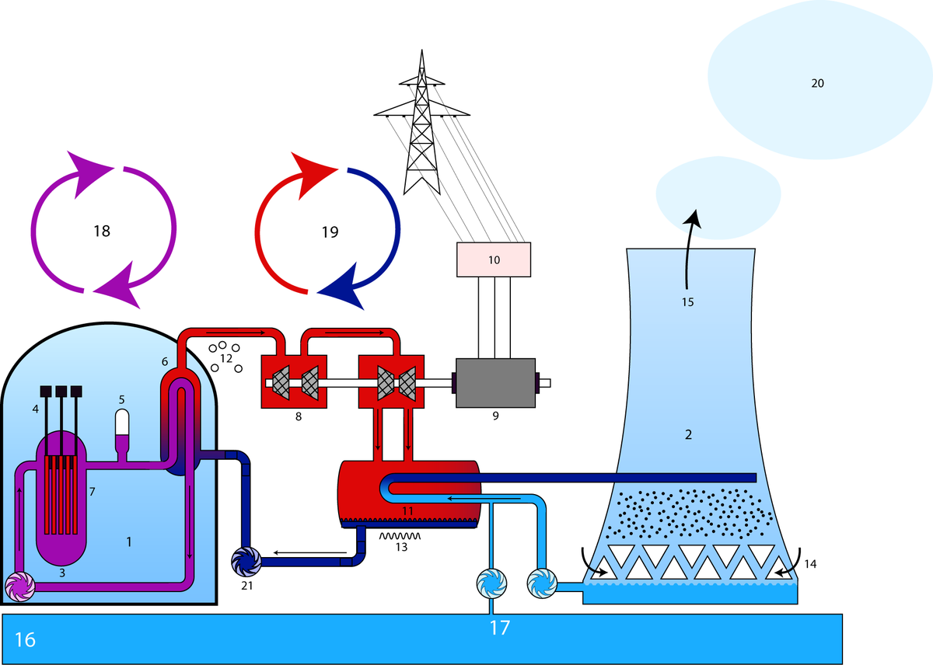
Quick Introduction to Nuclear Physics and Engineering
by two nuclear enthusiasts ☺:
E. de la Fuente, D. Amorim
Big thanks to: G. Jiménez and S. Larriba from Universidad Politécnica de Madrid (UPM)
Reactor Block
Cooling Tower
Reactor
Control Rod
Support For Pressure
Steam Generator
Fuel Element
Turbine
Generator
Transformer
Condenser
Gaseous
Liquid
Air
Air (Humid)
River
Cooling-water Circulation
Primary Circuit
Secondary Circuit
Water Vapor
Pump

Slide 2
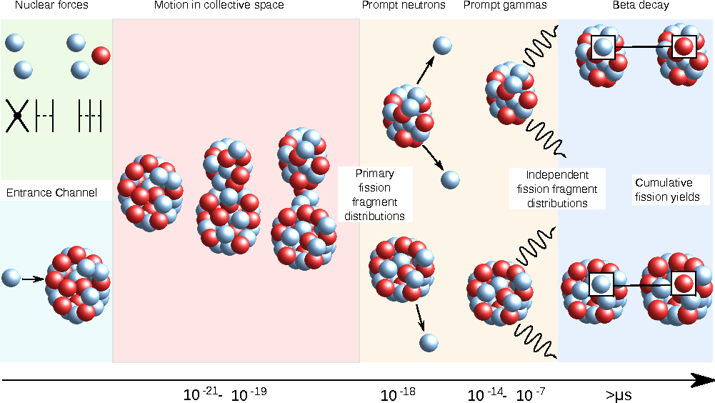
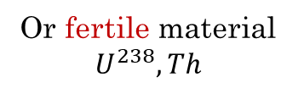
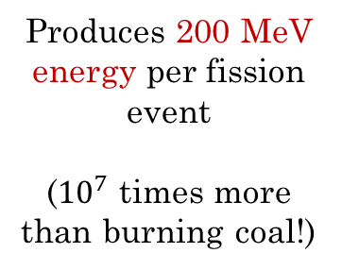
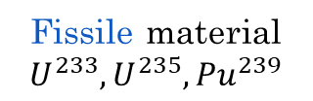
What is nuclear fission?
Discovered in 1938 by Otto Hahn and Lise Meitner
Produces 200 MeV energy per fission event
(${10}^{7}$ times more than burning coal!)
neutron
Fissile material $U^{233},U^{235},{Pu}^{239}$
Or fertile material $U^{238}, Th$

Slide 3
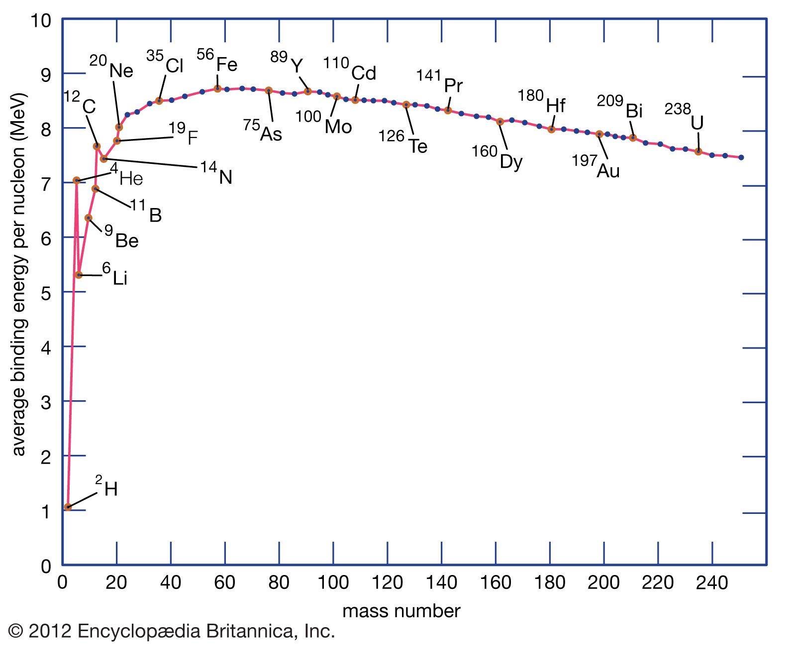
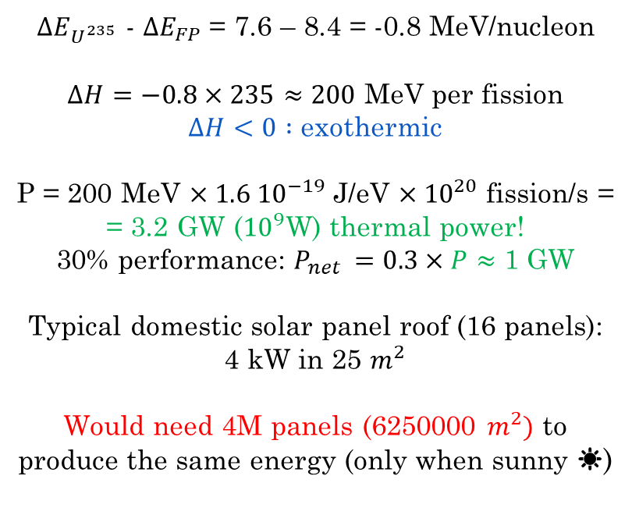
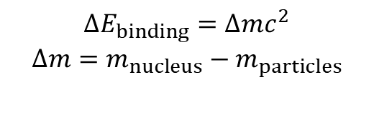
What is nuclear fission?
$ΔE_{U^{235}}$ - $ΔE_{FP}$ = 7.6 – 8.4 = -0.8 MeV/nucleon
$ΔH=−0.8×235≈200$ MeV per fission
$ΔH<0 :$ exothermic
P = 200 MeV $×1.6 {10}^{−19}$ J/eV $×{10}^{20}$ fission/s =
= 3.2 GW (${10}^{9}$W) thermal power!
30% performance: $P_{net }=0.3×P≈$ 1 GW
Typical domestic solar panel roof (16 panels):
4 kW in 25 $m^{2}$
Would need 4M panels (6250000 $m^{2})$ to produce the same energy (only when sunny ☀)
$$ΔE_{binding}=Δmc^{2}$$
$$Δm=m_{nucleus}−m_{particles}$$

Slide 4
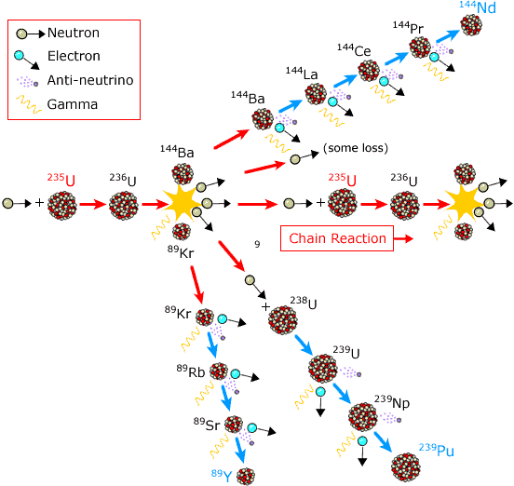
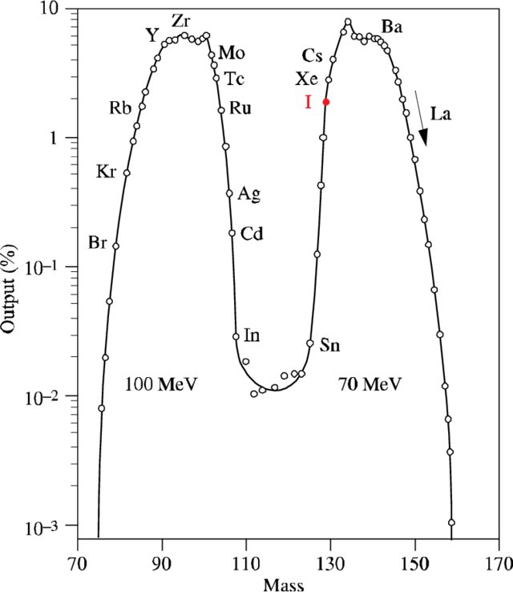
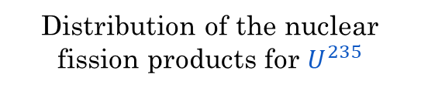
What is nuclear fission?
Distribution of the nuclear fission products for $U^{235}$
Nuclear fission chains of fission products
Each arrow has a certain probability (<1.0) of happening:
Cross section Radioactive decay

Slide 5
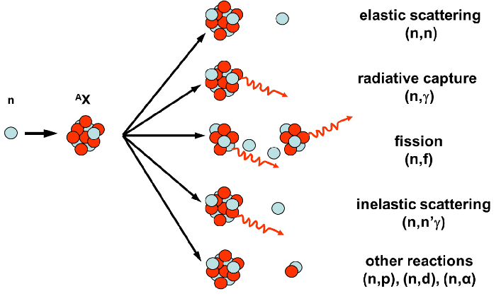
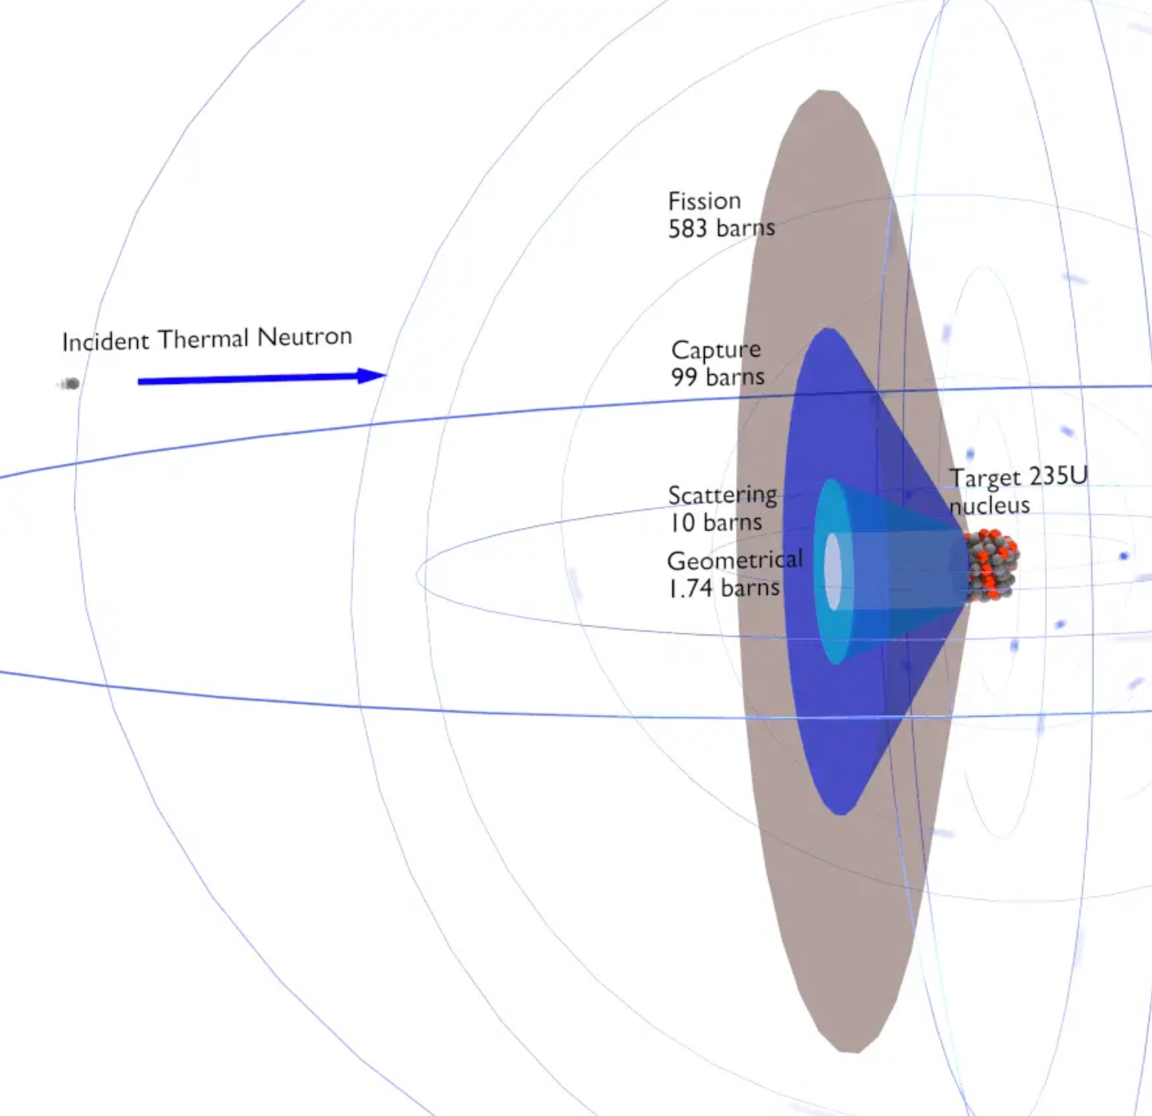
How to achieve nuclear fission?
The probability of each reaction is defined by the cross section of the nuclei, that depends on the energy of the colliding neutron
Fission is not the only nuclear reaction that can occur when a neutron interacts with the nuclei
If we want a sustained fission chain reaction, we need to maximize fission and minimize capture
Illustration of the cross section concept**

Slide 6
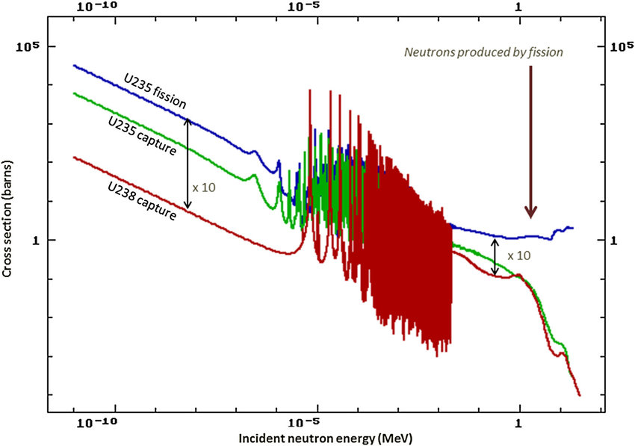





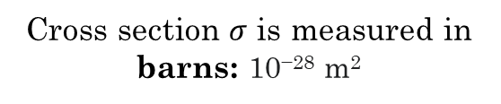
How to achieve nuclear fission?
Fission and capture cross section of nuclear fuel
Cross section $σ$ is measured in barns: 10⁻²⁸ m²
Only $U^{235}$ is fissile
$σ_{fission}>σ_{capture}$
Neutron flux ($n/m^{2})$
1 MeV
1 eV
thermalize
Neutrons are born from fission around 1MeV. To achieve a sustained fission chain, we need to thermalize the neutron flux
Energy (MeV)

Slide 7
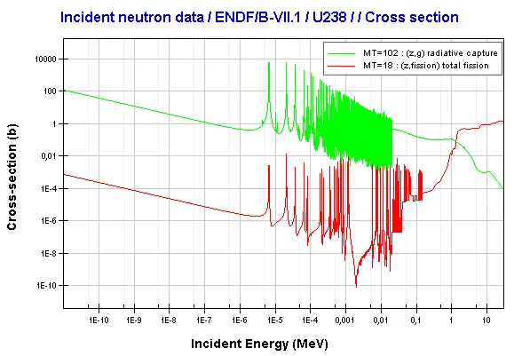

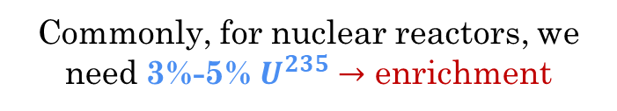
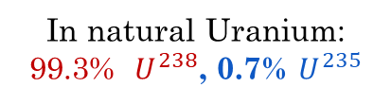
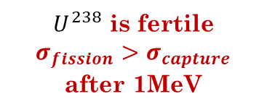
How to achieve nuclear fission?
$U^{238}$ is fertile
$σ_{fission}>σ_{capture}$ after 1MeV
Fission and capture cross section of U238
In natural Uranium: 99.3% $U^{238}$, 0.7% $U^{235}$
Commonly, for nuclear reactors, we need 3%-5% $U^{235}→$ enrichment
Neutron flux ($n/m^{2})$
1 MeV
1 eV
Energy (MeV)

Slide 8
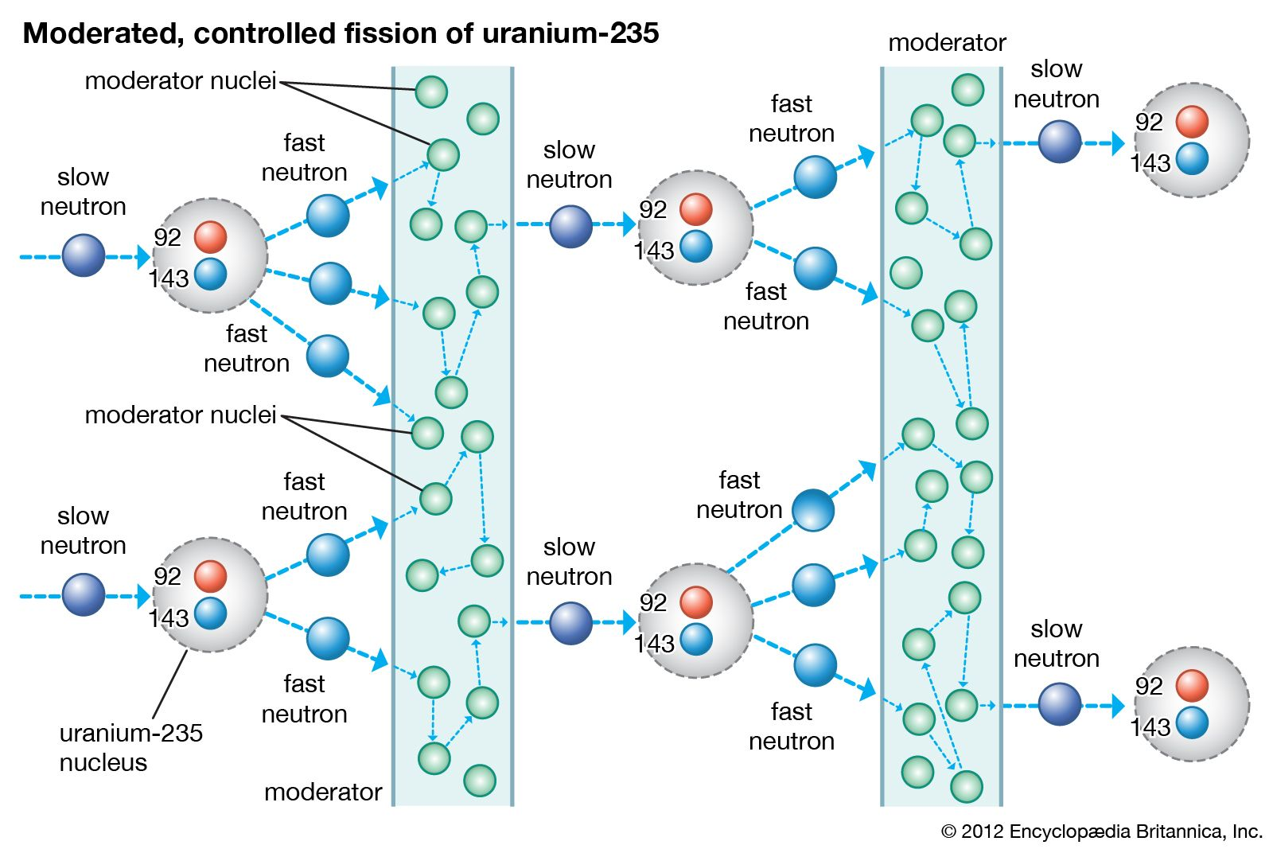
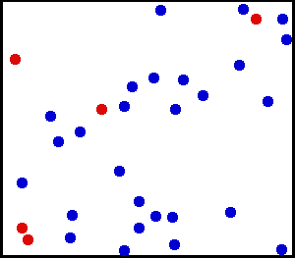


How to achieve nuclear fission?
To thermalize the neutron flux, we need to use a moderator. Neutrons will lose their energy through scattering: elastic collisions
Moderator Type | Neutron scattering cross section (σ_{s}) in barns | Neutron absorption cross section (σ_{s}) in barns
Light water (H₂O) | 49 | 0.66
Heavy water (D₂O) | 10.6 | 0.0013
Graphite (C) | 4.7 | 0.0035
$↑$ high scattering
$↓$ low capture
Notes:
Add nº collision water 27, graphite 112, heavy water is 35

Slide 9
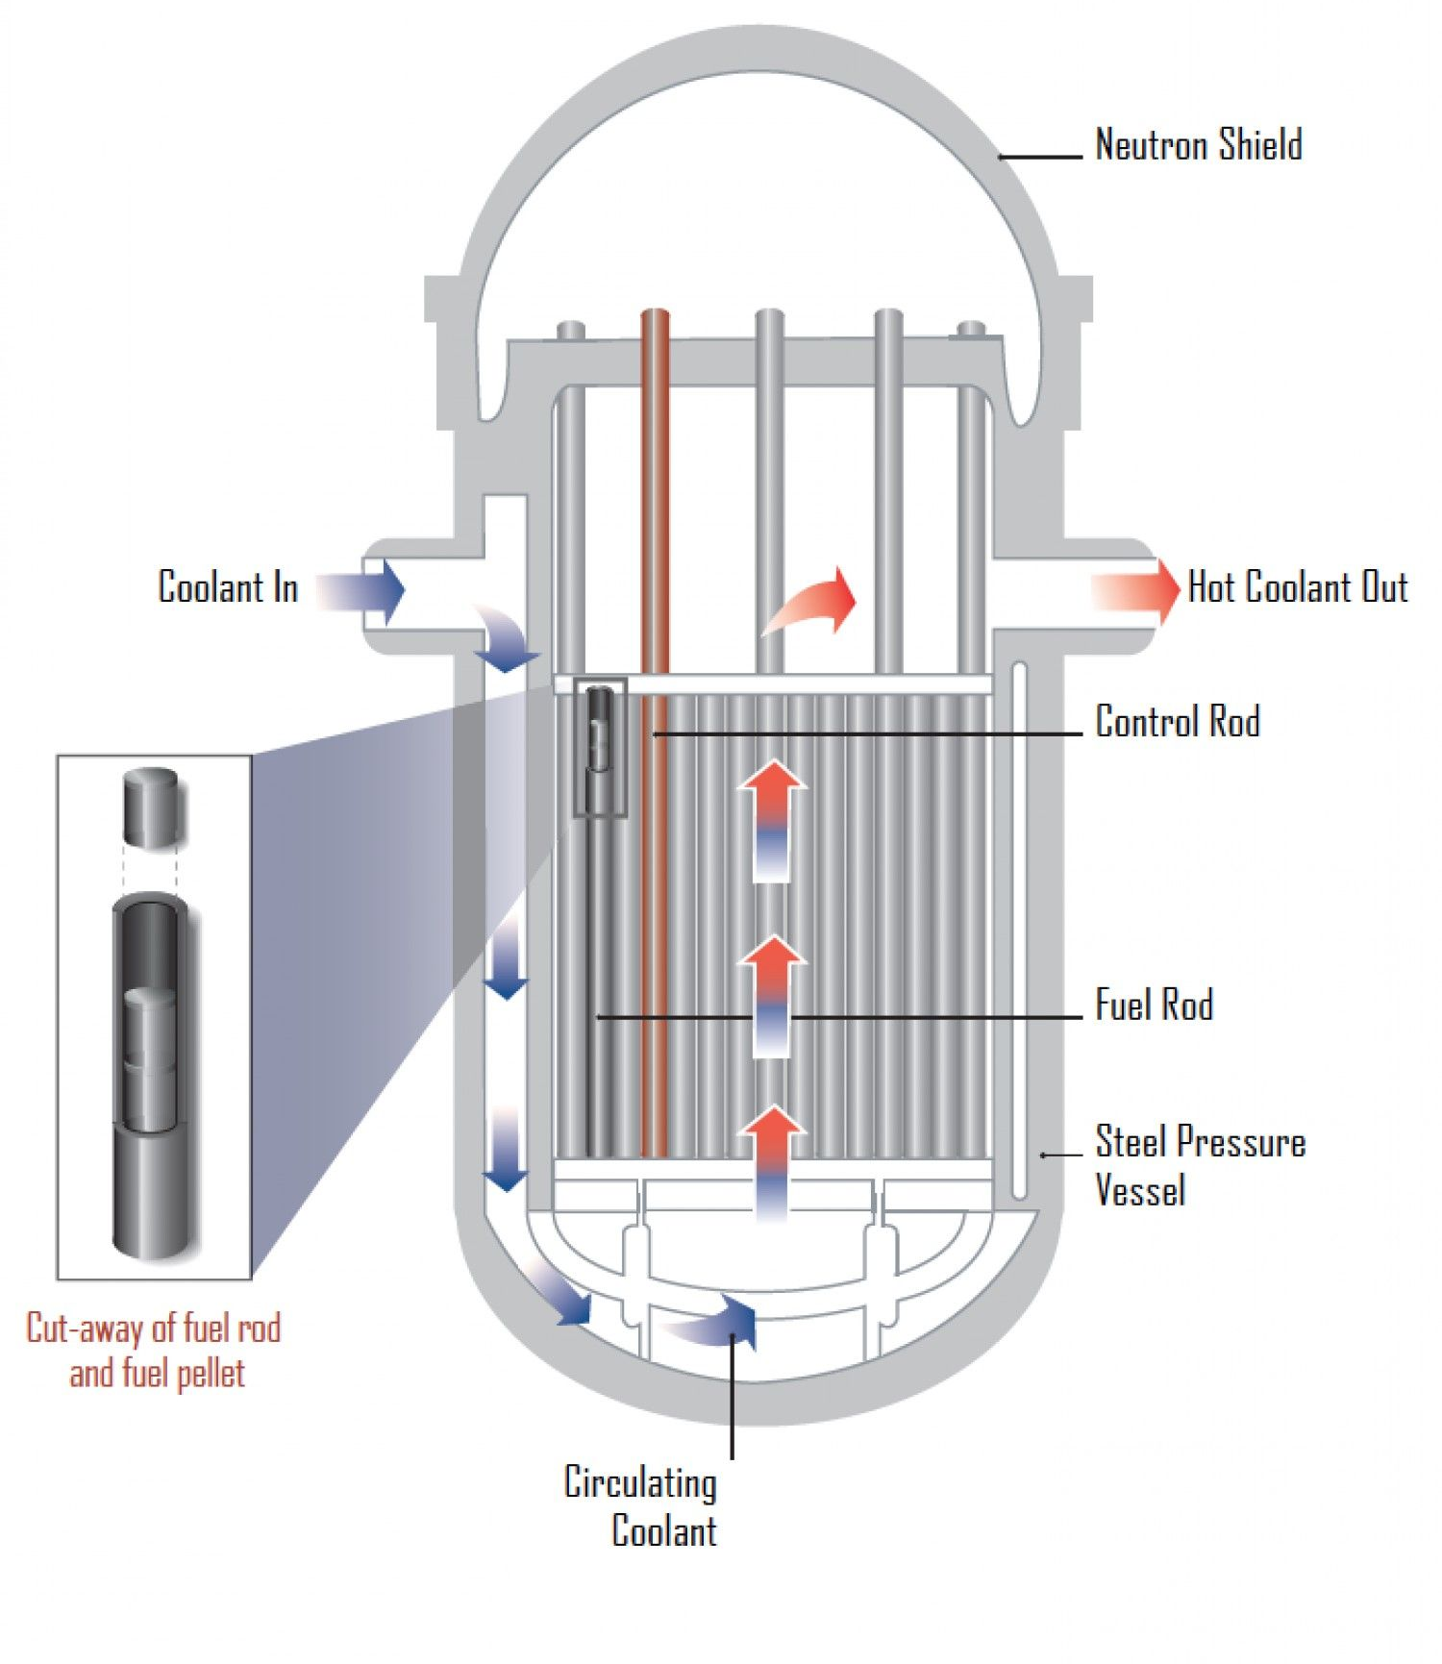
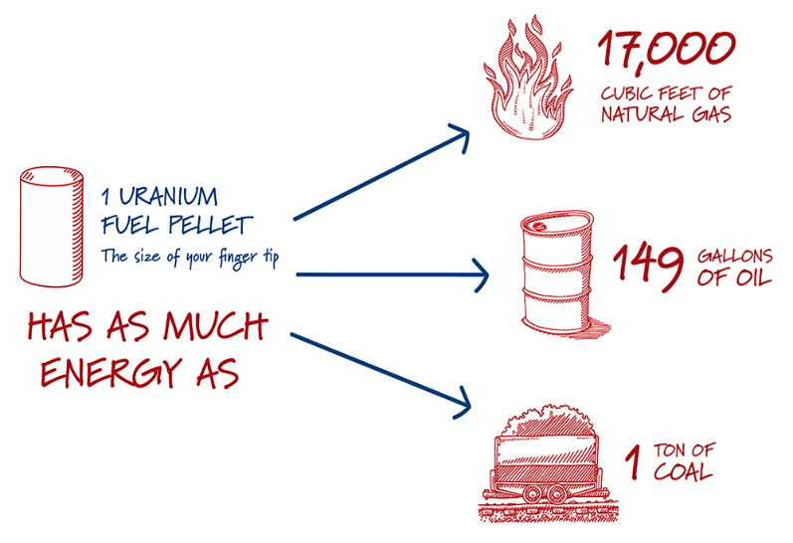
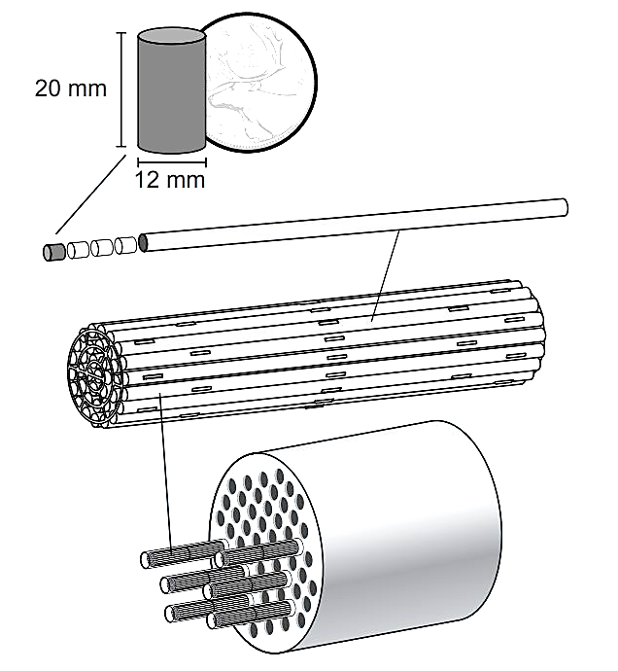
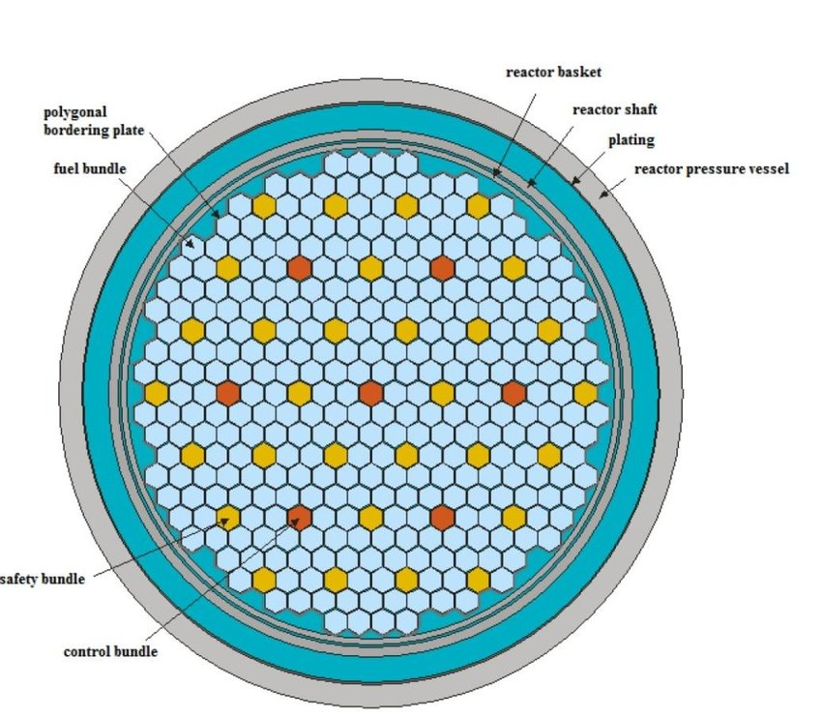
Inside the nuclear reactor core: Fuel
In a nuclear reactor, the fuel and the moderator are assembled inside of the reactor pressure vessel, forming the reactor core
As much energy as:
Reactor core example
Fuel is assembled in fuel rods, these in fuel bundles and distributed in the reactor core to have a uniform neutron flux distribution

Slide 10
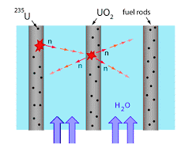
Inside the nuclear reactor core: Fuel assembly
In Presurized Water Reactors (PWR), the moderator, water, is also the coolant.
It flows between the fuel bundles, extracting the heat from the core and moderating the fission-born neutrons with a pressure of
P = 155 bar
T = 275 ºC
T = 315 ºC

Slide 11
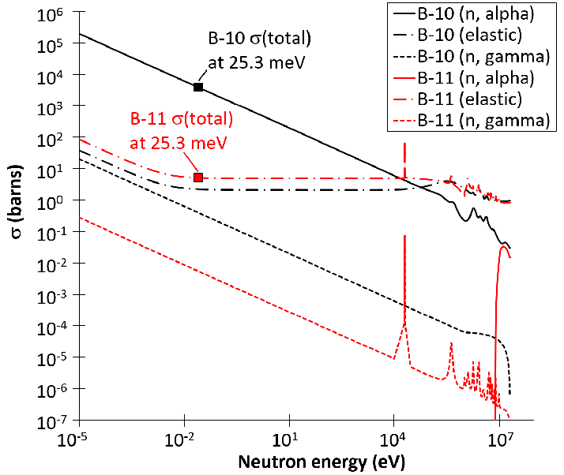


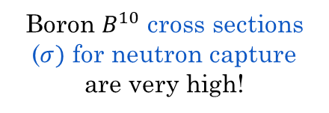
Inside the nuclear reactor core: Control rods
Moderation can be adjusted by control rods that can absorb many neutrons
neutron capture
$$B^{10}$$
$$B^{10}$$
Boron $B^{10}$ cross sections ($σ)$ for neutron capture are very high!

Slide 12
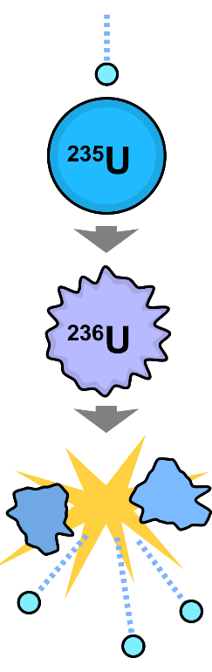
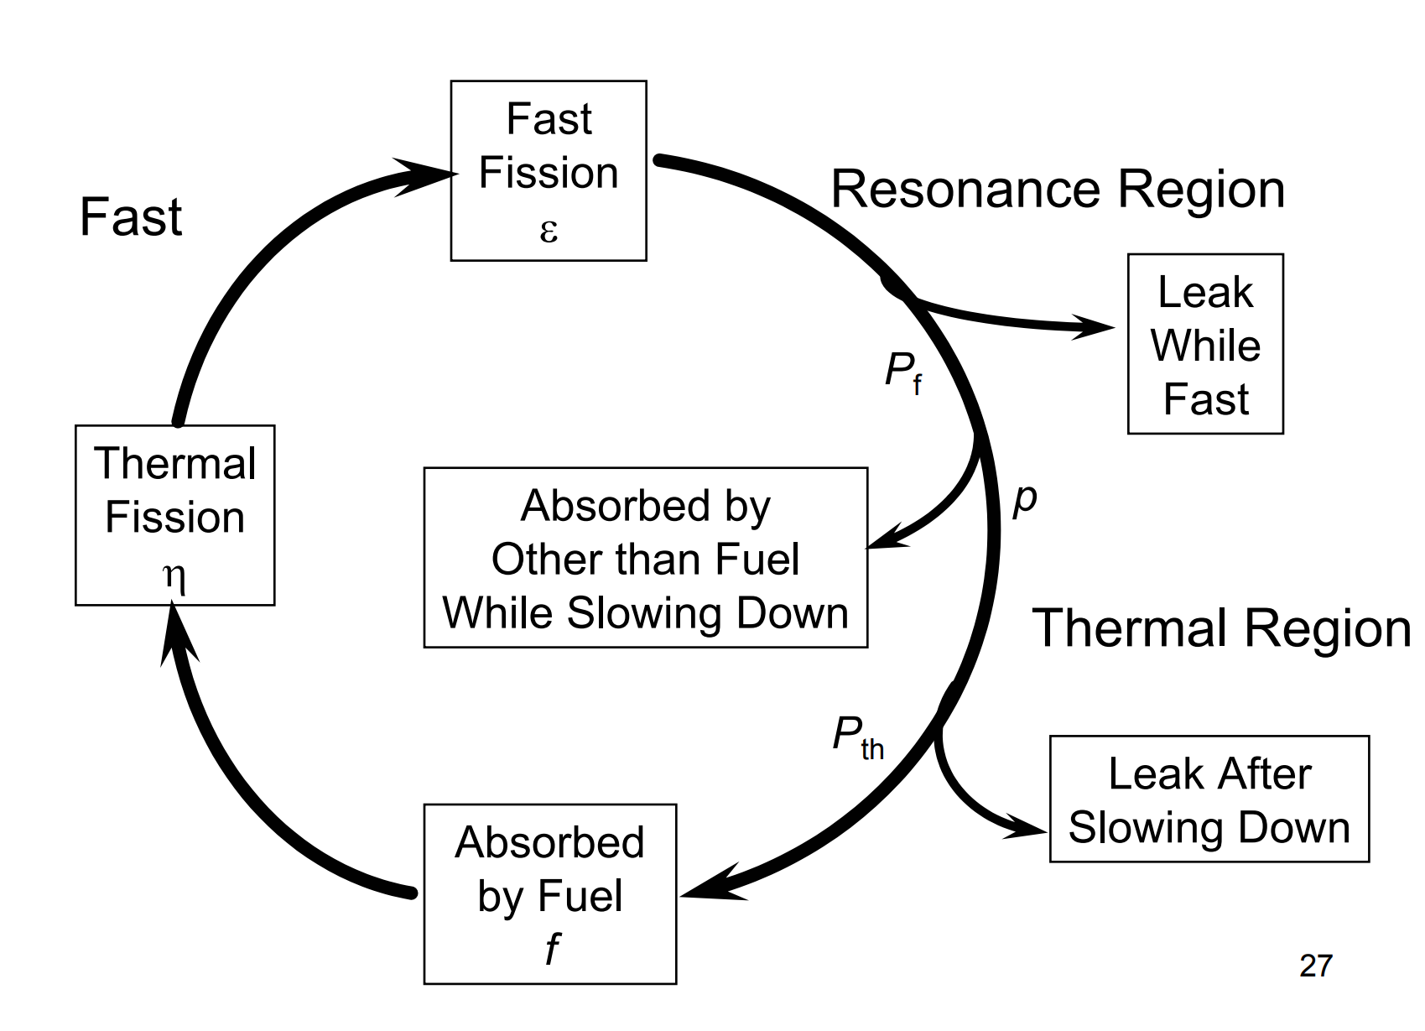
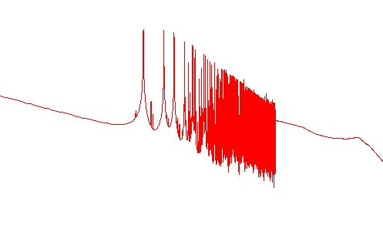


How to maintain a controlled fission chain?
$$U^{238}, Pu^{239}$$
Since the neutrons are born until they are able to produce a new fission, they go through a life cycle that accounts for the neutron losses before the next fission
(~ keV)
Cross section (barns)
(~ MeV)
Neutrons cycle
$$U^{235}$$
(~ eV)
Energy (MeV)
Moderator, Boron, structural elements
Thermal region
Resonances
Fast region

Slide 13
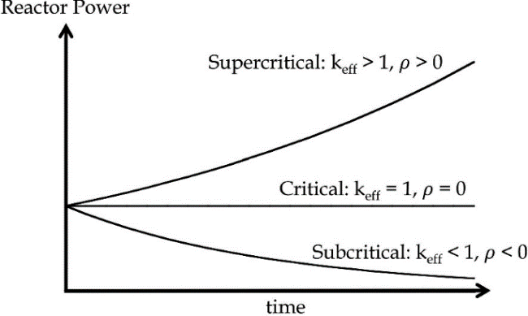
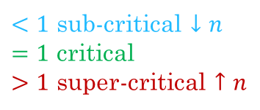

How to maintain a controlled fission chain?
$$k_{eff}=ηεP_{f}pP_{th}f$$
$<1$ sub-critical $↓n$
$=1$ critical
$>1$ super-critical $↑n$
Subcriticality
Neutrons cycle
Supercriticality
The chain reaction is not maintained and will stop (intrinsically safe)
The reactor will shut down and the power produced by the core will be only the decay heat
The chain reaction will lead to an exponential growth of the reactor power. If the safety system is not able to stop it, the core will melt
This is not possible in current reactors by design
(void coefficient)

Slide 14
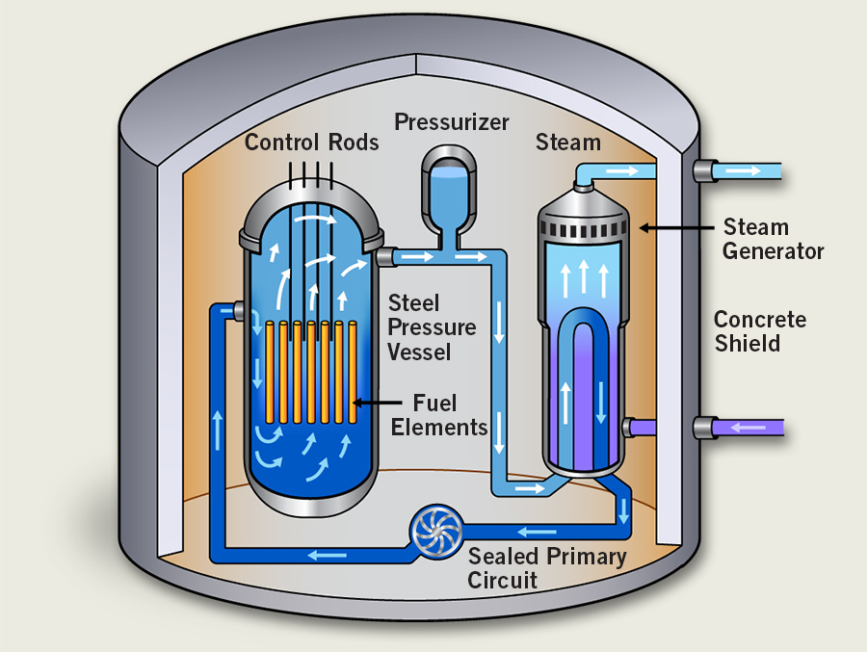

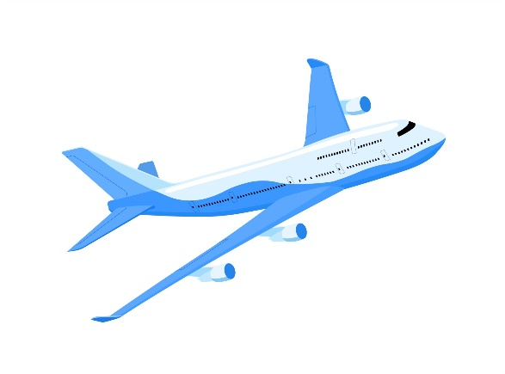
Inside a nuclear power plant: Containment
Inside, we find the reactor pressure vessel the primary coolant loop and the steam generators
For PWR design (image), the primary loop contains:
Primary pumps: maintain loop pressure
RPV: remove heat from core
Pressurizer: absorbs temperature (density) changes and aids in controlling the pressure during accident
U-tubes in steam generator: transfer heat to secondary loop
To turbine
Containment building is designed to mitigate the radiation and avoid any leakage to the environment.
Modern containments can withstand a plane crash.
Foundations are earthquake proof
From condenser

Slide 15
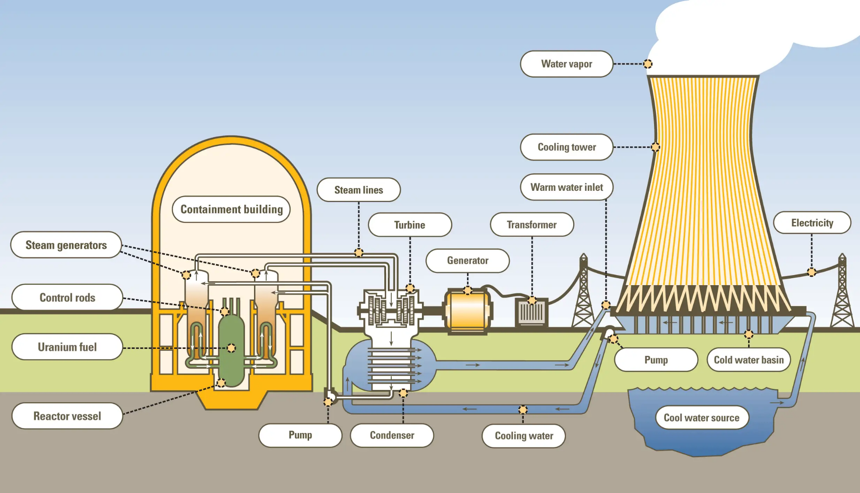
Inside a nuclear power plant: Electricity
Final heat sink can also be a river or the sea

Slide 16
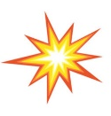

Safety in nuclear power plants: Accidents
Loss of coolant accident (LOCA)
Station Black Out (SBO)
Need a full presentation to cover them properly ☺

Slide 17
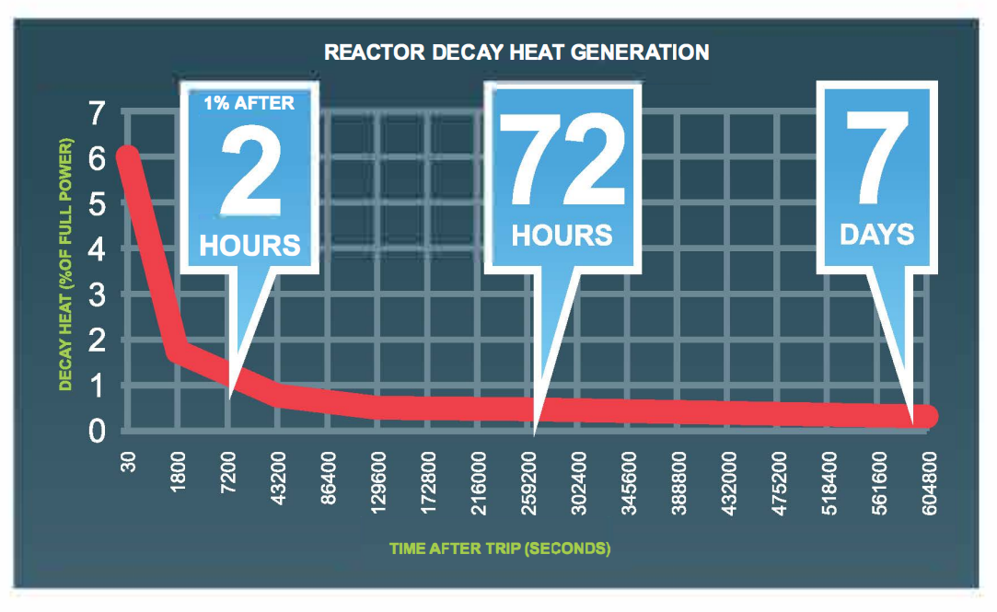
Safety in nuclear power plants: Decay Heat
The important concept is how to remove the decay heat from the reactor core once it is shut down (SCRAM), done automatically by the reactor when an anomaly is detected
For decay heat removal (DHR), we have active systems (powered by the grid or emergency diesel generators) and in Gen III+, passive systems driven by natural forces
After Fukushima, new safety measurements don’t require any human action the first 72h (This topic also requires a full presentation ☺)

Slide 18
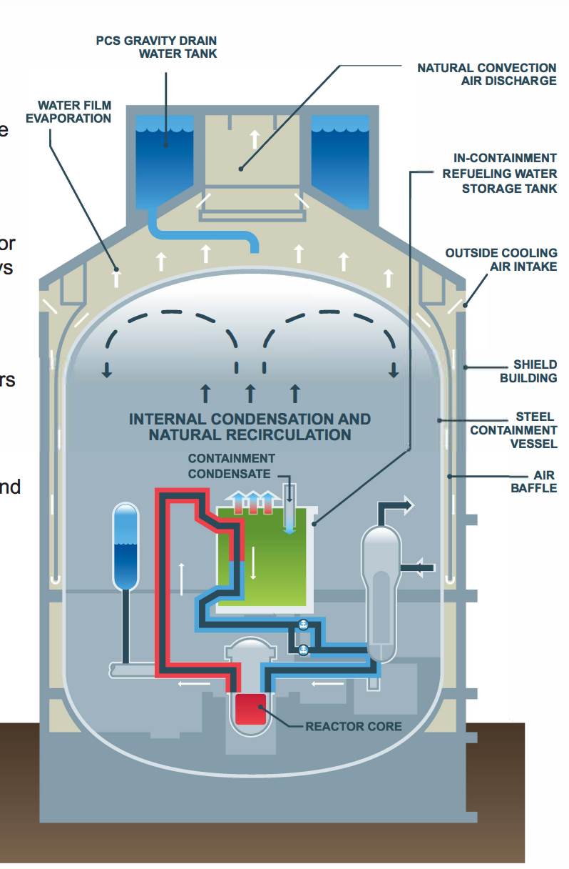
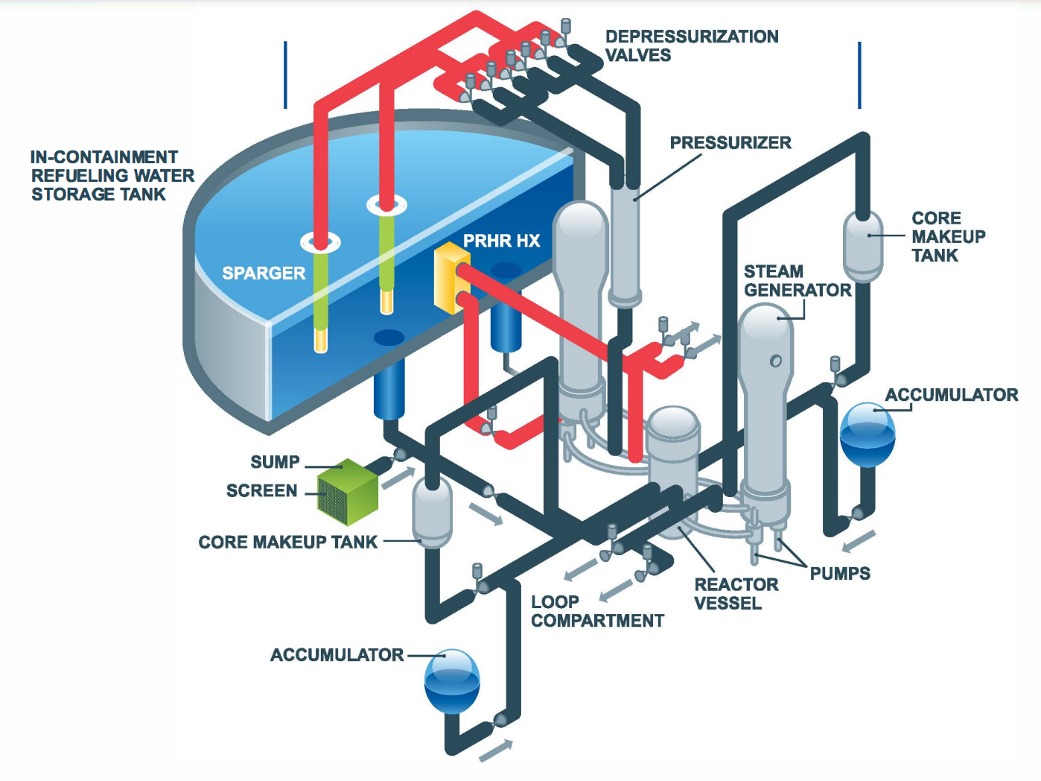
Safety in nuclear power plants: Safety systems
Active and passive safety systems for DHR (each system has redundancy in case one train fails)
Long term, passive cooling through containment walls condensation (just requires to refill the PCS after 72h)

Slide 19
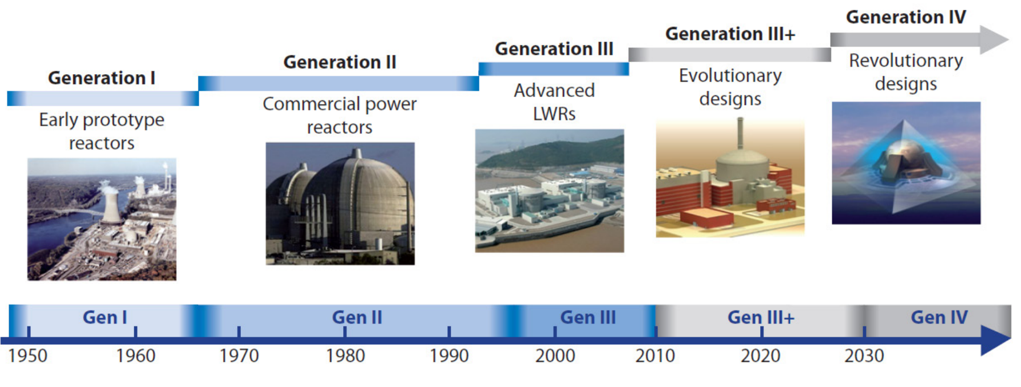
Gen IV nuclear reactors

Slide 20
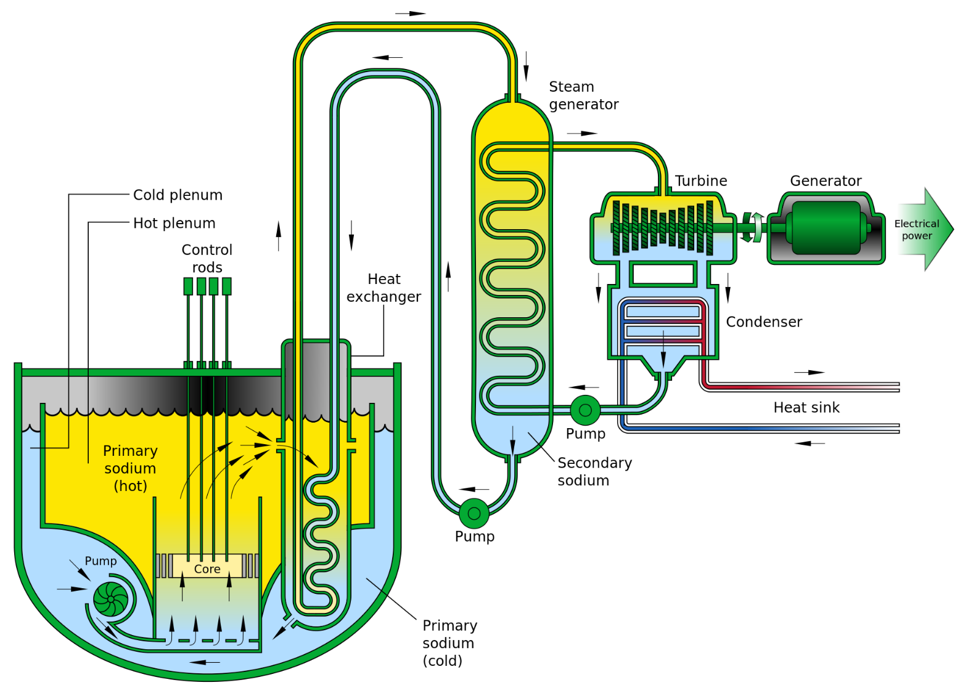
Gen IV Designs: SFR
Sodium Fast Reactor (SFR) has an innovative design, but introduced in the 50s as a proof of concept
Is cooled by sodium:
High thermal conductivity
Does not moderate: fast neutron spectrum
Very reactive to water and air (has to be leackage proof)
Corrosion

Slide 21
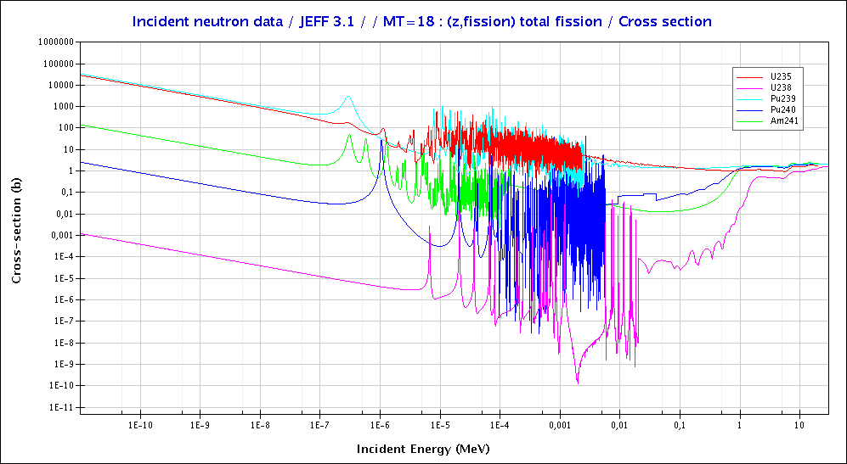
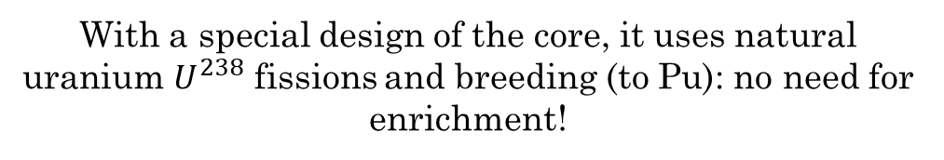

Advantages of SFR
Fission cross section of $U^{235},U^{238},{Pu}^{239}, Pu^{240}, Am^{241}$
Cross section (barns)
Neutron flux ($n/m^{2})$
PWR
SFR
Energy (MeV)
With a special design of the core, it uses natural uranium $U^{238}$ fissions and breeding (to Pu): no need for enrichment!
Notes:
Burn natural U without enrichment

Slide 22
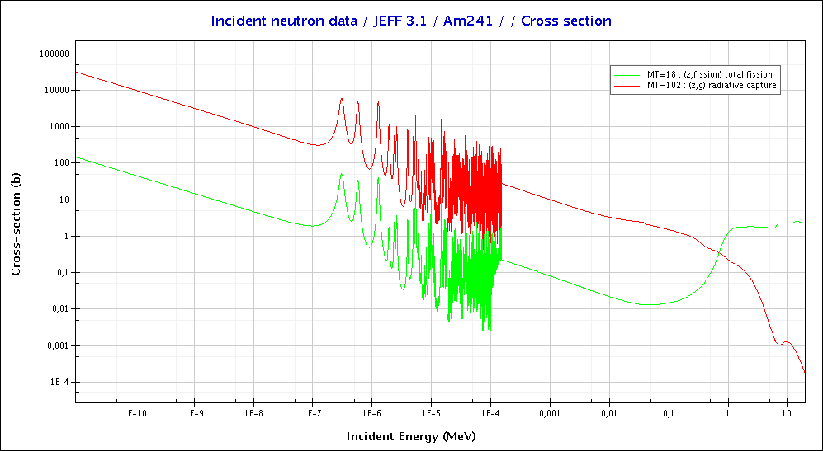
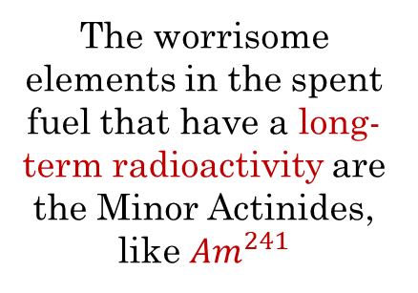
Advantages of SFR
Fission and capture cross section of $Am^{241}$
Cross section (barns)
Neutron flux ($n/m^{2})$
The worrisome elements in the spent fuel that have a long-term radioactivity are the Minor Actinides, like $Am^{241}$
With a fast spectrum reactor, we can do transmutation of long half-life radioactive waste into fissile fuel
PWR
SFR
Energy (MeV)

Slide 23
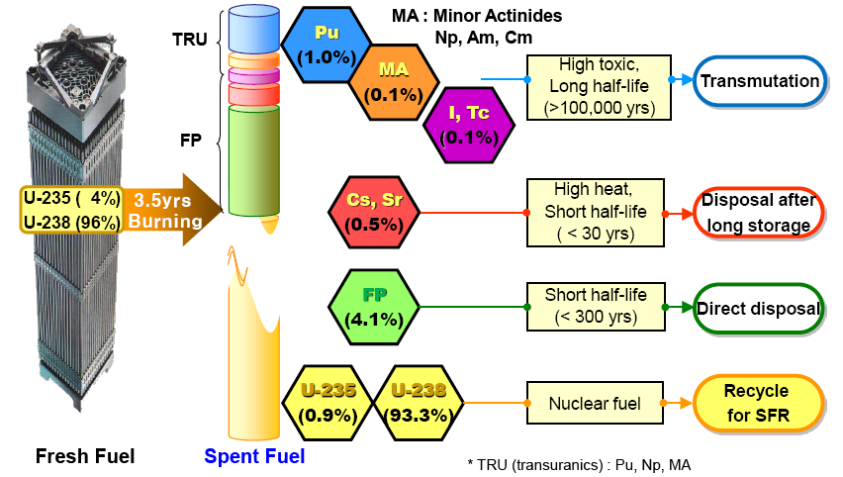
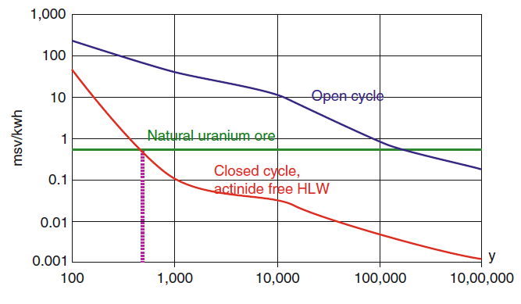
Advantages of SFR
Burn long half-lived Minor Actinides
Spent fuel storage needs
Radiation dose (mSv/kWh)
~800
~110,000
93% of unburnt $U^{238}$!!!!! $→$ recycling spent fuel ☺

Slide 24
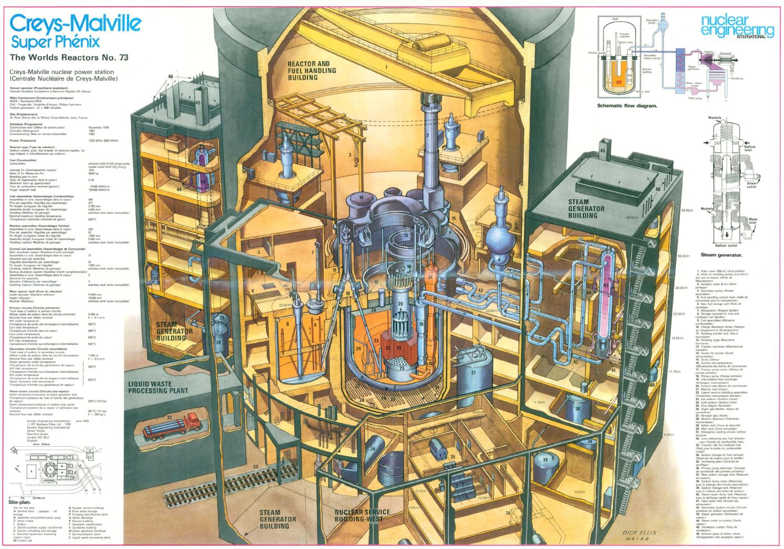
Superphenix

Slide 25
Thank you ☺
Quick Introduction to Nuclear Physics and Engineering
Elena de la Fuente García (BE–ABP–CEI)

Slide 26
Outline

