Slide 1
Engineering workflow for Cryo at TE-CRG-IC
Czeslaw Fluder
on behalf of the TE-CRG-IC section control team
CTTB Industrial Controls Forum #8 20-04-2023

Slide 2
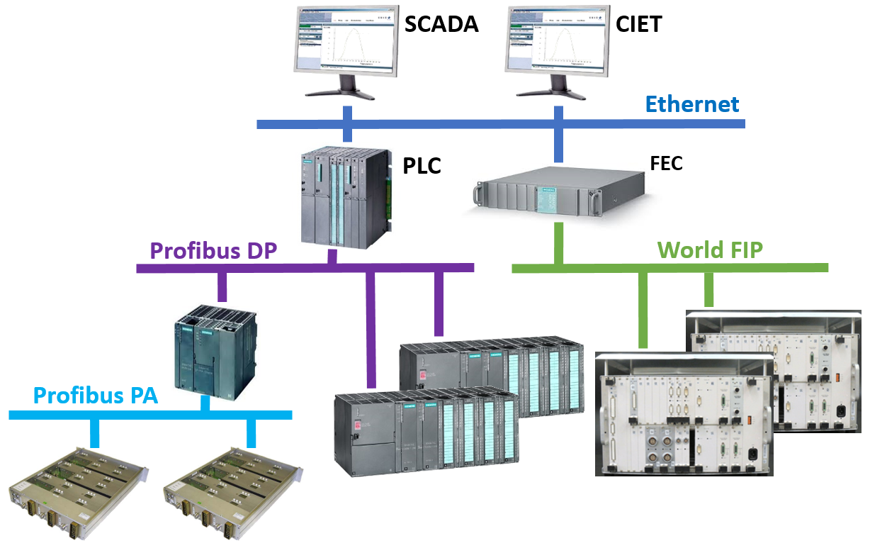
Introduction to CRYO control
Scope of activities:
The TE-CRG-IC controls team is responsible for the PLC software maintenance & development for the following cryogenic installations:
LHC tunnel [18 app. / ~110'000 objects],
Atlas & CMS LHC detectors [14 app. / ~25'000 objects],
non-LHC experiments & test facilities [69 app. / ~90'000 objects]
Typical control architecture

Slide 3





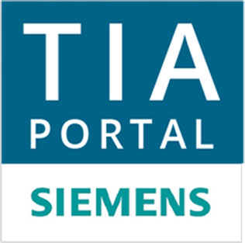
Introduction to CRYO control
Scope of activities:
The TE-CRG-IC controls team is responsible for the PLC software maintenance & development for the following cryogenic installations:
LHC tunnel [18 app. / ~110'000 objects],
Atlas & CMS LHC detectors [14 app. / ~25'000 objects],
non-LHC experiments & test facilities [69 app. / ~90'000 objects]
Typical control architecture
Technology overview:
All software change requests are tracked in JIRA projects (classified by cryo domains).
All applications are built on the basis of the UNICOS CPC framework and continuous integration practices. Application with hardware exposed to radiation environment uses the FESA framework, with support provided by BE/ICS.
In total 100 PLC applications implemented in one of the following technologies: Schneider M580, Siemens S7-400/300 and S7-1500 (TIA Portal).
The support for SCADA/CIET Data Servers is provided by BE/ICS.

Slide 4
Sources of engineering request
New project: typical for non-LHC experiments & test facilities domains.
Software correction / hardware failure: typically urgent/critical modification implemented on-the-fly, requested by operation or control-instrumentation support teams.
Control process improvements: an improvement in the process requested by cryo engineers in charge of installations, supported by an engineering change request (ECR) or new process logic specification.
Control frameworks upgrade: executed once per few years (like for UNICOS), to ensure homogeneity between cryogenic installations as well as support and maintainability of their control systems.
Control hardware upgrade: planned hardware replacement due to reached end-of-life or reliability issues.

Slide 5
Sources of engineering request
New project: typical for non-LHC experiments & test facilities domains.
Software correction / hardware failure: typically urgent/critical modification implemented on-the-fly, requested by operation or control-instrumentation support teams.
Control process improvements: an improvement in the process requested by cryo engineers in charge of installations, supported by an engineering change request (ECR) or new process logic specification.
Control frameworks upgrade: executed once per few years (like for UNICOS), to ensure homogeneity between cryogenic installations as well as support and maintainability of their control systems.
Control hardware upgrade: planned hardware replacement due to reached end-of-life or reliability issues.
  Non urgent/critical engineering requests are usually combined together
  and scheduled as a package to be deployed during installation technical stop / shutdown.

Slide 6
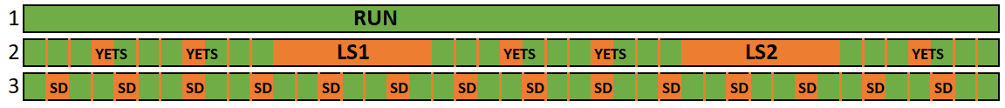
When we can update our control systems ?
Classification by operation cycles:
In nominal RUN since their start-up: critical installations like NA62 Krypton or ATLAS Argon calorimeters
  small modification can be implemented after an agreement with client, when there is no physics run
  PLCs reload once per ~12 years, with justification, complex preparatory work and compensatory measures
Following LHC schedule: LHC Tunnel or LHC Detectors
  small modification usually are implemented during YETS (TS if more urgent);
  PLCs reload done during LS1 & LS2
Following an individual schedule: non-LHC experiments & test facilities (SM18, Cryolab, NA, ISOLDE, …)
  many small modifications are implemented everyday (frequent evolution)
  PLCs reload done during installations shutdowns.

Slide 7




Workflow for urgent/small modifications implemented “on-the-fly”
Completed
Engineering
request
The workflow is common for all cryogenic domains (LHC & non LHC) and PLC software type (Schneider Control Expert, Siemens Step-7 and Siemens TIA Portal).
The urgent/small modification don’t require a PLC STOP and new UNICOS objects.
The PLCs source code modifications, build and downloads are done using 10 dedicated virtual machines (in TN) and 20 GIT runners (in GPN), both type configured on the CERN Open Stack.
The SCADA objects and process synoptic modifications are done simultaneously with PLC download.
*The LHC tunnel Specs DB modification are done directly in the Tunnel UNICOS Control DB (attached to the LHC Layout DB).
Urgent?
no
2nd WF
yes
Manual?
no
yes
Check-Out
Program manual modification
Download
Test by OP
Check-In
Compare to V[-1]
GIT commits
Update Git repository
[Specs DB*, templates,
static sources, …]
Compare to Prod. V
done

Slide 8
Workflow for urgent/small modifications implemented “on-the-fly”
Completed
Engineering
request
GIT commits
The workflow is common for all cryogenic domains (LHC & non LHC) and PLC software type (Schneider Control Expert, Siemens Step-7 and Siemens TIA Portal).
The urgent/small modification don’t require a PLC STOP and new UNICOS objects.
The PLCs source code modifications, build and downloads are done using 10 dedicated virtual machines (in TN) and 20 GIT runners (in GPN), both type configured on the CERN Open Stack.
The SCADA objects and process synoptic modifications are done simultaneously with PLC download.
*The LHC tunnel Specs DB modification are done directly in the Tunnel UNICOS Control DB (attached to the LHC Layout DB).
Urgent?
no
2nd WF
yes
Update Git repository
[Specs DB*, templates,
static sources, …]
Manual?
no
yes
Check-Out
Check-Out
Program manual modification
Copy code from GIT CI artefact
Download
Download
Test by OP
Test by OP
Check-In
Check-In
Compare to V[-1]
GIT commits
done
Update Git repository
[Specs DB*, templates,
static sources, …]
Compare to Prod. V
done

Slide 9
Workflow for planned control improvements & new projects
Engineering
request
New project?
New logic
specification
or ECR
Urgent?
no
no
Reverse Engineering
yes
yes
1st WF
Update specs DB in Git
HW selection
HW lab tests
UCPC version selection
Create from template or Update GIT project [baseline, libraries, default templates] and configure application
DEV
Fill/Update Specs DB [Objects, Interlocks & Logic templates]
Program templates
Create
hardware configuration
Commit & build project with GitLab CI and then deploy automatically to mirror system
GIT commits
Test project on mirror control system by DEV and OP

Slide 10
Workflow for planned control improvements & new projects
Completed
Engineering
request
New project?
New logic
specification
or ECR
Urgent?
no
no
Reverse Engineering
yes
yes
1st WF
Update specs DB in Git
HW selection
HW lab tests
Base/new version
UCPC version selection
Download to production
Program manual modification
Create from template or Update GIT project [baseline, libraries, default templates] and configure application
Commissioning / test by OP
Check-In
DEV
Fill/Update Specs DB [Objects, Interlocks & Logic templates]
Program templates
Create
hardware configuration
Compare to V[-1]
Update Git repository
[Specs DB*, templates,
static sources, …]
GIT commits
Commit & build project with GitLab CI and then deploy automatically to mirror system
GIT commits
Compare to Prod. V
Test project on mirror control system by DEV and OP
done

Slide 11
Conclusion
Presented workflows allow us to successfully maintain operational more than 100 PLC applications in unified way, independently from installation type and technology used.
Our workflows combined with an automatic software production allows us significantly reduce the time needed for development and testing as well as improve software quality. (For instance, the time need to review/update of ISOLDE control system was reduced from six months to three weeks.)
The workflows will be used for engineering of the HL-LHC tunnel control system.

