Slide 1
Functional Safety at BE-ICS
Borja Fernández Adiego
Andrea Germinario
Enrique Blanco Viñuela
Frédéric Chapron
Peter Sollander
31/05/2023

Slide 2
Agenda
A few basic concepts about Functional Safety
2 Functional Safety projects at BE-ICS
Management of Functional Safety projects at BE-ICS

Slide 3
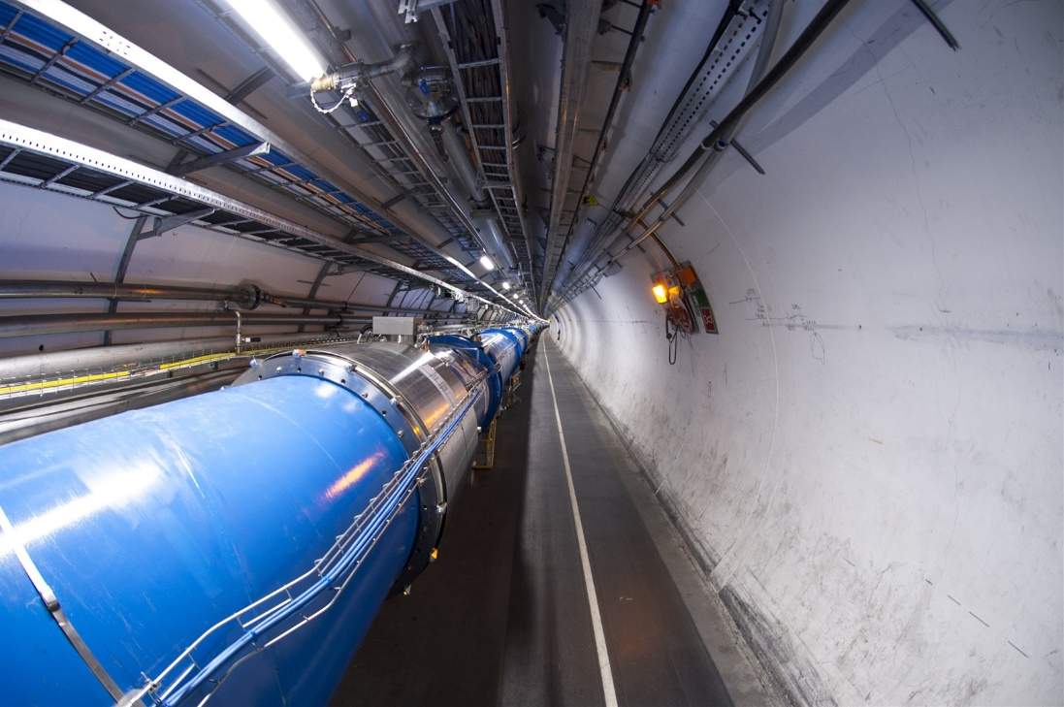
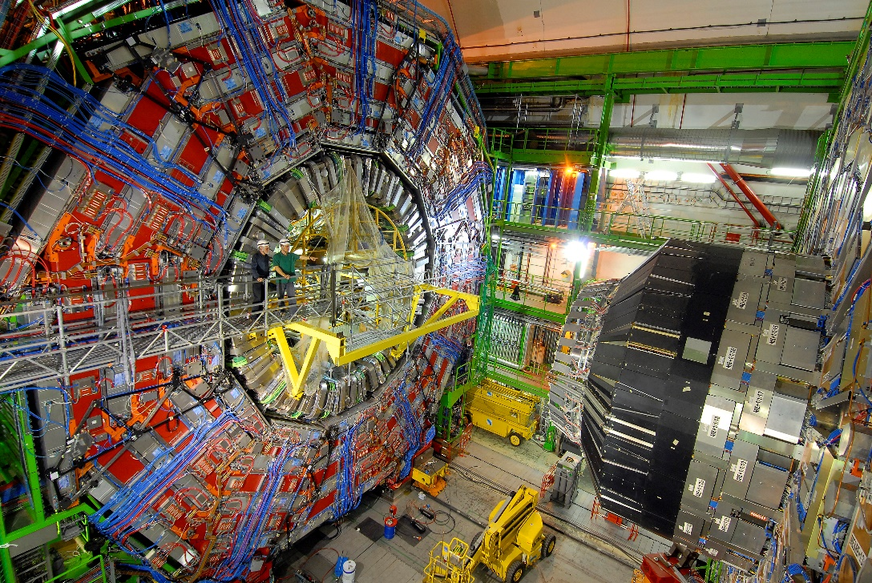
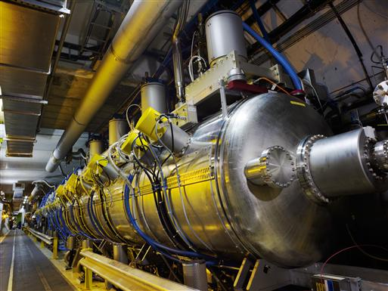
Risks at the industrial installations at CERN
CERN particle accelerators

Slide 4
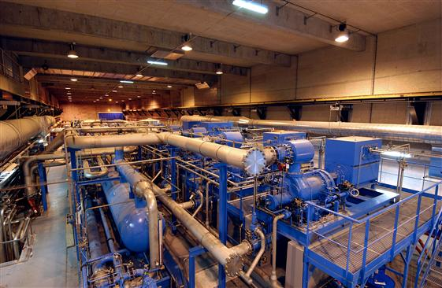
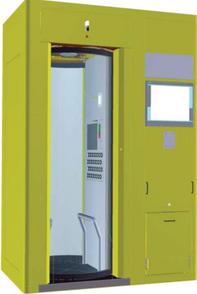
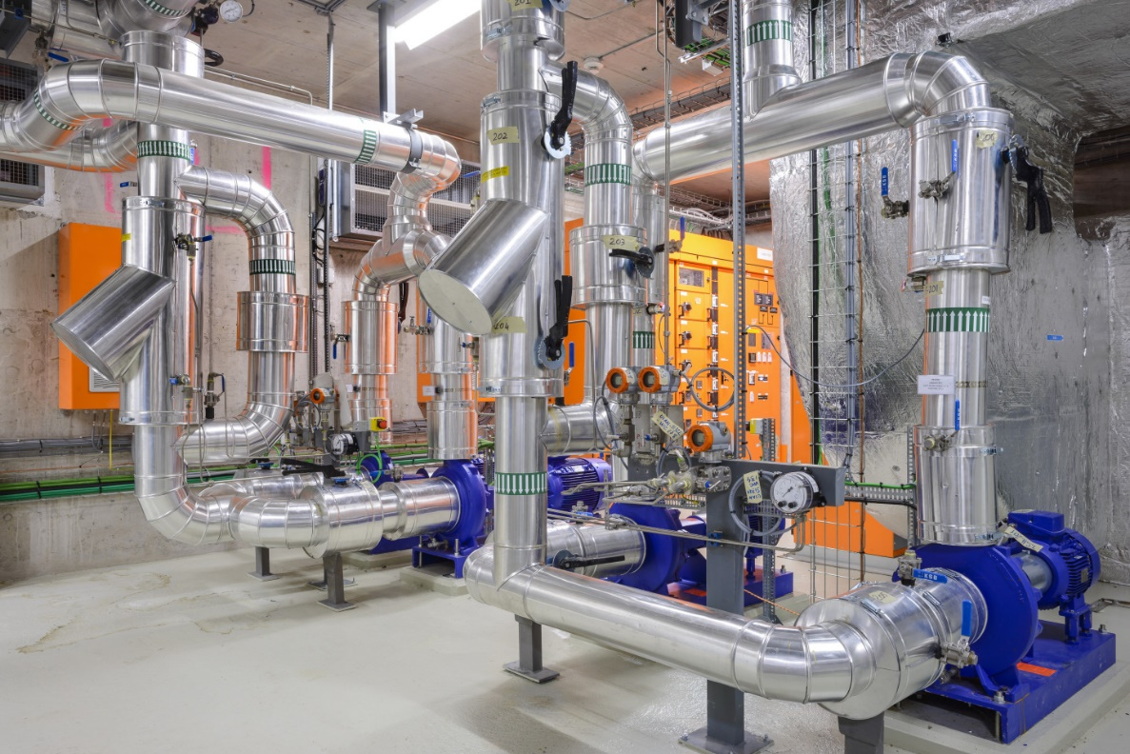
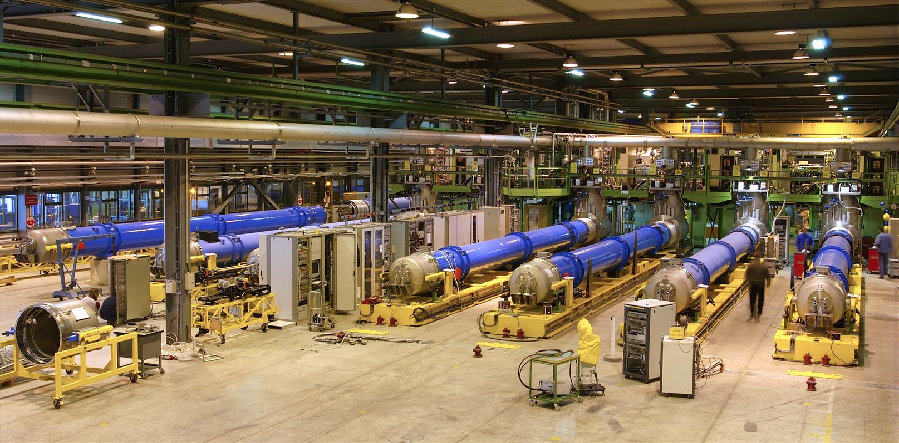
Risks at the industrial installations at CERN
CERN industrial facilities
Risk for the personnel, the installations (economic losses), the environment,
the reputation of the organization, etc.

Slide 5
Risk definition and risk reduction
Risk = f(F, C)
Initial risk -> Tolerable risk
Prevention measures (gas leak detection + interlock)
Protection measures (evacuation procedure)
Consequence (C)
e.g. 1 fatality, 1 year of delay of the LHC, etc.
Prevention
Initial risk
C
Protection
unacceptable risk
Target risk
tolerable risk
F
Frequency (F)
e.g. 1 failure in 10 years

Slide 6
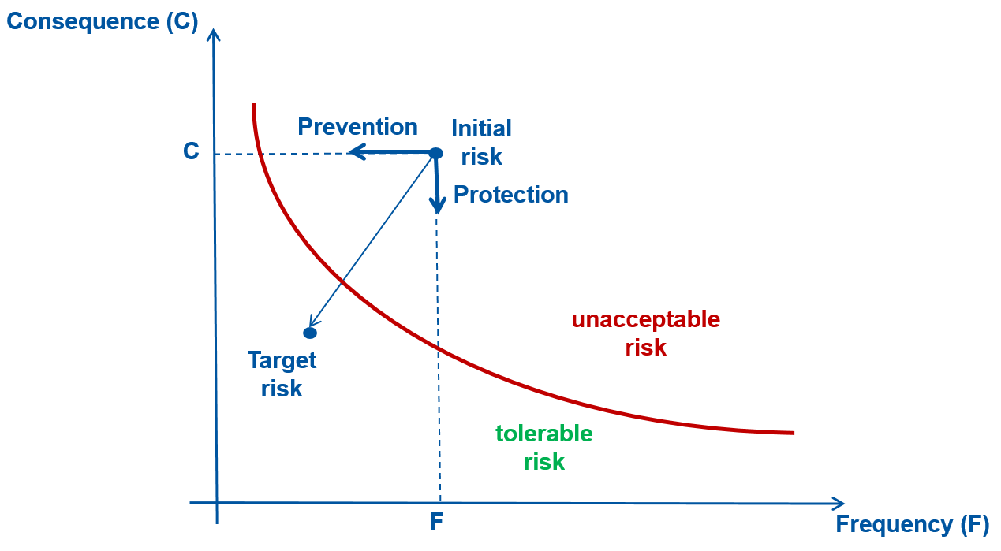
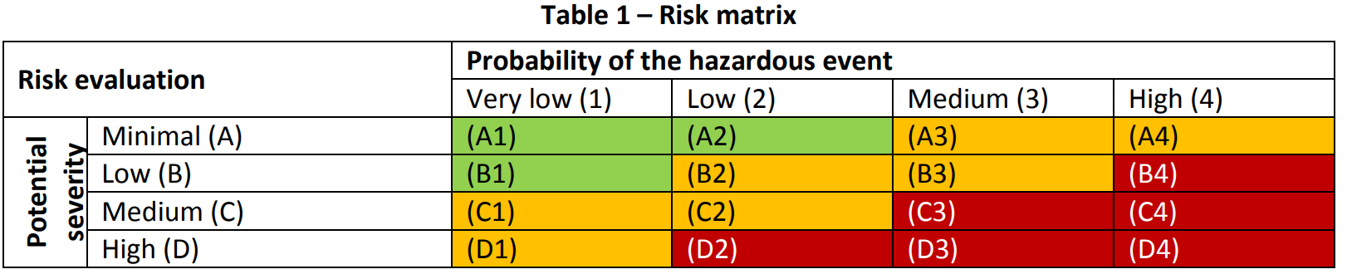
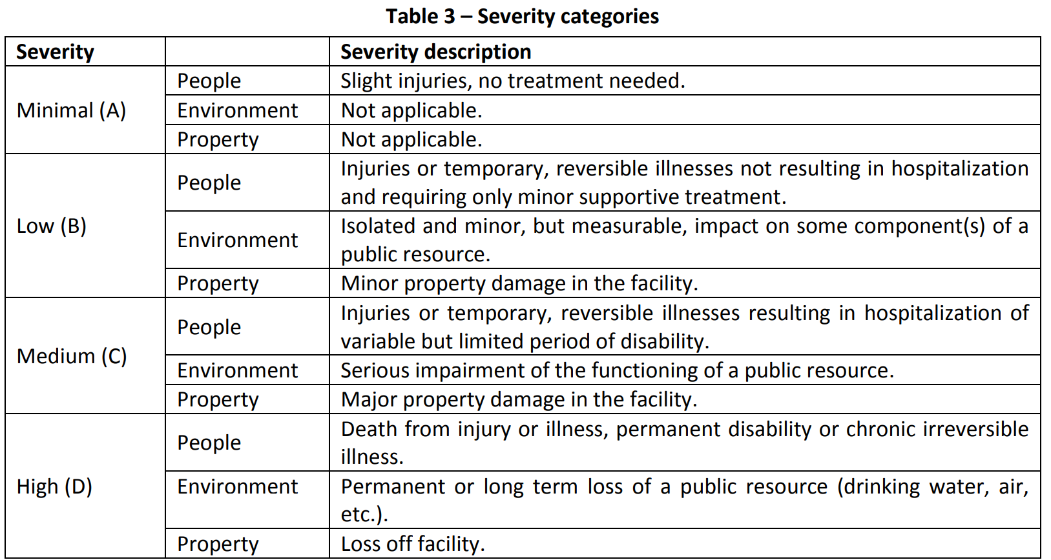
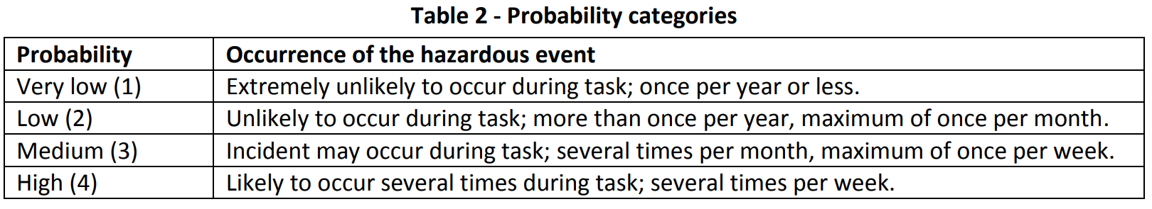
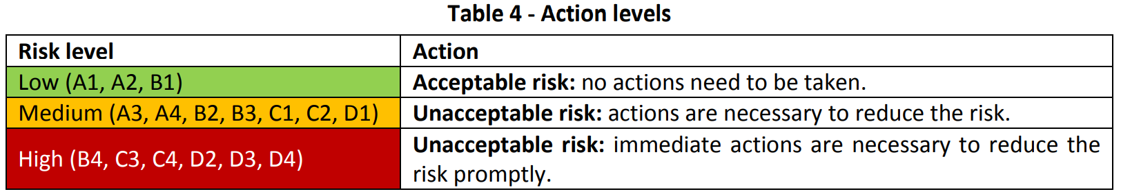
Tolerable risk at CERN
HSE risk matrix
https://edms.cern.ch/document/1114042/2

Slide 7
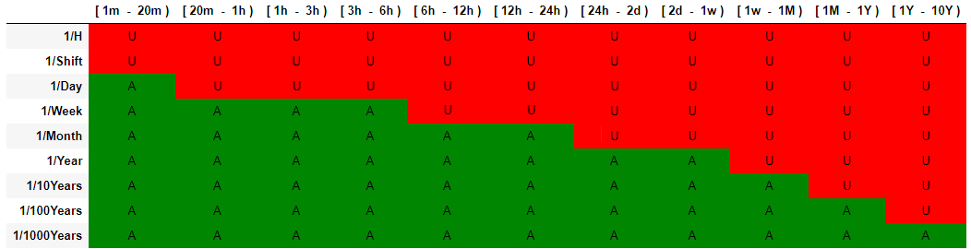

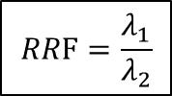


Tolerable risk at CERN
CERN accelerators risk matrices (BE-MPE)
https://edms.cern.ch/document/2647881/1
LHC example
Failure mode consequence (severity) – LHC downtime
Failure mode
frequency
$$λ_{1}$$
$$λ_{2}$$
$$RRF=\frac{λ_{1}}{λ_{2}}$$
$$RRF=\frac{1}{1y}/\frac{1}{100y}=100$$
Risk reduction factor
Related to SIL

Slide 8
Functional Safety
HSE (Health & Safety and Environmental) unit
DSO (Department Security Officer)
Process experts and responsible
Control engineers
Instrumentation engineers
Functional Safety engineers
…
The goal is to ensure safety in our industrial installations
Functional Safety is, “Systems that lead to the freedom from unacceptable risk … by the proper implementation of one or more automatic protection functions (often called safety functions).” from TÜV SÜD
Functional safety standards:
  IEC 61508: Functional Safety of Electrical / Electronic /
  Programmable Electronic Safety-related Systems
  IEC 61511: specific for the process industry
  IEC 62061: safety of machinery
  IEC 13849: safety-related Parts of Control Systems
  Specific industry standards (e.g chemical industry, radioprotection, etc.)
Functional Safety certified courses (by TÜV Rheinland):
  Safety Instrumented Systems and
  Process Hazard & Risk Analysis
Safety
Process safety
Occupational safety
Mechanical
integrity
Fall
prevention
Inherently
safer
design
Procedures
Ergonomics
Safety audits
Functional
Safety
Work
schedules
Training
Personal
Protective
Equipment
Emergency
response
Risk for the people, the environment and the installations

Slide 9


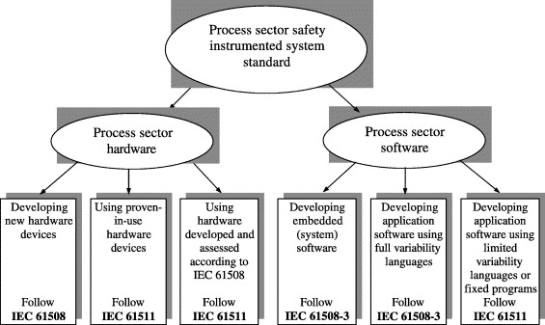
Context – Functional Safety
Which standard should we use?
e.g. Design a sensor to be used in Safety systems for a chemical plant
e.g. Design Safety system for a chemical plant

Slide 10
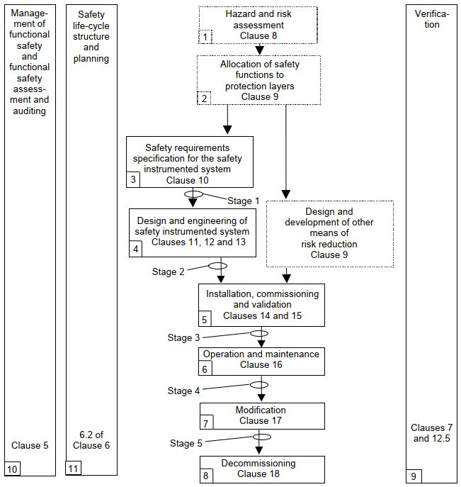
Context – IEC 61511
IEC 61511 standard - SIS (Safety Instrumented Systems) for the industrial process sector
It provides the safety life-cycle:
11 phases (to complete the project)
19 Clauses (requirements)
Very challenging task to implement all the requirements (lots of resources and time-consuming)

Slide 11
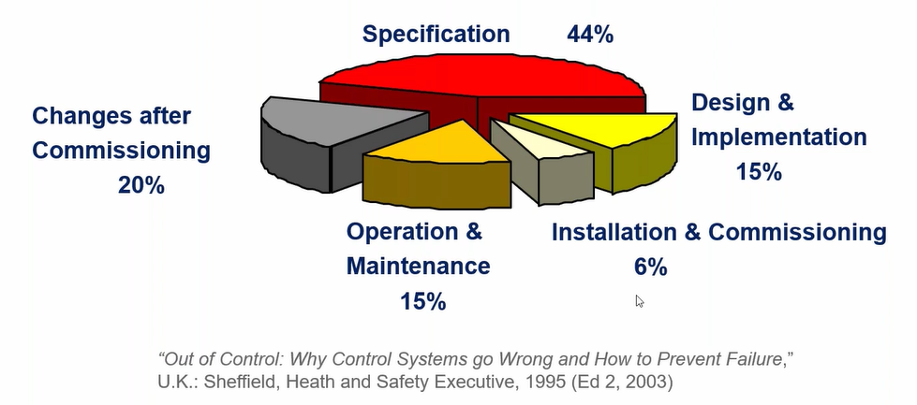
Failures types
Failure per project phase
Failure types according their nature:
  Random Hardware Failures
      From degradation mechanism
  Systematic Failures
      Incorrect specification
      Human errors
      Software errors
      Maintenance and modifications
      ….
Failure types according their criticality and diagnostics:
  Dangerous vs Safe
  Detected vs Undetected
Functional Safety cares about random and systematic failures but only about the dangerous undetected failures

Slide 12
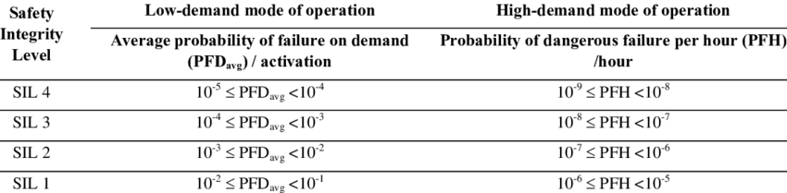
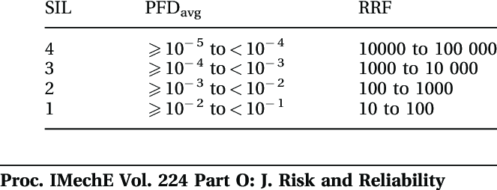
What about SIL?
SIL (Safety Integrity Level) = tool to quantify the risk reduction
Low Demand: Safety Function demand rate is less than or equal to once a year
High Demand Mode: Safety Function demand rate is more than once a year
But it is not only about hardware reliability

Slide 13

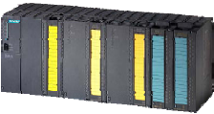
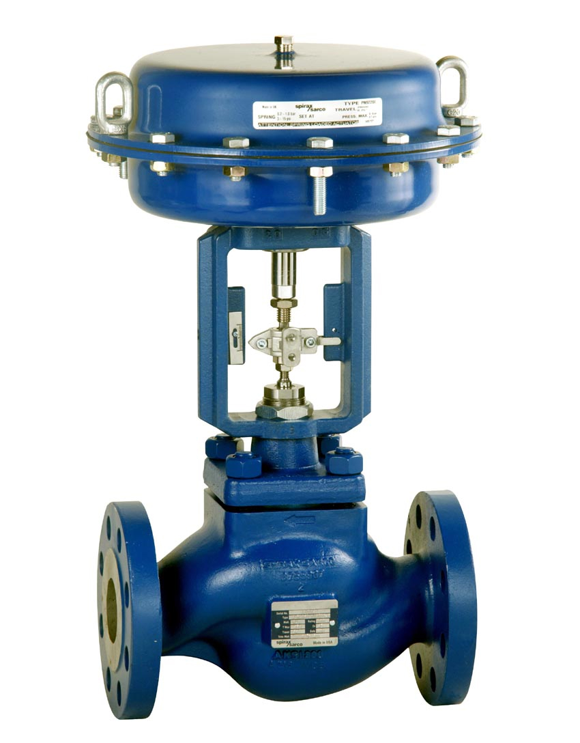
What about SIL?
Process engineer
Safety officer
….
Functional Safety engineer
FS standards
“agreement”
Risk reduction
Requirements = SIL
Risk analysis:
Identify the risk
Evaluate its criticality (consequence + frequency of the hazardous event)
Determine the needed risk reduction (tolerable risk) = SIL target
e.g. SIL2 Low demand SIF (if the temp. is higher than 60°C, open the valve)
Design the SIL2 Low Demand SIF according to the IEC 61511 (or other) by following the safety life cycle (hardware, software, communication protocols, architecture, etc.)
SIL2
TT
profisafe
it is not only about hardware reliability

Slide 14
CERN Safety systems examples
1
2
Safety Instrumented System for the SM18 cluster F (superconducting magnets test bench facility)
Protection layers for the HL-LHC Full Remote Alignment System (FRAS)

Slide 15
SM18 Cluster F Safety Instrumented System

Slide 16
SM18 Cluster F project
Taken from https://cds.cern.ch/record/724733

Slide 17
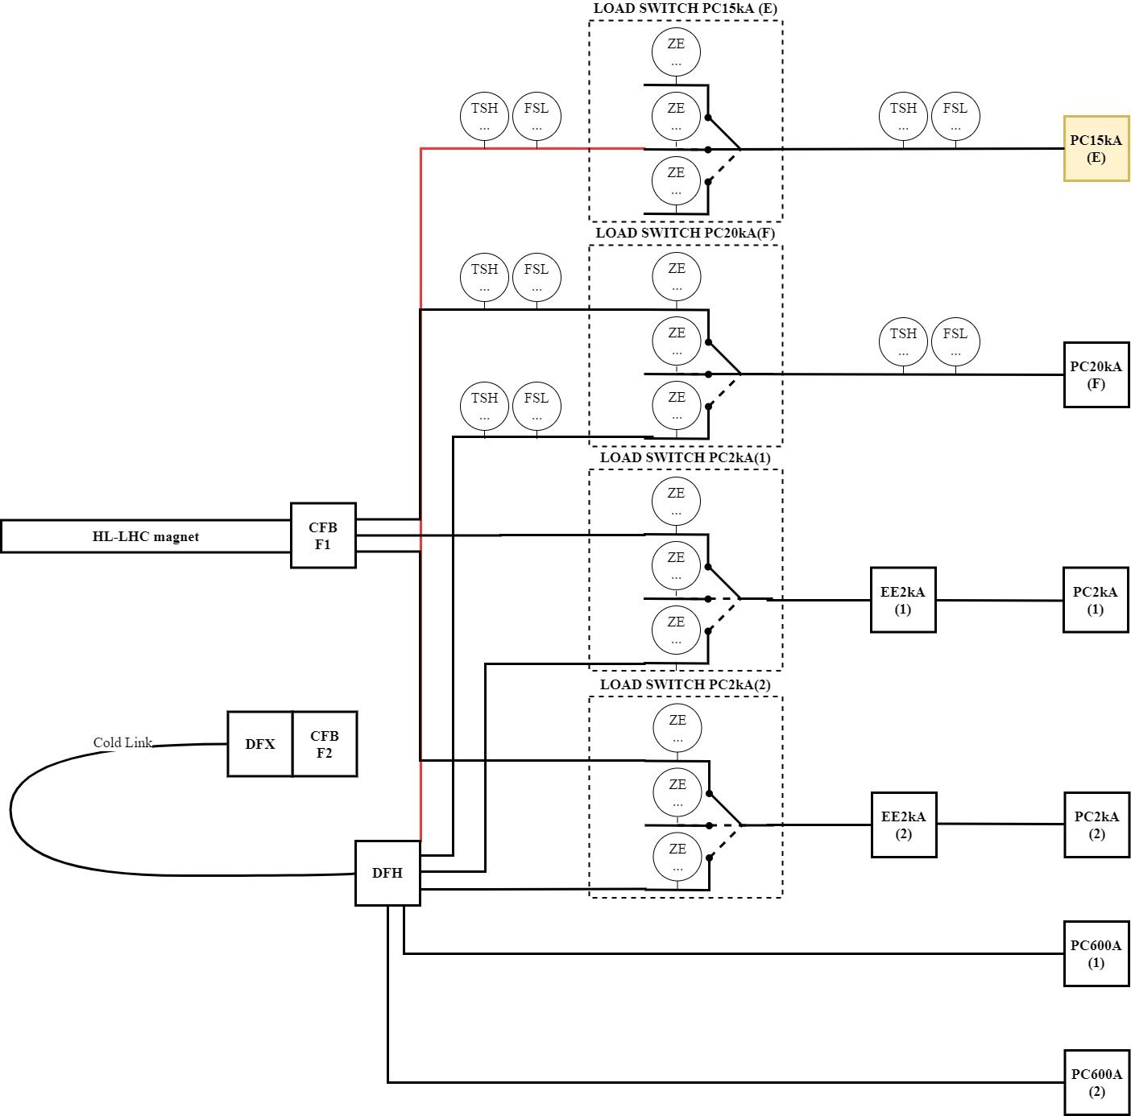
Context – SM18 Cluster F project
One of the several Magnet test bench facilities located in the SM18 building
Electrical and cryogenics risks
6 power converters
It consists of 2 test benches:
HL-LHC magnets
SC link

Slide 18
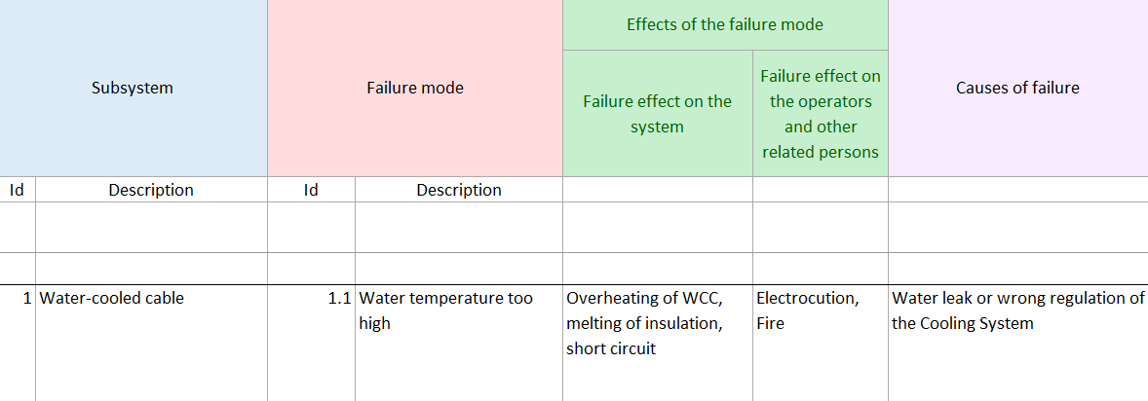
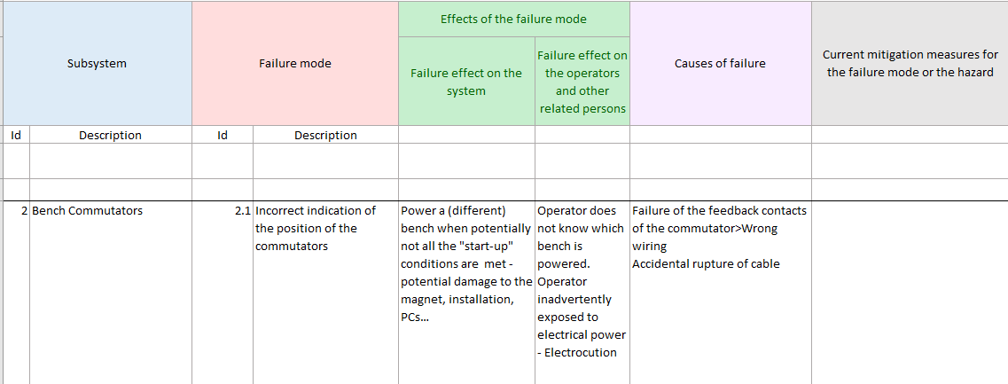
Risk analysis hazard identification –
Personnel and machine protection
FMEA (Failure Mode and Effect Analysis)
Other methods:
HAZOP: when you analyze deviations (e.g. high temperature, high pressure)
FTA: when you analyze the combination of multiple failures
What-if: based on experience
etc.

Slide 19
Risk assessment - Risk reduction and layers of protection
Depends on the definition of tolerable risk (combination of frequency and the severity of the risk)
How?
Judgement of the organization
Based on the IEC 61511 guidelines
Estimation of the original failure frequency due to (for example):
Operator/expert command
Software
Hardware
…
How?
Collected data from similar systems and operational experience
Reliability predictions (e.g. MIL-HDBK-217 https://www.isograph.com/software/reliability-workbench/prediction-software/mil-hdbk-217/ )
Based on the IEC 61511-3 guidelines
e.g.1/100Year
e.g. 1/Year
Necessary risk reduction
Target
risk
Original
risk
Conditional modifiers
Protection
Layers
Safety-related system
(SIL1, SIL2, SIL3)
According to the Functional Safety Standards
IEC 61508, IEC 61511 or IEC 62061

Slide 20
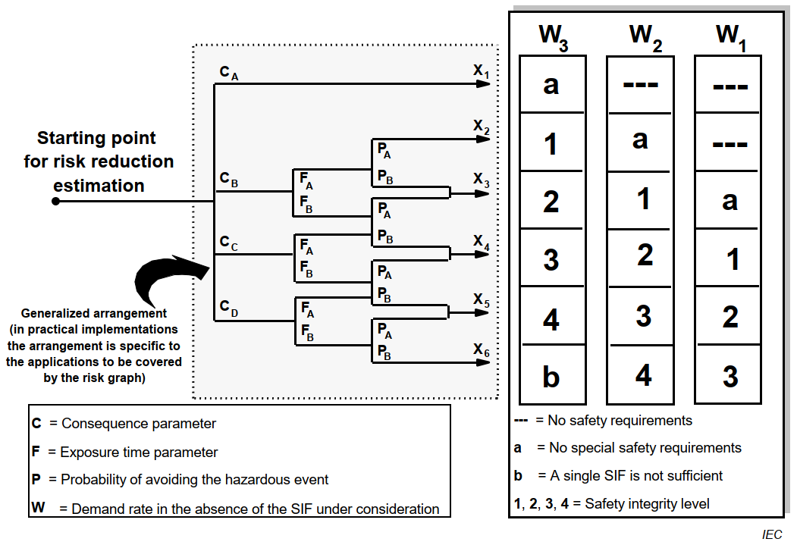
Risk assessment - Tolerable risk (Personnel protection)
IEC 61511-3 Annex D - Calibrated Risk Graph (qualitative method)
Calibration based on the IEC 61508 and IEC 61511 examples (and the HSE matrix)
Sometimes the necessary risk reduction is bigger for machine protection (mainly due to the F and P parameters)
SIL1 → necessary Risk Reduction Factor 10 < (RFF) ≤ 100

Slide 21
Calibrated Risk Graph – calibration (corporative decision)
Personnel protection:
Based on examples from IEC 61511-3:2016 Annex D or IEC 61508-5:2010 Annex E
Machine protection:
Based on the operational experience at CERN

Slide 22
Calibrated Risk Graph vs HSE matrix

Slide 23
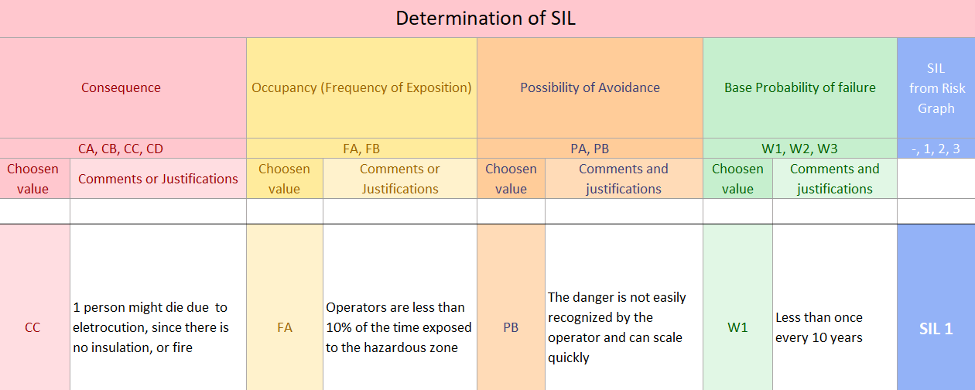
Risk analysis hazard identification –
Personnel and machine protection
SIL1
necessary Risk Reduction Factor 10 < RFF ≤ 100
Risk graph calibration

Slide 24
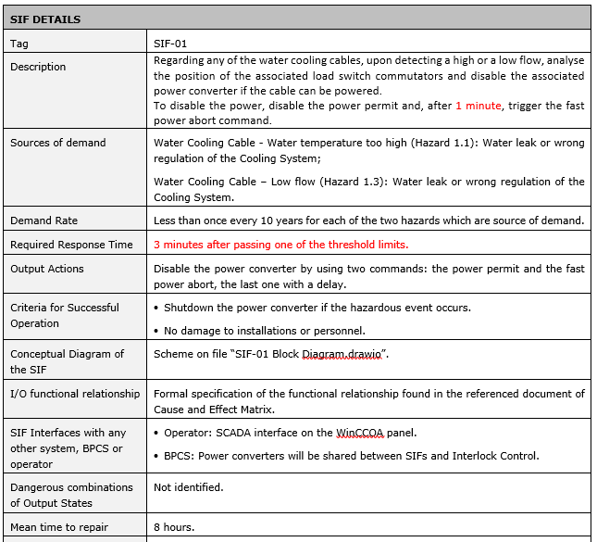
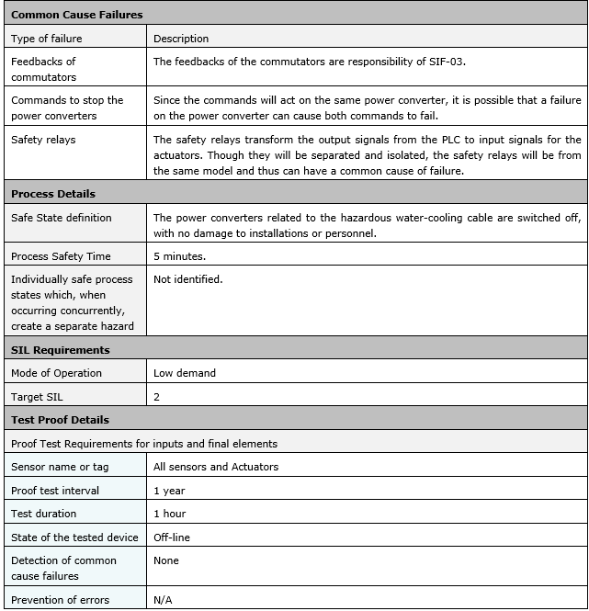
Safety Requirements Specification (SRS)
  Very detailed (and tedious) document to specify all details of each Safety Instrumented Functions (SIF)

Slide 25
SIS design and engineering
Design a SIS compliant with the SRS (Safety Requirements Specification)
Challenges:
  Design and engineering requirements:
    Hardware Fault Tolerance (11.4)
    Selection of the devices (11.5)
    Hardware random failures (11.9)
    Others (System behaviour on detection of a fault, field devices, interfaces, maintenance, etc.)
  Application program (AP) Requirements
  Factory Acceptance Test (FAT) requirements
IEC 61511-1:2016 Clause 11
SIS req.
Design and engineering
Req.
Clause 11
FAT
Req.
Clause 13
AP
Req.
Clause 12
IEC 61511-1:2016 Clause 12
IEC 61511-1:2016 Clause 13

Slide 26

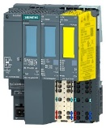
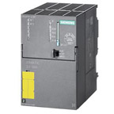
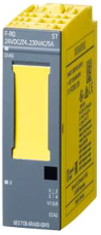
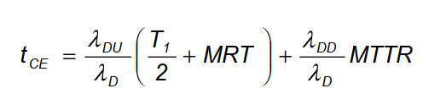
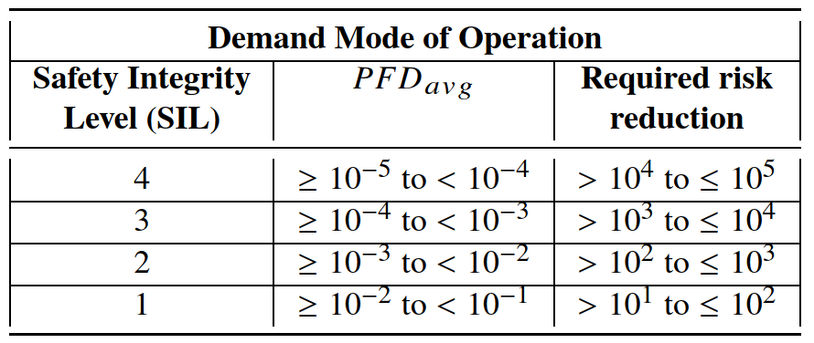
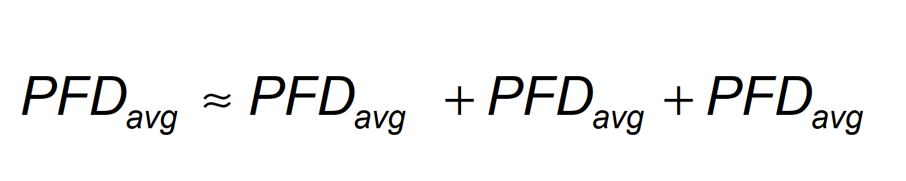

Hardware random failures analysis
Safety Chain PC
No certified device (reliability calculation is needed)
Reliability block diagram
Example 1oo1
IEC 61508-6:2010 Annex B
Average Probability of Failure
On Demand for the sensor group

Slide 27
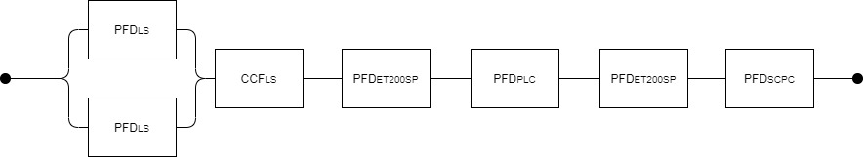
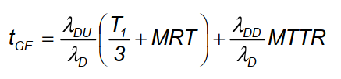
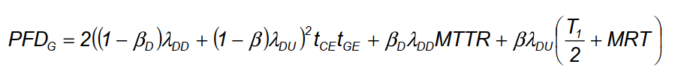
Hardware random failures analysis
Safety Chain PC
Reliability block diagram
IEC 61508-6:2010 Annex B

Slide 28
Hardware random failures analysis
Reliability Block Diagram (RBD) or Fault Tree Analysis (FTA) for SIFs - ISOGRAPH
Sensors failure
Actuators failure
PLC failure
CCF

Slide 29
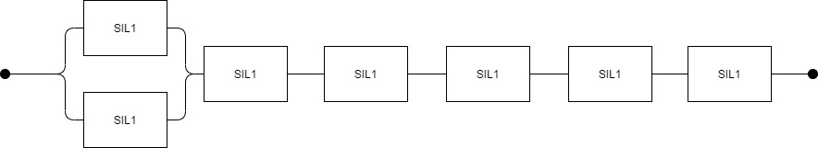
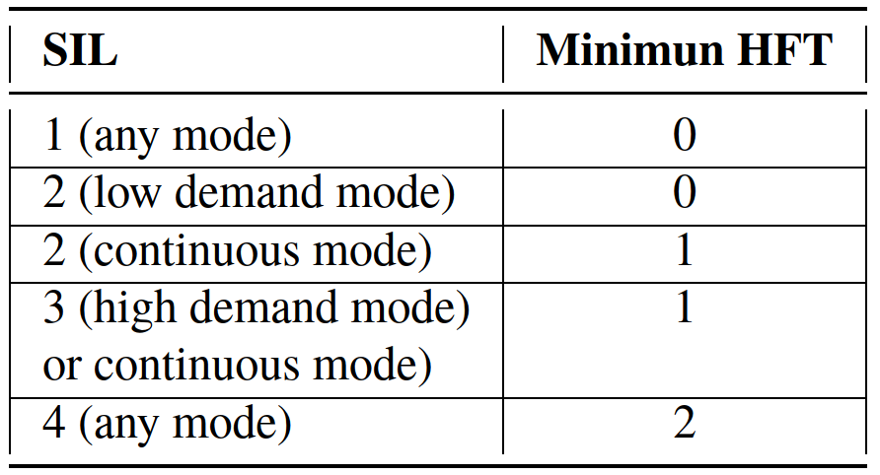
Architectural constraints analysis
Even if the prob. of failure is compliant with target SIL, we may need to apply redundancy
Use the reliability model (sensors + controller + actuators) and analyze the SIF architecture
Hardware Fault Tolerance
IEC 61511-1:2016 Clause 11.4
Redundancy is needed, if continuous mode
HFT (Hardware Fault Tolerance)

Slide 30
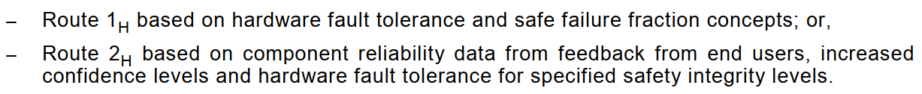
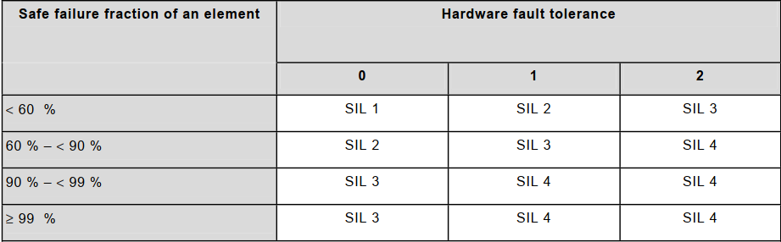
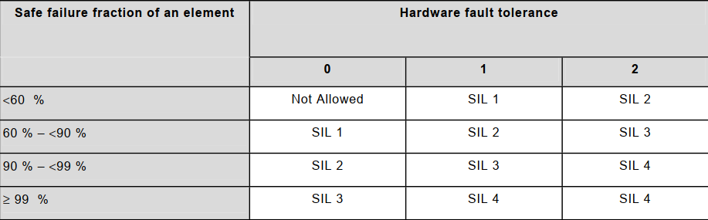
Architectural constraints analysis
Architectural Constraints
IEC 61508:2010-2 Clause 7.4.4 Route 1H or 2H
Architectural Constraints
IEC 61508-2:2010 Clause 7.4.4 Route 1H
Type A
(simple devices ≈
Mechanical devices)
Type B
(complex devices ≈
contain microprocessors)

Slide 31
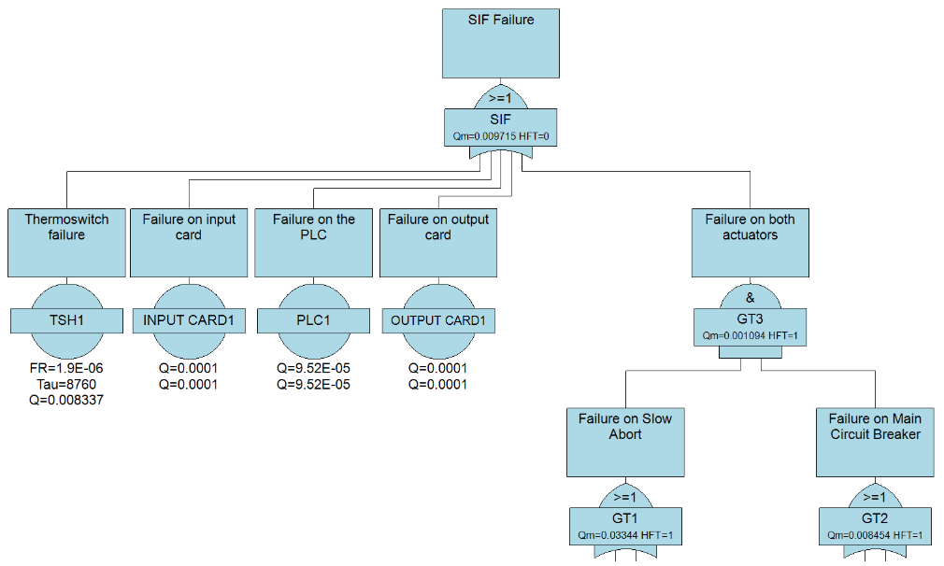
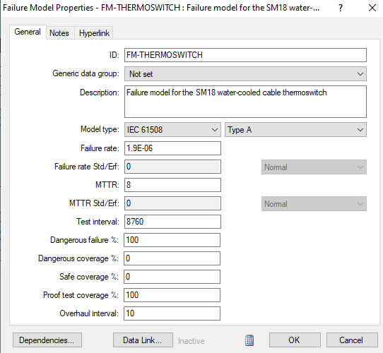
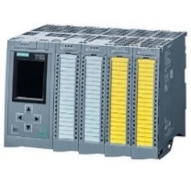
Architectural constrains analysis with Isograph
Related to SFF (Safe Failure Fraction)

Slide 32
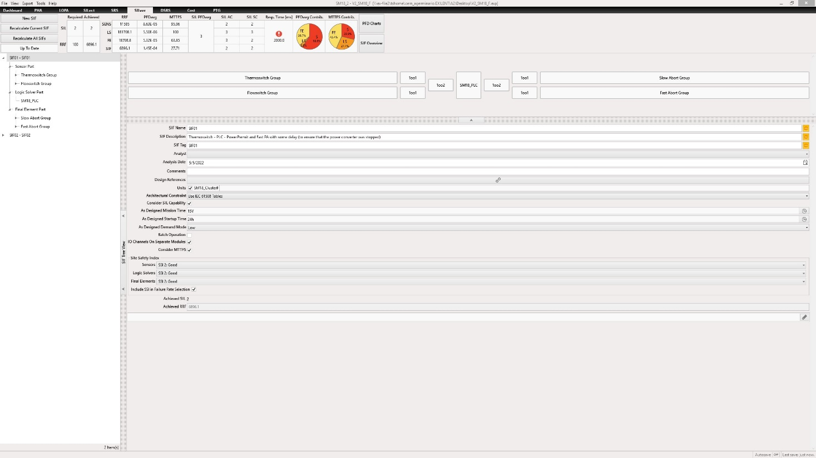
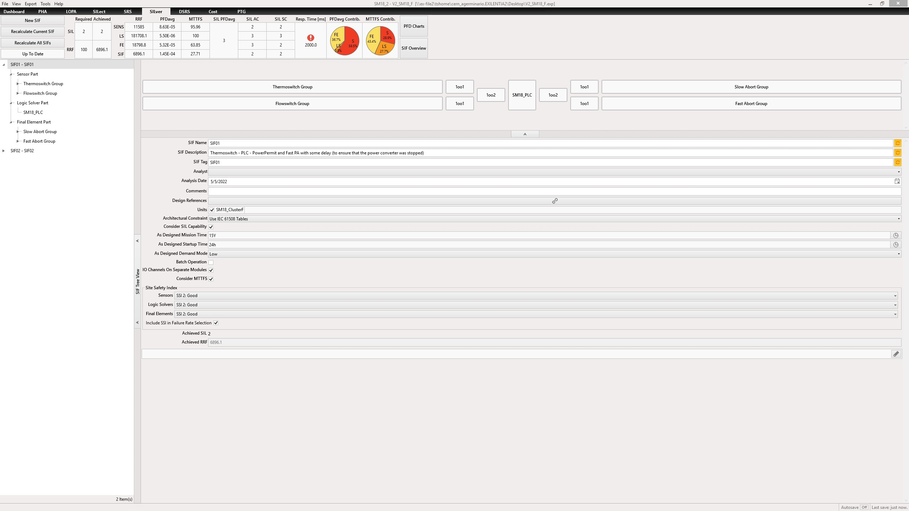
SILver
Other tools: ExSILentia from EXIDA
ExSILentia covers the “full safety life cycle”
The summary Matrix
Hardware reliability
Architectural contrains
Systematic Capability

Slide 33
SILver
Other tools: ExSILentia from EXIDA
The graphical model

Slide 34
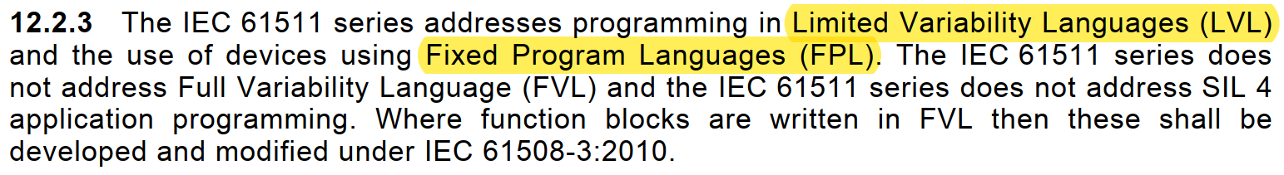
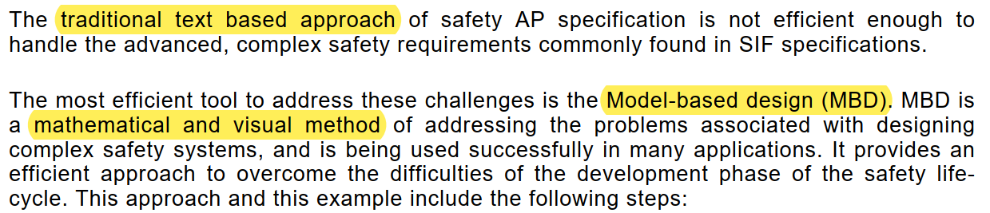

Application Program
IEC 61508-3 (2010). Software requirements
IEC 61511-1 (2016). Clause 12. SIS application program development
IEC 61511-2 (2016). Annex A and Annex B

Slide 35
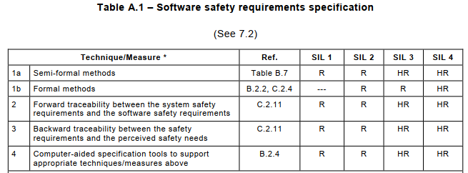

Testing and verification - Formal methods and the FS standards
IEC 61508: Functional safety of electrical/electronic/programmable electronic safety-related systems
IEC 61511: Functional safety – Safety instrumented systems for the process industry sector
several references to model checking. For example from IEC 61511-2:2016 Annex B:
“… specification should be implemented in the graphical language of the model checking workbench environment...”

Slide 36




Application Program
CEM (Cause and Effect Matrix) - SISpec
More details: MOPHA041
LD (Logic Diagrams) - Grassedit
Simulation, test and verification case generation and code generation are possible

Slide 37











Application Program
AP specification
AP development
AP verification
Exported source code
PLC program
LADDER
XML
IL
SISpec
PLCverif
✓
✗
Verification cases
PLCverif more details:
https://cern.ch/plcverif
MOPV042, WEPV042, etc.

Slide 38
FRAS Protection Layers design

Slide 39






Context – FRAS
CMS
Full Remote Alignment System for the HL-LHC EDMS 2166298
Installed in both Long Straight Sections (LSS) of IP1 (ATLAS) and IP5 (CMS)
ATLAS
Q45-D2: Q4, Q5, D2
Triplet-D1: Q1, Q2a, Q2b,
Q3, CP and D1
CMCT: Collimators, Q4/5 masks, Crab-cavities, TAXN

Slide 40


Context – FRAS
4 IP sides and each of them contains:
17 components for remote alignment
Capacitive sensors:
  54 WPS (Wire Positioning System)
  10 Inclinometers
FSI (Frequency Scanning Interferometer) sensors:
  27 HLS (Hydrostatic Levelling Sensors)
  16 FSI inclinometers
Resolvers (5 motors per component):
  85 resolvers
21 bellows
Universal Adjustment Platform (UAP)
5 Motorized jacks
v ≤ 20 µm/s
Exceeding the limits would imply up to 1 year of stop of the LHC
Bellow deformation limits
+/- 2.5 mm
1 mrad

Slide 41










FRAS control system (IP side)
BE-GM, BE-CEM and BE-ICS collaboration
17 components
21 bellows
Sensors:
  54 WPS
  10 Cap. inclin.
  27 HLS FSI
  16 FSI inclin.
17x5 = 85 motors
85 resolvers
Controllers and IO devices:
  2 FECs
  9 DIOTs
  2 PXI
  1 Inter FSI crate – up to 8 FSI boards
  17 Sambuca cards
1 WinCCOA server / project

Slide 42
IEC 61511 Safety Life Cycle
Safety Instrumented System requirements
SIL
Certified devices
Architectural constrains
Software requirements
…
Protection Layers
requirements

Slide 43

Protection Layers design (IEC 61511-3 Annex C)
Necessary Risk Reduction | Number of PLs
10 | 1
100 | 2
1000 | 3

Slide 44

Analysis of the Protection Layers (IEC 61511-2 Annex A)

Slide 45





Protection layers proposal for bellow and personnel protection
(functional schema)
FEC
PL1: capacitive sensors
PL2: resolvers
PL3: FSI
FRAS operator
DIOT
PXI
SAMbuCa
PC server
FSI interf.
by MPP (Machine Protection Panel)
DO
Driver
Motor relay
Motor relay
Motor relay
WPS
FSI
FSI
WPS
Component 1
Component 2
x5

Slide 46


FRAS control system vs FRAS Protection Layers
New hardware

Slide 47
FRAS control system vs FRAS PLs
New hardware
PLs and the FRAS control system share most of the components
We need to analyze the different FRAS control system failures and asses which protection layer protects from specific failures
Functional safety analysis:
  FMEA to analyze component failures
  FTA to analyze system failures
  LOPA to analyze the efficiency of our PLs and assess if we meet the risk reduction target

Slide 48
Reliability data
Source of information:
Failure records
Reliability studies
Standard recommendations
Operator errors (HEART method)
For safety analysis, we only care about dangerous undetected failures

Slide 49

FMEA – Individual component failures

Slide 50


FTA for FRAS control system
Isograph reliability workbench
Failure modes and frequency
from the FMEA

Slide 51

FTA – top FEC
Notes:
All failures records are considered dangerous undetected failures
However, many of them could be detected (e.g. most hardware errors)

Slide 52

FTA – actuation path
Notes:
A hardware failure in the SAMBUCA cards would be detected by the PXI
A software/logic error won't be detected

Slide 53

FTA – Operator mistake
Notes:
If the operator makes a mistake, the top FEC should avoid the wrong command to be transmitted
The HEART method was used to evaluate, the probability of the human failure

Slide 54


Operator mistakes
HEART (Human Error Analysis Reduction Technique) method
From “Critical evaluation of quantitative human error estimation methods in light of different incident causation models and Hollnagel’s research on performance variability”
by Esme Fowler (University of Aberdeen)
https://downloads.opito.com/downloads/Critical-evaluation-of-quantitative-human-error-estimation-methods-in-light-of-different-incident-causation-models-2018.pdf?mtime=20181029151433

Slide 55



HEART (Human Error Analysis Reduction Technique) method

Slide 56


HEART (Human Error Analysis Reduction Technique) method

Slide 57


HEART (Human Error Analysis Reduction Technique) method

Slide 58


HEART (Human Error Analysis Reduction Technique) method

Slide 59




HEART (Human Error Analysis Reduction Technique) method
FinalHEP $=0.17∗\left(\left(3−1\right)∗0.5+1\right)∗(\left(2−1\right)∗0.2+1)$ = 0.408
λ $=0.408 ∗50 op/y=$ 4.9 f/y = 5.6 E-4 y⁻¹

Slide 60





Conclusions FTA
TE-MPE risk matrices for the LHC (EDMS2647876)
$$λ_{1}$$
$$RRF=\frac{λ_{1}}{λ_{2}}$$
$$RRF=\frac{7.35}{10}/\frac{1}{100}=73.5$$
Risk reduction factor
≈ 100
$λ_{1}$ is 8.393E-5 h⁻¹ = 0.735 y⁻¹ = 7.35 failures per 10 years according to the collected data and the FTA
The biggest contributors to this risk are:
  the top FEC: λ = 0.27 y⁻¹ (FESA class is the biggest contributor)
  Actuation path: λ = 0.30 y⁻¹ (SAMBUCA cards and FESA software error are the biggest contributors here)
  Motors and UAPs: λ = 0.16 y⁻¹ (~ 50% each)
The PLs share most of the hardware (and software) with the FRAS control system, LOPA is a good choice to assess scenarios risk and the adequacy of the PLs

Slide 61


Layers of Protection Analysis (LOPA)
Initiating events and frequency from the FTA
Assuming independent (and diverse) PLs
Target from MPE matrices

Slide 62

Layers of Protection Analysis (LOPA)
We don’t meet the independence and diversity requirements
From the IEC 61511 standard

Slide 63

Layers of Protection Analysis (LOPA)
We don’t meet the independence and diversity requirements
From the IEC 61511 standard

Slide 64
Conclusions
About FRAS control system:
The biggest contributors to this risk are:
  the top FEC: λ = 0.27 y⁻¹ (FESA class is the biggest contributor)
  Actuation path: λ = 0.30 y⁻¹ (SAMBUCA cards and FESA software error are the biggest contributors here)
  Motors and UAPs: λ = 0.16 y⁻¹ (~ 50% each)
Software errors can be minimized by “exhaustive” functional testing
About the PLs:
We don’t meet all the requirements from IEC 61511 to claim a risk reduction of 10 per PL, therefore we only claim a maximum of 10 risk reduction for all PLs protecting from a specific event
According to this data, if the risk is present (motors are powered) more than 11 full days per year, we don’t meet the tolerable risk target
According to this data, if FRAS components are operated less than 11 days, we do NOT need to provide diversity and replace the PL1 FEC by a PLC (if a PLC is installed in PL1, full independence between 2 PLs can be achieved)
Human errors are analyzed by the HEART method, but it is not a critical source of danger
Cybersecurity issues will be addressed with different methods (determinist methods)

Slide 65
Functional safety projects management

Slide 66

Management of Functional Safety projects
Challenges:
  Define the roles and responsibilities of the project members
  Define the workflow and documentation to coordinate all project members

Slide 67

Management of Functional Safety projects (workflow)
Analysis
Design
Implementation
Operation
Maintenance

Slide 68

Functional Safety tools
More details in https://inspirehep.net/files/fcdeb3597bbefa61732b5fdbb53c53e6
Many more tools for phase 4 (SIL verification)

Slide 69
Conclusions / tips
  FS is about proving that your design, development and operation meet the risk reduction target (SIL)
  The SIL (risk reduction target) can be achieved (mainly) by:
    a SIS (IEC 61511-1 clauses 10, 11, 12 and 13)
    or independent protection layers (IEC 61511-1 clause 9)
  If SIS, then:
    Reliability calculations (random hardware failures)
    Architectural analysis
    Systematic failures analysis (e.g Operators, EMC, etc.)
    Software design and verification
    …
  If PLs, then: specificity, independence, dependability, auditability and diversity (when possible)
  Multidisciplinary teams (Safety engineers, process engineers, automation engineers, functional safety engineers, …)
  Proof tests (periodic test to maintain the SIL over the life of the industrial plant)

Slide 70
Future work at BE-ICS
Regarding management aspects:
Traceability (explore commercial tools)
Workflow procedures for functional safety projects (coordination and responsibilities of the different groups)
Functional safety service definition
Regarding technical aspects:
Code generation of application programs (Siemens safety LADDER code for TIA portal)
Integration in our frameworks (e.g. UNICOS)
Frequency estimation of software errors (?)

