Slide 1
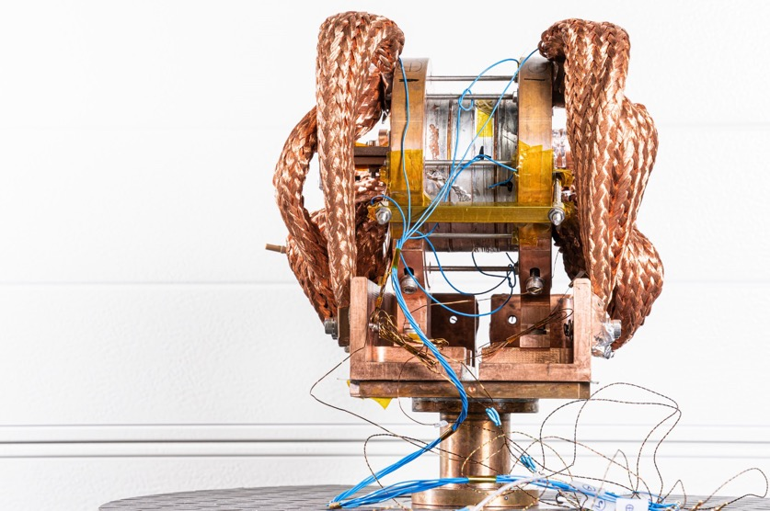


Status of High-Field Magnet R&D for Future Colliders in CHART
D. M. Araujo, B. Auchmann, A. Brem, M. Daly, M. Duda, O. Kirby, M. Koratzinos, J. Kosse, T. Michlmayr, H. G. Rodrigues, S. Sanfilippo, D. Sotnikov
MuCol slides by L. Bottura for the Muon Magnets Working Group
02.05.2023 – Future Colliders seminar
This work was performed under the auspices of and with support from the
Swiss Accelerator Research and Technology (CHART) program (www.chart.ch).

Slide 2
Overview
CHART – Swiss Accelerator Research and Technology
CHART contributions to FCChh HFMs
  Nb₃Sn
  HTS (ReBCO)
FCCee
  Baseline magnet system
    Arc cells
    MDI
  CHART contributions to HTS-based feasibility studies
    P³: Positron source capture solenoid
    HTS4: HTS Short Straight Section
Muon Collider magnet requirements
PSI Synergies

Slide 3
Overview
CHART – Swiss Accelerator Research and Technology
CHART contributions to FCChh HFMs
  Nb₃Sn
  HTS (ReBCO)
FCCee
  Baseline magnet system
    Arc cells
    MDI
  CHART contributions to HTS-based feasibility studies
    P³: Positron source capture solenoid
    HTS4: HTS Short Straight Section
Muon Collider magnet requirements
PSI Synergies

Slide 4
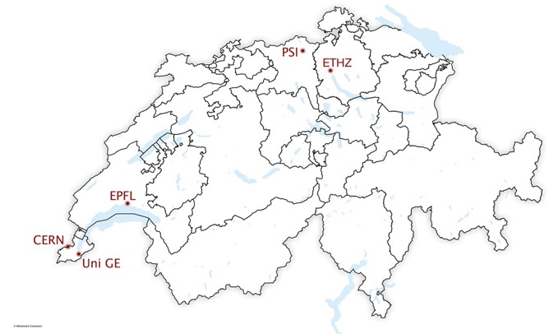









CHART
“CHART, the Swiss Center for Accelerator Research and Technology, was founded to support the future oriented accelerator project Future Circular Collider (FCC) at CERN and the development of advanced accelerator concepts in Switzerland beyond the existing technology. […] The high field magnet R&D has strong synergies with PSI projects […]”
[Application for support of the Swiss Accelerator Research and Technology Initiative, 2018]
~50% of the effort directed to Applied Superconductivity for accelerators.
http://chart.ch

Slide 5
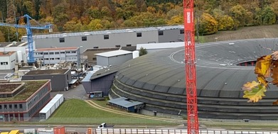
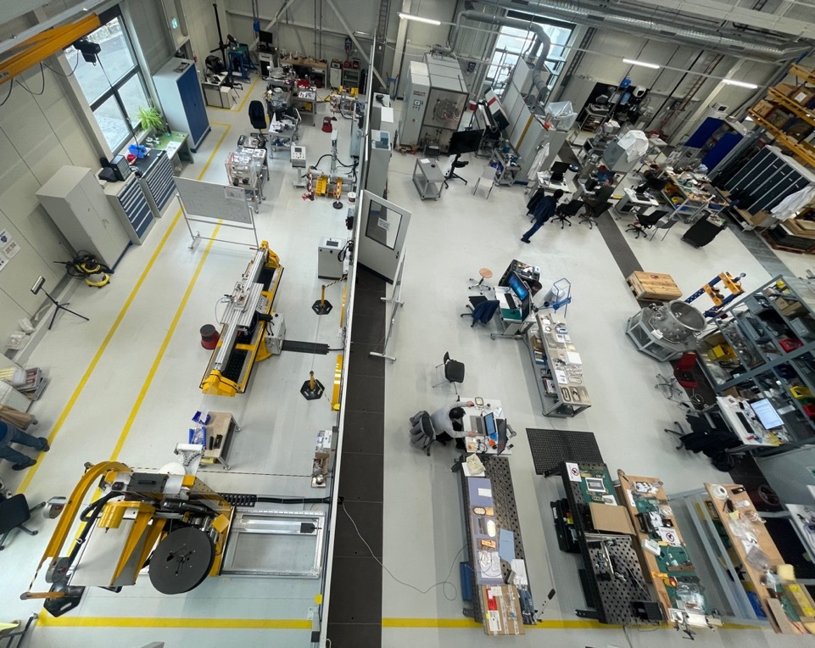
MagDev Laboratory
New extension to building WLHA next to SLS2.0.
Hand-over in August 2020.
3D Scanning
Heat treatment
HTS winding
Re-reeler
Impregnation
Storage
Instrumentation
LTS winding
Loading / Assembly

Slide 6
Overview
CHART – Swiss Accelerator Research and Technology
CHART contributions to FCChh HFMs
  Nb₃Sn
  HTS (ReBCO)
FCCee
  Baseline magnet system
    Arc cells
    MDI
  CHART contributions to HTS-based feasibility studies
    P³: Positron source capture solenoid
    HTS4: HTS Short Straight Section
Muon Collider magnet requirements
PSI Synergies

Slide 7
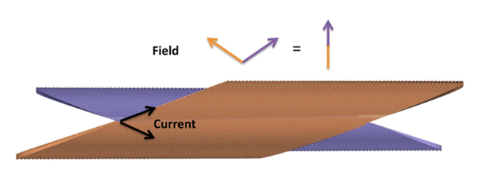
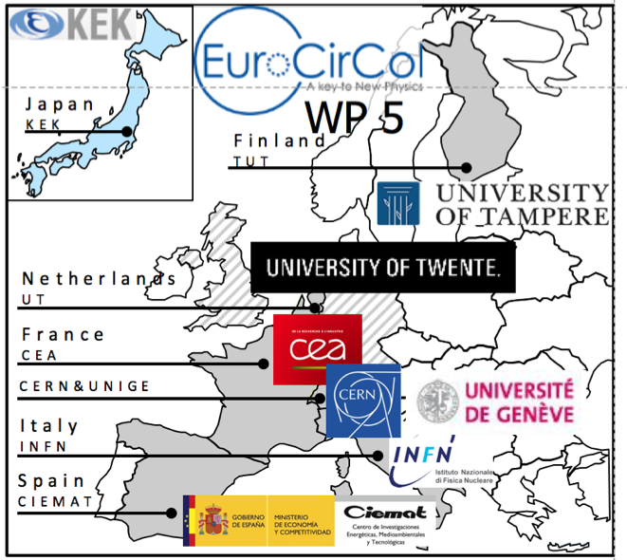
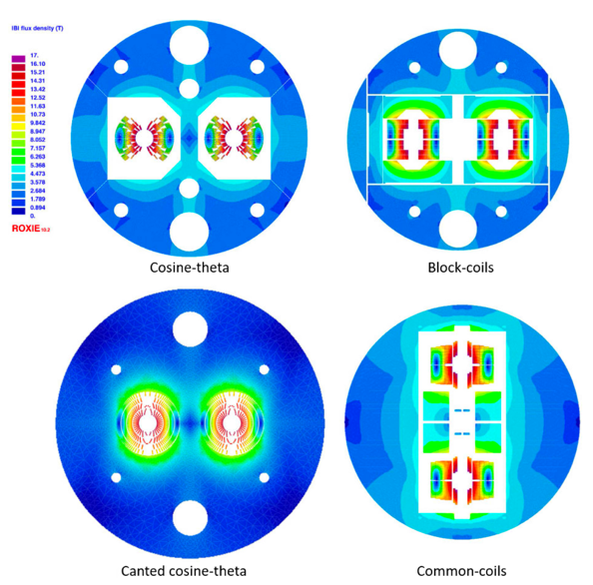

FCC-hh Nb₃Sn after EuroCirCol (2015-2019)
CHART joined the Nb3Sn HFM R&D during
the Horizon2020 EuroCirCol effort.
PSI studied the Canted Cosine Theta option.
[M. Benedikt et al., FCC Conceptual Design Report, Vol. 3 – The Hadron Collider (FCC-hh), January 2019.]

Slide 8
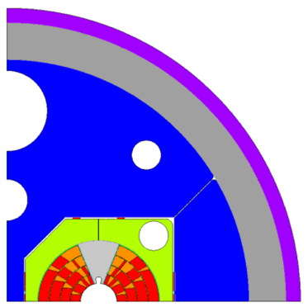
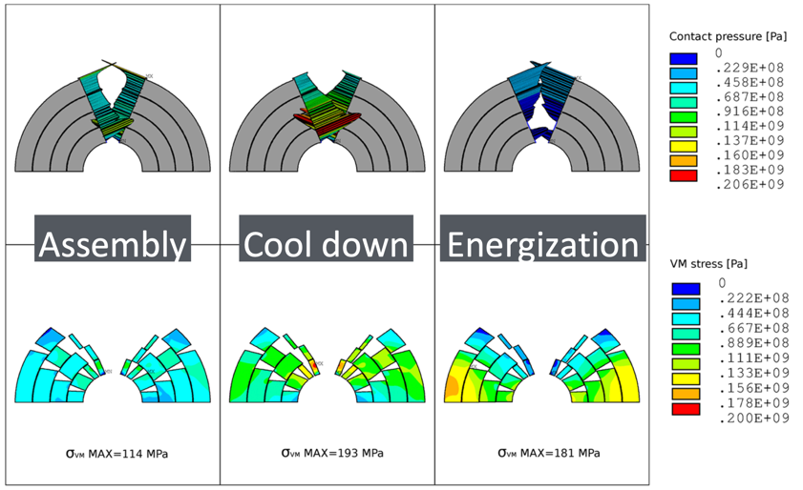
Full Pre-Stress Paradigm
A lesson learned from the Nb-Ti era.
Keep coils under compression at all stages of operation
→ avoid stick-slip motion.
  Forces scale quadratically with field. For 16 T dipole,
  forces equivalent of 1.5 kt/m pull coil-halves apart.
  10 µm abrupt movement is enough to cause quench.
However, need to limit stress on Nb₃Sn to 150-200 MPa.
[S. Farinon et al., in M. Benedikt et al., FCC Conceptual Design Report, Vol. 3 – The Hadron Collider (FCC-hh), January 2019.]

Slide 9
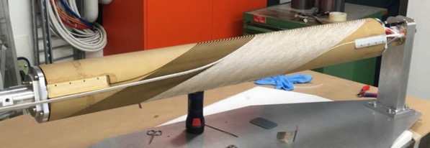
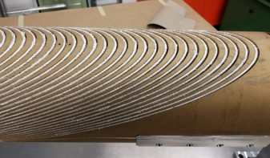
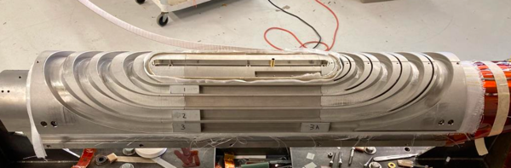
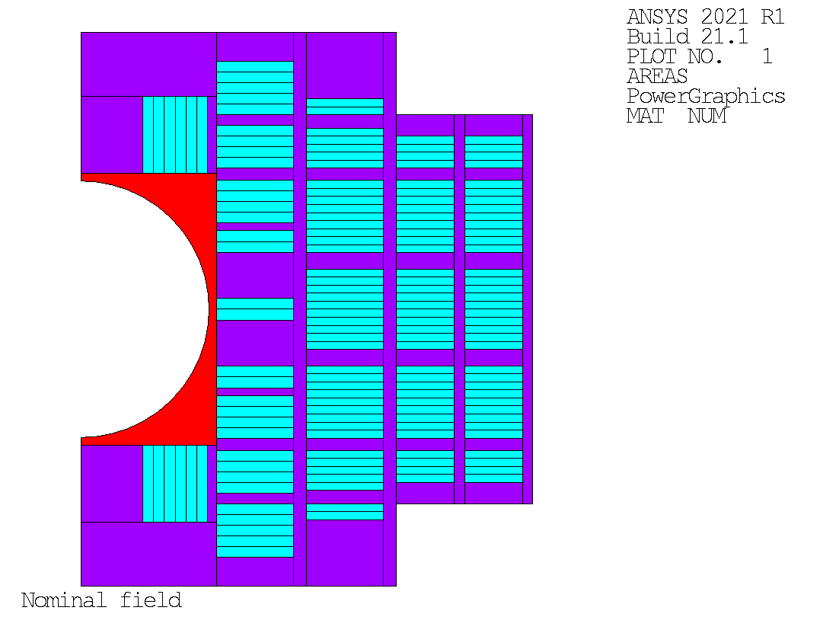
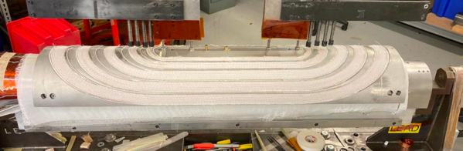
Stress Management Paradigm
For stress-managed coils, the winding mandrel acts as an endo-skeleton, intercepting forces, conferring rigid support, and protecting the conductor.
Stress-managed coils see (nearly) no stress before powering.
The mandrel acts as winding, reaction, and impregnation tooing.
CCT is the extreme case with force interception at every single turn.
[CCT winding, G. Montenero]
[Stress-managed common-coil concept, D. Araujo]
[SMCT winding; courtesy of A. Zlobin and I. Novitski, FNAL]

Slide 10
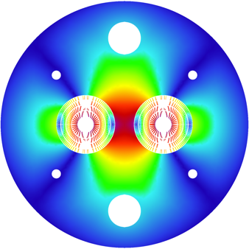
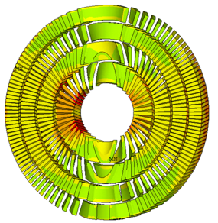
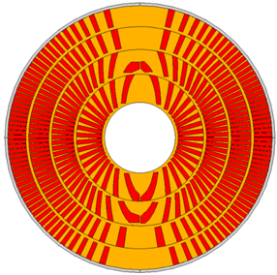
Design Goal for CHART HFM R&D
EuroCirCol Design Goal: Shared specs and minimization of conductor volume.
Stress Management adds mechanical margins and dilutes current density.
CCT has 1/3 lower conductor stress (135 MPa) for 20% more conductor vol.
[B. Auchmann et al., Electromechanical Design of a 16-T CCT Twin-Aperture Dipole for FCC, IEEE Trans. on Appl. SC 28 (April, 2018) no. 3.]
[M. Benedikt et al., FCC Conceptual Design Report, Vol. 3 – The Hadron Collider (FCC-hh), pp. 50-52.]

Slide 11


Design Goal for CHART HFM R&D
EuroCirCol Design Goal: Shared specs and minimization of conductor volume.
Stress Management adds mechanical margins and dilutes current density.
CCT has 1/3 lower conductor stress (135 MPa) for 20% more conductor vol.
Conductor cost is not the only cost component: simple procedures, high production yield, and robustness in operation constitute additional
savings and accelerate R&D.
Performance
Robustness
Cost

Slide 12
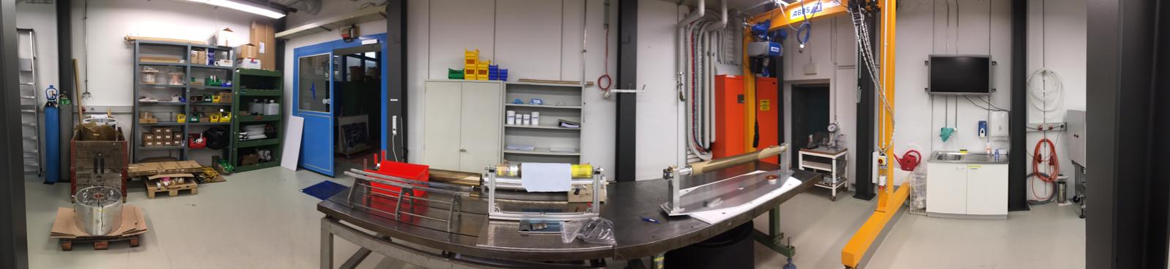
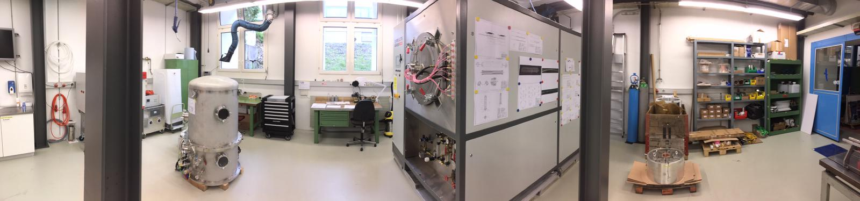
Canted Dipole 1 built at PSI
Magnet design, lab refurbishment, equipment, and commissioning, as well as magnet construction from 02.2017 to 10.2019.
Portal crane
Storage
Winding table
4-m winding/instrum/assembly bench
Vacuum Impregnation
Coil reaction

Slide 13
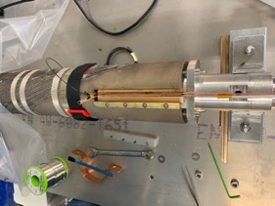
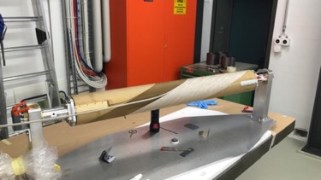
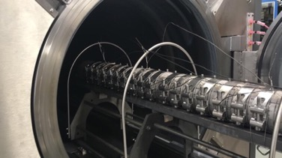
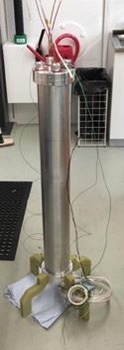
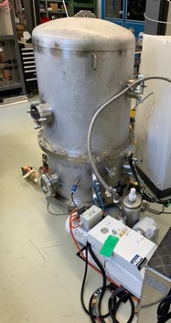
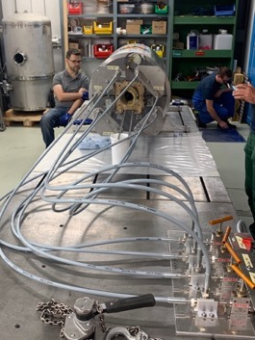
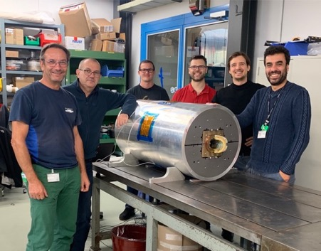
Canted Dipole 1 built at PSI
Magnet design, lab refurbishment, equipment, and commissioning, as well as magnet construction from 02.2017 to 10.2019.
[G. Montenero et al., Coil Manufacturing Process of the First 1-m-Long Canted-Cosine-Theta (CCT) Model Magnet at PSI, IEEE Trans. on App. SC., Vol 29(5), 2019.
G. Montenero et al., Mechanical Structure for the PSI Canted-Cosine-Theta (CCT) Magnet Program, IEEE Trans. on Appl. SC., Vol 28(3), 2018.]

Slide 14
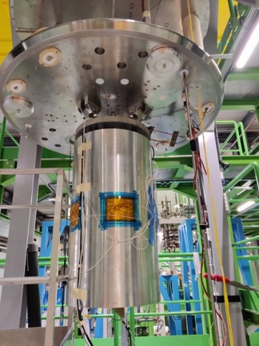
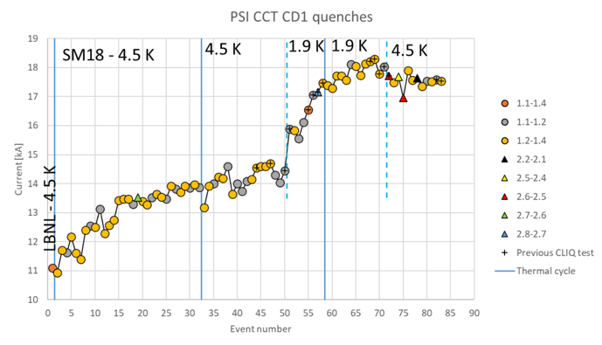
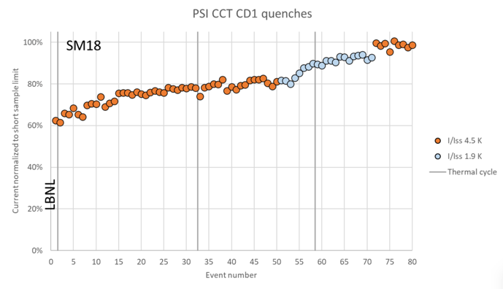
CD1 Lessons on Robustness and Performance
The magnet trained A LOT.
But, it reached 100% of maximum field at 4.5 K.
These were the first Nb₃Sn training coils at PSI:
  No conductor degradation occurred from handling, assembly, powering, or thermal cycling.
Stress-management works, CD1 is a robust magnet.
Courtesy F. Mangiarotti (CERN) and M. Daly (PSI).

Slide 15
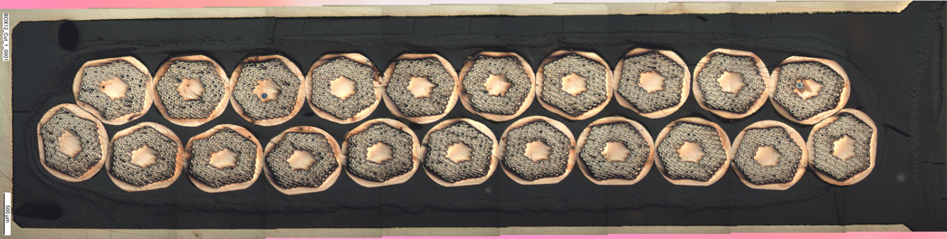
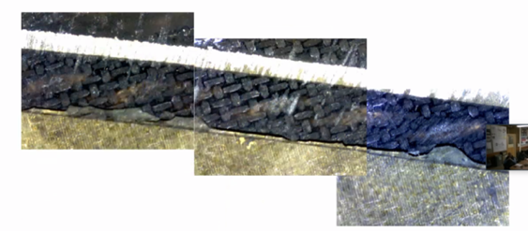
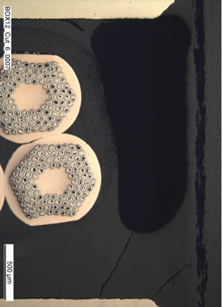
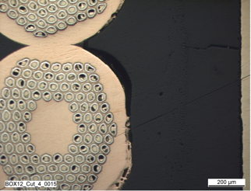
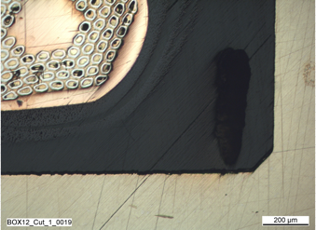
Training – Root Causes
Resin cracking.
De-bonding from winding former or strand diameter.
Voids due to processing → wire movement and/or crack initiation.
Cracks
Voids
Surface defects (de-bonding)
[Courtesy of O. Kirby, M. Daly.]
[Courtesy D. Arbelaez, LBNL.]

Slide 16

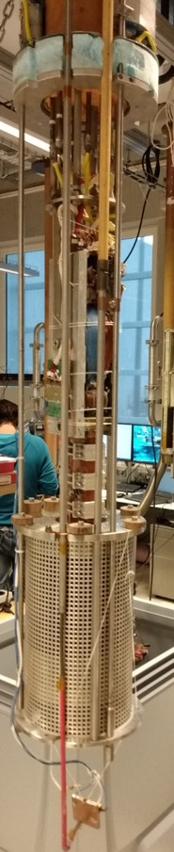
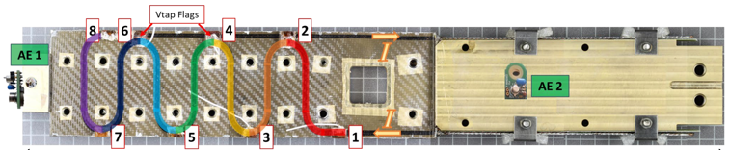
BOX Program
SC Transformer
11-T solenoid
Pictures by M. Daly, S. Sidorov, S. Otten
Notes:
LBNL is preparing a wax impregnated subscale CCT magnet

Slide 17
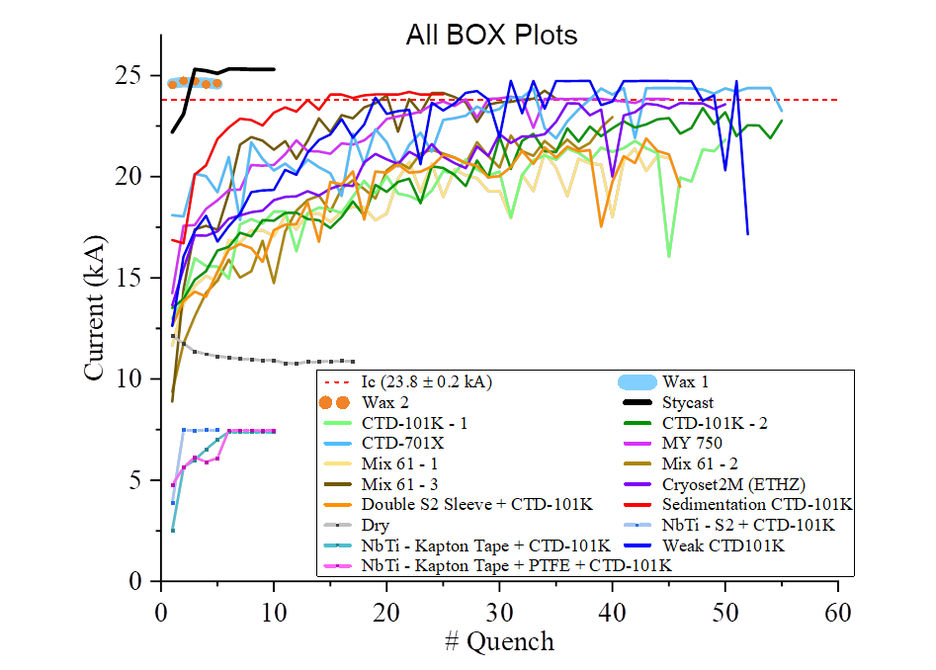
BOX Program
Pictures by M. Daly, S. Sidorov, S. Otten
BOX (BOnding eXperiment) program with uTwente has shown a wide variety of results,
from complete conductor degradation (no impregnation) to substantial training (epoxy) to
no-training (wax, Stycast), with 18 BOX samples successfully manufactured and tested to date.
Notes:
LBNL is preparing a wax impregnated subscale CCT magnet

Slide 18
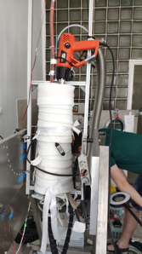
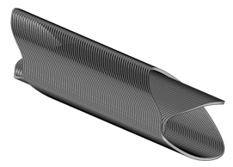
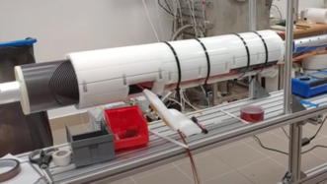
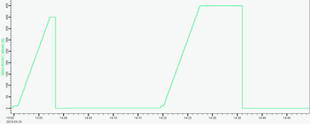
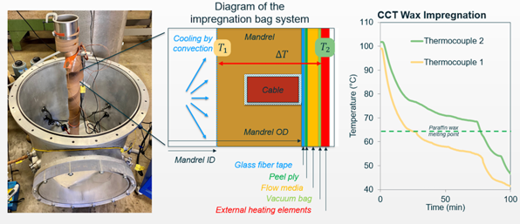
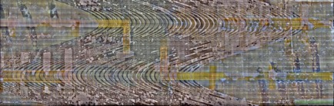
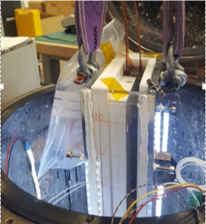
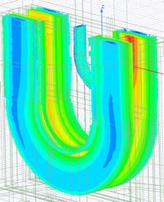
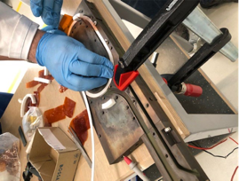
BOX Findings Implemented in Other Projects:
Wigner Institute and CERN collaboration for SuShi septum for FCC-hh:
  Wax impregnated CCT required no training to nominal current.
LBNL’s wax impregnated sub-scale (5 T) CCT.
  First Nb3Sn CCT without training.
  Next up: filled-epoxysub-scale.
PSI’s BigBOX: a 13-turn stress-managed racetrack.
  No training in 9 T background
  field of BNL’s DCC17 facility.
[Courtesy D. Barna et al., Wigner Institute]
Paraffin wax
(CCT Sub5)
[Courtesy J.L. Rudeiros Fernandez, LBNL]
[Courtesy D. Araujo et al]

Slide 19
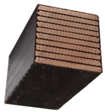

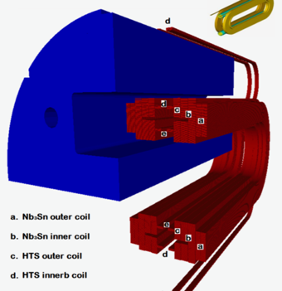
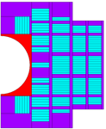
Turnaround, Innovation, and Risk Mitigation
HFM R&D has suffered from slow turnaround and late feedback on technology.
“We propose […] a succession of meaningful fast-turnaround demonstrations […]. In this way, new technologies can be tested under realistic conditions at the earliest possible stage, the smallest relevant scale and cost, and the fastest pace.“ [LDG Roadmap for High-Field Magnets.]
First deliverable
#Deliverables / year
2019
Materials and Composite Samples (not powered)
100s
2020
Powered Samples and Mechanical Models
10
2023
Sub-scale Magnets (5 T)
2-3
2025/26
Short Magnets
Ultimate Field (14…16T)
0.5-1
Long Magnets Ultimate Field Magnets
(14…16 T)
Long-magnet infrastructure
available only at CERN.
[Q. Xu, FCC Week 2016]

Slide 20
Overview
CHART – Swiss Accelerator Research and Technology
CHART contributions to FCChh HFMs
  Nb₃Sn
  HTS (ReBCO)
FCCee
  Baseline magnet system
    Arc cells
    MDI
  CHART contributions to HTS-based feasibility studies
    P³: Positron source capture solenoid
    HTS4: HTS Short Straight Section
Muon Collider magnet requirements
PSI Synergies

Slide 21
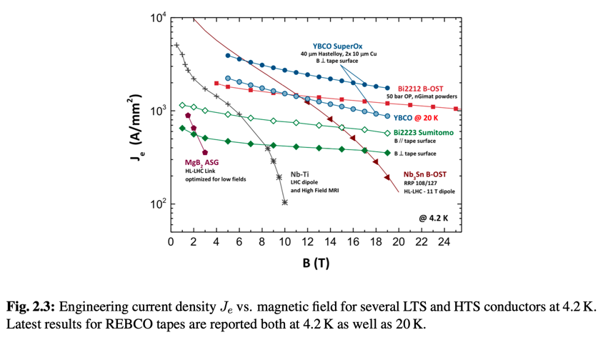
The Promises of HTS
LDG Roadmap on High-Field Magnets, p. 33
  “Consideration of only engineering current density would suggest that magnetic fields in the range of 25 T could be generated by HTS“
  “… performance of HTS in the range 10 to 20K has reached values of Je well in excess of 500 to 800A/mm2, i.e., the level that is required for compact accelerator coils. […] it would open a pathway towards a reduction of cryogenic power, [and] a reduction of helium inventory (e.g., dry magnets)”
[LDG Accelerator R&D Roadmap, High-Field Magnets, https://arxiv.org/abs/2201.07895]

Slide 22


ReBCO Tape and ReBCO Cables
LTS wires have filament sizes of few microns (Nb-Ti) to 50 µm (Nb₃Sn).
ReBCO tapes are 2-12 mm wide. Screening currents and associated losses
are substantially increased.
[J. v. Nugteren, High Temperature Superconductor Accelerator Magnets. PhD thesis, UTwente, 2016.]

Slide 23



A First Look at Ramp Losses
What are ramp losses in an all-HTS 20 T magnet at 4.2 K?
  The geometry is a block-coil design by J. v. Nugteren. Simulation carried out by L. Bortot.
  Part-homogenized model, ramping 0 to 20 T in 1150 s, operating at 4.2 K – to be validated.
  65 kJ/m cycle losses.
  FCC-hh CDR target: 10 kJ/m at 1.9 K.
How do losses scale to higher operating temperature?
  Multiple x-section models required.
How quickly can losses be transferred to cryogenic system?
  Fast enough for 2-6 h operational turnaround?
  By how much does the coil temperature rise?
  Is field quality affected from local temperature in
  cryogenic circuit?
Which cable geometry can make a difference?
  Can tape-stack cable fulfill the specs?
How important is the cable orientation?
  What coil geometries are eligible?
[Courtesy L. Bortot]
[Courtesy G. Kirby, J. v. Nugteren,
J. S. Murtomäki, et al.]

Slide 24
Systems Engineering Challenge
Interrelated elements of an HTS HFM technology:
Systems engineering is key.
CHART/MagNum at ETHZ has developed pyMBSE, a python package for
Model-Based Systems Engineering.
Cable and
coil design
Beam dynamics interface
Structural design
Thermal design
Cryogenics interface
Protection design
Key component for AC losses,
field quality, mechanical compliance,
protectability, etc.

Slide 25


ReBCO Tape and ReBCO Cables
ReBCO magnet technology is at the stage of LTS in the 1970ies.
[J. v. Nugteren, High Temperature Superconductor Accelerator Magnets. PhD thesis, UTwente, 2016.]
[M. Wilson, Pulsed Superconducting Magnets' CERN Academic Training May 2006]

Slide 26



Roadmap Towards HTS for HFM
Innovation funnel for HTS HFM R&D:
First deliverable
#Deliverables / year
2023
Materials and Numerical Design Studies
100s
2023
Powered Cable Samples
3
2024
Technology Racetrack Coils
2
Short Hybrid HTS/LTS
Sub-Scale and Ultimate-Field Magnets (7…17 T)
2026
1
Short All-HTS Magnets
(16…20 T)
(4.2…20 K)
Magnetic field.
Current distribution Jz through tapes in the stack.

Slide 27
Overview
CHART – Swiss Accelerator Research and Technology
CHART contributions to FCChh HFMs
  Nb₃Sn
  HTS (ReBCO)
FCCee
  Baseline magnet system
    Arc cells
    MDI
  CHART contributions to HTS-based feasibility studies
    P³: Positron source capture solenoid
    HTS4: HTS Short Straight Section
Muon Collider magnet requirements
PSI Synergies

Slide 28






FCC-ee NC Magnets
2900 magnets
Strength: 57 mT
Apert.: 130x84 mm
Power: 13.3 MW
2900 magnets
Strength: 10 T/m
ID: 84 mm
Power: 22.6 MW
4672 magnets
Strenth: 807 T/m2
ID: 76 mm
Power: 20.5 MW
[Design by A. Milanese, reproduced from M. Benedikt et al., FCC Conceptual Design Report, Vol. 3 – The Hadron Collider (FCC-hh), January 2019]

Slide 29


FCC-ee Main Magnet Prototypes
“Magnetically coupled [twin-]apertures for main dipole and quadrupole magnets offer significant energy savings and reduce the number of coils, thus simplifying the construction of these magnets.”
[A. Milanese, M. Bohdanowicz, Twin aperture bending magnets and quadrupoles for FCC-ee, August 2017
https://indico.cern.ch/event/445667/contributions/2561905/attachments/1514144/2362295/FCC_ee_warm_magnets.pdf]

Slide 30

FCC-ee Machine-Detector-Interface
22 superconducting magnets:
  6 final focus (ID 40 mm, 100 T/m),
  12 correctors
  2 compensation solenoids (4.9 T, 118-195 mm tapered)
  2 screening solenoids (2 T, OD 390 mm)
Most located SC magnets in the heart of the detector.
High complexity due to multiple strongly coupled systems: IP, detector solenoid (forces and protection), mechanics and alignment, beam dynamics, etc.
[M. Boscolo, Pre-engineering design review and roadmap discussion for FCC-ee IR magnets, April 2022]

Slide 31

FCC-ee Machine-Detector-Interface
22 superconducting magnets:
  6 final focus (ID 40 mm, 100 T/m),
  12 correctors
  2 compensation solenoids (4.9 T, 118-195 mm tapered)
  2 screening solenoids (2 T, OD 390 mm)
Most located SC magnets in the heart of the detector.
High complexity due to multiple strongly coupled systems: IP, detector solenoid (forces and protection), mechanics and alignment, beam dynamics, etc.
[M. Boscolo, Pre-engineering design review and roadmap discussion for FCC-ee IR magnets, April 2022]

Slide 32



FCC-ee Final Focus Quadrupoles
Current final focus design based on CCT concept.
Room-temperature measurement of field quality < 0.15 units.
May soon be impregnated with wax at PSI.
To be tested at cold at CERN.
[M. Koratzinos, Pre-engineering design review and
roadmap discussion for FCC-ee IR magnets, April 2022]

Slide 33
Overview
CHART – Swiss Accelerator Research and Technology
CHART contributions to FCChh HFMs
  Nb₃Sn
  HTS (ReBCO)
FCCee
  Baseline magnet system
    Arc cells
    MDI
  CHART contributions to HTS-based feasibility studies
    P³: Positron source capture solenoid
    HTS4: HTS Short Straight Section
Muon Collider magnet requirements
PSI Synergies

Slide 34


HTS4: HTS Short Straight Sections for FCC-ee
By using HTS sextupoles and quadrupoles instead of the RT baseline, HTS4 aims to:
Reduce energy consumption from up to 80 MW (43 MW in CDR) to <10 MW
Increase dipole filling factor – decrease SR
Enhance optics flexibility
Challenges:
Accelerator-grade field quality with HTS
Balance cooling power with conductor volume
High-reliability cryocooler-based operation
Low heat-load powering
Mitigation of radiation issues on electronics
Sub-scale coils and 1-m prototype module to be constructed and tested at PSI
CCT variant courtesy M. Koratzinos
Page 34

Slide 35



HTS4: HTS Short Straight Sections for FCC-ee
Can magnets be cooled by cryocoolers with high availability?
  First estimates say YES, IF redundancy is implemented
  Total system coldhead reliability >0.999 over 3 year period possible
Two competing sub-scale demonstrators are under preparation.
$k$ number of required operational coolers
$n$ Installed coolers per magnet
$$R$$ | $$k=1$$ | $$k=2$$ | $$k=3$$ | $$k=4$$ | $$k=5$$ | $$k=6$$
$$n=1$$ | 0.0000
$$n=2$$ | 0.9817 | 0.0000
$$n=3$$ | 1.0000 | 0.9462 | 0.0000
$$n=4$$ | 1.0000 | 0.9998 | 0.8954 | 0.0000
$$n=5$$ | 1.0000 | 1.0000 | 0.9995 | 0.8321 | 0.0000
$$n=6$$ | 1.0000 | 1.0000 | 1.0000 | 0.9991 | 0.7594 | 0.0000
Courtesy, M. Koratzinos.
Sextupole CCT subscale magnet.
Page 35

Slide 36

Cryogenic Power Supply CHART Project at ETHZ
In support of FCCee HTS4,
CPES develops a cryogenic
power supply which, in its
first iteration, may reduce
heat load to the cryo-cooler
by 50%.
CPES development follows
specifications provided by
CERN power-supply specialists.
The CPES unit may incorporate
magnet protection functionality.
Cold-testing and integration
studies at PSI cryogen-free
test station.
Courtesy J. Huber

Slide 37

4-Stack Technology Solenoid

Slide 38



4-Stack Technology Solenoid Cold Test
Successful test in cryogen-free test station of 4-pancake HTS NI solenoid, built in-house at PSI and using licensed Tokamak Energy Ltd technology.
Coil reached 18.2 T in the center,
20.3 T on the conductor at the
maximum current of the power
converter of 2 kA and
12 K coil temp.
Hall probes were qualified
at UniGE up to 19 T.
radiation shield
top plate
thermal
connectors
2nd cryocooler
20K coldhead
1st cryocooler
4K coldhead
Diameter: 100 mm
Aperture: 50 mm
SC type: ReBCO
# tapes: 2
# turns: 2 x 170
SC length: 2 x 49 m
Cu leads
HTS leads
Stack of 4 NI HTS
coils with thermal/
electrical connectors
Courtesy of M. Duda, J. Kosse, H. Rodrigues

Slide 39


FCCee Injector Study:P³ (PSI
Positron Production)
HTS NI target solenoid, to demonstrate
high-yield positron source concept
  stable DC operation,
  high thermal conduction due to solder
  impregnation to extract heat
  deposited in coils,
  radiation robustness due to
  absence of insulators.
Manufacturing/commissioning Q3’23-Q2’24
Experiment at PSI’s SwissFEL 2025/26
15 K conduction-cooling
5 coils from 12 mm ReBCO, 110 mm ID
21 T peak field
target
Solid-state (Pb)
thermal buffer
15 T in 72 mm warm bore
Courtesy J. Kosse, T. Michlmayr, H. Rodrigues

Slide 40
Overview
CHART – Swiss Accelerator Research and Technology
CHART contributions to FCChh HFMs
  Nb₃Sn
  HTS (ReBCO)
FCCee
  Baseline magnet system
    Arc cells
    MDI
  CHART contributions to HTS-based feasibility studies
    P³: Positron source capture solenoid
    HTS4: HTS Short Straight Section
Muon Collider magnet requirements
PSI Synergies

Slide 41






Muon Collider magnets
HTS !
NC ±1.8 T, 400 Hz 100 mm x 30 mm
SC < 10T
100 mm x 30 mm
20 T, 200 mm
Radiation heat load ≈ 5…10 kW
Radiation dose: 80 MGy
HTS ?
SC dipole
NC dipole
NC dipole
SC dipole
RCS
> 40 T, 60 mm
16 T peak, 150 mm
Radiation heat load ≈ 5 W/m
Radiation dose ≈ 20…40 MGy
HTS ?
HTS !
Slides courtesy of L. Bottura for the for the Muon Magnets Working Group

Slide 42




Target and capture solenoid (20 T)
A Portone, P. Testoni, J. Lorenzo Gomez, F4E
Operating current: 61 kA
Operating field: 20 T
Operating temperature: 20 K
SS JACKET
SS WRAP
MIT “VIPER” conductor
COPPER FORMER
SOLDERED HTS STACK
COOLING CHANNEL
8
23.5
M. Takayasu et al., IEEE TAS, 21 (2011) 2340
Z. S. Hartwig et al., SUST, 33 (2020) 11LT01
39.5
Strong connection to HTS magnets for fusion
Slides courtesy of L. Bottura for the for the Muon Magnets Working Group

Slide 43







Final cooling (40 T)
σ_{max} = 600 MPa
A. Dudarev, CERN
Inner Ring
‘Correction’ Coil
Outer Ring
Bore
40 T solenoid design
‘Modular’ Coil
1 % Field Homogeneity
Support Plate
B. Bordini, CERN
T. Mulder, CERN
B. Bordini, CERN
Strong connection to HTS magnets for science
Slides courtesy of L. Bottura for the for the Muon Magnets Working Group

Slide 44






Accelerator magnets (±1.8 T)
Warm dipoles are pulsed from
-Bmax to +Bmax at high speed (0.35 to 6.37 ms) every 200 ms
5.07 kJ/m
5.65…7.14 kJ/m
5.89 kJ/m
The main challenge is the management of the power in the resistive dipoles (several tens of GW):
Minimum stored magnetic energy
Highly efficient energy storage and recovery
A simple HTS racetrack dipole could match the beam requirements and aperture
HTS flat racetracks
b3 = -7.2 units
b5 = -1.4 units
b7 = -0.03 units
peak field
10.4 T
Cold dipoles provide a steady baseline field of about 10 T
Rectangular magnet bore 100 mm x 30 mm
F. Boattini, CERN
Slides courtesy of L. Bottura for the for the Muon Magnets Working Group

Slide 45


Collider magnets limits (Nb₃Sn)
Stress limit
Margin limit
Stress limit
Margin limit
Dipoles
Quadrupoles
Work in progress to provide analytical expression for the magnet design limits (including protection and cost)
  Maximum field and gradient vs. magnet aperture in LTS and HTS
  Combined function limits B+G and B/G
Proposal: take provisionally 9 T for NbTi and 14 T for Nb₃Sn
Slides courtesy of L. Bottura for the for the Muon Magnets Working Group

Slide 46

Compact windings
Example of 16 T muon collider main dipole built with HTS
We need to increase the winding current density to fall in a reasonable range of conductor mass (applies both to LTS and HTS)
Unresolved issues:
  Winding geometry for tapes and stacks (ends, alignment, transposition possibly superfluous ?)
  Mechanics of coils under the exceptional electromagnetic loads (longitudinal stress in the range of 600 MPa, transverse stress in the range of 400 MPa)
  Quench management at high current and energy density (above 100 MJ/m³)
  Radiation hardness of materials and coils (40…80 MGy and 10²² n/m²)
350 A/mm²
500,000 km
950 A/mm²
150,000 km
Slides courtesy of L. Bottura for the for the Muon Magnets Working Group

Slide 47
Overview
CHART – Swiss Accelerator Research and Technology
CHART contributions to FCChh HFMs
  Nb₃Sn
  HTS (ReBCO)
FCCee
  Baseline magnet system
    Arc cells
    MDI
  CHART contributions to HTS-based feasibility studies
    P³: Positron source capture solenoid
    HTS4: HTS Short Straight Section
Muon Collider magnet requirements
PSI Synergies

Slide 48

Synergies for PSI and Swiss Research Landscape
Magnetic field improves the physics reach in many experiments.
Ongoing discussions at PSI
X-ray scattering
  Miniaturized (2 cm ID, 1 cm height) source
  of 6 T on sample.
Neutron Scattering
  Split coils for vertical-field scattering;
  wide-aperture horizontal solenoids.
HIMB project (High-Intensity Muon Beams)
  Radiation hard, large-aperture capture solenoid.
All projects have direct synergies with FCCee capture solenoid, MuCol target and cooling system.
RIXS manipulator mockup.
Courtesy J. Kosse

Slide 49
Conclusion
An ambitious SC magnet R&D program has been set up within CHART at PSI and in other national labs (CEA, CIEMAT, INFN) and at CERN.
These are exciting times to work on SC accelerator magnets.
  LTS magnets will see innovative technological solutions in the coming years to reach performance, robustness, and cost targets.
  The HTS revolution is becoming real.
    We are researching the building blocks of HTS accelerator magnet technology.
    Challenges are real and should not be underestimated.
    Momentum is building and ideas abound.
Collaboration, coordination, and communication will be the key to an innovative and ultimately successful European R&D network that creates technology to enables the HEP adventures of the future.

Slide 50







Accelerator Magnets with ReBCO HTS
Very few accelerator-type magnets have been built with ReBCO tape in a
Roebel-bar cable configuration.
Both magnets experienced performance limitations:
  Feather M2: probably due to stress in Roebel cable and/or
  currents induced in copper rings.
  Cos-theta: due to over-heating during manufactuing.

Slide 51



Take-aways
Transfer function and quench
behavior well predicted by
magneto-electro-thermal
models.
First-of-a-kind hybrid test
Feather M2 in FRESCA2

Slide 52


Roebel Bar Cable
Do we need some degree of
hard-way bending?
(Roebel ~2m radius)
If screening currents dominate
losses and field quality, “full
transposition” may not be
relevant.
Are there mechanical limitations
with Roebel?

Slide 53
Choice of a Cable

