Slide 1
CERN Open Science Policy
Open Education, Training & Outreach
Tim Smith and Sarah Zoechling for the
Open Science Strategy Working Group | April 2023

Slide 2
Aim of our roundtable today
“To elaborate these [i.e. CERN’s Open Science goals for (1) training, (2) education, and (3) outreach] further in a coherent, comprehensive and scalable manner, a roundtable will be convened with those responsible for Training, Education and Outreach across CERN (e.g. representatives from Learning and Development; Academic Training Lectures; and the Accelerator, Physics, and Computing Schools) to discuss the first measures presented below and to assure that all their respective areas are represented appropriately.”
see Implementation Plan: https://cds.cern.ch/record/2856044

Slide 3
Agenda
1 Introduction to the Open Science Policy
Defining Open Education, Training & Outreach
Material developed for CERN’s Education, Training & Outreach Efforts
Impact of CERN’s Education, Training & Outreach Efforts

Slide 4
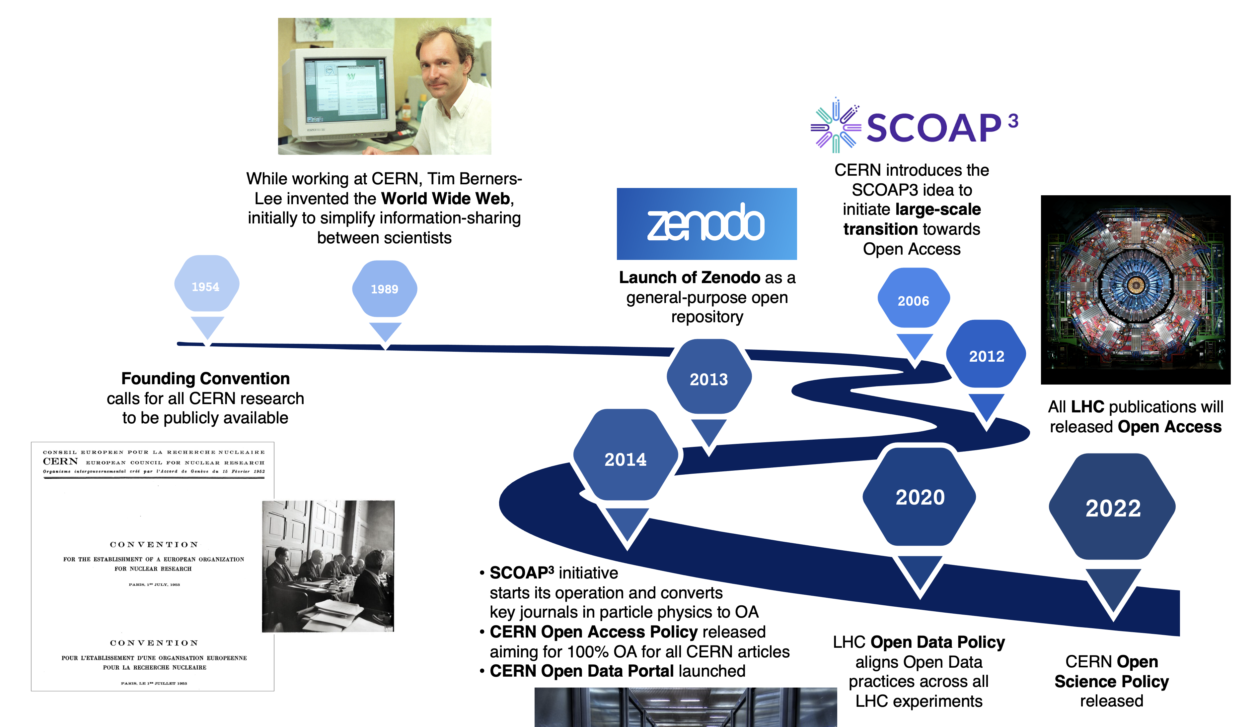

CERN – on the path to universal Open Science
be
Notes:
Sponsoring Consortium for Open Access Publishing in Particle Physics: https://scoap3.org/
Zenodo: CERN Data Centre-backed research data repository for the long-tail of science, enabling researchers to preserve and share their research output from any science, regardless of the size and format.
Sarah until here

Slide 5
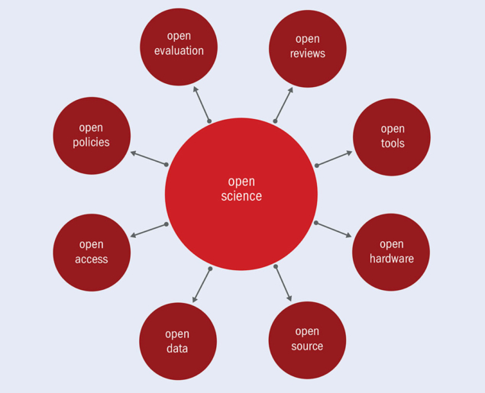
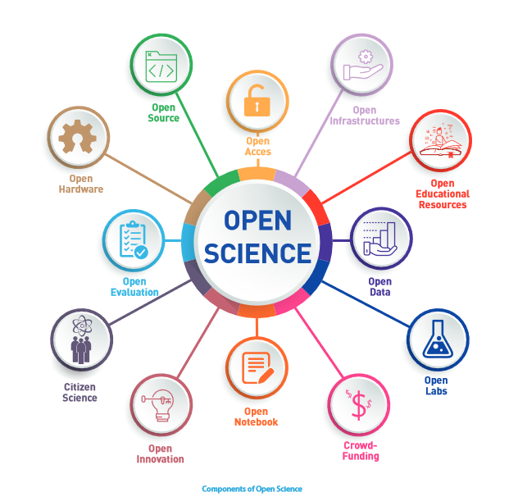
CERN – practice first, then describe in a policy!
www (1989), arXiv (1991), CDS (1993), SCOAP3 (2006), LHC papers (2012)
2014 CERN Open Access Policy
www open licence (1994), open source TF licence recommendation (2012)
2021 OSPO proposal
Open Hardware licence v1 (2011), OHL v2 (2020)
KT policy: 3 variants; strong reciprocal, weak reciprocal, permissive
CDS (2000), Zenodo(2013), CERN Open Data (2014), HEPData@CERN (2016)
2020 CERN Open Data Policy for LHC
CERN 2019 UNESCO 2021
Similarly for Open Education: Schools, Academic Training, Colloquia, Masterclasses, …
Notes:
Sponsoring Consortium for Open Access Publishing in Particle Physics: https://scoap3.org/
Zenodo: CERN Data Centre-backed research data repository for the long-tail of science, enabling researchers to preserve and share their research output from any science, regardless of the size and format.
Tim

Slide 6
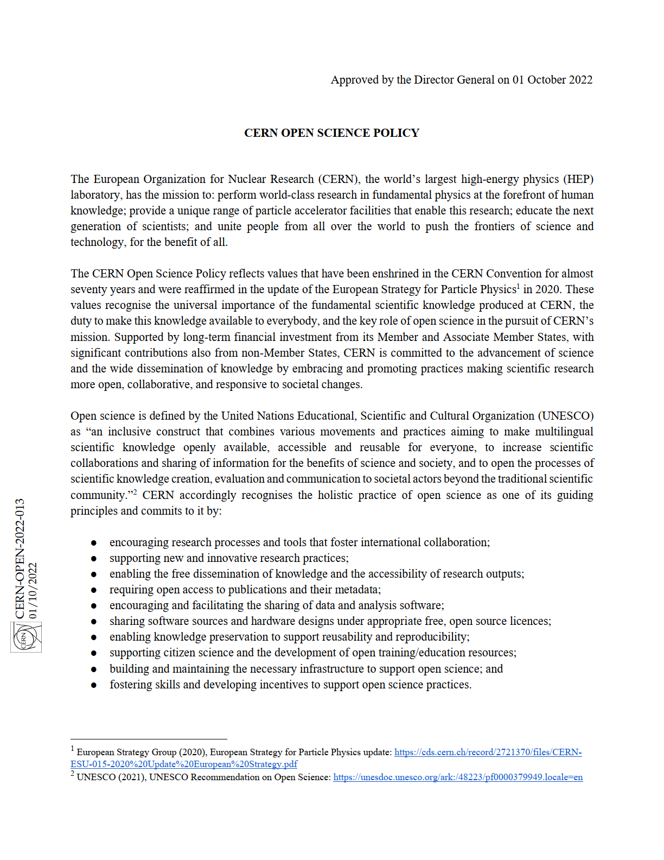
CERN – on the path to universal Open Science
CERN’s first institutional Open Science Policy
  One year of collaborative drafting,
  incl. discussions with the Directorate
  29th September 2022: presentation to the CERN Council
  1st October 2022: Open Science Policy formally in place
  The policy can be found here: https://cds.cern.ch/record/2835057

Slide 7
CERN Open Science Policy
The policy covers 9 areas:
  Open access to publications
  Open data
  Open source software
  Open hardware
  Research integrity, reuse and reproducibility
  Infrastructure provision for open science
  Research assessment and evaluation
  Education, Training and Outreach
  Citizen science

Slide 8
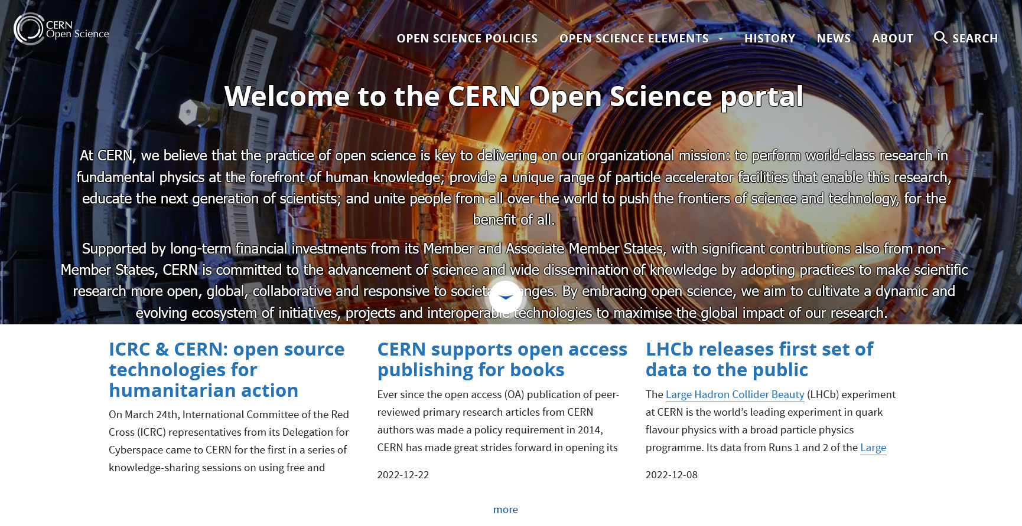
CERN Open Science Policy
CERN’s Open Science Website:
  More information on the different areas can be found here: https://openscience.cern/

Slide 9
CERN Open Science Policy
Open Science Strategy Working Group (OSWG):
  Formed in 2021 as a CERN-wide exchange forum on open science activities
  Established the Open Science Policy
  Currently working on an implementation plan for the Open Science Policy
  ~30 members
  We, Tim and Sarah, are responsible for the Open Training, Education, and Outreach area

Slide 10
CERN Open Education, Training & Outreach
“CERN is committed to developing training courses to facilitate the adoption of open science and equip researchers and supporting personnel at all levels with the necessary skills and expertise to conduct research in an open and reusable (FAIR) way. Furthermore, CERN commits to facilitating the use of open educational material in teaching/education at schools and universities. CERN encourages the preparation of resources to engage pupils and teachers, both inside and outside the classroom setting, in interactive learning exercises with open datasets and software products. Wherever possible, CERN links open data, software, hardware and additional open resources to published research articles so that they can be used in university courses to practise research and corresponding methodologies (e.g. statistics, machine learning).”
see Open Science Policy: https://cds.cern.ch/record/2835057
Notes:
FAIR: Findability, Accessibility, Interoperability, and Reuse of digital assets

Slide 11
CERN Open Education, Training & Outreach
“CERN is committed to developing training courses to facilitate the adoption of open science and equip researchers and supporting personnel at all levels with the necessary skills and expertise to conduct research in an open and reusable (FAIR) way.
Furthermore, CERN commits to facilitating the use of open educational material in teaching/education at schools and universities. CERN encourages the preparation of resources to engage pupils and teachers, both inside and outside the classroom setting, in interactive learning exercises with open datasets and software products. Wherever possible, CERN links open data, software, hardware and additional open resources to published research articles so that they can be used in university courses to practise research and corresponding methodologies (e.g. statistics, machine learning).”
see Open Science Policy: https://cds.cern.ch/record/2835057
Training
Education &
Outreach
Notes:
I added this line break to give a better overview
FAIR: Findability, Accessibility, Interoperability, and Reuse of digital assets
Tim until here

Slide 12
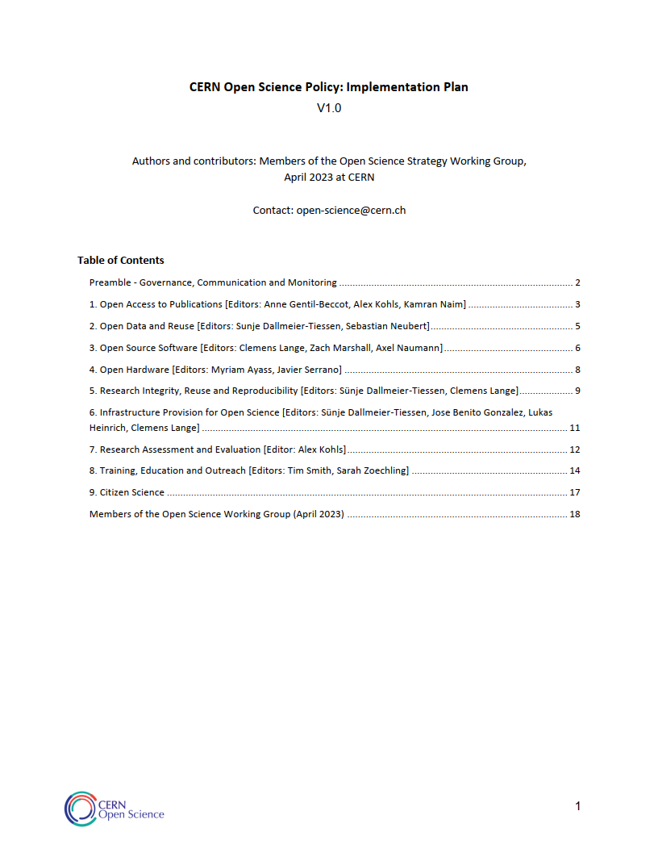
CERN Open Education, Training & Outreach
How can we implement this Open Science Policy in our practice?
CERN Open Science Policy: Implementation Plan
https://cds.cern.ch/record/2856044
  draft definitions,
  draft aims and
  iterate with practitioners
Notes:
Sarah from here on again

Slide 13
CERN Open Education, Training & Outreach
Draft definitions (in this context):
Training: within CERN, refers to activities that promote the building of capacity on Open Science related activities/practices.
Education: beyond CERN (especially focusing on school and university students), refers to activities that promote the conceptual understanding of CERN’s scientific domains (e.g. physics and engineering) and how the nature of science (e.g. “science is a social endeavour”) is facilitated by Open Science practices.
Outreach: beyond CERN (especially focusing on the general public), refers to activities that promote awareness of CERN’s field of research and research methods emphasising Open Science activities/practices.
see Implementation Plan: https://cds.cern.ch/record/2856044

Slide 14
CERN Open Education, Training & Outreach
Implementation
“Embedding Open Science in CERN’s Training, Education and Outreach efforts means providing training courses on the principles of Open Science (e.g. Open Data) and the tools used for practising Open Science within the CERN community. Beyond the CERN community, this also means making the Education and Outreach material used openly available. CERN aims to embody UNESCO’s definition of an Open Science organisation “aiming to make multilingual scientific knowledge openly available, accessible and reusable for everyone” (UNESCO 2021), through the following Open Science goals for (1) training, (2) education, and (3) outreach.”
see Implementation Plan: https://cds.cern.ch/record/2856044
Notes:
The goals were developed in line with the definitions of training, education, and outreach.

Slide 15
CERN Open Education, Training & Outreach
(1) Open Science Training aims:
establish training courses on the principles of Open Science covering FAIR data.
establish training courses on the practicalities of Data Management Plans, reusable analysis and analysis preservation services.
establish training courses on the practicalities of Open Access and Open Data publishing.
see Implementation Plan: https://cds.cern.ch/record/2856044
Notes:
FAIR: Findability, Accessibility, Interoperability, and Reuse of digital assets
Training: within CERN, refers to activities that promote the building of capacity on Open Science related activities/practices.

Slide 16
CERN Open Education, Training & Outreach
(2) Open Science Education aims:
host education programmes (e.g. hands-on workshops) for teachers, school and university students covering the open nature of science.
offer online education material about modern physics for teachers, school and university students, and interested individuals.
conduct physics education research promoting the conceptual understanding of CERN’s scientific domains and the open nature of science.
publish new or already existing educational material, and education research findings according to the Open Science standards (see #3 below).
continued
Notes:
Education: beyond CERN (especially focusing on school and university students), refers to activities that promote the conceptual understanding of CERN’s scientific domains (e.g. physics and engineering) and how the nature of science (e.g. “science is a social endeavour”) is facilitated by Open Science practices.

Slide 17
CERN Open Education, Training & Outreach
(2) Open Science Education aims:
act as publishing house for an Open Access Science Education Journal - PriSE (Progress in Science Education) - the only multilingual international journal in this area.
make material from the CERN schools (physics, accelerator, computing), Summer student programmes, and the Academic Training series (presentations, videos) available according to Open Science standards (see #3 below).
see Implementation Plan: https://cds.cern.ch/record/2856044
Notes:
Education: beyond CERN (especially focusing on school and university students), refers to activities that promote the conceptual understanding of CERN’s scientific domains (e.g. physics and engineering) and how the nature of science (e.g. “science is a social endeavour”) is facilitated by Open Science practices.

Slide 18
CERN Open Education, Training & Outreach
(3) Open Science Outreach aims:
host outreach events (e.g. physics masterclasses) in the local area and in the Member and Associate Member States based on CERN’s Open Data sets.
develop exhibitions for visitors (on- and off-site) on the theme of Open Science and the importance of open data practices for wider society (e.g. data driven decision making).
publish outreach material according to the Open Science standards (see #3 below).
see Implementation Plan: https://cds.cern.ch/record/2856044
Notes:
Outreach: beyond CERN (especially focusing on the general public), refers to activities that promote awareness of CERN’s field of research and research methods emphasising Open Science activities/practices.

Slide 19
CERN Open Education, Training & Outreach
How would you define “CERN’s Training, Education and Outreach material relevant for Open Science”?
What would you change about the draft definitions and related aims?
What would you add/delete?
Notes:
I would first let them think about this individually. Then they can discuss it among themselves, and finally, discuss it with all of us.
Sarah until here

Slide 20
CERN Open Education, Training & Outreach
Where do we go from here?
To implement and reach the aims described above, the following tasks should be completed within the next year:
Agree on a definition of “CERN’s Training, Education and Outreach material relevant for Open Science”.
Based on this definition, compile a list of recommended CERN’s Training, Education and Outreach material and external training offers and material relevant for Open Science, including whether it is already openly available online on a CERN website and has a clear licence, and if not, document whether it can or cannot be published openly.
The material identified as suitable should be gradually made available openly on a CERN website and ultimately under an open licence (i.e. CC-BY for text, CC0 for data).
continued
Notes:
Tim from here

Slide 21
CERN Open Education, Training & Outreach
Where do we go from here?
To implement and reach the aims described above, the following tasks should be completed within the next year:
Agree on a definition of “CERN’s Training, Education and Outreach material relevant for Open Science”.
Based on this definition, compile a list of recommended CERN’s Training, Education and Outreach material and external training offers and material relevant for Open Science, including whether it is already openly available online on a CERN website and has a clear licence, and if not, document whether it can or cannot be published openly.
The material identified as suitable should be gradually made available openly on a CERN website and ultimately under an open licence (i.e. CC-BY for text, CC0 for data).
continued
Notes:
Highlight => This is what we did/are doing today

Slide 22
CERN Open Education, Training & Outreach
Where do we go from here?
To implement and reach the aims described above, the following tasks should be completed within the next year:
Those responsible for CERN’s Training, Education and Outreach efforts should continuously update the OSWG on additional material to be added to the list.
Those responsible for CERN’s Training, Education and Outreach efforts are recommended to consult the future CERN Open Science Policy Office. They will facilitate and publicise CERN’s contributions to society through openly available Training, Education and Outreach material and promote CERN as an “Open Science lab” to provide implementation guidance for the Training, Education and Outreach part of CERN’s Open Science Policy.
see Implementation Plan: https://cds.cern.ch/record/2856044

Slide 23
Material developed for CERN’s Education, Training & Outreach Efforts
How do you develop Training, Education and Outreach material?
Which experts do you commonly approach?
Where do you publish the produced material? Is it openly available?
Do you see a benefit in such a catalogue of recommended CERN’s Training, Education and Outreach material and external training offers and material relevant for Open Science?
Notes:
I would first let them think about this individually. Then they can discuss it among themselves, and finally, discuss it with all of us.

Slide 24
Impact of CERN’s Education, Training & Outreach Efforts
How do you measure the impact of your Training, Education and Outreach efforts?
Do you usually produce statistics about the audience?
If yes, is it literally who turns up or more broadly (views, downloads, …)?
For example, the accelerator school writes (used to write?) a “Yellow Report" - How often is it downloaded?
Notes:
I would first let them think about this individually. Then they can discuss it among themselves, and finally, discuss it with all of us.
Tim until here

Slide 25
Conclusions
  3 main points of our meeting today:
  Definition of CERN’s Training, Education and Outreach material relevant for Open Science
  Material developed for CERN’s Education, Training & Outreach Efforts
  Audience/impact of CERN’s Education, Training & Outreach Efforts
  Further input/feedback/questions?
Notes:
Sarah here

Slide 26
Thank you very much for your time and input!
Tim Smith and Sarah Zoechling for the
Open Science Strategy Working Group | April 2023

