Slide 1
CERN Stores roadmap
Vision, Objectives & Strategies
Cédric Garino (SCE-SSC)
16.05.2023

Slide 2
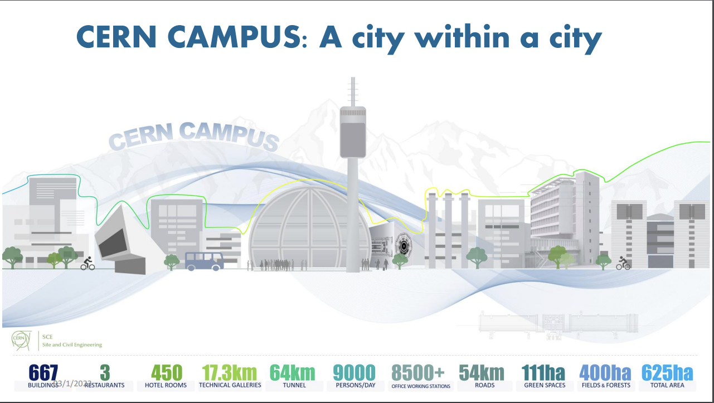
Context: CERN Stores as part of SCE-SSC
The Site and Civil Engineering (SCE) Department manages and develops CERN’s real estate assets and infrastructures in agreement with CERN’s scientific strategy, as well as all the services related to the caretaking and operation of the CERN site.
The Services & Supply Chain group (SCE-SSC) provides CERN’s community with high standard campus experience and optimal industrial supply chain execution by offering a full set of rationalized, efficient, and transparent services.

Slide 3
Supply Chain vision
Professional and integrated Supply Chain to support all CERN’s community advancing the scientific program

Slide 4
CERN Stores mandate
CERN Stores is responsible to provide material supply for referenced items (i.e. references with recurrent demands and a long-term interest for the Organization). This includes:
Referencing of items based on the needs of the CERN Community through a referencing process;
A centralized front line capturing and processing demands of referenced items. It also covers non-referenced material requests in technical areas such as raw materials if the process benefits of existing CERN Stores expertise;
Stock management and replenishment via order management using a pre-defined contractual framework following CERN’s procurement rules;
Inbound, internal and outbound warehousing operations (reception, quality control, put-away, inventory, picking preparation).
The ultimate goal is to ensure availability, optimal lead time, traceability, quality and best value for CERN’s community of items referenced in CERN Stores.
Prior to initiate any purchasing procedure, the end user shall verify whether his/her requirement is covered by CERN stores standard equipment, in which case the purchase shall be handled by the CERN stores.
The purchasing of the said items falls under the responsibility of the Purchasing Service.

Slide 5
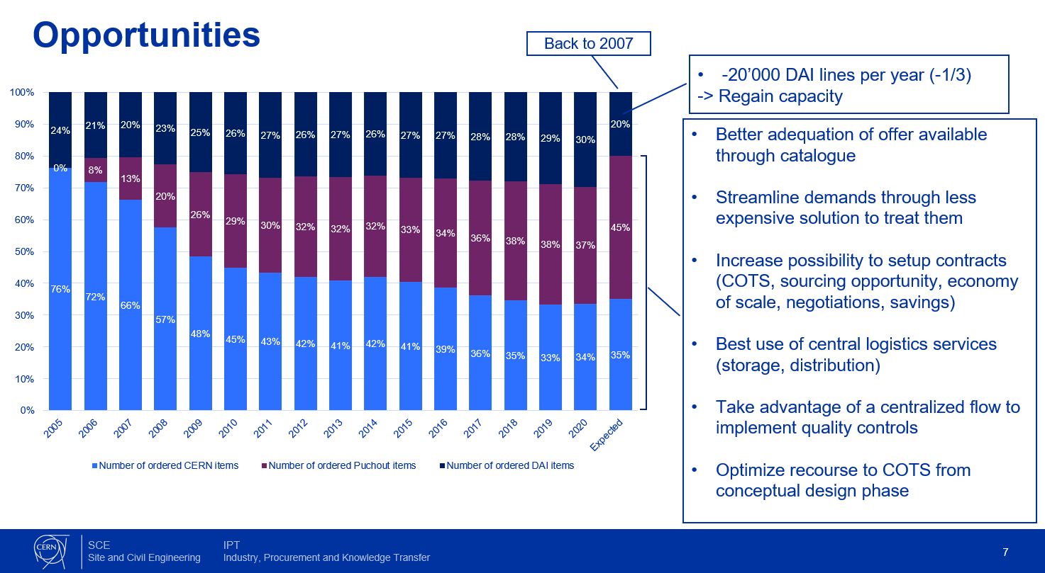
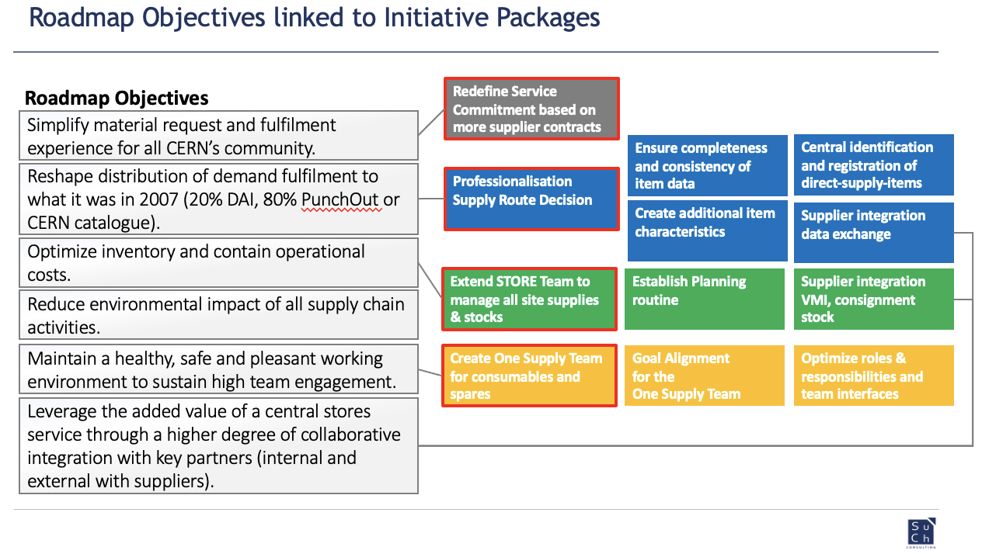
Long-term objectives
Reshape distribution of demand fulfilment routes to the values of 2007 (20% DAI, 80% PunchOut or CERN catalogue)
Simplify material request and fulfilment experience for all CERN’s community
Reduce inventory value and contain operational costs
Reduce environmental impact of all SC activities
Leverage the added value of a central stores service through a higher degree of collaborative integration with key partners (internal and external with suppliers)
Maintain a healthy, safe and pleasant working environment to sustain high team engagement

Slide 6
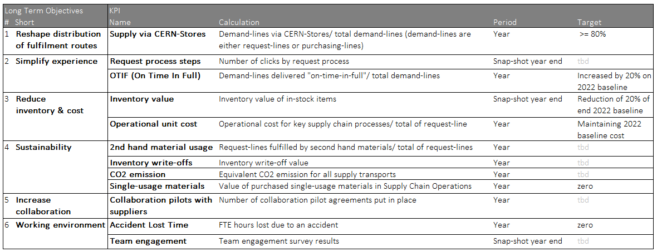
KPIs

Slide 7







Strategy principles
Service
Technology
Collaboration
Integration
Process & Organisation
Sustainability
High professional standards

Slide 8
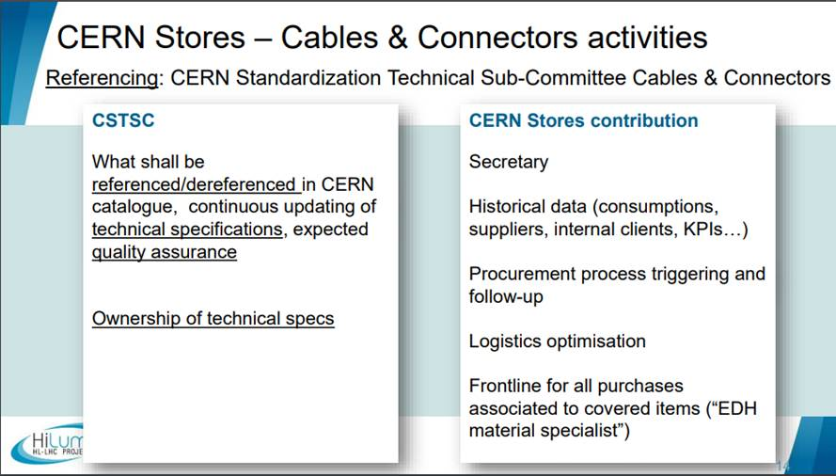
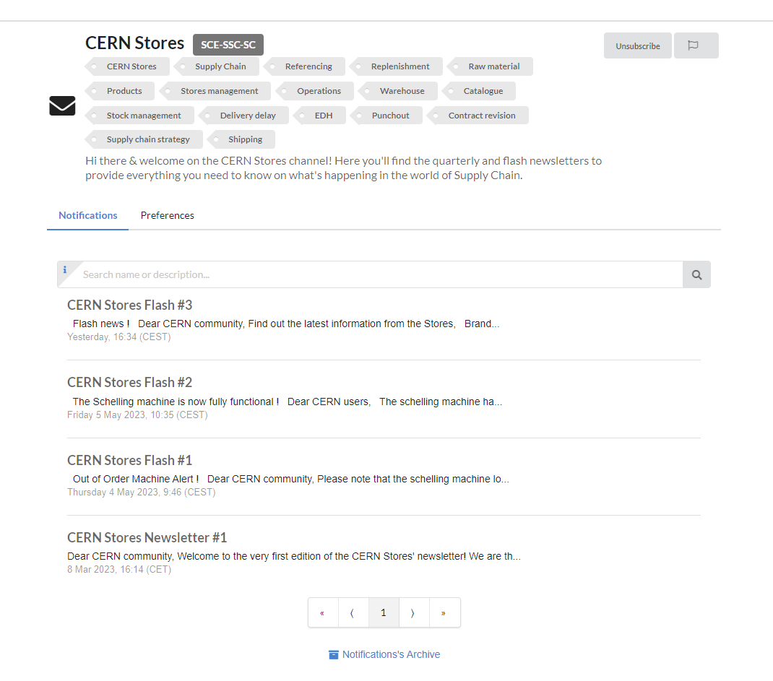
Collaboration
Foster goal alignment aiming for structured collaboration and create dedicated partnerships with key stakeholders (internal clients, technical experts, CERN Standardisation Committee, Procurement, HSE, logistics, industrial support contracts).
Develop bidirectional communication channels.

Slide 9
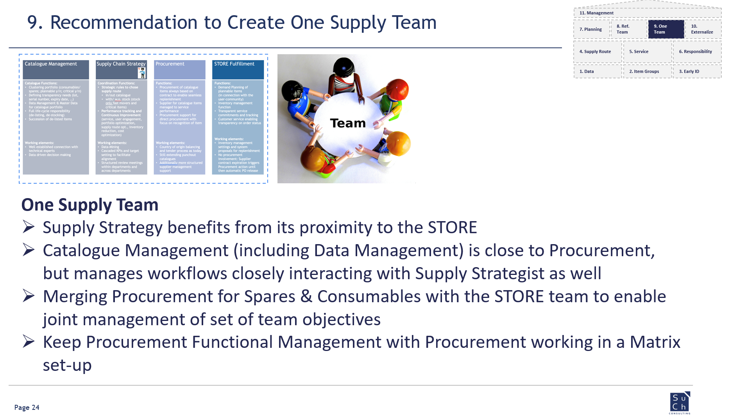
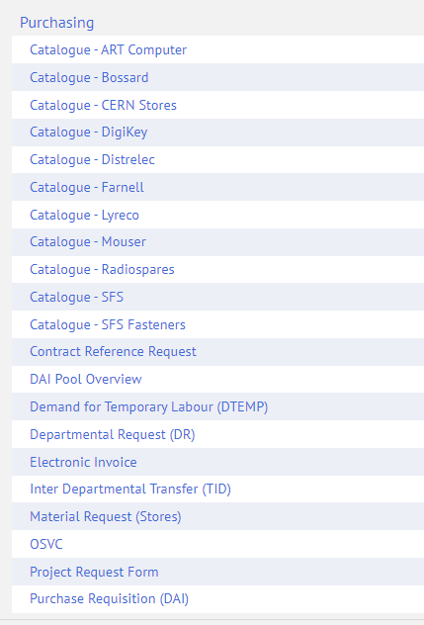
Process & Organisation
Document, streamline and standardize key processes.
Adapt the organisation supporting the service.
Converge towards one guided and transparent process to request and obtain material at CERN.

Slide 10
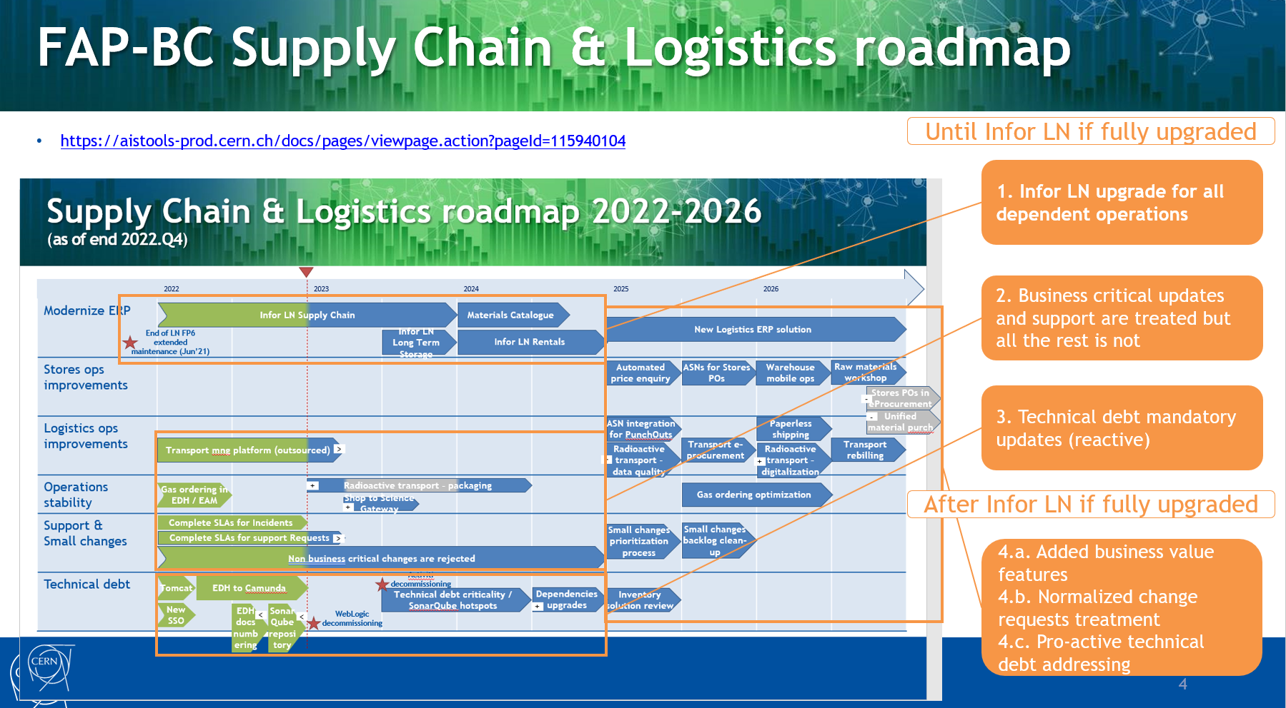
Technology
Leverage technology and digitalization to modernize the entire SC. Support business processes evolution.
Focus will be on enhanced data management, improved user experience, mobile ops, automations, integration, and alignment of software solutions.

Slide 11
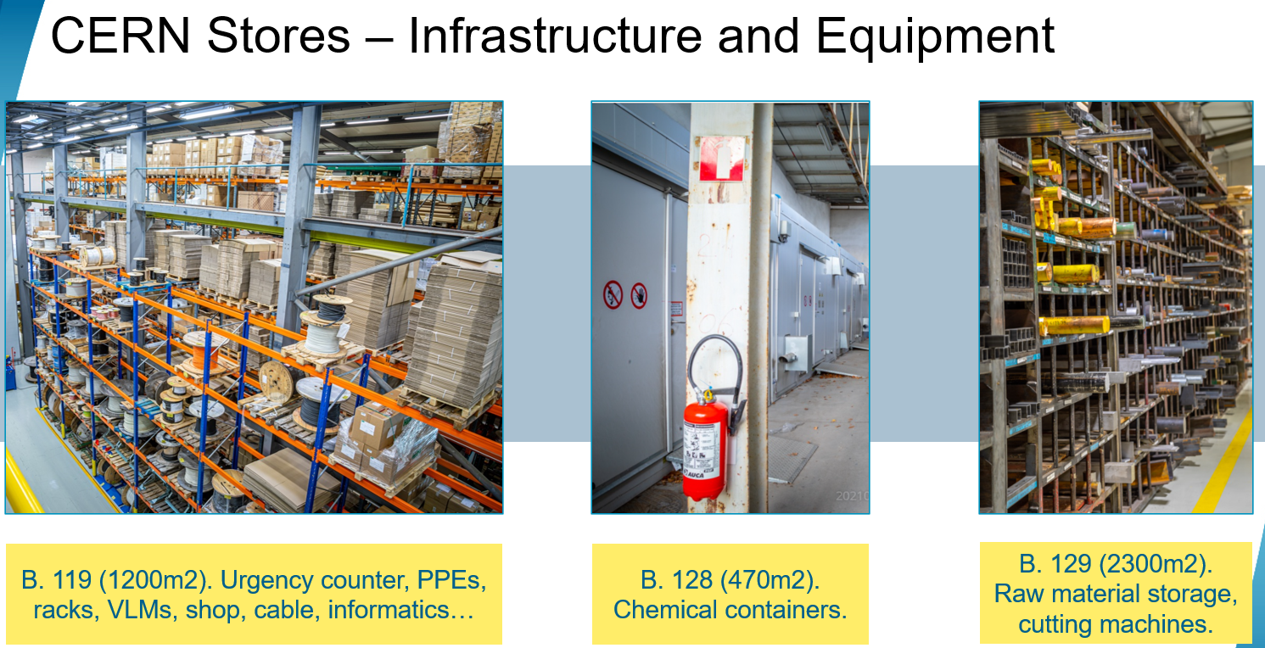

Service
Adapt and evolve the service offer to CERN’s community needs (CERN catalogue offer, new PunchOut catalogs, cutting machines, storage infrastructure, SC frontline).
Expend service offerings to equipment group: Stock holding, inventory management and warehouse operations.

Slide 12
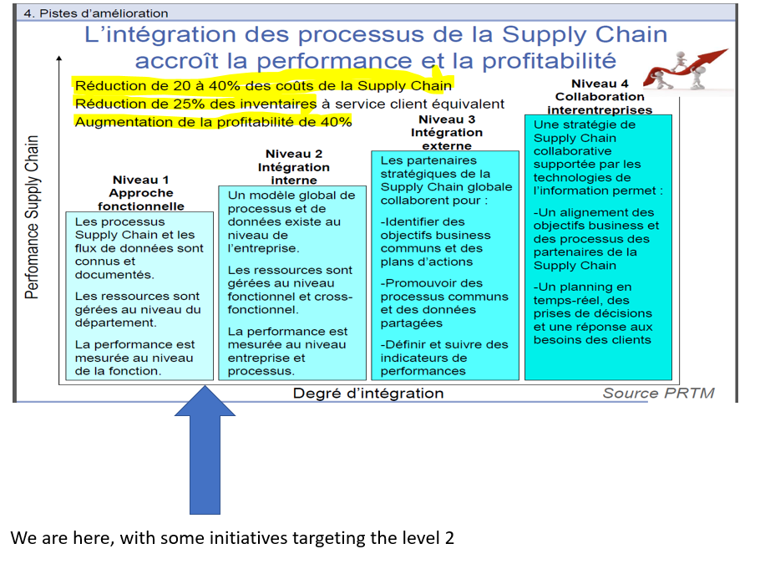
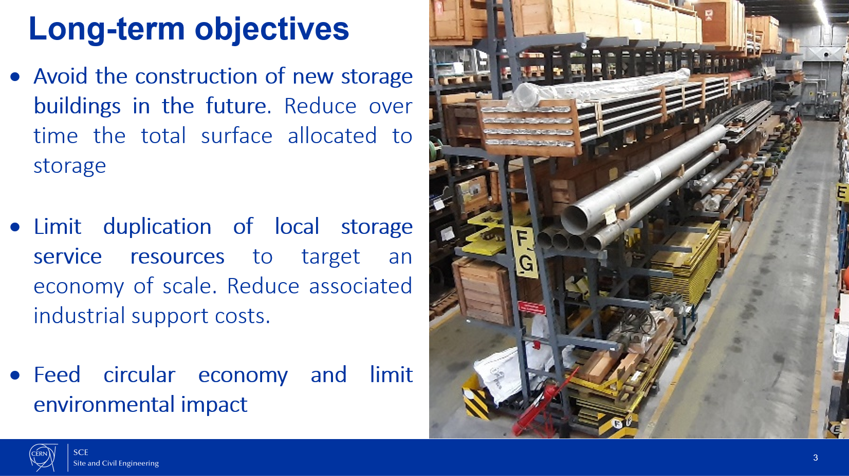
Integration
Increase maturity of the SC integration, internally and externally.
Connect with storage management roadmap.

Slide 13
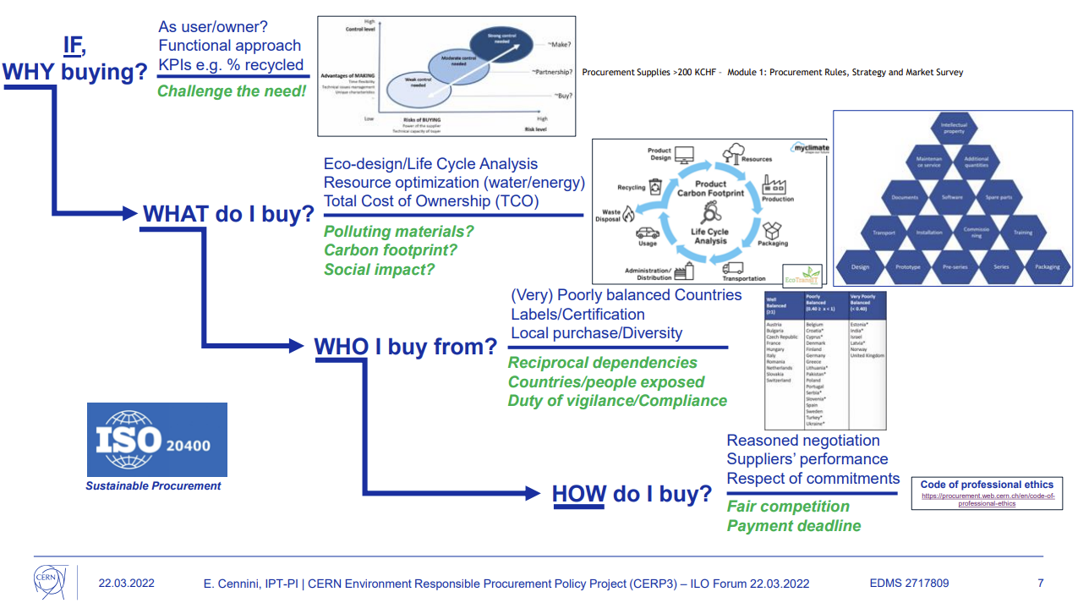
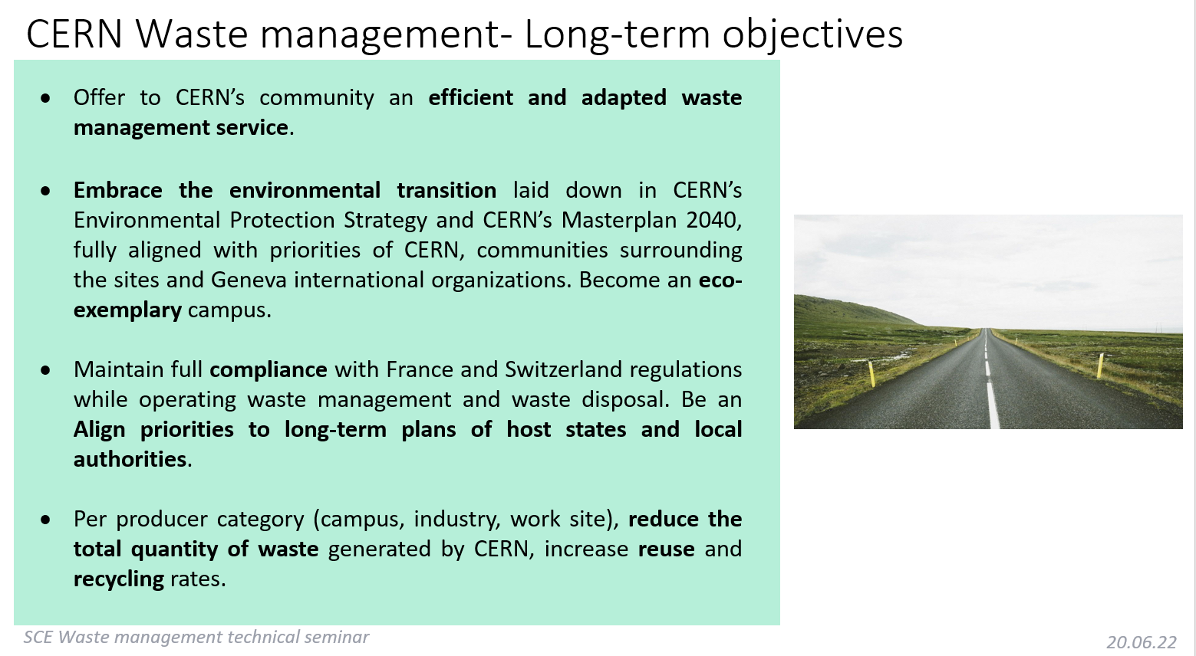
Sustainability
Implement sustainable procurement and eco responsibility guidelines.
Introduce a new set of KPIs to track CERN SC sustainability efforts and results (request-lines fulfilled by second-hand materials, inventory write-offs, eq. CO2 due to supply transports, single-usage materials in SC operations).
Connect CERN stores roadmap with waste management roadmap.

Slide 14
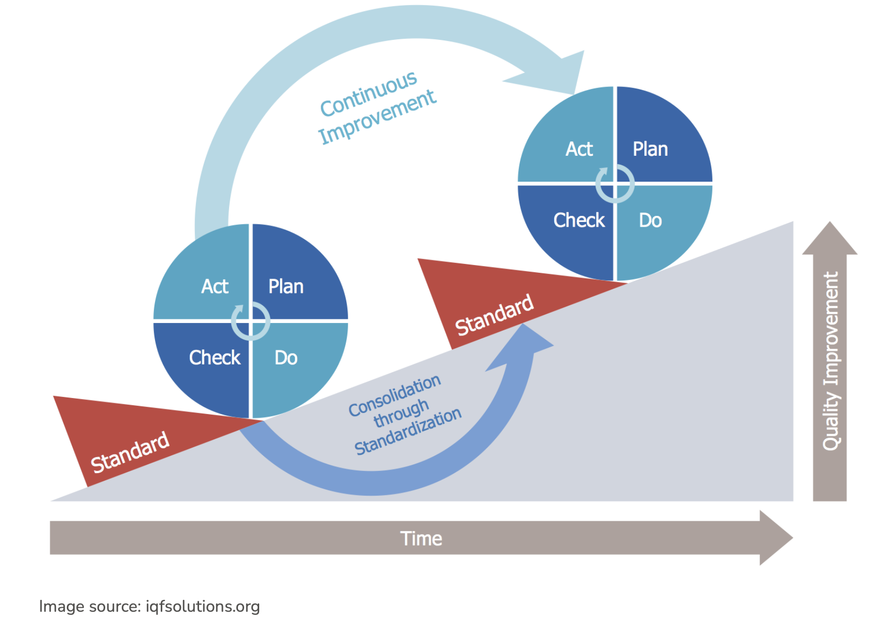
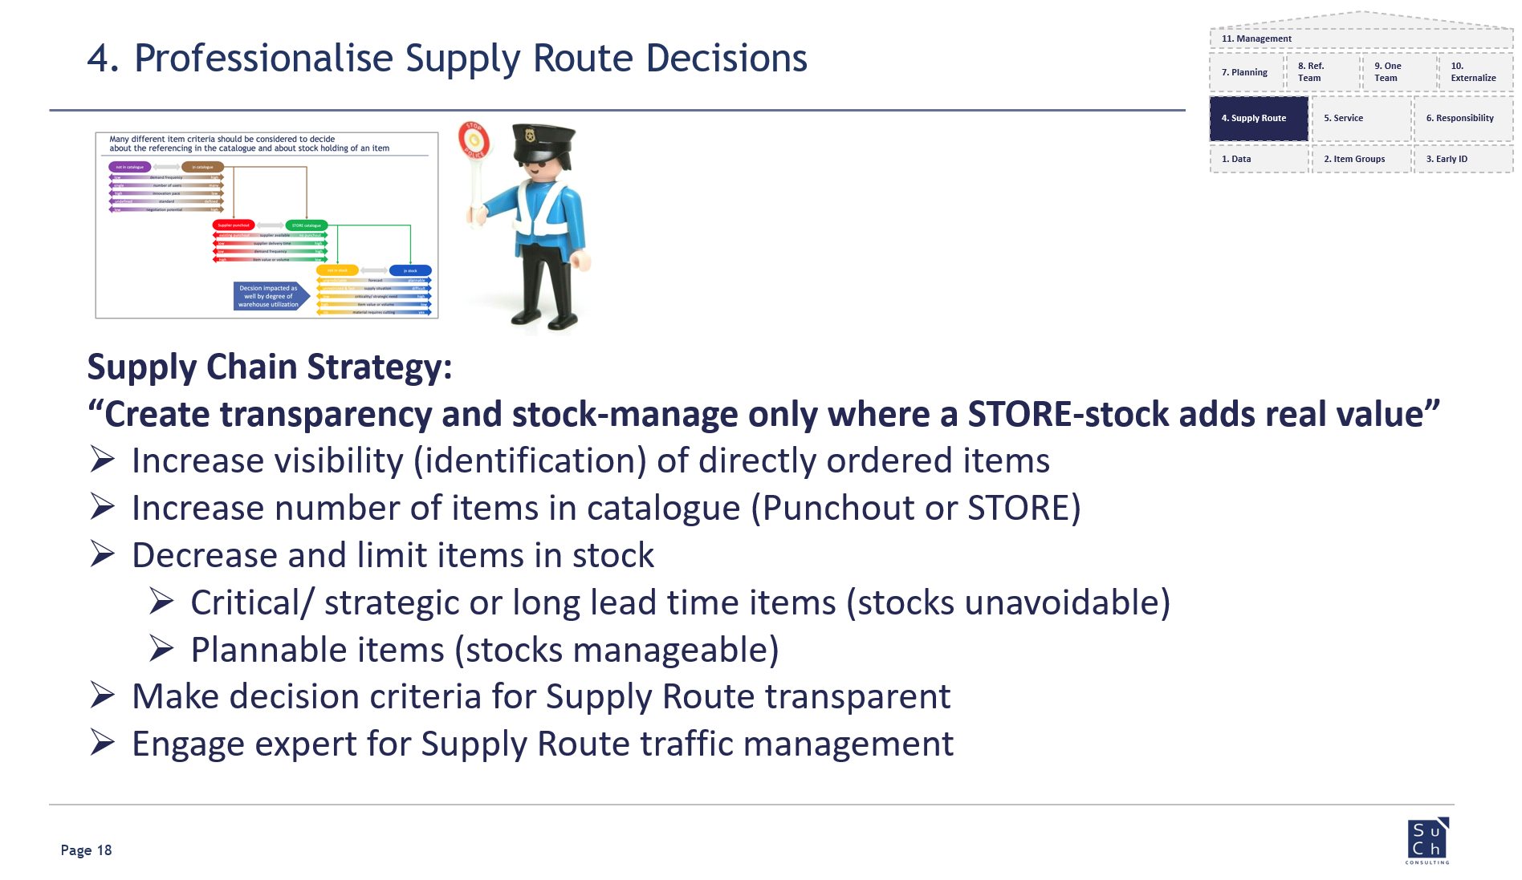
High professional standards
Apply industry best-practices (ex: LEAN methodology, Inventory Management, Demand Planning, Activity-Based Costing) ensuring a sustainable economic model.
Enrol CERN stores collaborators in training programs to maintain a high level of expertise.
Invest in pleasant and ergonomic work environment that promotes comfort, productivity, and well-being.
Deploy team engagement methodologies and tools.

Slide 15
References and Q&A
EDMS: https://edms.cern.ch/document/2884962/1
Next
Q2/23:Tasks and schedule (David, Maggie, Ralf)
Thanks for your attention.
Questions ?

