Slide 1

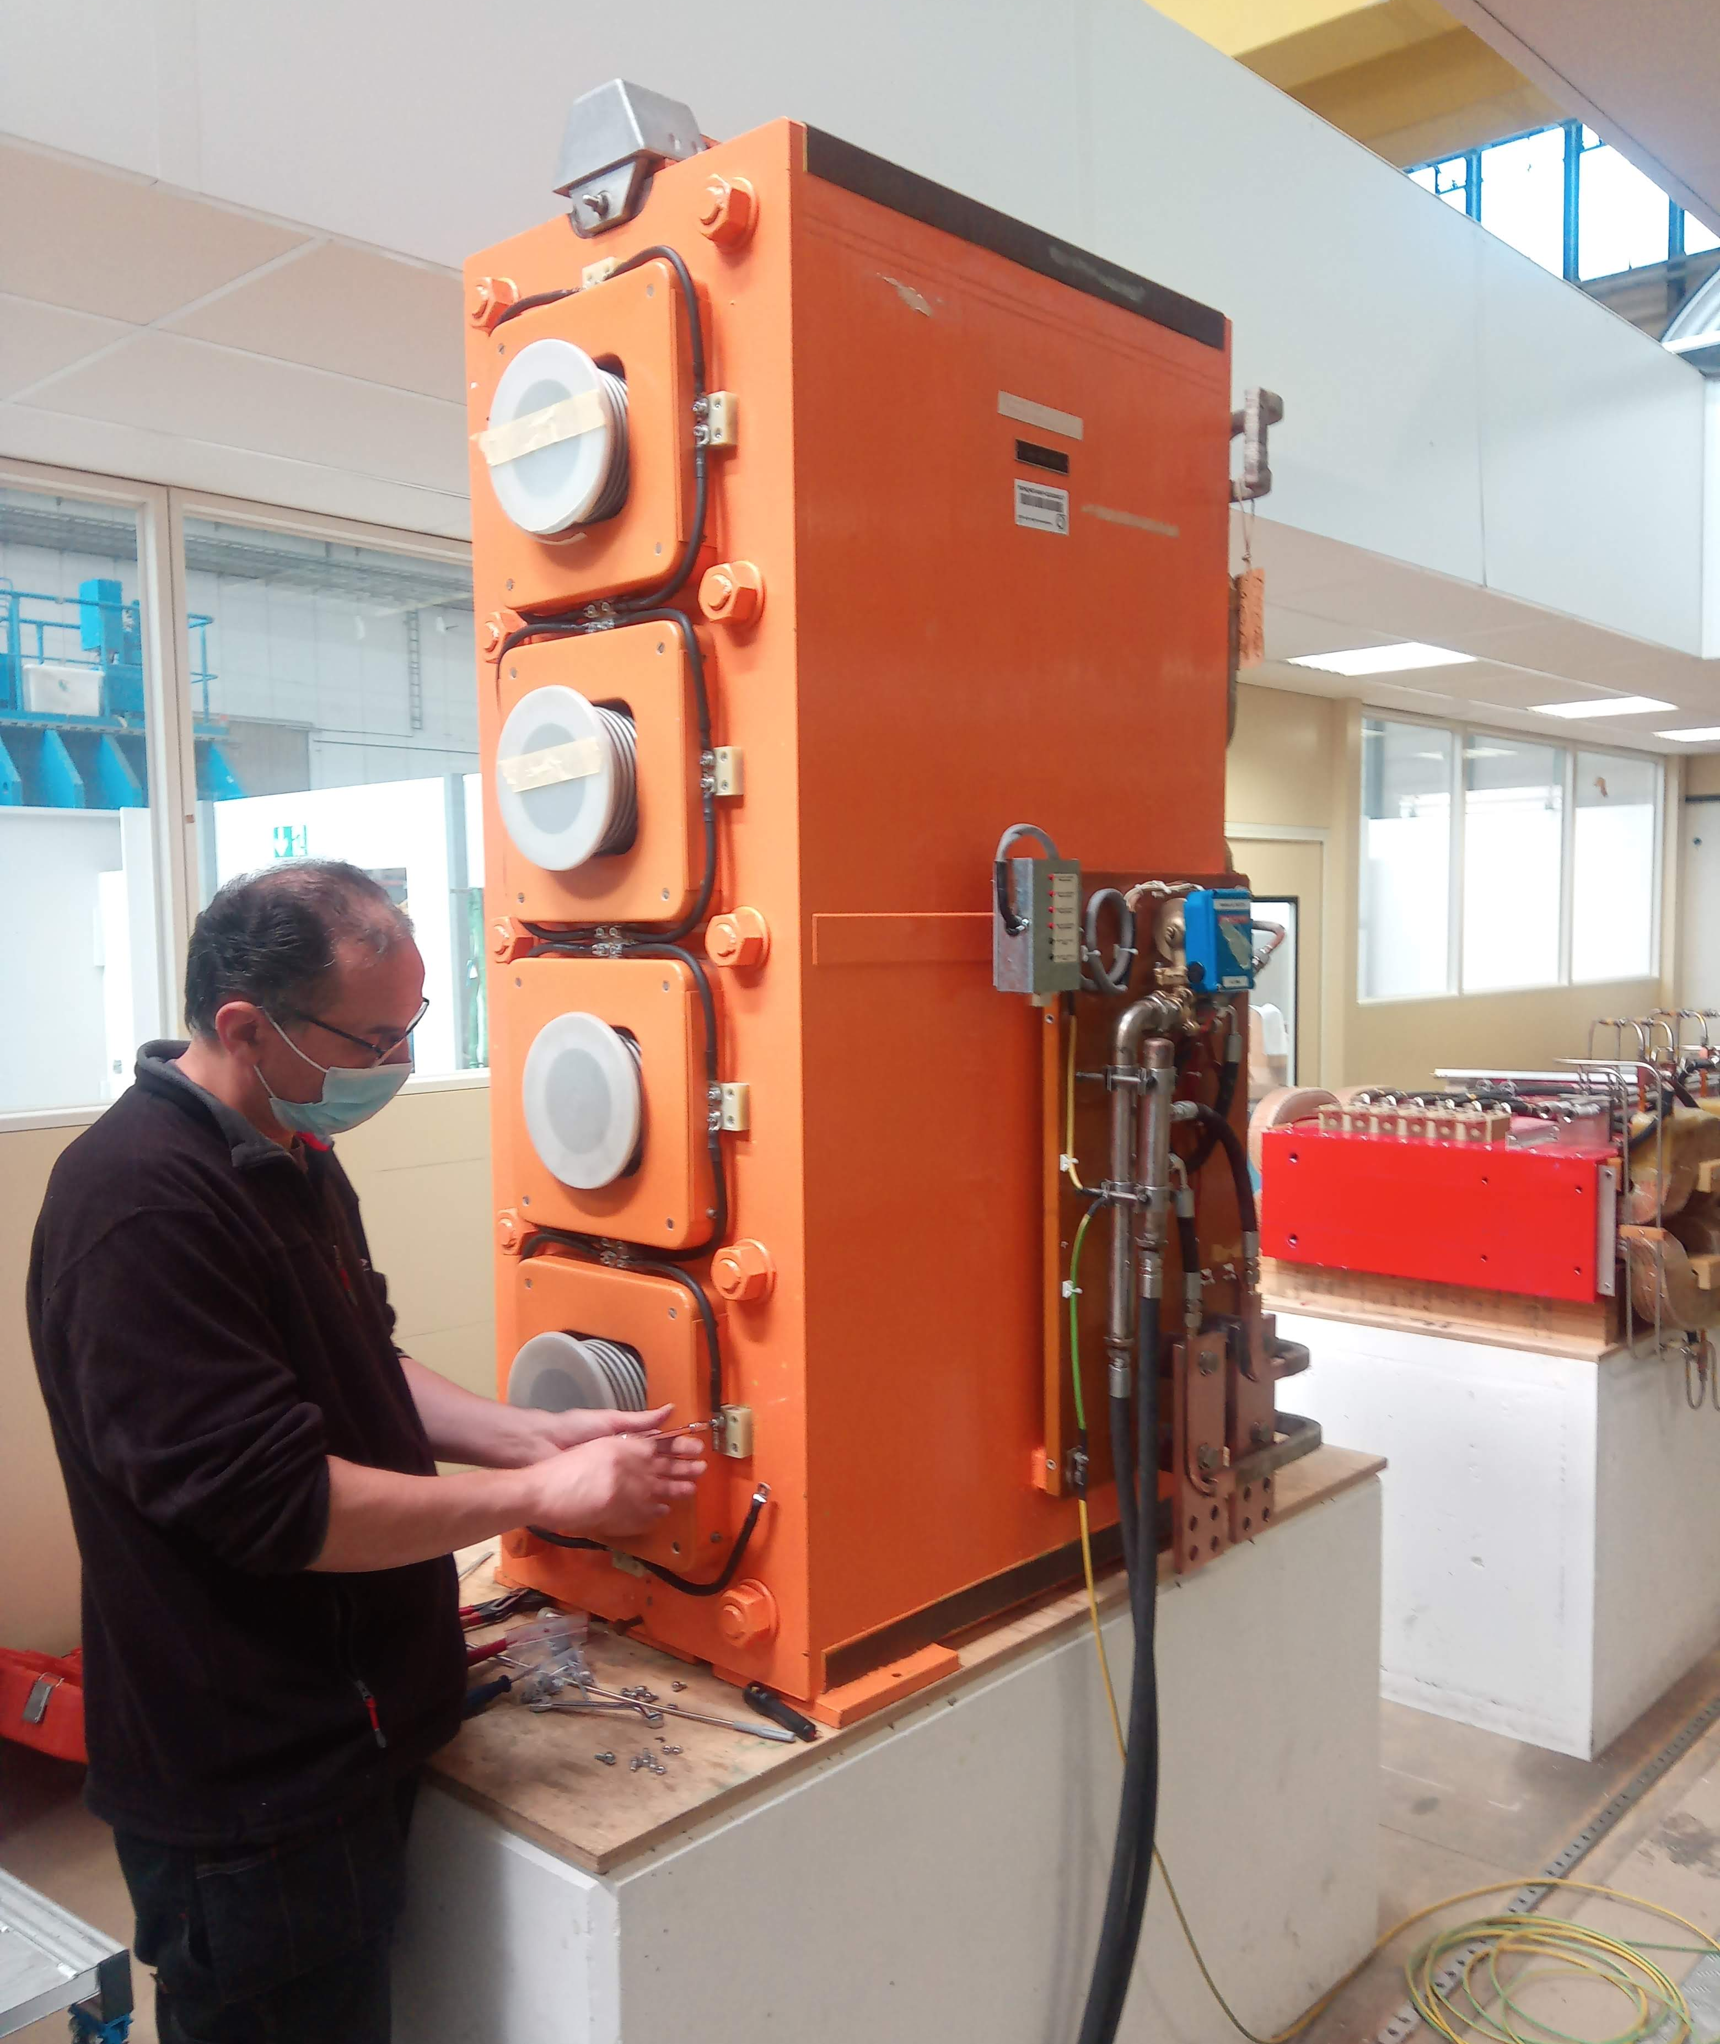
PSB Quadrupole
Renovation & Production
M. Karppinen

Slide 2
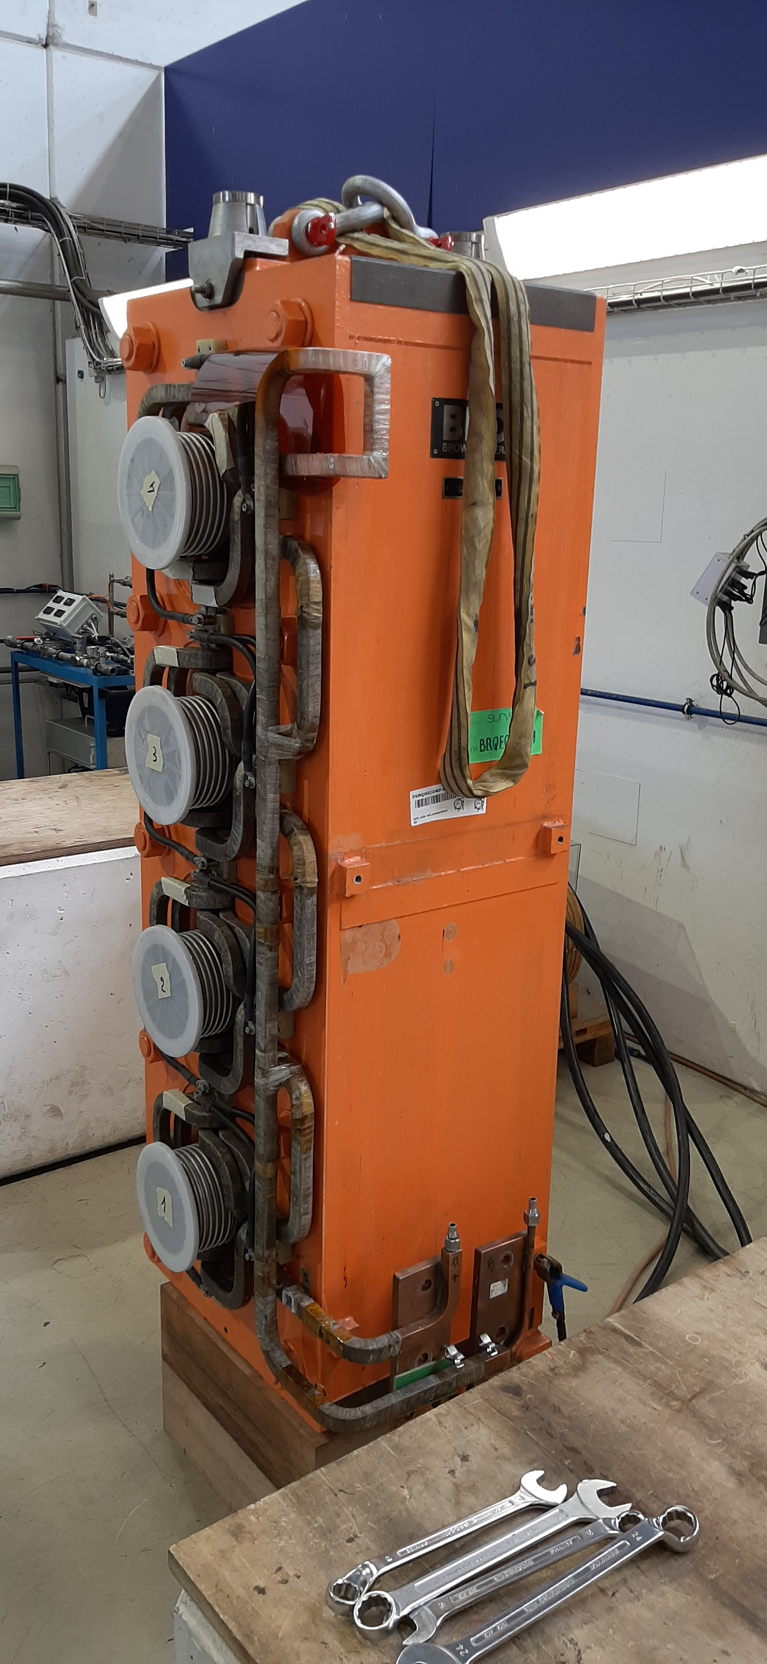
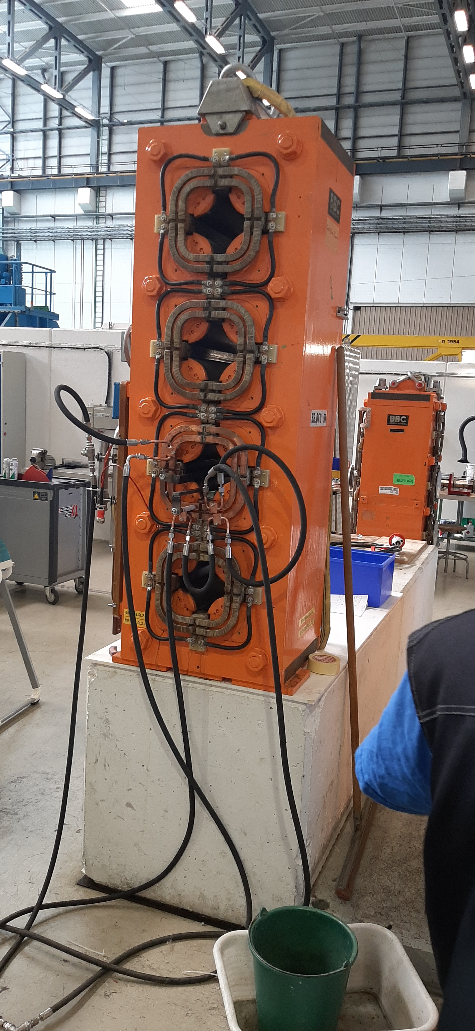
PSB Main Quadrupole
48 installed magnets of 4 types (from 1970’s)
5 Spare units
Laminated iron yoke, no split planes
Coil with 2 turns built up within the yoke
76 brazed connections
Insulation based on Mica/glass fiber wrap
VPI of the whole magnet after coil assembly
After 50 years of reliable operation, water leaks caused by selective corrosion of Cu at and adjacent to the Ag-Cu-P brazing.
Process enhanced by the presence of Sulphur in the cooling water.

Slide 3
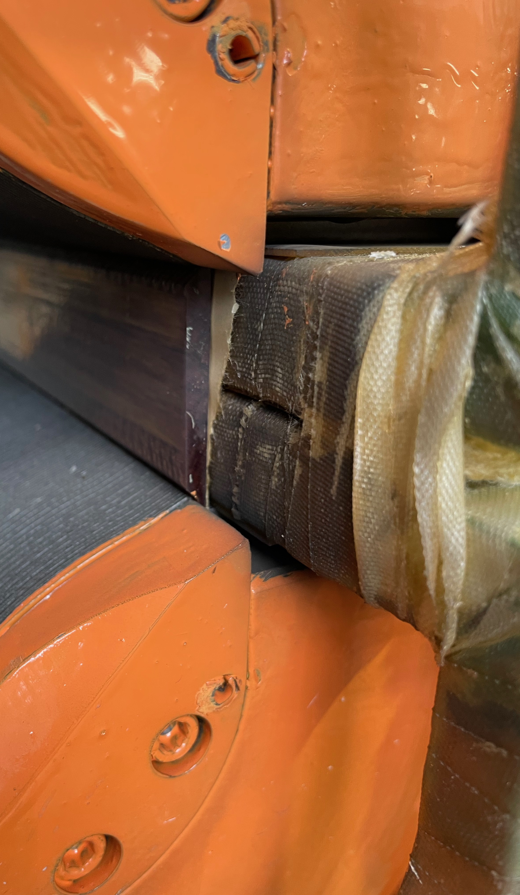
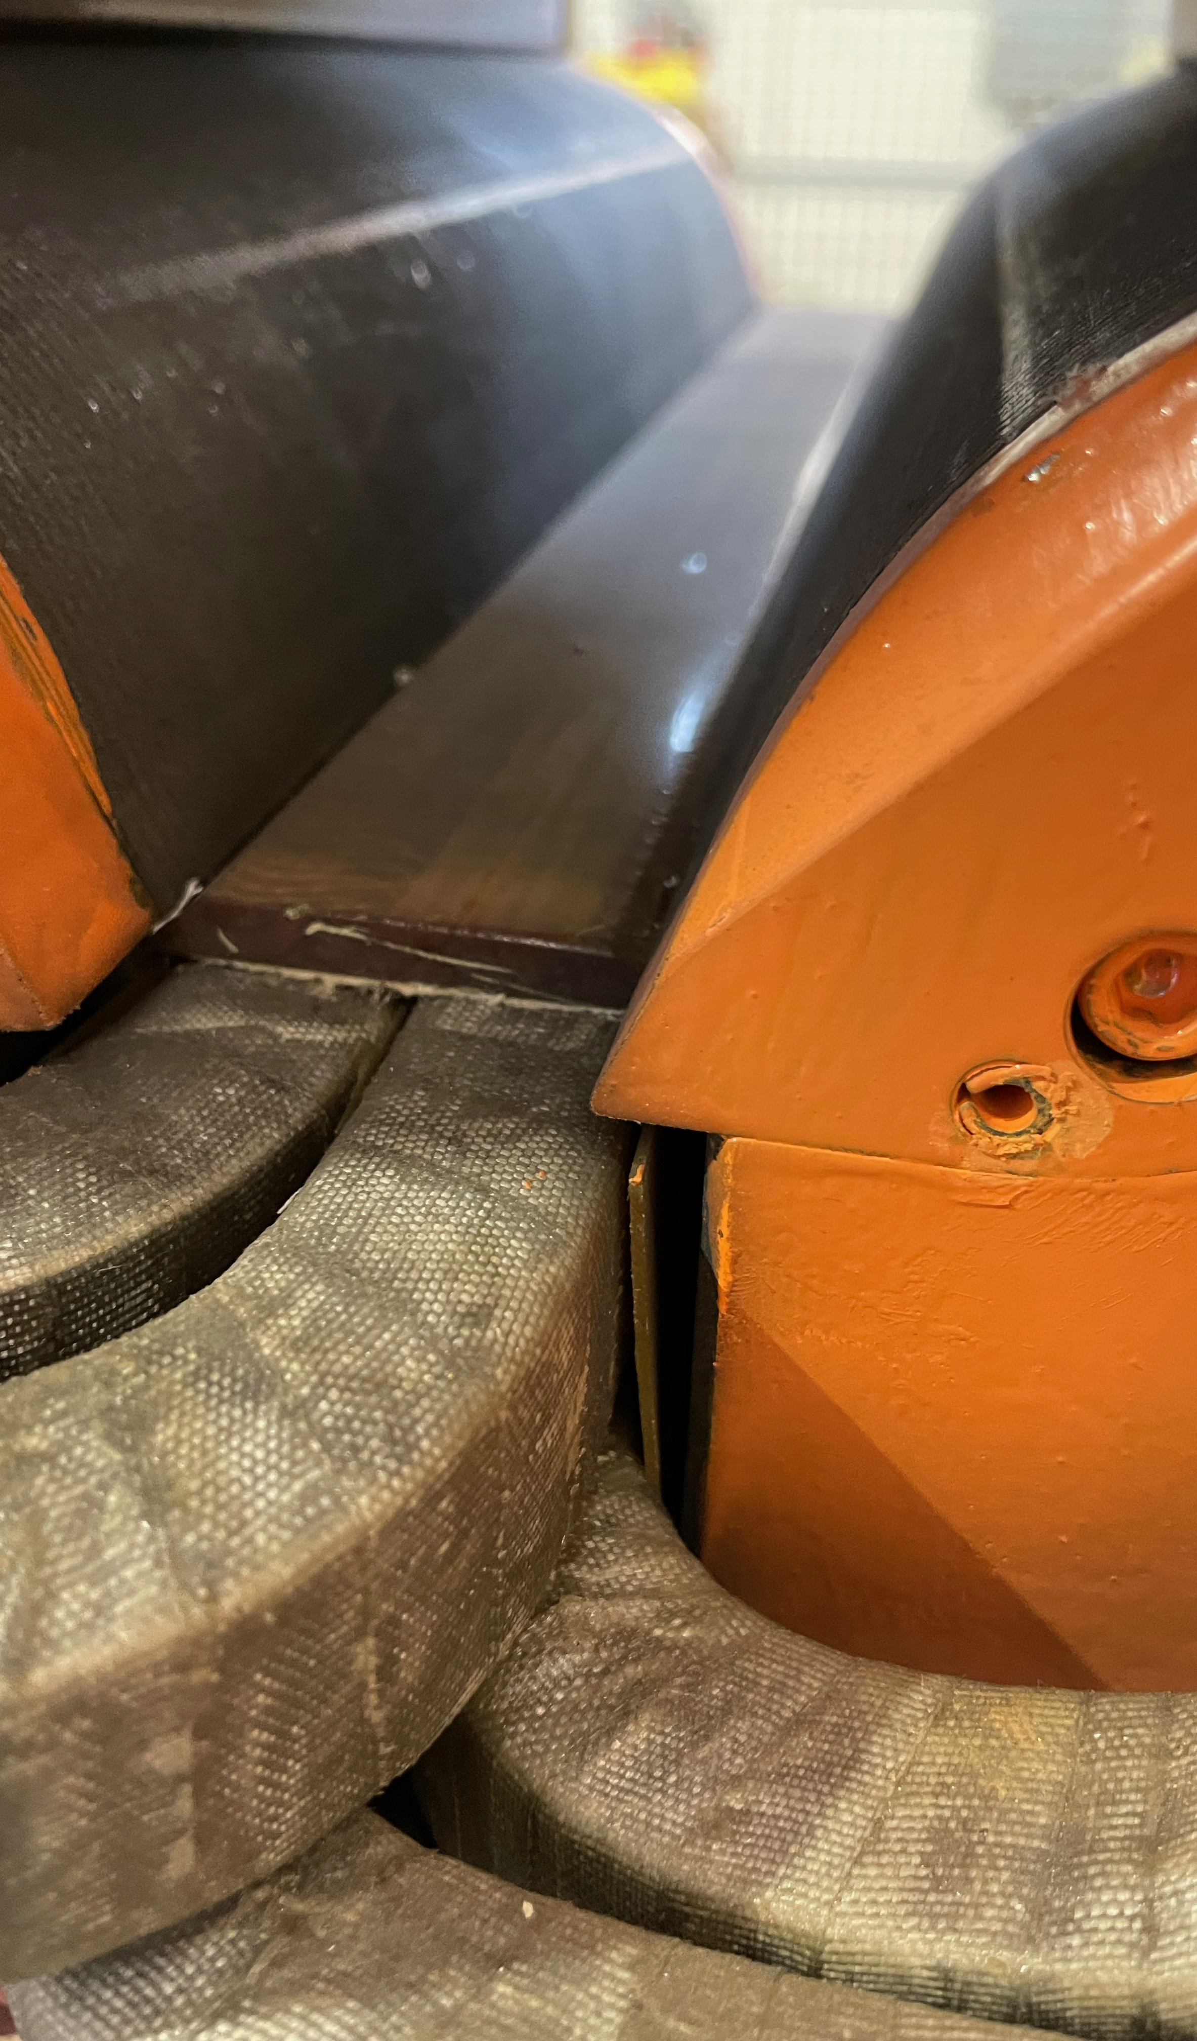
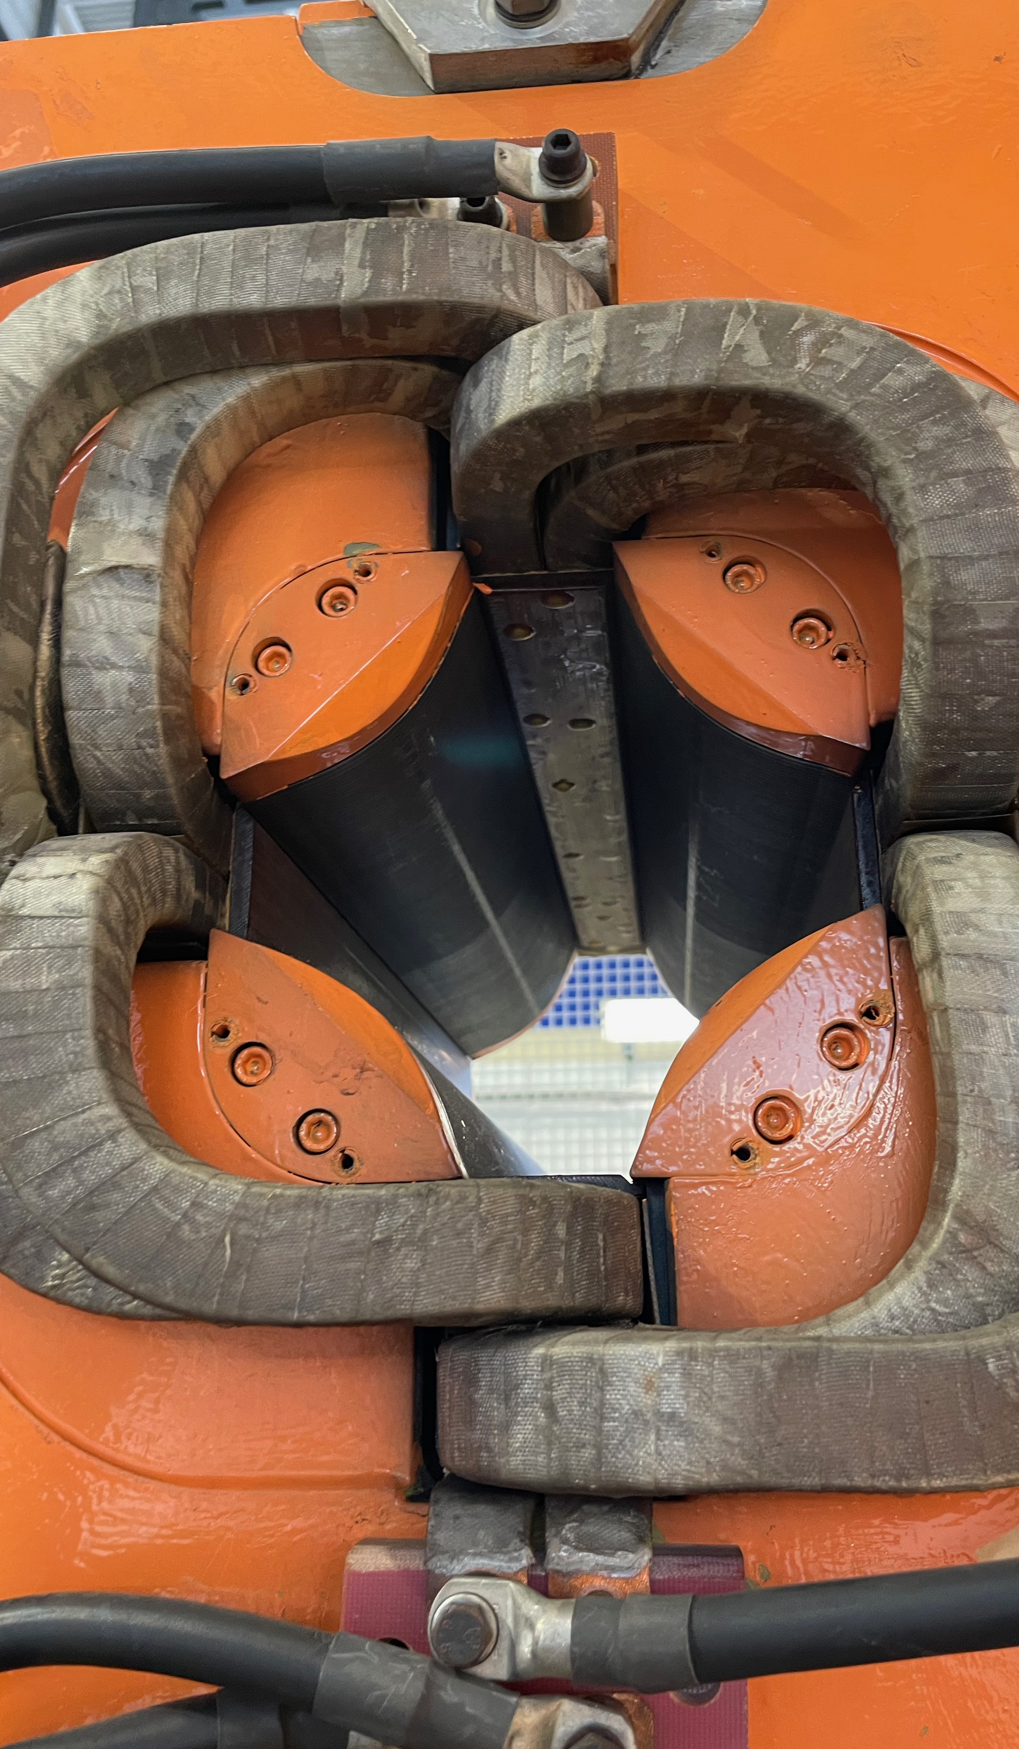

Slide 4
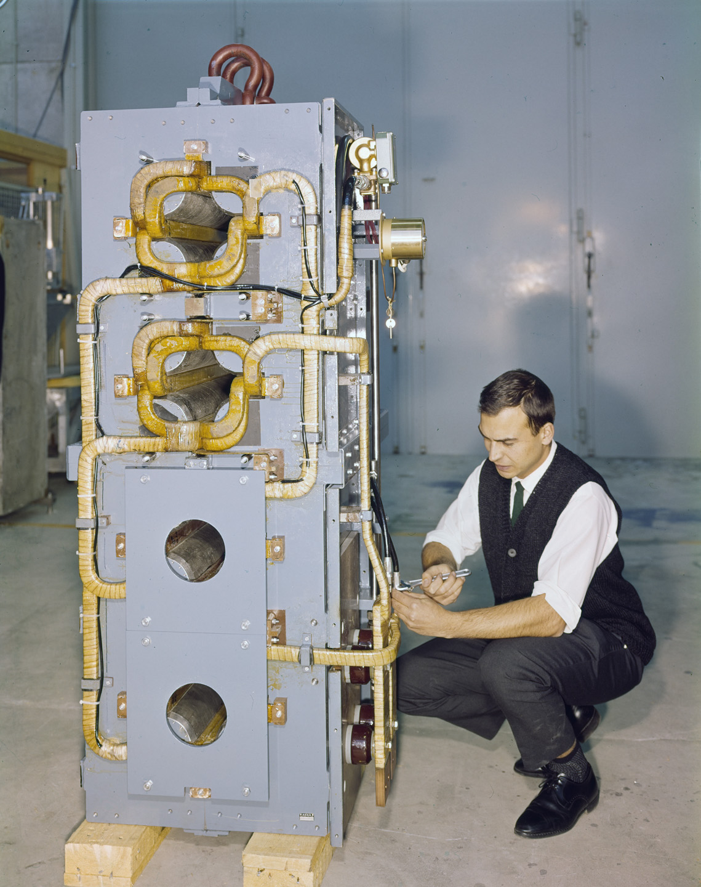
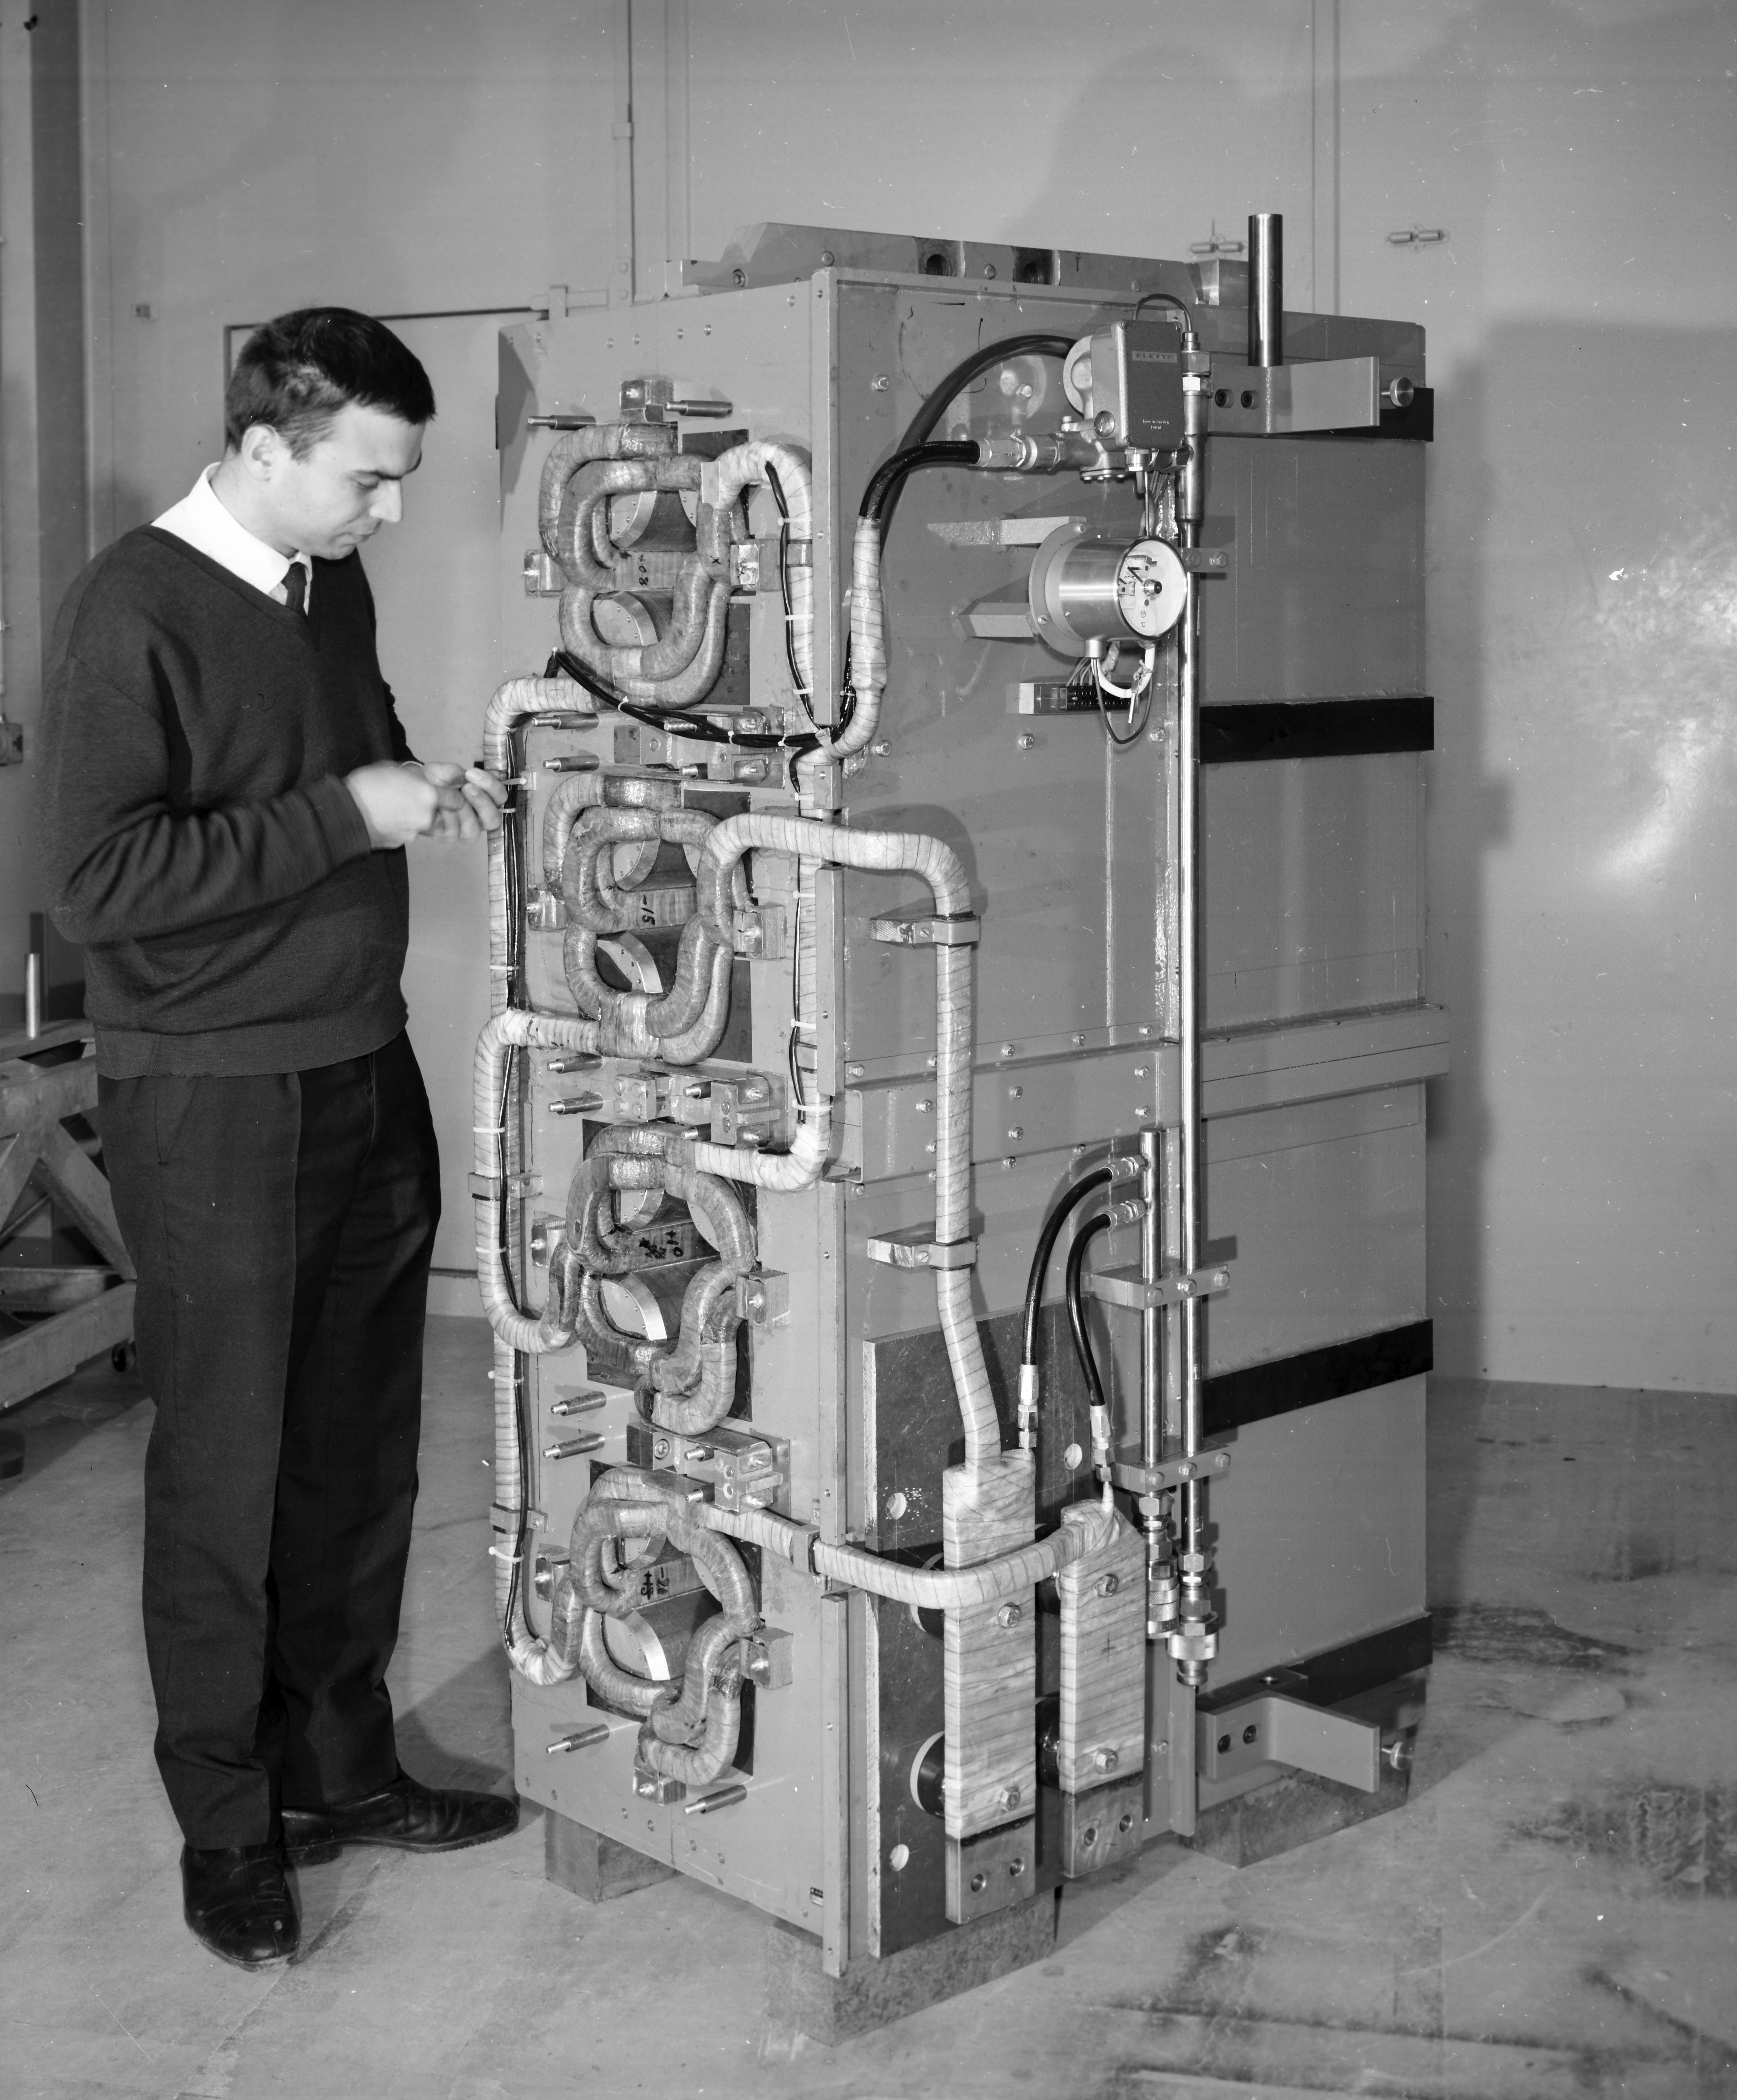

Slide 5
General Strategy
Renovation of 5 spare units at CERN
Production of 20-50 new units in industry
  Single Contractor
  Split supply: Yoke – Magnets
In the meantime corrective maintenance of leaking units
CERN supply:
  Conductor
  Iron (optionally punched laminations)

Slide 6
Design File
EN-MME allocated additional external resources
Mock-up:
  Coil design
  Bending tool, brazing jig, CNC jig
Quadrupole magnet:
  3D CATIA design of yoke, coils, assembly (Input for EM FEA vs MM)
  Yoke lamination drawing (press tool & study of alternative methods)
  First design iteration based on archived drawings
  Verification against spare magnets and reverse engineering as required
  As-built design file by Jul-23

Slide 7
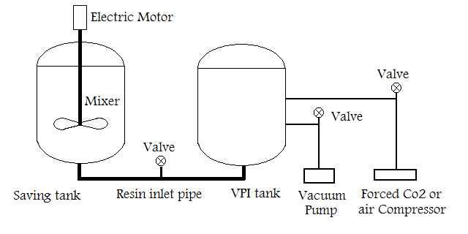
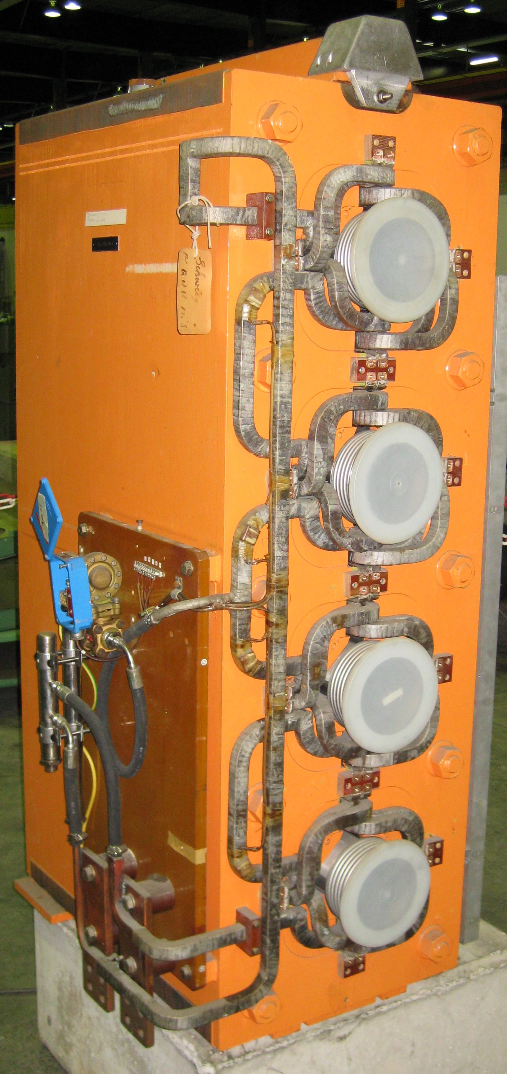
Autoclave
Top-loaded vs. horizontal loading
Resin reservoir
Flooding reservoir
Vacuum system
Injection system (with pumps?)
Pressurisation system (5-12 bars)
Heating (outgassing, injection, gelling)
Dripping of excess resin
Curing in separate oven

Slide 8
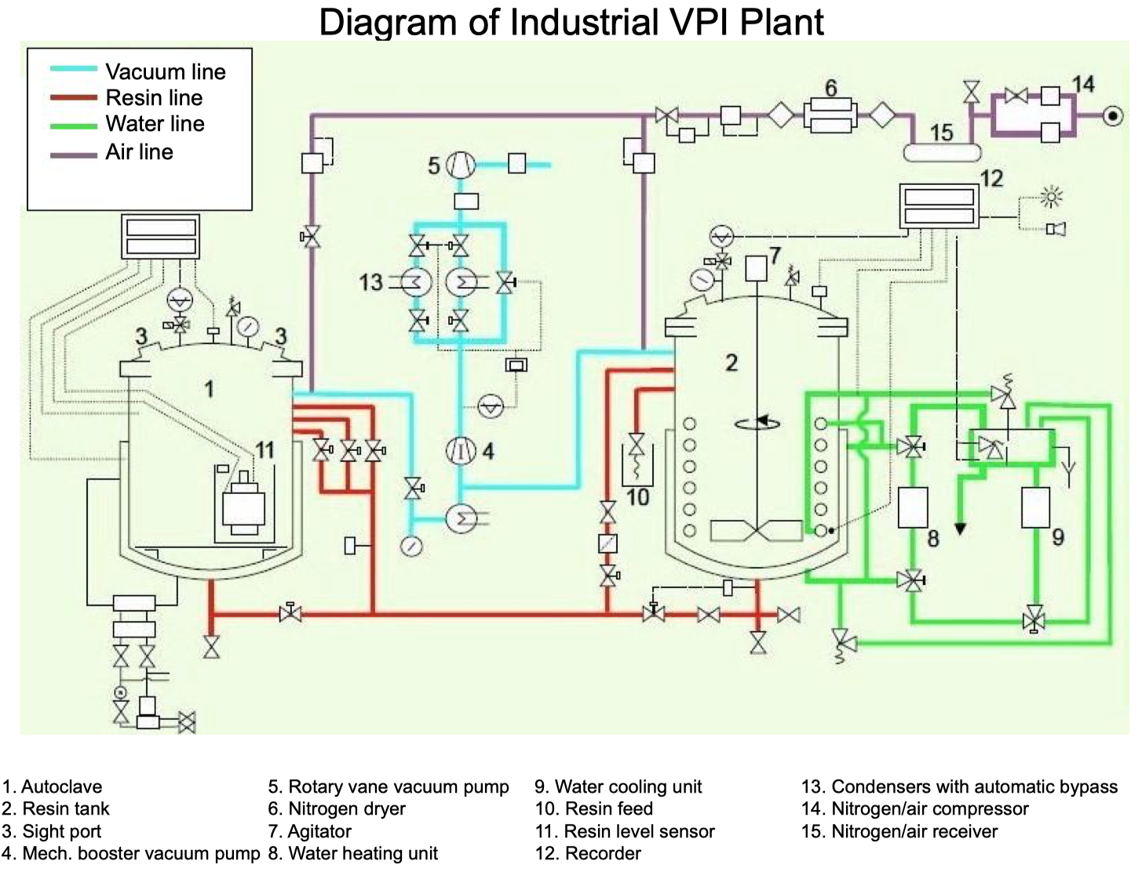
Tendering 3 months
Lead-time 5-12 months
Budget 500-700 kCHF^{(*}
^{*)}Provisional indication from 2 suppliers

Slide 9
Type D: L x W x H = (960 x 700 x 1750) mm, m = 5640 kg

Slide 10
(Possible) VPI Process overview
Coils are wrapped with dry/absorbent Mica-based insulation tape that is not cured prior to assembly in the yoke. All brazings are made before the impregnation.
The magnet assembly is dried over several hours in the autoclave under elevated temperature (~80°C) and purged with dry N₂ (or CO₂) flow at p = 1..10 mbar.
Vacuum drying at p = 0.1..0.5 mbar.
The impregnation resin is pre-heated (~60°C) and de-gassed p = ~0.5 mbar.
Magnet flooded with the epoxy resin under vacuum (~60°C).
High pressure (5-12 bars) is applied in the autoclave to push the impregnation resin into the insulation.
Raise temperature (~80°C) by hot water circulation / electric current to partially gel the resin around the conductor and/or use insulation tape with accelerator for better resin retention.
Temperature of the autoclave is decreased and the impregnation resin is pushed back to a storage tank.
The magnet is removed from the autoclave and excess of resin is cleaned off.
Curing at 80°C and 120-130 °C in an oven

Slide 11
Resin choice
Araldite F, HY 905, DY 040, DY 061 (100 pbw , 100 pbw, 0 - 20 pbw, 0.2 - 1 pbw), often used for NC magnet coils (VARTM).
Other resins to be investigated for the VPI process along with tapes with and without accelerator.
The woven glass backed tapes may be used at all voltage levels. But especially tapes with accelerator in conjunction with bisphenol A epoxy resin and anhydride hardener are used for largest turbine generator windings because of the best impregnability of all known systems.
Sample testing & mock-up assembly to finalise the resin choice and associated process.

Slide 12
Impregnation & Insulation Samples
Impregnation samples
  As-built insulation (VPI)
  As-built insulation (VARTM)
  Tape with accelerator (VPI)
  Tape with accelerator (VARTM)
Hot water flow
Hollow Cu- conductor
Clamp & grnd ins.

Slide 13
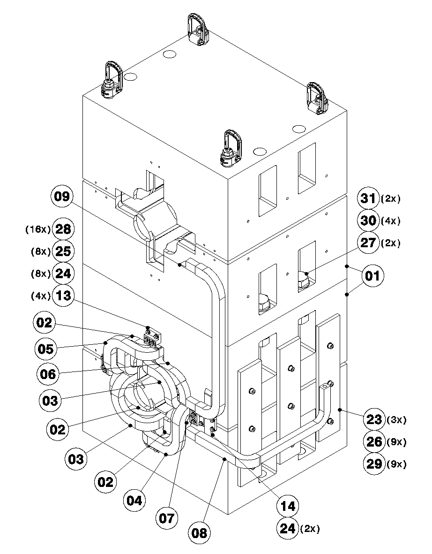
Mock-up: Coil assembly
As-built:
  Coil forming and preparation of parts & sub-assemblies
  Representative qualification samples (CT, SEM)
  Connection end assembly of the coil
    SIL-FOS (as-built)
    Vacuum brazing
  Insulation
  Coil assembly in the yoke incl. trim circuit and grnd insulation
    SIL-FOS (as-built)
  Insulation

Slide 14
Mock-up Impregnation
As-built
  VPI at industrial partner
    Process to define and validate through samples
    Heating concept (electric, water circulation, ..)
    Resin system (viscosity, pot-life, cure-cycle)
    Insulation (with or without accelerator)
VARTM at CERN?
Dismounting and cleaning of the aperture
1st assembly-disassembly completed by End-23

Slide 15

Renovation of 5 Spare Units
Activated magnets
  Shipping outside of CERN complicated (possible?)
  Safety aspects related to dismounting of the coils
Infrastructure
  Autoclave
  Curing oven
Stripping and assembly procedure validated with mock-up
1st certified unit by (earliest) Mid-2024
Unit #2 completed End-24
Unit #5 completed Mid-26

Slide 16
Production of New Magnets
Tendering process (MS & IT) targeting FC in March-24
Strategy:
  Scenario 1: Single Contractor for the entire supply
  Scenario 2: Split supply: Yoke – Magnet assembly
CERN supplied items:
  Conductor
  Iron sheets
  Option 1: Yoke laminations (press-tool)
  Option 2: Yoke assemblies (stacking fixture)

Slide 17
Production Scenario 1:
Scenario 1: Single Contractor for the entire supply
2 parallel production lines
CERN supplied items:
  Conductor
  Iron sheets
  Option 1: Yoke laminations (press-tool)
Pre-series unit validated by (earliest) Mid-25
10 series magnets Q3-26
20 series magnets Q3-27…

Slide 18
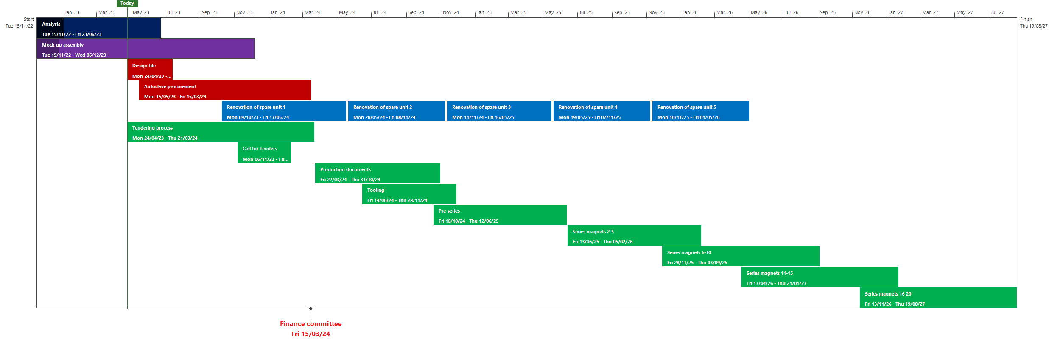
Project Time-line: Scenario 1

Slide 19
Production Scenario 2:
Scenario 2: Split supply: Yoke – Magnet assembly
2 parallel production lines for both magnet assembly
1 production line for yoke assembly (sequential production)
CERN supplied items:
  Conductor
  Iron sheets
  Option 1: Yoke laminations (press-tool)
  Option 2: Yoke assemblies (stacking fixture)
    Pre-series yoke by Mid-24
    5 Yoke assemblies by End-24
Pre-series unit validated by (earliest) Mid-25
10 series magnets Beg-26
20 series magnets Q3-26…
Rebuilding 4 Spare magnets at CERN

Slide 20
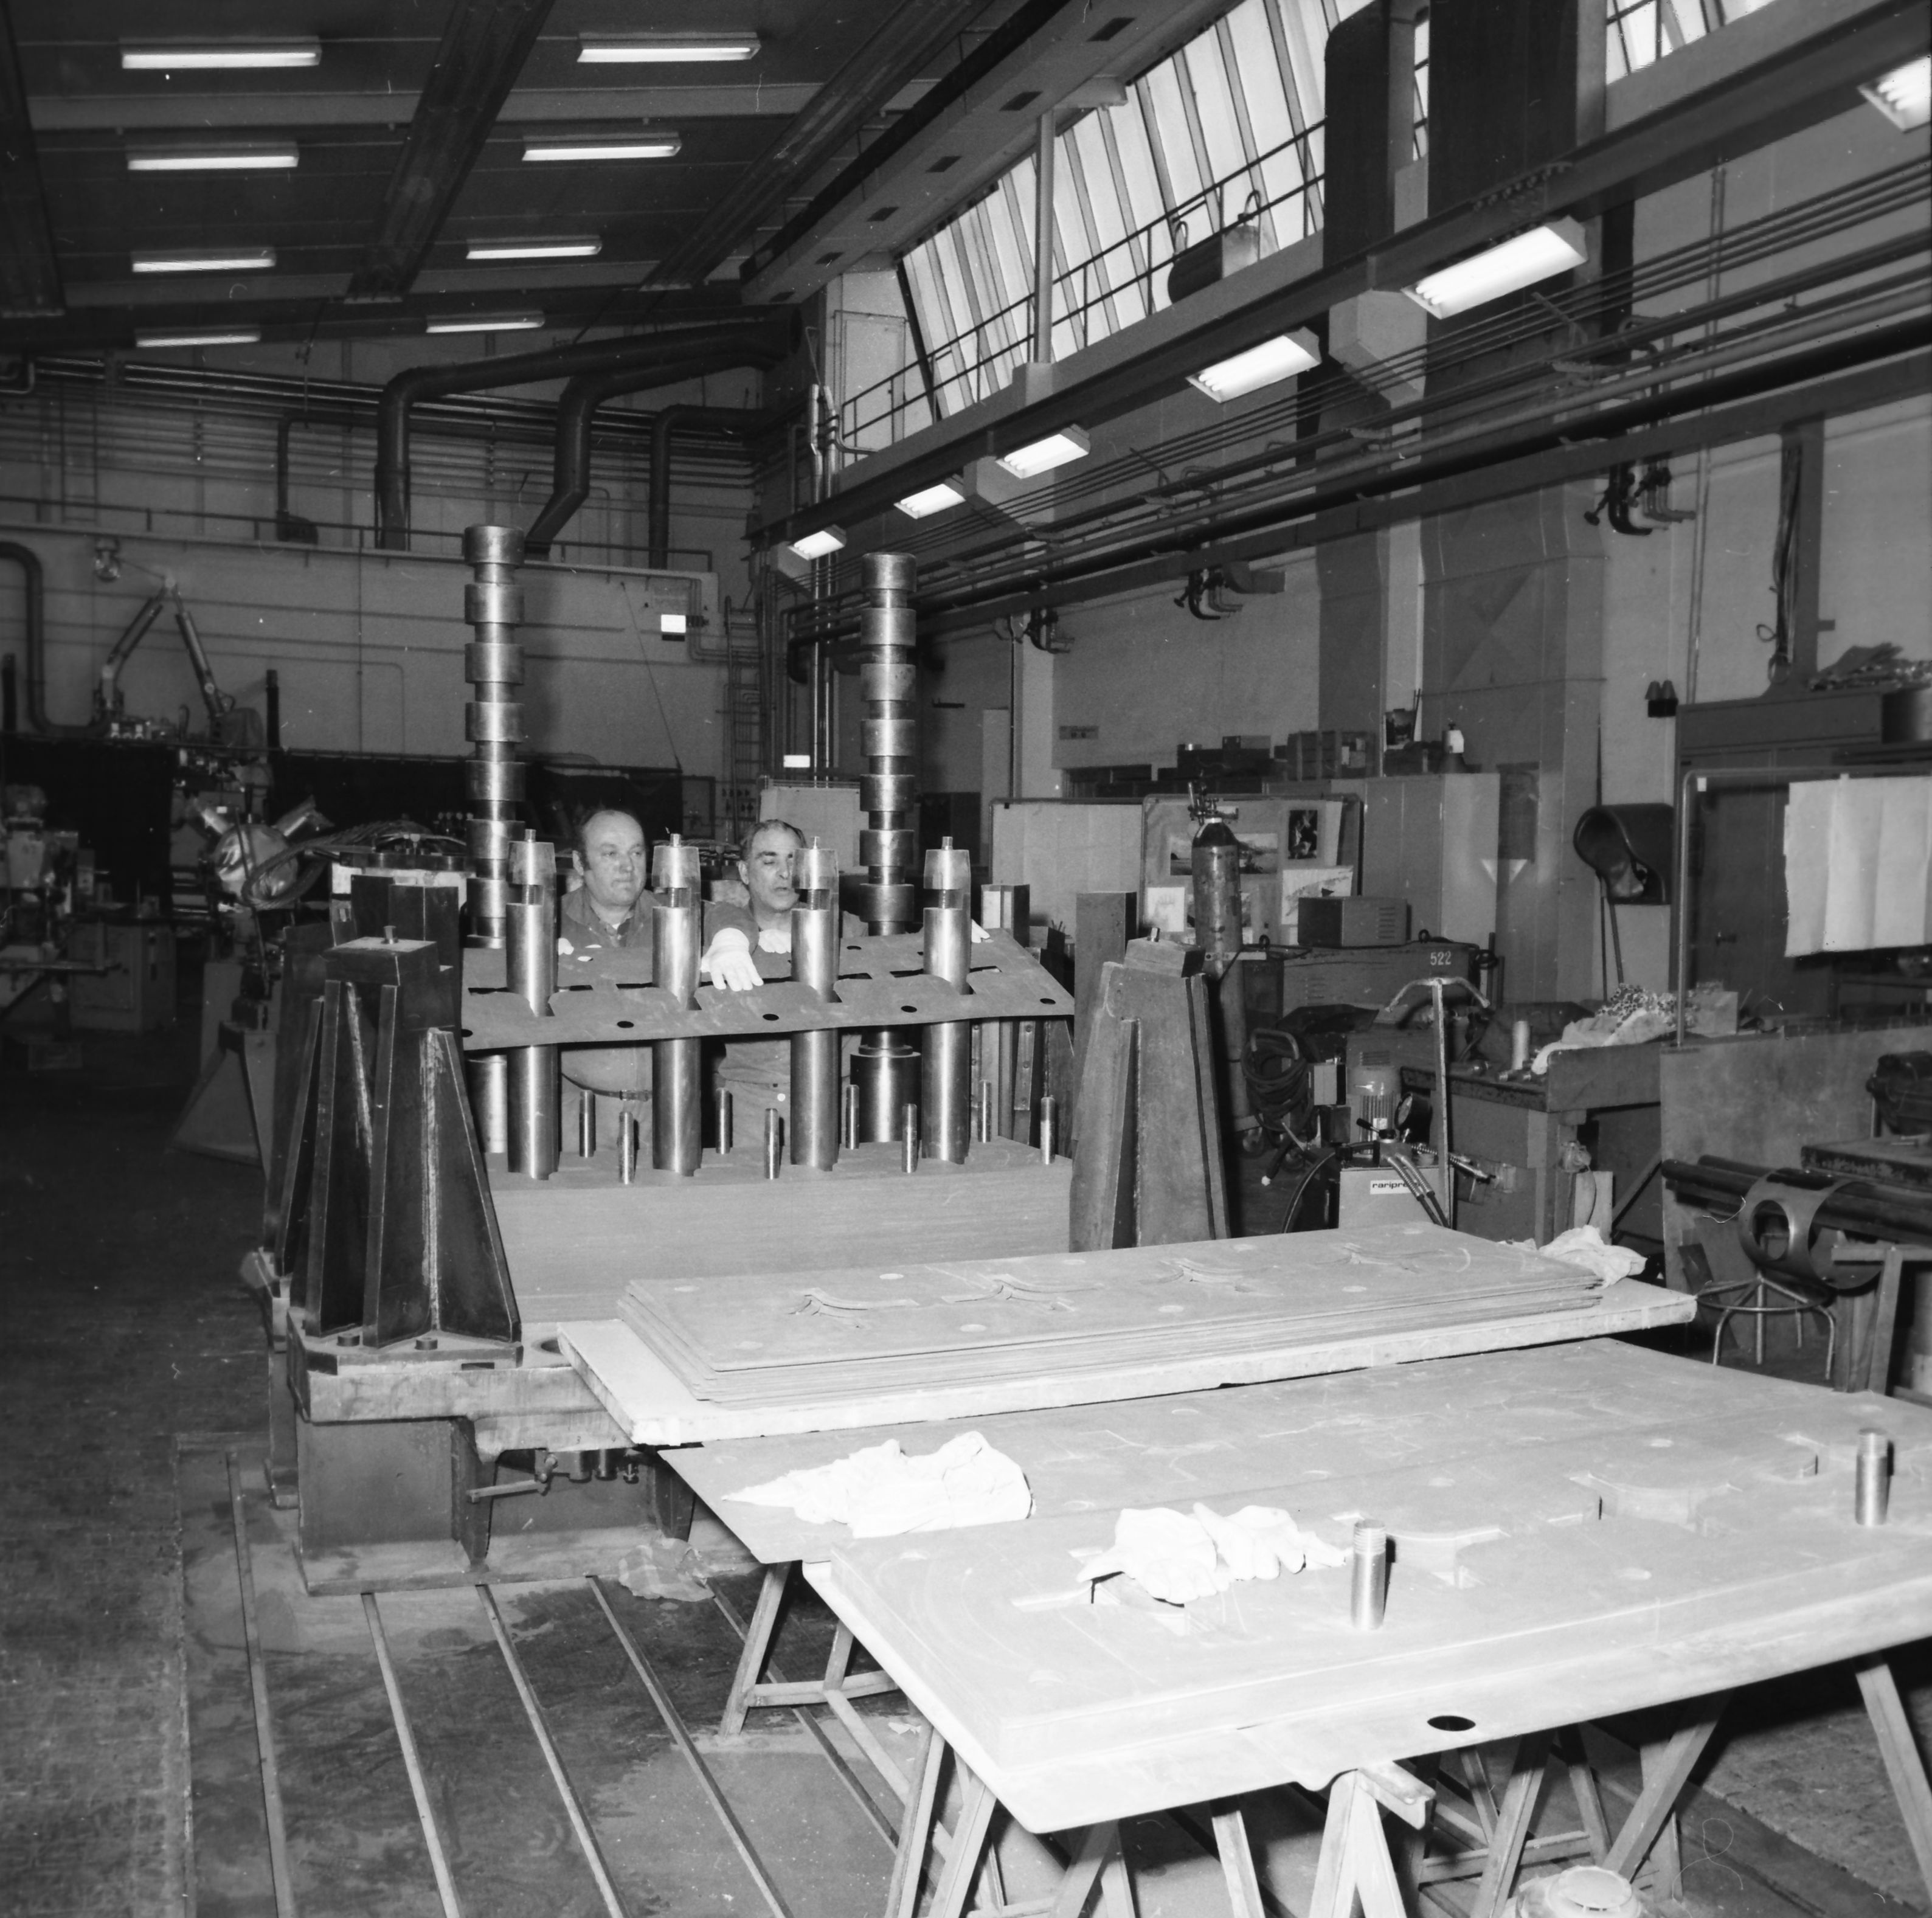
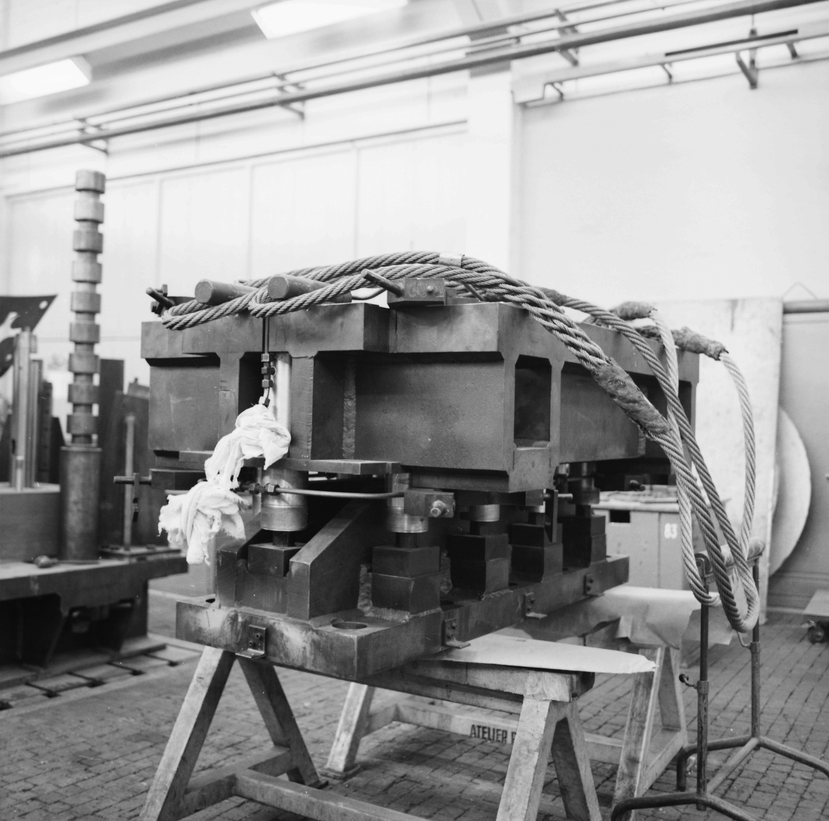
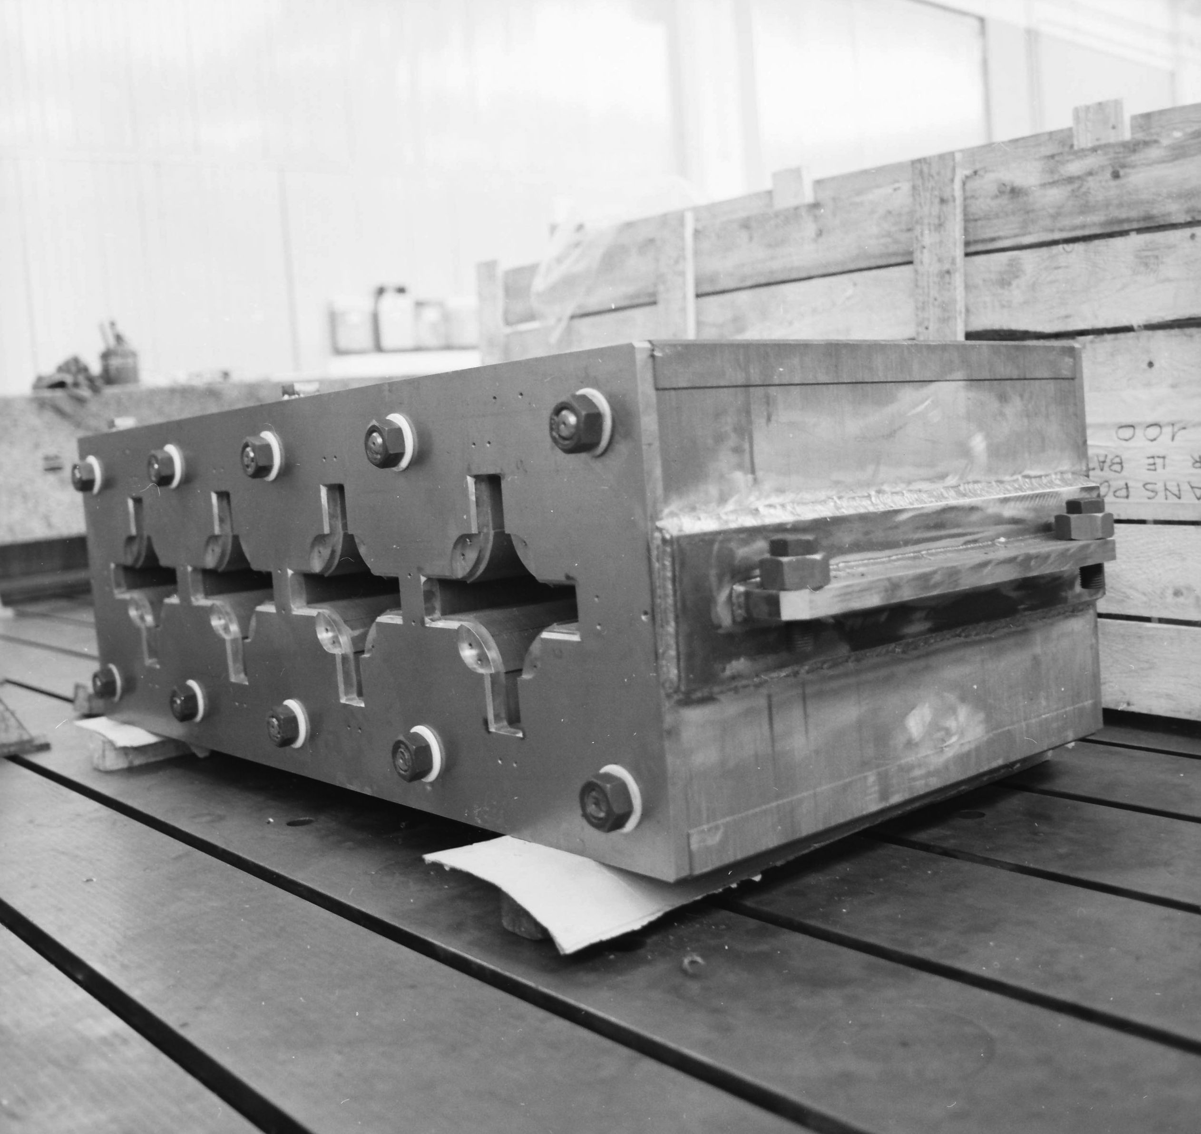
Yoke Assembly

Slide 21
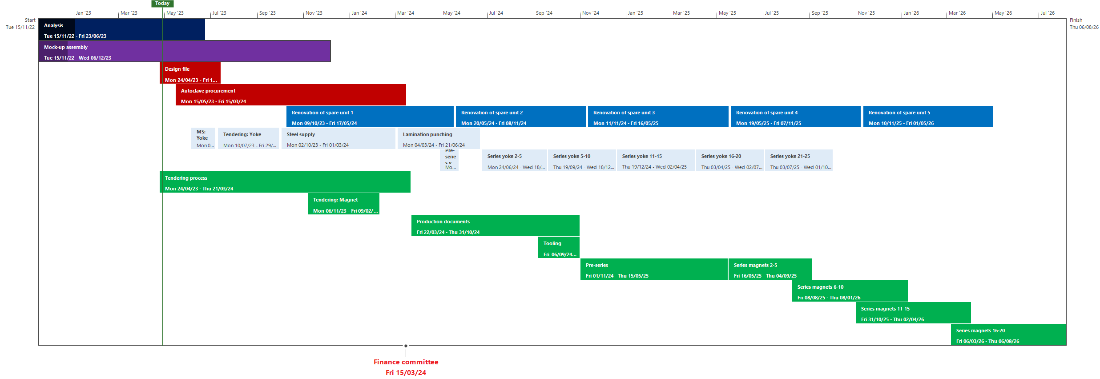
Project Time-line, Scenario 2

Slide 22
Proposed Strategy
Complete design file
Procurement of an autoclave
Mock-up to define the process, VPI in industry
CERN to launch production of the yoke assemblies
Launch industrial procurement of up to some 50 units
Renovation of 1 spare unit at CERN
Assembly of up to 5 magnets at CERN

Slide 23
Cost-estimate

Slide 24
DO & FSU

Slide 25
Renovation of Spares

Slide 26
Production Magnets
Does not include:
Engineering
Profit margin
Risk
…

