Slide 1

IdeaSquare and EU Projects
Pablo and Roy
Why are we here?

Slide 2

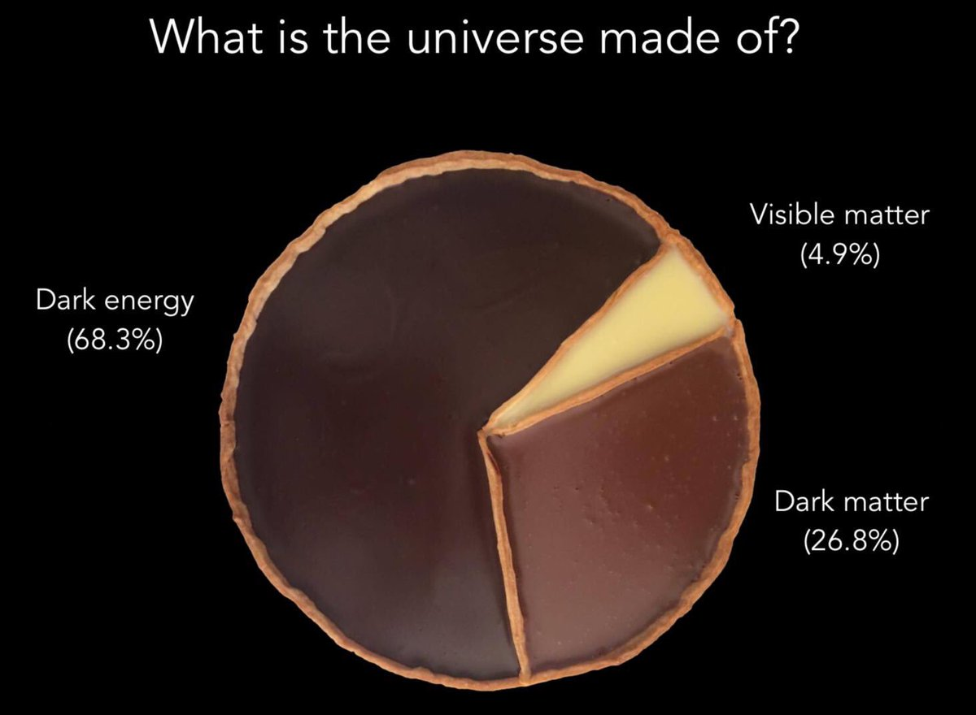

IdeaSquare
Running EU Projects
Future EU projects
Submitted EU Projects

Slide 3
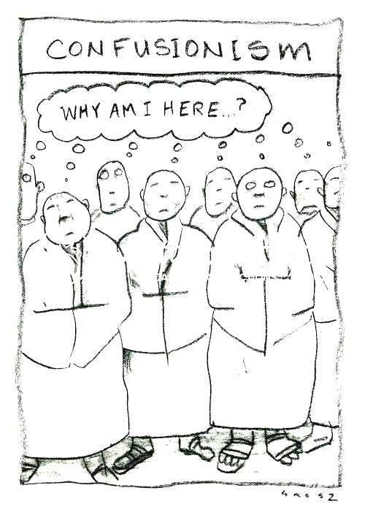
Why?
Surviving.
Surviving.
Being linked to the EU Office in the IPT organigram.

Slide 4
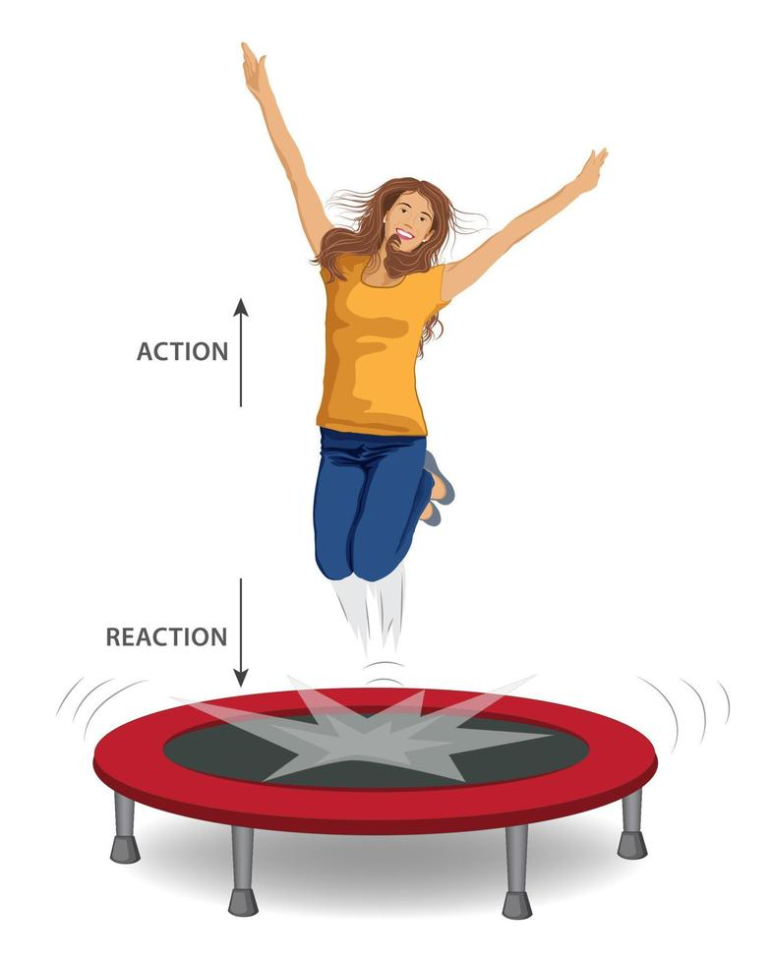
Newton’s
third law
of motion!!
If we take EU Projects as a burden, they will become a burden.
If we take them as a way to realize our activities, though with the “evil” of managing them, they will become a way to grow and also a shield against management wind.
Up to each one of us…
Reaction
Action

Slide 5
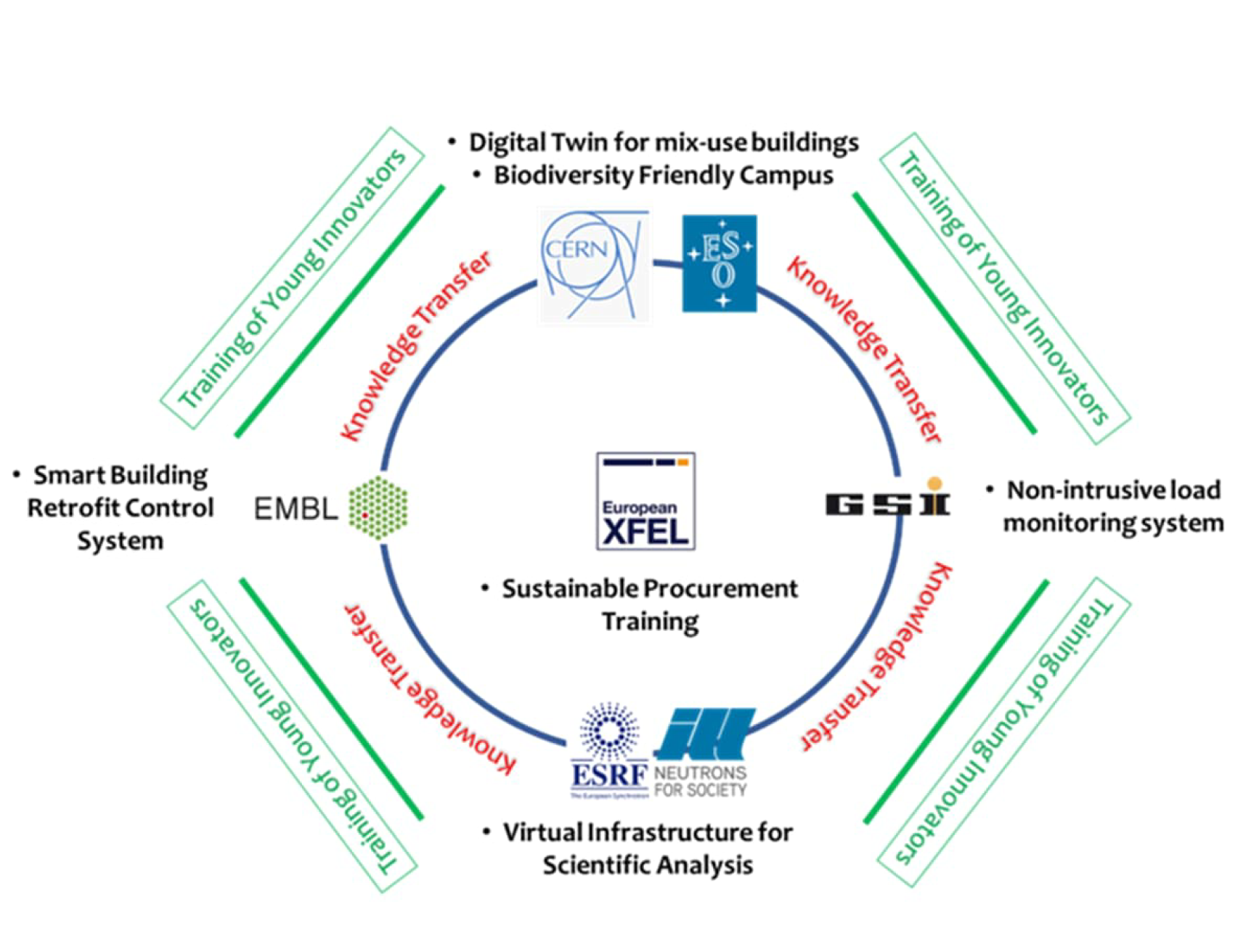
Pipeline: CARAT
Why?
Surviving after 2025.
Linking to Green Village.
Financing our student activities.
What?
Biodiversity Pilot
Digital Twin of a CERN Building Pilot.
IdeaSquare’s role?
Provide Training for students (mostly PhDs) recruited among the consortium partners.
They should spend at least two weeks (total time) along the training at IdeaSquare.
Training about Sustainability/SDGs inspired by the pilots.
By September, we would expect to know the result regarding funding.

Slide 6
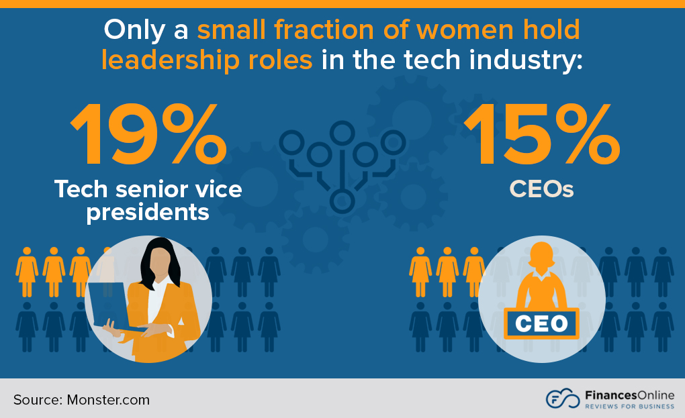
Pipeline: REACH
Why?
Surviving after 2025 and possibly longer-term income.
Linked to ATTRACT.
Financing our student activities.
What?
Funding 130 projects for SMEs/Start-ups led by women.
IdeaSquare’s role?
Support Aalto and ESADE for the training of young female innovators.
Training about Sustainability/SDGs inspired by the SMEs/Start-ups projects.
Similar to ATTRACT Academy but way simpler.
By September, we would expect to know the result regarding funding.

Slide 7
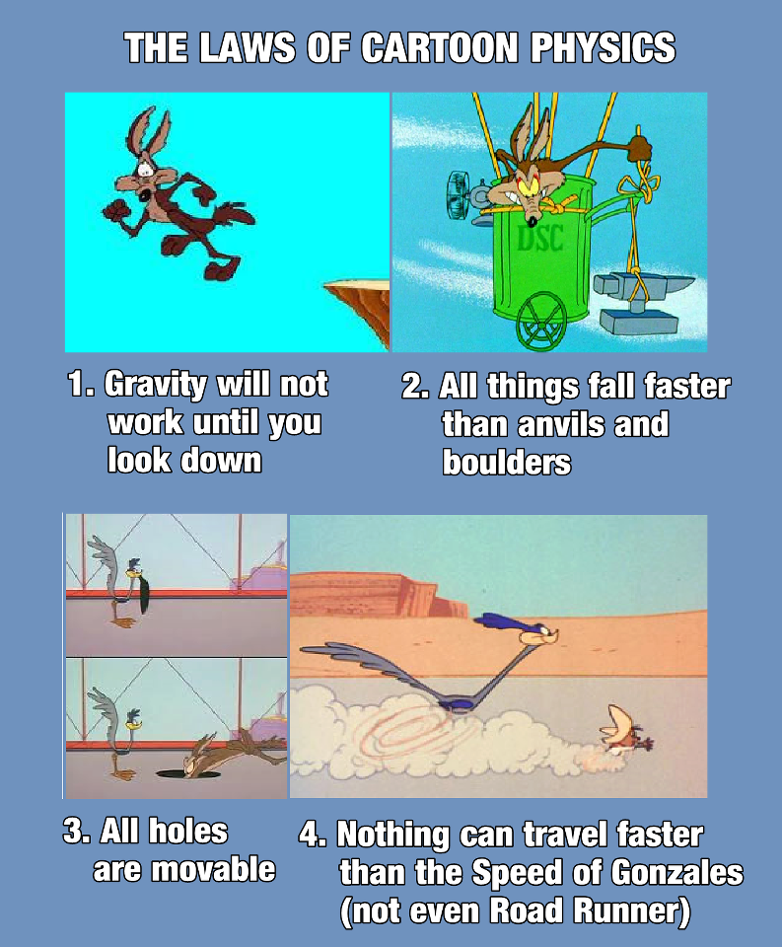
Conclusions
The Future is not an issue until you think it is.
All things fall faster than a committing team.
All hurdles are avoidable and/or solvable.
Nothing can travel faster than IdeaSquare.

Slide 8
Questions

