Slide 1

FCC-hh: D1 and D2
Ezio Todesco
Technology Department
European Organization for Nuclear Research (CERN)
Acknowledgements to M .Giovannozzi

Slide 2
REQUIREMENTS
Integrated field: 160 T m
  28 T m in LHC
  35 T m in HL-LHC
  For the 80 TeV baseline it will be 128 T m
D1 aperture: 116 mm
  LHC: 80 mm
  HL LHC: 150 mm
D2 aperture: 80 mm
  LHC: 80 mm
  HL-LHC: 105 mm

Slide 3
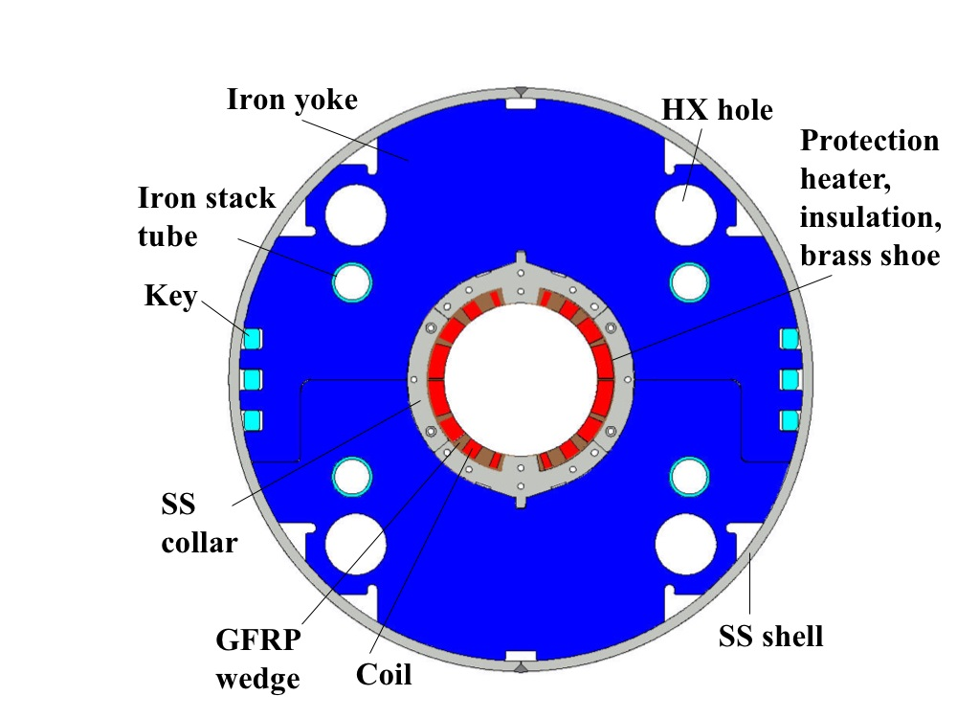
D1 MAIN PARAMETERS
First option: Nb-Ti version similar to HL-LHC D1 (5.6 T)
  One layer magnet, Nb-Ti at 1.9 K
  Total length: 28.5 m
  Two modules of 14.25-m-long magnets (magnetic length)
  For the 80 TeV baseline, two 11.6-m-long magnets

Slide 4
D1 MAIN PARAMETERS
Second option: Nb-Ti version double layer à la LHC (7 T)
  Stress is proportional to jBr - it will be lower than in the LHC dipole
    25% larger field (7 T versus 5.6 T)
    25% lower aperture (116 mm versus 150 mm)
    15% lower current density (380 A/mm² versus 450 A/mm²)
  Use a two-layer coil (double the coil width of HL-LHC D1) to have adequate margin
    Short sample will be around 9.5 T, at 7 T we are at 70% of loadline fraction – it is a magnet similar to D1 as challenges
Total length: 23 m
  Two modules of 11.5-m-long magnets
  80 TeV baseline: 2 modules of 9.3-m-long magnets

Slide 5
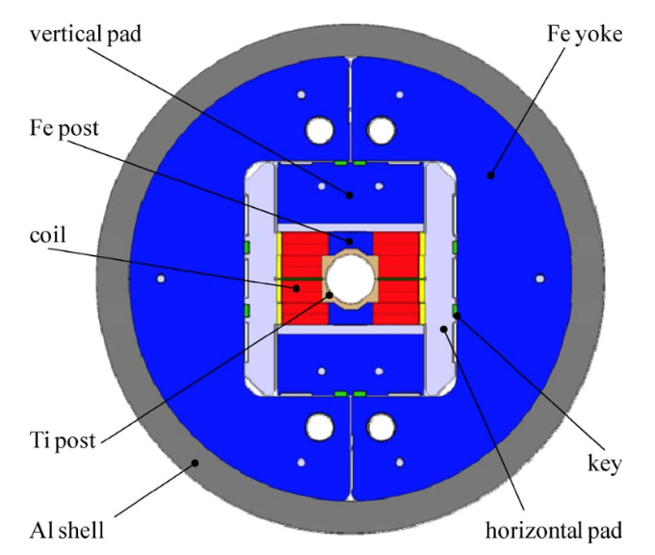
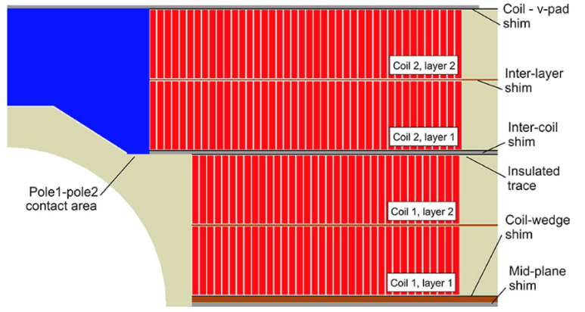
D1 MAIN PARAMETERS
Third option: Nb₃Sn à la Fresca2 (13 T)
  Aperture is 116 mm, 15% larger than Fresca2
  With the block design, the issue of accumulation of stress in removed
  Fresca2 reached 14.5 T, 13 T is a challenging but reasonable operational point
Total length: 12.3 m
  One 12.3-m-long magnet
  80 TeV baseline: one 10-m-long magnet

Slide 6
D2 MAIN PARAMETERS
First option: Nb-Ti version à la HL-LHC D2 (5 T)
  The limiting factor if this magnet is field quality, dominated by the cross-talk
  One layer magnet, Nb-Ti at 1.9 K
  We can increase from 4.5 T (HL-LHC D2) to 5 T since the aperture is smaller (80 mm versus 105 mm) and the separation is larger (250 mm versus 192 mm)
  Total magnetic length: 32 m
  Three modules of 10.7-m-long magnets
  For the 80 TeV baseline, two 13-m-long magnets

Slide 7
D2 MAIN PARAMETERS
Second option: Nb-Ti version à la LHC MB (7 T)
  One has to carefully check the field quality to see if this is viable – or add ad hoc correctors
    One could probably push the field towards 7.5 or 8 T if needed
  Two-layer magnet, Nb-Ti at 1.9 K
  Total magnetic length: 22.8 m
  Two modules of 11.4-m-long magnets
  For the 80 TeV baseline, two 9.3-m-long magnets
No space for having a design à la Fresca2

Slide 8
SUMMARY
D1
Inspiring magnet | Field (T) | Lenght for 100 TeV (m) | Lenght for 80 TeV (m)
á la HL-LHC D1 | 5.6 | 2×14.3 | 2×11.6
á la LHC MB | 7.0 | 2×11.5 | 2×9.3
á la Fresca2 | 13.0 | 12.3 | 10.0
D2
Inspiring magnet | Field (T) | Lenght for 100 TeV (m) | Lenght for 80 TeV (m)
á la HL-LHC D2 | 5 | 3×10.7 | 2×13
á la LHC MB | 7.0 | 2×11.3 | 2×9.3

