Slide 1
EBTS regular meeting
OTR measurements at EBTS
Sedlacek Ondrej
02.05.2023

Slide 2
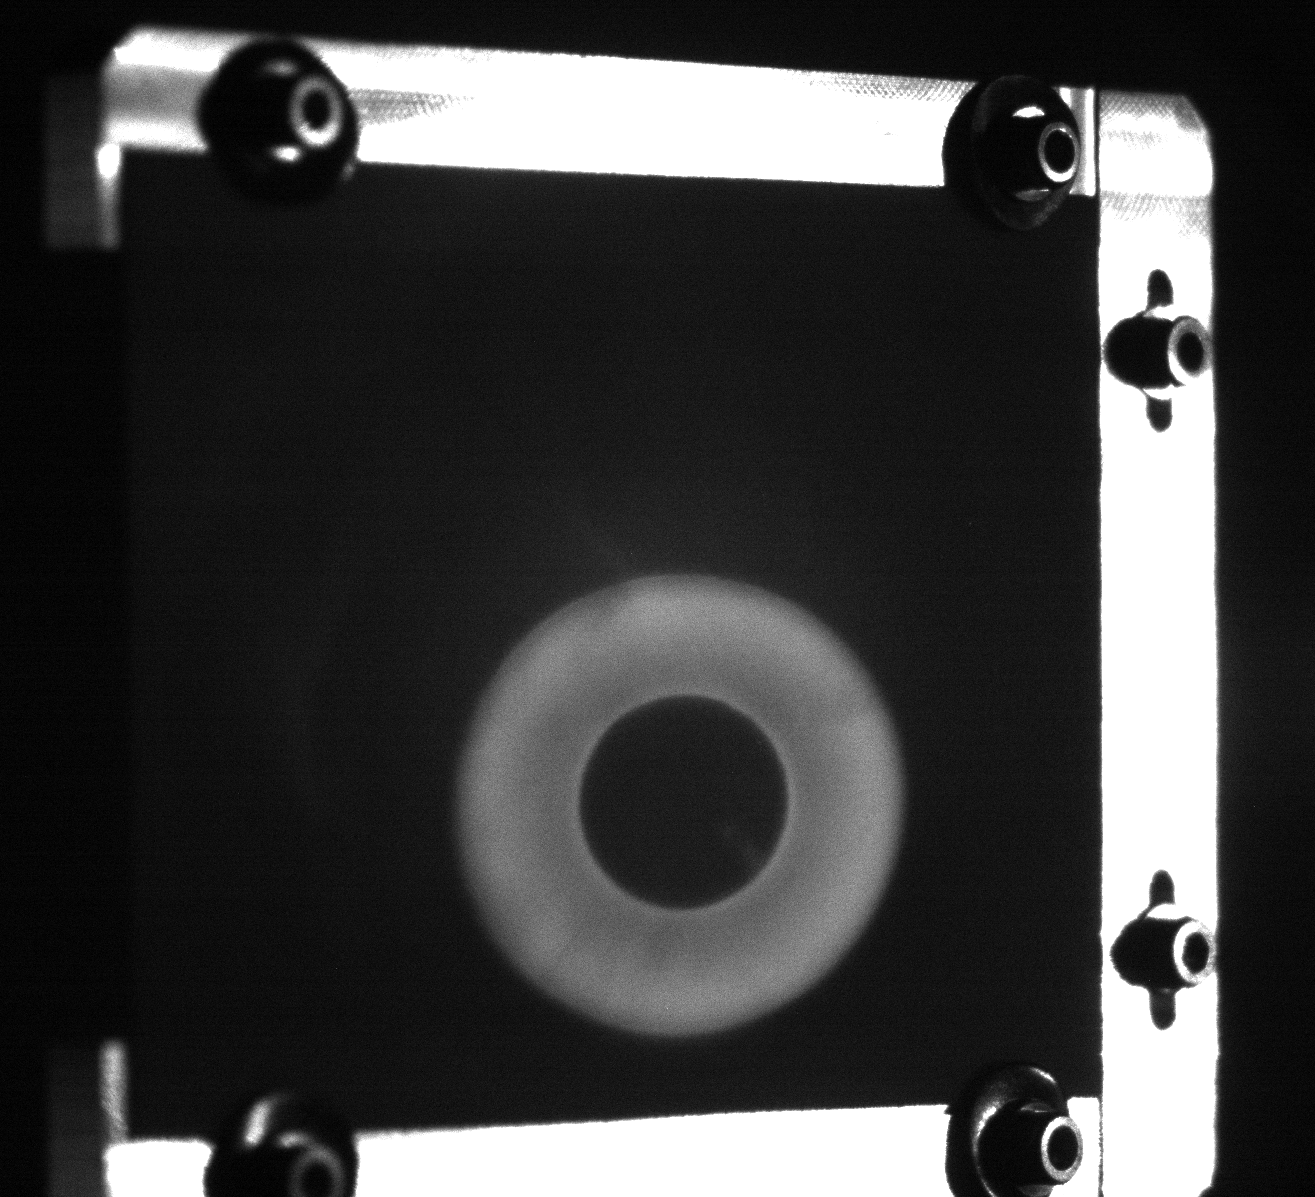
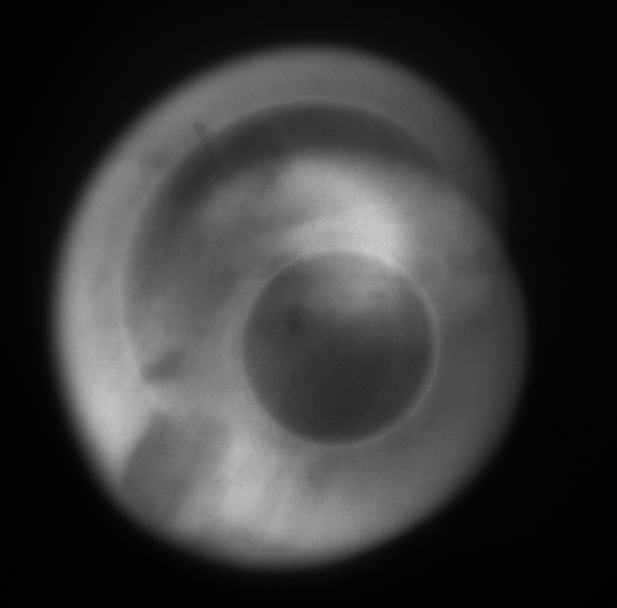
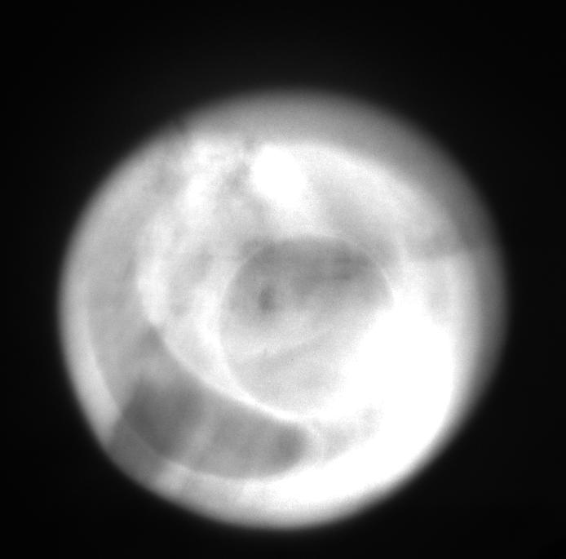
2022 - CHROMOX experiments
Dates: 24.10. (main); 17.-20.10.;
I = 0-400mA
R_out = 5.4-10.5 mm
E = 3.0, 4.6, 7.0 keV
Notable measurements
  I = 2.5mA, Pulse = 3us, R_out = ~5.4-10mm;
Note: Higher current or beam pulse - tail dominates the figure
Log: https://be-op-logbook.web.cern.ch/elogbook-server/#/logbook?logbookId=2781&dateFrom=2022-10-24T00%3A00%3A00&dateTo=2022-10-25T00%3A00%3A00
Figures: https://cernbox.cern.ch/s/HoOODOwfDY3Obm0

Slide 3
27.10.2022 - BTV experiments
1) Full beam:
  I = 0-1.2A
  R_out = 6-10.5 mm
  Heating at 50, 56V
  For Heating at 50V both Marx and Squeeze more fine
2) Slicing beam:
  Slicing at -5-5us, 0-10us, …, 15-25us, 20-+5us;
  I = ~400 mA
  Squeeze: CA300 CB600, CA200 CB840, CA100 CB840
  R_out = 5.1, 7.0 ,10.5 mm
  Heating at 50, 56V
Log: https://be-op-logbook.web.cern.ch/elogbook-server/#/logbook?logbookId=2781&dateFrom=2022-10-27T00%3A00%3A00&dateTo=2022-10-28T00%3A00%3A00
Figures: https://cernbox.cern.ch/s/c9ykG7e79NFHWuQ

Slide 4
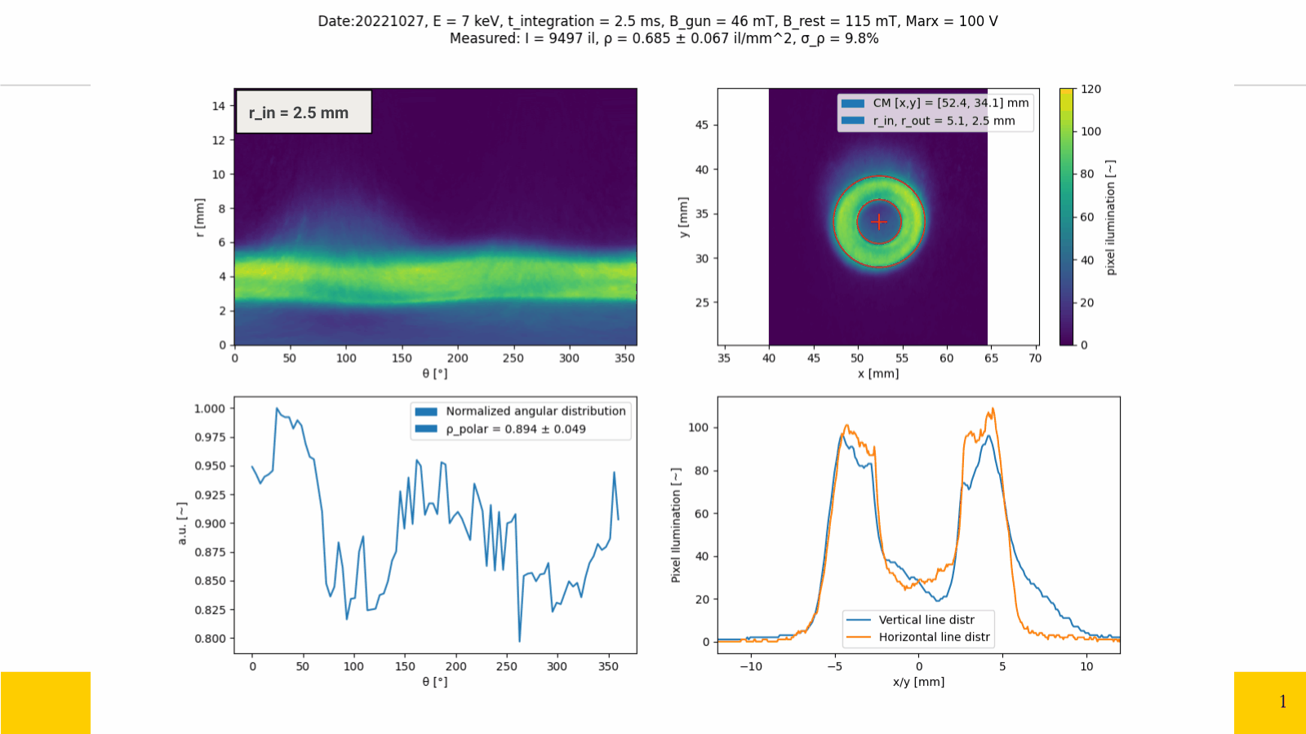
Small bright spots
Stay motionless → Screen impurities?
Larger trends
Change with beam → Beam property
Flare
Moves and changes with beam → Beam effect - reason?

Slide 5
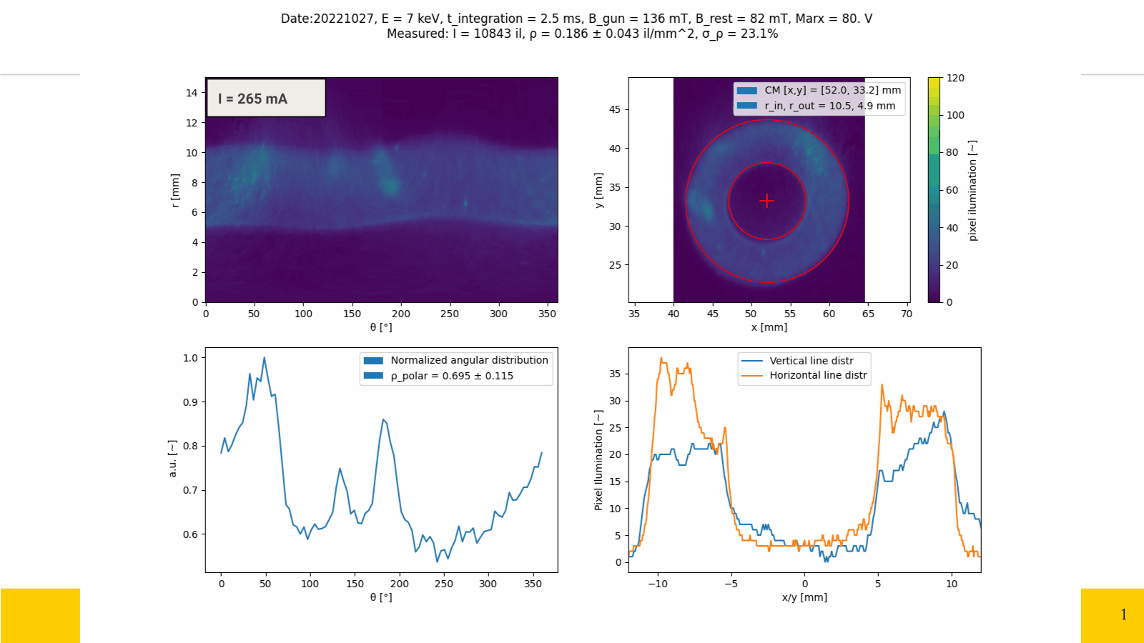

Slide 6
29.03.2023 - BTV experiments
1) Full beam:
  55 measurements
  I = 0, 0.4-1.2A
  R_out = 5.1-10.5 mm
  Scanning correctors (not a full scan)
  Current measurements (at collector) matching each measurements
Some notable measurements:
  ID043 - Same conditions to main BGC measurement
    I = 1A, R_out = ~6mm, correctors used
  ID004/005/010 matching to 2022 OTR
Full log: https://cernbox.cern.ch/s/hw3ArTC7GNLVqdl

Slide 7
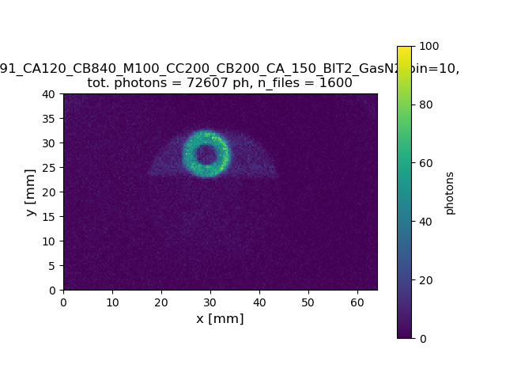
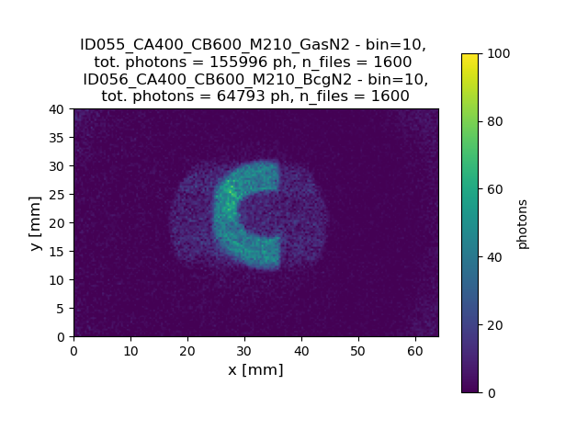
2022-BGC experiments at EBTS
96 measurements
  I = 0, 0.4-1.5 A
  R_out = 5.1-~10.5 mm
  Scanning correctors (not a full scan)
  Simultaneous current measurements at collector
  Gas: Ne, N2, Ar
Main measurements:
  ID091-096 - Nice whole beam on the curtain
    I = 1 A, R_out = ~6 mm, correctors used
  ID055-061 - Huge beam, high current, ~half on curtain
    I = 1.5 A, R_out = 10.5 mm, no correctors
Full log: https://cernbox.cern.ch/s/hw3ArTC7GNLVqdl

Slide 8
Needed measurements
BGC - OTR comparison
  ID091-096 - Nice whole beam on the curtain - Done
    I = 1 A, R_out = ~6 mm, correctors used
  ID055-061 - Huge beam, high current, ~half on curtain
    I = 1.5 A, R_out = 10.5 mm, no correctors
  Scanning correctors (not a full scan) - Partially done
  Slicing the beam
    ID091 & ID055
  And more
Compare new cathode to the old one
  Repeat the BGC:ID091 & BGC:ID055
  Repeat the OTR:004/005/010 - Same to all OTRs & slicing
Full log: https://cernbox.cern.ch/s/hw3ArTC7GNLVqdl

Slide 9






Thank you for your attention
Any questions?

Slide 10
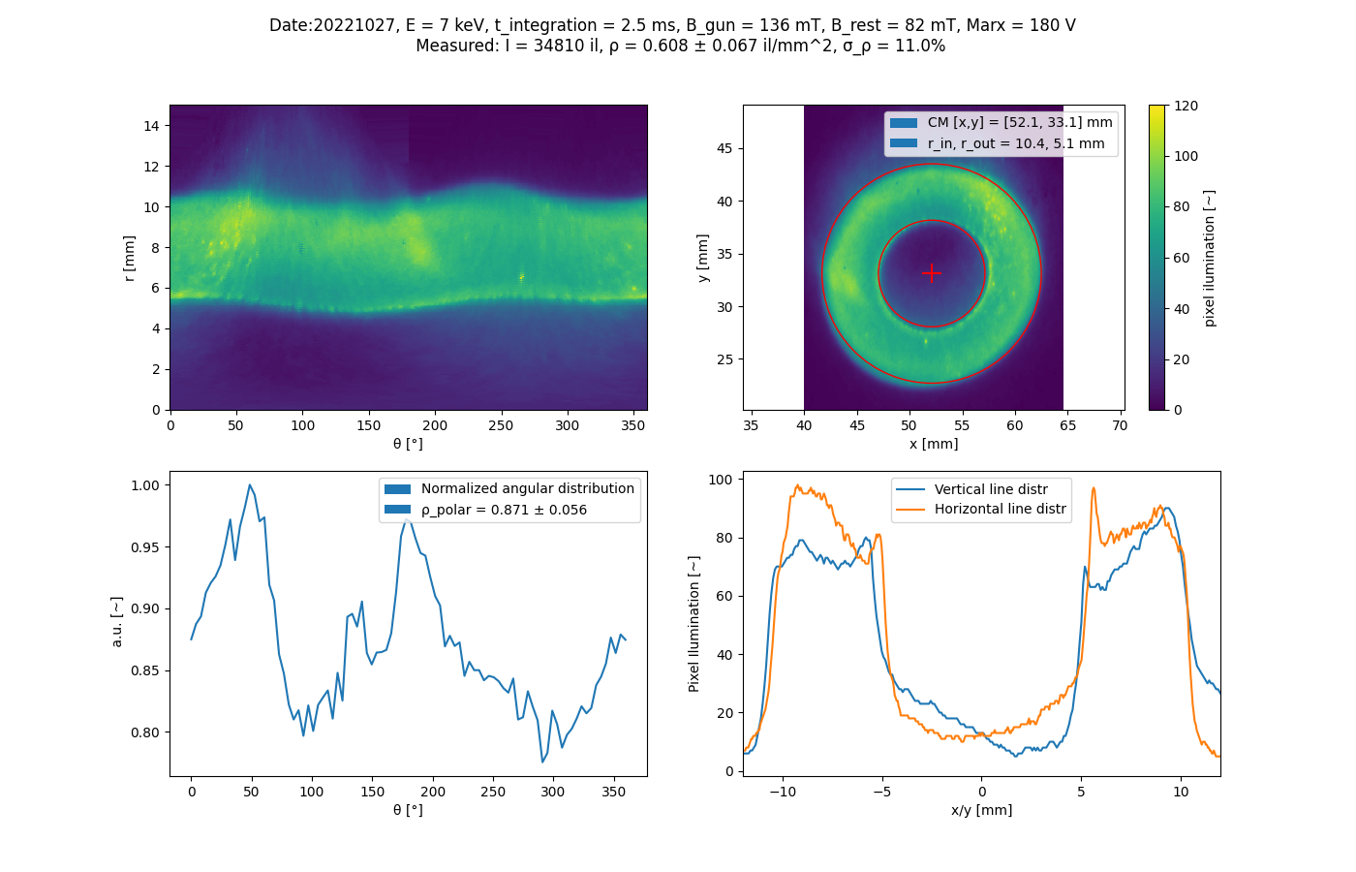
OTR measurements
E = 7.0 keV r_in = 5.1 mm
I = 1.2 A r_out = 10.4 mm
I = 1.2 A
Polar plot
2D distr
Line plots
Normalized angular distribution

Slide 11
OTR measurements
E = 7.0 keV r_in = 5.1 mm
I = 1.2 A r_out = 10.4 mm
I = 1.2 A
Polar plot
2D distr
Small bright spots
Line plots
Normalized angular distribution

Slide 12
OTR measurements
E = 7.0 keV r_in = 5.1 mm
I = 1.2 A r_out = 10.4 mm
I = 1.2 A
Polar plot
2D distr
Small bright spots
Larger “trends”
Line plots
Normalized angular distribution

Slide 13
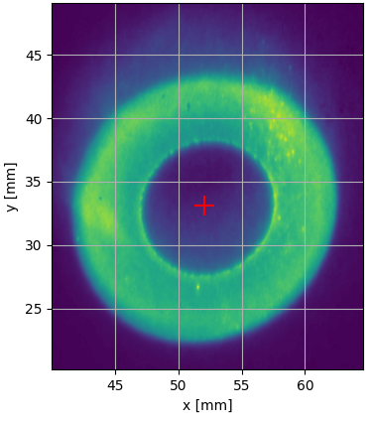
OTR measurements
E = 7.0 keV r_in = 5.1 mm
I = 1.2 A r_out = 10.4 mm
I = 1.2 A
Polar plot
2D distr
Small bright spots
Larger “trends”
Flare
Line plots
Normalized angular distribution

Slide 14
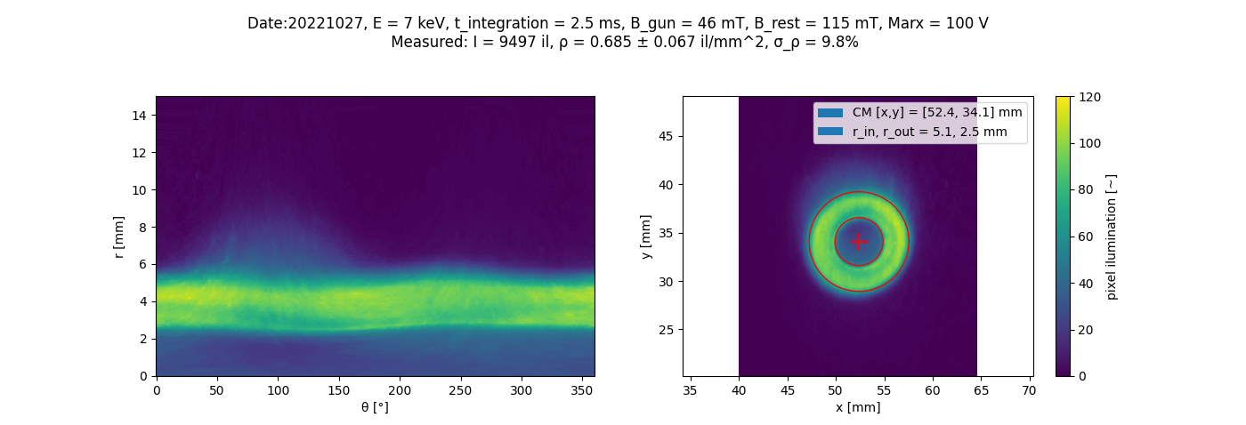
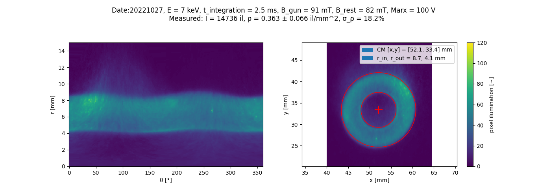
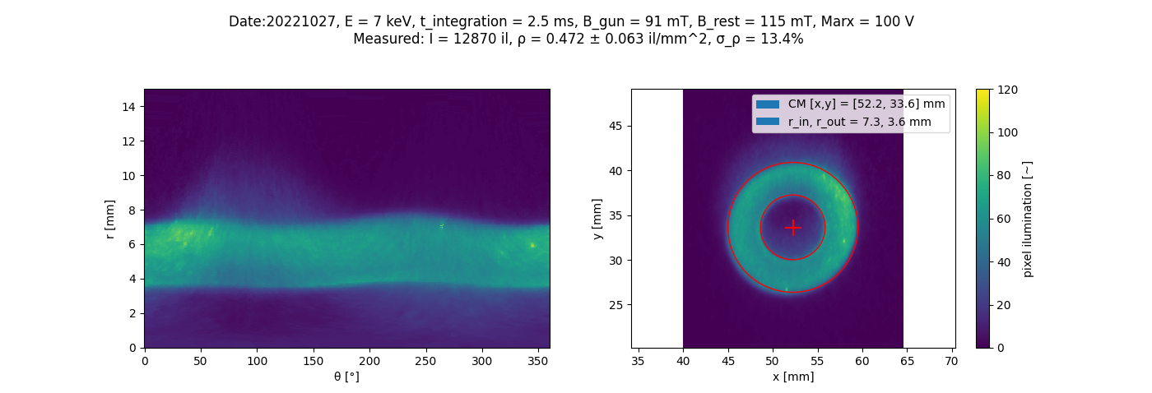
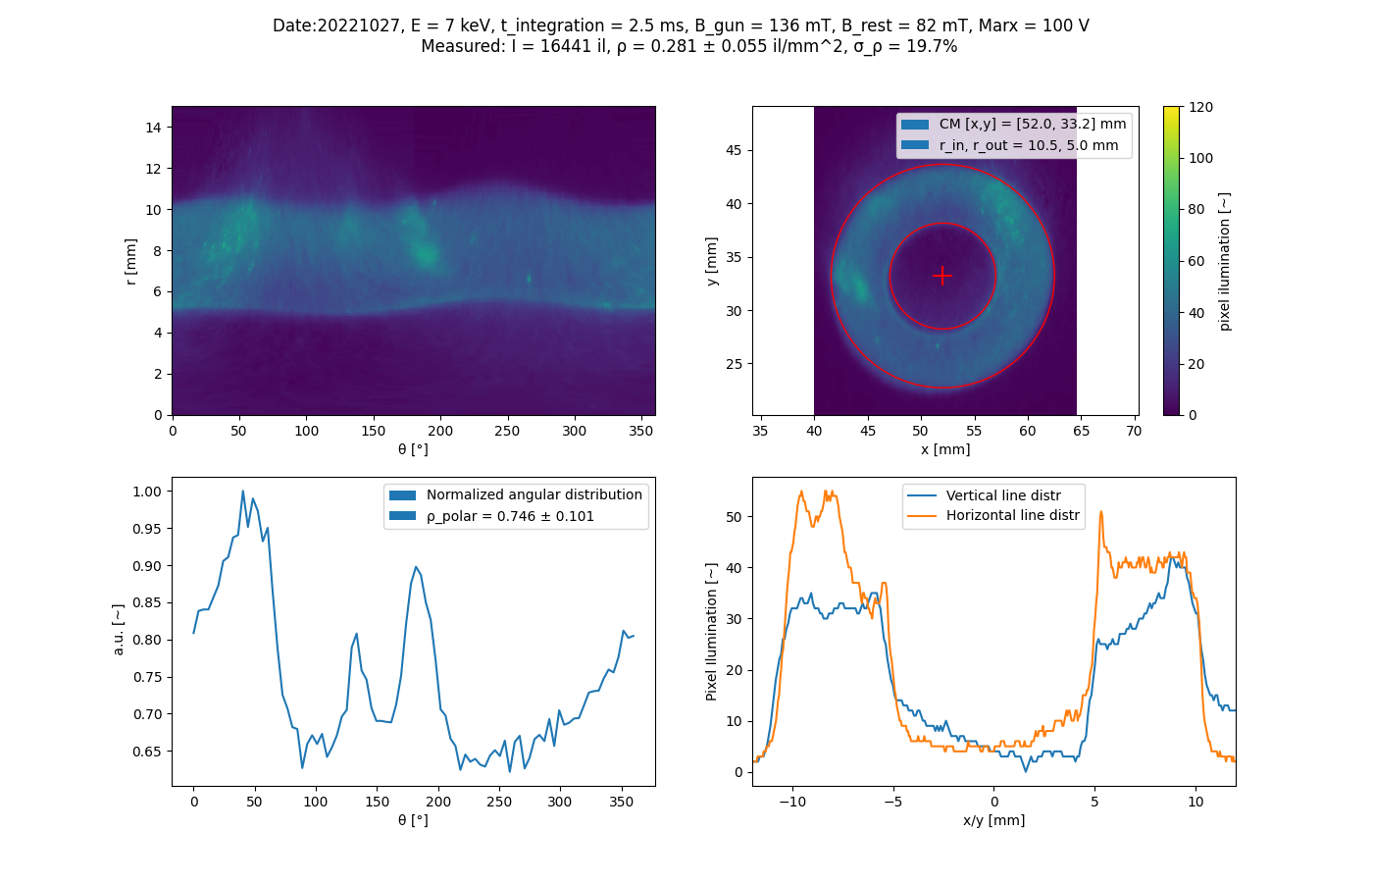
r_in = 2.5 mm
r_in = 4.1 mm
E = 7.0 keV
I = 0.4 A
r_in = 3.6 mm
r_in = 5.0 mm

Slide 15
Small bright spots
Stay motionless → Screen impurities?
r_in = 2.5 mm
r_in = 4.1 mm
E = 7.0 keV
I = 0.4 A
r_in = 3.6 mm
r_in = 5.0 mm

Slide 16
Larger trends
Change with beam → Beam property
r_in = 2.5 mm
r_in = 4.1 mm
E = 7.0 keV
I = 0.4 A
r_in = 3.6 mm
r_in = 5.0 mm

Slide 17
Flare
Moves and changes with beam → Beam effect - reason?
r_in = 2.5 mm
r_in = 4.1 mm
E = 7.0 keV
I = 0.4 A
r_in = 3.6 mm
r_in = 5.0 mm

Slide 18
New set of BTV experiments
BGC interaction chamber kept at EBTS
Identical condition to BGC at EBTS - No magnets moved
New holder and OTR screen manufactured
Assembled and installed
Ready for measurements starting next week

Slide 19
CLEAR proposal
Bunched e-beam
- E = 200 MeV
~ LHC injection 𝛾
- Up to ~40 nC train
- Size_tr ~ 2mm
Separated gas chamber
  Arbitrary pressure (ideal ~1e-3 mbar)
  5 orders higher than LHC
  Noise from air and window passage
Easy installation and operability at CLEAR
Any desirable gas
Simple experimental setup
  Gas chamber + pressure gauge + TMP
  Simple optics
  Passive spectrometer - GSI
CLEAR beamtime needs to be requested by 31.3.2023
Air
Gas chamber
CLEAR beam
Spectral lines
Cross - sections
Different gases (Ne, Ni, Ar, ?)
At LHC injection 𝛾
Passive spectrometer + basler

Slide 20

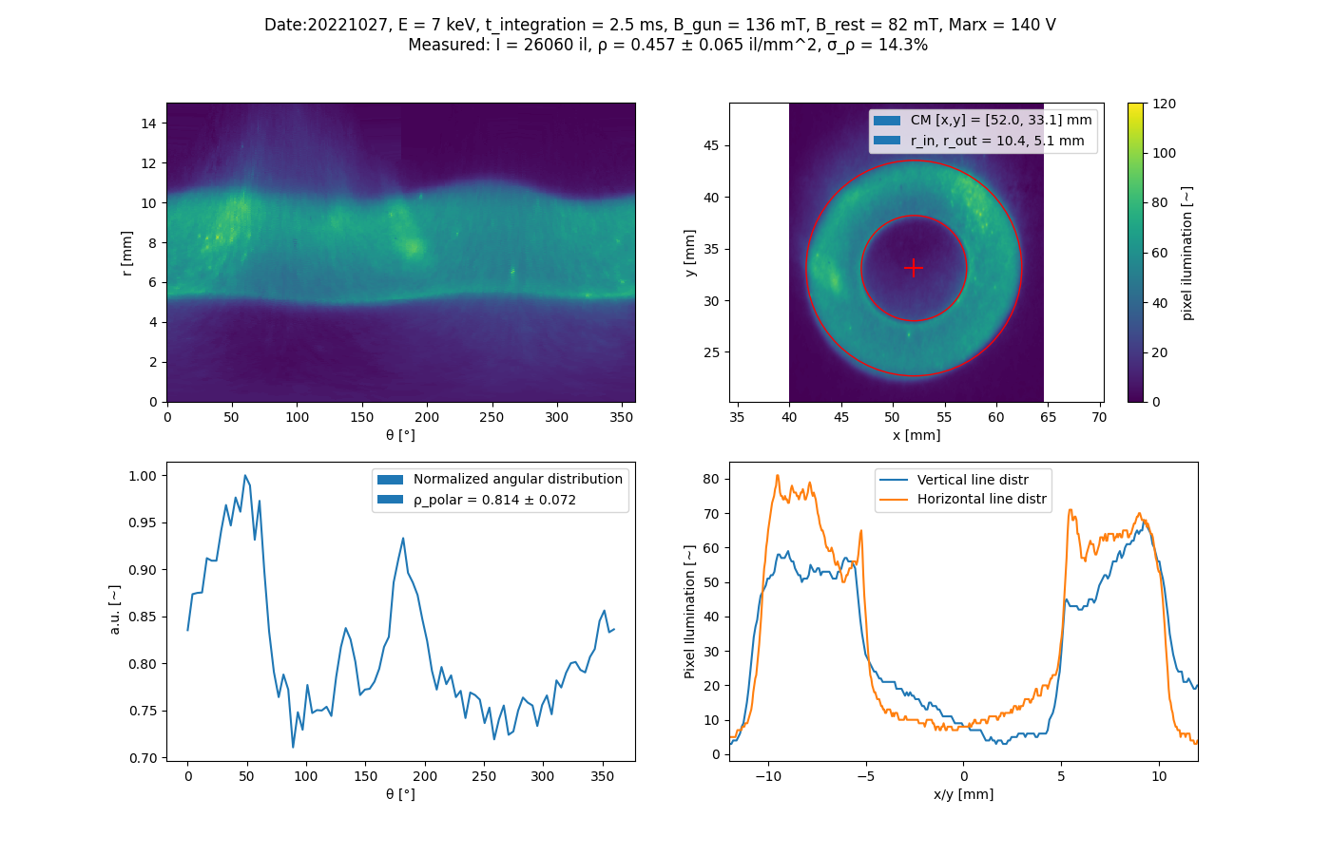
I = 418 mA
I = 945 mA
I = 750 mA
I = 1173 mA

Slide 21
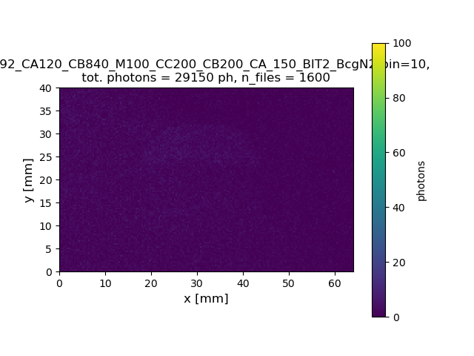
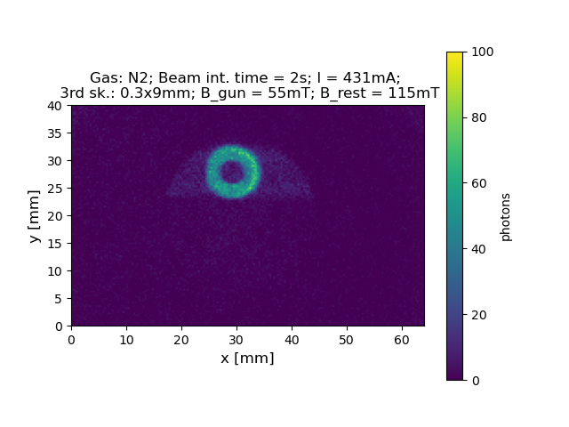
15.12.2022 - BGC-EBTS Christmas present - N2
Window flange
Signal
Correctors:
Vertical Gun: 20V
Horizontal DB: 20V
Horizontal Gun: 15V
Background
Beam: 0.4A
Gas Jet: N2
Beam int. time: 1s
B: Gun:55 Rest:115 mT
Bcg subtracted

Slide 22
12.12.2022 - Beam size
Expected size (Simulation):
CST sim done by Sameed
R_inner = ~5.97mm
R_outer = ~11.95mm
R_inner = ~4.2-5.5mm
- Sim/meas = 40-10%
R_outer = ~10mm
- Sim/meas = 20%
Beam: 1.5A
Gas Jet: N2
Beam int. time: 2s
B: Gun:181 Rest:82 mT

Slide 23
12.12.2022 - Curtain size
Beam: 1.5A
Gas Jet: N2
Beam int. time: 2s
B: Gun:181 Rest:82 mT
Curtain size =~12mm

Slide 24
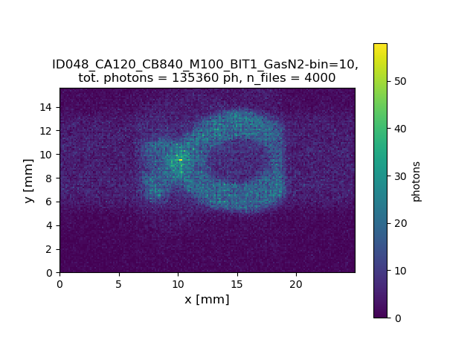
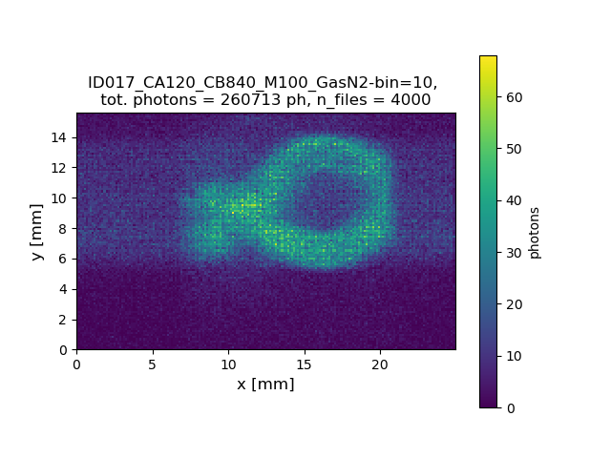
24.11.2022 - skimmers
12 mm
14 mm
Beam: 0.4A
Gas Jet: N2
Beam int. time: 1s
B: Gun:55 Rest:115 mT
N2 - 0.3x9mm 3rd skimmer
N2 - 0.7x9mm 3rd skimmer

Slide 25
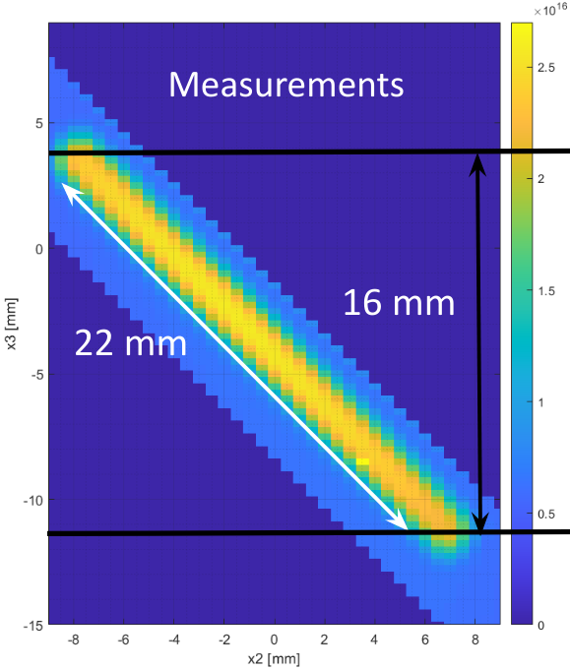
12.12.2022 - Curtain size
0.7x9mm skimmer
0.3x9mm skimmer
Beam: 1.5A
Gas Jet: N2
Beam int. time: 2s
B: Gun:181 Rest:82 mT
Curtain size =~12mm
Shorter on this edge -> misalignment?

