Slide 1
EBTS BPM and Collector installation sequence
Antti Kolehmainen EN-MME
Frantisek Sanda EN-MME
2023-04-05

Slide 2
INTRODUCTION
Based on BI 3D model ST1564092 HEL TEST STAND INTEGRATION – PHASE 4
Installation sequence proposal for the BPM
Straigthforward collector installation
Overhead crane available for the installation

Slide 3
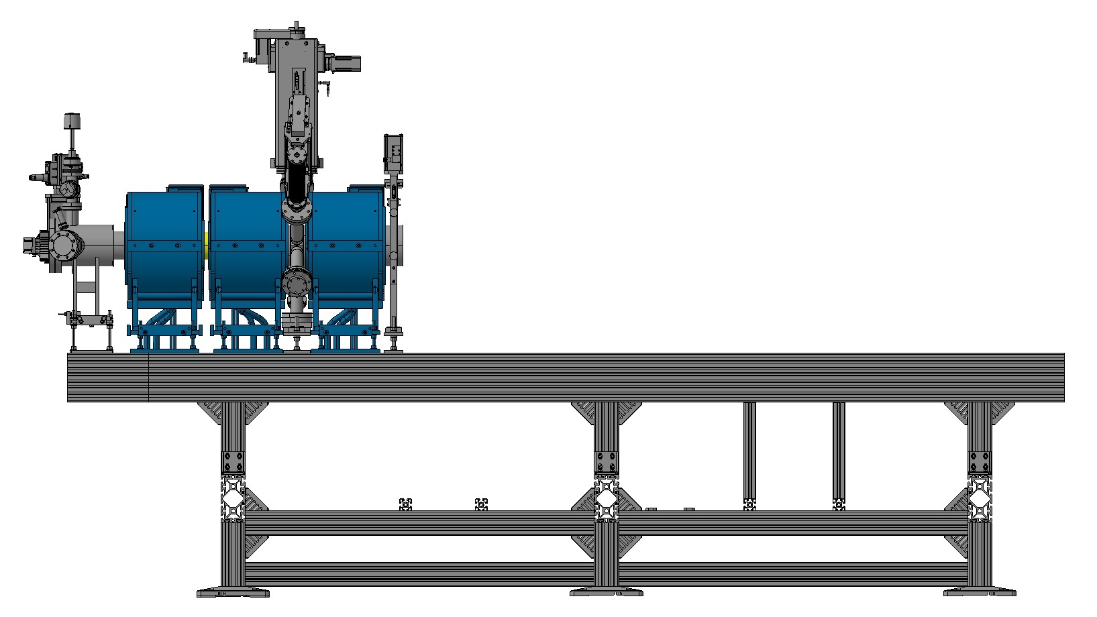
INSTALLATION START
Access to the valve

Slide 4
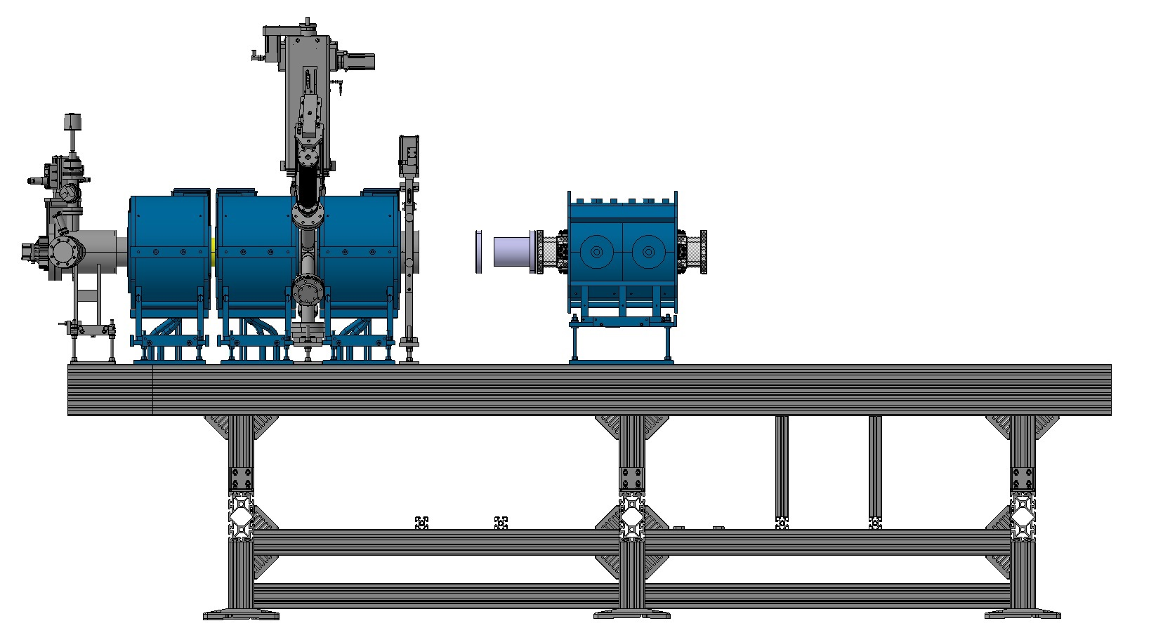
STEP 1
2. Add valve side edge welded bellow on the BPM
1. Install the BPM inside the double solenoid

Slide 5
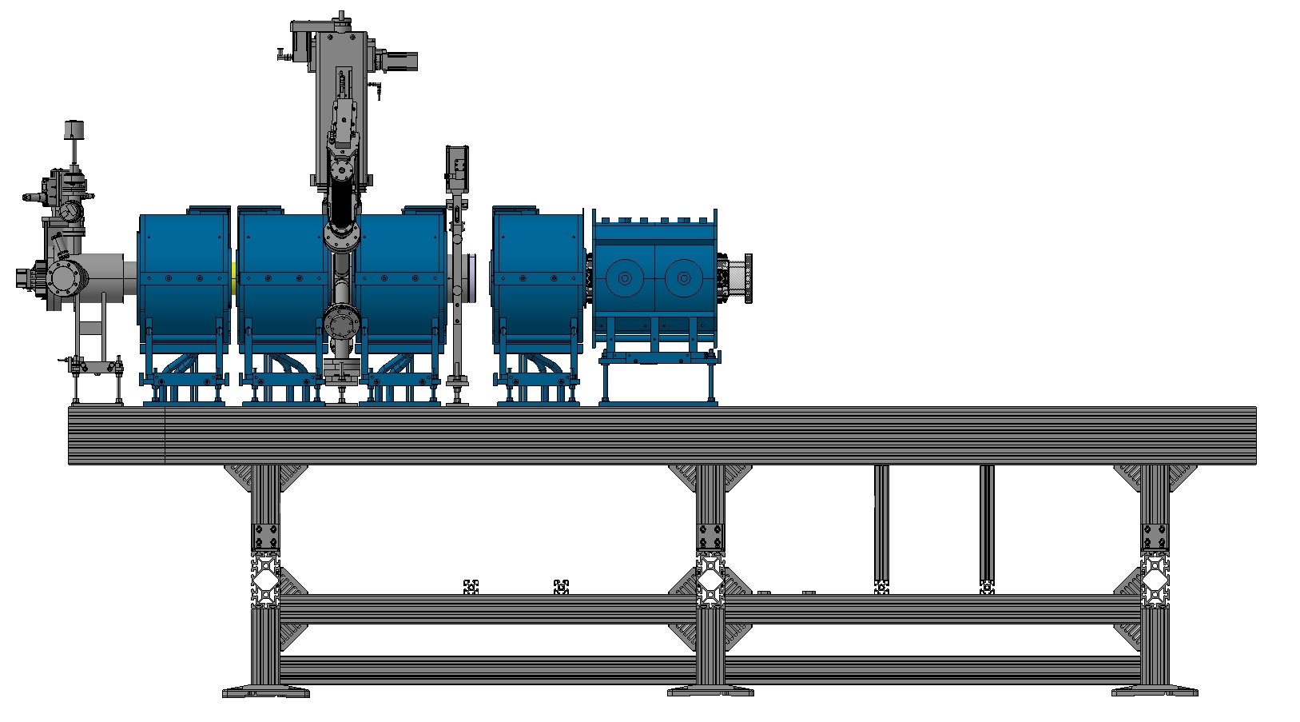
STEP 2
3. Pull the bellow and connect flange on the valve
1. Add solenoid leaving space for flange connection
2. Bring solenoid with BPM as close to the solenoid as possible

Slide 6
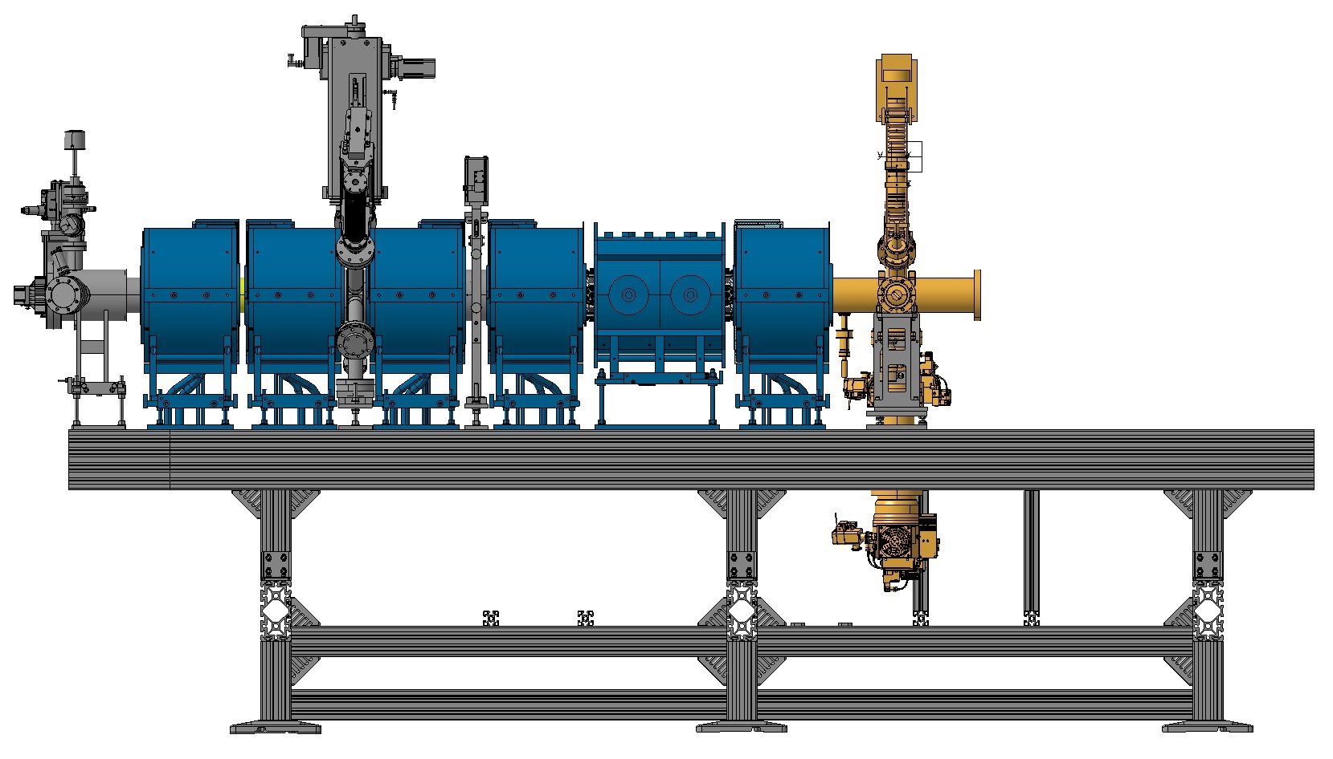
STEP 3
1. Bring solenoids and BPM into final position
2. Mount edge-welded on the BPM
3. Bring solenoid into position
4. Bring BGC on the chassis, pull bellow to connect flanges

Slide 7
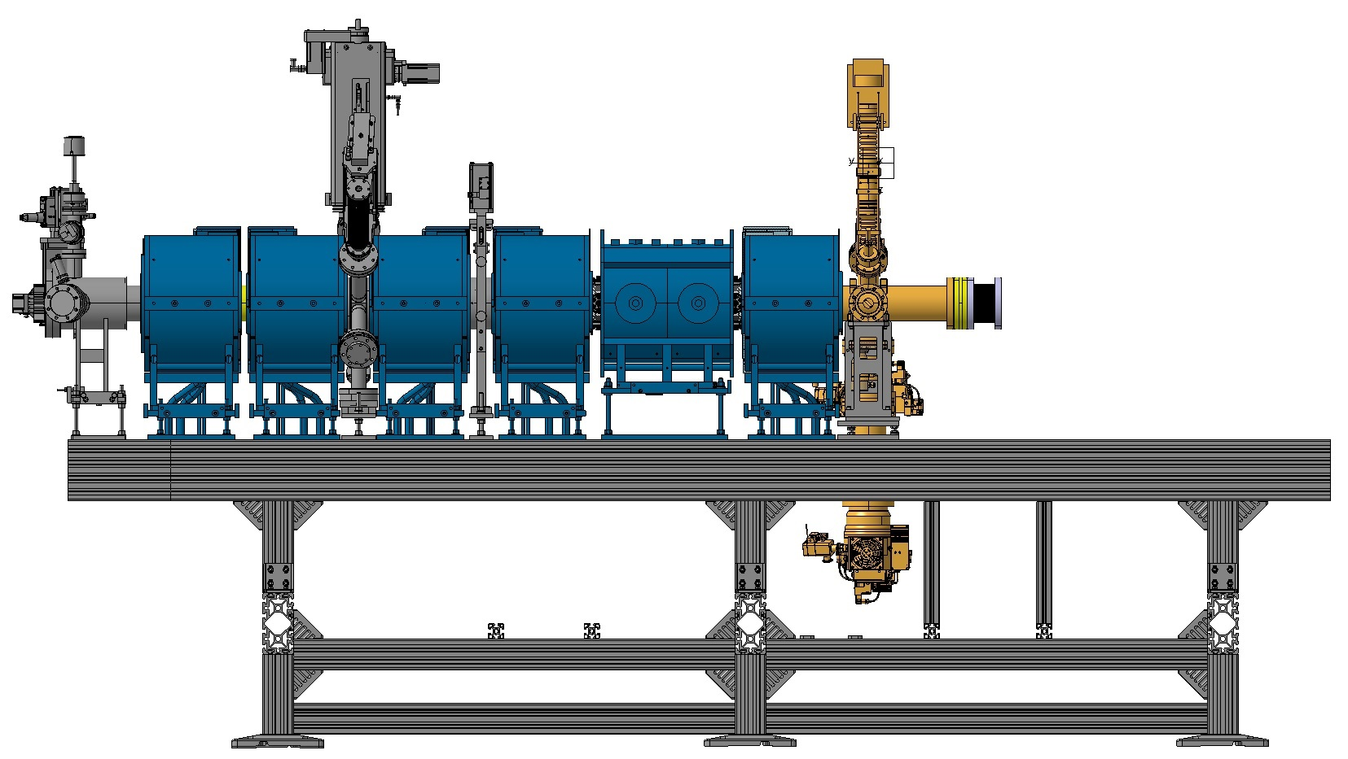
STEP 4
1. Bring BGC to final position
2. Add bellows for HEL collector connection

Slide 8
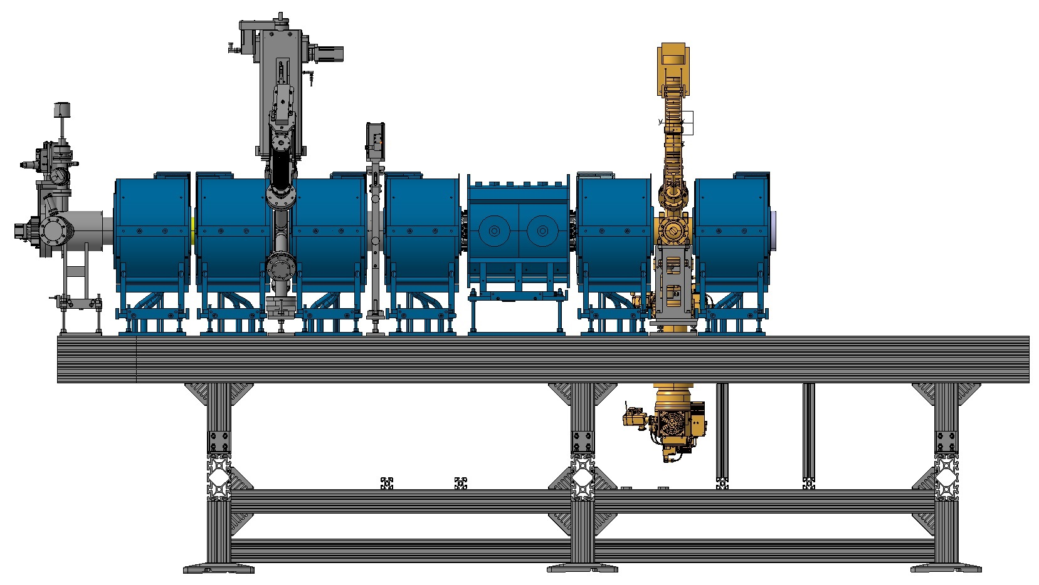
STEP 5
1. Bring the last solenoid into final position

Slide 9
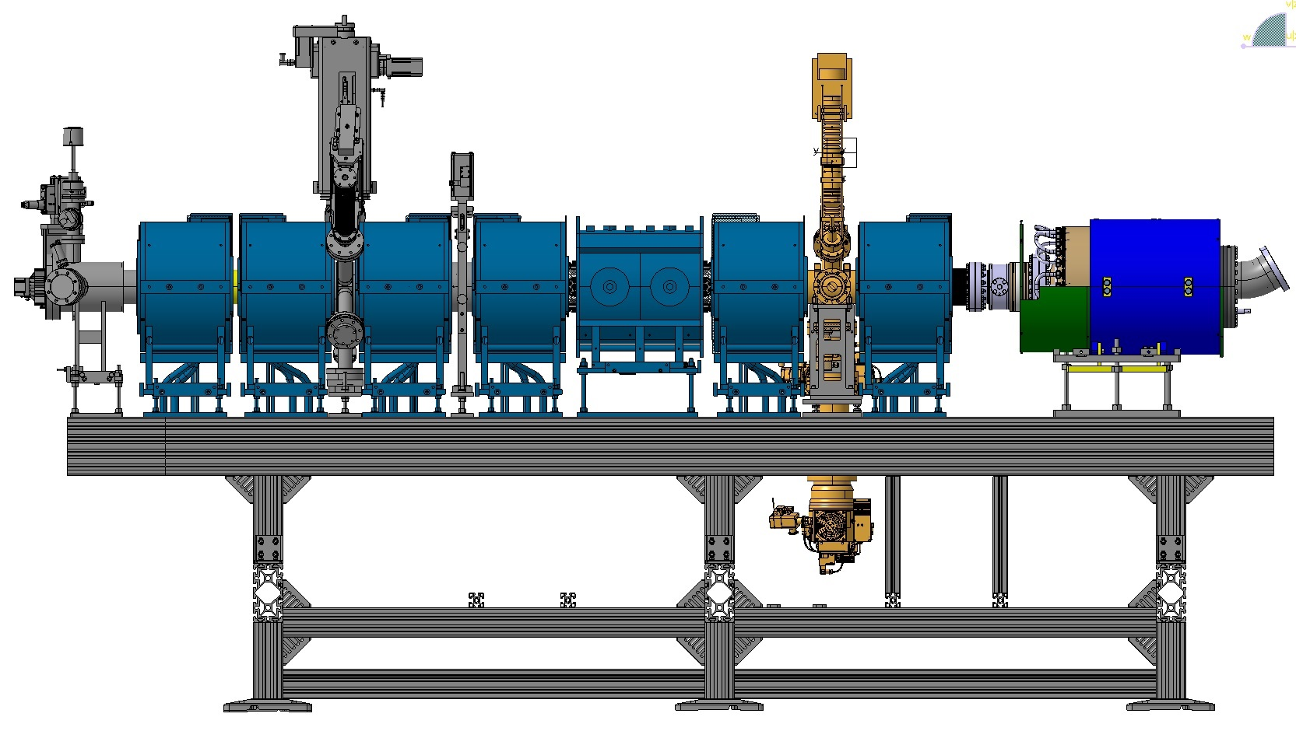
STEP 6
1. Connect the HEL collector to EBTS vacuum and bring it to the final position

