Slide 1


Play right with playwright
Easy ui testing
Elizaveta ragozina
CERN IT Lightning talks #24

Slide 2

Once upon A time…
We did time consuming manual testing of user flows
Prone to errors

Slide 3
But then…
Once upon A time…
We did time consuming manual testing of user flows
Prone to errors
We decided to automate
Selected Playwright
Notes:
We decided to automate. Were checking different frameworks and selected Playwright

Slide 4

Advantages of playwright
Cross-browser support
Reliable and fast
Language flexibility
Easy setup and maintenance
Notes:
… for it‘s advantages
- Playwright allows you to test your UI across multiple browsers and browser versions
- It provides reliable testing capabilities
- You can implement the tests in different languages
-..

Slide 5


Advantages of playwright
Cross-browser support
Reliable and fast
Language flexibility
Easy setup and maintenance
Notes:
And something that really makes it oustaning from competitors is how easy you can setup and I‘ll show you how ☺

Slide 6
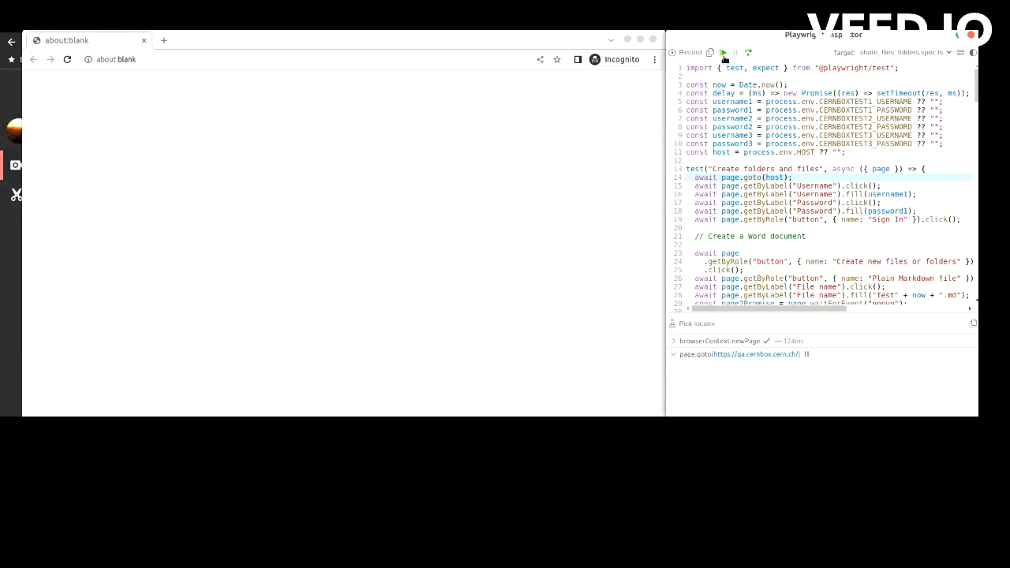
e2e: sharing in CERNBox
Notes:
Here you can see how a typical e2e test of sharing runs with Playwright. On the right you see the code of the test that is executed.
One user logs in, creates a file and shares, the other opens the file.

Slide 7

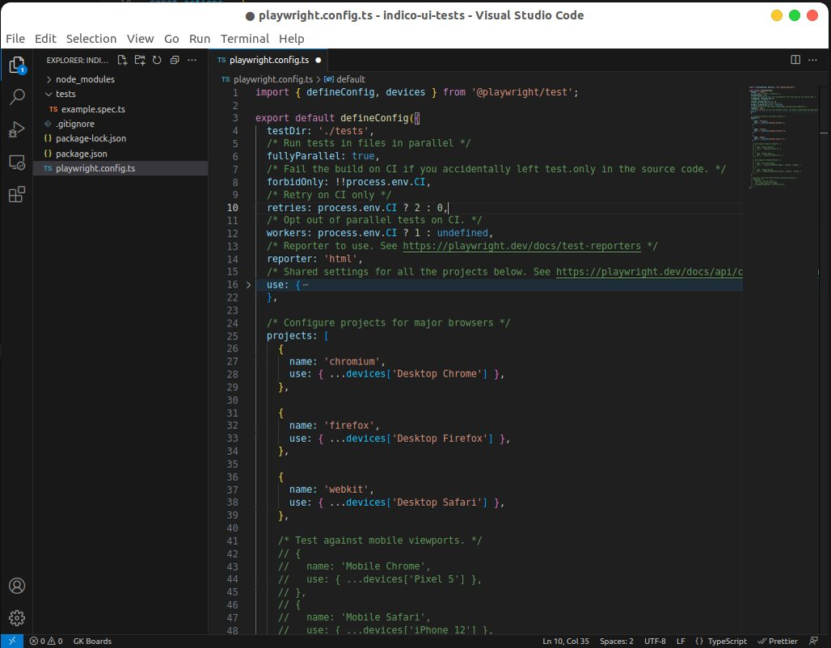
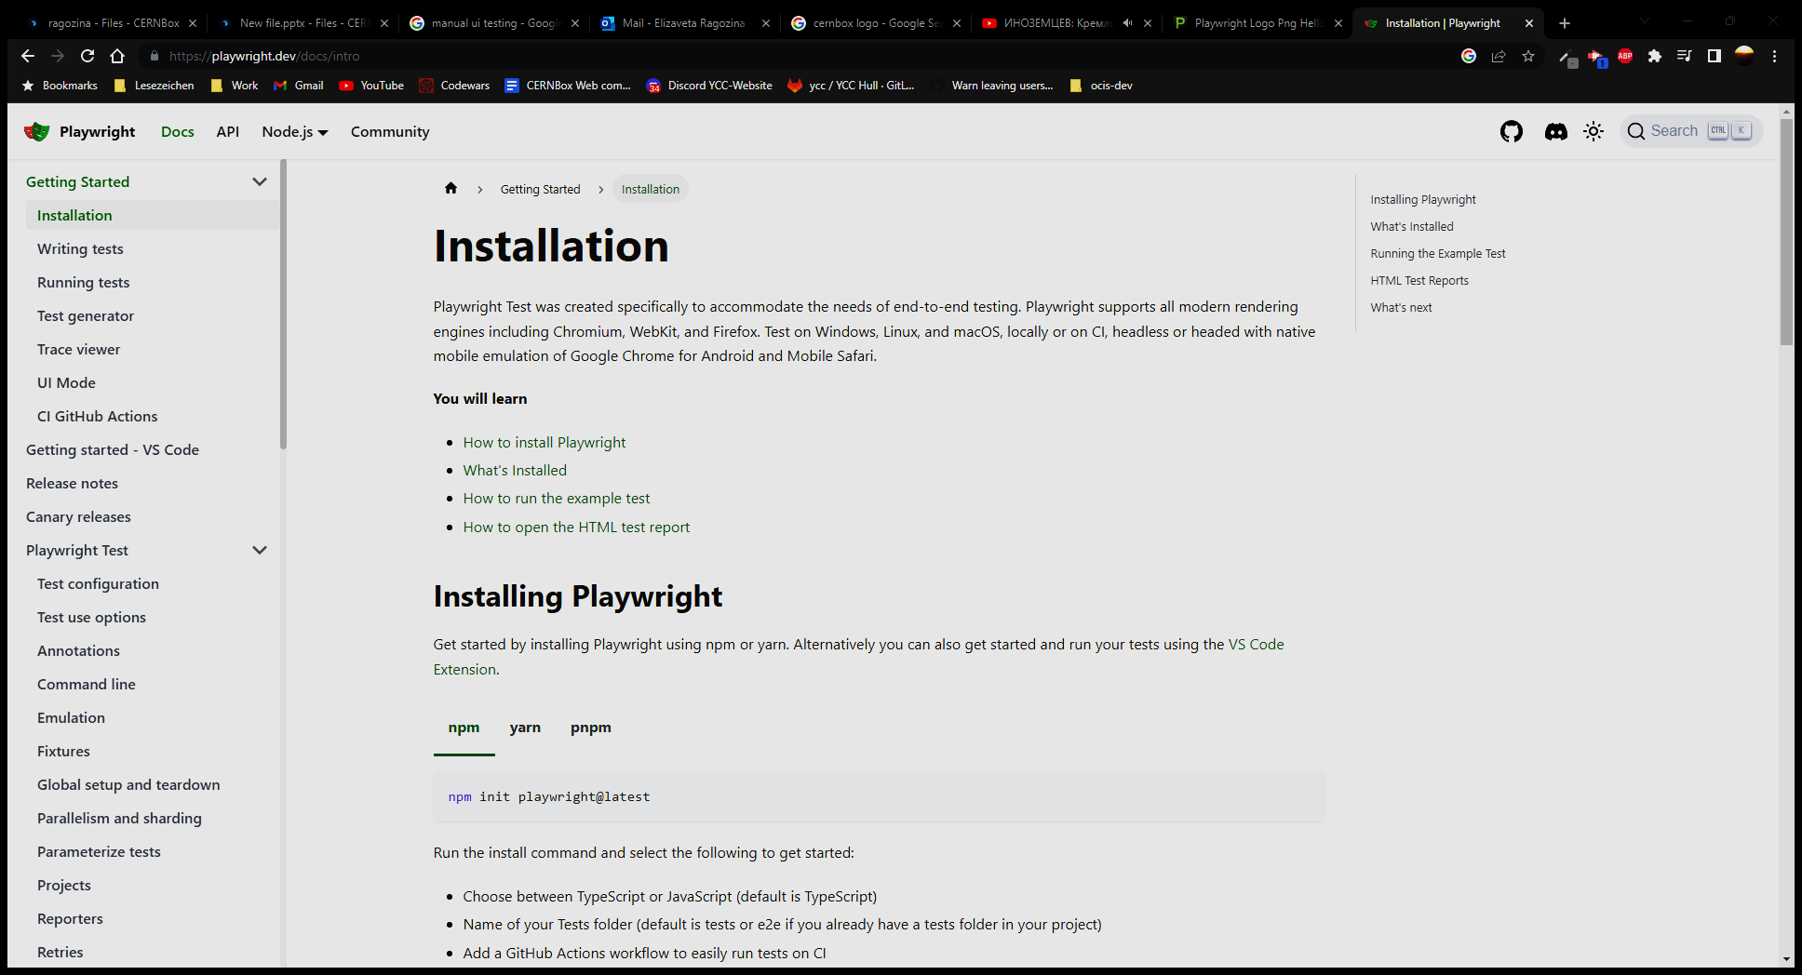
Notes:
So, how to setup testing? After you install Playwright with a package manager, you get the following folder structure:
Folder where you put you test files and a config file where you can setup what browsers, env variables, parallelization etc.

Slide 8
THE Basics
Locators
CSS selectors
getByRole, getByText, …
const locator = page.getByRole('checkbox', { name: 'Subscribe' })
Notes:
There are 3 components for writing the tests:
1) locators to locate the object to test. Can be css, get Element by Role, text etc.

Slide 9
THE Basics
Locators
CSS selectors
getByRole, getByText, …
const locator = page.getByRole('checkbox', { name: 'Subscribe' })
Actions
click, push, focus, hover, type, …
await locator.click();
Notes:
Actions to perform on locator like click or type.

Slide 10
THE Basics
Locators
CSS selectors
getByRole, getByText, …
const locator = page.getByRole('checkbox', { name: 'Subscribe' })
Actions
click, push, focus, hover, type, …
await locator.click();
Assertations
toBeVisible, toBeEnabled, toHaveCount, toContainText, …
await expect(locator).toBeVisible();
Notes:
And assertations. When you for example expect a locator to be visible or contain some text…

Slide 11
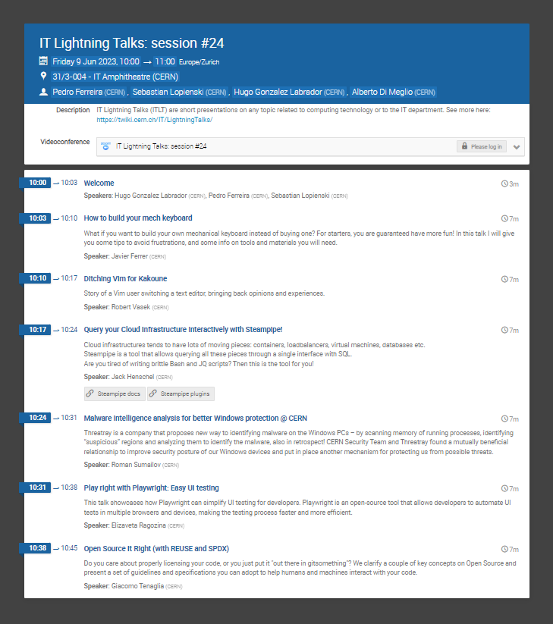
Let‘S write a simple test for indico
Notes:
Let‘s write a simple test with this knowledge. We test copying the zoom link on Indico

Slide 12
Let‘S write a simple test for indico
Using the
code generator magic
Notes:
We will use a unique feature of Playwright: code generator as help.

Slide 13
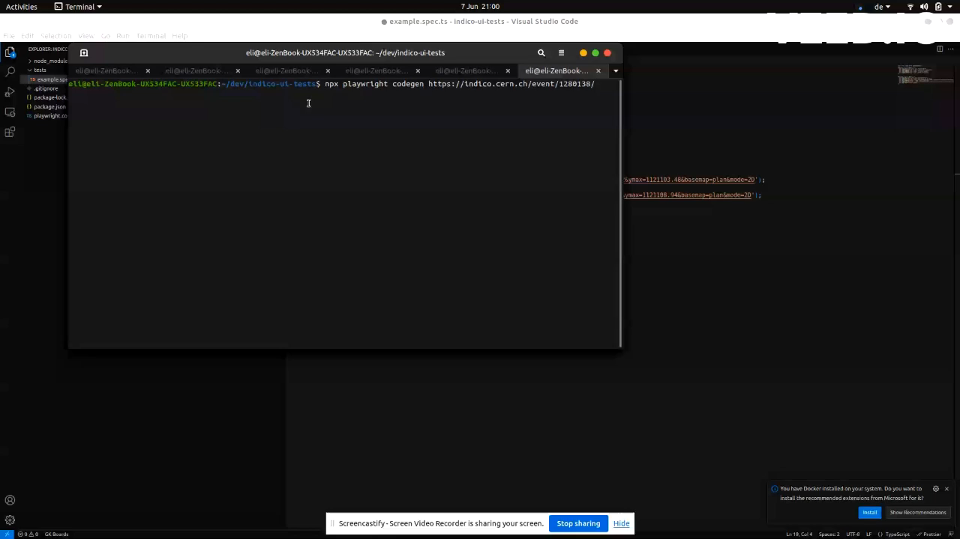
Write a test with codegen
Notes:
For that I just run the codgen command and perform actions on opend browser while codegen writes them down.

Slide 14
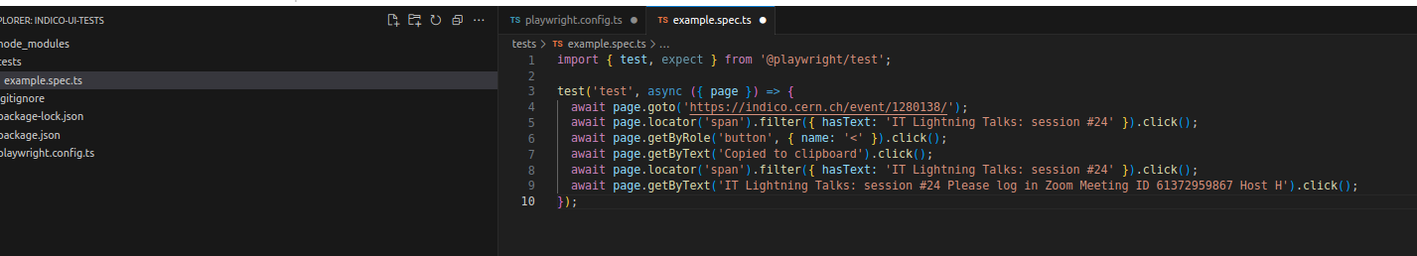
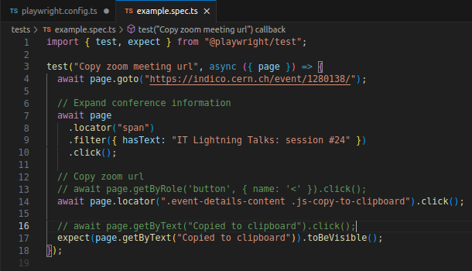
adjust generated code
Improve selectors,
Add comments, assertations
Notes:
In most cases you need to do some adjustmens, add comments, select better locators for the object

Slide 15
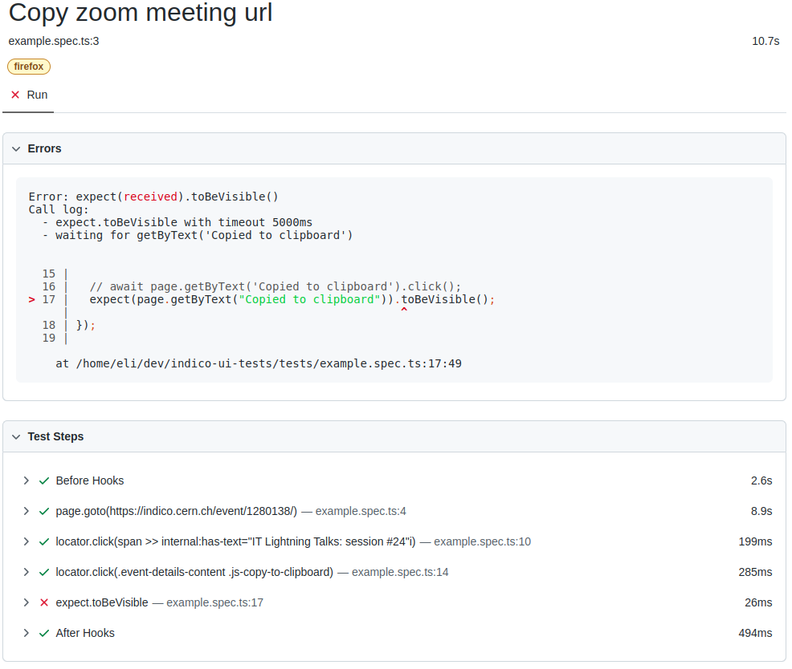
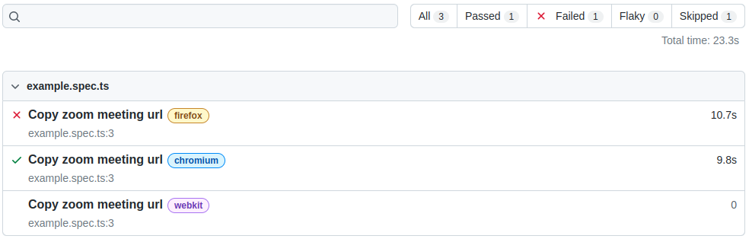
Test reports
Notes:
And then after you run it, a test report is generated, that can show on what step in what browser what failed.

Slide 16
More features
Parallelization
Testing of APIs
Testing browser extensions
Mocking different network conditions
…
https://playwright.dev

Slide 17

Do you have any questions?

