Slide 1

Case Study Sacral Chordoma
Univ Prof Piero Fossati, MD, Msc
Scientific Director and Director of the Carbon Ions Program
@ MedAustron Ion Therapy Centre
&
Full professor @
Division Radiation Oncology, Department for Basic and Translational Oncology and Haematology
Karl Landsteiner University of Health Sciences

Slide 2
Sacral chordoma
Female 35 YO
Presenting symtoms: Urinary retention
Fecal retention
Perineal hypoestesei
Mild sacral pain
Comorbidities : unremarkable

Slide 3
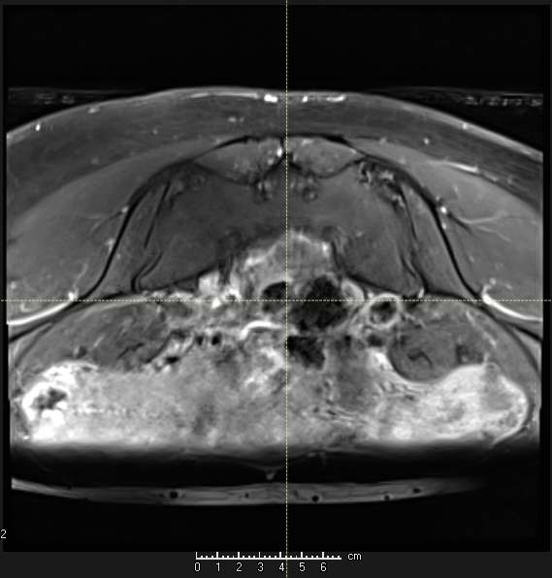
MRI

Slide 4
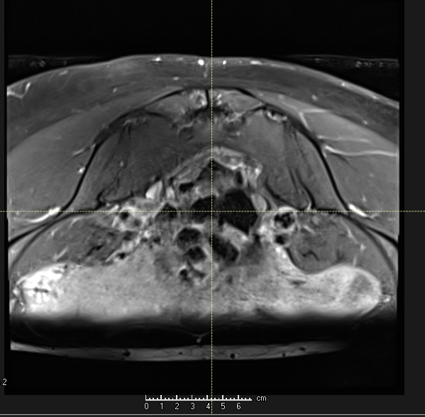

Slide 5
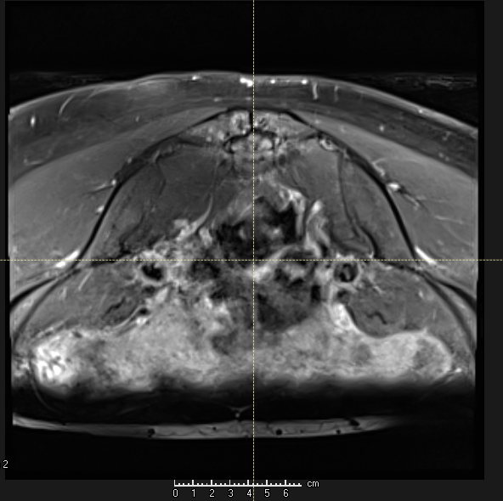

Slide 6
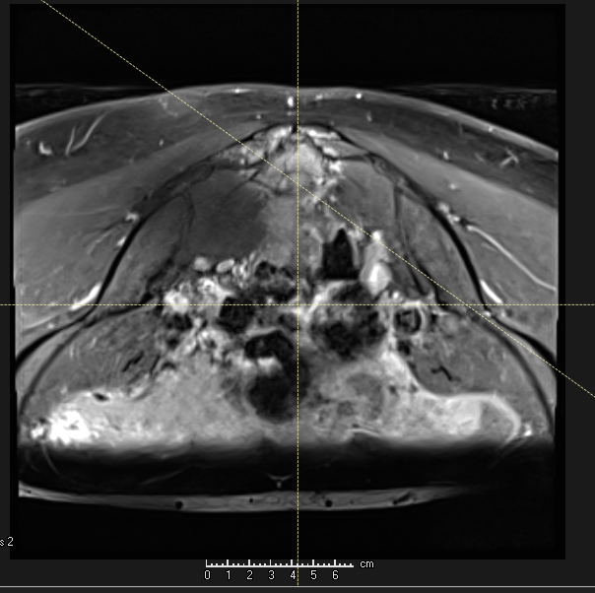

Slide 7
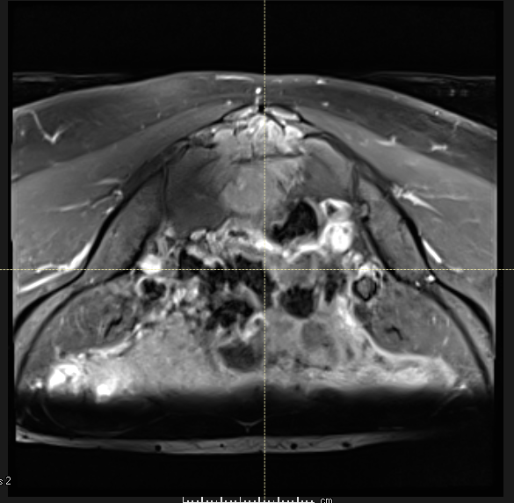

Slide 8
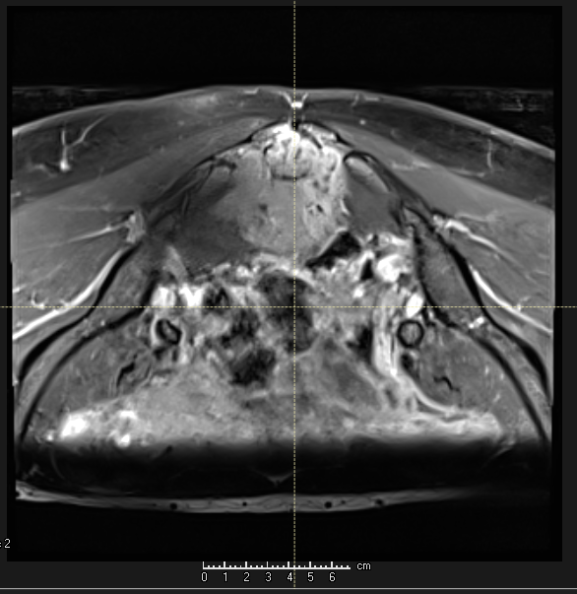

Slide 9
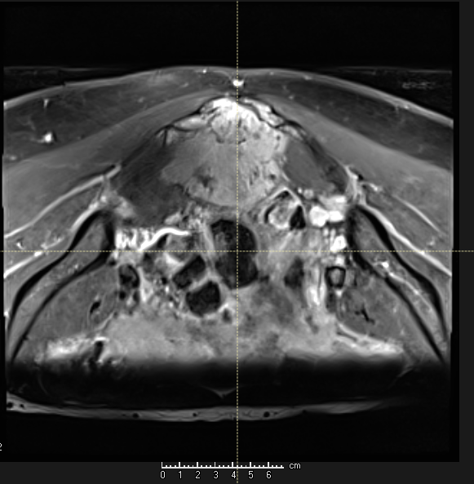

Slide 10
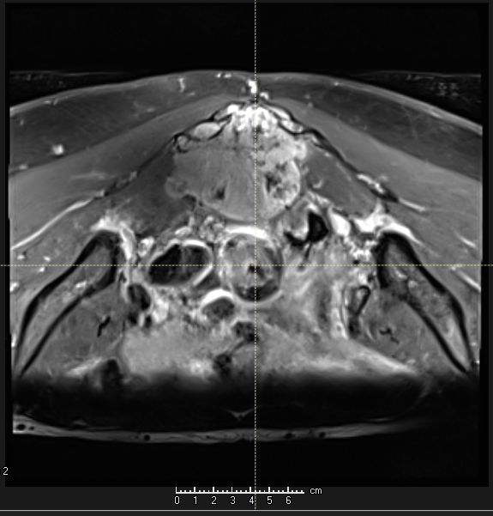

Slide 11
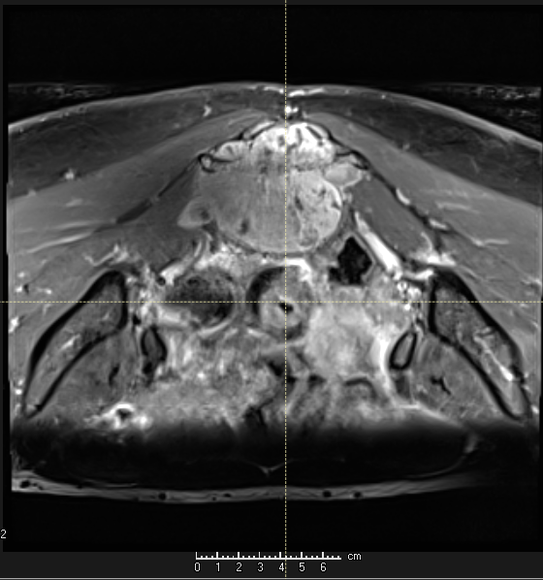

Slide 12
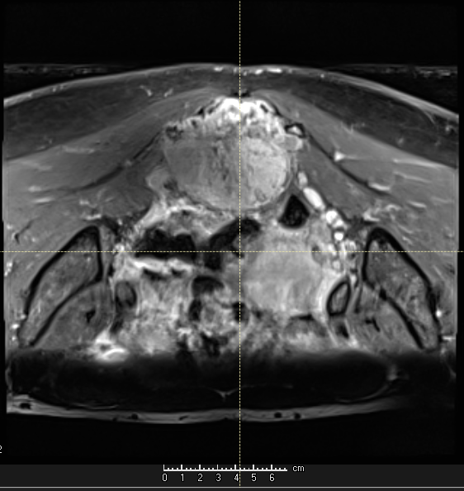

Slide 13
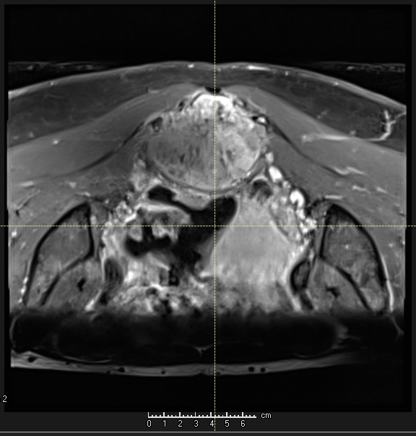

Slide 14
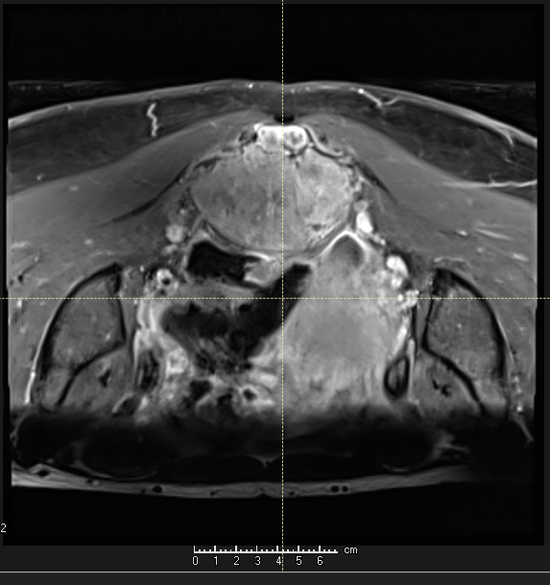

Slide 15
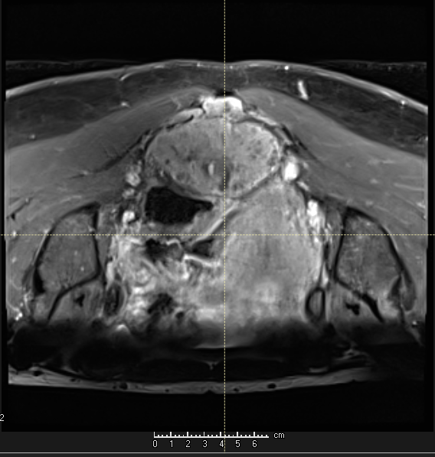

Slide 16
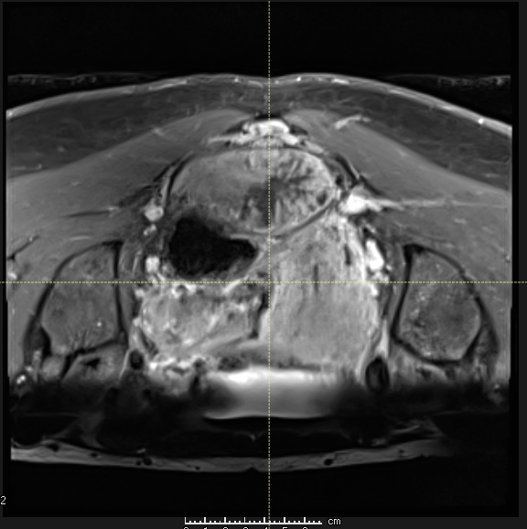

Slide 17
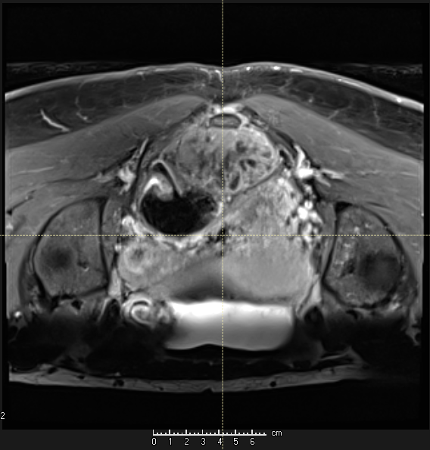

Slide 18
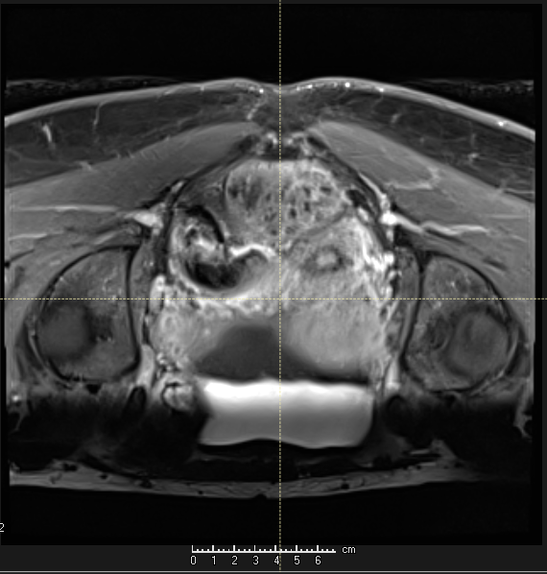

Slide 19
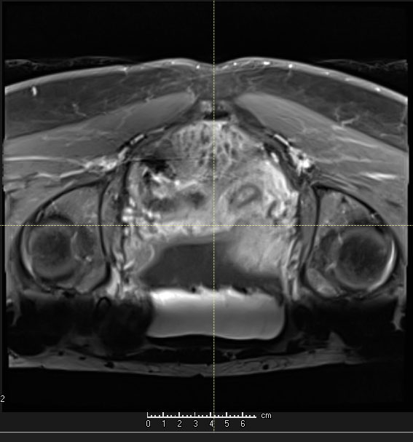

Slide 20
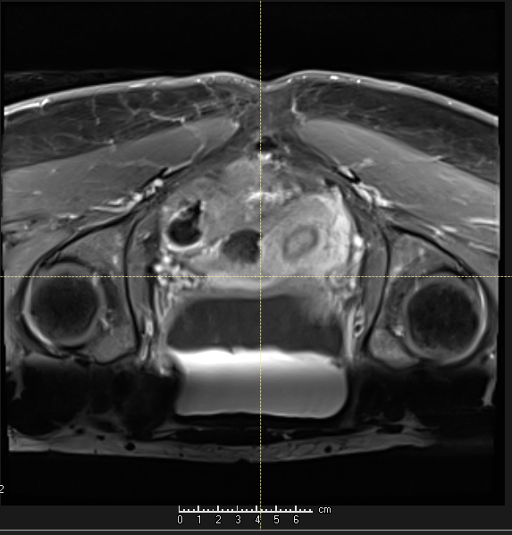

Slide 21
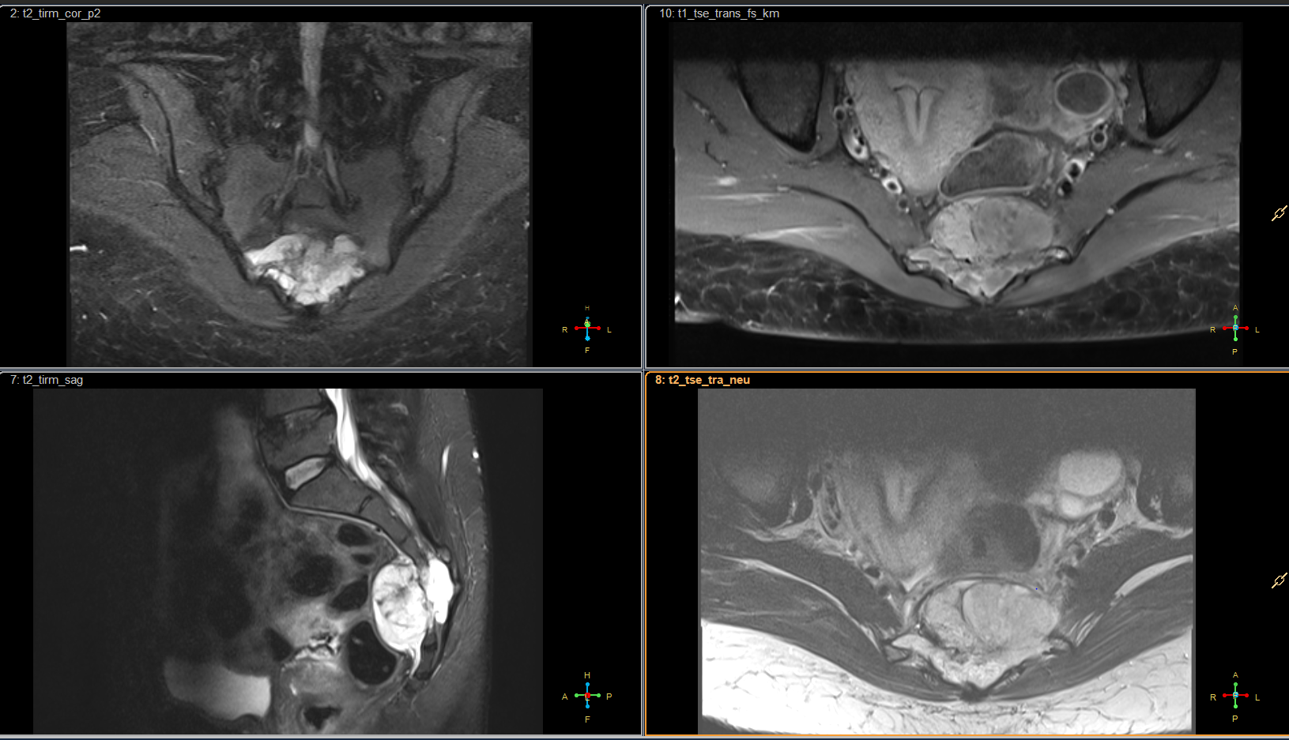
Biopsy proven sacral chordoma of S3

Slide 22
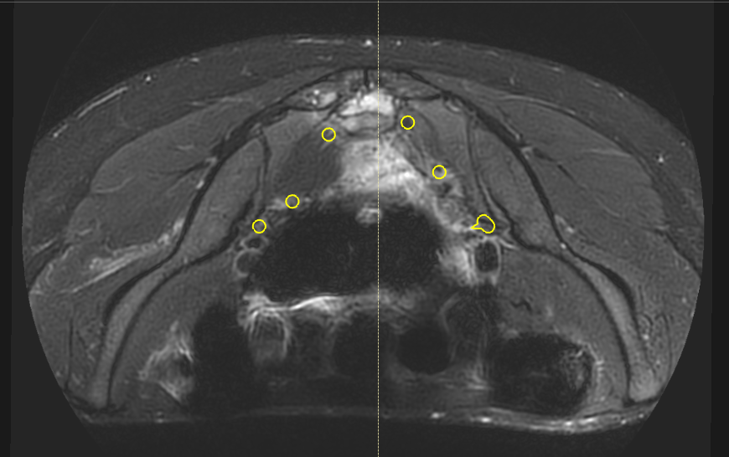
S2
S1

Slide 23
Which therapy would you recommend?
Radical surgery
Particle therapy only if patient refuses surgery
Particle therapy as alternative to surgery
Enrollment in a trial

Slide 24
Prescritpion
exclusive CIRT
PTV1 : 4.6 Gy RBE x 9 (41.4 Gy RBE )
PTV2 : 4.6 Gy RBE x 7 (32.2 Gy RBE)
Total dose 73.6 Gy RBE
in 16 fr in 4 weeks

Slide 25
LEM vs mMKM
LEM 73.6 Gy
should be equivalent to
mMKM 67.2 Gy RBE

Slide 26
Dose constraints
Rectum
D (RBE, 1 ccm) < 66 Gy
D (RBE, 5 ccm) < 63 Gy
D (RBE, 10 ccm) < 55 Gy
Cauda Equina
D (RBE, max) < 70 Gy
Nerve roots
D (RBE, 5%) < 70 Gy
Contralateral ovary
D (RBE, mean) < 2 Gy

Slide 27
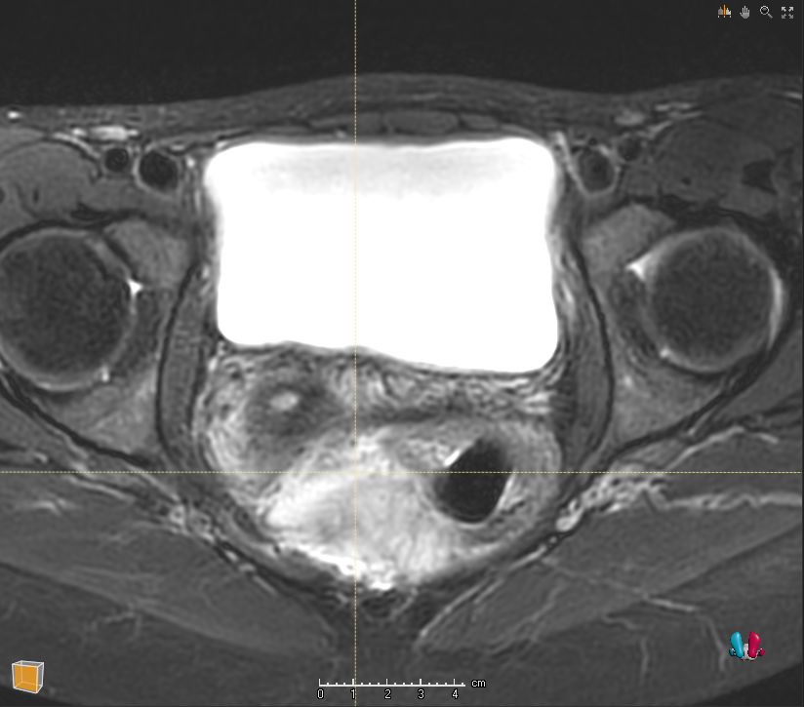
Would you require a spacer?

Slide 28
Contouring
Contouring :
Include piriform muscle
Adequate bone margins
Adequate gluteus margins

Slide 29
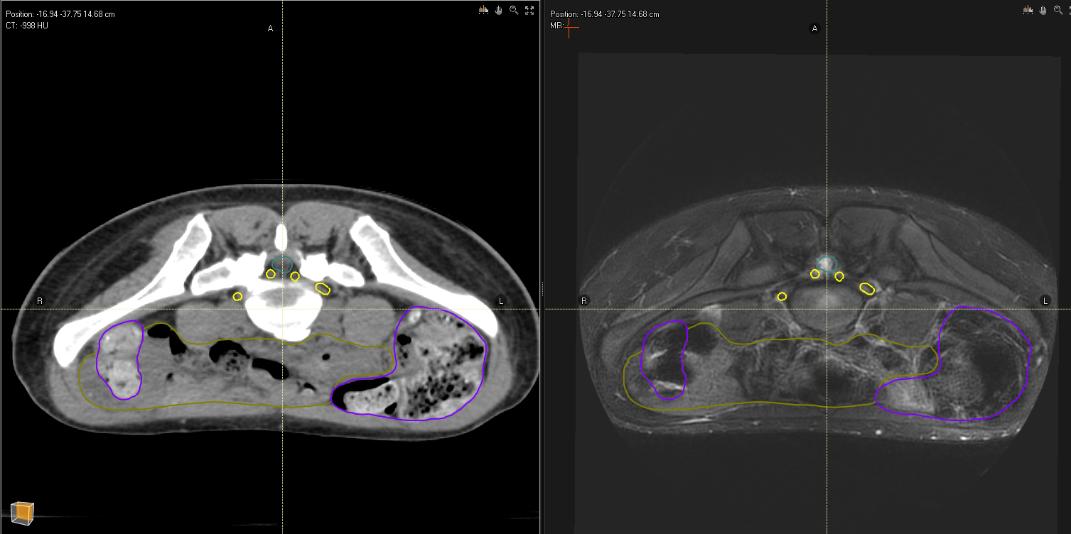

Slide 30
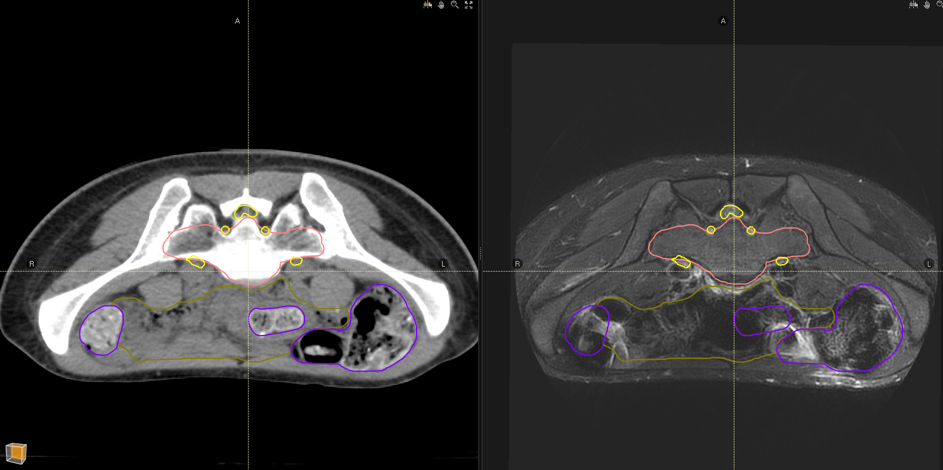

Slide 31
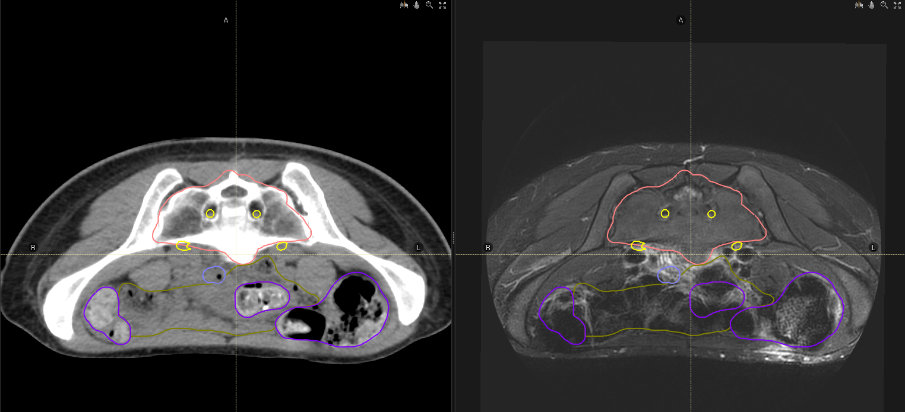

Slide 32
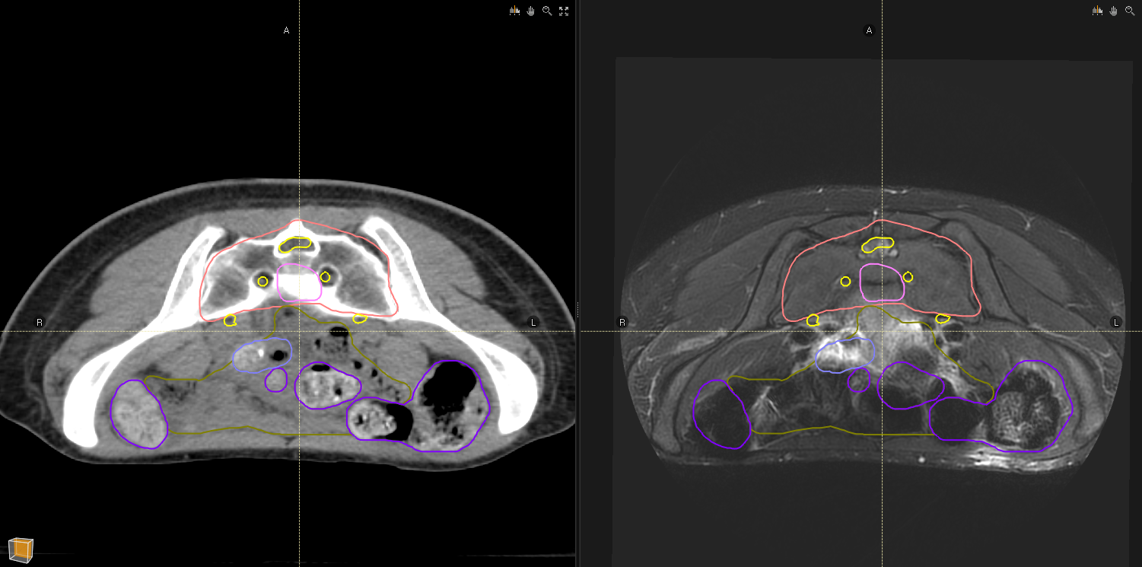

Slide 33
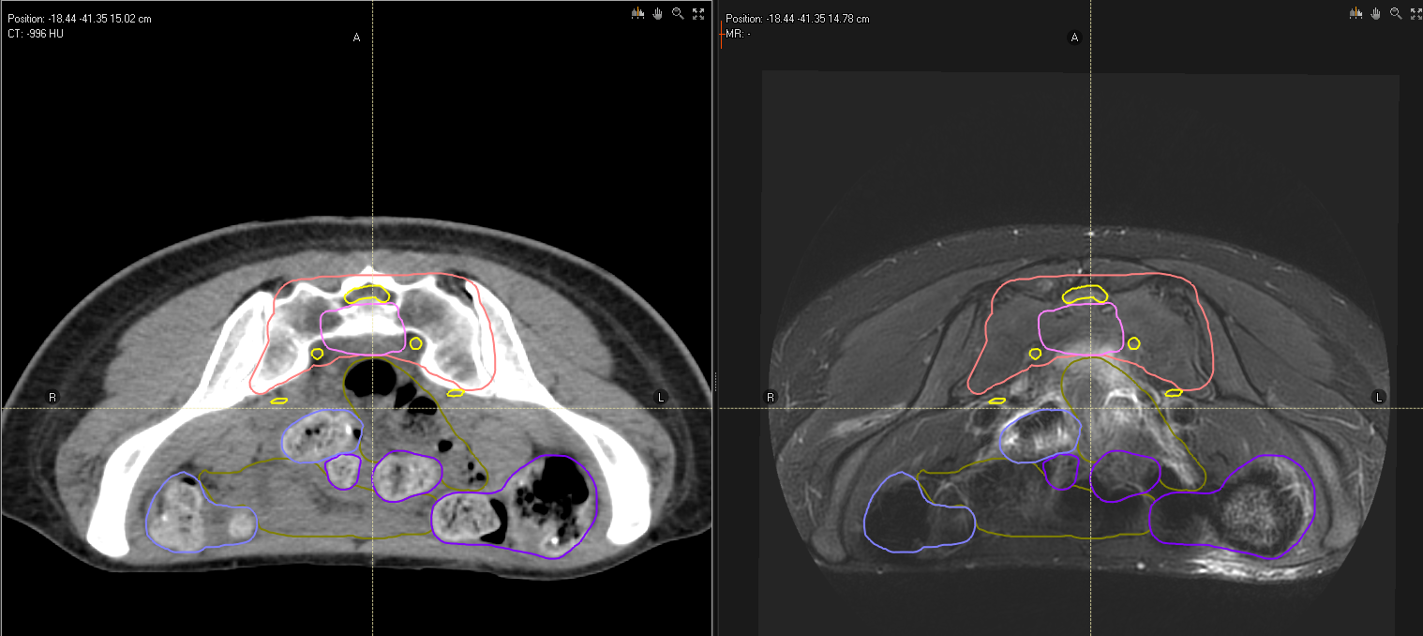

Slide 34
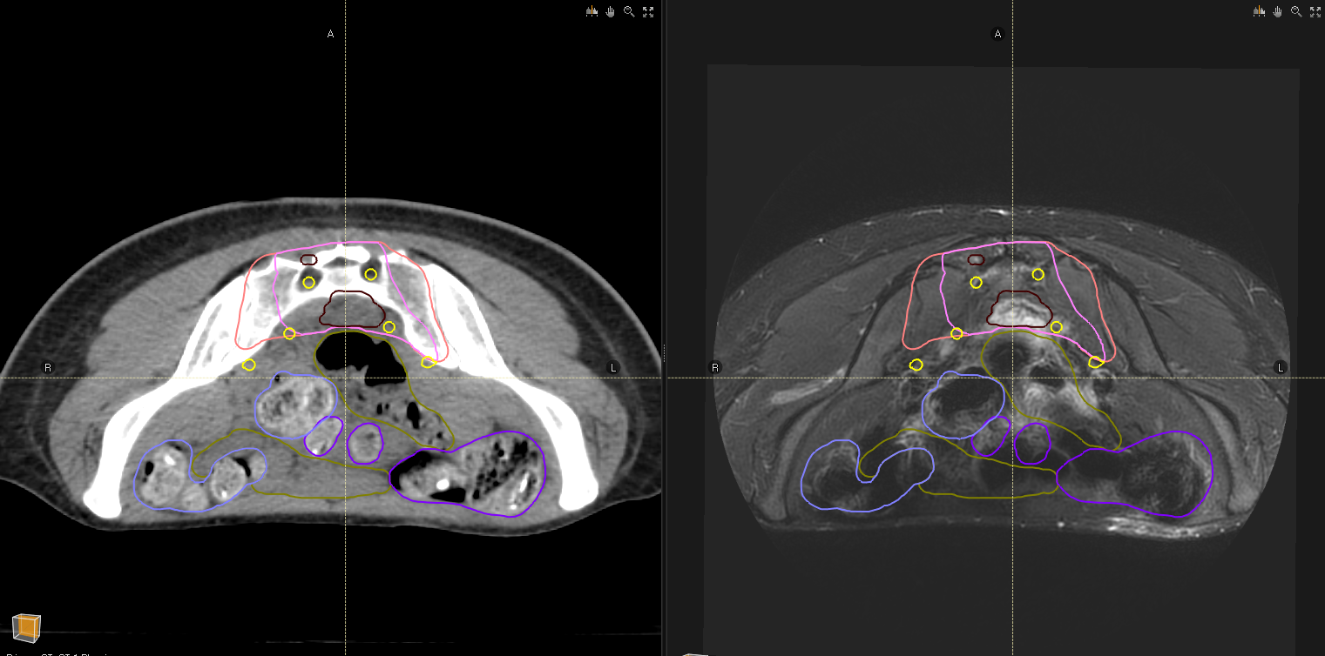

Slide 35
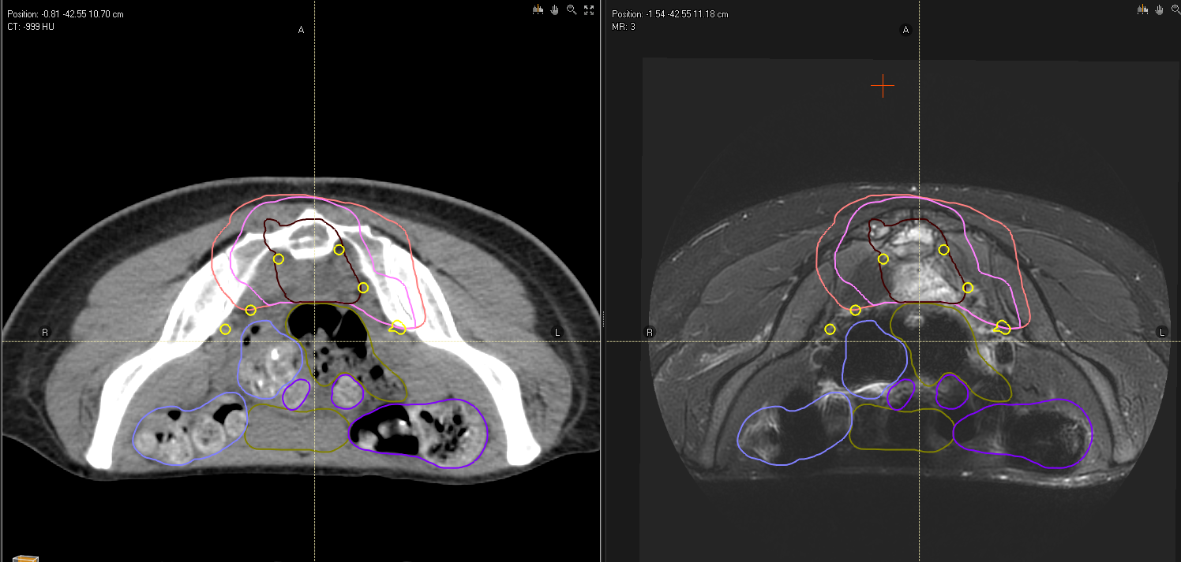

Slide 36
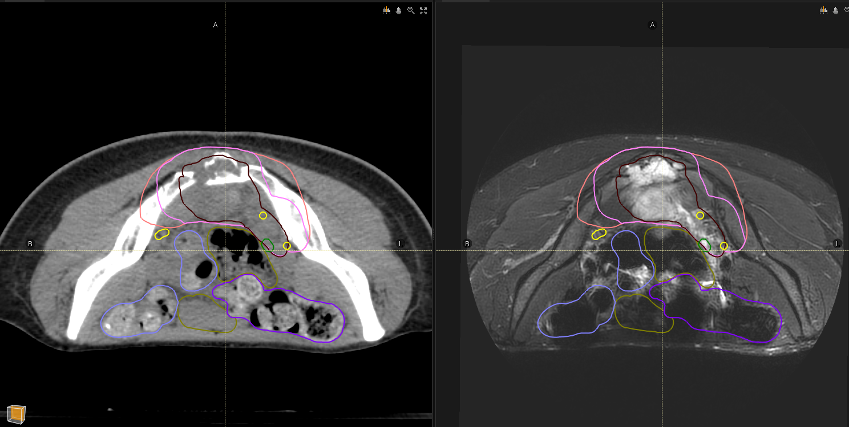

Slide 37
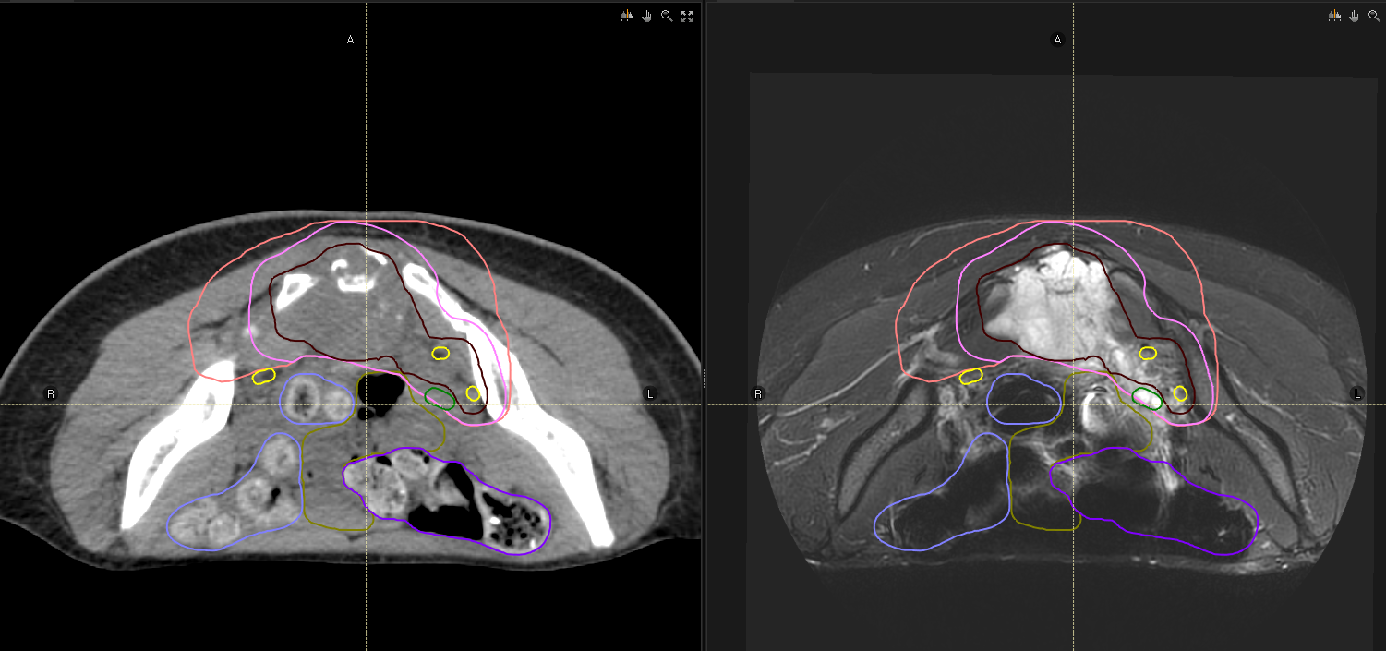

Slide 38
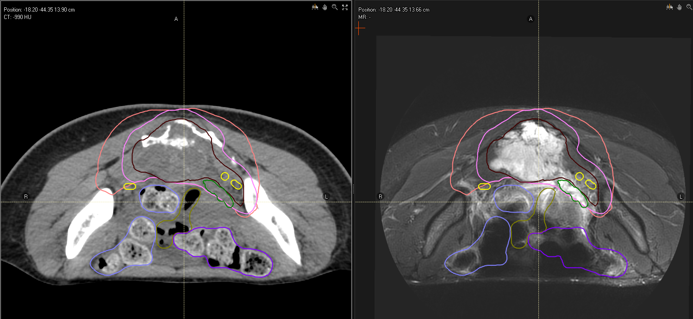

Slide 39
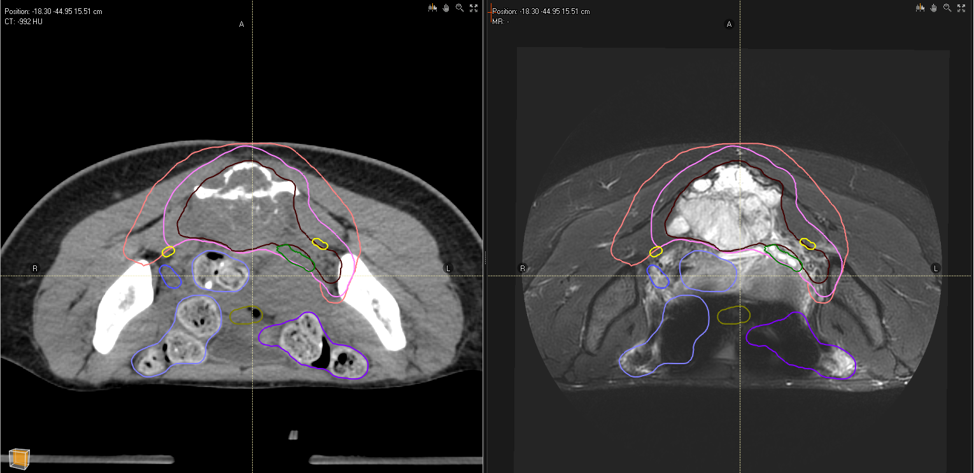

Slide 40
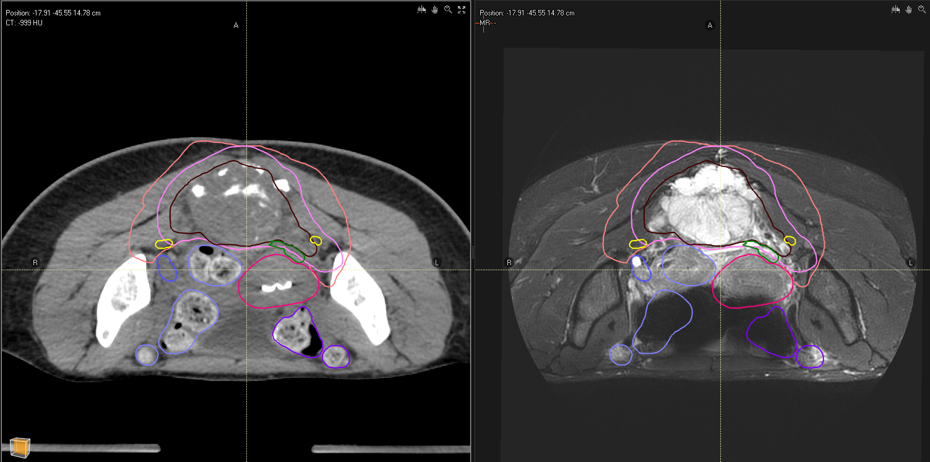

Slide 41
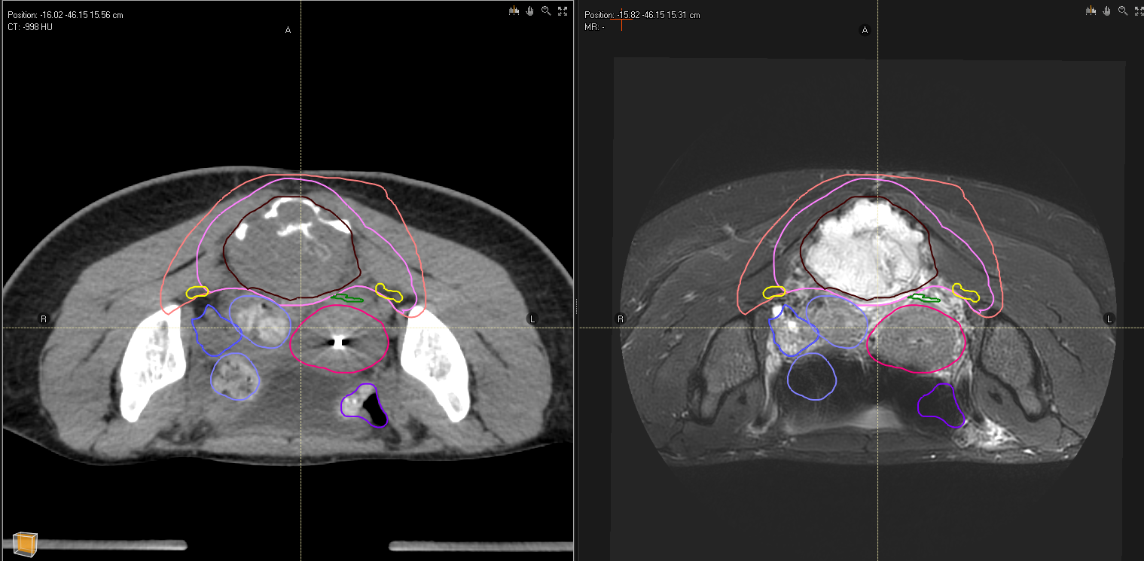

Slide 42
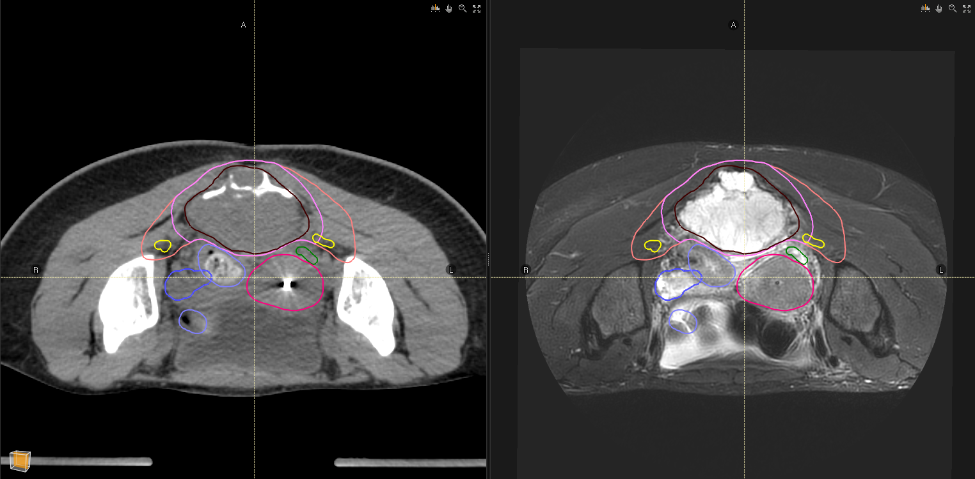

Slide 43
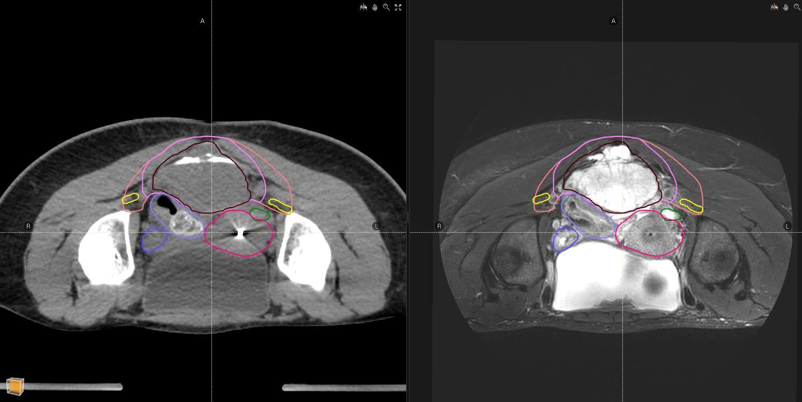

Slide 44
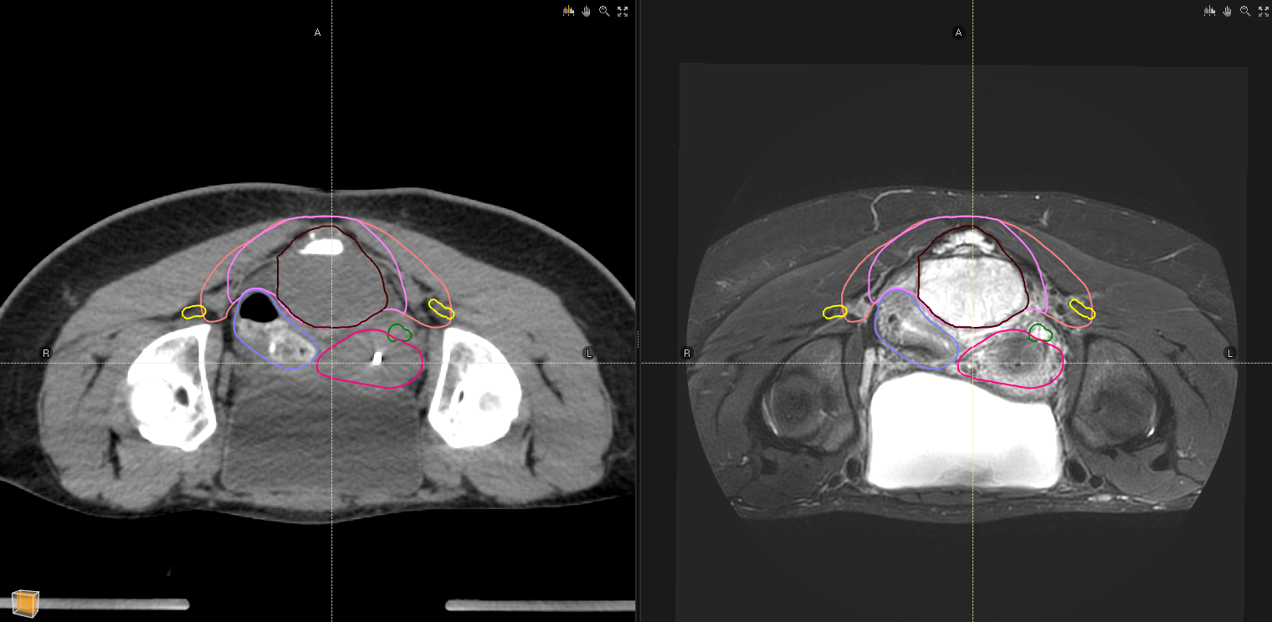

Slide 45


Slide 46
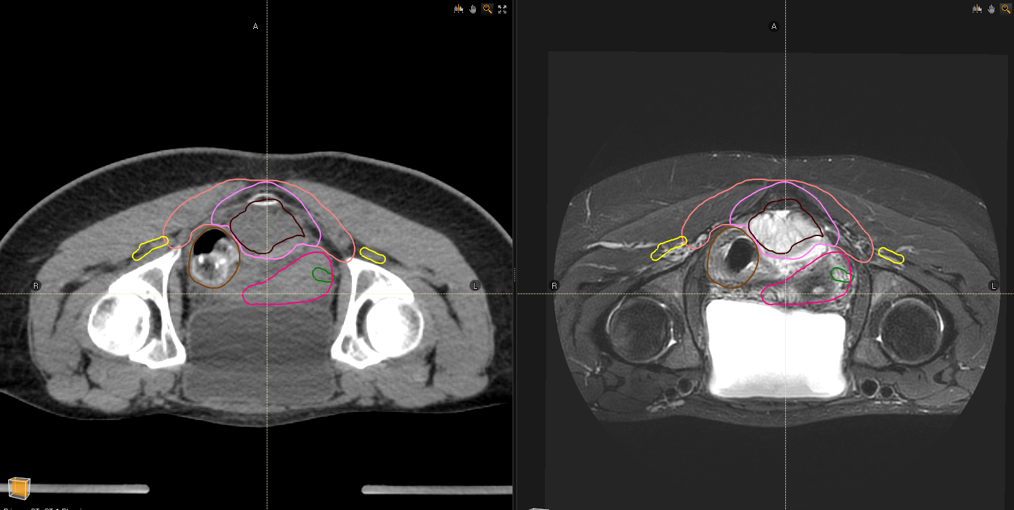

Slide 47
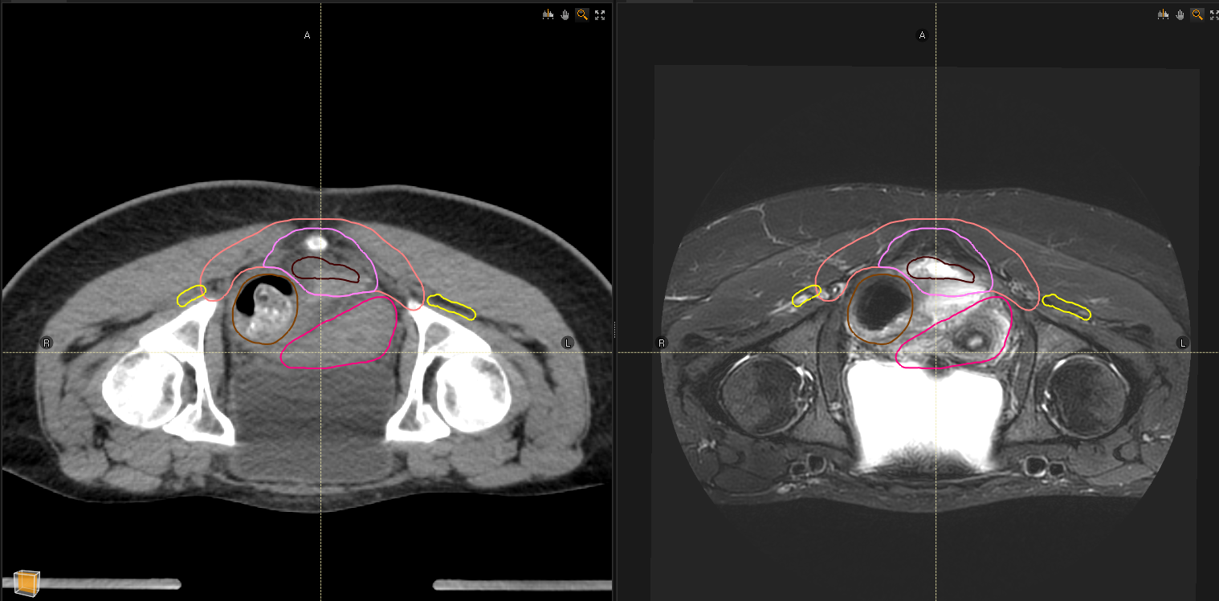

Slide 48
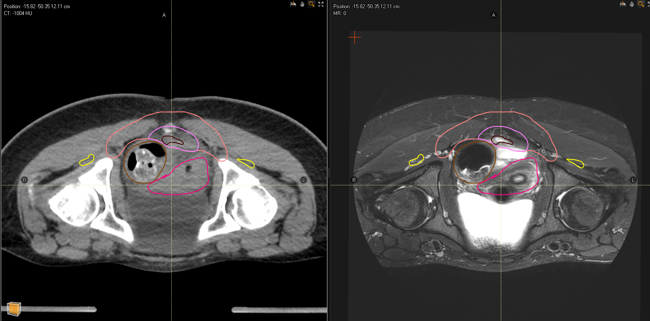

Slide 49
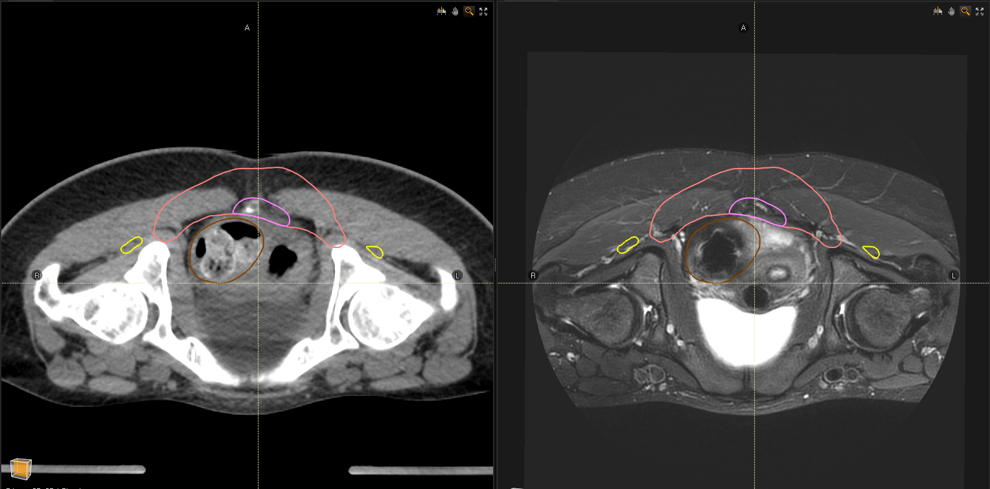

Slide 50
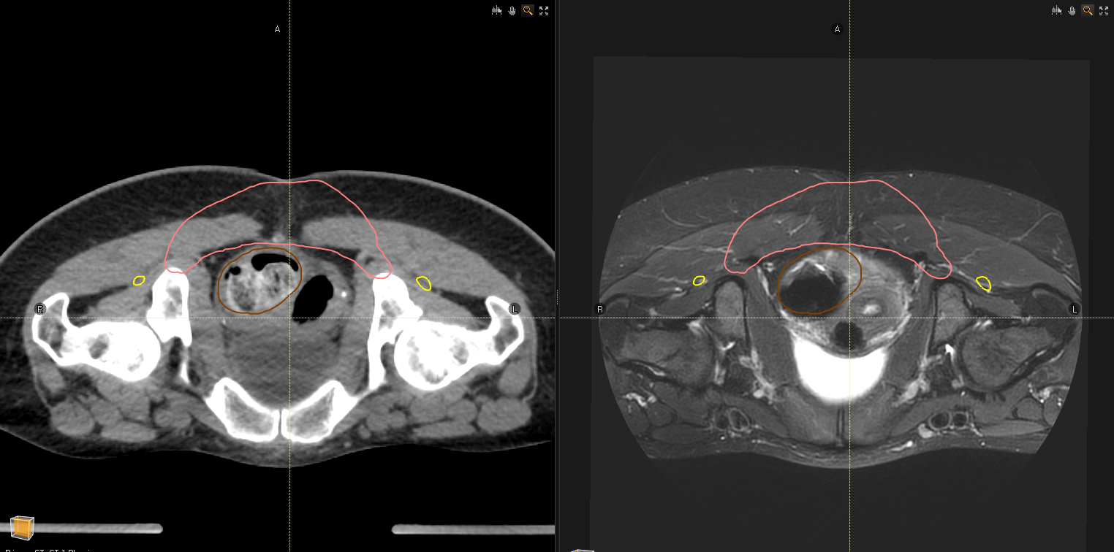

Slide 51
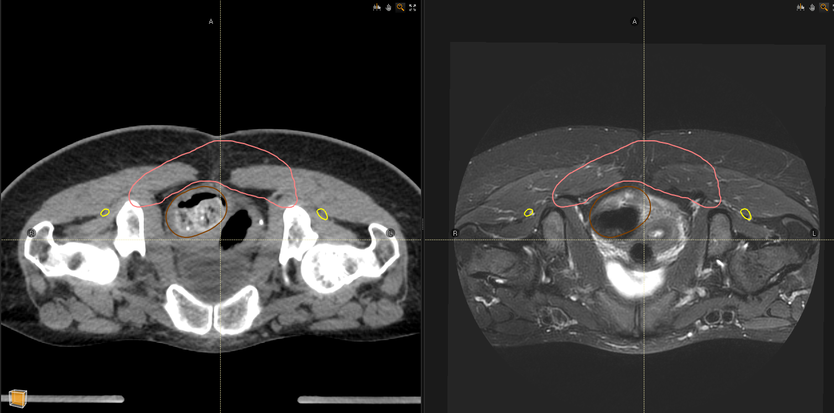

Slide 52
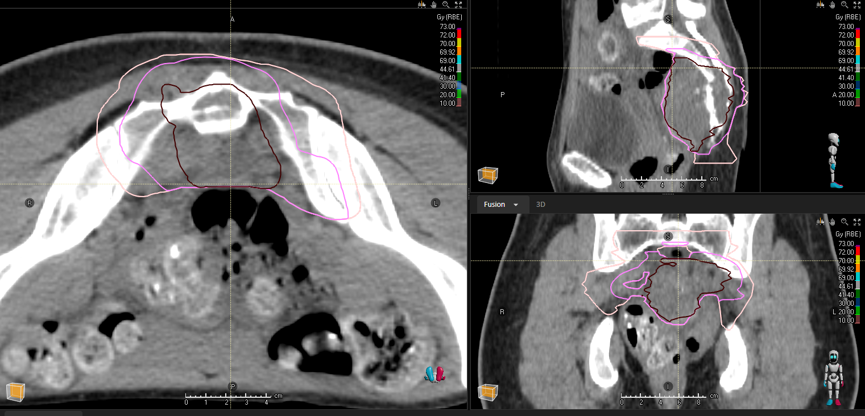

Slide 53
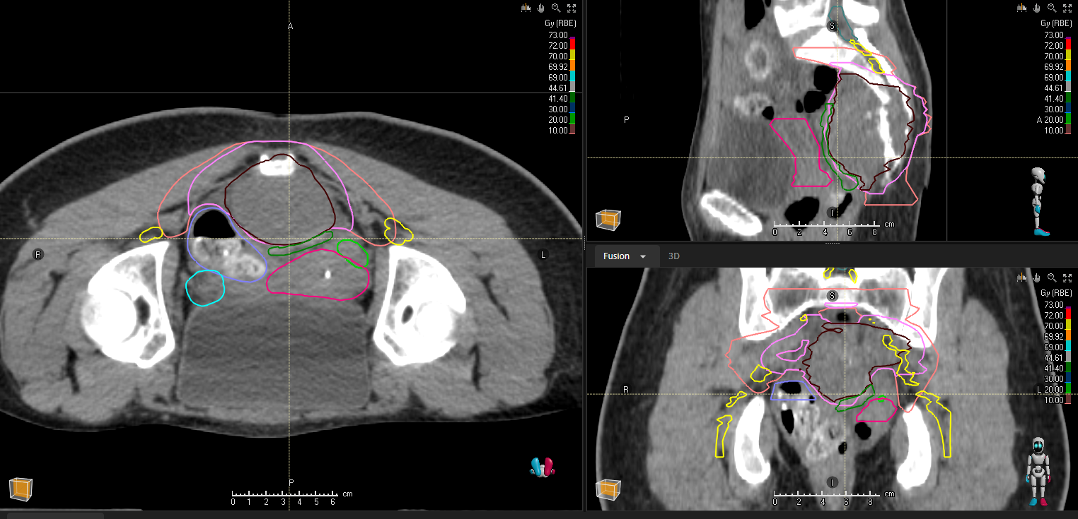

Slide 54
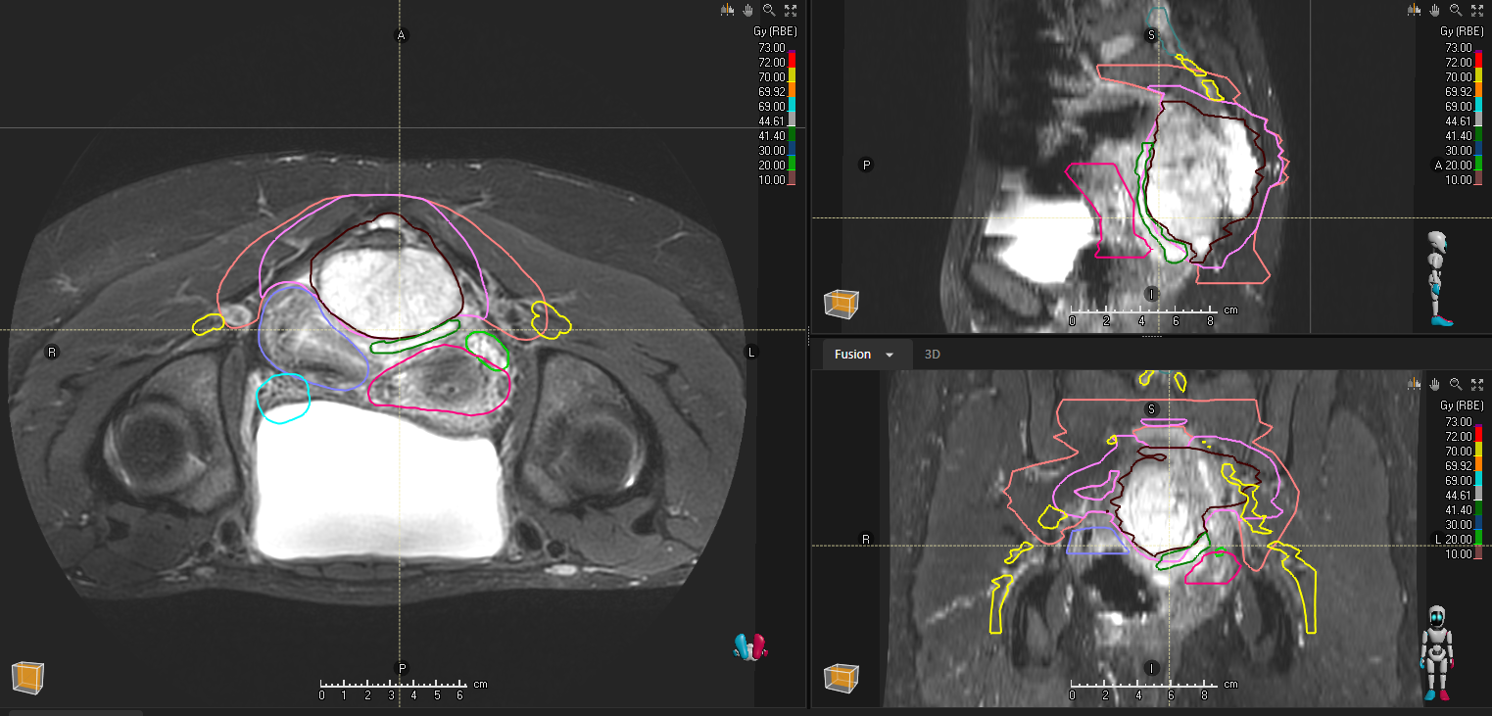

Slide 55
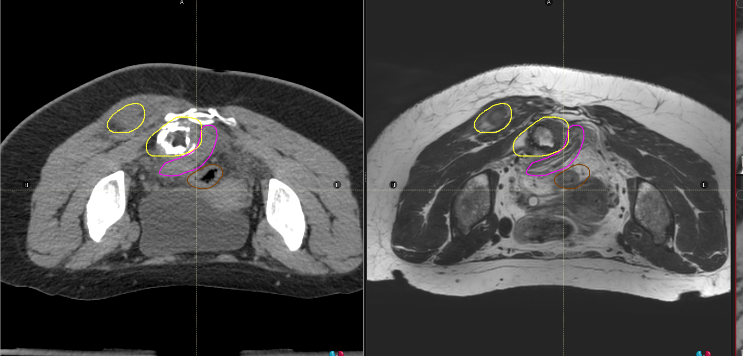

Slide 56
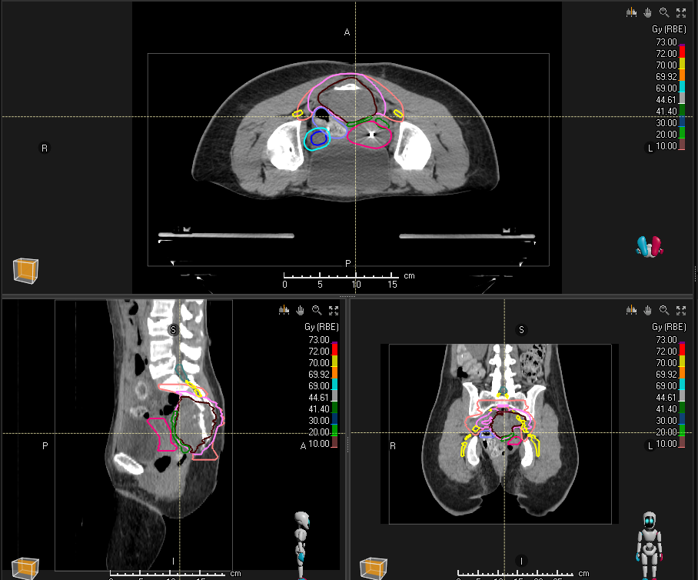
4 beams , MFO

Slide 57
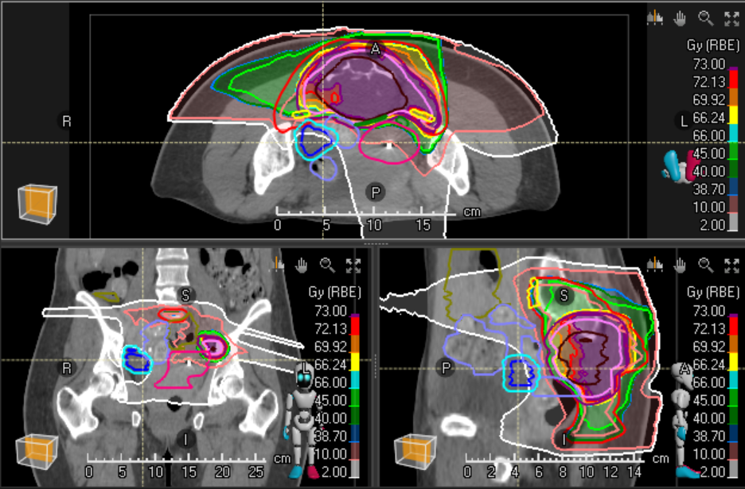

Slide 58
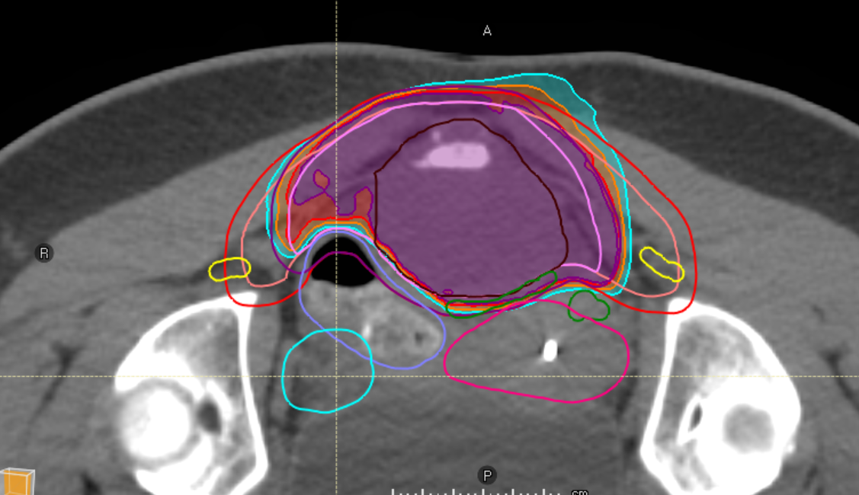

Slide 59


Slide 60


Slide 61






Slide 62


Slide 63
LEM vs mMKM
LEM 73.6 Gy
should be equivalent to
mMKM 67.2 Gy RBE

Slide 64


LEM
MKM

Slide 65

Target coverage: LEM 73.6 Gy RBE, MKM 67.2 Gy RBE

Slide 66

Rectum/sigmoid: LEM D1cc< 66 Gy RBE, MKM D1cc < 60Gy RBE

Slide 67

Nerve roots: LEM D5%< 73/71 Gy RBE, MKM D5% < 69/66 Gy RBE

Slide 68


Slide 69

Ovaries

Slide 70
Which risks ?
Might happen:
Neuropathy
Bone fracture
Will not happen:
Rectal toxicity
Fertility?

Slide 71


Small bowel

Slide 72

Nerve roots

Slide 73

ovary

Slide 74

9 Months

Slide 75

21 Months
Asymptomatic sacral insufficiency fracture
255 ml
77 ml

Slide 76

Quantitative volumetric evaluation
% of initial volume
Months

Slide 77


Slide 78





