Slide 1
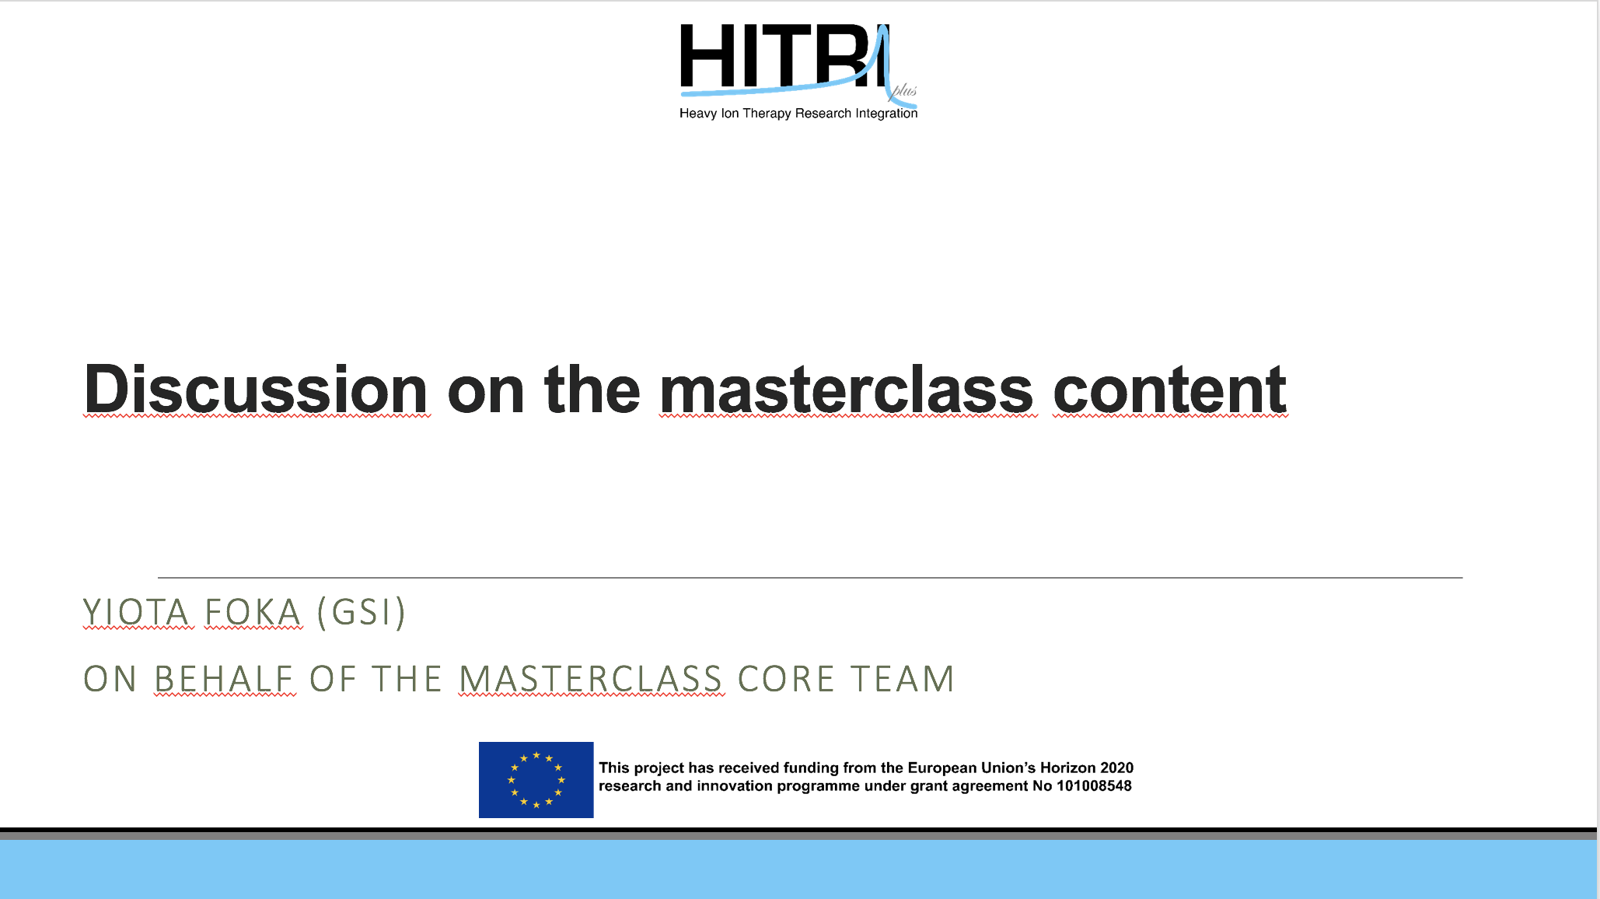

Slide 2
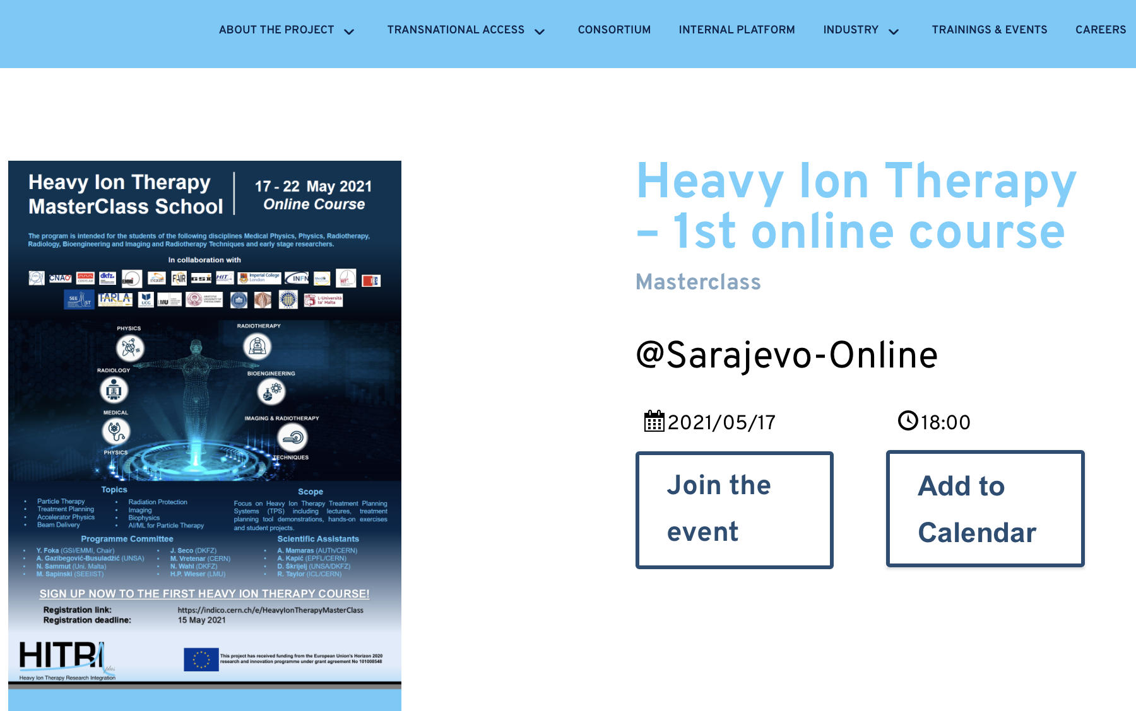
HITPIplus Schools
In order to facilitate sustainability and
spreading to the max the acquired knowledge
all HITRIplus schools foresee
“Train the Trainer” sessions:
train tutors that could perform
back at their home institutes
the Particle Therapy MasterClasses
that are one-day events addressing
high-school students.
https://indico.cern.ch/event/1019104/
HITRIplus schools:
https://www.hitriplus.eu/event-calendar/
17-22 May 2021 https://indico.cern.ch/event/1019104/
4-8 July 2022 https://indico.cern.ch/event/1160802/
3-7 July in 2023. https://indico.cern.ch/event/1248018/
HITRIplus YouTube channel:
https://www.youtube.com/@hitriplus9177/about
Heavy Ion Therapy Masterclass School
in HITRIplus “Education and Training”
addressing university students,
starting from basics assuming no specialisation,
and up to early stage researchers
and even professionals
SLIDE
IAEA-CN301-059
Slide 6
Panagiota Foka

Slide 3
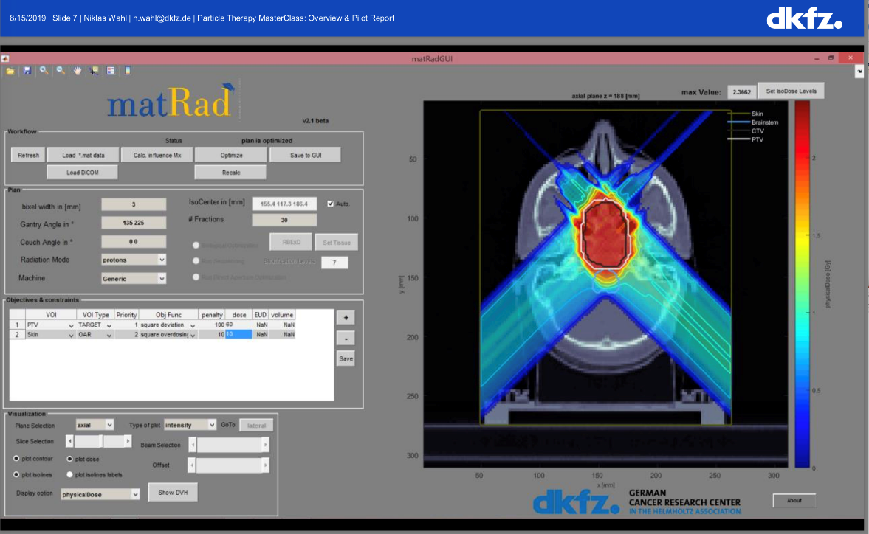
Hands-on Treatment Planning
Hands-on: based on professional open source treatment planning toolkit
matRad, developed by Heidelberg DKFZ for research and training www.matrad.org
Please submit the results of the hands-on by email to: nicholas.sammut@um.edu.mt by 10 July 2023.
For any issues related to the Train the Trainers Hands-on Session please contact:
yiota.foka@cern.ch and/or n.wahl@dkfz-heidelberg.de
IAEA-CN301-059
Slide 14
Panagiota Foka

Slide 4
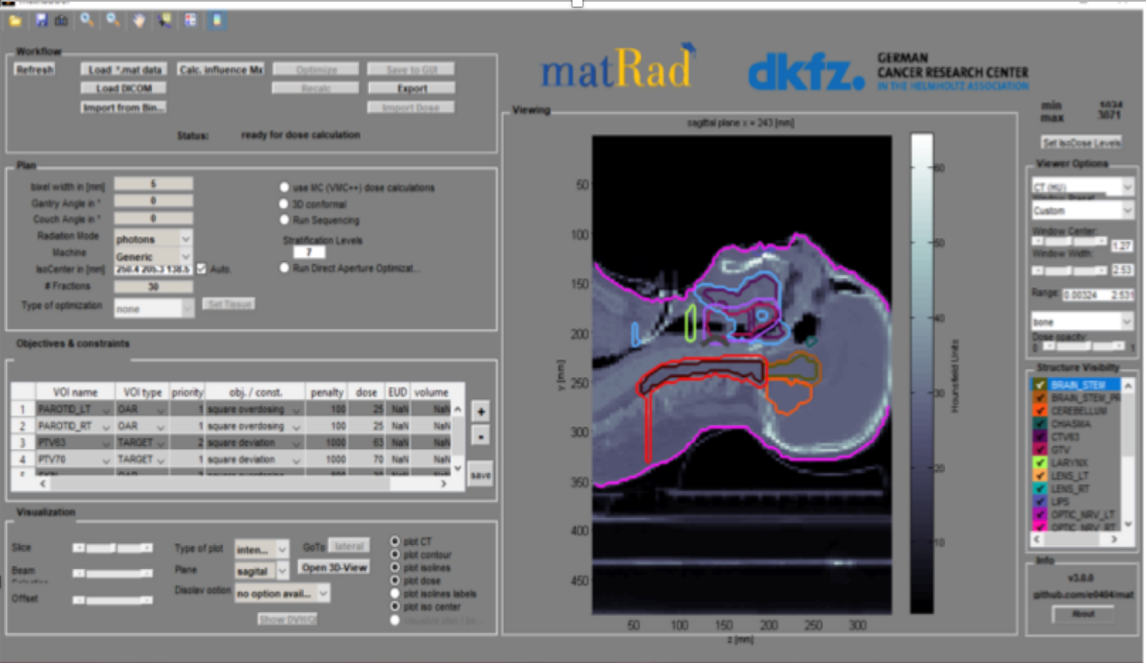
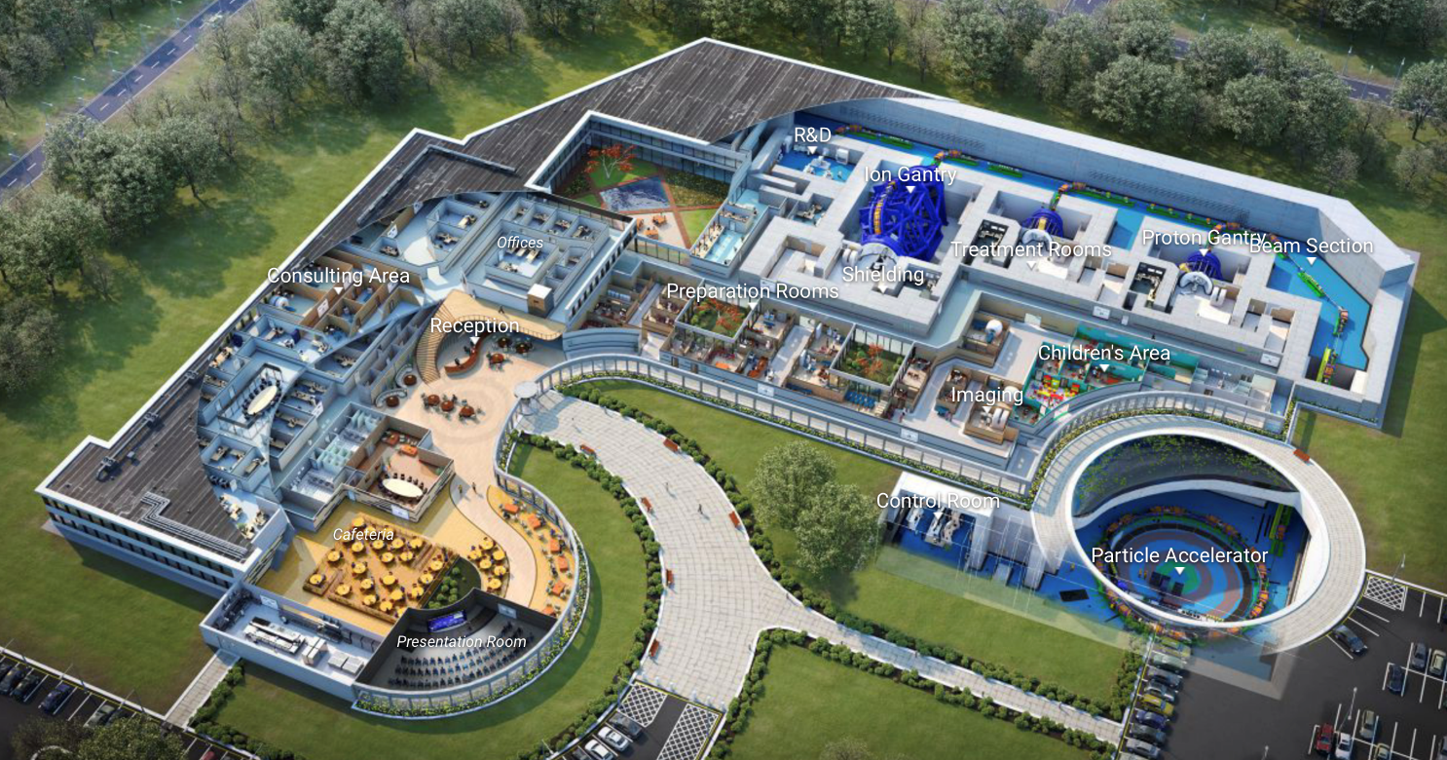

Particle Therapy MasterClasses
PTMC
Treatment Planning
https://indico.cern.ch/event/840212/
Virtual Therapy Centre
Treatment Planning and all it entails to deliver the beam to the target
multidisciplinary facets of heavy- ion therapy
aim: give the full image what happens from the beginning to the end
https://event/840212/page/18001-articles
IAEA-CN301-059
Slide 10
Panagiota Foka
Yiota Foka , HITM 17-15 May 2021

Slide 5
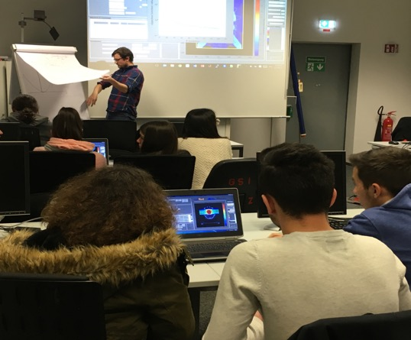
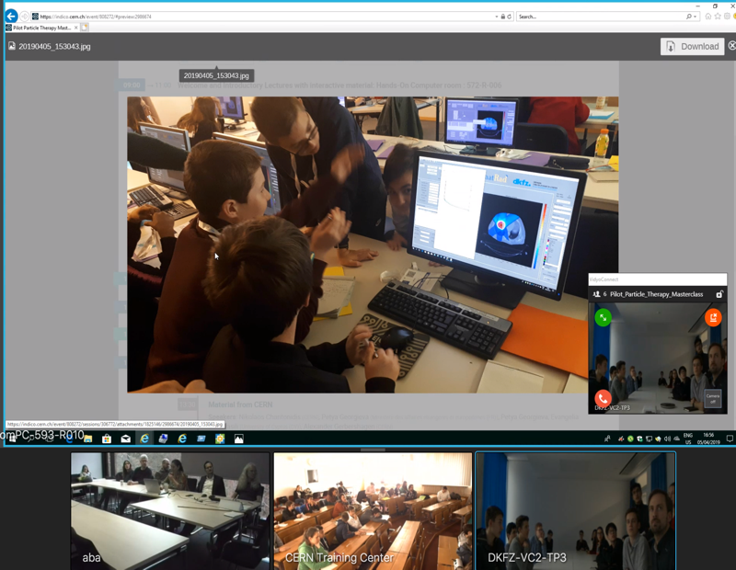
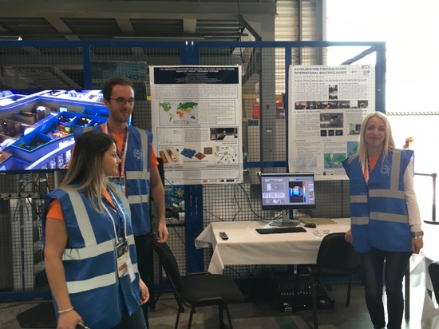
New PTMC and Treatment Planning
matRad open source Treatment Planning toolkit: DKFZ German Cancer Research Centre
First Local Test: GSI Feb 2019
International Pilot: CERN, GSI, DKFZ April 2019
CERN Open days
First tests positive feedback:
“motivation to contribute to the fight against cancer”
IMC Steering Group Approval: GSI May 2019
web pages: Sarajevo Uni students Aug 2019 at CERN

Slide 6
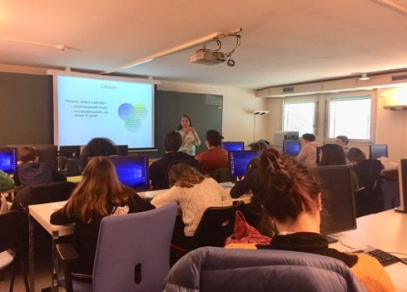
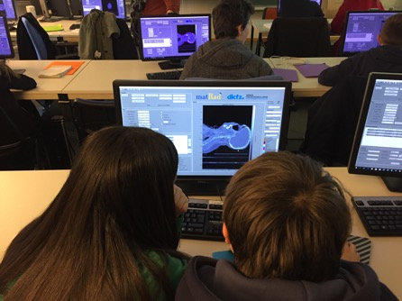
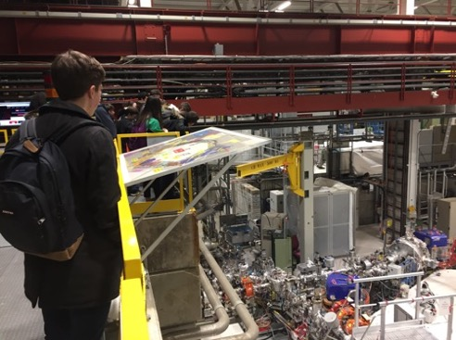
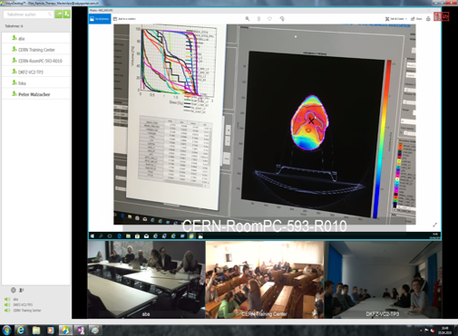
PTMC: Typical MasterClass Day Agenda
Scientists for a day !!
Local: Morning Presentations
Local: Afternoon Hands-on
Adapted online/zoom due to covid
Every year, mid-February to mid-April
school-children (15-19 year old)
are invited at/by an institute of their area.
2-5 institutes per day performing
the same programme
Local: Morning Visits
Common: Afternoon at 16:00
Video-Conference
LOCAL TIME: ACTIVITY
8:30 - 9:00 Registration and Welcome
9:00 - 10:00 Introductory lectures
10:30 - 11:30 Visit of a lab or experiment
12:00 - 13:00 Lunch
13:00 - 15:00 Hands-on session
15:00 - 16:00 Discuss results locally
16:00 - 17:00 Common Video Conference
IAEA-CN301-059
Slide 11
Panagiota Foka

Slide 7
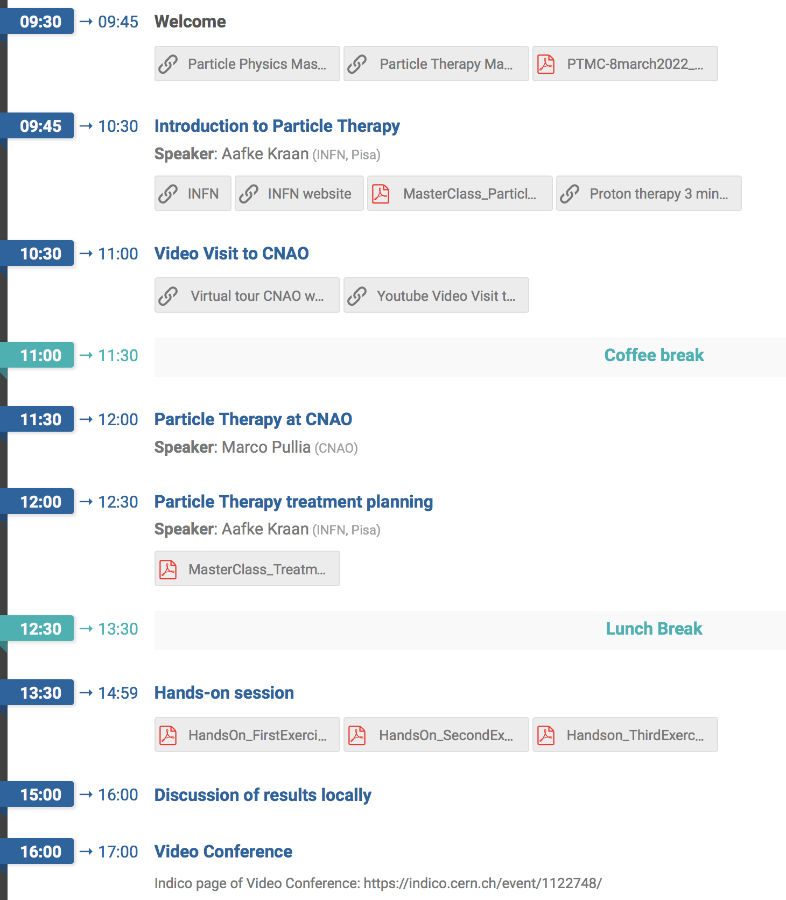
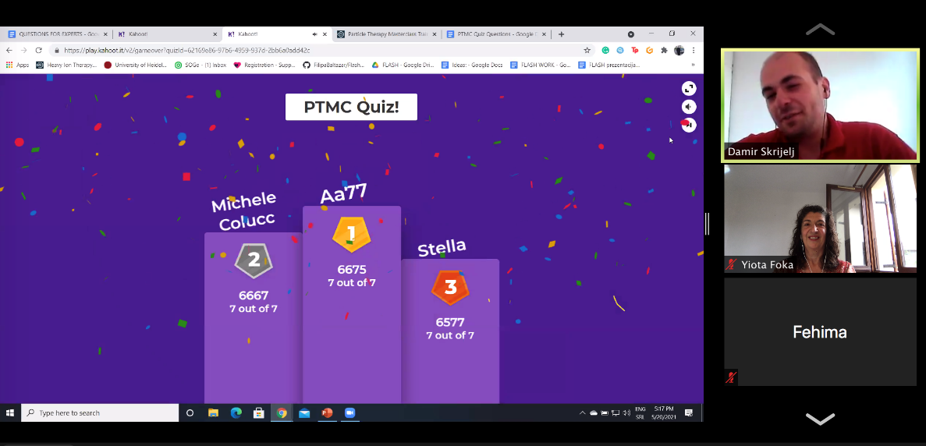
Check List
Contact school/teachers (during week days) or announce via proper channels and social media (on Saturday)
Organise room (and lunch) at the institute or zoom
Lectures in the morning
Connect to virtual visits to existing therapy centres guided by their experts
Hands-on in the afternoon
Prepare students’ presentations and discussions of their results locally
Connect to common video-conference
Finish with Quiz

Slide 8
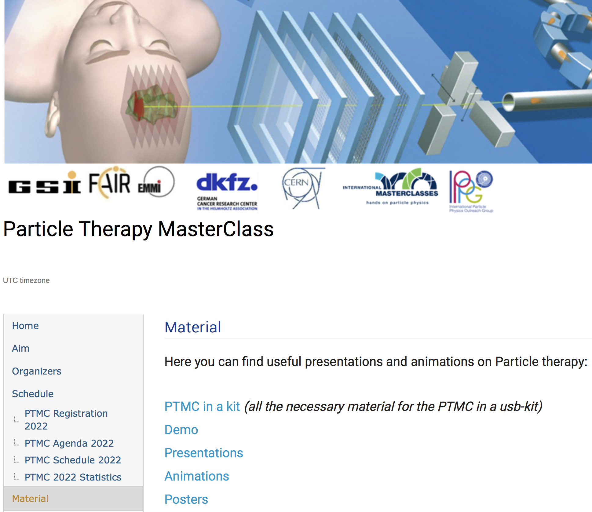
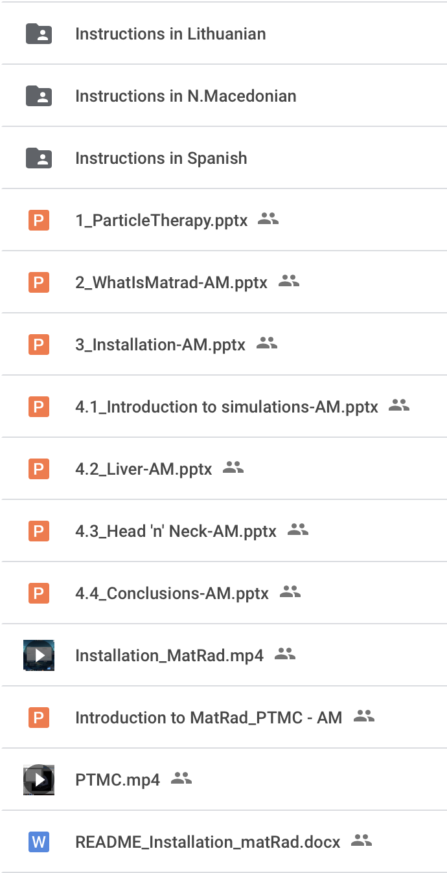
https://indico.cern.ch/event/840212/
IAEA-CN301-059
Slide 24
Panagiota Foka

Slide 9
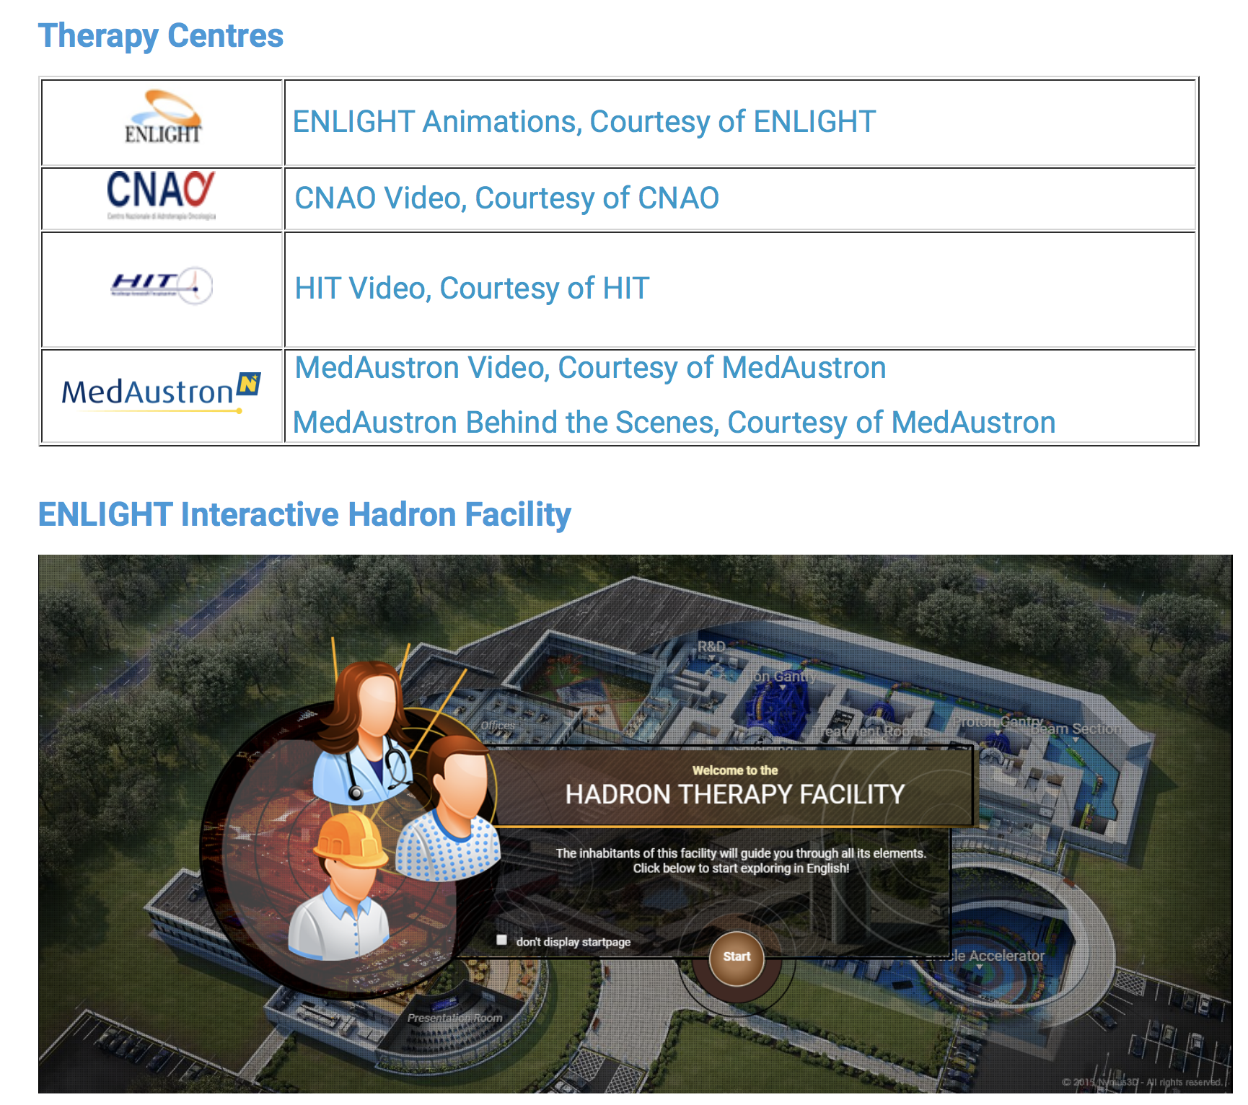
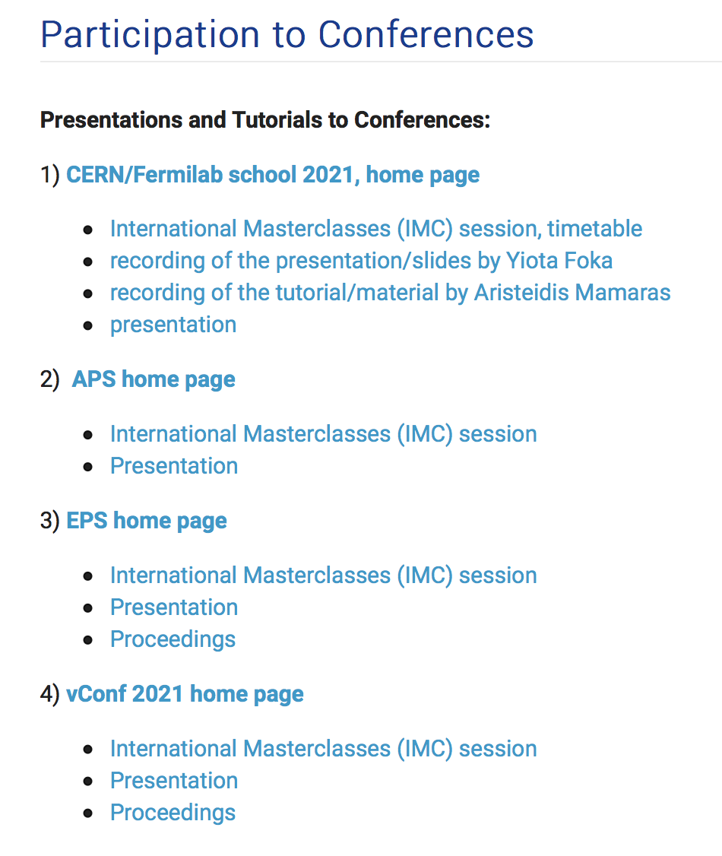
IAEA-CN301-059
Slide 24
Panagiota Foka

Slide 10
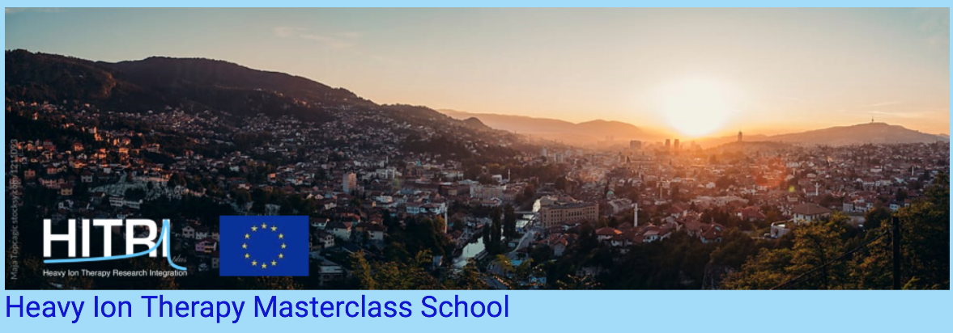
Heavy Ion Therapy Masterclass school format
https://indico.cern.ch/e/HeavyIonTherapyMasterClass
HITM school format: inspired by PTMC
Highlight:
Hands-on sessions, “do it yourself” guided by experts,
with real data and professional tools and methods
Pedagogical elements facilitating learning
Lectures in the morning
Hands-on in the afternoon
Students’ presentations and discussions of their results with experts
Virtual visits to existing therapy centres guided by their experts,
supported by web-cam or videos
Every day started with videos while participants were connecting
to give them a visual impression and help them relate what they would listen
Every day ended with social events, to provide opportunities for networking and entertainment
Last day dedicated to “future developments” just before the “Careers Fair” in the evening
IAEA-CN301-059
Slide 12
Panagiota Foka

Slide 11

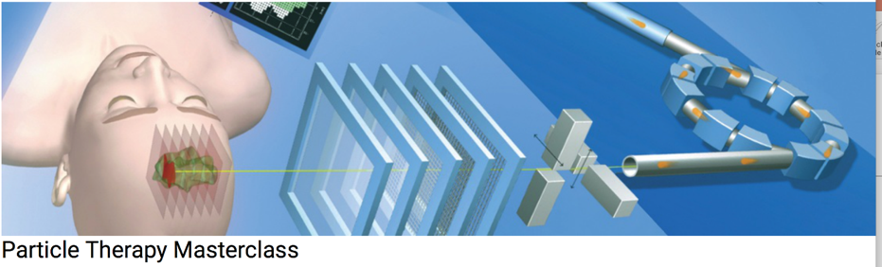
https://indico.cern.ch/e/HeavyIonTherapyMasterClass
https://indico.cern.ch/event/840212/
Full week course
One day activity
The HITM school is aimed at university students,
early stage researchers…
The Particle Therapy MasterClass,
is aimed at high-school students (16-18)
Future tutors
Interesting career paths in emerging fields where often there is lack of specialised personnel
Future Tutors
Information about upcoming modern techniques for cancer tumour therapy and new research avenues,
where clearly the development of technology and the expertise of research laboratories is crucial.
IAEA-CN301-059
Slide 30
Panagiota Foka

Slide 12
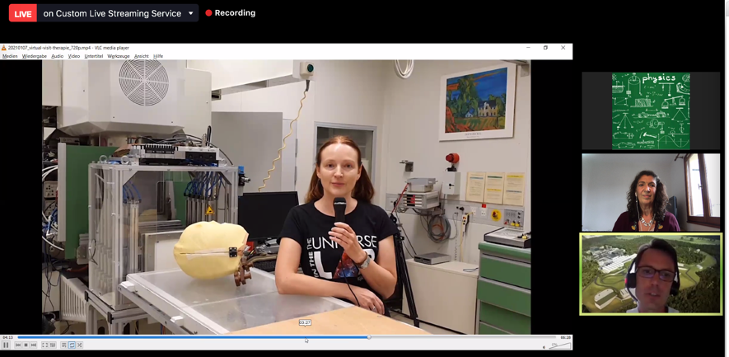
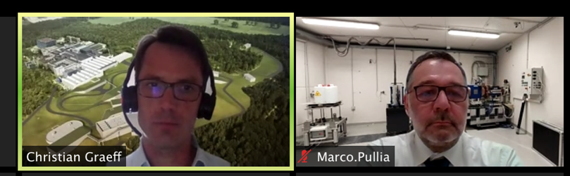
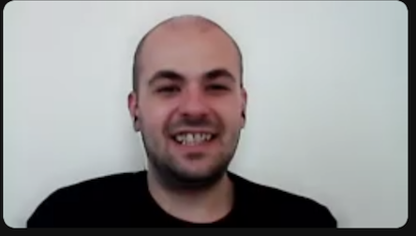
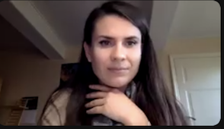
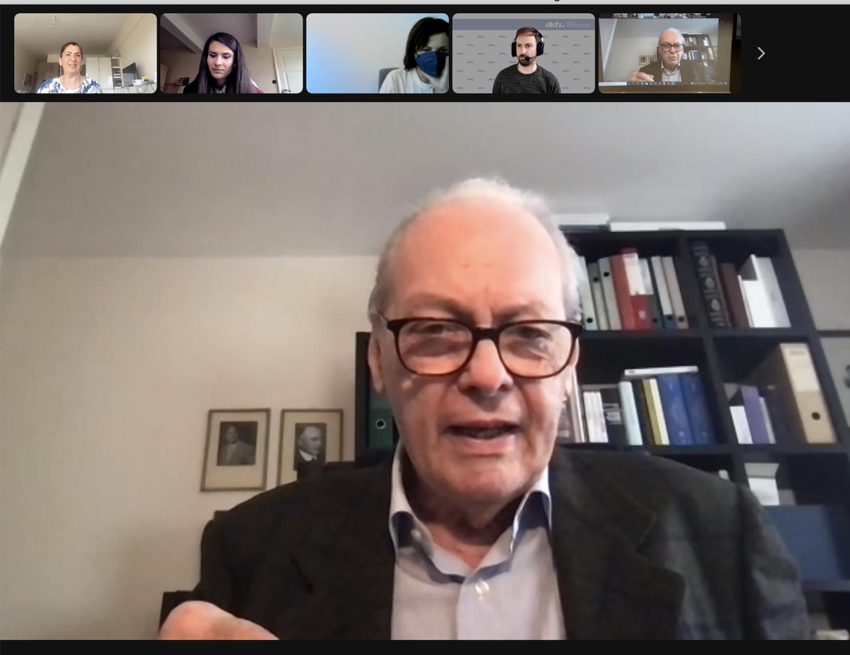
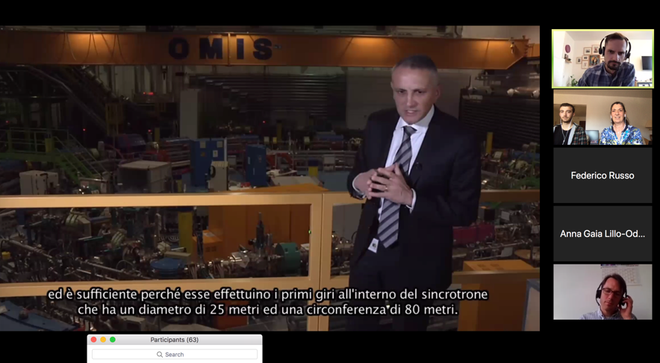
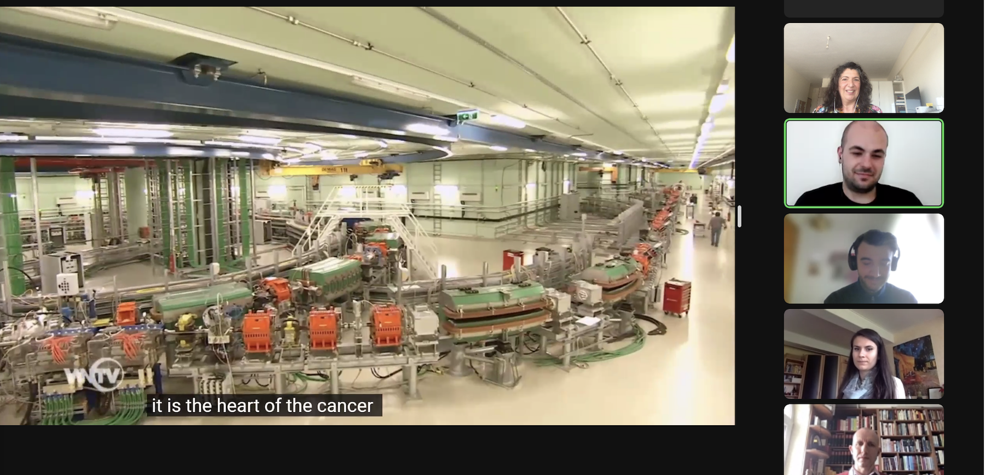
Virtual visits and video-conferences
Virtual visits during video-conference: GSI research institute, CNAO, MedAustron therapy centers
GSI moderators
CNAO moderator
medAustron moder.
U. Amaldi: HI therapy pioneer

Slide 13
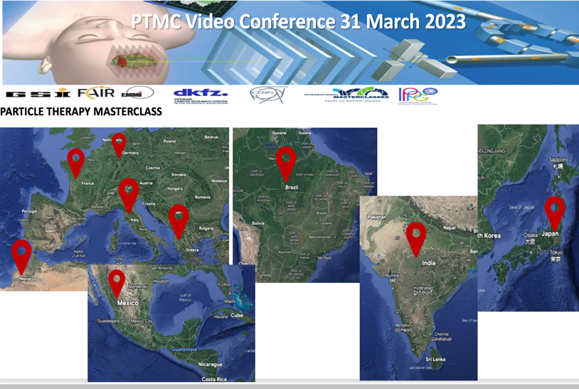
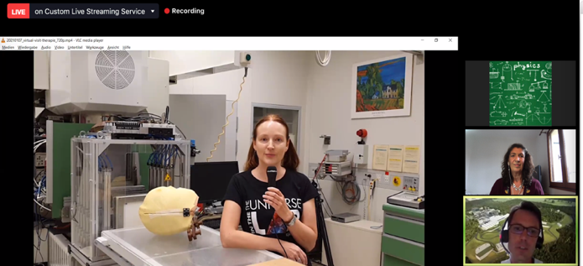
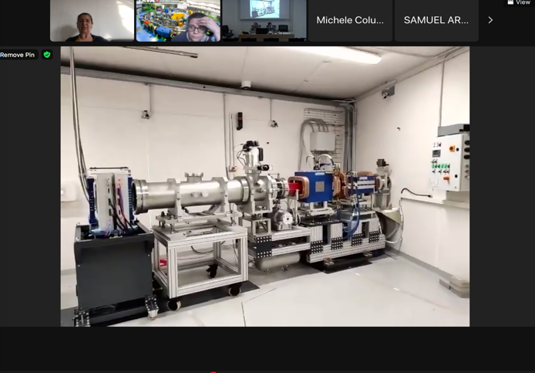
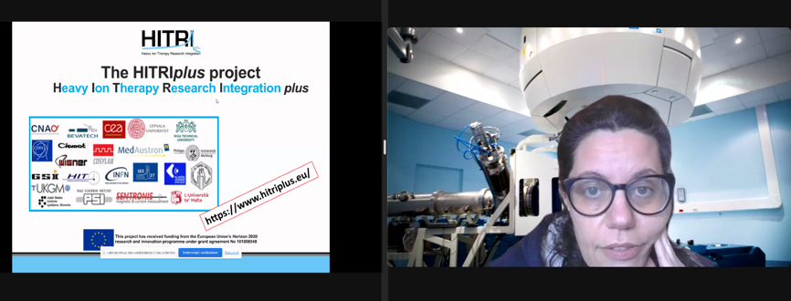
Virtual visits and video-conferences
At the end of the 31 March 2023 PTMC local sessions: common video-conference
among 10 participating institutes !!
Moderated by GSI with strong support from
HITRIplus, CNAO…..
Call for Moderators, Virtual Visits !
GSI Cave M: Christian Graeff
HITRIplus educational opportunities: Angelica Facoetti
CNAO experimental room: Marco Pullia

Slide 14
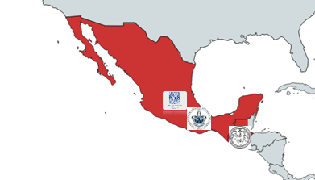
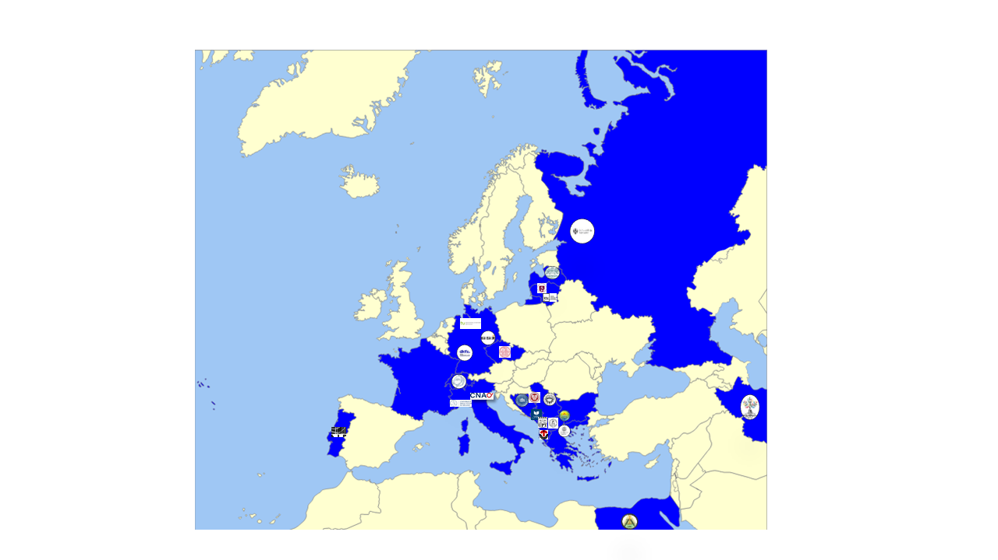
Participants of online PTMC in IMC2021
PTMC: https://indico.cern.ch/event/840212/
PTMC2021 online:
more than 1500 students participated
from 20 countries and 37 institutes during 6 sessions

Slide 15
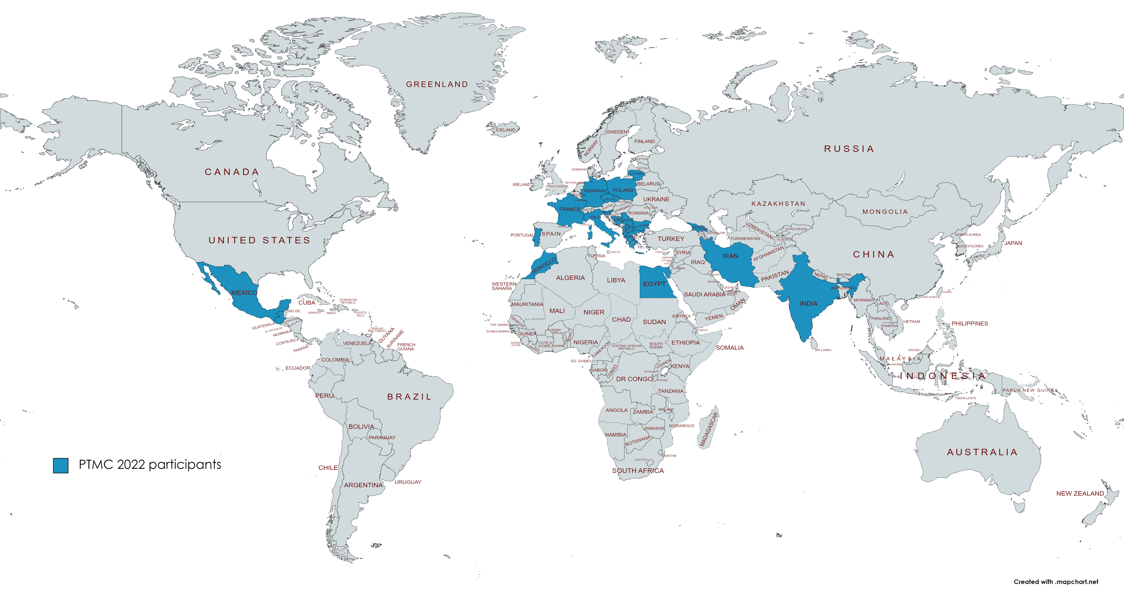
Participants of online PTMC in IMC2022
PTMC: https://indico.cern.ch/event/840212/
PTMC2022 online:
more than 1500 students participated
from 22 countries and 37 institutes during 6 sessions
online and in-person participation
web pages with agendas of every institute with material
in different languages, publicly available for future events
Training sessions planned and upon request
Interest of students, motivation of tutors (voluntary work), potential impact

Slide 16
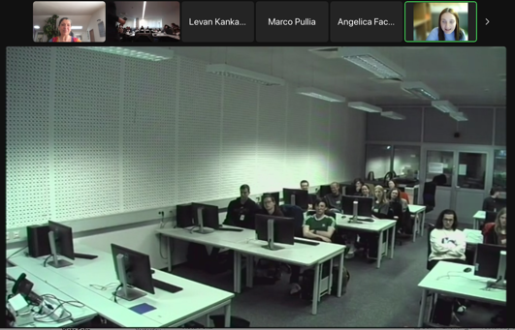
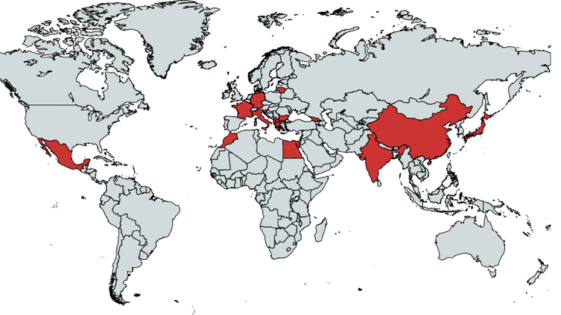
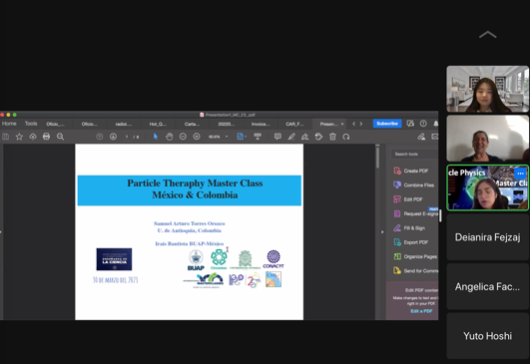
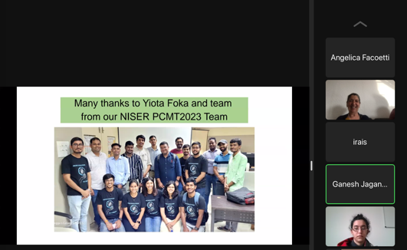
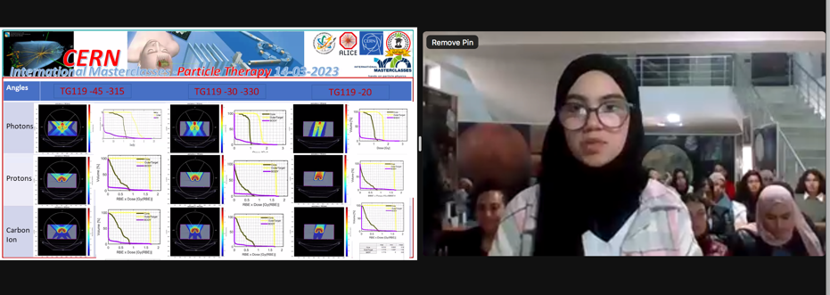
Participants of PTMC 2023
PTMC 2023:
9 days, 37 institutes, 20 countries
In person, hybrid, online modes
GSI
MEXICO and COLOMBIA
Contacted by Mayo Clinic Florida
PTMC found on web searching for related material
JAPAN
ALGERIA
Call for Local Organisers/Institutes

Slide 17
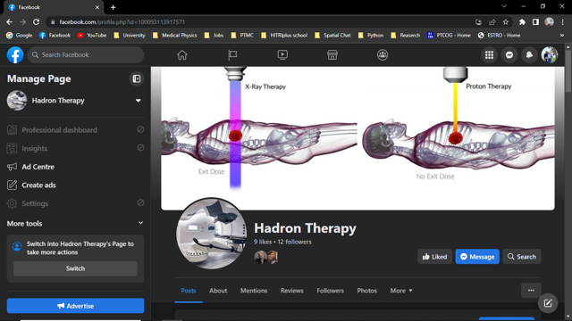
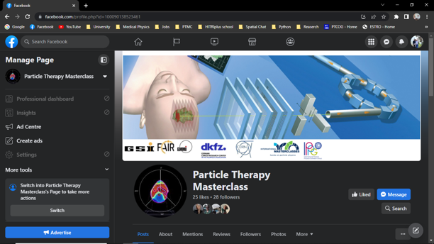
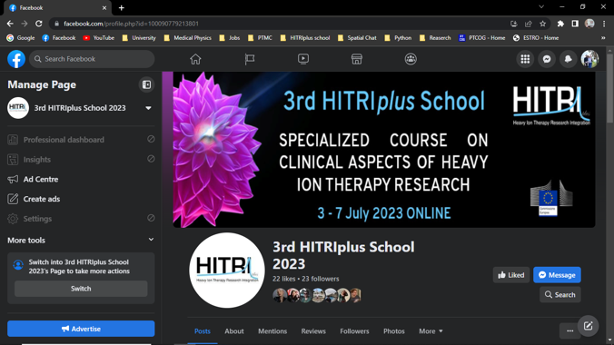
Important Impacts
Tutors:
  motivated to search for in depth relevant info, enhancing related knowledge, follow relevant studies, career paths
High-school students: interested to follow STEM studies, medical applications
Extra Contributions to Facebook
Hadron Therapy FB Page:
https://www.facebook.com/profile.php?id=100093113917571
3rd HITRIplus School FB Page:
https://www.facebook.com/profile.php?id=100090779213801
Particle Therapy MasterClass FB Page:
https://www.facebook.com/profile.php?id=100090138523461

Slide 18
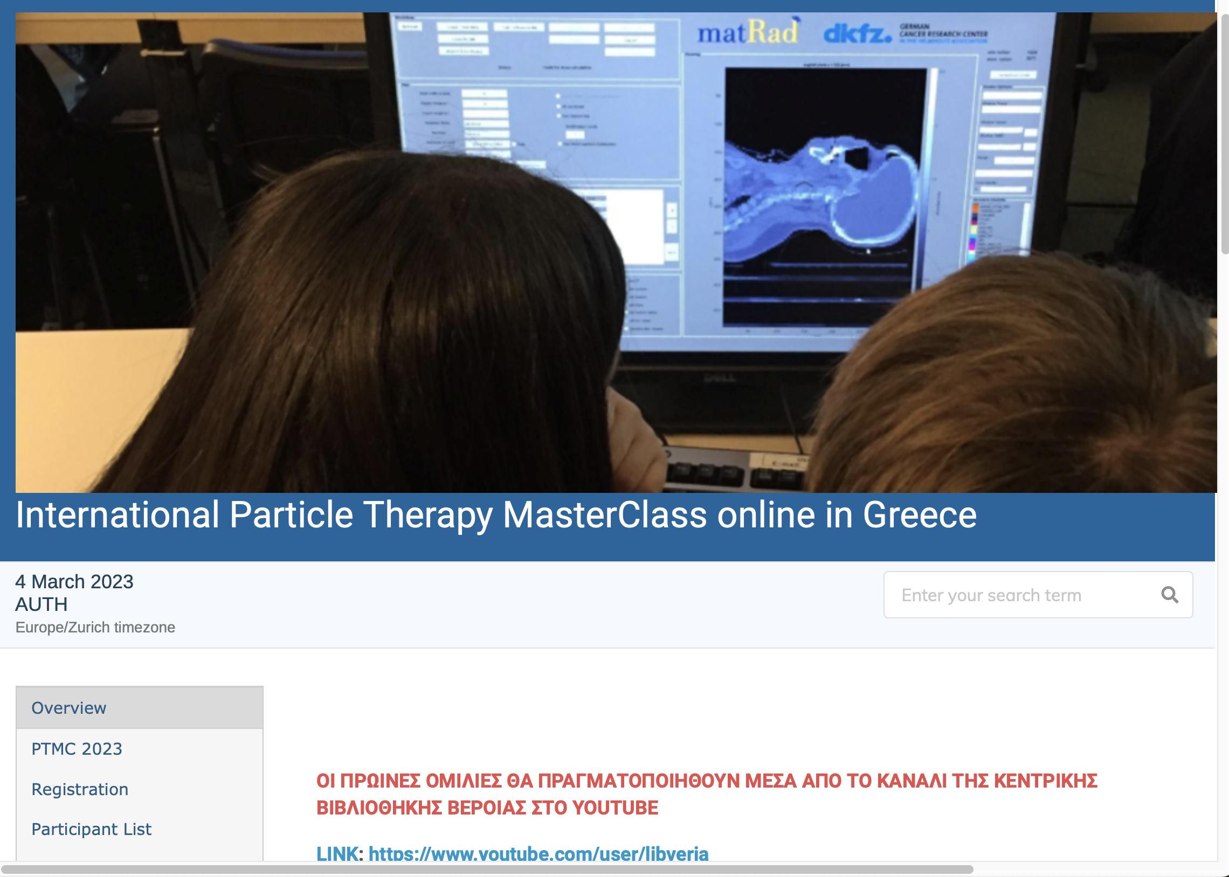
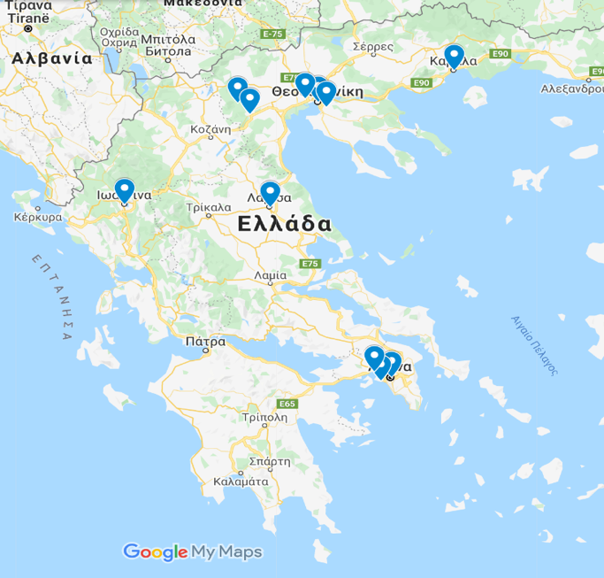

PTMC in Greece
PTMC2021 online: through Library of Veroia
PTMC2023 online: 240 participants and in-person 40 students
AUTH uni, Dimokritos research centre, Papageorgiou Hospital, Technopolis.
Publicity: Library of Veroia extended networks and national press
Total of 366 live views
from at least 20 major regions of Greece
Press Release published in nation-wide media
Post on Facebook resonated with 3,600 people
Announcement viewed 941 times on website

Slide 19
Aims and expectations
Attract school-children to STEM at early stages: decide future studies/career
Cultivate confidence through the hands-on (I can do it!)
and “demystify the difficulty” of physics, math….
NOTE: a Master thesis survey/study has shown that students do learn!
Support female students (i.e. 11 Feb, 8 March sessions) handle prejudices (i.e. MSc/PhD in Mexico)
Create groups of Uni assistants/tutors that learn better in order to teach
Demonstrate a return to society from investment in fundamental research
Enhance awareness of broader public
extended reach to family, friends, personal environment
Prepare future generations aware of importance of fundamental research and its applications:
  favourable politicians,
  evidence-based decision-making society

Slide 20
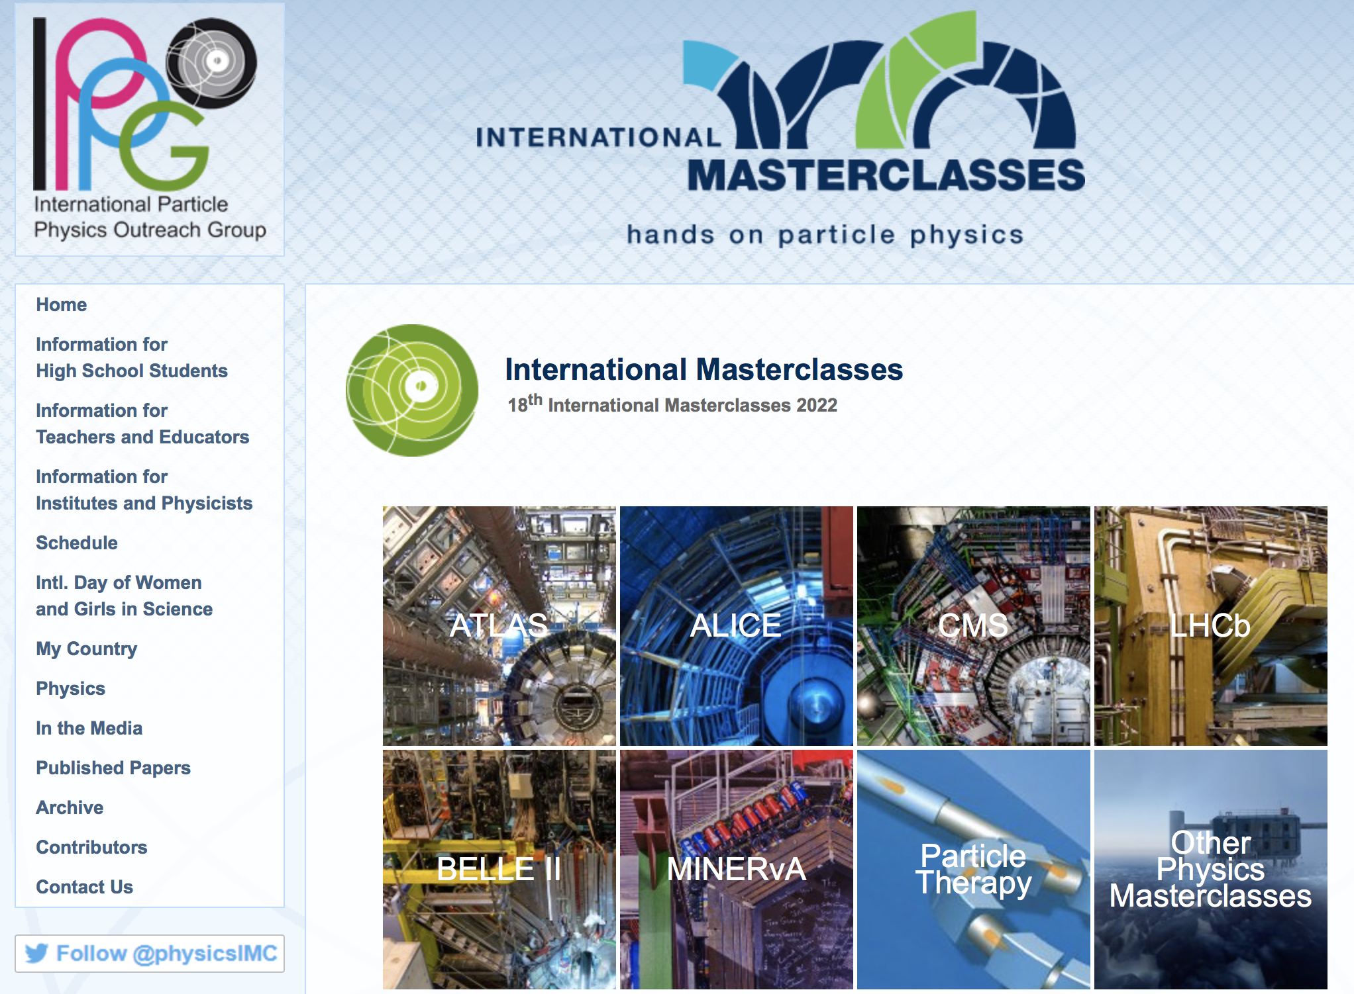

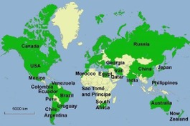
World-wide reach motivating next generation of scientists
International MasterClasses one day activity; material can be used in different ways, for different occasions
https://physicsmasterclasses.org/
Flagship project of IPPOG,
the International Particle Physics Outreach Group
IAEA-CN301-059
Slide 31
Panagiota Foka
Feedback: example from Serbia, almost 50% of IMC participants enrolled at UNI

Slide 21
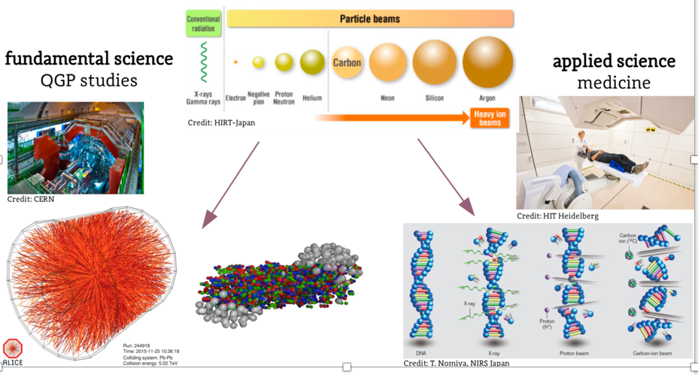
Heavy-ion research and heavy-ion therapy
Pb-Pb at 5.5 TeV
pp at 14 TeV
88-430 MeV/u carbon
50-221 MeV/u protons

Slide 22






Acknowledgements PTMC 2019 pilot
matRad Developers
Wahl, Niklas
Bangert, Mark
Hans-Peter Wieser
DKFZ Heidelberg
LoC: Wahl, Niklas
Katrin Platzer, Malte Ellerbrock
Noa Homolka Amit Ben Antony Bennan
GSI
LoC: Yiota Foka
GSI Biophysics:
Christian Graeff, Radek Pleskac
GSI ALICE, EMMI :
Ralf Averbeck, Malzacher, Peter
GSI IT :
Thorsten Kollegger, Behnert, Katharina
Osdoba, Sascha
CERN (staff and users)
CERN: tutors
Loc Org: Nikolaos Charitonidis
Alexander Gerbershagen
Evangelia Dimovasili
Elena Benedetto
CERN/ARIES: Maurizio Vretenar, Valerie Brunner
CERN/ENLIGHT: Manjit Dosanjh Petya Georgieva
CERN/KT: Manuela Cirilli Anais Rassat Rita Ferreira Giovanni Porcellana
CERN: Visits Service Erwan Harrouch Francois Butin
CERN: Training Centre: Eric Bonnefoy M-L LECOQ
Uni Sarajevo: web pages
Amila Avdic
Amra Ibrahimovic
Mirsad Tunja
Damir Skrijelj
Sponsors : Edmond Offermann
General Coordination :
p.foka@gsi.de
yiota.foka@cern.ch

Slide 23
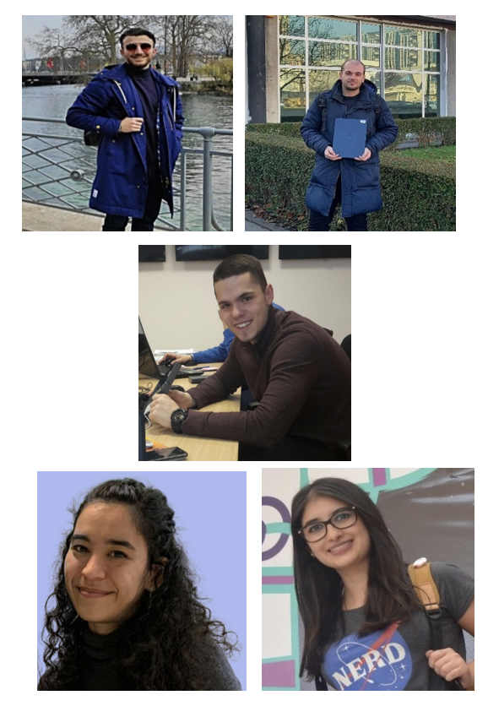
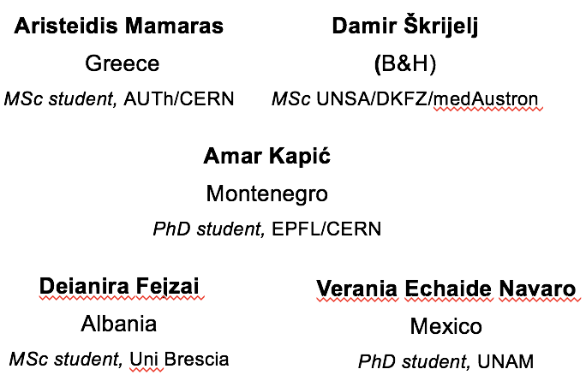
Acknowledgements PTMC
PTMC2022 core team
matRad Developers
Wahl, Niklas
Bangert, Mark
Hans-Peter Wieser
DKFZ Heidelberg
LoC: Wahl, Niklas
Katrin Platzer, Malte Ellerbrock
Noa Homolka Amit Ben Antony Bennan
GSI
LoC: Yiota Foka
GSI Biophysics:
Christian Graeff, Radek Pleskac
GSI ALICE, EMMI :
Ralf Averbeck, Malzacher, Peter
GSI IT :
Thorsten Kollegger, Behnert, Katharina
Osdoba, Sascha
CERN (staff and users)
CERN: tutors
Loc Org: Nikolaos Charitonidis
Alexander Gerbershagen
Evangelia Dimovasili
Elena Benedetto
CERN/ARIES: Maurizio Vretenar, Valerie Brunner
CERN/ENLIGHT: Manjit Dosanjh Petya Georgieva
CERN/KT: Manuela Cirilli Anais Rassat Rita Ferreira Giovanni Porcellana
CERN: Visits Service Erwan Harrouch Francois Butin
CERN: Training Centre: Eric Bonnefoy M-L LECOQ
Uni Sarajevo: web pages
Amila Avdic
Amra Ibrahimovic
Mirsad Tunja
Damir Skrijelj
Online mode, web pages, training
Sponsors : Edmond Offermann
Aris Mamaras (AUTH), Damir Skrijelj (UNSA)
General Coordination :
p.foka@gsi.de
yiota.foka@cern.ch

Slide 24
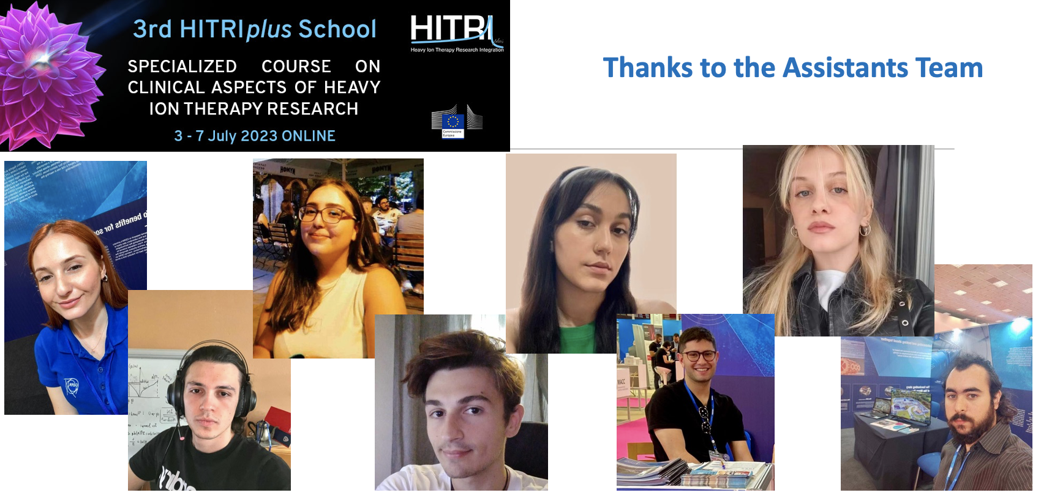

Acknowledgements PTMC
PTMC2023 core team
matRad Developers
Wahl, Niklas
Bangert, Mark
Hans-Peter Wieser
DKFZ Heidelberg
LoC: Wahl, Niklas
Katrin Platzer, Malte Ellerbrock
Noa Homolka Amit Ben Antony Bennan
GSI
LoC: Yiota Foka
GSI Biophysics:
Christian Graeff, Radek Pleskac
GSI ALICE, EMMI :
Ralf Averbeck, Malzacher, Peter
GSI IT :
Thorsten Kollegger, Behnert, Katharina
Osdoba, Sascha
CERN (staff and users)
CERN: tutors
Loc Org: Nikolaos Charitonidis
Alexander Gerbershagen
Evangelia Dimovasili
Elena Benedetto
CERN/ARIES: Maurizio Vretenar, Valerie Brunner
CERN/ENLIGHT: Manjit Dosanjh Petya Georgieva
CERN/KT: Manuela Cirilli Anais Rassat Rita Ferreira Giovanni Porcellana
CERN: Visits Service Erwan Harrouch Francois Butin
CERN: Training Centre: Eric Bonnefoy M-L LECOQ
Uni Sarajevo: web pages
Amila Avdic
Amra Ibrahimovic
Mirsad Tunja
Damir Skrijelj
Online mode, web pages, training
Sponsors : Edmond Offermann
Aris Mamaras (AUTH), Damir Skrijelj (UNSA)
General Coordination :
p.foka@gsi.de
yiota.foka@cern.ch

Slide 25

Support preparation of
next generation experts
for next generation facilities
for research and therapy
of cancer tumours with ions
Architectural design, Kaprinis Architects

Slide 26

Thank you for your attention !

