Slide 1
PROSPER Study:
A Comparative Effectiveness Trial of Surgery, Carbon Ion Radiotherapy, and Proton Therapy for Pelvic Sarcomas involving the Bone
Bradford Hoppe MD, MPH
Professor of Radiation Oncology
Mayo Clinic, Florida

Slide 2
Disclosures
I am employed by Mayo Clinic
I have no relevant financial relationships with ineligible companies to disclose, and I will include off-label or unapproved product usage in my presentation or discussions.

Slide 3
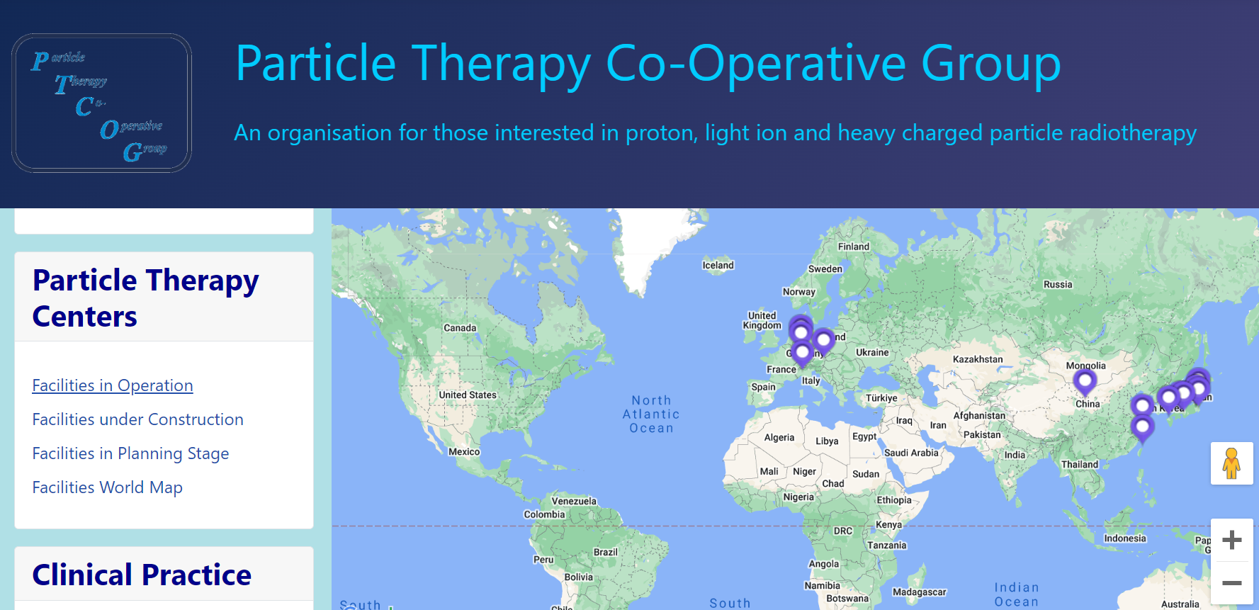
Why is the US interested in CIRT?

Slide 4
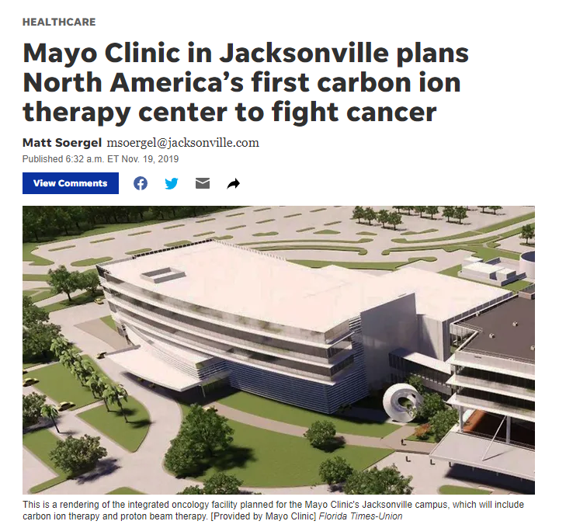
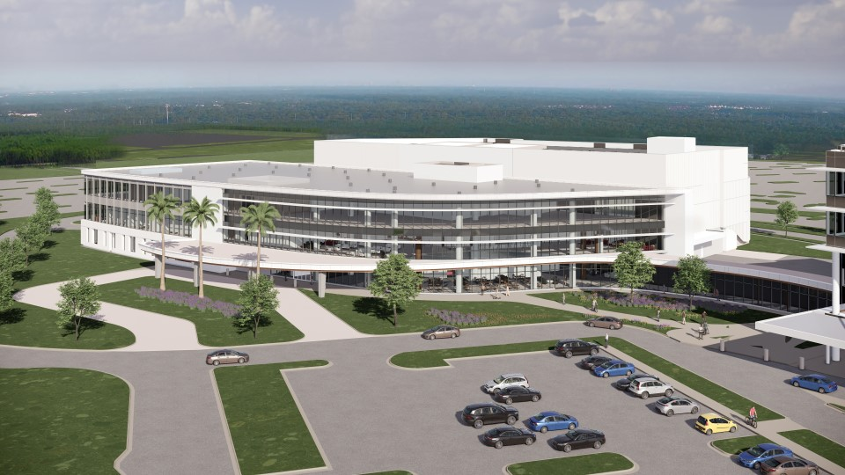
Why is the US interested in CIRT?
November 19, 2019

Slide 5
Why is the US interested in CIRT?
2022
2026
2024
2027
Groundbreaking
IOB Opens (XRT)
Proton ready
Carbon ion ready
November 19, 2019

Slide 6
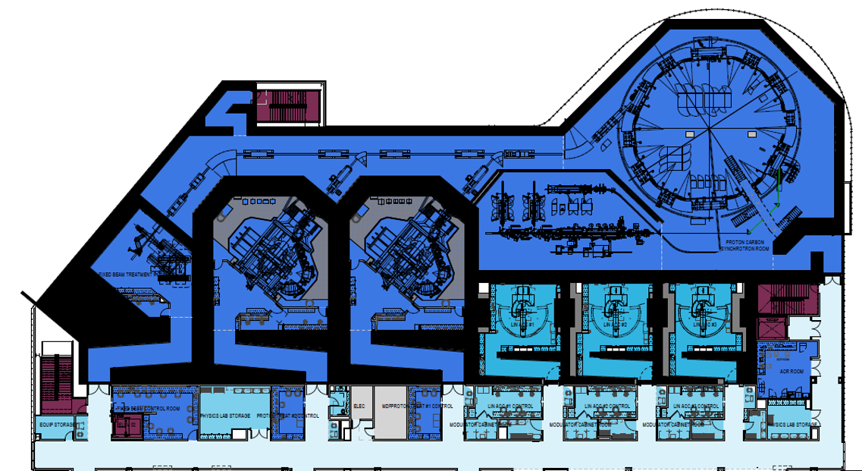
Integrated Oncology Building

Slide 7
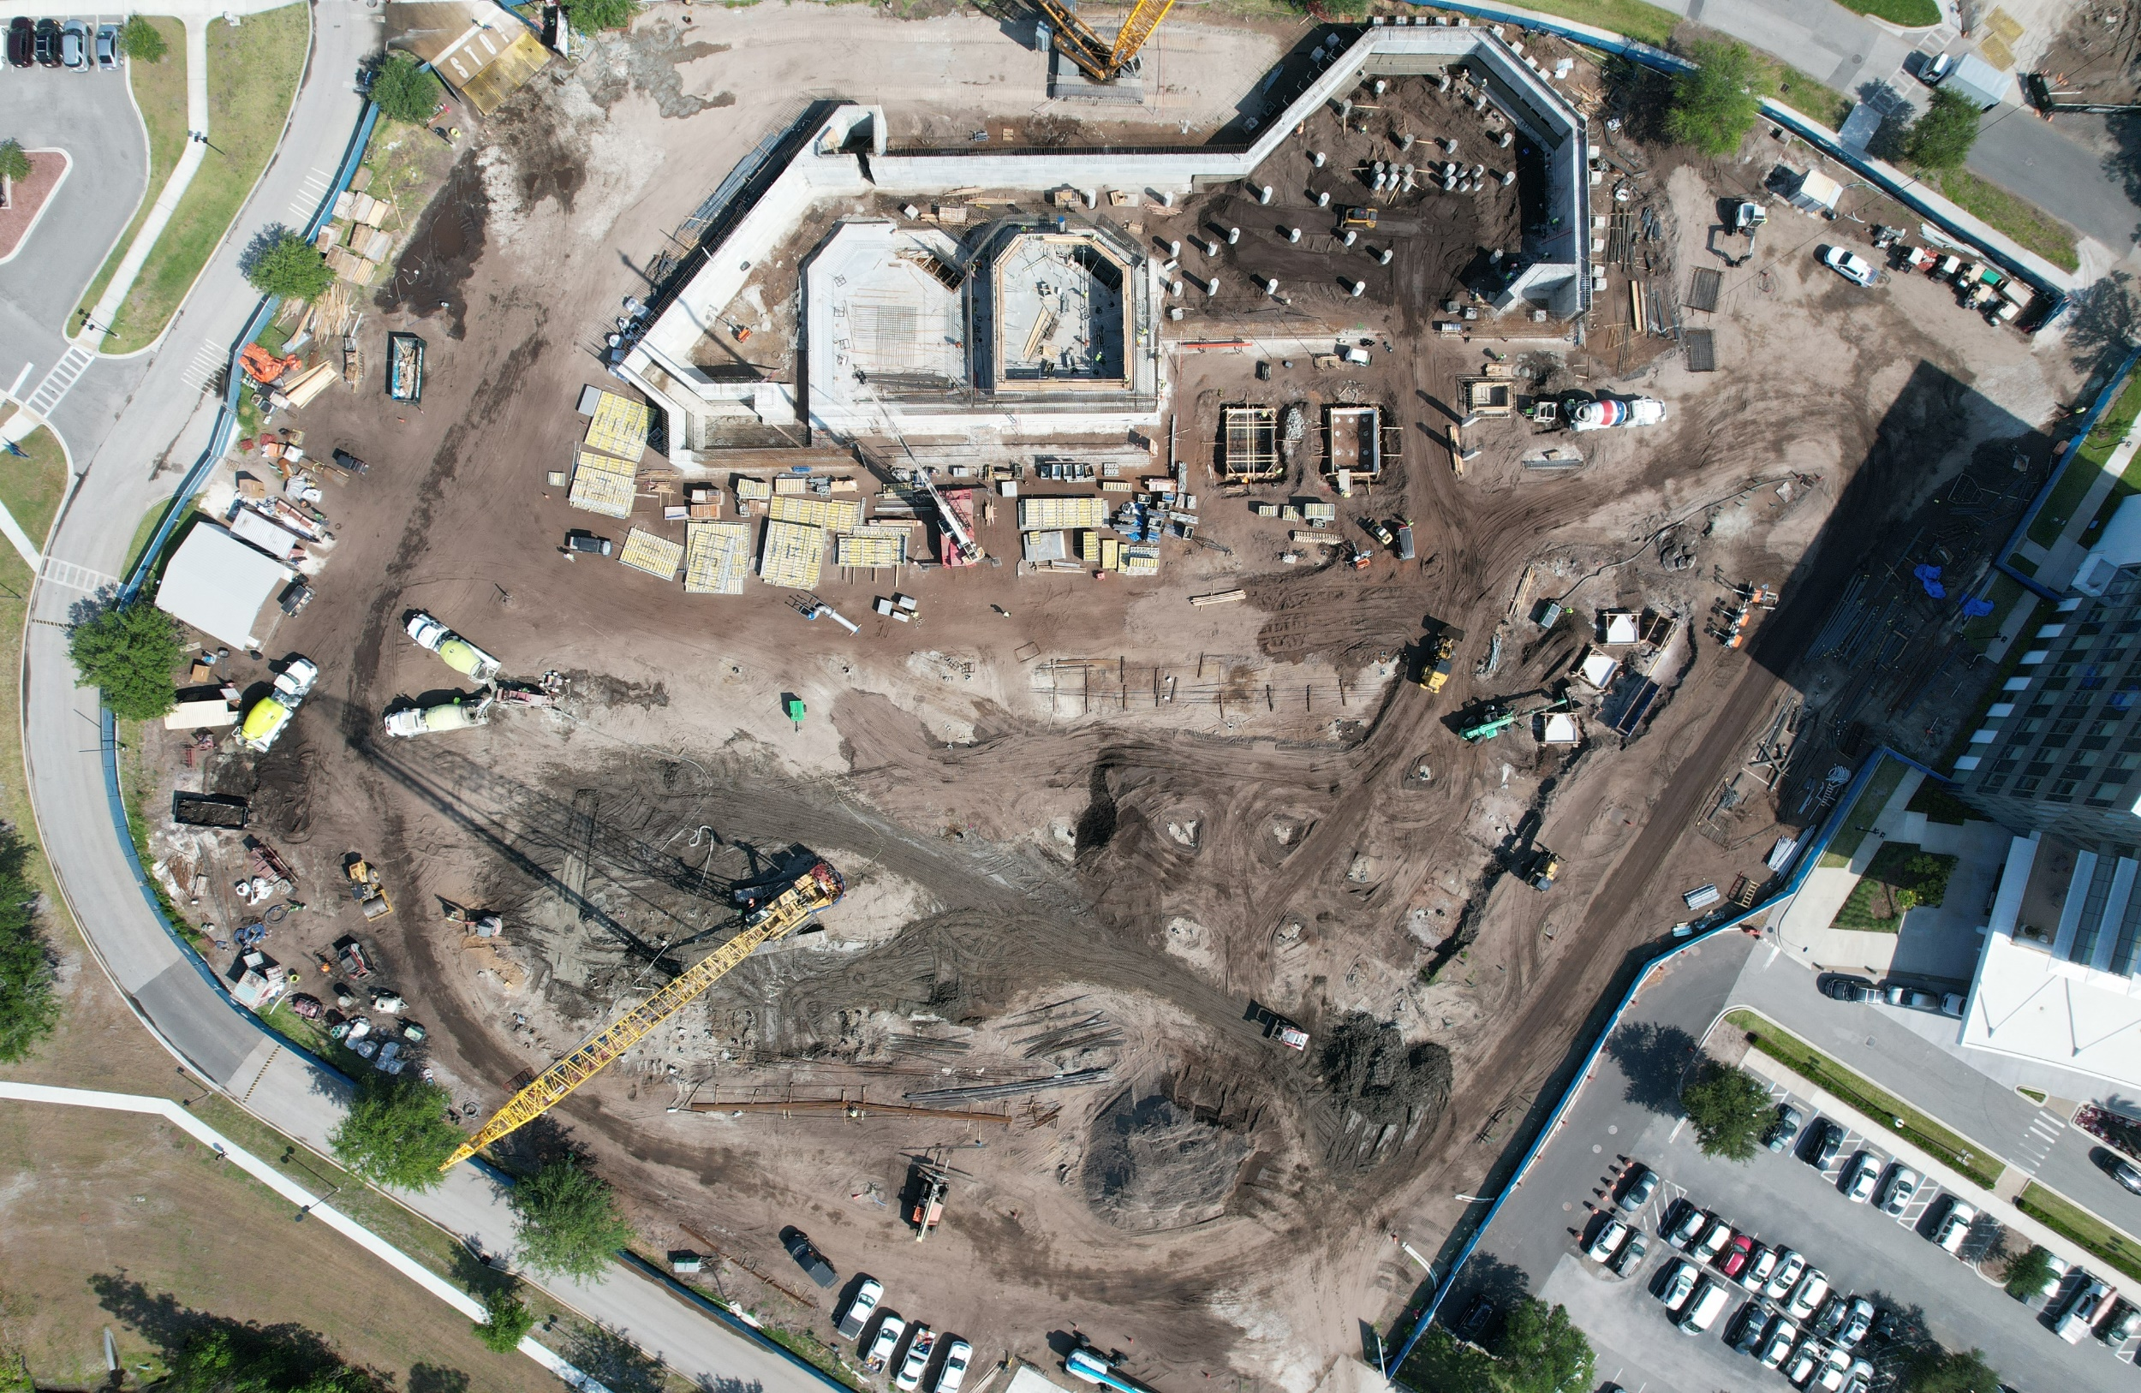

Slide 9
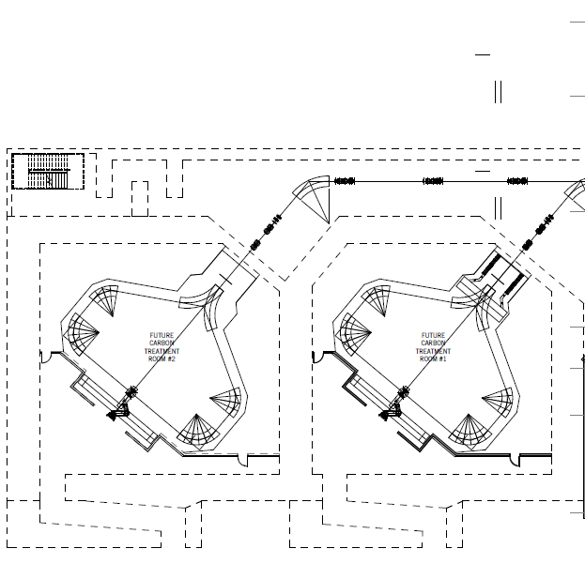
Future CIRT Gantries?

Slide 10
Why a Clinical Trial on CIRT prior to 2027?
Collaboration with international carbon ion centers
Obtain experience with carbon ion therapy
Develop evidence to help with FDA approval & reimbursement
Develop infrastructure to conduct additional trans-continental CIRT trials

Slide 11
Clinical Trial 1.0- Pre-COVID
Phase I trial (5-10 patients)
  Evaluate ability of sending patients abroad (Europe/Asia) to successfully receive CIRT for radioresistant cancers
    Locally recurrent rectal cancer
    Non-squamous cell Head & Neck
    Pelvic bone sarcomas
Phase II trial (45 patients)
  If Phase I is successful and funding secured, convert into 3 single arm Phase II studies (15 patients each)

Slide 12
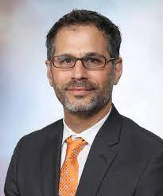
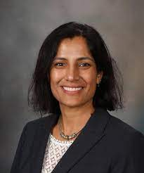
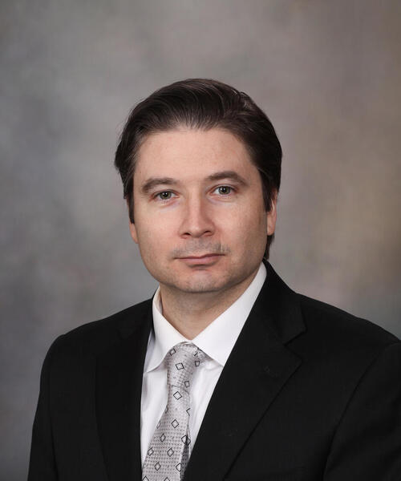
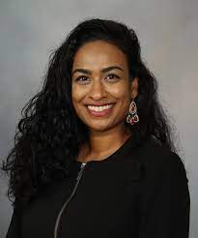
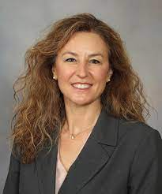
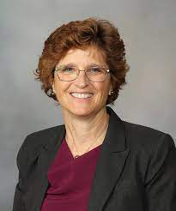
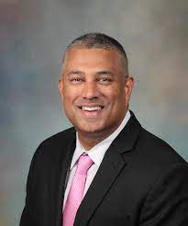
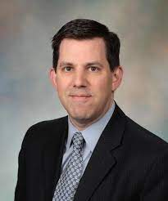
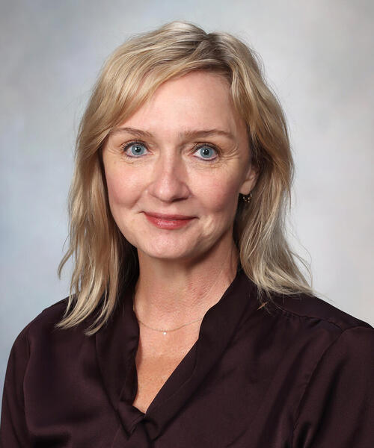
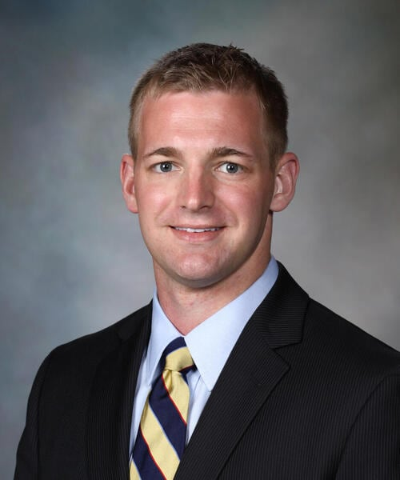
Clinical Trial 2.0- COVID era

Slide 13
Clinical trial 2.0- What disease site?
Address a cancer site, where there is little doubt that CIRT is critical

Slide 14
CIRT in pelvic bone sarcomas
Systematic review found 18 publications– 60-70 GyE in 16 fxns
  5 Prospective studies (191 patients)
  13 Retrospective studies (almost 500 patients)
Author, Year, and Center | Histology | Study Design | No. of Pts. | Median Total Dose and/or Dose Range, GyE | Total Fxs | Median Follow-up, months (range) | Local Control Rate | Overall Survival Rate | Grade 3+ Toxicity or Other QOL Outcome
Matsunobu A 2012 NIRS²¹ | mixed | prospective phase 1/2 | 78 | 52.8 - 73.6 | 16 | 24 (2 - 166) | 2 and 5 yrs, 73% and 62% | 2 and 5 yrs, 58% and 33% | Acute: gr 3 skin reactions, 3 pts (4%) Late: gr 3 skin/soft tissue reaction, 4 pts (5%); gr 4 skin/soft tissue reaction, 3 pts (4%) Other: 4 pts with radiation-induced neurologic complications; bone fractions, 2 pts
Kamada T 2002 NIRS¹⁸ | mixed | prospective phase 1/2 | 57 | 52.8 - 73.6 | 16 | 21 (2 - 60) | 1 and 3 yrs, 88% and 73% | 1 and 3 yrs, 82% and 46% | Acute: gr 3 skin/soft tissue, 8 pts (14%) Late: gr 3 skin/soft tissue, 6 pts (11%)
Imai R 2011 NIRS²⁰ | chordoma | prospective phase 1/2 | 95 | 52.8 - 73.6 | 16 | 42 (13 - 112) | 5 yrs, 88% | 5 yrs, 86% | Acute: gr 3 acute skin reactions, 3 pts; Late: gr 3 late skin reactions, 2 pts; gr 4 late skin and soft tissue complications requiring skin grafts, 2 pts. Other: Continuing medication for sciatic nerve neuropathy, 15 pts (incl. 3 post-op pts)
Imai R 2010 NIRS¹⁹ | chordoma | prospective phase 1/2 | 38 | 70.4 (52.8 -73.6) | 16 | 80 | 3 and 5 yrs, 95% and 89% | 3 and 5 yrs, 95% and 86% | Acute: gr 3 acute skin reactions, 3 pts Late: gr 3 skin reactions, 2 pts; gr 4 reactions that required skin grafts, 2 pts; temporary or permanent neurologic complications, 10 pts
Evangelisti G 2019 CNAO²² | chordoma | prospective phase 1/2 | 18 | 70.4 | 16 | 23.3 (6 - 47) | PR, 10 pts (56.3%); SD, 5 (28.3%); LR, 2 (11%); DP, 1 | 2 yrs, 100% | Late: neuropathy, 8/18 pts (44%)

Slide 15
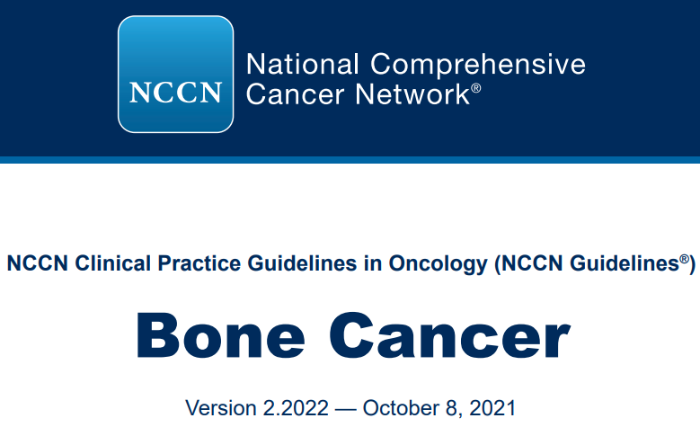
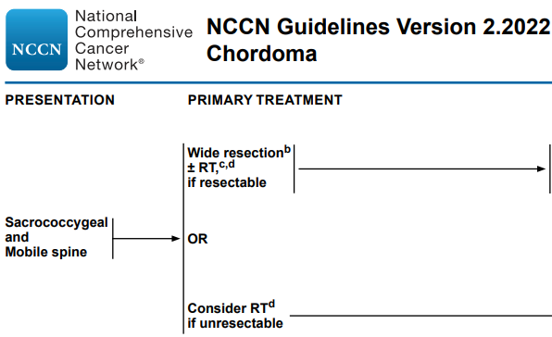
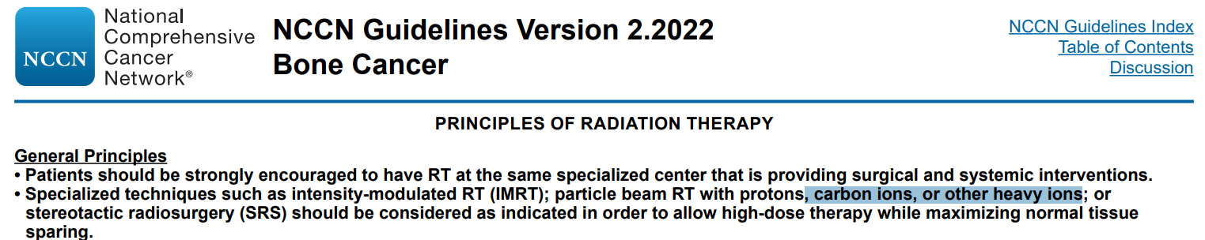
CIRT in Bone Sarcomas

Slide 16
What Clinical Trial Design?
Trial design that allows Mayo to contribute pts
  Comparative effectiveness study
    CIRT vs XRT/PT
    CIRT vs surgery

Slide 17
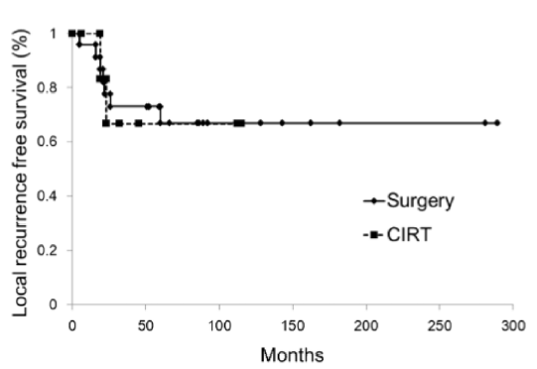
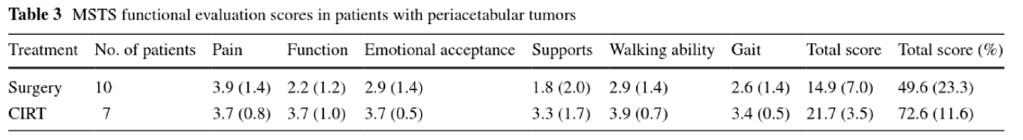
CIRT > surgery in pelvic chondrosarcoma
Outani et al IJCO 2016

Slide 18
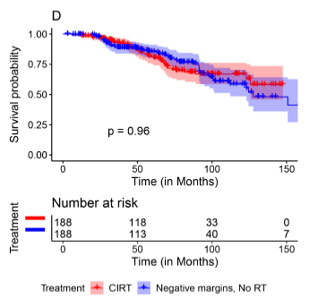
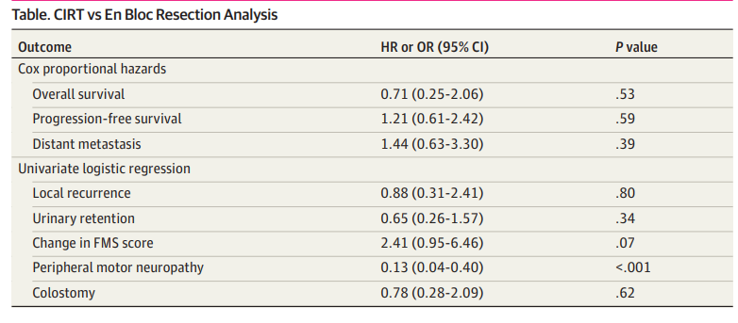
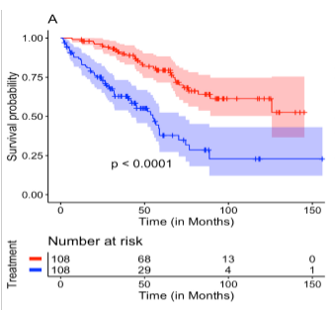
CIRT > Surgery or XRT in Sacral Chordoma
MCR surgery
N=54
CIRT-QST
N=188
NCDB
N=669
CIRT
Surgery
CIRT
XRT
Yolcu et al JAMA Network 2022

Slide 19
Carbon Trial in Bone Sarcoma
Primary Endpoints
  Quality of life & toxicity of CIRT compared with Surgery
  Local Control of CIRT compared with proton/photon RT

Slide 20
How to ensure patients and centers will enroll?
Pragmatic trial
  Prospective cohort design, non-randomized (eg COMPPARE)
  Few ineligibility criteria
  Allow institutional variations in RT guidelines
Minimal Risk study- everything is standard of care

Slide 21
Background- Carbon Trial
Proposed concept to possible partners
  QST Hospital
  MedAustron
  CNAO
  SPHIC
  University of Heidelberg
Additional development with the partners

Slide 22
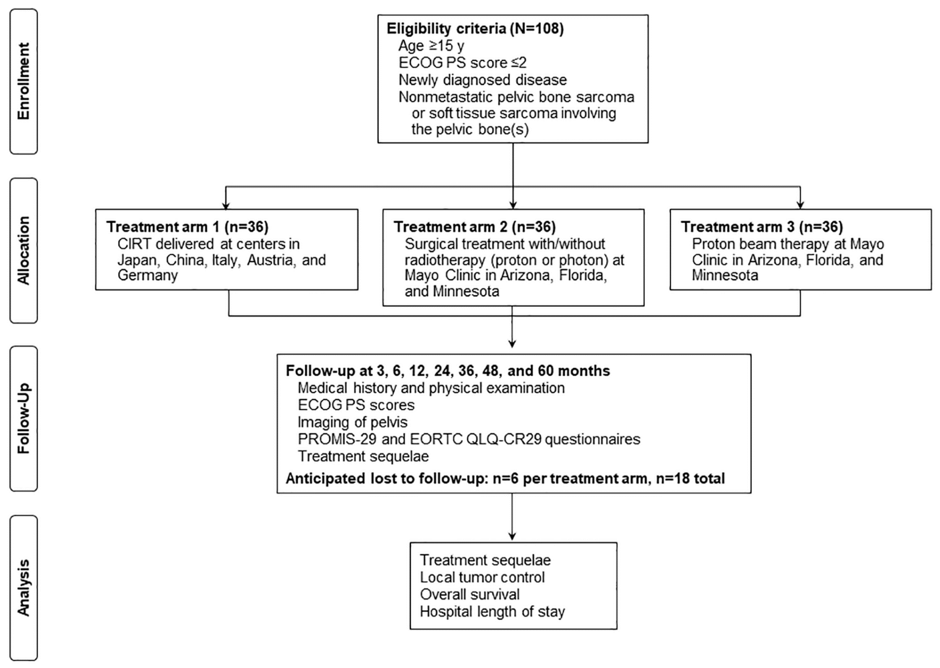

Slide 23
Inclusion criteria
Males and females ≥ 15 years of age
Newly diagnosed, histologic confirmation of pelvic chordoma, chondrosarcoma, osteosarcoma, Ewing sarcoma with bone involvement, rhabdomyosarcoma (RMS) with bone involvement or non-RMS soft tissue sarcoma with bone involvement
No evidence of distant sarcoma metastases
Eastern Cooperative Oncology Group (ECOG) Performance Status (PS) ≤ 2
Patients capable of childbearing must agree to use adequate contraception.
Ability to complete questionnaire(s) by themselves or with assistance.
Ability to provide written informed consent.
Chemotherapy per institutional guidelines is allowed
Notes:
definition for bulky Ewing’s/Rhabdo sarcomas

Slide 24
Exclusion criteria
Patients receiving palliative treatment
Recurrent disease
Males and females < 15 years of age
Prior RT to the site of sarcoma
Patients with distant sarcoma metastases
Benign pelvic bone histologies

Slide 25
Statistics
Primary End Point: Compare the difference in change of functional QOL from pre-treatment (baseline) to 1-year post-treatment between CIRT (Arm 1) and Surgery (Arm 2) (one-sided test for a two-sample t-test for independent means).
  PROMIS 29 – physical functioning domain (4 questions)
    Are you able to do chores such as vacuuming or yard work (1-5)
    Are you able to go up and down stairs at a normal pace (1-5)
    Are you able to go for a walk of at least 15 minutes? (1-5)
    Are you able to run errands and shop? (1-5)
Expect an average decline of functional QOL from CIRT of 2 points while surgery will decline 4.6 points (higher than defined minimal clinically important difference [MCID]) with equal standard deviation of 4 points.
80% power (α = 0.05) to detect significantly improved functional QOL from CIRT over surgery with 30 patients per treatment arm.
No difficulty
Little difficulty
Some difficulty
Much difficulty
Unable to do

Slide 26
Statistics
Secondary End Point: Evaluating local control between carbon ion therapy and proton therapy at 3 years.
  Analyses of local control will be:
    stratified by histology
    subset analyses (sacral chordomas vs. non-sacral chordoma histologies)
  The proportion of patients experiencing local control at 3 years will be calculated along with 95% confidence intervals with a one-sided test for non-inferiority to be conducted between the PT and CIRT arms.
Exploratory End Point:
  Local control- CIRT vs surgery
  CTCAE Toxicities
  PROMIS QOL
  EORTC- CRC Q29

Slide 27
Radiation Treatment -- Pragmatic
Target Volumes
  Per treating institution standards
Dose-fractionation
  Per treating institution standards
RBE model for CIRT (LEM, MKM, other?)
  Per treating institution standards
Plan to collect DICOM files of the RT plans centrally after completion of treatment and will review retrospectively

Slide 28
Trial Infrastructure
Funding from MCF & MCE Cancer Center
MC research is overseeing patients treated at MCF, MCA, MCR
Contracted with a Clinical Research Organization (CRO)- ICON
  Provide administrative support for opening the trials at centers in Europe & Asia
Paying case-based rate to the institutions for enrolling patients
Redcap database

Slide 29
Prosper Timeline
January 20, 2022- MCF opened trial
February 14, 2022- MCA opened trial
June 1, 2022- MCR opened trial
May 2023- First patient enrolled (MCF- surgery)
September 2023- Open at European and Japan sites
Finish accrual 2026 to all 3 arms

Slide 30
Challenges
Rare tumor trials can be difficult to accrue
International trials are challenging administratively
Value of a CRO for research assistance?
CIRT RBE model (LEM vs MKM)
Surgical patients likely have smaller, less invasive tumors

Slide 31
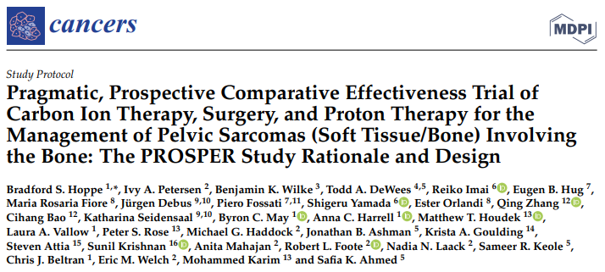
Successes

Slide 32
Thanks!
QST Hospital
Reiko Imai
Shigeru Yamada
MedAustron
Eugen Hug
Piero Fossati
CNAO
Maria Rosaria Fiore
Ester Orlandi
SPHIC
Qing Zhang
Cihang Bao
University of Heidelberg
Juergen Debus
Katharina Seidensaal
MCR
Ivy Peterson
Matt Houdek
Pete Rose
Michael Haddock
Robert Foote
Eric Welch
Mohammad Karim
Anita Mahajan
Nadia Laack
MCA
Jon Ashman
Krista Goulding
Safia Ahmed
MCF
Ben Wilke
Byron May
Mike Rutenberg
Anna Harrell
Laura Vallow
Steven Attia
Chris Beltran

