Slide 1


Spatial Fractionation: Partial Tumor Irradiation

Slide 2

Disclosures
I have no relevant financial relationships with ineligible companies to disclose.
E-Mail: slavisa.tubin@medaustron.at

Slide 3
„PATHY“ Approach
PATHY: PArtial Tumor irradiation targeting HYpoxic segment
Novel, unconventional, immunomodulatory approach
Designed for exploitation of the non-targeted effects of RT:
bystander and abscopal.
SBRT-PATHY²⁰¹⁵ / Particle-PATHY / CARBO-PATHY²⁰²⁰
E-Mail: slavisa.tubin@medaustron.at

Slide 4
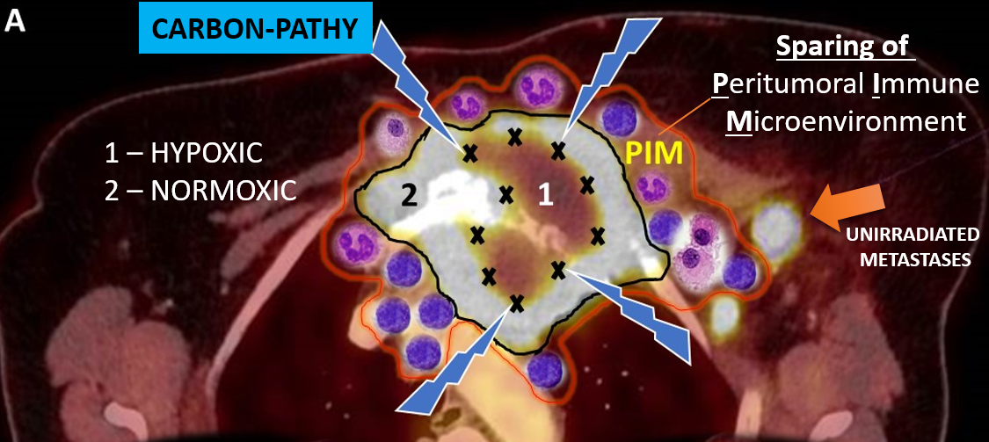
PARTIAL TUMOR IRRADIATION USING CARBON IONS
CARBO-PATHY = CARBON ion-based PArtial Tumor irradiation targeting HYpoxic segment
IMMUNOGENEICITY = CARBON ions + highly heterogeneous dose + HYPOXIC target + IMMUNE-SPARING.
E-Mail: slavisa.tubin@medaustron.at

Slide 5
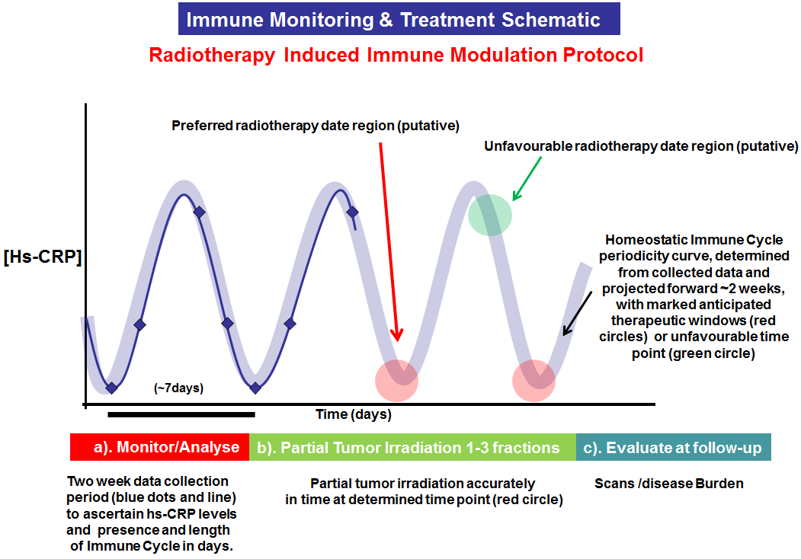
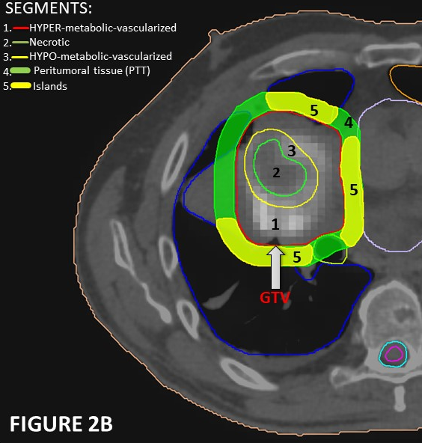
-PATHY:
PArtial Tumor irradiation targeting HYpoxic tumor segment
3 key-components of -PATHY:
1.) PARTIAL TUMOR IRRADIATION TARGETING HYPOXIC SEGMENT
2.) SPARING OF PERITUMORAL IMMUNE MICROENVIRONMENT (NEW OAR)
3.) TIME-SYNCHRONIZED IMMUNE-GUIDED TUMOR IRRADIATION
E-Mail: slavisa.tubin@medaustron.at

Slide 6

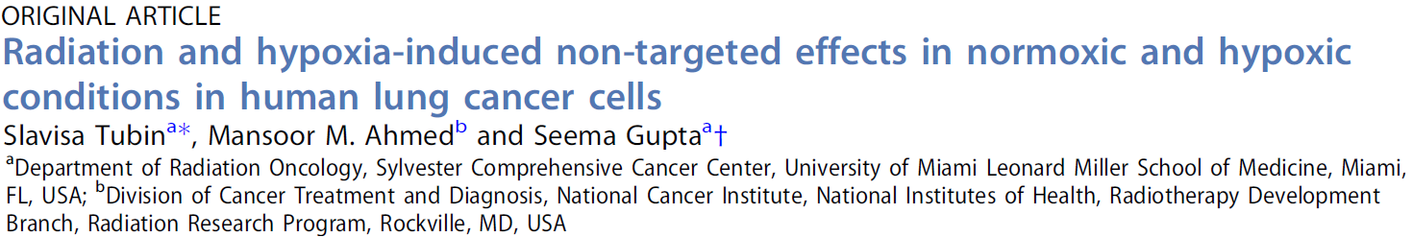
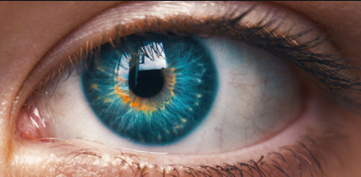
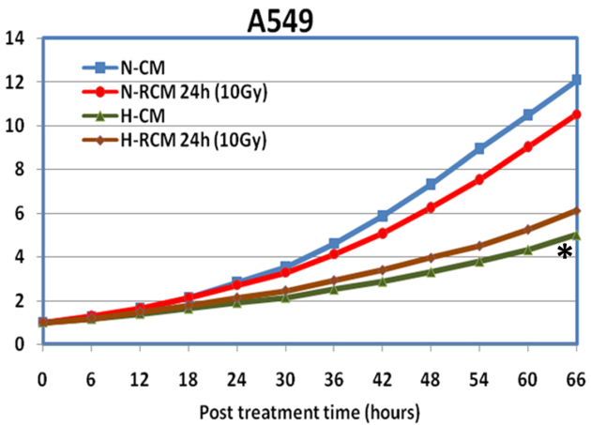
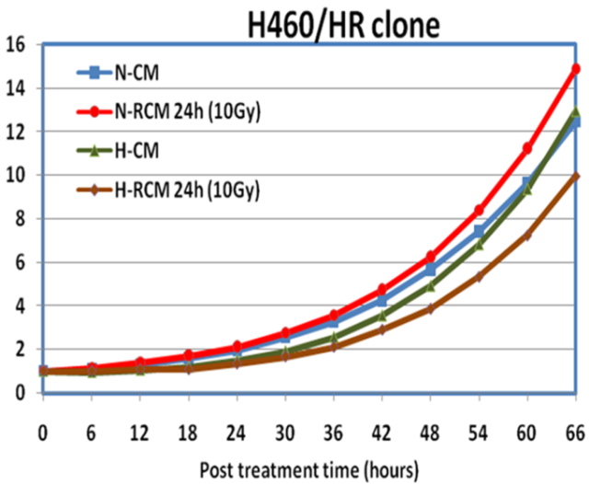
TARGET-VOLUME: HYPOXIC TUMOR SEGMENT
Tumor hypoxia is a potent immunosuppressor (abolished IFN-1β response, enhances expression of immunosuppressive proteins),
Hypoxic tumor cells stronger abscopal inductor.
2010-2011
Translational Oncology Research
NORMOXIC
HYPOXIC
ANOXIC
PRECLINICAL RESULTS ON BYSTANDER/ABSCOPAL EFFECT-INDUCTION:
10Gy SINGLE DOSE irradiation of the HYPOXIC (vs. normoxic) tumor = stronger bystander effect!
TUMOR GROWTH after induction of abscopal effect with 10Gy x 1 to the hypoxic tumor
E-Mail: slavisa.tubin@medaustron.at

Slide 7
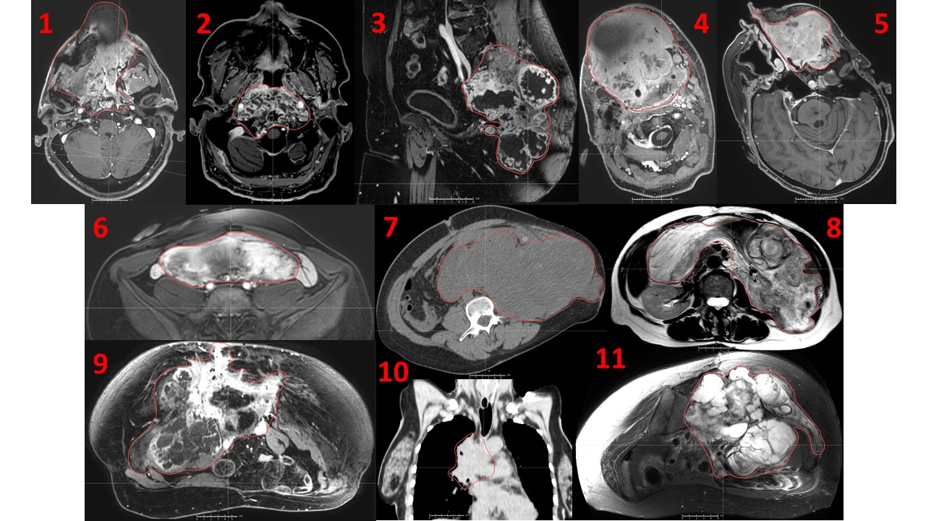
INDICATIONS
unresectable, recurrent bulky tumors unsuitable for conventional RT-CHT/RE-IRRADIATION

Slide 8
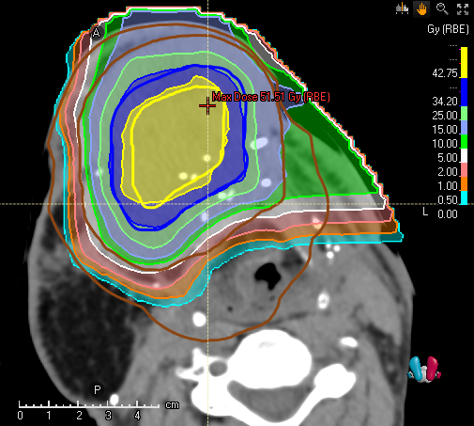
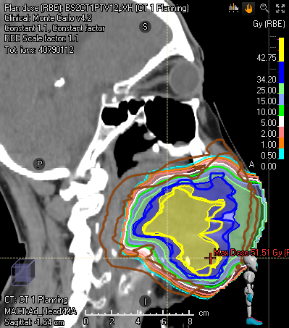
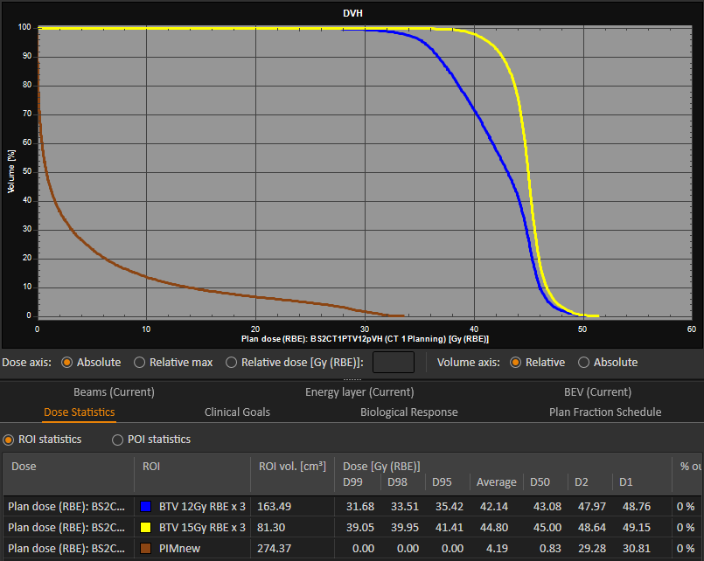
DOSE: HIGH, HETEROGENEOUS, GRADIENTs
Prescription of heterogeneous dose(-gradients):
INITIAL: 10-12Gy x 1 to 60-70% (2015)
ESCALATED: 15Gy x 3 to 60-70% (2020)
BTV 15Gy x 3
TME
SPARE APC
RE-PROGRAM TAMs
MATURE DCs
BTV 12Gy x 3
0-1 Gy
PIM D30%=0Gy
GTV
1-3 Gy
NORMALIZE
VASCULARISATION
PRODUCE NEOANTIGENs
BTV
15 Gy
17Gy
18 Gy
NEUTRALIZE HYPOXIA
15 Gy
19 Gy
15Gy
15Gy
15 x 1 to 70%
E-Mail: slavisa.tubin@medaustron.at

Slide 9

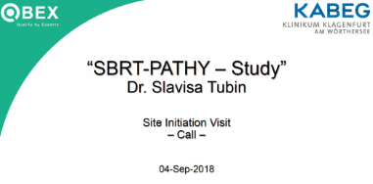
TIMING
TIME-SYNCHRONIZED IMMUNE-GUIDED SBRT-PATHY
CRP, LDH, IL-2, IFNg and Lymphocyte/Monocyte analyzed for levels and cyclical fluctuations to determine each patient’s idiosyncratic immune cycle’s periodicity and then each patient’s time-position of initiation of treatment and response to therapy.
E-Mail: slavisa.tubin@medaustron.at

Slide 10
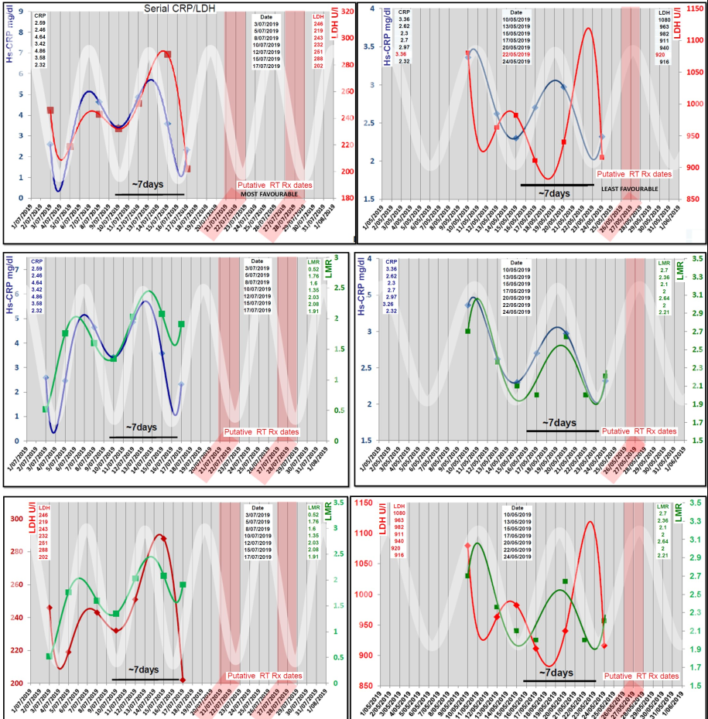

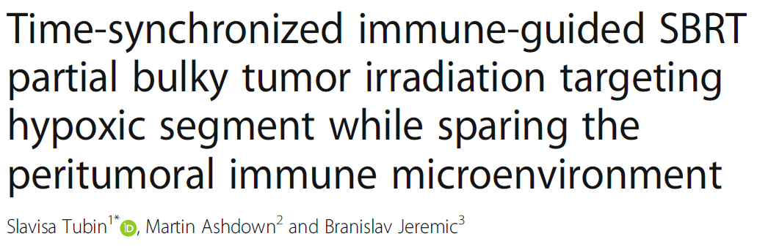
Median follow-up: 12 months (4–22).
Optimally synchronized SBRT-PATHY with the favourable immune cycle period was associated with improved clinical outcomes (three complete responses plus significant abscopal effects in 3 patients).
E-Mail: slavisa.tubin@medaustron.at

Slide 11

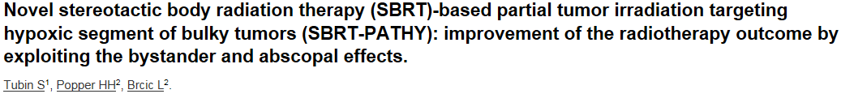


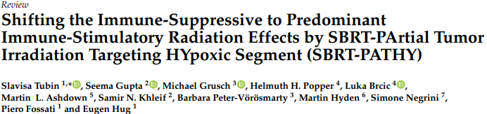

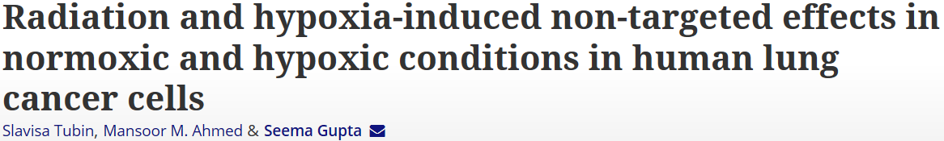

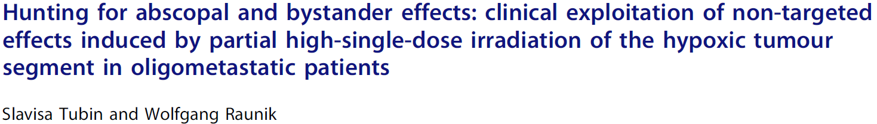
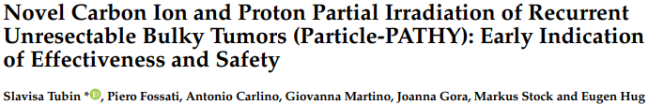
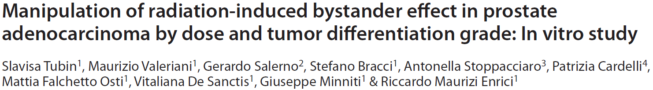

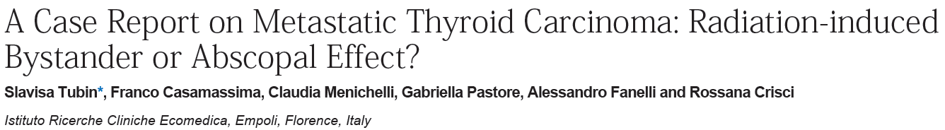
PUBLISHED DATA
Time-synchronized immune-guided SBRT partial bulky tumor irradiation targeting hypoxic segment while sparing the peritumoral immune microenvironment.
2019
Tubin S, Ashdown M, Jeremic B.
120 patients
2019
Tubin S, Khan M.M, Salerno G, Mourad W.F, Weisi Y, Jeremic B.
Tubin S, Khan M.M, Salerno G, Mourad W.F, Weisi Y, Jeremic B.
2019
8
8
8
CLINICAL
CLINICAL
2018
PRECLINICAL
PRECLINICAL
2017
2
2
2015
2012
E-Mail: slavisa.tubin@medaustron.at

Slide 12
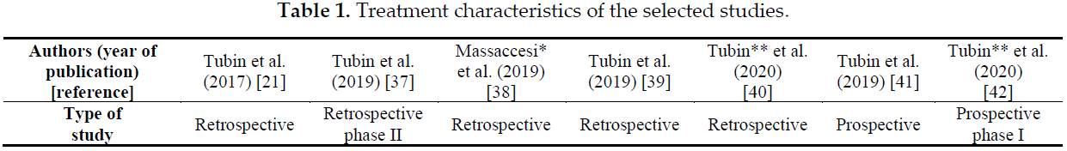
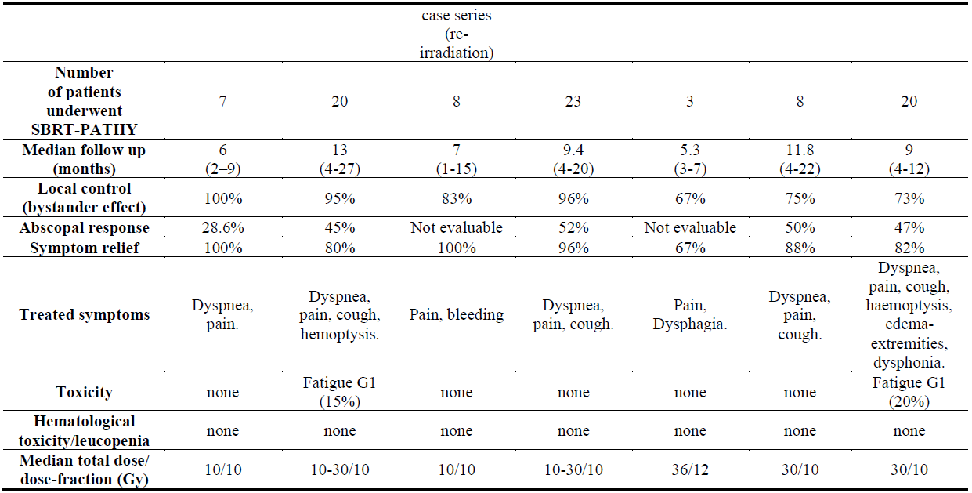
PATIENTS TREATED WITH -PATHY APPROACH
E-Mail: slavisa.tubin@medaustron.at

Slide 13
RADIOBIOLOGICAL EFFECTS OF PATHY
E-Mail: slavisa.tubin@medaustron.at

Slide 14
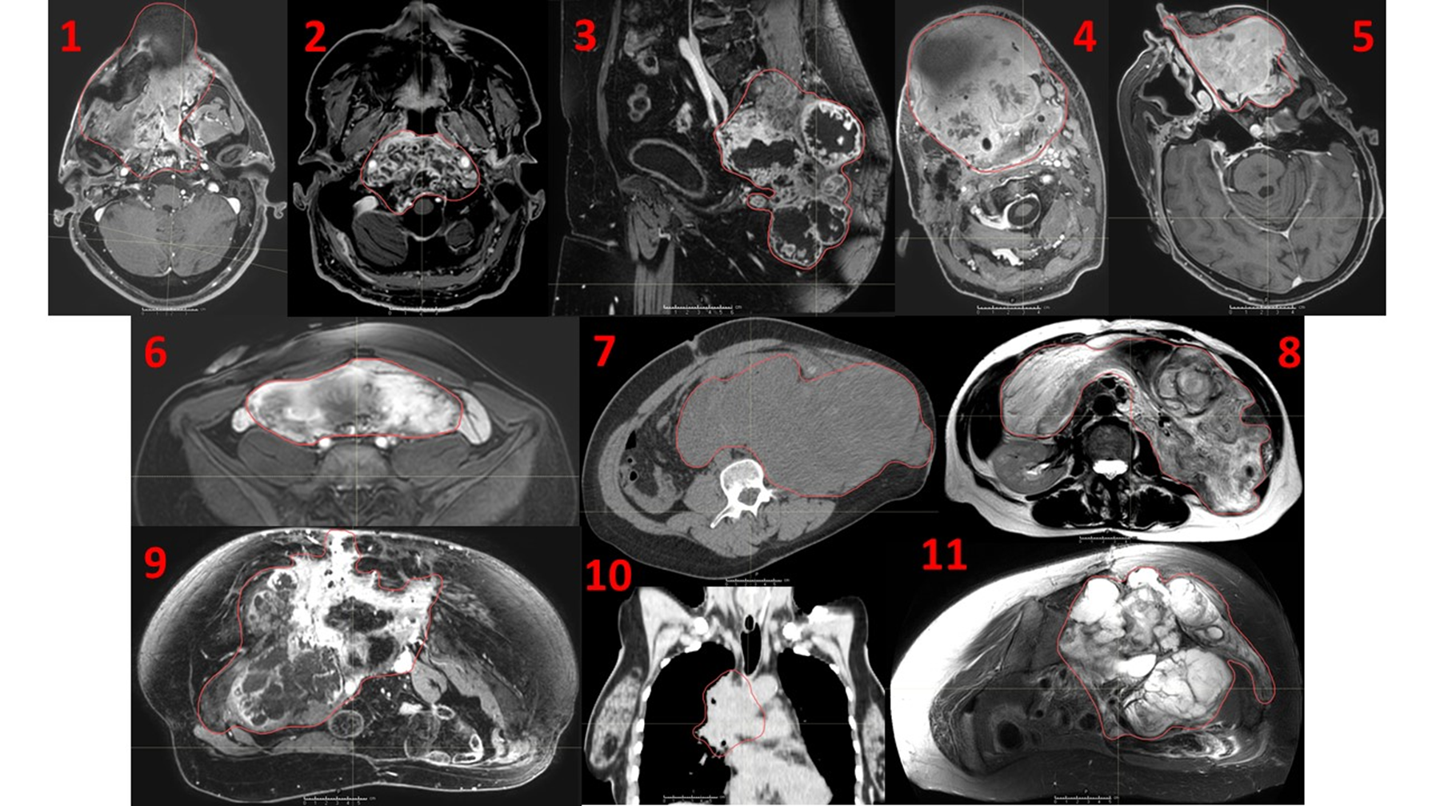
Large spectrum of malignancies: lung, H&N, kidney, liver, pancreas, rectum, brain, prostate, adrenal etc.
E-Mail: slavisa.tubin@medaustron.at

Slide 15
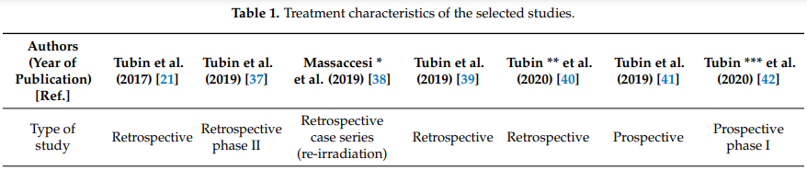
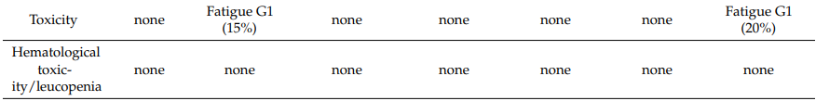
PATHY: safety
- The only side effects observed were flu-like symptoms -
E-Mail: slavisa.tubin@medaustron.at

Slide 16
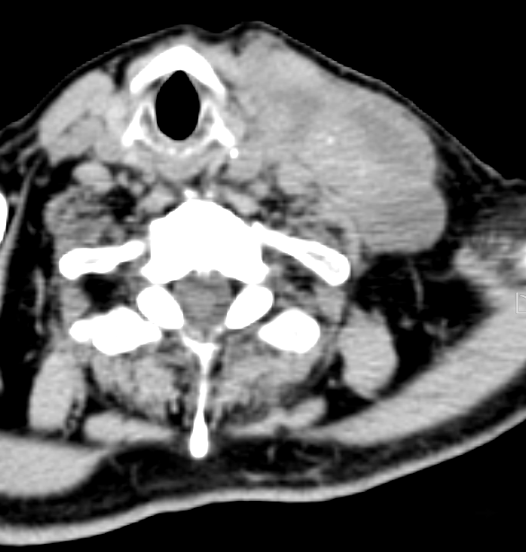
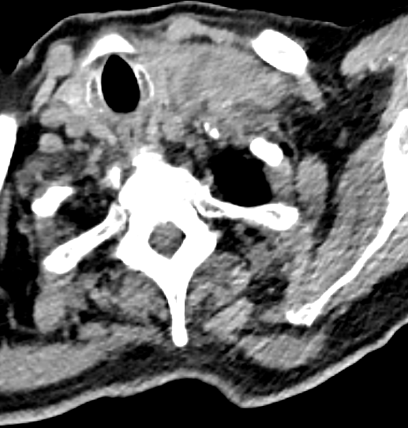
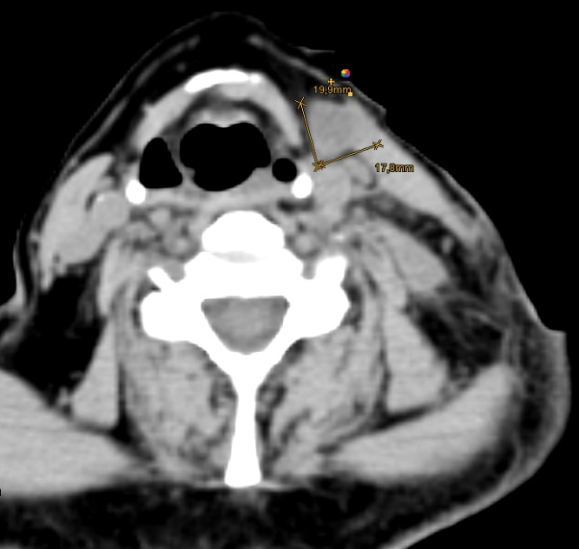
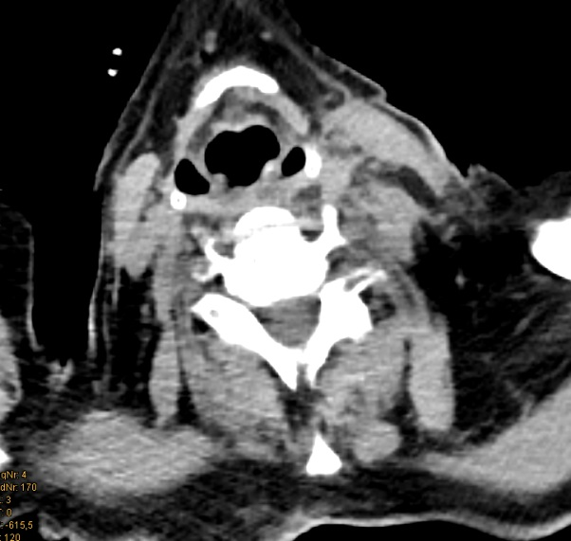
SINGLE FRACTION
BYSTANDER EFFECT
METASTATIC MELANOMA
PATHY: immunogenic effects
Progressive under immunotherapy
BEFORE SBRT-PATHY
4 WEEKS AFTER SBRT-PATHY
DOSE: 10Gy x 1 to 70%
Disease free till death (2 years)
?
ABSCOPAL EFFECT
UNIRRADIATED LYMPH NODE METASTASIS BEFORE SBRT-PATHY
UNIRRADIATED LYMPH NODE METASTASIS 4 WEEKS AFTER SBRT-PATHY
E-Mail: slavisa.tubin@medaustron.at

Slide 17
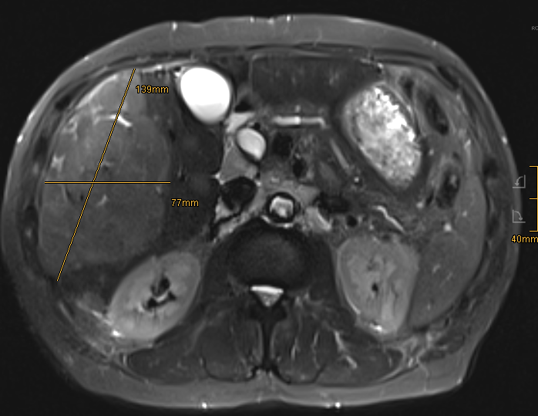
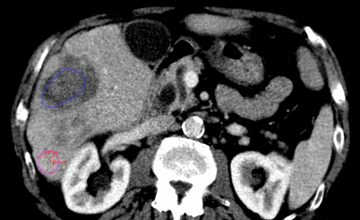
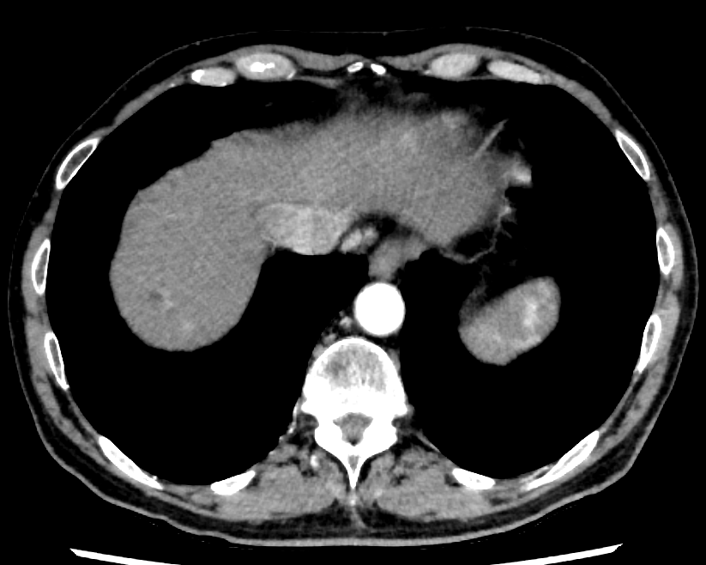
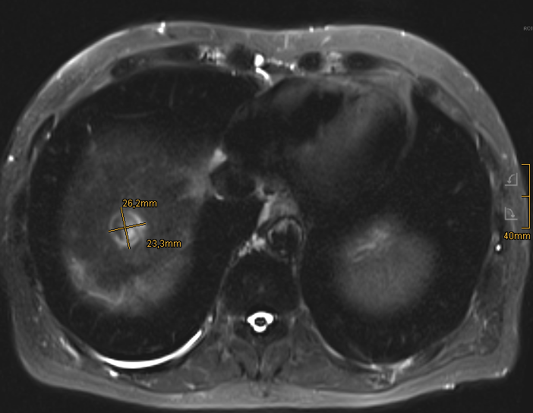
THREE FRACTION
BEFORE PATHY
1 MONTH AFTER PATHY
BYSTANDER EFFECT
HCC
PATHY: immunogenic effects
70% volume regression
Progressive under immunotherapy
DOSE: 10Gy x 3
ABSCOPAL
EFFECT
E-Mail: slavisa.tubin@medaustron.at

Slide 18
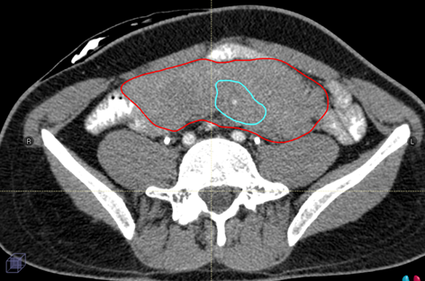
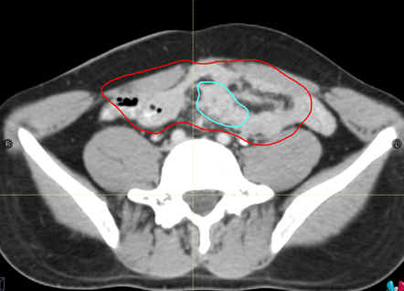
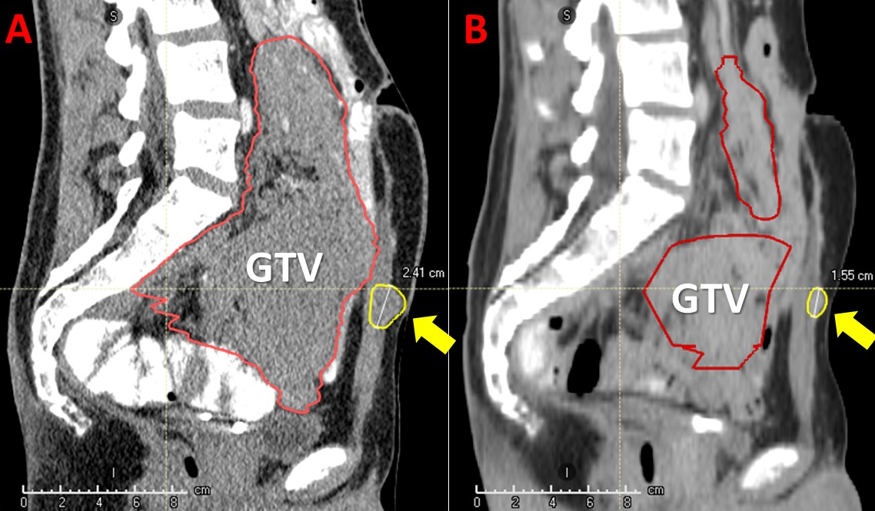
BEFORE
90% volume regression
AFTER
HOT
BYSTANDER EFFECT
DESMOID
Progressive under IMMUNO Tx
DOSE: 10Gy x 3
ABSCOPAL EFFECT
E-Mail: slavisa.tubin@medaustron.at

Slide 19
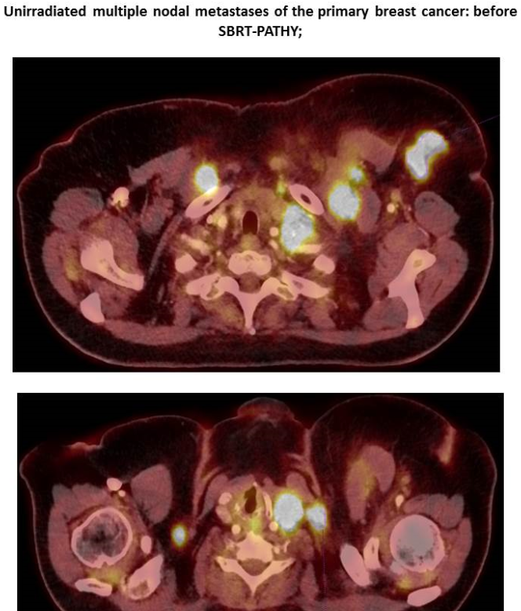
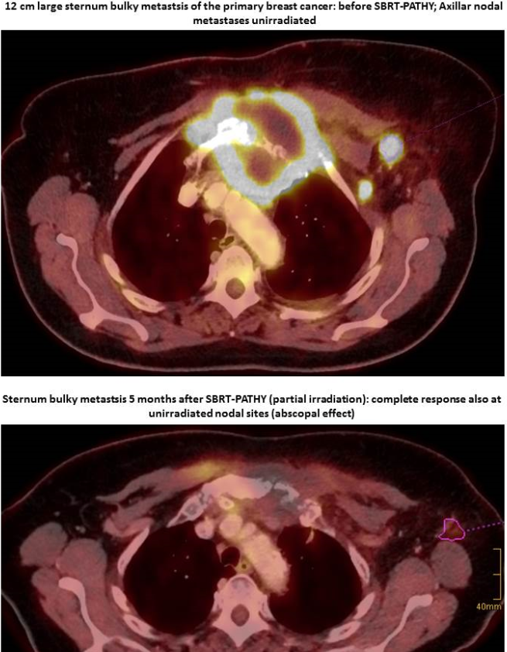
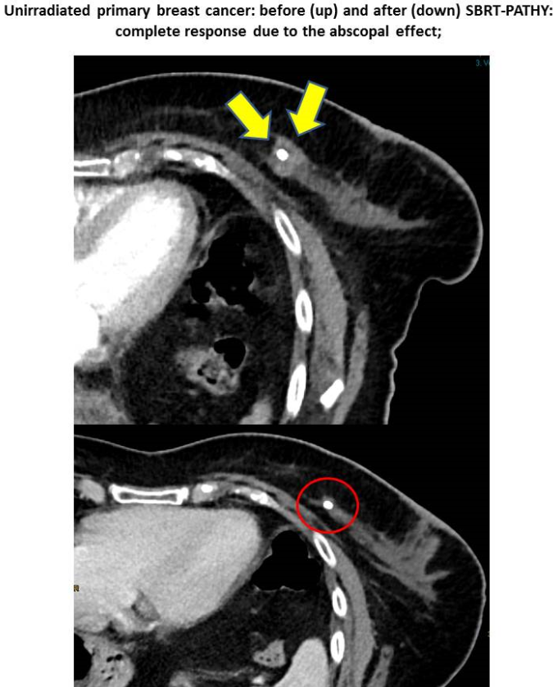
NED / clinical complete response
COLD
002
BREAST (cM1)
BREAST (cM1)
Progressive under CHT
DOSE: 10Gy x 3
BYSTANDER
ABSCOPAL
ABSCOPAL
E-Mail: slavisa.tubin@medaustron.at

Slide 20
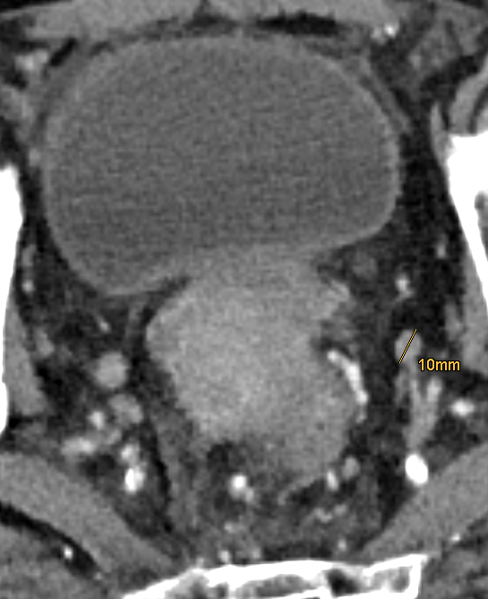
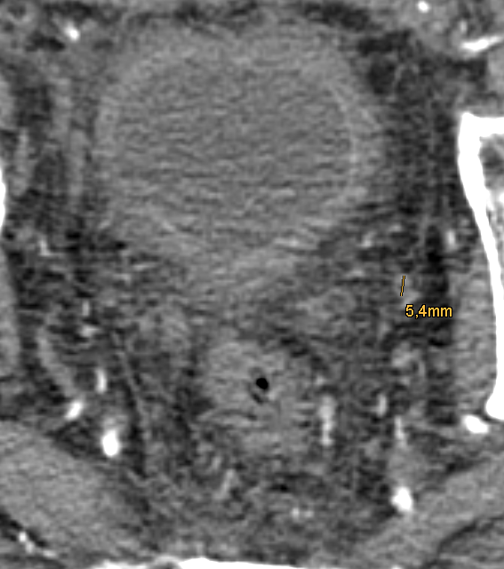
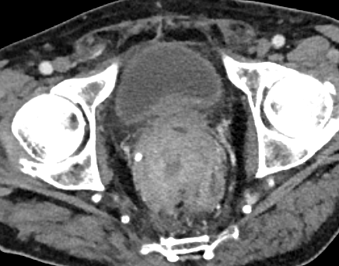
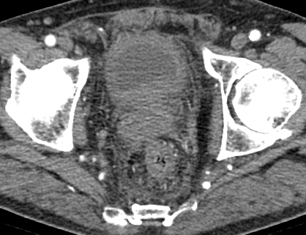
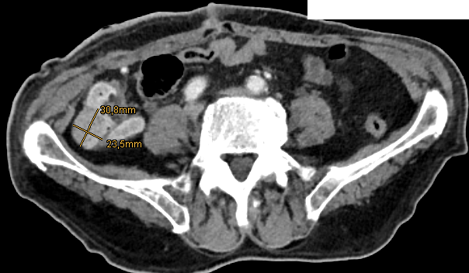
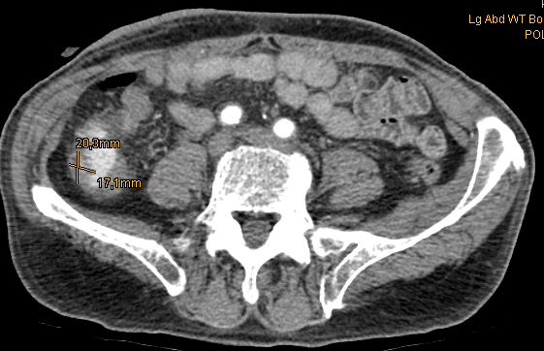
SYNCHRONOUS ABSCOPAL
BEFORE PATHY
2 MONTH AFTER PATHY
RECTUM
DOSE: 10Gy x 3
Synchronous colon cancer
70% volume regression
E-Mail: slavisa.tubin@medaustron.at

Slide 21
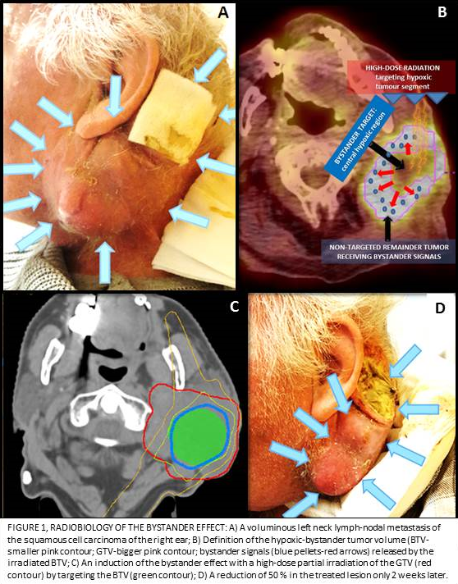
RESPONSE DYNAMIC:
AFTER 2 WEEKS!!
LYMPH NODE METASTASIS OF
THE SQUAMOUS CELL H&N
DOSE: 10Gy x 1 to 70%
GTV
50% volume regression
BTV
E-Mail: slavisa.tubin@medaustron.at

Slide 22
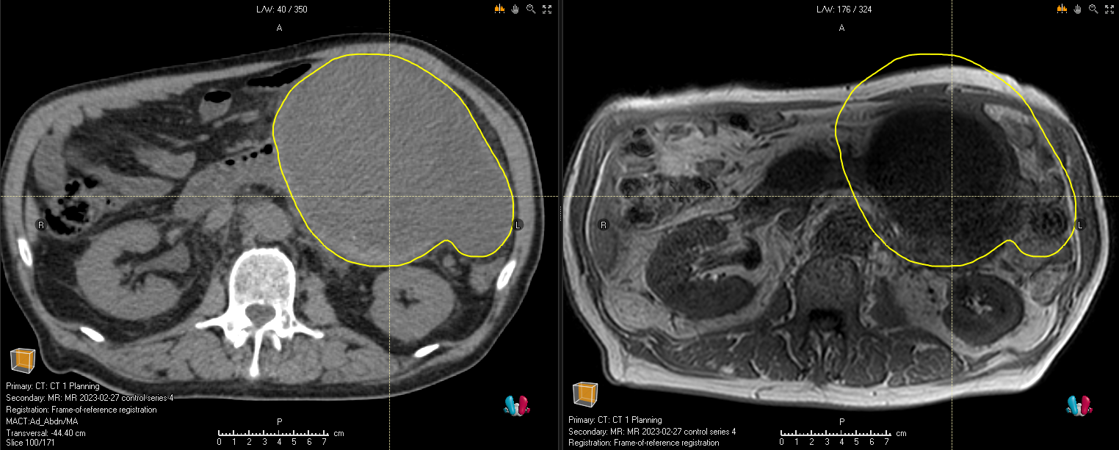
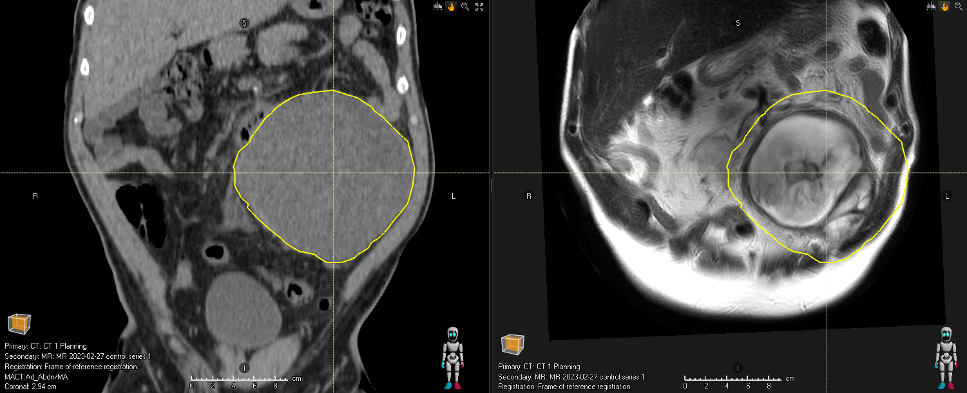
DEDIFFERENTIATED LIPOSARCOMA
Before CARBO-PATHY
5 months after partial tumor irradiation
AFTER
5 MONTHS
50% volume regression
E-Mail: slavisa.tubin@medaustron.at

Slide 23
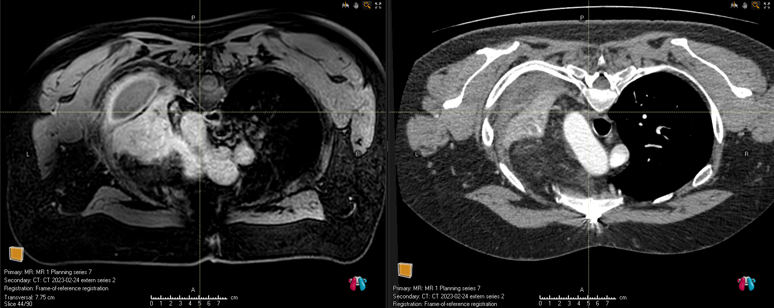

ADENOID-CYSTIC CARCINOMA OF LUNG
RADIO-RESISTANT TUMORS
Before CARBO-PATHY
1 month after partial tumor irradiation
DOSE: 15Gy x 3
80% volume regression
E-Mail: slavisa.tubin@medaustron.at

Slide 24

FOLLOW UP
3 months
RADIO-RESISTANT TUMORS
TUMOR VOLUME
358cc
RESIDUAL VOLUME
141cc
G2 LIPOSARCOMA
DOSE: 15Gy x 3
60% volume regression
E-Mail: slavisa.tubin@medaustron.at

Slide 25


COMPLETE RESPONSE
Before SBRT-PATHY
PRIMARY ADC OF THE LUNG
7 months after partial tumor irradiation
10Gy x 1 to the 70%
E-Mail: slavisa.tubin@medaustron.at

Slide 26




LONG- and SHORT-lasting RESPONSES
SECONDARY GERMINOMA, 10Gy x 3
SCC FLOOR OF MOUTH, 15Gy x 3
6 months
2 months
18 months
DESMOID
10Gy x 3
E-Mail: slavisa.tubin@medaustron.at

Slide 27





NEOADJUVANT POTENTIAL by UNRESECTABLE RADIORESISTANT BULKY TUMORS
DEDIFFERENTIATED LIPOSARCOMA
G2 LIPOSARCOMA
G2 LIPOSARCOMA
ADENOID-CYSTIC

Slide 28


Prediction of abscopality
BYSTANDER EFFECT
ABSCOPAL EFFECT
BYSTANDER EFFECT
ABSCOPAL EFFECT
ABSCOPAL EFFECT
BYSTANDER EFFECT
Predictive by the local response: ≥ 50%
E-Mail: slavisa.tubin@medaustron.at

Slide 29



SURVIVAL
UNDER PATHY
LIFE EXPECTANCY
Palliative Prognostic Index: <2months!
PATHY (only 1 course)
12
13
14
OVERALL SURVIVAL
8 months
E-Mail: slavisa.tubin@medaustron.at

Slide 30

MECHANISMS BEHIND THE PATHY NON-TARGETED EFFECTS
Immunohistochemistry
Tubin et al. 2020
Immunohistochemistry was performed using antibodies for apoptosis-inducing factor (AIF), CD3, CD4, CD8, CD20, CD56, CD14, CD15, and S100 protein to explore for the activation and modifications within the tumor microenvironment.
Gene analysis focused on the expression of cell death and immune activation-related genes in the necrotic tumor, PIM and abscopal sites. Specific regions were identified from H&E stained sections cut in parallel and dissected from the slides to isolate RNA. RNA was reverse transcribed and qPCRs were run on a Biorad CFX 96 Real-Time System.
PARTIALLY IRRADIATED bulky site
UNIRRADIATED (abscopal) site
AIF was massively upregulated in the partially irradiated bulky, but also at abscopal tumor sites.
E-Mail: slavisa.tubin@medaustron.at

Slide 31

MECHANISMS BEHIND THE NON-TARGETED EFFECTS
Immunohistochemistry
Tubin et al. 2020
Abundant infiltration of the CD20+ B-lymphocytes, CD3+/CD8+ T-lymphocytes was observed, indicating a possible anti-tumor-directed-activation of the immune system!
PARTIALLY IRRADIATED BULKY TUMOR SITE
UNIRRADIATED DISTANT-METASTATIC TUMOR SITE
The same signs of immune system activation at abscopal site were clearly absent.
E-Mail: slavisa.tubin@medaustron.at

Slide 32


MECHANISMS BEHIND THE NON-TARGETED EFFECTS
Gene expression analysis
Tubin et al. 2020
Despite absent immune infiltration those apoptotic abscopal sites showed a strong expression of the cell death-inducing cytokines!
For AIF, IL-6 and TNFA, abscopal sites had higher expression levels compared to the partially irradiated tumors!
suggesting an abundance of potentially cell death-inducing signals not only in the partially irradiated tumors but even more so in non-irradiated abscopal sites.

Slide 33
Conclusions
RT has great immunogenic potential, can brake tolerance, convert cold into hot environments!
PARTIAL T Rx resulted in effective, safe and well tolerated treatment.
Improvement in symptoms and quality of life without associated treatment related toxicity.
PATHY resulted in varying degrees of tumor downsizing (neoadjuvant effect!).
Optimum patient selection and definition of most suitable disease characteristics are currently explored in an ongoing, prospective study.
MedAustron
1.)
Particle-based Partial Tumor Irradiation of Unresectable Bulky Tumors (PARTICLE-PATHY)
Recruitment Status: Recruiting
Hypothesis-generating study on the mechanisms behind radiation-hypoxia-induced abscopal response
KABEG Klinikum Klagenfurt
2.)
SBRT-based PArtial Tumor Irradiation of HYpoxic Segment
(SBRT-PATHY)
Recruitment Status: Recruiting
E-Mail: slavisa.tubin@medaustron.at

