Slide 1

Gynae and Rare Indications:
Gynaecological Melanoma and Oligomet Ovarian Cancer
Amelia Barcellini, MD
Radiation Oncology Unit, Clinical Department
CNAO National Center for Oncological Hadrontherapy

Slide 2
Disclosure
None

Slide 3
Agenda
Gynecological Melanomas
    Epidemiology
    Current Evidence: role of hadrontherapy in gynecological melanomas
Oligometastatic/ oligorecurrent/ oligorefractory ovarian cancers
    Literature data: epidemiology and current management
    What role for CIRT?

Slide 4
Agenda
Gynecological Melanomas
    Epidemiology
    Current Evidence: role of hadrontherapy in gynecological melanomas
Oligometastatic/ oligorecurrent/ oligorefractory ovarian cancers
    Literature data: epidemiology and current management
    What role for CIRT?

Slide 5
Gynecological Mucosal Malignant Melanomas
Epidemiology
National Cancer Data Base Report → report on 84.836 cases (1985-1994)
  91.2% cutaneous, 5.2% ocular, 1.3% mucosal ,2.2% unknown origin
Chang A.E. et al, Cancer, 1998
McLaughlin C.C et al,Cancer. 2005
Mallone S et al, Eur J Cancer. 2012

Slide 6
Gynecological Mucosal Malignant Melanomas
Epidemiology
National Cancer Data Base Report → report on 84.836 cases (1985-1994)
  91.2% cutaneous, 5.2% ocular, 1.3% mucosal ,2.2% unknown origin
Incidence rate for mucosal melanomas is similar around the world estimated at 2.2 cases per million per year in USA and 2.6 cases per million per year in Europe
Chang A.E. et al, Cancer, 1998
McLaughlin C.C et al,Cancer. 2005
Mallone S et al, Eur J Cancer. 2012

Slide 7
Gynecological Mucosal Malignant Melanomas
Epidemiology
National Cancer Data Base Report → report on 84.836 cases (1985-1994)
  91.2% cutaneous, 5.2% ocular, 1.3% mucosal ,2.2% unknown origin
Incidence rate for mucosal melanomas is similar around the world estimated at 2.2 cases per million per year in USA and 2.6 cases per million per year in Europe
Significant regional variation in incidence across Europe: the highest rate (2.7 cases per million per year) in Northern Europe and the lowest (0.88 cases per million per year) in Eastern Europe (differences in reporting rare malignancy?)
Chang A.E. et al, Cancer, 1998
McLaughlin C.C et al,Cancer. 2005
Mallone S et al, Eur J Cancer. 2012

Slide 8
Gynecological Mucosal Malignant Melanomas
Epidemiology
Compared to cutaneous melanoma (annual ↗ in incidence), annual incidence stable over several decades
Chang A.E. et al, Cancer, 1998
McLaughlin C.C et al,Cancer. 2005
Mallone S et al, Eur J Cancer. 2012

Slide 9
Gynecological Mucosal Malignant Melanomas
Epidemiology
Compared to cutaneous melanoma (annual ↗ in incidence), annual incidence stable over several decades
Incidence ↗ with age, > in ♀ ( for higher rate of gynecological melanomas)
Chang A.E. et al, Cancer, 1998
McLaughlin C.C et al,Cancer. 2005
Mallone S et al, Eur J Cancer. 2012

Slide 10
Gynecological Mucosal Malignant Melanomas
Epidemiology
Compared to cutaneous melanoma (annual ↗ in incidence), annual incidence stable over several decades
Incidence ↗ with age, > in ♀ ( for higher rate of gynecological melanomas)
Absolute incidence higher in Caucasian populations (2:1)
Chang A.E. et al, Cancer, 1998
McLaughlin C.C et al,Cancer. 2005
Mallone S et al, Eur J Cancer. 2012

Slide 11
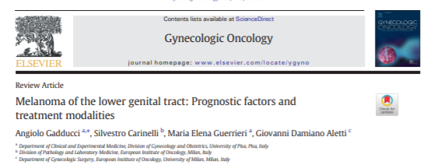
Gynecological Mucosal Malignant Melanomas
Epidemiology
Vulva: 2.4-10% of all vulvar cancers
3-7% of all melanomas in women
Incidence: 0.48-1.4/1000.000 women
5-year OS: 37–50%
Vagina: <3% of all vaginal cancers
    0-4-0-8% of all melanomas in women
Approximately 500 cases reported in
the literature
5-year OS : 13–32%
Cervix: extremely rare
approximately 80 cases reported in the literature
5-year OS: approximately 10%
Gadducci A et al., Gynecol Oncol. 2018

Slide 12
Gynecological Mucosal Malignant Melanomas
    Current Evidence: role of hadrontherapy
based on data concerning gyn cancers & cutaneous melanoma
Gadducci A et al., Gynecol Oncol. 2018

Slide 13
Gynecological Mucosal Malignant Melanomas
    Current Evidence: role of hadrontherapy
based on data concerning gyn cancers & cutaneous melanoma
Surgery is the treatment of choice (early stages) → surgical challenges (proximity of bladder, anus rectum)
Gadducci A et al., Gynecol Oncol. 2018

Slide 14
Gynecological Mucosal Malignant Melanomas
    Current Evidence: role of hadrontherapy
based on data concerning gyn cancers & cutaneous melanoma
Surgery is the treatment of choice (early stages) → surgical challenges (proximity of bladder, anus rectum)
Adjuvant treatment is unproven
Gadducci A et al., Gynecol Oncol. 2018

Slide 15
Gynecological Mucosal Malignant Melanomas
    Current Evidence: role of hadrontherapy
based on data concerning gyn cancers & cutaneous melanoma
Surgery is the treatment of choice (early stages) → surgical challenges (proximity of bladder, anus rectum)
Adjuvant treatment is unproven
RT can be used in the adjuvant setting ( R+ or/and N+)
Gadducci A et al., Gynecol Oncol. 2018

Slide 16
Gynecological Mucosal Malignant Melanomas
    Current Evidence: role of hadrontherapy
based on data concerning gyn cancers & cutaneous melanoma
Surgery is the treatment of choice (early stages) → surgical challenges (proximity of bladder, anus rectum)
Adjuvant treatment is unproven
RT can be used in the adjuvant setting ( R+ or/and N+)
CIRT is a promising alternative
Gadducci A et al., Gynecol Oncol. 2018

Slide 17

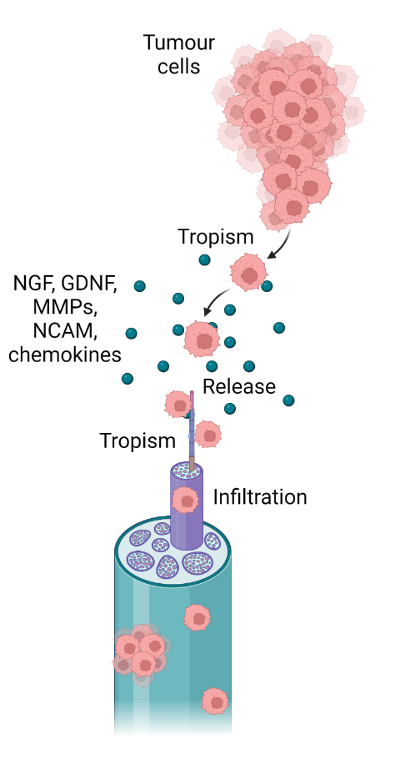
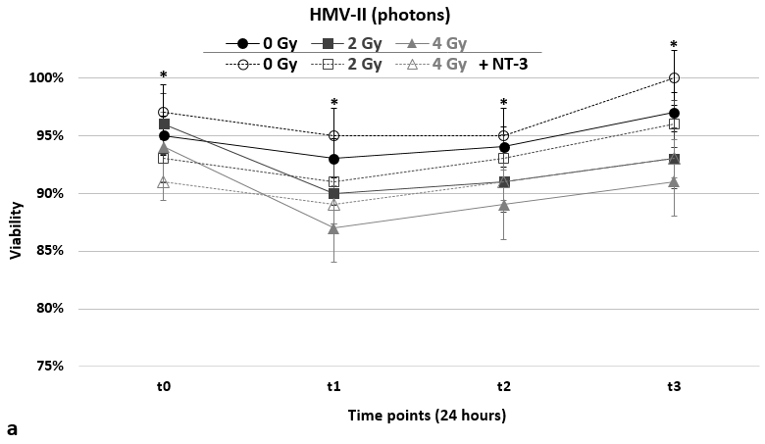
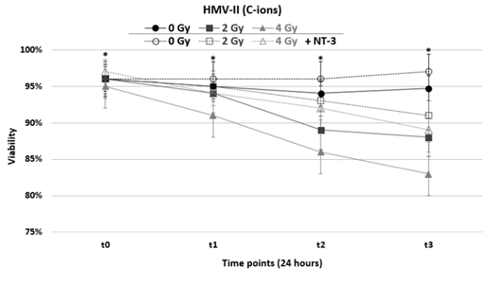
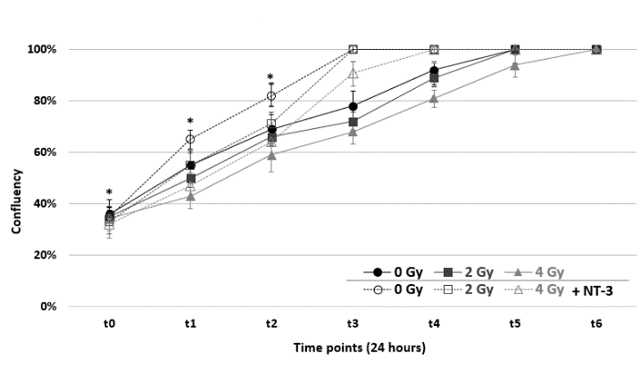
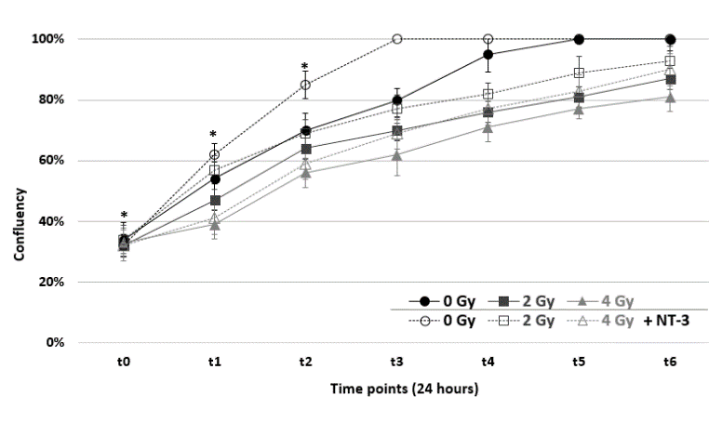
Gynecological Mucosal Malignant Melanomas
    Current Evidence: role of hadrontherapy
Photons
C-ions
Charalampopoulou A. et al., 2023

Slide 18
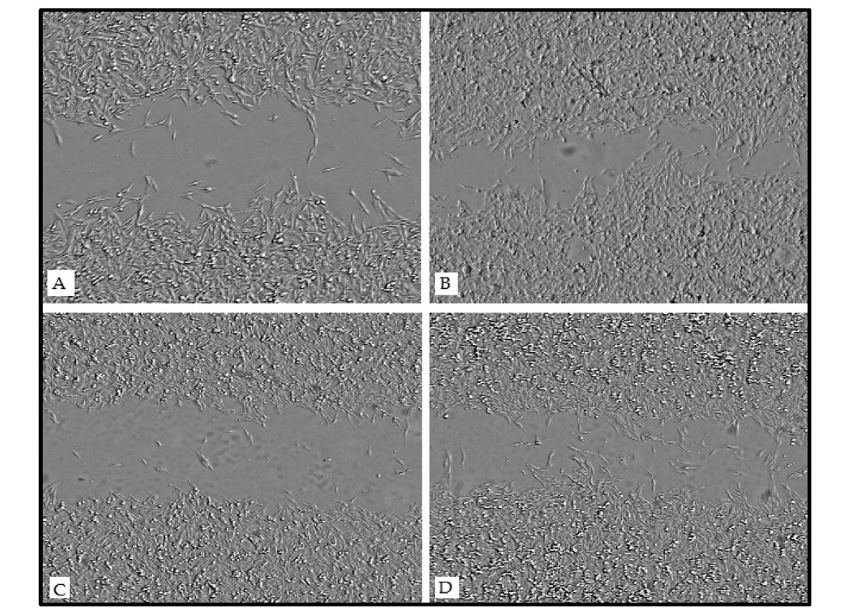
Gynecological Mucosal Malignant Melanomas
    Current Evidence: role of hadrontherapy
Scratch migration assay after the exposure of HMV-II cells to C-ions without and with the addition of NT-3
CIRT cause a more significant decrease in cell migration in vaginal mucosal melanoma cells since cell-free area percentages remain higher in all conditions
Charalampopoulou A. et al., 2023

Slide 19
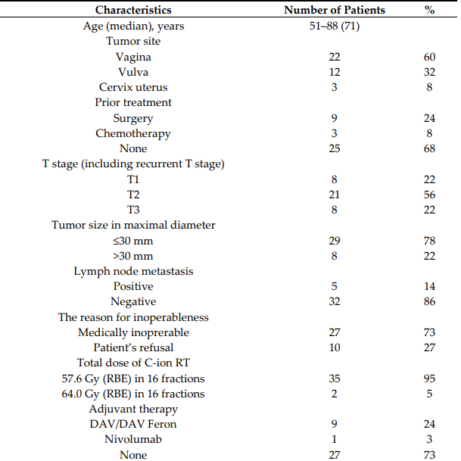
Gynecological Mucosal Malignant Melanomas
    Current Evidence: role of hadrontherapy
Retrospective analysis of 37 patients
Murata et al Cancers (Basel). 2019

Slide 20
Gynecological Mucosal Malignant Melanomas
    Current Evidence: role of hadrontherapy
Retrospective analysis of 37 patients
Median follow-up periods: 23 months (range: 5–103 months) for all patients and 53 months (range: 16–103 months) for survivors
Murata et al Cancers (Basel). 2019

Slide 21
Gynecological Mucosal Malignant Melanomas
    Current Evidence: role of hadrontherapy
Retrospective analysis of 37 patients
Median follow-up periods: 23 months (range: 5–103 months) for all patients and 53 months (range: 16–103 months) for survivors
Vagina 22
Vulva 12
Cervix uterus 3
Murata et al Cancers (Basel). 2019

Slide 22
Gynecological Mucosal Malignant Melanomas
    Current Evidence: role of hadrontherapy
Retrospective analysis of 37 patients
Median follow-up periods: 23 months (range: 5–103 months) for all patients and 53 months (range: 16–103 months) for survivors
Surgery 9
Chemotherapy 3
None 25
Murata et al Cancers (Basel). 2019

Slide 23
Gynecological Mucosal Malignant Melanomas
    Current Evidence: role of hadrontherapy
Retrospective analysis of 37 patients
Median follow-up periods: 23 months (range: 5–103 months) for all patients and 53 months (range: 16–103 months) for survivors
57.6 GyRBE 35
64.0 GyRBE 2
Murata et al Cancers (Basel). 2019

Slide 24
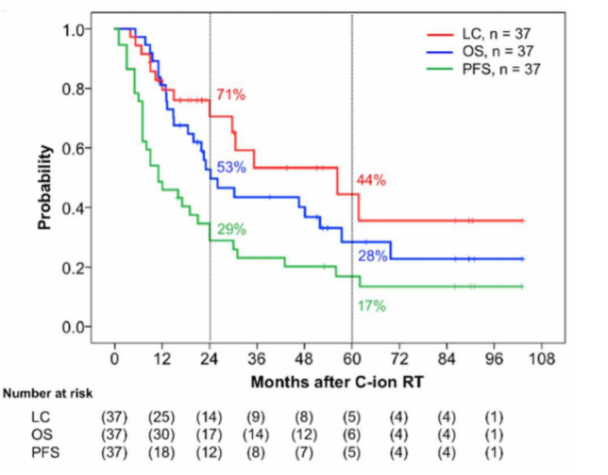
Gynecological Mucosal Malignant Melanomas
    Current Evidence: role of hadrontherapy
Within 6 months : 19 CR, 14 PR and 4 SD
Murata et al Cancers (Basel). 2019

Slide 25
Gynecological Mucosal Malignant Melanomas
    Current Evidence: role of hadrontherapy
Within 6 months : 19 CR, 14 PR and 4 SD
Murata et al Cancers (Basel). 2019

Slide 26
Gynecological Mucosal Malignant Melanomas
    Current Evidence: role of hadrontherapy
Within 6 months : 19 CR, 14 PR and 4 SD
Murata et al Cancers (Basel). 2019

Slide 27
Gynecological Mucosal Malignant Melanomas
    Current Evidence: role of hadrontherapy
Within 6 months : 19 CR, 14 PR and 4 SD
Murata et al Cancers (Basel). 2019

Slide 28
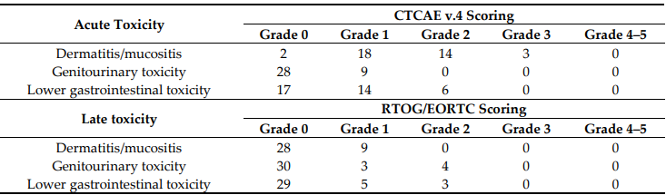
Gynecological Mucosal Malignant Melanomas
    Current Evidence: role of hadrontherapy
Murata et al Cancers (Basel). 2019

Slide 29
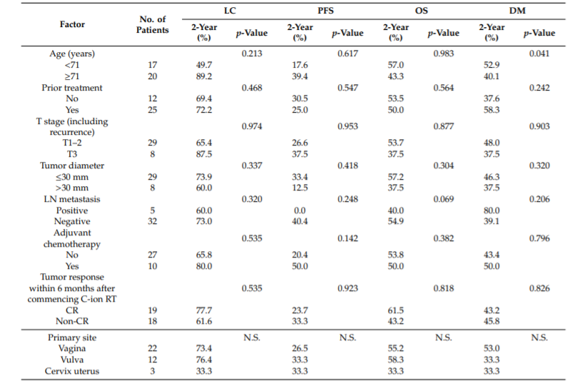
Gynecological Mucosal Malignant Melanomas
    Current Evidence: role of hadrontherapy
None of the factors examined significantly influenced LC, PFS, and OS in univariate analysis
Murata et al Cancers (Basel). 2019

Slide 30
Gynecological Mucosal Malignant Melanomas
    Current Evidence: role of hadrontherapy
None of the factors examined significantly influenced LC, PFS, and OS in univariate analysis
Age was associated with the rate of distant metastasis
Age (Year) 2-y DM(%) p-Value
<71 52.9 0.041
>71 40.1
Murata et al Cancers (Basel). 2019

Slide 31
Gynecological Mucosal Malignant Melanomas
Copyright Amelia Barcellini CNAO Copyright Amelia Barcellini CNAO
    Current Evidence: CNAO’s preliminary experience
Copyright Amelia Barcellini CNAO Copyright Amelia Barcellini CNAO
Retrospective analysis of 15 patients
Median follow-up period: 35 months (range: 5–98 months) for all patients
Higher mottled data!!! → prospective trial!
Copyright Amelia Barcellini CNAO Copyright Amelia Barcellini CNAO
Copyright Amelia Barcellini CNAO Copyright Amelia Barcellini CNAO
Copyright Amelia Barcellini CNAO Copyright Amelia Barcellini CNAO
Copyright Amelia Barcellini CNAO Copyright Amelia Barcellini CNAO
Copyright Amelia Barcellini CNAO Copyright Amelia Barcellini CNAO
Unpublished data

Slide 32
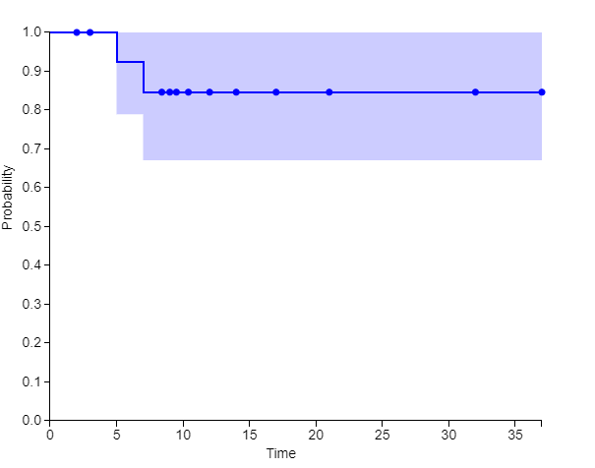
Gynecological Mucosal Malignant Melanomas
Copyright Amelia Barcellini CNAO Copyright Amelia Barcellini CNAO
    Current Evidence: CNAO’s preliminary experience
Copyright Amelia Barcellini CNAO Copyright Amelia Barcellini CNAO
Retrospective analysis of 15 patients
Median follow-up period: 35 months (range: 5–98 months) for all patients
Higher mottled data!!! → prospective trial!
Copyright Amelia Barcellini CNAO Copyright Amelia Barcellini CNAO
Copyright Amelia Barcellini CNAO Copyright Amelia Barcellini CNAO
Copyright Amelia Barcellini CNAO Copyright Amelia Barcellini CNAO
Copyright Amelia Barcellini CNAO Copyright Amelia Barcellini CNAO
Copyright Amelia Barcellini CNAO Copyright Amelia Barcellini CNAO
1-y LC and 2-y LC 82%
Unpublished data

Slide 33



Gynecological Mucosal Malignant Melanomas
    Current Evidence: role of hadrontherapy

Slide 34
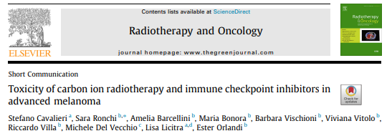
Gynecological Mucosal Malignant Melanomas
    Current Evidence: role of hadrontherapy
Thirty-three patients
15% (N=5) vaginal melanomas
Age | Primary | Site of CIRT | max acute AE | max late AE | ICI | ICI vs CIRT timing
59 | Vaginal | primary T-N | 1 | 1 | anti-PD1 | ICI after CIRT
52 | Vaginal | primary (first course) | 3 | 2 | anti-CTLA4 | sandwich
 |  | liver recurrence (second course) | 3 |  | anti-PD1 | sandwich
75 | Vaginal | recurrence after surgery T-N | 1 | 1 | anti-CTLA4 followed by anti-PD1 | ICI before CIRT
78 | Vaginal | primary T | 1 | 1 | anti-PD1 | sandwich
Cavalieri et al Radiother Oncol. 2021

Slide 35
Gynecological Mucosal Malignant Melanomas
    Current Evidence: role of hadrontherapy
With sequential CIRT and ICIs G3+ AEs are observed in 21% of patients.
Late Aes are experienced in 79% of patients treated with sequential CIRT and ICIs.
The frequency of G3+ local AEs is similar to what is observed with CIRT alone.
The frequency of G3+ AEs is similar to what is observed with ICI without CIRT.
Cavalieri et al Radiother Oncol. 2021

Slide 36

Gynecological Mucosal Malignant Melanomas
    Current Evidence: role of hadrontherapy

Slide 37
Agenda
Gynecological Melanomas
    Epidemiology
    Current Evidence: role of hadrontherapy in gynecological melanomas
Oligometastatic/ oligorecurrent/ oligorefractory ovarian cancers
    Literature data: epidemiology and current management
    What role for CIRT?

Slide 38
Oligometastatic/oligorecurrent/oligorefractory ovarian cancer
Copyright Amelia Barcellini CNAO Copyright Amelia Barcellini CNAO
Epidemiology
7th most frequent cancer diagnosed worldwide
5th cause of death in woman due to cancer after lung, breast, colorectal, and pancreas
1st cause of death due to gynecological cancer
80% diagnosed in advanced stage: a ‘chronic’ disease with multiple relapses
Copyright Amelia Barcellini CNAO Copyright Amelia Barcellini CNAO
Copyright Amelia Barcellini CNAO Copyright Amelia Barcellini CNAO
Copyright Amelia Barcellini CNAO Copyright Amelia Barcellini CNAO
Copyright Amelia Barcellini CNAO Copyright Amelia Barcellini CNAO
Copyright Amelia Barcellini CNAO Copyright Amelia Barcellini CNAO
Copyright Amelia Barcellini CNAO Copyright Amelia Barcellini CNAO

Slide 39
Oligometastatic/oligorecurrent/oligorefractory ovarian cancer
Copyright Amelia Barcellini CNAO Copyright Amelia Barcellini CNAO
    Management
Copyright Amelia Barcellini CNAO Copyright Amelia Barcellini CNAO
Copyright Amelia Barcellini CNAO Copyright Amelia Barcellini CNAO
Copyright Amelia Barcellini CNAO Copyright Amelia Barcellini CNAO
Copyright Amelia Barcellini CNAO Copyright Amelia Barcellini CNAO
Copyright Amelia Barcellini CNAO Copyright Amelia Barcellini CNAO
Copyright Amelia Barcellini CNAO Copyright Amelia Barcellini CNAO
Pignata S, Ann Oncology 2017
Wilson MK Ann Oncol 2017
du Bois A J. Zentralbl Gynakol. 2004

Slide 40
Oligometastatic/oligorecurrent/oligorefractory ovarian cancer
Copyright Amelia Barcellini CNAO Copyright Amelia Barcellini CNAO
    Management
Copyright Amelia Barcellini CNAO Copyright Amelia Barcellini CNAO
Copyright Amelia Barcellini CNAO Copyright Amelia Barcellini CNAO
The traditional is represented by systemic CT chosen on the basis of platinum sensitivity, histotype, status of BRCA genes or homologous recombination deficiency, pattern of relapse
The introduction of PARP-inhibitors in first and second-line for BRCA mutated OC would modify the management of disease relapse
RT shifts from a palliative aim toward the concept of RT as an active and definitive treatment that can be integrated into a multidisciplinary approach
Copyright Amelia Barcellini CNAO Copyright Amelia Barcellini CNAO
Copyright Amelia Barcellini CNAO Copyright Amelia Barcellini CNAO
Copyright Amelia Barcellini CNAO Copyright Amelia Barcellini CNAO
Copyright Amelia Barcellini CNAO Copyright Amelia Barcellini CNAO
Pignata S, Ann Oncology 2017
Wilson MK Ann Oncol 2017
du Bois A J. Zentralbl Gynakol. 2004

Slide 41
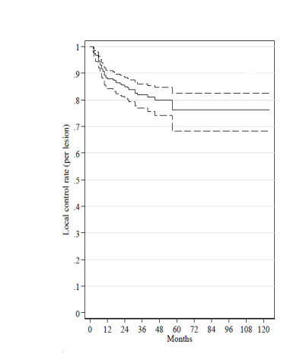
Oligometastatic/oligorecurrent/oligorefractory ovarian cancer
Copyright Amelia Barcellini CNAO Copyright Amelia Barcellini CNAO
    Role of Radiotherapy: MITO R1 study
Copyright Amelia Barcellini CNAO Copyright Amelia Barcellini CNAO
Copyright Amelia Barcellini CNAO Copyright Amelia Barcellini CNAO
261 patients carrying a total of 449 lesions
the 24‐ and 36‐month actuarial LC rates were 81.9% and 79.9%
ORR: 89% with 13.7% of PD
Copyright Amelia Barcellini CNAO Copyright Amelia Barcellini CNAO
Copyright Amelia Barcellini CNAO Copyright Amelia Barcellini CNAO
Copyright Amelia Barcellini CNAO Copyright Amelia Barcellini CNAO
Copyright Amelia Barcellini CNAO Copyright Amelia Barcellini CNAO
Macchia G et al . Oncologist. 2020

Slide 42
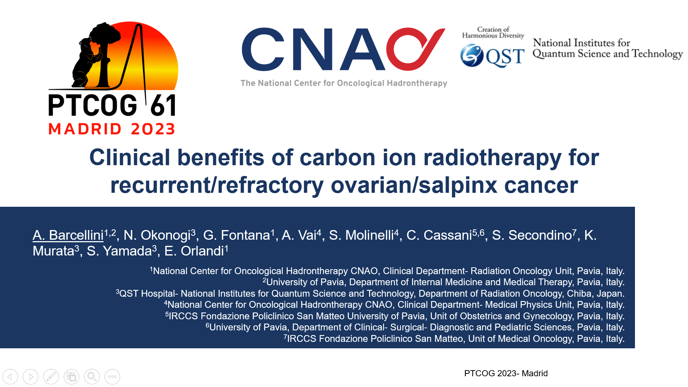
Oligometastatic/oligorecurrent/oligorefractory ovarian cancer
Copyright Amelia Barcellini CNAO Copyright Amelia Barcellini CNAO
    What role for CIRT?
Copyright Amelia Barcellini CNAO Copyright Amelia Barcellini CNAO
Copyright Amelia Barcellini CNAO Copyright Amelia Barcellini CNAO
Copyright Amelia Barcellini CNAO Copyright Amelia Barcellini CNAO
Copyright Amelia Barcellini CNAO Copyright Amelia Barcellini CNAO
Copyright Amelia Barcellini CNAO Copyright Amelia Barcellini CNAO
Copyright Amelia Barcellini CNAO Copyright Amelia Barcellini CNAO

Slide 43
Oligometastatic/oligorecurrent/oligorefractory ovarian cancer
Copyright Amelia Barcellini CNAO Copyright Amelia Barcellini CNAO
    What role for CIRT?
Copyright Amelia Barcellini CNAO Copyright Amelia Barcellini CNAO
Background: CIRT for recurrent/refractory ovarian/salpinx cancer (RR-OSC) commenced in 2006 at QST and in 2019 at CNAO
Aim: to analyze the real‐world data set of the (RR‐OSC) treated with carbon ion radiotherapy (CIRT) at QST (Japan) and CNAO (Italy).
Copyright Amelia Barcellini CNAO Copyright Amelia Barcellini CNAO
Copyright Amelia Barcellini CNAO Copyright Amelia Barcellini CNAO
Copyright Amelia Barcellini CNAO Copyright Amelia Barcellini CNAO
Copyright Amelia Barcellini CNAO Copyright Amelia Barcellini CNAO
Copyright Amelia Barcellini CNAO Copyright Amelia Barcellini CNAO

Slide 44
Oligometastatic/oligorecurrent/oligorefractory ovarian cancer
Copyright Amelia Barcellini CNAO Copyright Amelia Barcellini CNAO
    What role for CIRT?
Copyright Amelia Barcellini CNAO Copyright Amelia Barcellini CNAO
Material and Methods:
  Observational, retrospective study on "per-lesion" basis
  Logistic and Cox regression were used for the uni- and multivariable analysis of factors predicting clinical OR rate and actuarial outcomes.
Copyright Amelia Barcellini CNAO Copyright Amelia Barcellini CNAO
Copyright Amelia Barcellini CNAO Copyright Amelia Barcellini CNAO
Copyright Amelia Barcellini CNAO Copyright Amelia Barcellini CNAO
Copyright Amelia Barcellini CNAO Copyright Amelia Barcellini CNAO
Copyright Amelia Barcellini CNAO Copyright Amelia Barcellini CNAO
  First endpoints:
  objective response (OR) = sum of complete response (CR) and partial response (PR).
  1 and 2-year local control (LC)
  Secondary endpoints:
  Toxicity scored using RTOG/EORTC and CTCAE scales according to Center policy

Slide 45
Oligometastatic/oligorecurrent/oligorefractory ovarian cancer
Copyright Amelia Barcellini CNAO Copyright Amelia Barcellini CNAO
    What role for CIRT?
Copyright Amelia Barcellini CNAO Copyright Amelia Barcellini CNAO
Copyright Amelia Barcellini CNAO Copyright Amelia Barcellini CNAO
26 women (58% Asian and 42% Caucasian), for a total of 36 lesions, underwent CIRT for RR-OSC
Median age at CIRT was 59.5 years (range:44-81)
21 patients were radiotherapy naïve, while 5 patients received CIRT for re-irradiation
Median total dose of 52.8 GyE (range:39-64 GyE)
Copyright Amelia Barcellini CNAO Copyright Amelia Barcellini CNAO
Copyright Amelia Barcellini CNAO Copyright Amelia Barcellini CNAO
Copyright Amelia Barcellini CNAO Copyright Amelia Barcellini CNAO
Copyright Amelia Barcellini CNAO Copyright Amelia Barcellini CNAO
.

Slide 46
Oligometastatic/oligorecurrent/oligorefractory ovarian cancer
Copyright Amelia Barcellini CNAO Copyright Amelia Barcellini CNAO
    What role for CIRT?
Copyright Amelia Barcellini CNAO Copyright Amelia Barcellini CNAO
Copyright Amelia Barcellini CNAO Copyright Amelia Barcellini CNAO
Copyright Amelia Barcellini CNAO Copyright Amelia Barcellini CNAO
Characteristics | N | %
Histotype High grade serous cell Mucinous Endometrioid Clear Cells Mixed mullerian Undifferentiated Other | 11 3 2 1 5 1 3 | 42.3% 11.5% 7.7% 3.8% 19.2% 3.8% 11.5%
Characteristics | N (%)
Type of lesion(s) Lymph node Parenchyma Abdominal Pelvic Brain | 15 (41.7%) 21 (58.3%) 14 5 2
Copyright Amelia Barcellini CNAO Copyright Amelia Barcellini CNAO
Copyright Amelia Barcellini CNAO Copyright Amelia Barcellini CNAO
Copyright Amelia Barcellini CNAO Copyright Amelia Barcellini CNAO
.

Slide 47
Oligometastatic/oligorecurrent/oligorefractory ovarian cancer
Copyright Amelia Barcellini CNAO Copyright Amelia Barcellini CNAO
15 lesions (41%) achieved CR within 12 months
OR rate was 97%
    What role for CIRT?
Copyright Amelia Barcellini CNAO Copyright Amelia Barcellini CNAO
Copyright Amelia Barcellini CNAO Copyright Amelia Barcellini CNAO
Copyright Amelia Barcellini CNAO Copyright Amelia Barcellini CNAO
Copyright Amelia Barcellini CNAO Copyright Amelia Barcellini CNAO
Copyright Amelia Barcellini CNAO Copyright Amelia Barcellini CNAO
Copyright Amelia Barcellini CNAO Copyright Amelia Barcellini CNAO

Slide 48
Oligometastatic/oligorecurrent/oligorefractory ovarian cancer
Copyright Amelia Barcellini CNAO Copyright Amelia Barcellini CNAO
15 lesions (41%) achieved CR within 12 months
OR rate was 97%
    What role for CIRT?
Copyright Amelia Barcellini CNAO Copyright Amelia Barcellini CNAO
Copyright Amelia Barcellini CNAO Copyright Amelia Barcellini CNAO
Macchia G et al . Oncologist. 2020
OR rate: 89%
Copyright Amelia Barcellini CNAO Copyright Amelia Barcellini CNAO
Copyright Amelia Barcellini CNAO Copyright Amelia Barcellini CNAO
Copyright Amelia Barcellini CNAO Copyright Amelia Barcellini CNAO
Copyright Amelia Barcellini CNAO Copyright Amelia Barcellini CNAO
Notes:
.

Slide 49
Oligometastatic/oligorecurrent/oligorefractory ovarian cancer
Copyright Amelia Barcellini CNAO Copyright Amelia Barcellini CNAO
15 lesions (41%) achieved CR within 12 months
OR rate was 97%
    What role for CIRT?
Copyright Amelia Barcellini CNAO Copyright Amelia Barcellini CNAO
Copyright Amelia Barcellini CNAO Copyright Amelia Barcellini CNAO
Copyright Amelia Barcellini CNAO Copyright Amelia Barcellini CNAO
Copyright Amelia Barcellini CNAO Copyright Amelia Barcellini CNAO
Copyright Amelia Barcellini CNAO Copyright Amelia Barcellini CNAO
Copyright Amelia Barcellini CNAO Copyright Amelia Barcellini CNAO
Dose per fraction> 4.2 Gy[RBE]
(OR: 7,27% CI: 1,72-37,54, p=0.01)
Total dose > 52,8 Gy[RBE]
(OR: 6,88% CI: 1,67-33,93, p=0.01)

Slide 50
Oligometastatic/oligorecurrent/oligorefractory ovarian cancer
Copyright Amelia Barcellini CNAO Copyright Amelia Barcellini CNAO
    What role for CIRT?
Copyright Amelia Barcellini CNAO Copyright Amelia Barcellini CNAO
Copyright Amelia Barcellini CNAO Copyright Amelia Barcellini CNAO
After a median follow-up of 12.45 months (3-193 months) :
Copyright Amelia Barcellini CNAO Copyright Amelia Barcellini CNAO
Copyright Amelia Barcellini CNAO Copyright Amelia Barcellini CNAO
Copyright Amelia Barcellini CNAO Copyright Amelia Barcellini CNAO
Copyright Amelia Barcellini CNAO Copyright Amelia Barcellini CNAO
1- year LC:92% (95% CI: 82%- 100%)
2- year LC:83% (95% CI: 65%-100%)

Slide 51
Oligometastatic/oligorecurrent/oligorefractory ovarian cancer
Copyright Amelia Barcellini CNAO Copyright Amelia Barcellini CNAO
    What role for CIRT?
Copyright Amelia Barcellini CNAO Copyright Amelia Barcellini CNAO
Copyright Amelia Barcellini CNAO Copyright Amelia Barcellini CNAO
After a median follow-up of 12.45 months (3-193 months) :
Copyright Amelia Barcellini CNAO Copyright Amelia Barcellini CNAO
Copyright Amelia Barcellini CNAO Copyright Amelia Barcellini CNAO
Copyright Amelia Barcellini CNAO Copyright Amelia Barcellini CNAO
Copyright Amelia Barcellini CNAO Copyright Amelia Barcellini CNAO
1- year LC:92% (95% CI: 82%- 100%)
2- year LC:83% (95% CI: 65%-100%)
Macchia G et al . Oncologist. 2020
2-y LC 81.9%

Slide 52
Oligometastatic/oligorecurrent/oligorefractory ovarian cancer
Copyright Amelia Barcellini CNAO Copyright Amelia Barcellini CNAO
    What role for CIRT?
Copyright Amelia Barcellini CNAO Copyright Amelia Barcellini CNAO
Copyright Amelia Barcellini CNAO Copyright Amelia Barcellini CNAO
After a median follow-up of 12.45 months (3-193 months) :
Copyright Amelia Barcellini CNAO Copyright Amelia Barcellini CNAO
Copyright Amelia Barcellini CNAO Copyright Amelia Barcellini CNAO
Copyright Amelia Barcellini CNAO Copyright Amelia Barcellini CNAO
Copyright Amelia Barcellini CNAO Copyright Amelia Barcellini CNAO
1- year LC:92% (95% CI: 82%- 100%)
2- year LC:83% (95% CI: 65%-100%)
Prognostic factors (adjusted for RBM):
Age (p=0.69)
Dose per fraction (p=0.30)
Total dose ( p=0.63)
Tumor site (p=0.93)

Slide 53
Oligometastatic/oligorecurrent/oligorefractory ovarian cancer
Copyright Amelia Barcellini CNAO Copyright Amelia Barcellini CNAO
    What role for CIRT?
Copyright Amelia Barcellini CNAO Copyright Amelia Barcellini CNAO
Copyright Amelia Barcellini CNAO Copyright Amelia Barcellini CNAO
Copyright Amelia Barcellini CNAO Copyright Amelia Barcellini CNAO
Copyright Amelia Barcellini CNAO Copyright Amelia Barcellini CNAO
Copyright Amelia Barcellini CNAO Copyright Amelia Barcellini CNAO
Copyright Amelia Barcellini CNAO Copyright Amelia Barcellini CNAO

Slide 54
Oligometastatic/oligorecurrent/oligorefractory ovarian cancer
Copyright Amelia Barcellini CNAO Copyright Amelia Barcellini CNAO
    What role for CIRT?
Copyright Amelia Barcellini CNAO Copyright Amelia Barcellini CNAO
Copyright Amelia Barcellini CNAO Copyright Amelia Barcellini CNAO
Copyright Amelia Barcellini CNAO Copyright Amelia Barcellini CNAO
Copyright Amelia Barcellini CNAO Copyright Amelia Barcellini CNAO
Copyright Amelia Barcellini CNAO Copyright Amelia Barcellini CNAO
Copyright Amelia Barcellini CNAO Copyright Amelia Barcellini CNAO

Slide 55
Oligometastatic/oligorecurrent/oligorefractory ovarian cancer
Copyright Amelia Barcellini CNAO Copyright Amelia Barcellini CNAO
    What role for CIRT?
Copyright Amelia Barcellini CNAO Copyright Amelia Barcellini CNAO
Copyright Amelia Barcellini CNAO Copyright Amelia Barcellini CNAO
Only one case of G3 EORTC/RTOG enterocolitis in the acute and late phases was observed.
No G≥3 toxicities were recorded in re-irradiated patients.
4 patients received PARP-i and 6 anti-VEGF (before and/or after CIRT), which seemed not to exacerbate the risk of severe toxicities
Copyright Amelia Barcellini CNAO Copyright Amelia Barcellini CNAO
Copyright Amelia Barcellini CNAO Copyright Amelia Barcellini CNAO
Copyright Amelia Barcellini CNAO Copyright Amelia Barcellini CNAO
Copyright Amelia Barcellini CNAO Copyright Amelia Barcellini CNAO
.

Slide 56
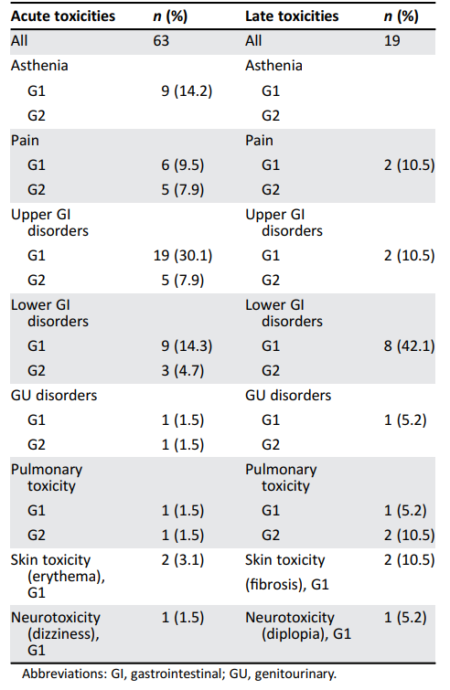
Oligometastatic/oligorecurrent/oligorefractory ovarian cancer
Copyright Amelia Barcellini CNAO Copyright Amelia Barcellini CNAO
    What role for CIRT?
Copyright Amelia Barcellini CNAO Copyright Amelia Barcellini CNAO
Copyright Amelia Barcellini CNAO Copyright Amelia Barcellini CNAO
Only one case of G3 EORTC/RTOG enterocolitis in the acute and late phases was observed.
No G≥3 toxicities were recorded in re-irradiated patients.
4 patients received PARP-i and 6 anti-VEGF (before and/or after CIRT), which seemed not to exacerbate the risk of severe toxicities
Copyright Amelia Barcellini CNAO Copyright Amelia Barcellini CNAO
Copyright Amelia Barcellini CNAO Copyright Amelia Barcellini CNAO
Copyright Amelia Barcellini CNAO Copyright Amelia Barcellini CNAO
Copyright Amelia Barcellini CNAO Copyright Amelia Barcellini CNAO
.

Slide 57
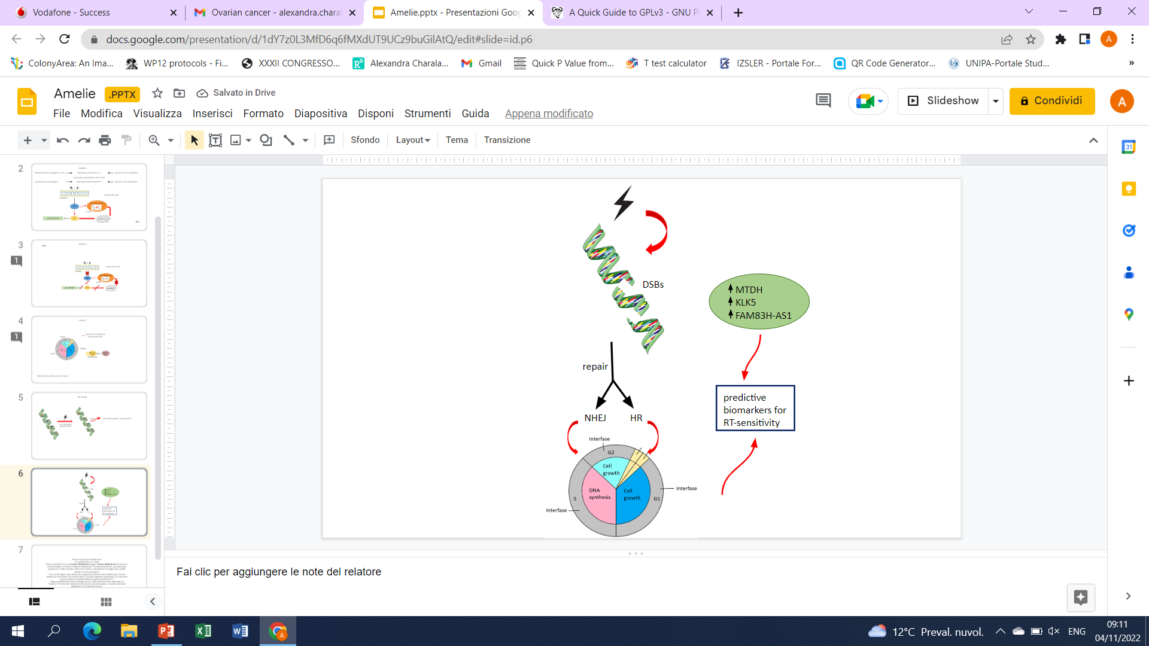
Oligometastatic/oligorecurrent/oligorefractory ovarian cancer
    What role for CIRT?
Repair Pathway Choice
The two main DNA DSB repair pathways are non-homologous end joining (NHEJ) and homologous recombination (HR), the latter only active in S and G2-phases of the cell cycle
An increased usage of HR has been observed after exposure to CIRT
Tinganelli W Cancers (Basel). 2020
Barcellini A, Charalampopoulou A Life (Basel), 2022
.

Slide 58
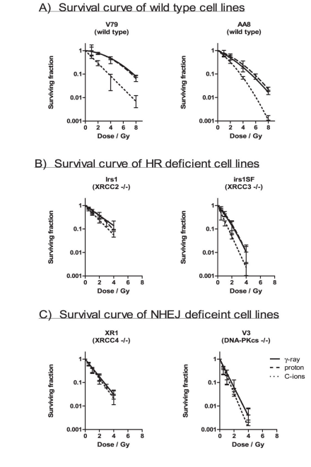
Oligometastatic/oligorecurrent/oligorefractory ovarian cancer
    What role for CIRT?
The wild-type cells were most resistant, followed by the HR-deficient irs1, NHEJ-deficient XR1, HR-deficient irs1SF and NHEJ-deficient V3 cells to all radiation types examined
The cells responded to γ rays and proton beams in a nearly identical manner
The wild-type and HR-deficient cell lines were more strongly sensitized to C ions than the NHEJ-deficient cell lines
Gerelchuluun A. Radiat Res. 2015
.

Slide 59
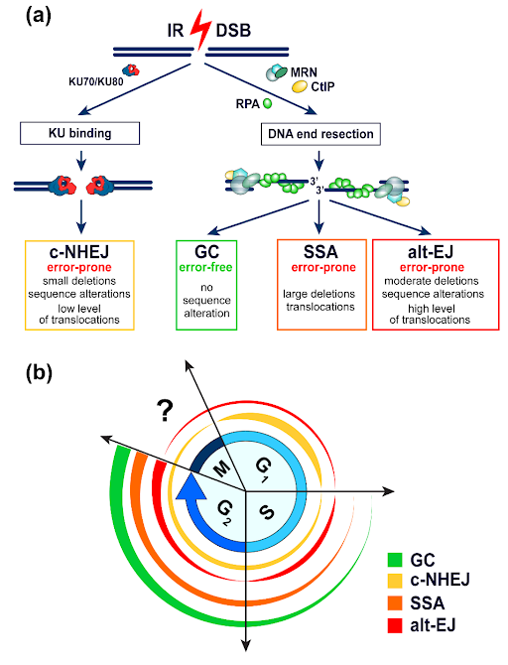
Oligometastatic/oligorecurrent/oligorefractory ovarian cancer
    Which role for CIRT?
Repair Pathway Choice
DSB due to high LET triggers alternative, error-prone DNA damage repair pathways
alternative NHEJ: DNA break resection followed by microhomology-mediated recombination (intrinsically error-prone, formation of translocations)
Resection in G1 increase with LET (↑↑ for 100 keV/μm)
Iliakis G Cancers (Basel). 2019
Tinganelli W Cancers (Basel). 2020
.

Slide 60
Oligometastatic/oligorecurrent/oligorefractory ovarian cancer
    What role for CIRT?
Repair Pathway Choice
A large fraction of DSB due to CIRT is processed by NHEJ
An increased usage of HR has been observed after exposure to CIRT
Dose-dependent with more breaks repairing by NHEJ at high dose when HR becomes saturated
Fontana AO, Radiother Oncol 2015
Grosse N et al Int J Radiat Oncol Biol Phys 2014
Barcellini A, Charalampopoulou A Life (Basel), 2022
.

Slide 61
Oligometastatic/oligorecurrent/oligorefractory ovarian cancer
    What role for CIRT?
The Cancer Genome Atlas Research Network, Nature 2011
Konstantinopoulos PA, et al. Cancer Discov 2015
.

Slide 62
Oligometastatic/oligorecurrent/oligorefractory ovarian cancer
.

Slide 63

Conclusions
Hadrontherapy appears to be a safe, effective and feasible treatment method, which has shown advantages over photon therapy
To test the combo approach
Preclinical studies are crucial
RCTs (maybe for ROC?) are unrealistic →the development of clinical registries might help to elucidate current uncertainties
National and International multidisciplinary cooperation is of utmost importance to make a step forward
.

Slide 64
Gynae and Rare Indications:
Gynaecological Melanoma and Oligomet Ovarian Cancer
Amelia Barcellini, MD
Radiation Oncology Unit, Clinical Department
CNAO National Center for Oncological Hadrontherapy

