Slide 1
LHCONE L3VPN status update
Enzo Capone
Head of Research Engagement and Support
LHCONE-OPN Meeting @ HEPIX2023
18th October 2023

Slide 2









































LHCONE around the world

Slide 3
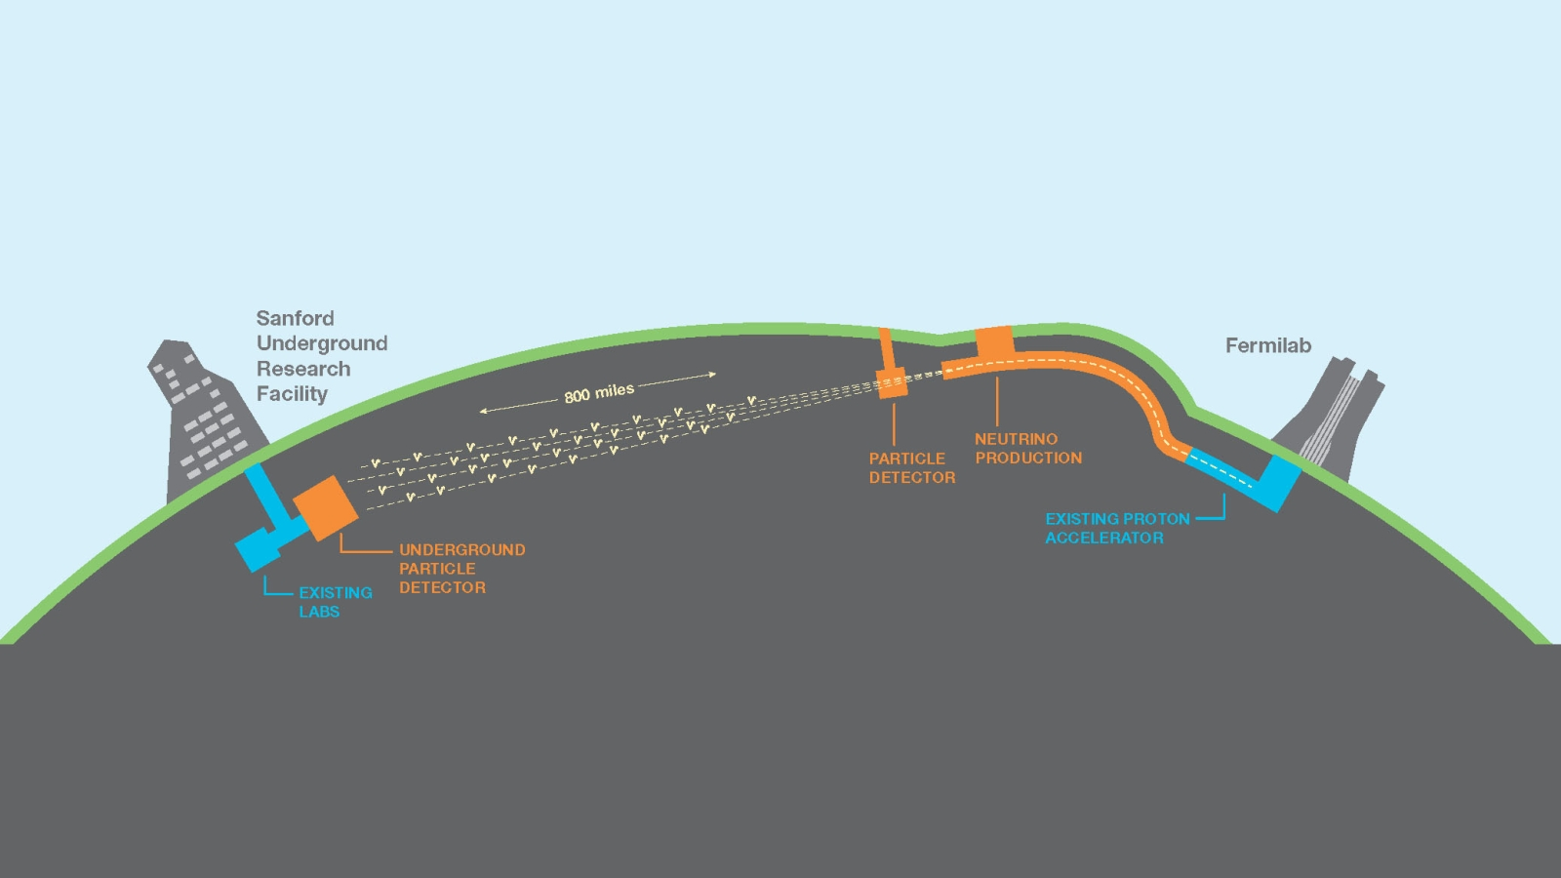

New experiment supported!
Notes:
Just added to the AUP

Slide 4
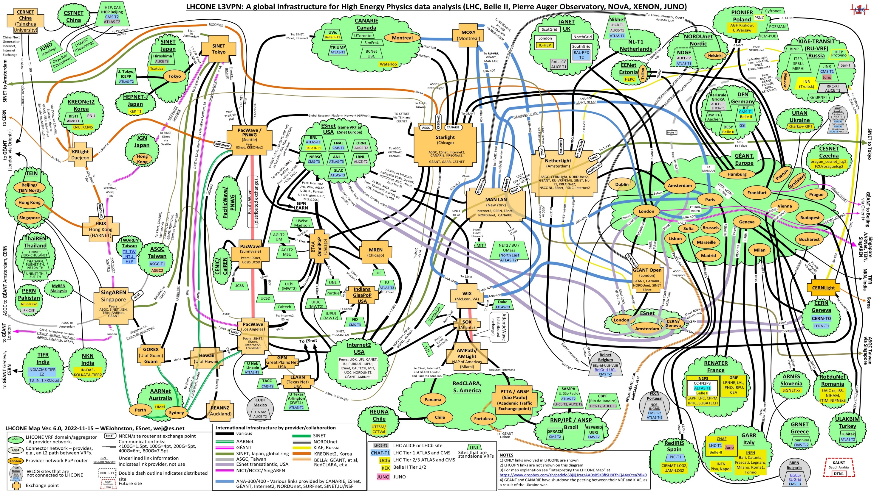
Notes:
No big changes in the last period. Mostly visualization tweaks

Slide 5
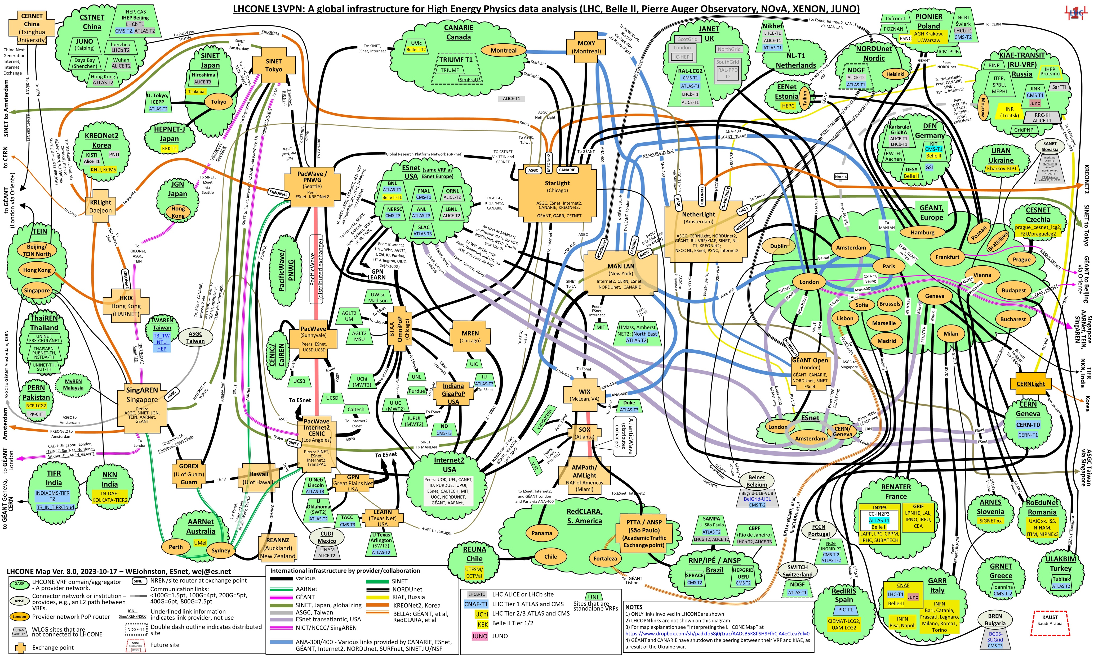
Notes:
Few changes here and there, compared to the last period. Mostly visualization tweaks

Slide 6
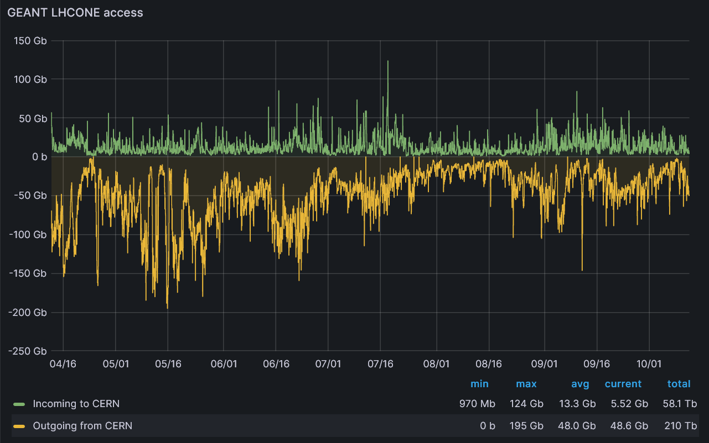
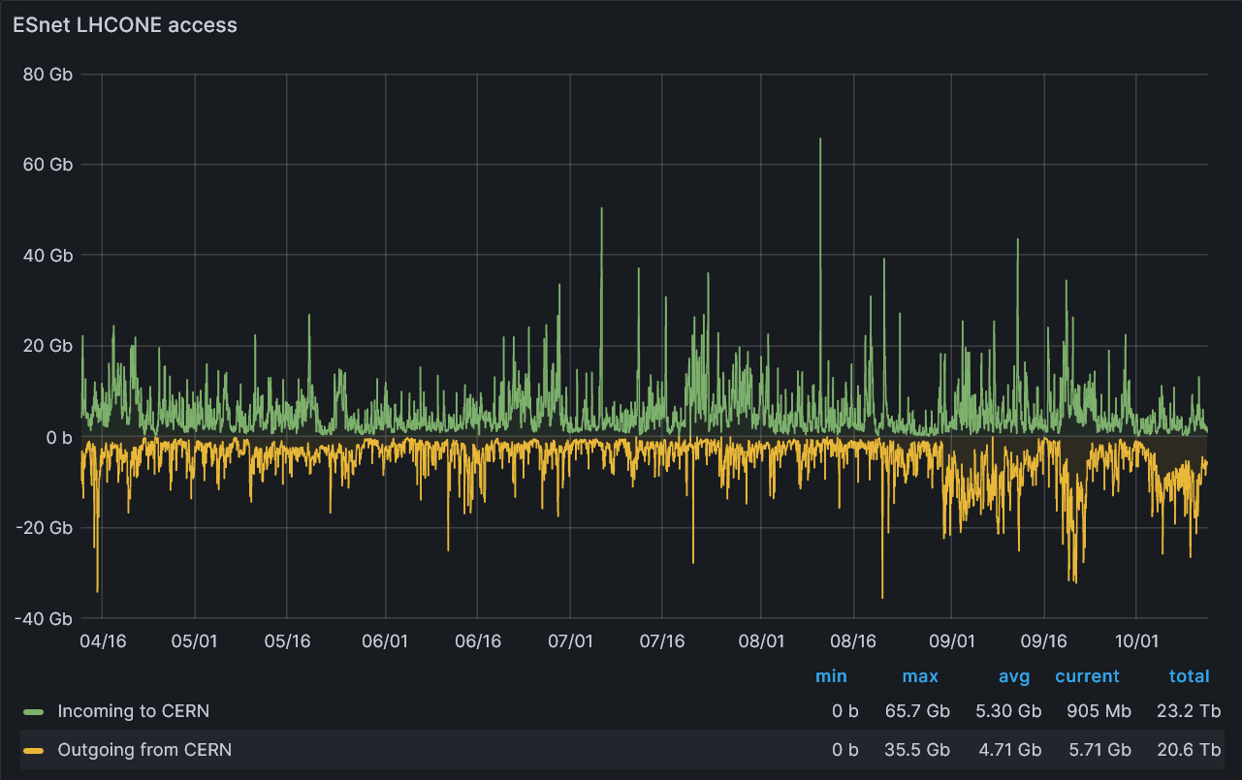

CERN
Notes:
https://monit-grafana-open.cern.ch
Traffic from CERN is pretty steady

Slide 7
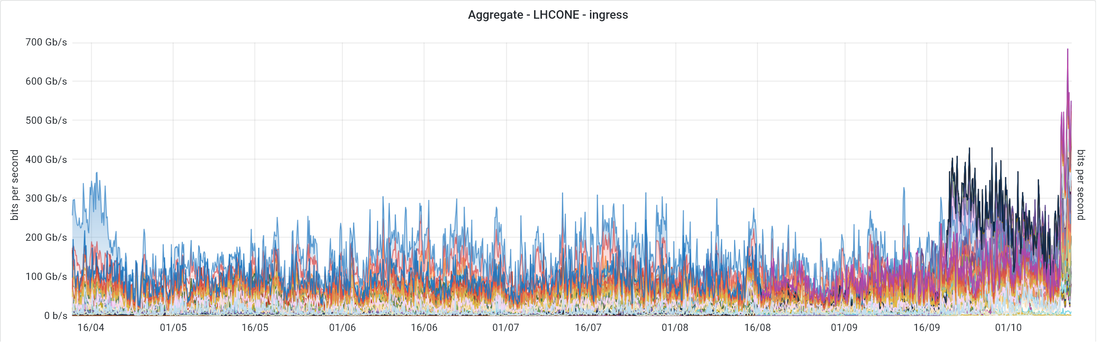
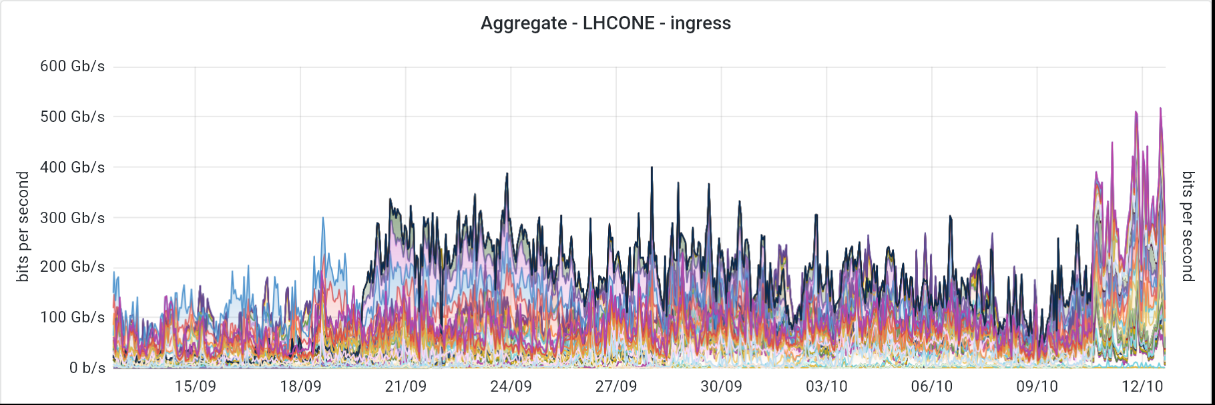
GÉANT overall
Notes:
Massive increase in traffic in the last 3 months

Slide 8
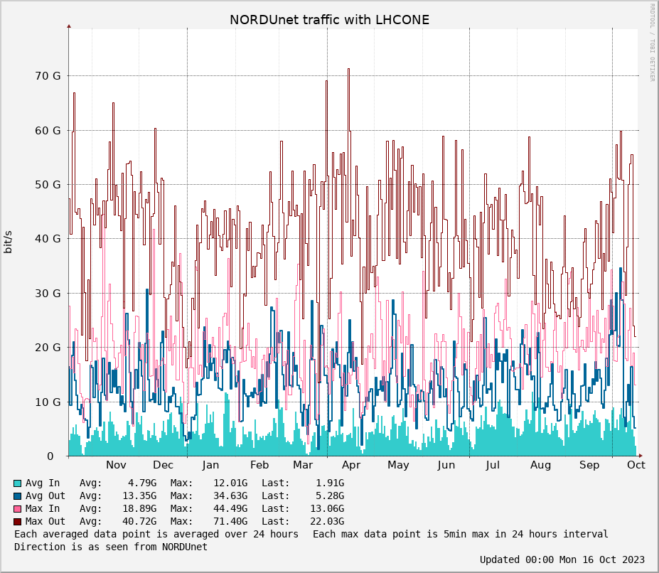
NORDUNet
Notes:
http://stats.nordu.net/connections.html
The graph shows total LHCONE traffic in NORDUnet which include links to CERN, GÉANT, Esnet and other connectors, in the last year.

Slide 9

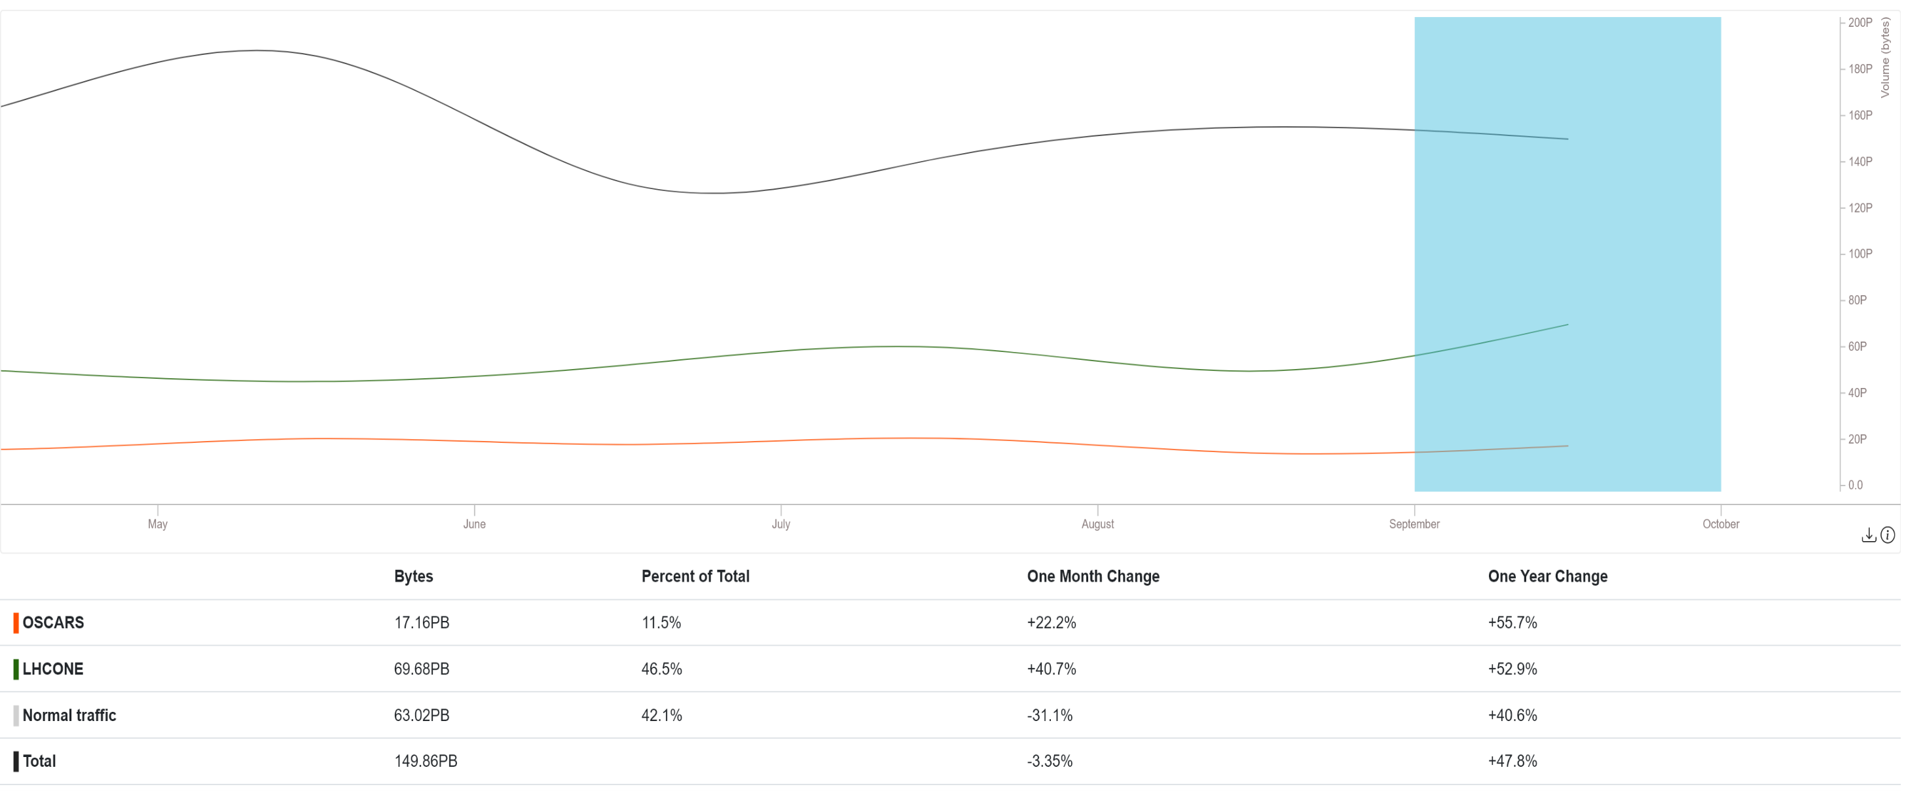
ESnet
Notes:
https://my.es.net/traffic-volume?t=6M&scale=linear
+53% YoY

Slide 10

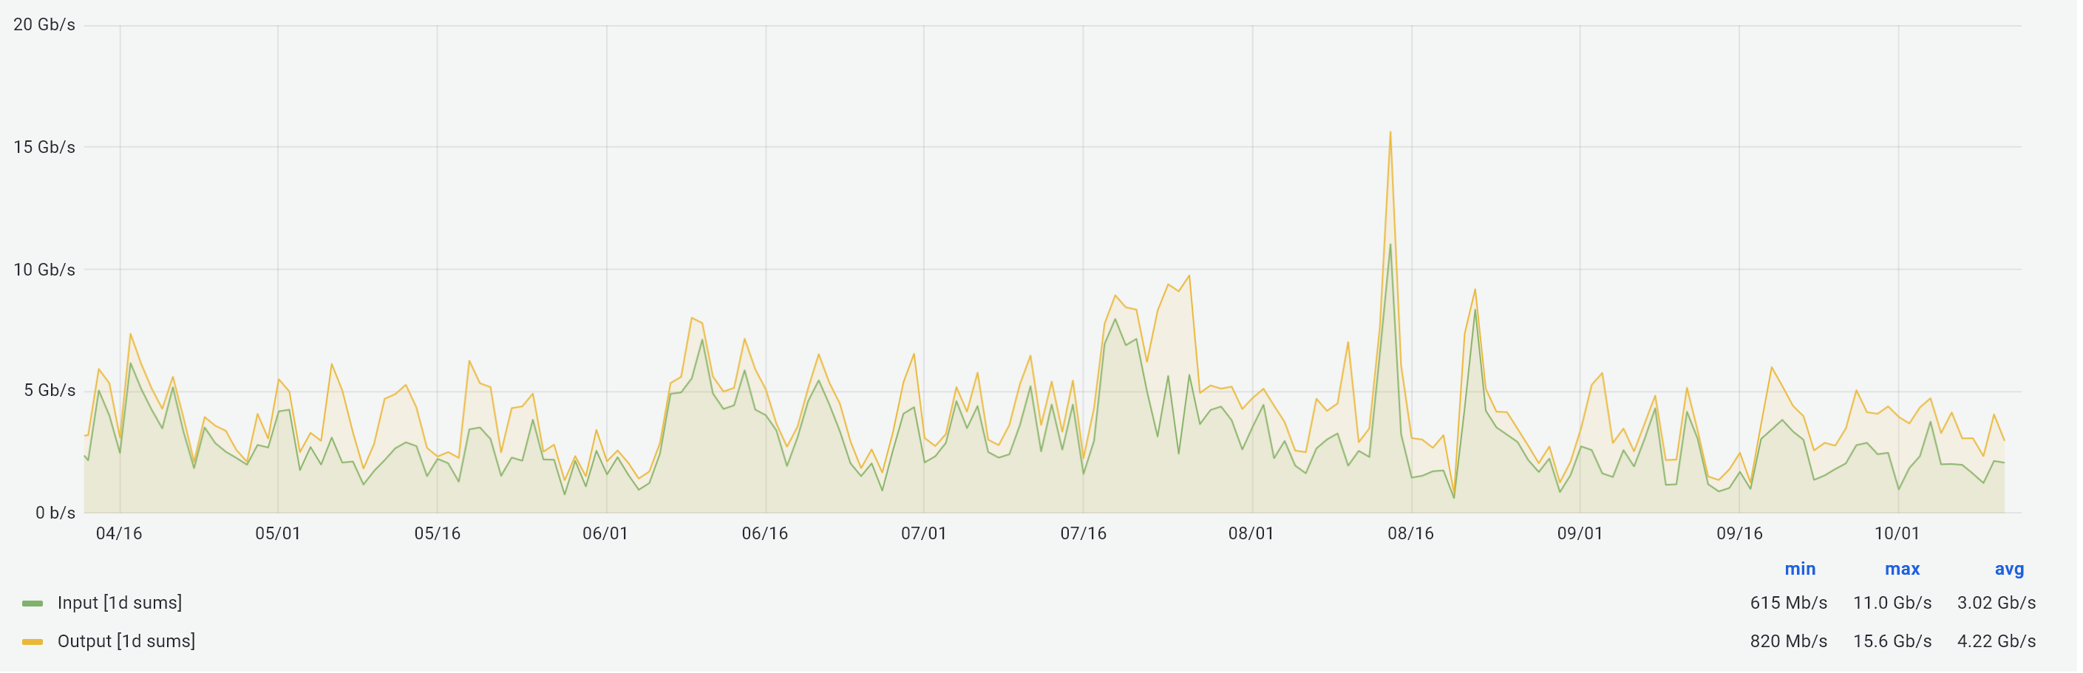
Internet2
Notes:
https://snapp-portal.net.internet2.edu/grafana/d/86accab5aab6402a726547024df93fbf2/browse-interfaces?orgId=2&from=now-6M&to=now&var-POP=All&var-Node=All&var-Search=lhcone&var-identifier=All&var-Metrics=input&var-Metrics=output&var-Aggregation=average
I2 traffic trending constant

Slide 11
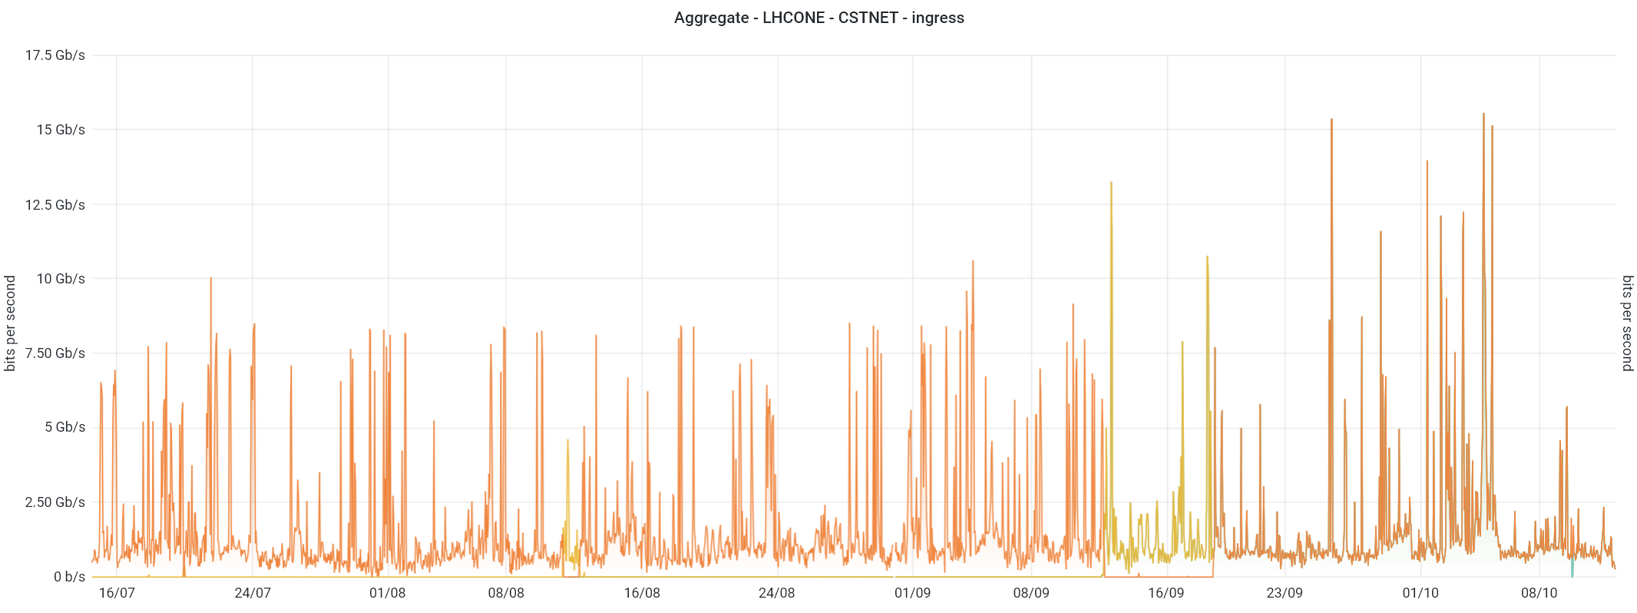
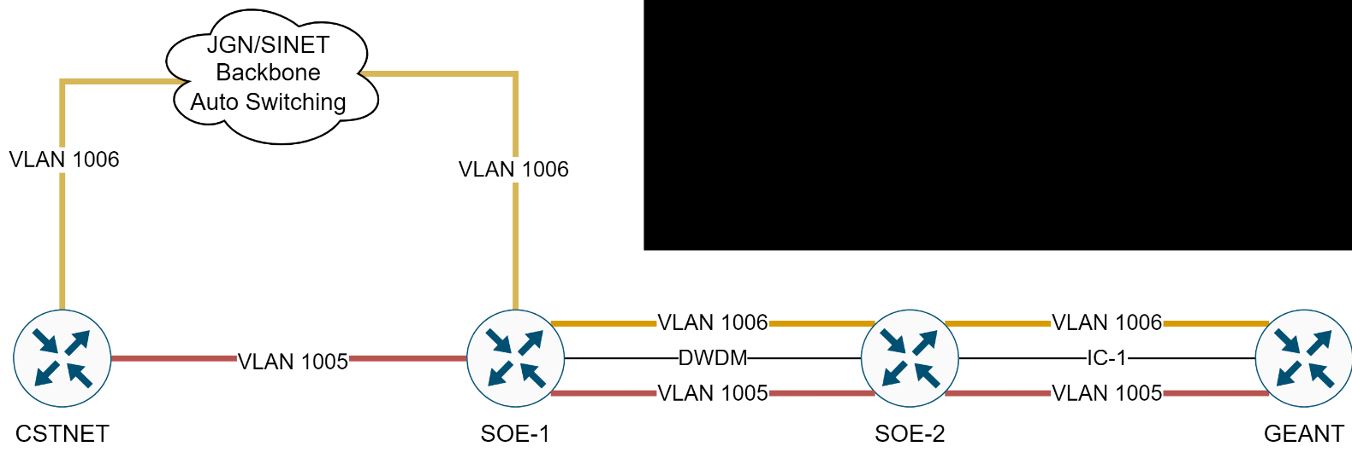
CSTNET
Notes:
New 100G link GÉANT-CSTNET (London-Singapore-HongKong-Beijing).
Peaks over 16Gb/s

Slide 12
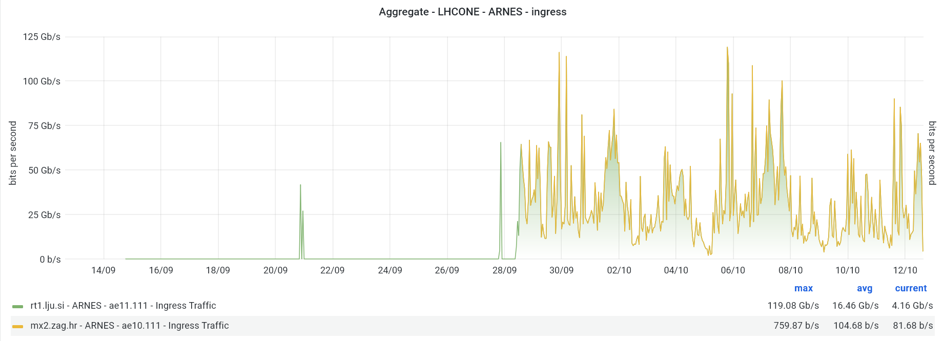
Highlights
Notes:
http://stats.nordu.net/connections.html
ARNES keeps moving very large amounts of data, almost on par with the largest NRENs in Europe. Traffic is mostly from VEGA in Maribor

Slide 13
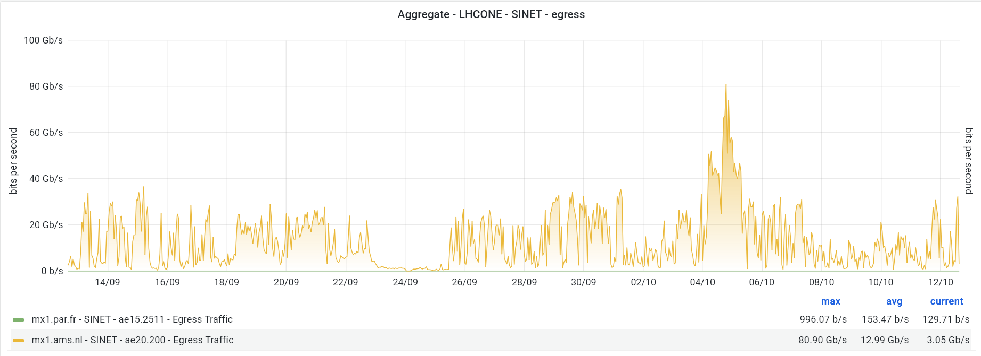
Highlights
Notes:
Massive spikes of traffic from SINET, reaching over 80GB/s

Slide 14
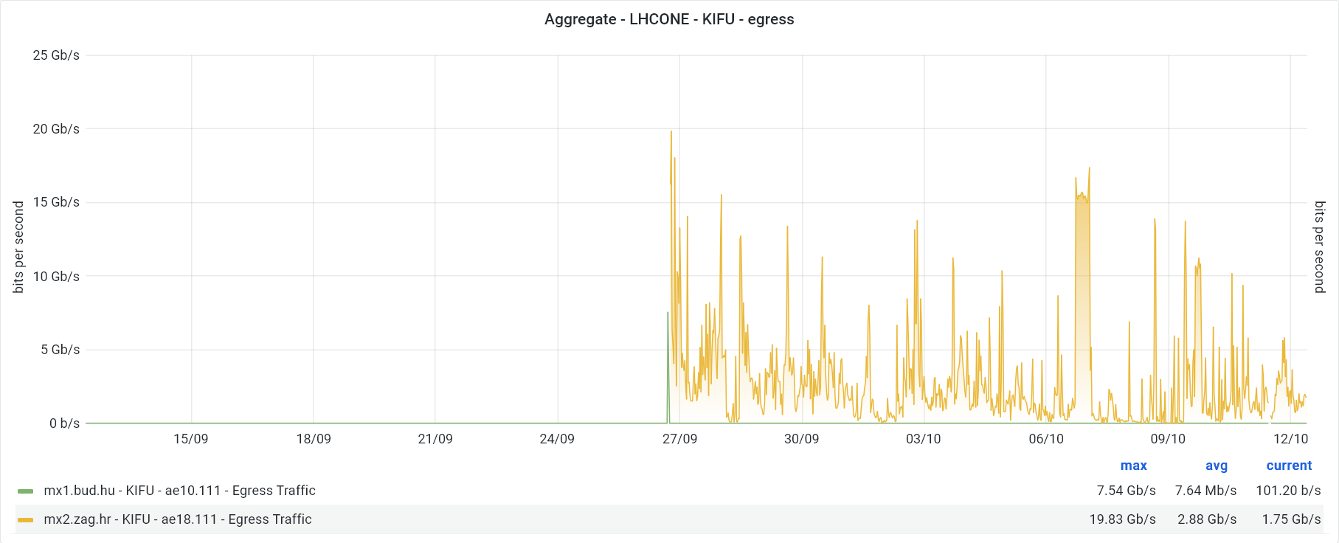
Highlights
Notes:
Just recently connected, and already using it at full speed

Slide 15
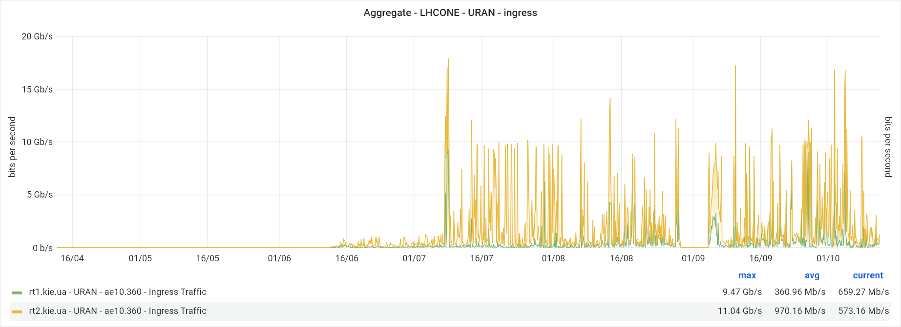
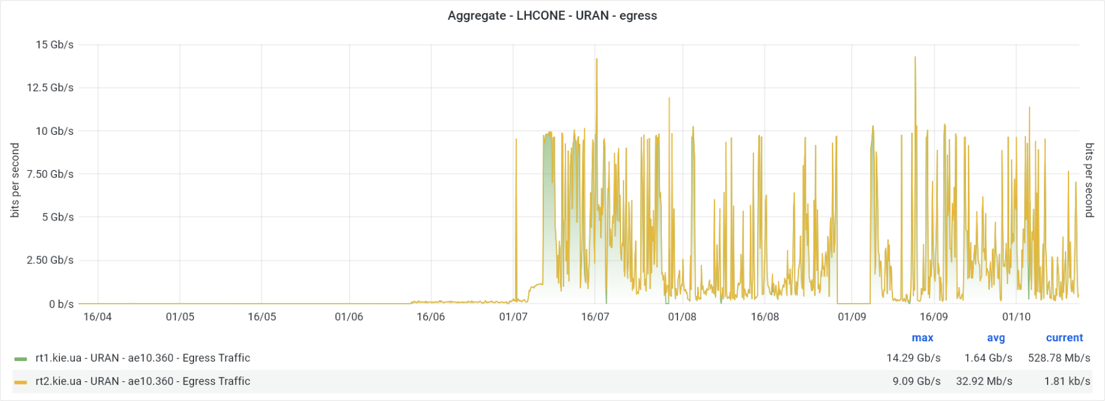
Highlights
Notes:
Ukranian sites have restarted moving data!

Slide 16
Sites news
CERN LHCOPN/ONE connection to ESnet have been upgraded to 400G (400G for each pair of routers, so 2x400G in total )
RAL-LCG2 has started deploying hosts under the new IPv6 2001:630:54::/52 prefix
PIC upgraded to 100G from 70G
INFN-NAPOLI upgraded to 100G

Slide 17
NRENs news
GEANT
IP service
GEANT
LHCONE
VRF
New LHCONE joiners (not yet completed):
  SWITCH (University of Bern-LHEP)*
  FCCN (NCG-INGRID-PT)
CSTNET-GÉANT peering moved to 100G London-Singapore-Beijing link
Fixed GÉANT-I2 and GÉANT-ESnet IPv6 peering in London and Paris
VRF
SWITCH
IP service
NREN PE router
General IP link
LHCONE link
(separate link or VLAN on trunk)
TierX LAN
Site CE router
Site LAN

Slide 18
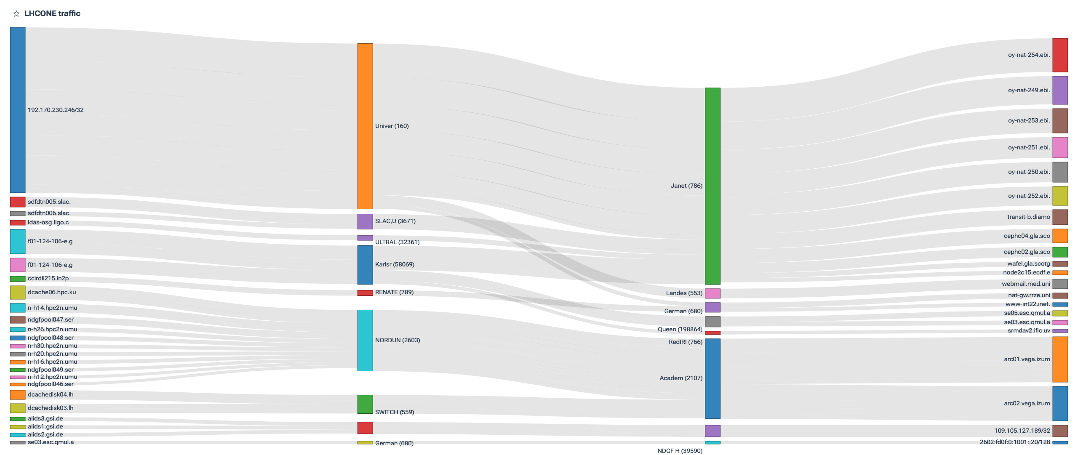
Flow analysis (stay tuned…)
Notes:
Extracted from the CRIC database. We’ll start playing around with it, and let you know….
Come forward if you have some ideas in mind of useful querys

Slide 19

Thank you!
vincenzo.capone@geant.org
@EnzinoCapone
www.geant.org
@GEANTnews
© GÉANT Association
As part of the GÉANT 2020 Framework Partnership Agreement (FPA), the project receives funding from the European Union's Horizon 2020 research and innovation programme under Grant Agreement No. 856726 (GN4-3).

