Slide 1




CERN-CNAF DCI
Involved organizations
CERN, GEANT, GARR, INFN
Edoardo Martelli (CERN)
Lorenzo Chiarelli (GARR e INFN CNAF)
Donato De Girolamo (INFN CNAF)
S.Zani (INFN CNAF)
Guy Roberts (GEANT)
Gloria Vuagnin (GARR)
Paolo Bolletta (GARR)
Massimo Carboni (GARR)
Matteo Colantonio (GARR)
18-10-2023
LHCOPN-LHCONE meeting

Slide 2
Main motivations to start a pilot project on an optical direct link between CERN and CNAF
“HL-LHC connectivity requirements for TIER1s: More than 1Tbps in 2027” (S.Campana Presentation at LHCONE/OPN meeting 23/3/2021)
A direct link with CERN without traversing too many router interfaces should be a cheaper solution for High Bandwidth link.
A programmable transponder based interconnection infrastructure could be used to dynamically resize the T0 –T1 Link on the needs.
A DCI interconnection could be used as the underlay network for a Data Lake spanning between CERN and CNAF
High bandwidth end to end optical channels for specific purposes could be deployed in few minutes.
More efficient use of the physical network infrastructure, sharing spectrum available on NREN backbones.

Slide 3
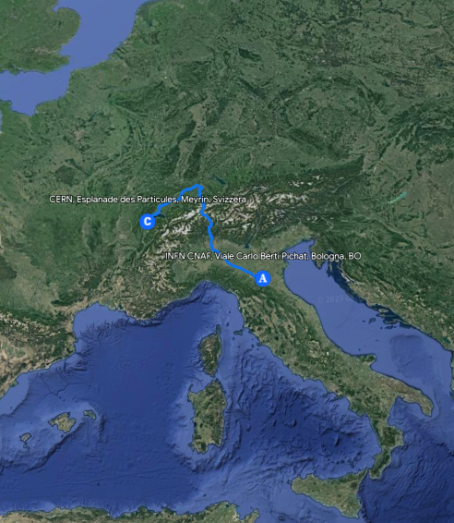




Shematic view of the DCI realized
Proposed in GEANT GN4-3 (WP7-T2) as a possible usecase for experimenting the multi domain Spectrum Connection Service at about 1000 km of distance.
Geneva
CERN DC
Bologna
CNAF DC
Nx100 G
or
Nx400 G
Nx100 G
or
Nx400 G
TRX
TRX
Add/Drop
Add/Drop
GEANT
Open Line System
ROADM
ROADM
GARR
Open Line System
8x AMP
3x AMP
Milan PoP

Slide 4

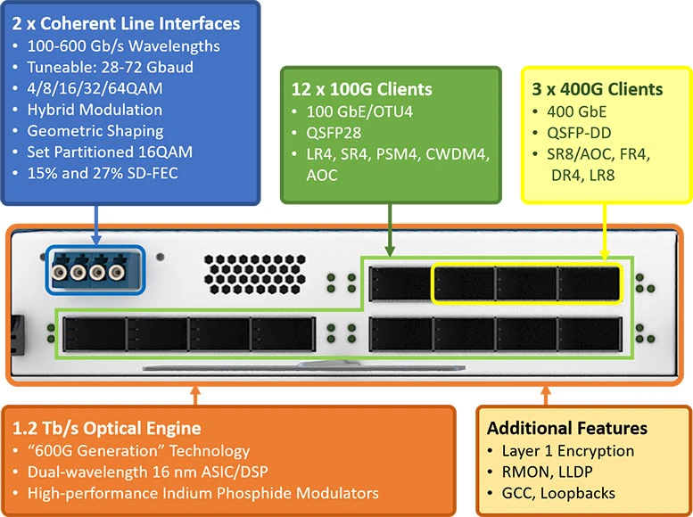
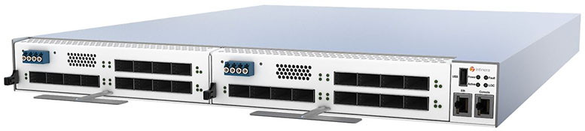
HW Installed for the experimental DCI CERN-CNAF
The transponders installed in test phase are ready for the future production phase (2 devices in each site).
Power consumption: < 700W
Budget per site: 80 K€
CERN
2 x Groove G30 (4 slot Transponder)
2 x CHM2T DCI Metro card (one for each G30)
2 x Plug QSFP28 (SR4) + 1 QSFP-DD 400G
CNAF
2 x Groove G30 (4 slot Transponder)
2 x CHM2T DCI Metro card (one for each G30)
2 x Plug QSFP28 (SR4) + 1 QSFP-DD 400G
CHM2T

Slide 5
UNIs
ROADM WSS
(Wavelength Selective Switch)
CERN – GEANT in Geneva
CNAF – GARR in Bologna
Configuration of the “Line system” CERN-GEANT side and CNAF-GARR side

Slide 6
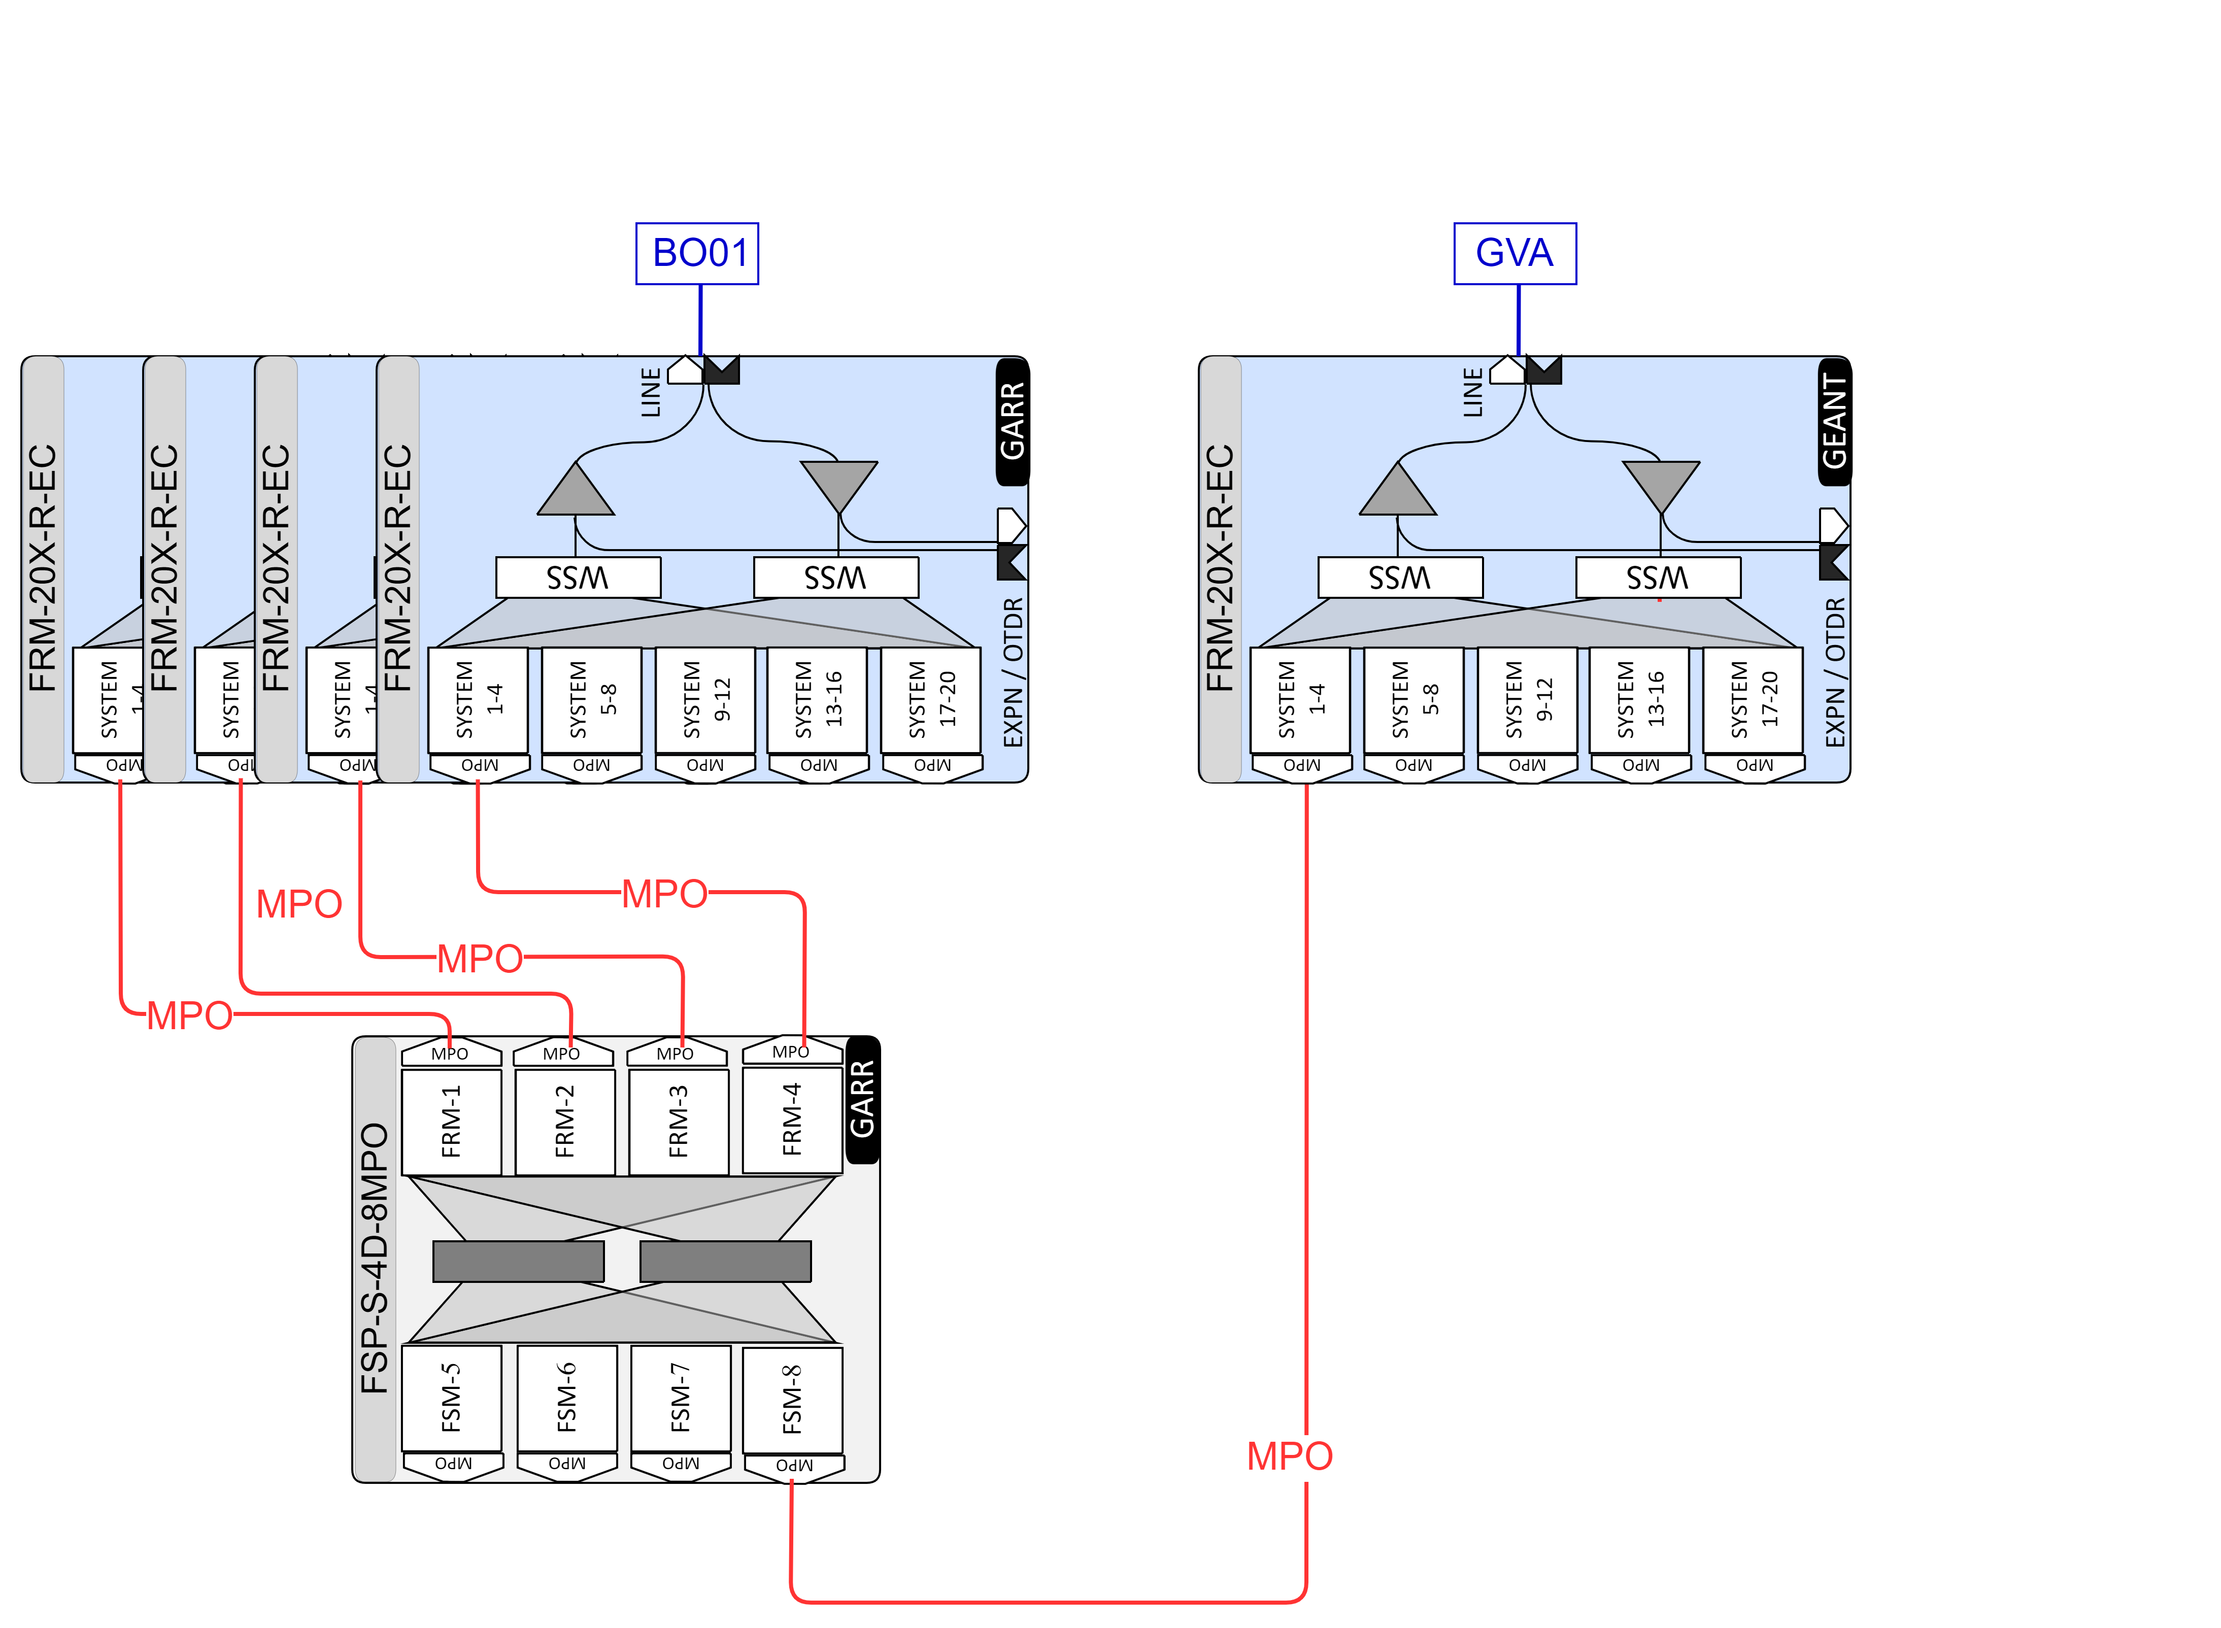
NNI (POP GEANT-GARR POP located in Milan)
WSS directly interconnected
  Privacy: Each circuit is present only on a fiber (no broadcasts)
  Spectrum Policing: circuits are interrupted if the optical power is out of the allowed range.
  Spectrum Shielding: The optical signal is not affected by overlapping with possible spurious signals on the same frequency
FRM = 1x20 twin WSS w/ amps FSP-S = shuffles MPO

Slide 7
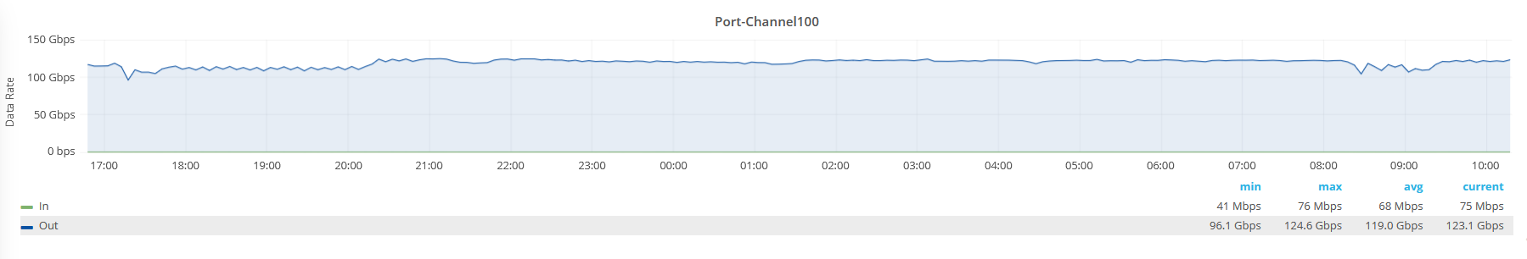
Current state of DCI (CERN-CNAF)
1.6 Tbps available end to end
On 1000 km distance using 69 Gbaud DP-16 QAM* modulation, it is possible to reach 400Gbps per carrier
Having 4 line ports on transpoders, it is possible to reach 1.6 Tbps on this «Circuit» that could be used as up to 4x400Gb Ethernet or 16x100Gb Ethernet .
The spectrum occupation for each carrier is 100Ghz, so 400Ghz (10% of the C band) are suffcient to transport 1.6 Tbps with 9.5 ms of Round Trip Time (Standard routed path is about 13.5ms)
CERN
Geneva
CNAF
Bologna
First end to end IP traffic injection test:
Connected 2 servers in each site to inject about 100Gbps sustainted traffic (iperf) for days in order to test the stability of the circuit and to give the opportunity to tune up the monitoring tools on line systems.
TEST SERVER 1
TEST SERVER 1
SCS
TEST SERVER 2
TEST SERVER 2
2x100Gb LACP
Shared PTP vlan
2x100Gb LACP
«Switch port mode trunk»
Shared PTP vlan
*Dual-Polarization 16 Quadrature Amplitude Modulation

Slide 8
DCI pilot state (CERN-CNAF)
Next steps
Grow in terms of capacity adding 100G Ethernet ports and activating 400G Ethernet interfaces.
Test different transceivers (also third party transceivers on Transpoders)
100G LR (10km)
100G FR (2km)
400G FR4 (2km)
400G LR4 (10km)
CERN
Geneva
CNAF
Bologna
SCS
TEST SERVER 1
TEST SERVER 1
TEST SERVER 2
TEST SERVER 2
CNAF T0-T1 LHCOPN traffic
CERN DC
CNAF DC
Connect DCI directly to Production CORE Routers at CNAF and to production Routers ad CERN
Move OPN (T0-T1) Traffic on DCI circuit to test the link with real traffic setting up the backup path on currently routed lhcopn connectivity.
SCS

Slide 9
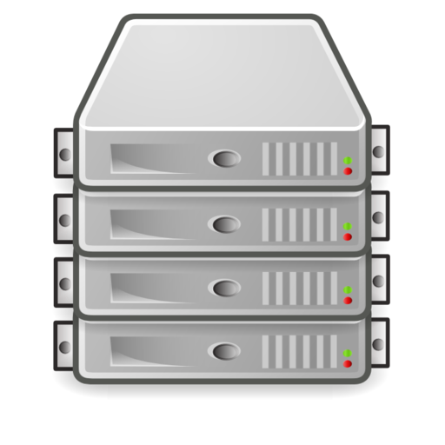
New opportunities
Considering that, this kind of DCI gives the possibility to connect up to 16 x 100G Ethernet or 4x400G Ethernet interfaces to whatever device both sides having only 9.5 ms RTT penalty the possible applications could be many.
Some examples:
A «Classic» BGP peering with a dynamic number of ports contributing to the total capacity - Easy growing in capacity (Shure interest for future production OPN link CNAF)
L2 Stretching of specific networks or IP Fabric stretching between the DCs having for example Leaves located in different Datacenters using the DCI links between spines and Leaves
DATACENTER A
Border LEAF
Border LEAF
DATACENTER B
IP FABRIC
SPINE
SPINE
SPINE
SPINE
Transponder
LEAF
LEAF
LEAF
LEAF
Transponder
LEAF
LEAF

Slide 10
That’s it

Slide 11
Backup Slides

Slide 12
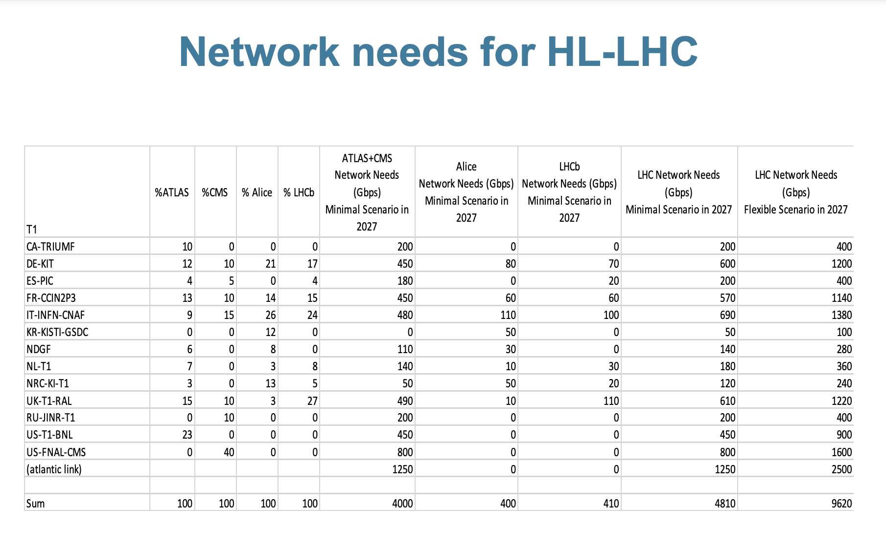
https://indico.cern.ch/event/983436/contributions/4226012/attachments/2213578/3746895/LHCOPN-LHCONE-Mar2021.pdf

