Slide 1
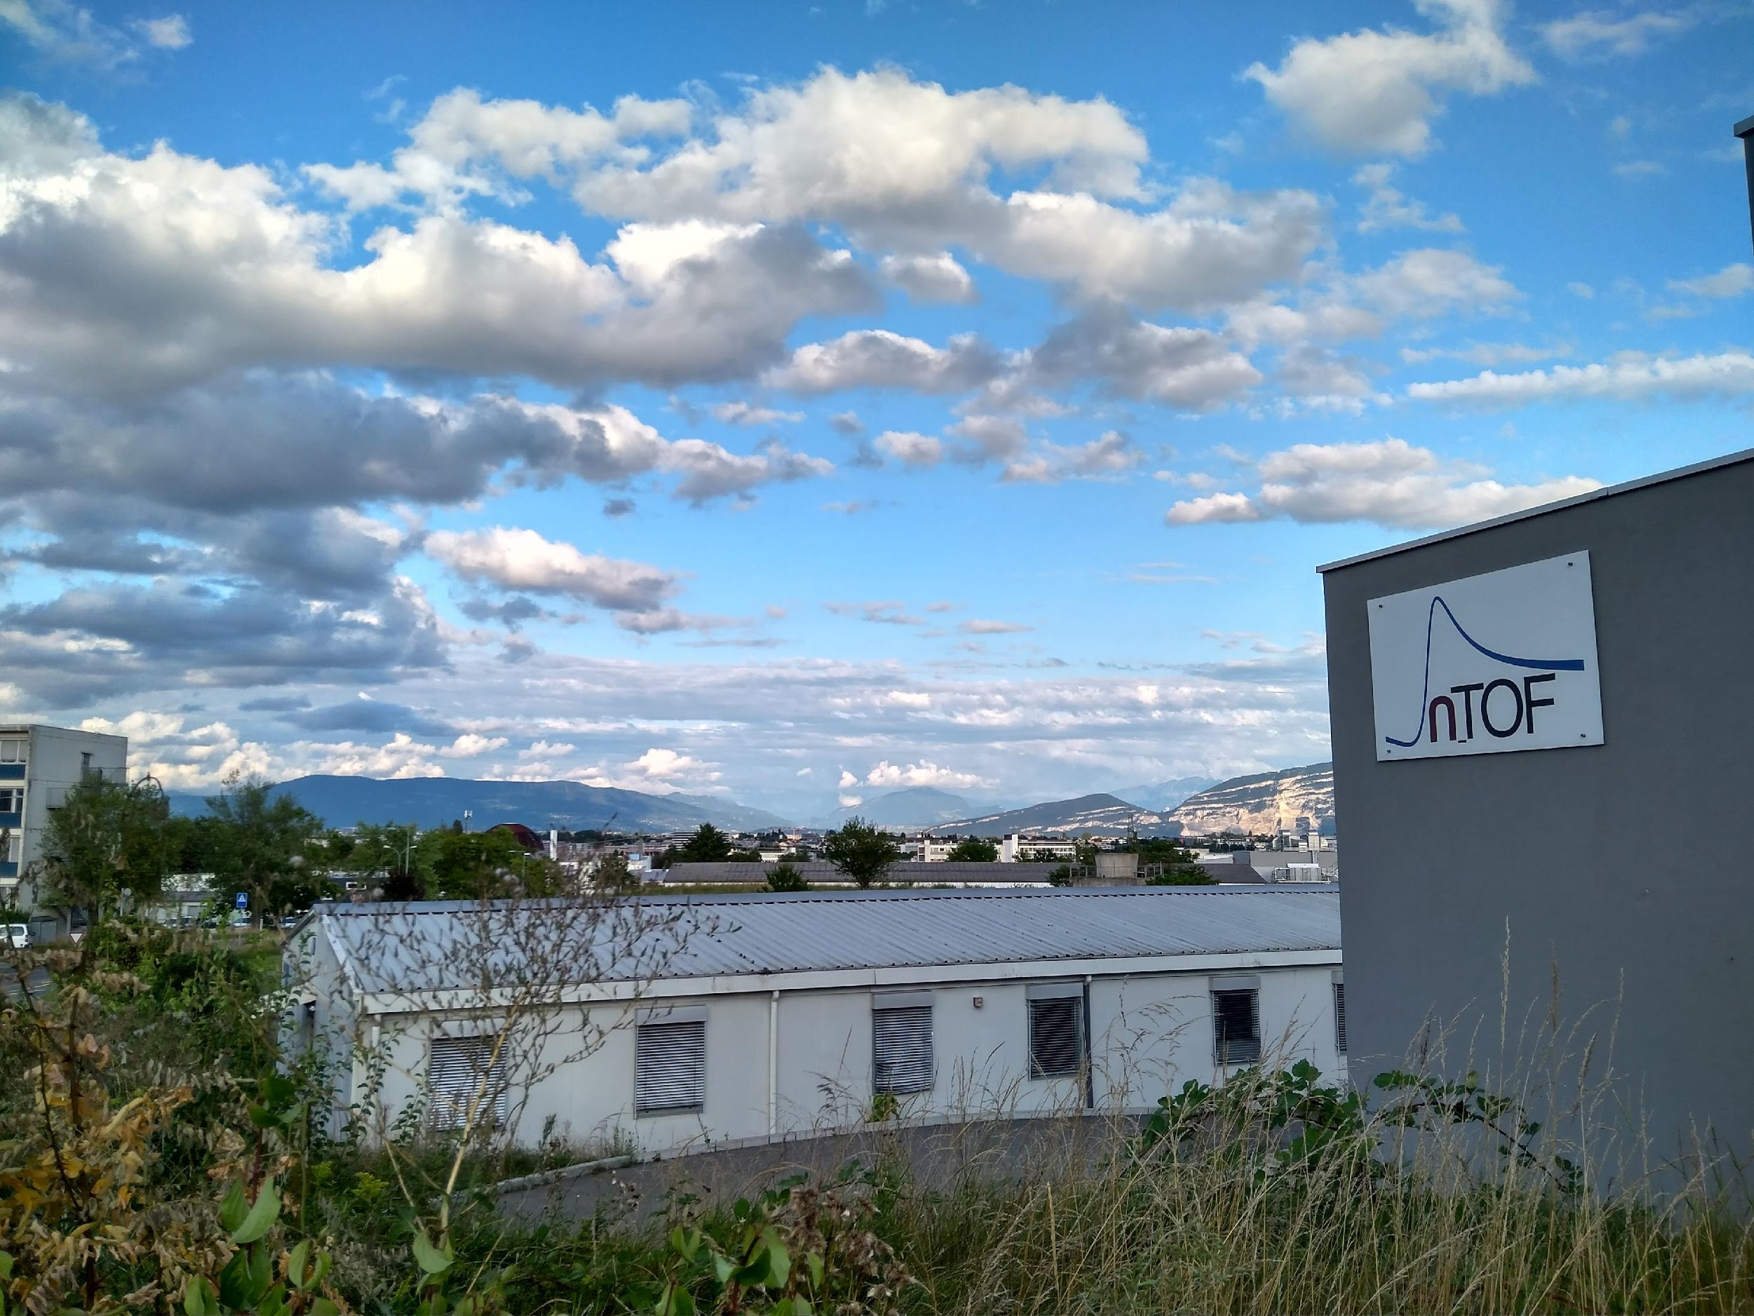



STATUS REPORT OF THE n_TOF FACILITY
Nikolas Patronis n_TOF Physics Coordinator CERN & Univ. of Ioannina | Michael Bacak n_TOF Run Coordinator CERN

Slide 2
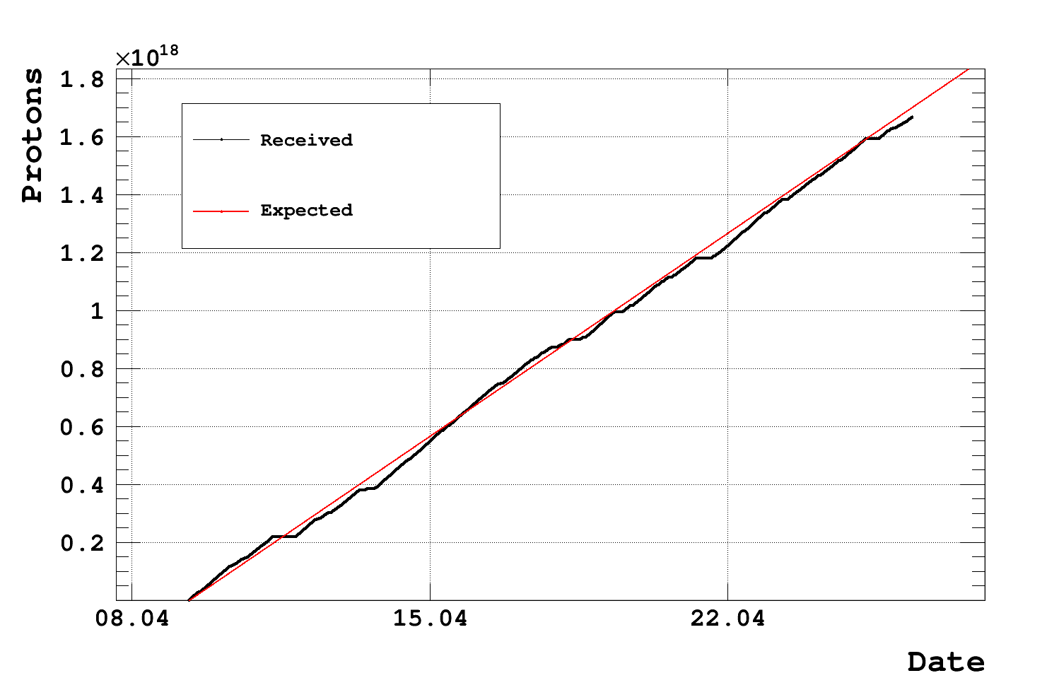
Week 17 Status
Total Physics PoT: 1.7E18

Slide 3
Week 17 Status
The experiments are in data taking mode:
-Neutron inelastic test measurement in EAR1 using HPGe [6Li(n,n’), 56Fe(n,n’)]. This is proof of principle measurement looking into the possibility to launch this kind of measurements at n-TOF
-Capture auxiliary characterization measurements in EAR2
-NEAR: ⁹⁴Zr(n,γ) with 10 mm B4C filter
-NEL: Timepix detector test for ATLAS
Low intensity pulses are requested for optimal signal processing conditions (needed in EAR1)
On Wednesday morning (03.05.2023) a ~5h intervention will be needed to modify sample/filter configuration @ NEAR
Many thanks to the PS teams for being patient with our frequent interventions!

Slide 4
Thank you
iTED @ EAR1
sTED @ EAR2

