Slide 1
Supervisors session / IR
HR-PXE / Lore & Jenni
4 May 2023

Slide 2

Supervising?
Finding your way in the current programmes:
need identification, selecting, managing.

Slide 3



Agenda
WHERE TO START?
Identify your need & select the right profile
BEFORE WE START
Fellows, grads, and students - incl. philosophy
GUIDELINES & SUPPORT
Navigating full cycle from
opening a position until
end of contract

Slide 4


Objectives
You as a supervisor
Understanding your resourcing options
Identifying your need/ opportunity
Selecting a candidate
Managing a grad/fellow/student: responsibilities
You are not alone – support
THEN
NEXT
START

Slide 5
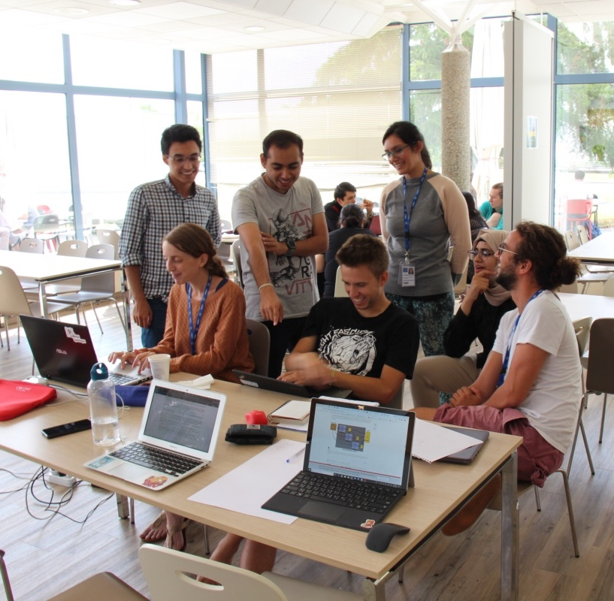
Students (MPAt) TECH / ADMIN / DOCT
Philosophy: here to LEARN, to get experience & exposure in their field, finish their thesis on a common topic
Work on a (1) project (2) in their field (Thesis!)
Work content: non-critical work or deadlines
Exposure = OK, but SV is responsible and accountable
Supervisor in same field to support and challenge them, give feedback. Can be a FELL/GRAP IF trained and motivated
For DOCT, person with PhD themselves
Developmental value: work environment, work content, developmental feedback & dialogue
Talent pipeline!
Important ambassadors for CERN
Notes:
You have an opportunity, more than a need

Slide 6
Graduate programmes: a shift in paradigm

Slide 7
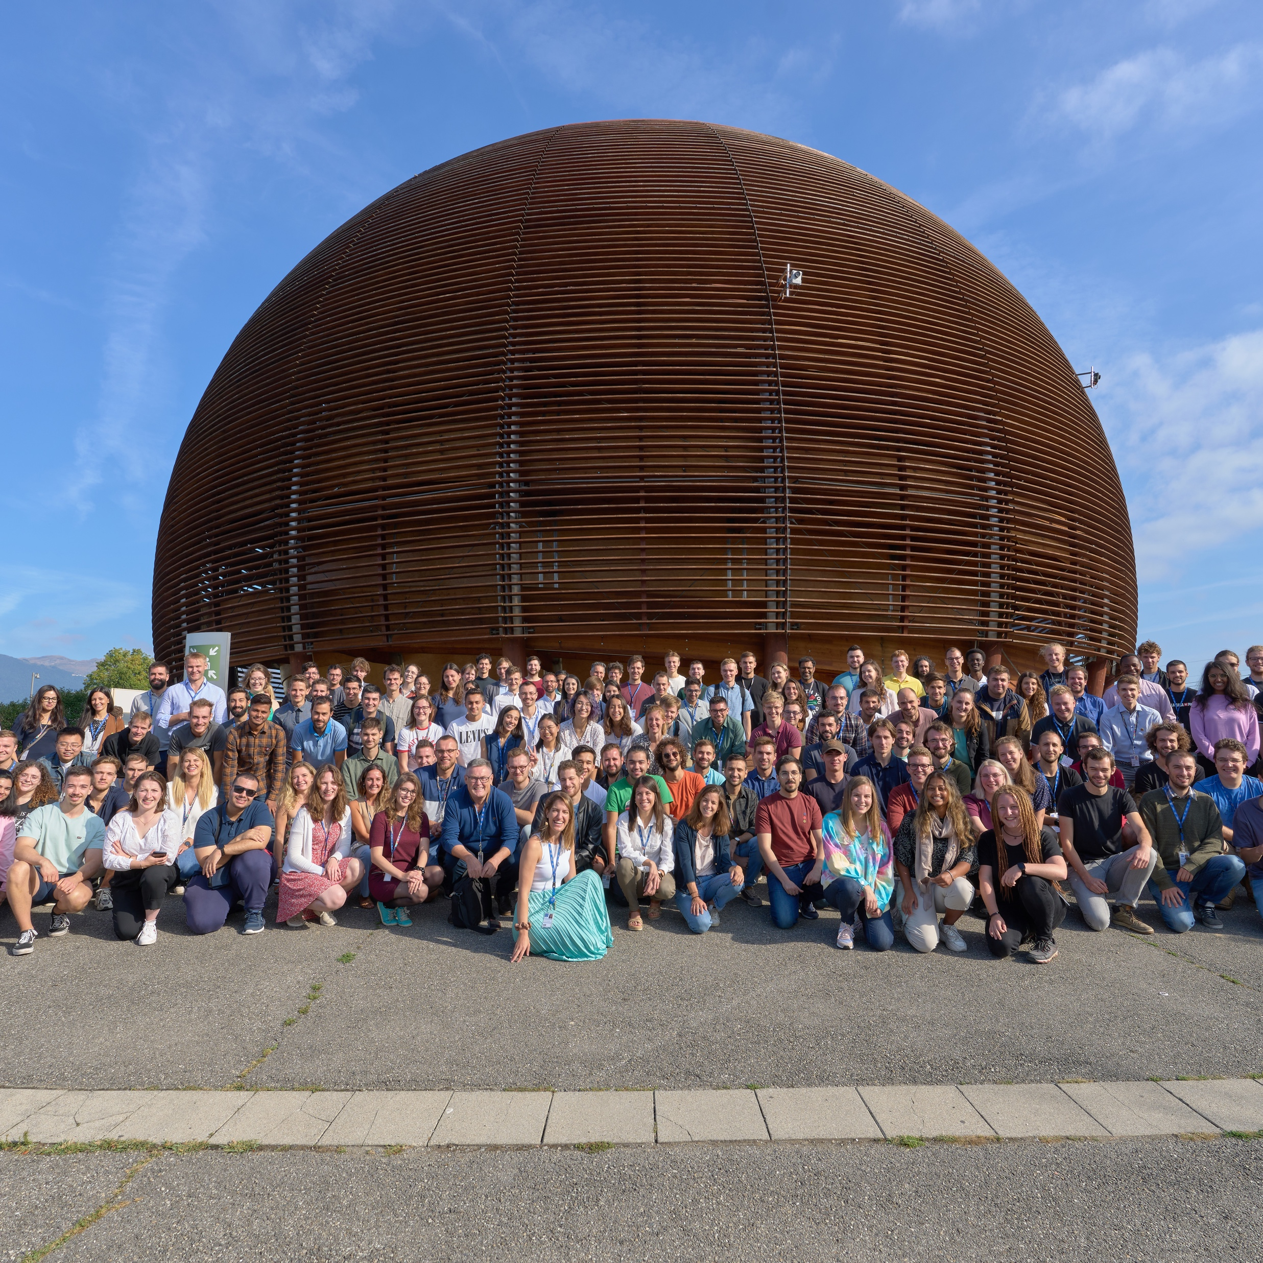
Fellows (MPE)
Philosophy: “springboard for your career”
Types: Senior, junior, TTE
Work content: project
Supervisor: staff, motivated & trained
Mis-use: missing staff
No new ones (in IR)

Slide 8
Graduate programmes: a shift in paradigm
No mapping previous vs current programmes (jr FELL = NOT an ECP!)
Start with the need – specific vs 'supermarket shopping'
All GRAD programmes developmental, but in different ways
Type of work different

Slide 9

Introducing the grads
Clear philosophy
Talent pipeline!
~ Pillar of education/development
Similar conditions for similar work;
proper employment contract
Opportunities to welcome more Grads vs FELL -
if used appropriately (<> Sr vs Jr FELL)
Corresponding to Org’s needs (GRAE vs GRAP)

Slide 10

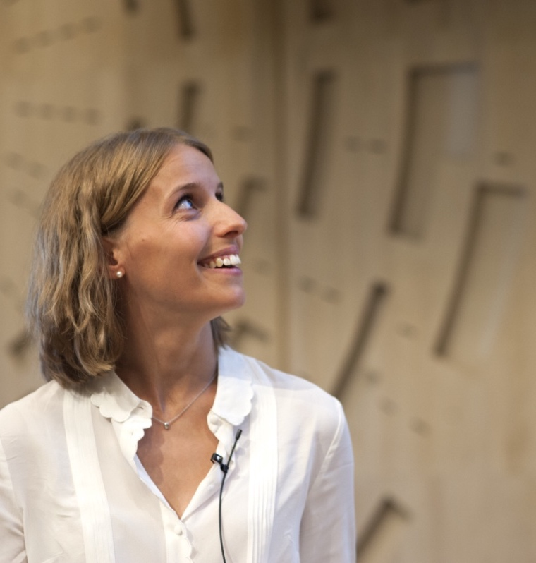
Early Career Professional (GRAE/ORIGIN)
Up to 2 years relevant job experience
Starting their career: learning to work / work in their field (investment!)
Work: participating to bottom-line operational work
Developmental value < mainly on-the-job learning
SV: staff in same field = a professional
Talent Pipeline; ambassadors!
Eligibility: From general secondary education to Master level, with max. 2 years of relevant experience after your highest degree
Length: From 6 to 36 months, in principle duration of 24 months

Slide 11
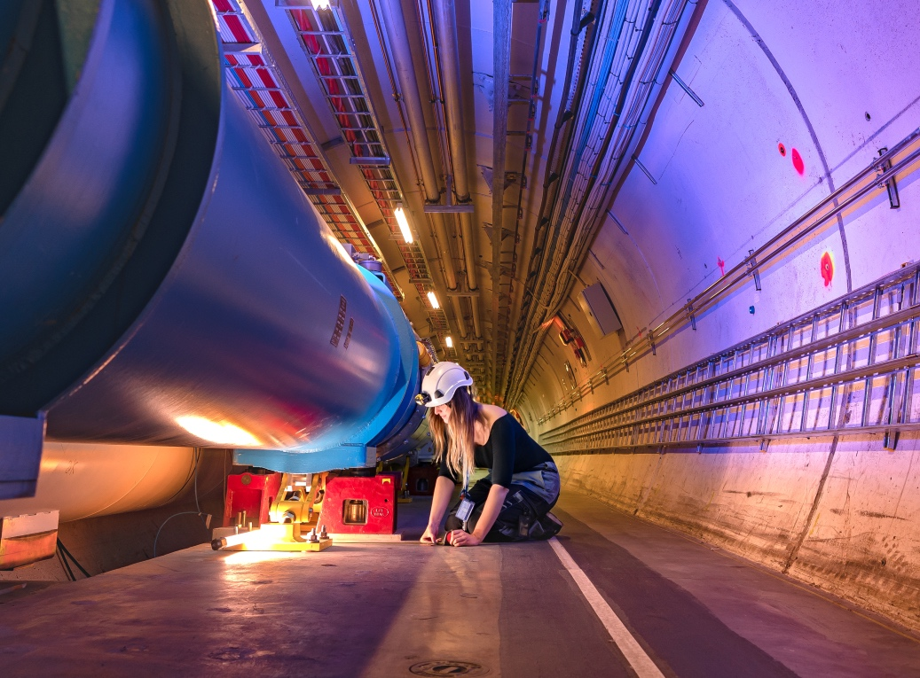

Experienced Project Graduate (GRAP/QUEST)
~ 100 positions/year
Up to 6 years relevant job experience
Work: specifically to do projects A-Z
No operational work!
Developmental value: deepening expertise,
building a network – exposure, conferences, presentations…
SV: staff with MSc or PhD; expert in the field ideally
Eligibility: Master’s with 2 to 6 years of relevant experience or PhD with up to 3 years of relevant experience
Length: From 6 to 36 months, in principle duration of 24 months

Slide 12
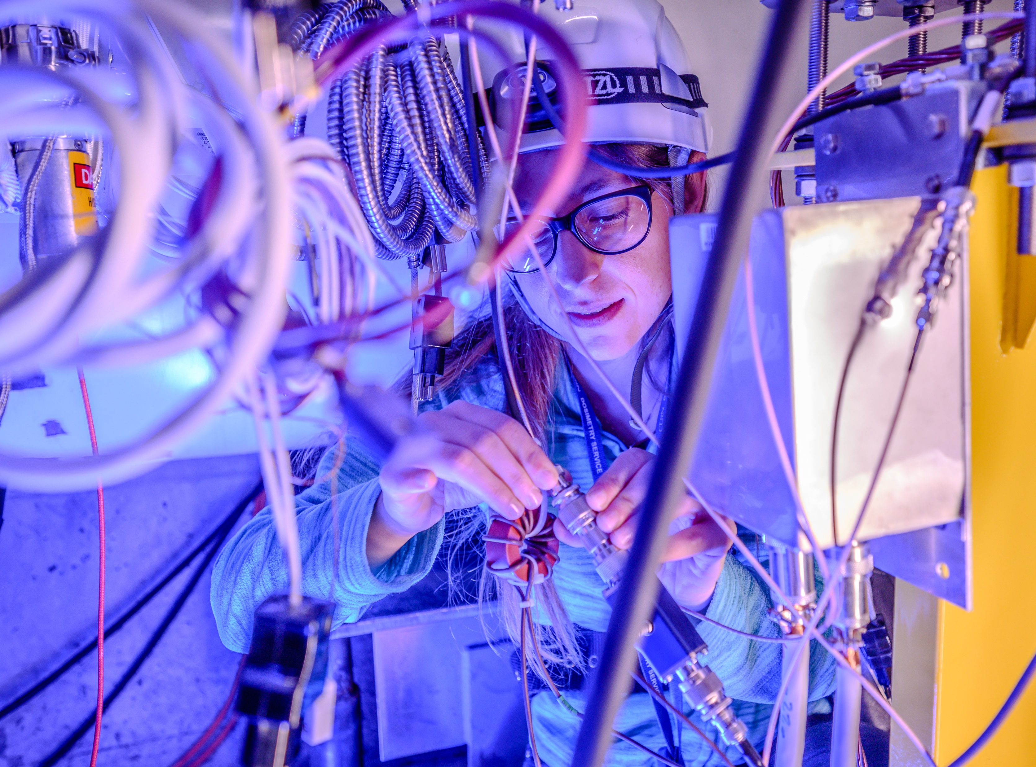

Research Fellows
~ 40 positions/year
Applied physics, electrical or electronics engineering, general or civil engineering, IT, mathematics and robotics, material and surface science, mechanical engineering…
Establish credibility and gain international exposure
A stipend ranging from 6650 to 7050 Swiss Francs per month (net of tax)
Comprehensive health insurance (for yourself, your spouse/partner, and children)
Membership of the CERN Pension Fund
Other benefits may include: installation grant, family, child and infant allowances; payment of travel expenses at the beginning and end of appointment
2.5 days of paid leave per month
Eligibility: Theoretical and Experimental Physics: PhD with up to 6 years of relevant experience
Applied Sciences and Engineering: PhD with up to 3 years of relevant experience
Length: From 6 to 36 months, in principle duration of 24 months

Slide 13

Identifying your need
What can you offer?
Nr of projects, a bit of operations at the right level, solid and motivated supervisor
Operational work, day-to-day
Specialized work requiring deep skills, in the context of a project
In any case: work needs to be at the level of the person’s relevant studies!
Work/project description: clear, concise, honest. Ask to be challenged/ assess level!
It starts with your need, not with a(ny) person
Best support if you are transparent with HR

Slide 14

Selecting
Screening: seek to eliminate biases (review candidates with # people)
Students & ECPs: based on potential
Diploma = proxy of field; motivation
Conversation with candidates prior to selection - plan, exchange, be clear on the topic and what you have to offer!
Understand motivation & interests.
Make time for questions (iterate); on culture & context too!
Make sure the profile matches the needs, team, and role(s).
Second call after the selection moment to confirm mutual interest

Slide 15

(Pre-) Onboarding
Pre-onboarding period: stay in touch! (key moments)
Onboarding: be present, plan, and make time for your new hire
Objective setting (IND but also for students): revert to your project description/ PRQ -> SMART. Stay true to promises! .
Agree on how to work together – what does the person need to do their best work? what do you expect?
Organize regular check-ins from the outset. Are things working from both ends?
Check alignment with expectations in terms of behaviour and delivery and follow up closely

Slide 16


Your contact throughout
the Onboarding stage
Keep an open door via different channels
Offer contact with other colleagues in your team
Regular Check-ins in critical moments:
    After signing the contract
    A month before starting at CERN
    A week before starting at CERN
Schedule a meeting on the first work-day from lunch onwards

Slide 17




Changing perspective
First time professional work experience?
First time at CERN?
First time living abroad?
Which implication does this have on your management style?

Slide 18

Onboarding support from HR side
Welcome Session in the Globe on the first day
DAO picks up new colleagues afterwards
Dedicated welcome session with PXE colleagues during the second week
Information sessions with pension fund / CHIS / IT security
quarterly "connecting the dots"
MoP need to reach out to medical service -> check whether the Organization needs to adjust the workplace to individual needs

Slide 19




Supervising
STUDENTS
regular check-in.
Touch base on
how it's going with school/uni work.
QUEST
need exposure,
contacts, network.
Developmental feedback.
STUDENTS & ECP
often junior, need guidance, learning how to ‘work’. Developmental feedback.
DOCT
3-way collaboration.
PhD = most important.

Slide 20
Support
Student/grad/fellow themselves: ask them to share their needs, expectations & feedback
Set time aside to both supervise and create/maintain a good relationship
& HR-PXE – here to support all the way; regular pulse-checks
& Training – Getting to grips & more
& Community – 12+18; Mattermost;
        each other
      & CERN psychologists

Slide 21


Exercise

Slide 22

How would you like to work together?
Beginning of the work relationship is a crucial time. You only have one first impression.
  Which supervisory style works for yourself and for your new colleague? (check-ins/expectations)
  What does the work culture in the team and department look like?
  Which flexibility can you allow regarding work times?
  Which flexibility exists for your supervisee in terms of teleworking?
  When is it useful or even critical to be on site in your team?
  Which meeting times are convenient for my new colleague?
  Which response times do we expect in our team?
  Which topics do we discuss in person, which ones rather by phone or email?

Slide 23
Successful induction
When? Within 6 weeks from start date
How long? Take the time – we recommend at least 1h
What? Discuss the work, expectations, deadlines and necessary trainings
Any doubts? Ask your HRA/HRC for tips!
Set measurable objectives
SMART: specific – measurable - achievable – relevant – time – bound
Bigger picture
Align how you will work together (e.g. weeklies, regular check-ins) from the beginning
Work relation
Learning/training
Motivate the specific objectives by explaining how this fits in the bigger picture!
Wherever meaningful or possible, you may specify longer term goals
Discuss any learning/training they need to be operational & for their development
Bringing the best out of them depends also on your ability to adapt and create an environment for them to perform at their best
For the first 6-12 months in line with the duration of probation – go back to work/project description
04/05/23

Slide 24
How to set goals during the induction interview?
1) Work objectives
SMART goal - ECP example
Get back to all tickets within 15 hours concerning the CERNBOX functionality to reduce response time to the current 17 hours.
SMART goal - Project Graduate example
Develop at least 3 ideas for the design of cables connecting the ATLAS small wheel and the ATLAS Data interface by 15 of August to ensure the production start of cables by 15 October that eventually lead to a successful installation of the new cables during the next YETS.
SPECIFIC
2) Development goals
Develop Python programming skills by participating in a UDEMY course and finalising 2 coding assignments until end of June
MEASURABLE
Important for 2 reasons:
  to have clarity about tasks, the role and expectations throughout the probation period
  important document to check whether your supervisee is on track
ACHIEVABLE
RELEVANT
TIME-BOUND

Slide 25
And then what?
Stay tuned
Adapt
Evaluate
Steer
Feedback
Touch base regularly with your supervisee and have discussions that go beyond daily tasks: what drives them, what are they enjoying/not?
Always aim to put people in a position where they can deliver well!
Good supervision takes time: be available for questions and/or guidance.
Everybody needs feedback – give it & ask for it as a supervisor! Don't wait for a report to observe, assess and discuss. Intervene as soon as you see misalignment on priorities, expected behaviours etc.
Ask how they are doing: what is working, what could be better.
04/05/23

Slide 26

Mid/end probation
When?
Staff (12 months): mid-report at 5/6 months; end-report 11th month
Grads/fellows (6 months): no mid-report but an email to supervisor with support and instructions. Important milestone: check in! End-report 5th month
What?
Assessing the what and the how against induction objectives
(quality – quantity – behaviour)
Good opportunity for a structured and detailed exchange: what went well, what could be improved. Are they on track for reaching objectives and what do they need to do their best work?
Possibilities
Confirm contract / Extend probation / End contract
Don’t wait!
Observe,
assess & give feedback,
steer/ intervene early
Don’t observe for failure: set up for success.
When in doubt, call us!

Slide 27

The floor is yours

Slide 29
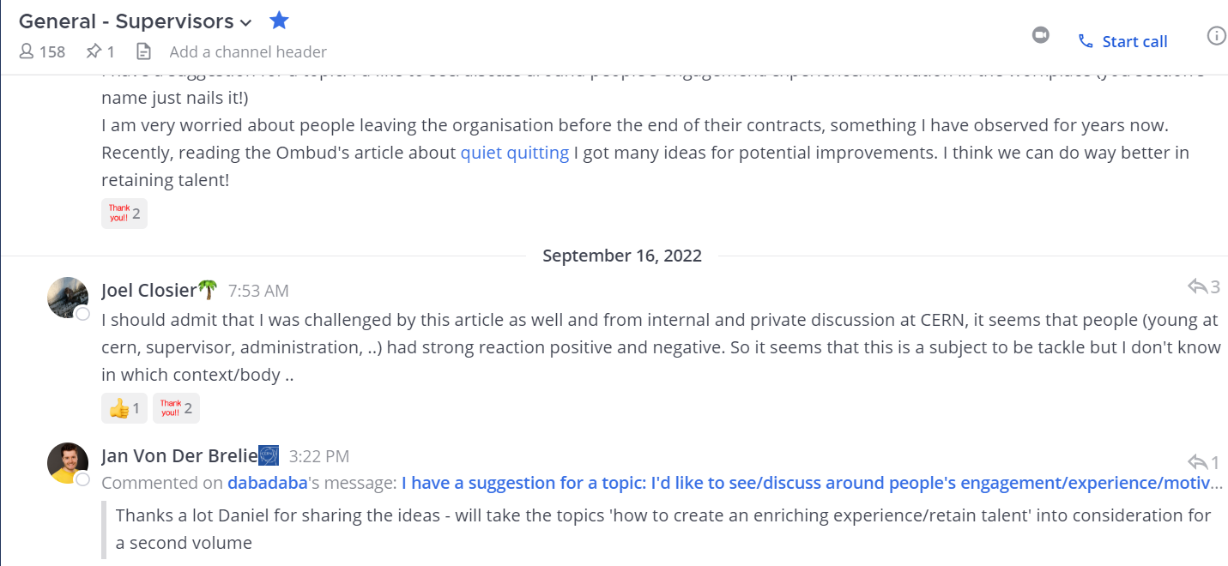
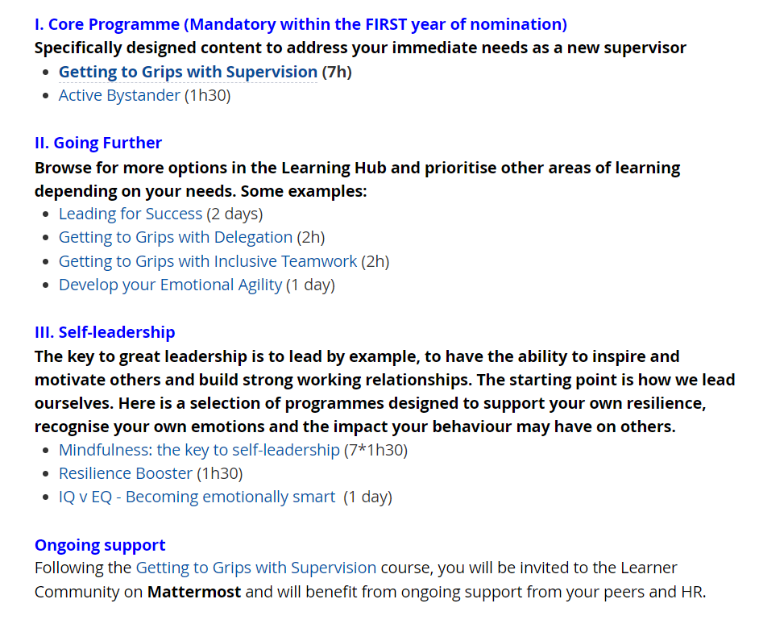
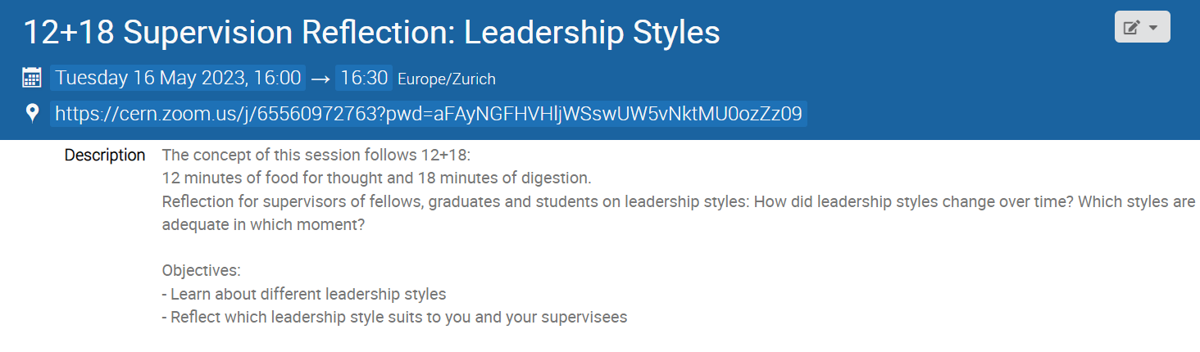
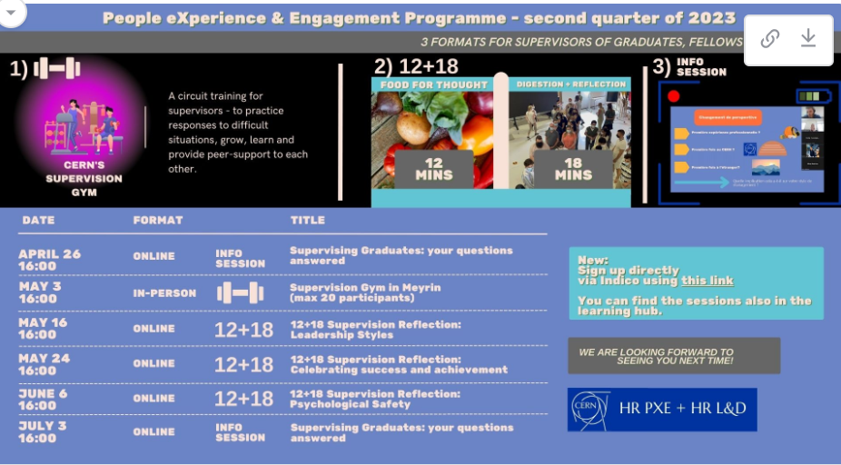
learning journey supervisors

