Slide 1
Flat optics for HL-LHC at the start of leveling
S. Kostoglou for the BB team

Slide 2
Introduction
A first HL-LHC scenario with flat optics based on DA studies:
  Using 8b4e filling scheme to simulate exact BB patterns: Simulating bunch with the largest number of LR encounters in all IPs.
  Focusing on H (IP1)/V (IP5) crossing with the following optics:
    0.5/1 m for the start of the luminosity leveling with crab cavities enabled.
    7.5/18 cm for the end of luminosity leveling with crab cavities enabled.
    Choice of optics is under discussion, simulations will be repeated once a specific optics scenario is decided.
  Focusing on start of luminosity leveling, to evaluate impact of:
    Chromaticity: 5 vs 15
    Bunch intensity: 2.3e11 ppb vs 2.5e11 ppb
    Octupole current: a look into negative octupole polarity
    IP1/5 crossing angles: ↑ crossing angle w.r.t 250 urad to see if DA improves (within specific constraints), ↓ crossing angle to identify BB limit.

Slide 3
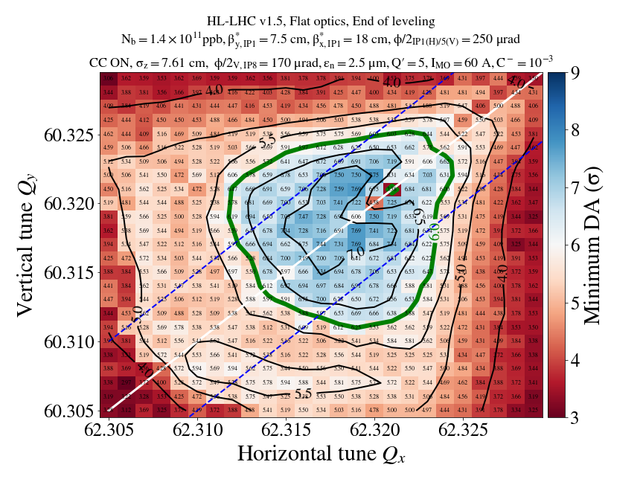
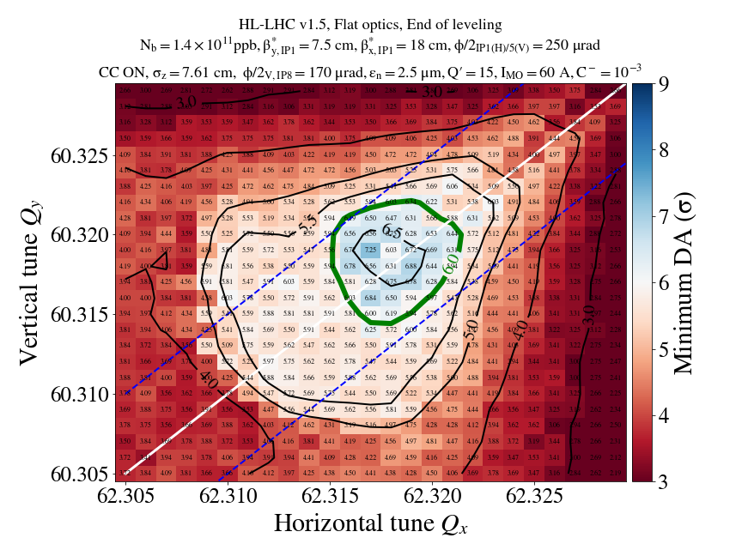
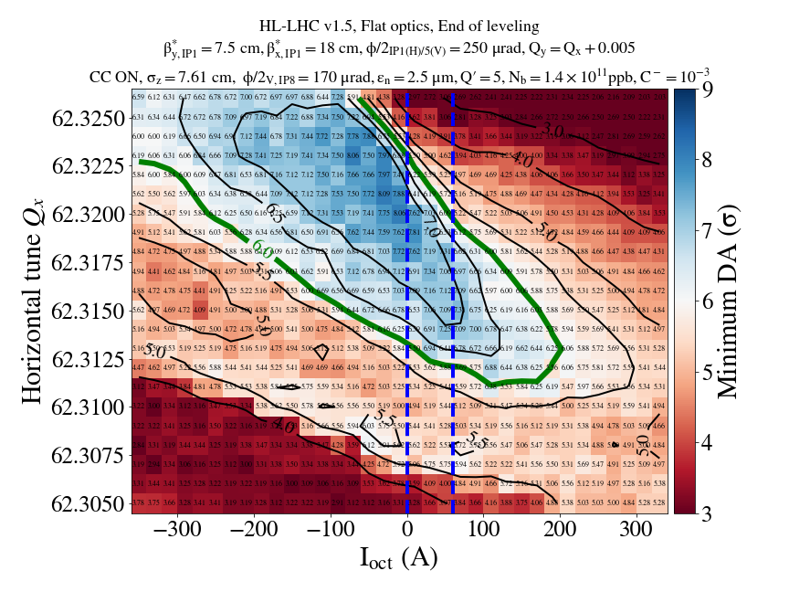
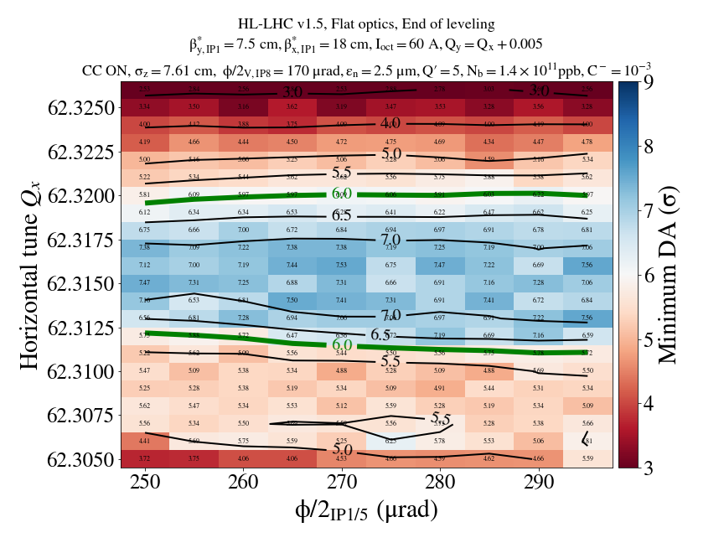
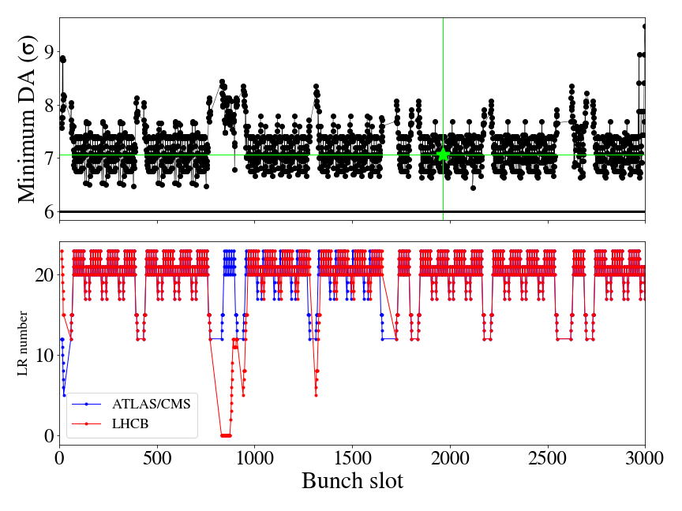
Summary of previous studies
  Summary of EOL studies:
    Bunch intensity: DA target reached with 1.4e11 ppb, +60 A, 250 urad and chroma up to 15.
    Chromaticity: Powerful knob, chromaticity 5 instead of 15 with 8b4e yields a 1σ DA improvement.
    Octupole current: Switching to negative octupole polarity (& applying tune trim to stay optimized) is a powerful knob.
    IP1/5 crossing angle: No significant improvement when increasing from 250 to 290 urad. Extended crossing angle scan to identify BB limits.
    Bunch-by-bunch DA variations: maximum 0.5 σ DA bbb variations (tested only for 1 WP). Attempt to identify a bunch classification approach to reduce number of simulations.

Slide 4
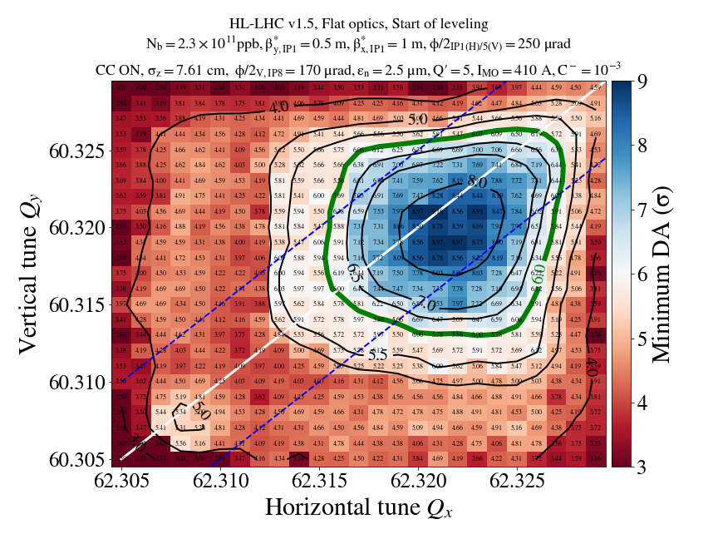
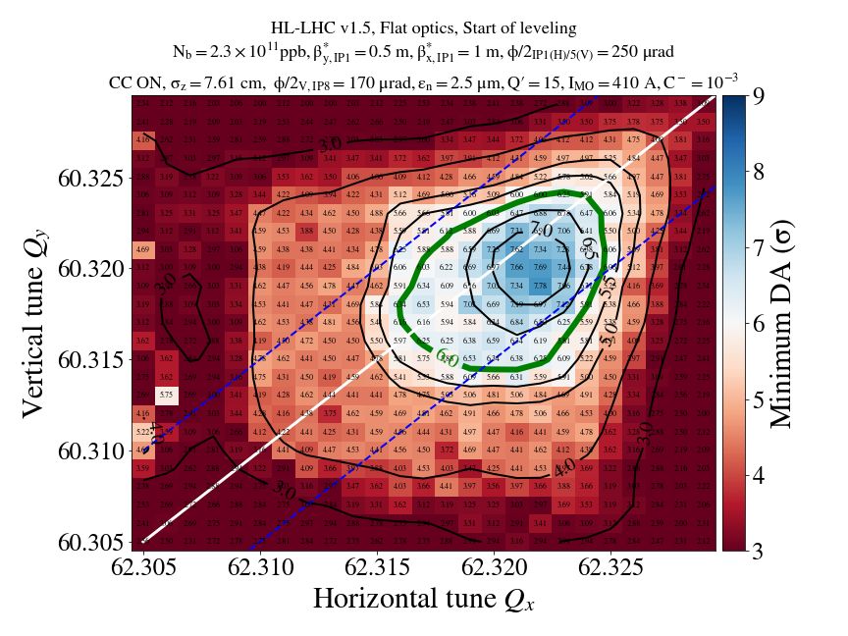
Tunescan chroma 5 vs 15, 2.3e11 ppb
As observed with EOL, 1σ DA reduction if chroma 15 instead of 5

Slide 5

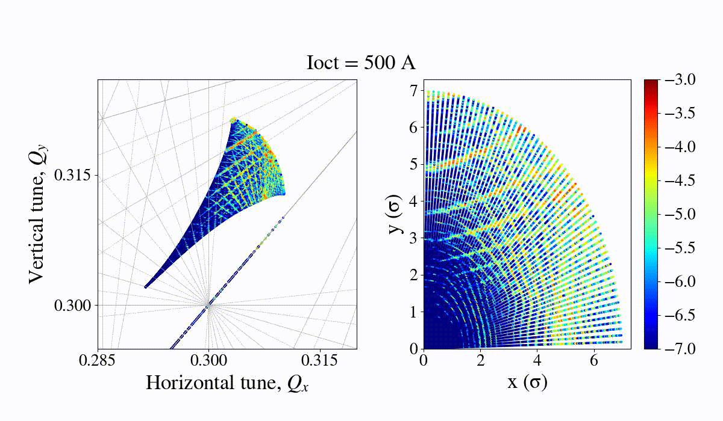
FMA, octupole scan

Slide 6
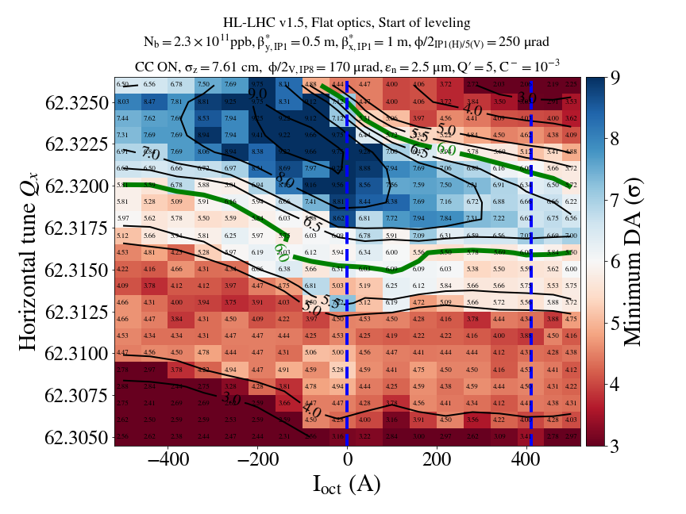
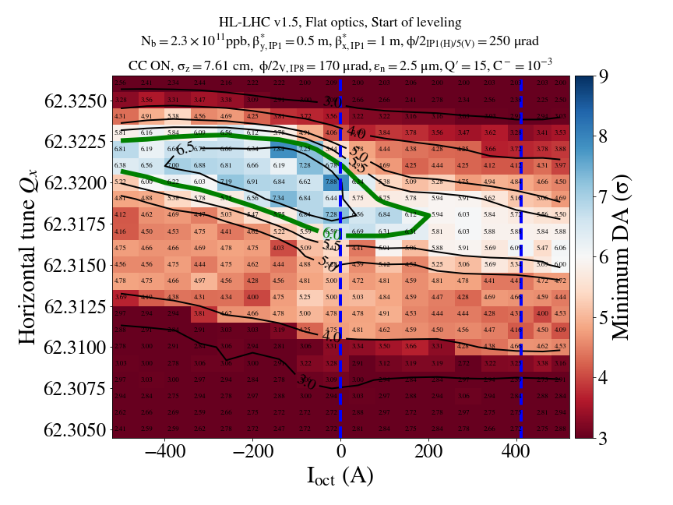
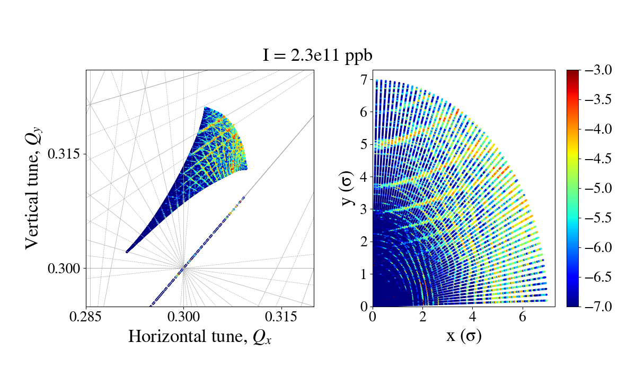
Octupoles vs WP for chroma 5 vs 15, 2.3e11 ppb

Slide 7
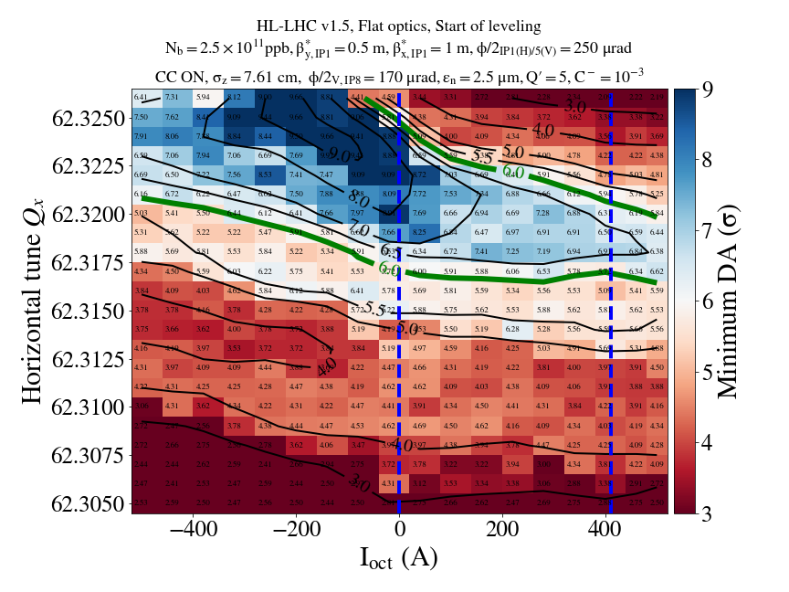
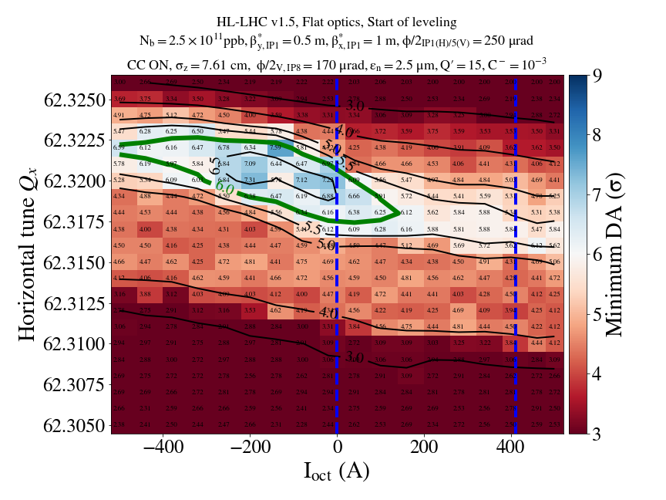

Octupoles vs WP for chroma 5 vs 15, 2.5e11 ppb

Slide 8
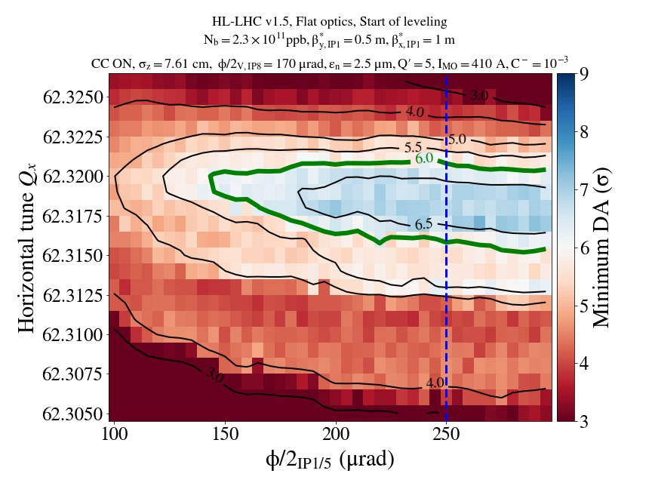
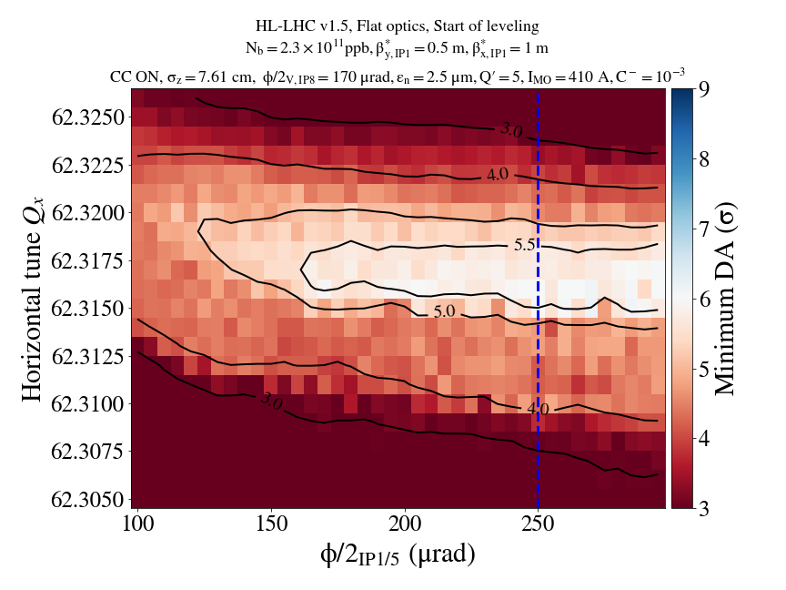
Crossing angle vs WP for chroma 5 vs 15, 2.3e11 ppb

Slide 9
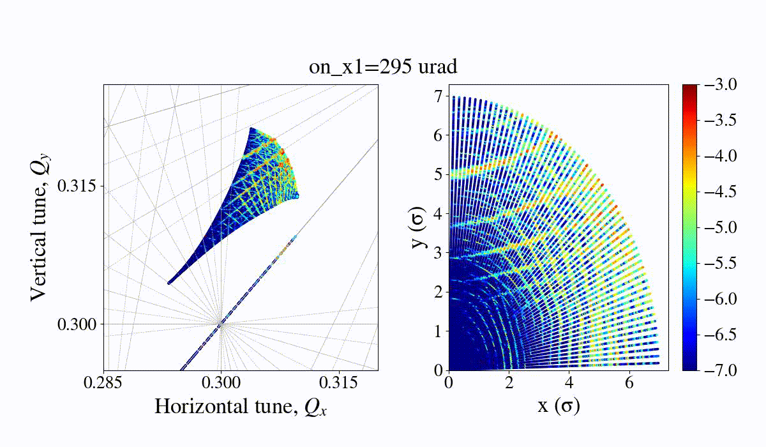
FMA, crossing angle scan

Slide 10
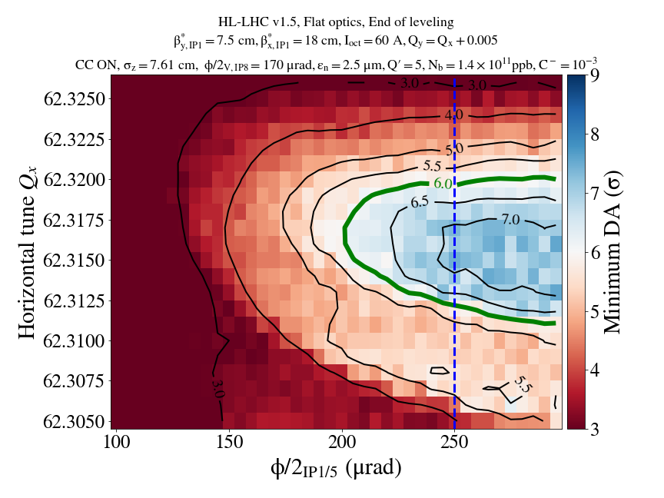
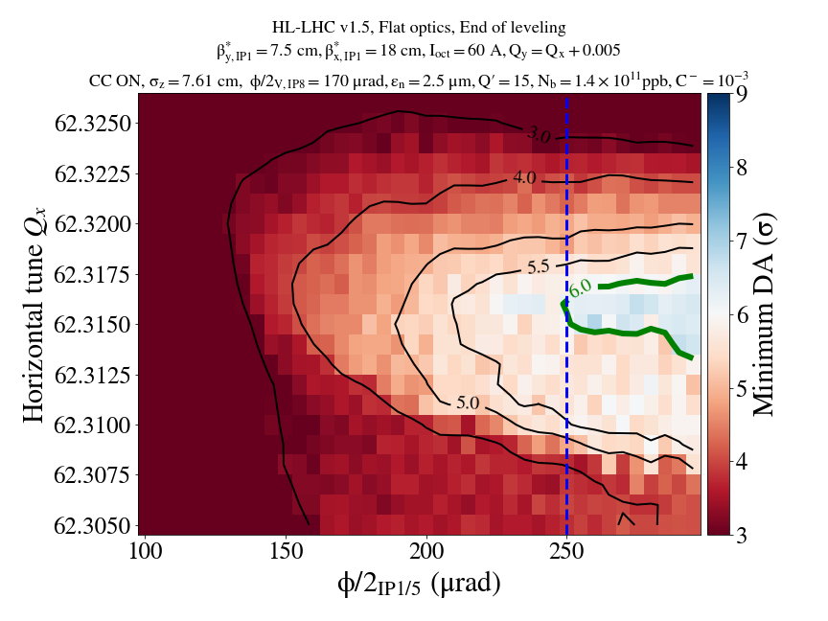
EOL: Crossing angle vs WP for chroma 5 vs 15, 1.4e11 ppb

Slide 11
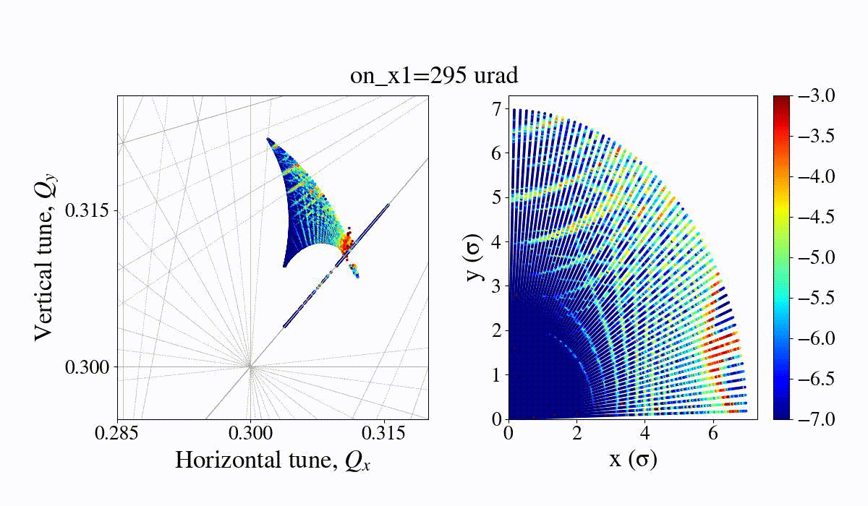
EOL FMA, crossing angle scan

Slide 12
Next steps
G. Sterbini & C. Droin will take over DA simulations in collaboration with HL optics team R. De Maria & Y. Angelis.
Main open points:
  Optics: Converge towards the optics of the whole leveling process, prepare optics and repeat simulations for various optics (Y. Angelis). Ultimate goal to simulate the whole leveling process.
  Filling schemes: Repeat simulations for different filling schemes such as hybrid or standard (C. Droin).
  Negative octupole polarity & chromaticity: Promising results (especially when chromaticity=5) not only for EOL but also for SOL (would allow operating even with 2.5e11 ppb while maintaining a good lifetime). Can it be considered for the whole duration of collisions? Only EOL?
  Crossing angle: Increasing above 250 is not beneficial. However, margin to decrease the crossing angle to reach BB limit both at SOL and EOL and to push performance. Is this something to be considered?
  DA bbb variations:
    Requires bunch classification. Clustering analysis (C. Droin) shows that simple observables such as number of LR encounters and footprints are not enough to decompose into a few bunch classes, more complex early indicators are currently studied.
    To repeat studies for different filling schemes. Are we still around 0.5σ for end of leveling? Start of leveling?
  Other activites: Studies of wire with flat optics, presence of coupling in the strong beam with flat optics (WP2 action).

