Slide 1
String test and drawings readiness
R. De Maria

Slide 2
Introduction
HL-LHC Working Group on Alignment Meeting Minutes #63 on March 1 2023
When discussing Survey Guidelines drawings, “RDM asks if the document is already applied for surface installations like the collimator mock-up and the SM18 String Test. It is confirmed that the document is applied to these installations and that equipment owners that are not familiar with the process are guided by BE-GM personnel in their contribution. AH confirms that for SM18 String Test, the process is running smoothly.”
Fast forward to April 26 2023:
Bonjour Sebastien,
Unfortunately we will have to postpone the tracing on the floor until week 22.
This morning with Jean-Fred we had a meeting with Riccardo and Oussama on the matter of the drawings. The biggest issue was the changes caused by the D1 bump. Because of that, we will need some more time for the changes and approval process.
I will keep you informed and confirm the final date as soon as we know it!
Kind regards,
Kacper WIDUCH

Slide 3
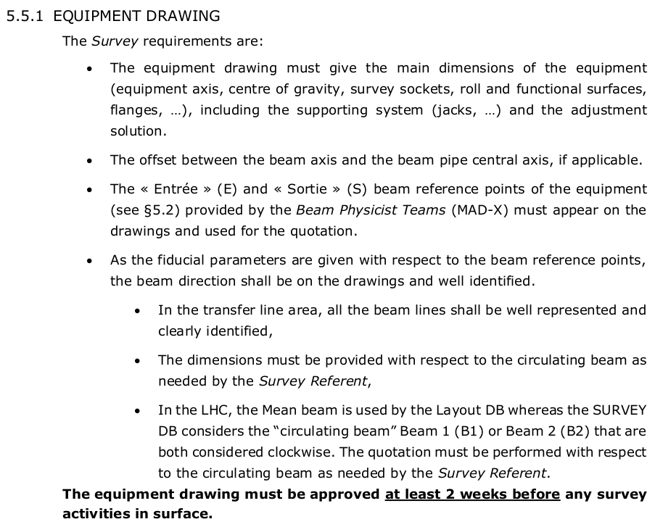
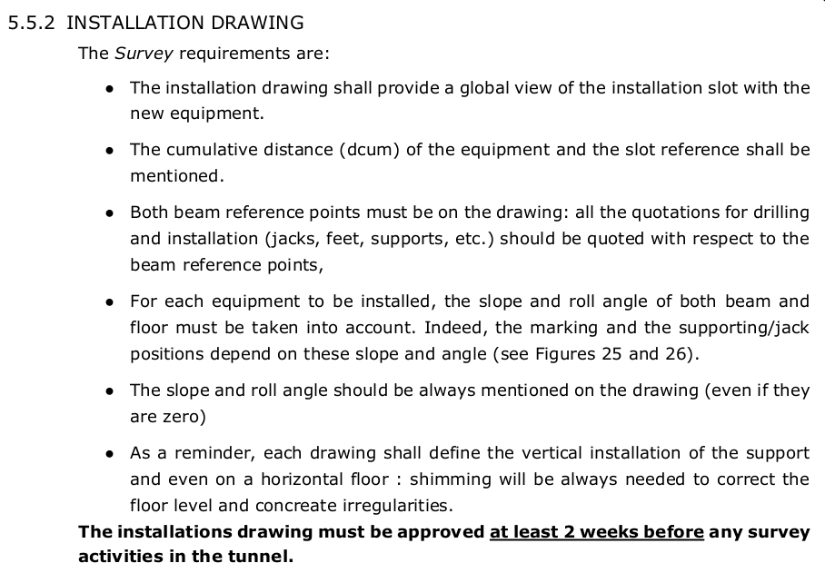
Survey guidelines and drawings
Survey Guidelines approved by all DH and GL states that:
The Equipment Owner is responsible for the delivery of two types of drawings (see §5.5) that will be needed by the Survey Referent as a nominal input:
A “equipment drawing” (assembly drawing) defining the supporting and adjustment system for each equipment,
An “installation drawing” taking into account the in-situ configuration of the beam and the tunnel floor inclination (slope, roll).
The equipment and installation drawing for D1 and the string do not exist yet.

Slide 4
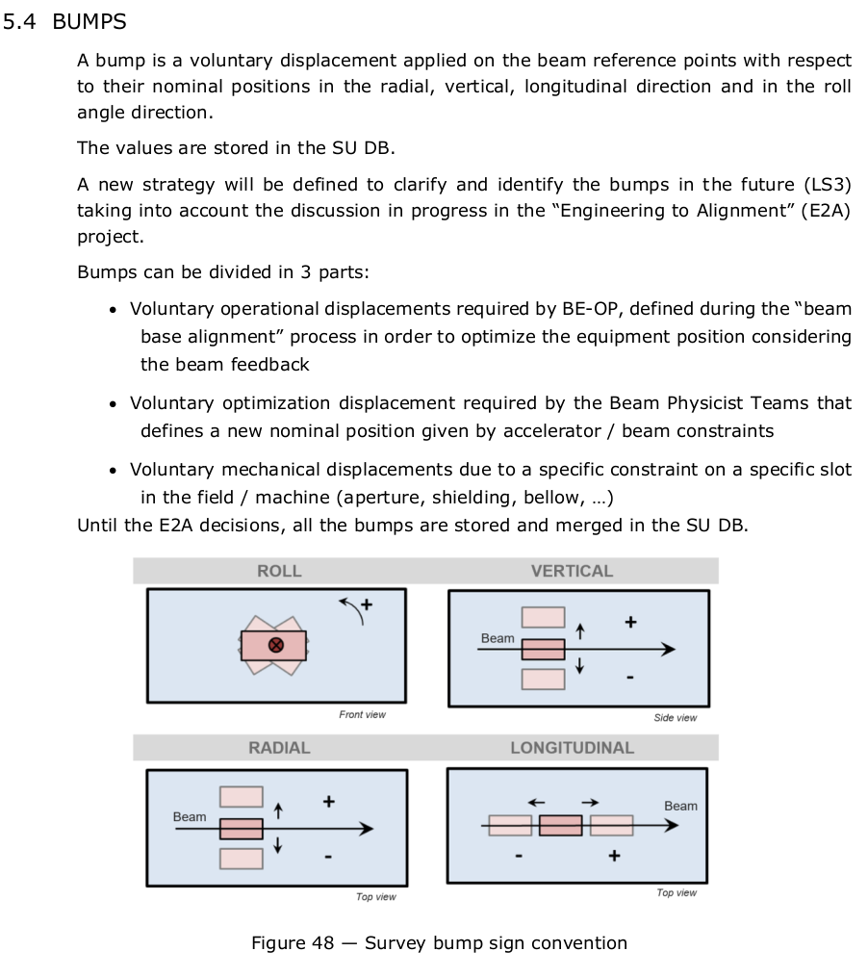
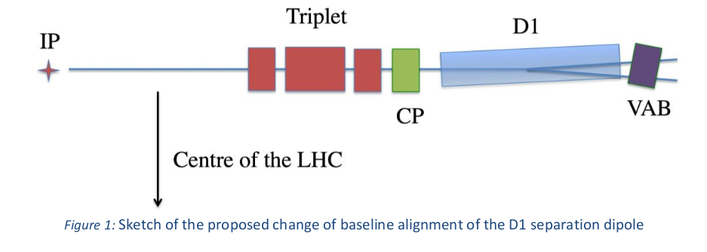
Survey guidelines and bumps
D1 requires a voluntary displacement: HL-LHC ECR WP15-WP3: Alignment of the D1 separation dipole in IR1 and 5 to maximize available beam aperture
This is the best approved information we have!
This description fully specifies the request, but does not provide drawings needed for installation.
Conventions on bumps other concepts used by survey are thoroughly described in Beamline Element Definitions with Conventions and Derivations.

Slide 5
Status of the preparation
Although not responsible, WP2 was contacted to help the designer to produce the installation drawings, who contributed to the following sketch and data. Designer to put the data and sketch below in the drawings in some form.
LBXFC (D1) tilted
Edge of the beam screen
LBXFC (D1)
Comments
1) VD (voluntary displacement) are defined in (-R)ST frame
2) DCUM is the accumulated path length, not (Z)
3) Given small angles involved:
R_{LB} and R_{MB} are both approximately parallel to (-X)
S_{LB} and S_{MB} are both approximately parallel to (Z)
DCUM-IP5 is approximately equally to ΔZ
(X)
S_{MB}
IP5
S_{LB}
MBXF
Turning point
(Z)
Point | DCUM | DCUM - IP5 | Radial position wrt IP5 | Radial offset | Voluntary displacement | Deflection angle
 | [mm] | [mm] | [mm] | [mm] | Right | [mrad]
LBXFC.4SF start (L) | 13246741.6 | -82700.0 | -7.762 | 2.071 | VDXE
Edge of beam screen (ECR) | 13247055.6 | -82386.0 | -7.290 | 2.000
MBXF.4SF magnetic start (L) | 13248772.6 | -80669.0 | -4.710 | 1.613 | VDXE | 1.50245
MBXF.4SF magnetic end (L) | 13255042.6 | -74399.0 | 0.000 | 0.198 | VDXS
LBXFC.4SF end (L) | 13255844.6 | -73597.0 | 0.000 | 0.017 | VDXS
Turning point (ECR) | 13255922.1 | -73519.5 | 0.000 | 0.000 |  | -0.22557
IP5 | 13329441.6 | 0 | 0 | 0
Start
String
R_{LB}
R_{MB}
NB drawing not in scale!

Slide 6
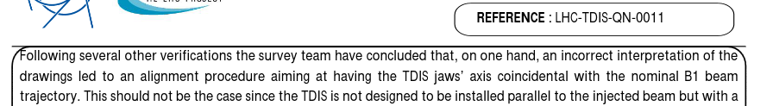
Comments
In LS2 TDIS and TCLIA (the only two devices in the separation recombination area installed in LS2) had severe installation issues.
HL-LHC (and LMC) project does not require technical drawings be ready at the time ECR is approved.
HL-LHC does not contribute to the definition of the installation processes and guidelines, relying on what is provided by the groups.
The present process requires the coordination of several groups. Required competencies are not matched with the assigned responsibilities (e.g. WP2 needed for drawings but not responsible). Drawing procedure and conventions compatible with survey requirements are still missing. Typical drawings do not have the correct scale to appreciate the level of details required.
E2A project aims at addressing this process, but it has not started yet. Preparation for the next ATS-MB schedule at the end of the week, during which I will bring these points.
WP2 positions:
Regardless of the process, WP2 asks to anticipate the technical preparation for installation at the time of ECR approval, after the approval engineering check, to prevent installation delays.
WP2 asks to review the process to be data-driven, based on the layout database platform to
  eliminate the ambiguities and costs associated with drawings (that could still be generated as side product) to define an installation,
  allow automatic consistency checks that would be otherwise impossible given the large number of data to check.

