Slide 1
I/O performance studies of analysis workloads on production and dedicated resources at CERN
A. Sciabà
ROOT I/O meeting, 31 May 2023

Slide 2
Current work
Goal is to collect analysis workloads and tools to measure I/O performance in different storage configurations and levels of parallelism
  The scope is CERN but it could be easily extended
  The final objective is to optimize resource allocation
Several workloads available now or soon
  ROOT’s rootreadspeed I/O benchmark
  ROOT’s RDataFrame benchmark
  IRIS-HEP Analysis Grand Challenge, both Coffea and RDataFrame implementations
  A real CMS analysis using Coffea by A. Novak
  A real CMS analysis using RDF by T. Tedeschi
  The list will expand! Please contact us if you want to contribute
Almost all input data is in TTree format
  RNTuple is expected to show different behavior

Slide 3
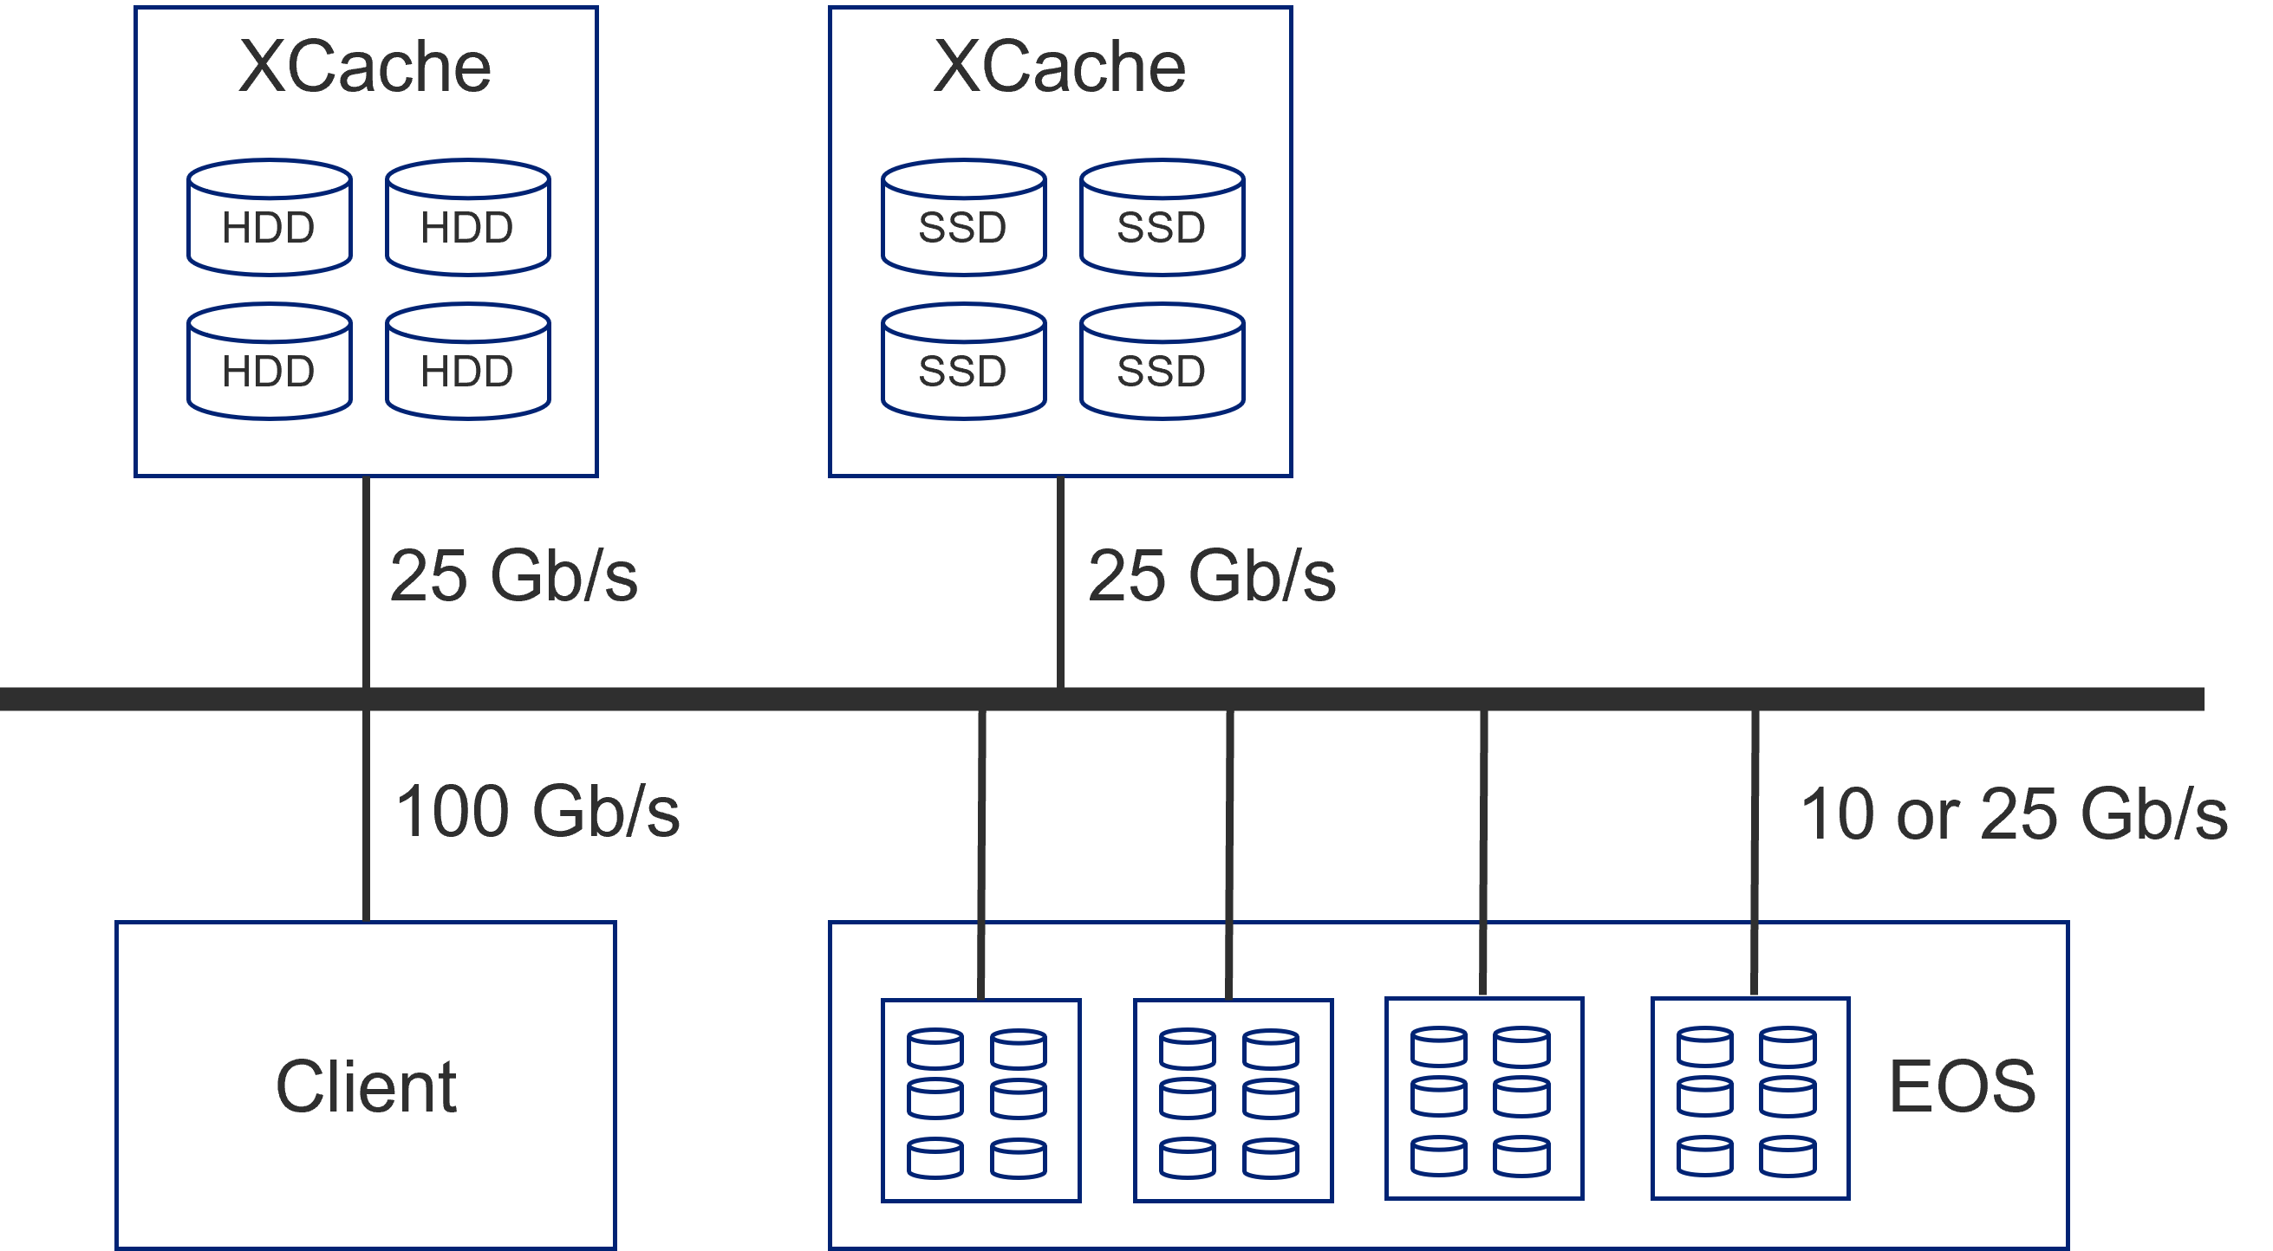
Testbed setup and metric measurement
High performance client node
  Two AMD EPYC 7702 (128 cores)
  1 TB of RAM
  20 SSD of 4 TB each (of which 10 in RAID0)
  100 Gb/s connection
Two Xcache nodes
  Two Intel Xeon Silver 4216 (32 cores)
  192 GB of RAM
  One with ~ 1 PB in HDD, the other with 32 TB in SSD
Storage systems
  EOS at CERN (EOSCMS and CERNBOX)
  Xrootd server at UNL
HSF PrMon tool to measure performance
  Wallclock time
  CPU time
  Read bytes (from storage or network)
  Time spent in data processing
  CPU (pseudo) efficiency
    CPU time / (wallclock time × workers)
  Average read data rate
    read bytes / processing time

Slide 4
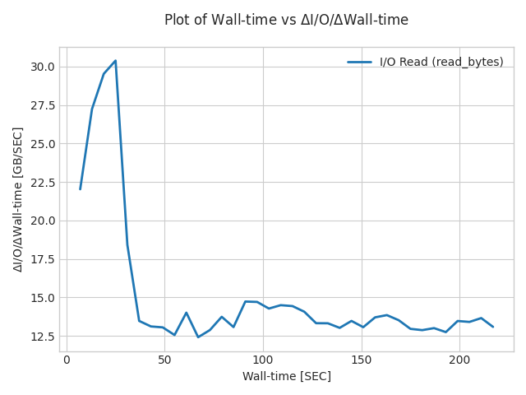
Local storage speed test with xrdcp
Using xrdcp with 128 parallel copies to read the entire dataset
  export XRD_PARALLELEVTLOOP=10
  xrdcp -N --parallel 128 -r /data/datasets/agc/datasets/merged - > /dev/null
Average read speed 16.2 ± 1 GB/s

Slide 5
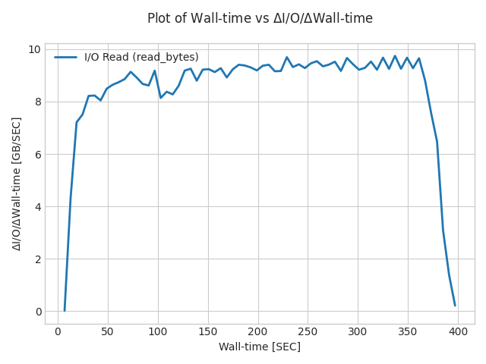
Local storage speed test with rootreadspeed
Using rootreadspeed to read the entire dataset with 128 threads
  XRD_PARALLELEVTLOOP=10
  rootreadspeed --files `cat merged_cern-local.txt` --trees events --all-branches --threads 128
Average read rate is 9 GB/s

Slide 6
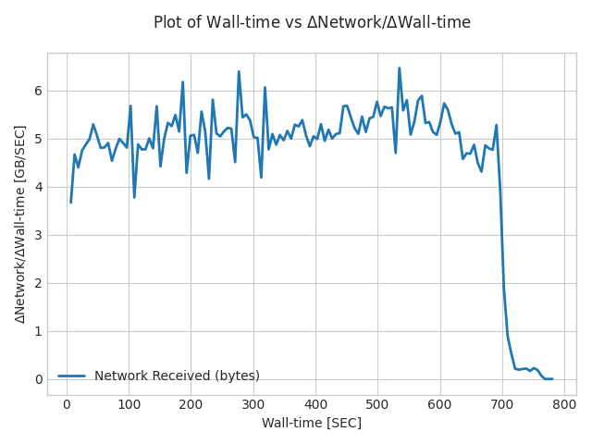
Network speed test with xrdcp
Read the input dataset from EOS using 128 parallel copies
  XRD_PARALLELEVTLOOP=10
  xrdcp -N --parallel 128 -r root://eoscms.cern.ch//eos/cms/store/test/agc/datasets/merged - > /dev/null
The limit seems to be at 40 Gb/s

Slide 7
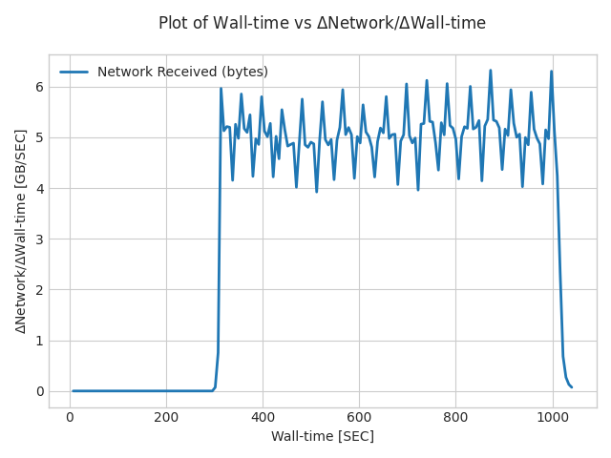
Network speed test with rootreadspeed
Reading the input dataset from EOS using 128 threads
  XRD_PARALLELEVTLOOP=10
  rootreadspeed --files `cat merged_cern-xrootd.txt` --trees events --all-branches --threads 128
The limit seems to be at 40 Gb/s

Slide 8
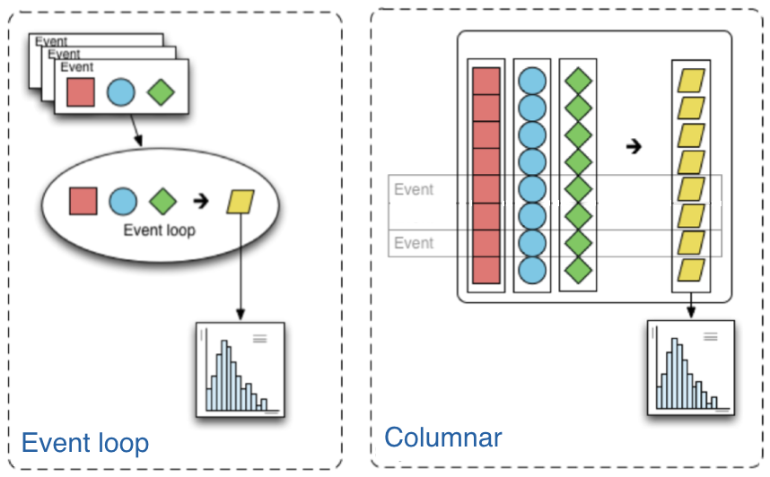
Analysis Grand Challenge ttbar analysis
Simplified analysis from CMS used as technical demonstrator in IRIS-HEP
  Input dataset 3.6 TB, 2300 ROOT files, 1.5 GB/file consisting of CMS 2015 Open Data
Columnar analysis paradigm
  Distributed using a map-reduce concept
Original Coffea implementation
  ROOT-less, parallelism via Python futures or Dask
RDataFrame port (talk)
  ROOT-based, parallelism via implicit multithreading, Dask and other
Measure performance and scalability
  Local parallelism on client node
  Data read from local node vs. directly from EOS via xrootd vs. via an XCache instance
  NOT a comparison between Coffea and RDF
    Simply, different workloads with different behaviors

Slide 9
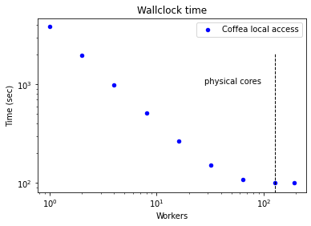
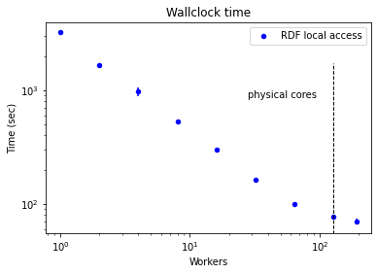
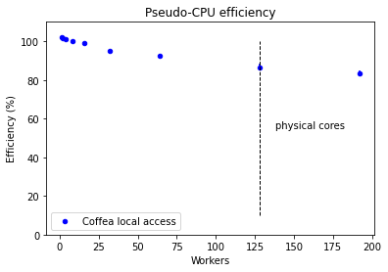
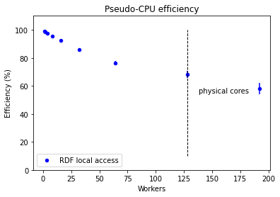
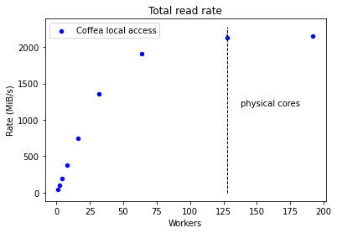
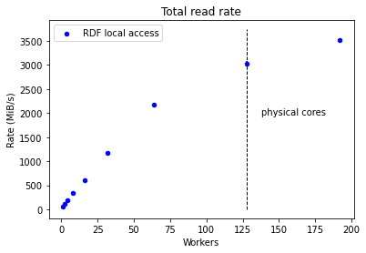
Local access
Scalability is excellent
  Some bottleneck appears for high numbers of workers
  Overcommitting does not help for Coffea, but it increases throughput for RDF
    Indication that Coffea is more CPU-constrained
The CPU efficiency comparably high
  I/O not a strong bottleneck
Local, fast SSD storage is always going to work well
  Aggregate read rates up to 3 GB/s
Coffea
RDF

Slide 10
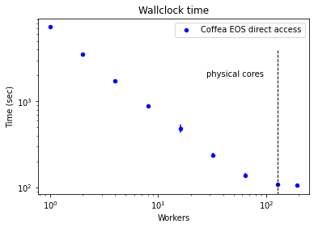
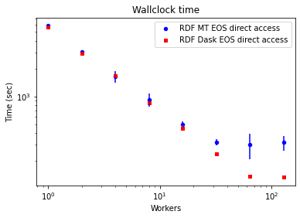
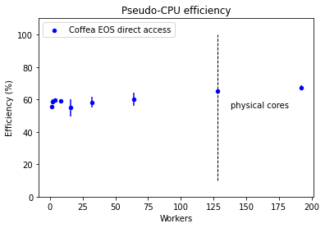
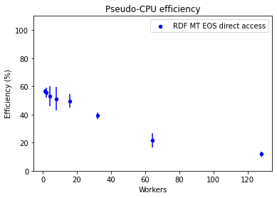
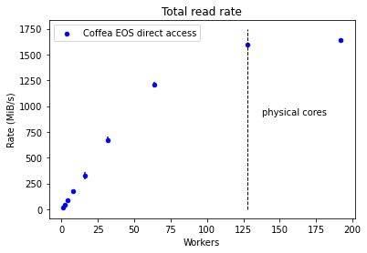
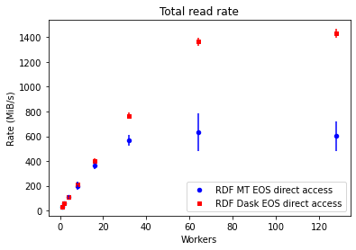
Direct access to EOS
Scalability still good when parallelism is via multiprocess
  RDF implicit multithreading does not perform well with xrootd and many threads
  RDF via Dask is multiprocess, scales better
CPU efficiency practically constant around 60% with multiprocess parallelism
  I/O time is not negligible anymore but no bottlenecks
Two EOS instances tested
  EOSCMS by default, but CERNBOX produces similar (slightly worse) results
RDF
Coffea

Slide 11
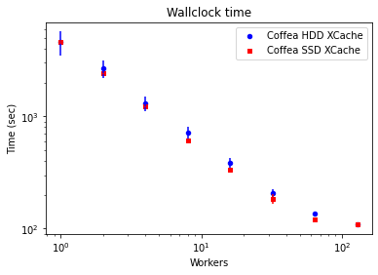
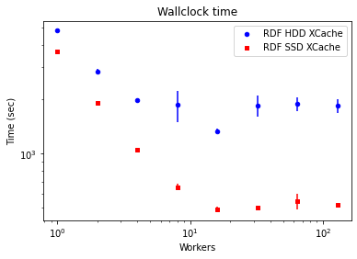
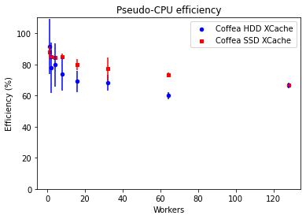
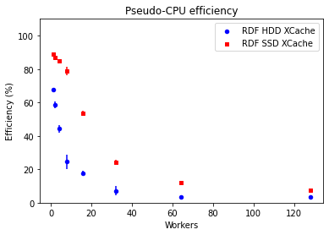
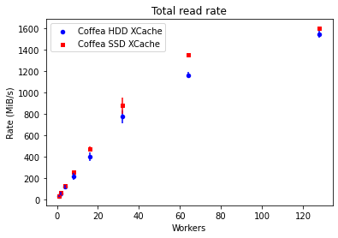
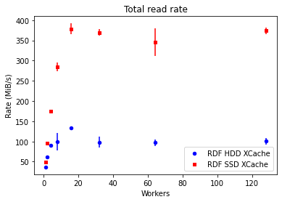
HDD/SDD-based XCache
Compared performance of direct access to Nebraska and CERN, cold cache and warm cache
Performance results
  A cold cache is slower than direct access!
    Due to sparse file access and network latency
  Multiprocess scales very well
    HDD XCache almost as good as SSD XCache
  RDF multithreaded scales very poorly “out of the box”
    All connections multiplexed into one ⇒ bottleneck!
    SDD XCache helps a lot, but scalability is still broken
Coffea + HDD XCache: wallclock time (s)
Site | Direct | Cold | Warm
Nebraska | 442 ± 16 | 608 | 133 ± 6
EOSCMS | 139 ± 8 | 325 | 137 ± 3
RDF MT + HDD XCache: wallclock time (s)
Site | Direct | Cold | Warm
Nebraska | 5470 ± 910 | 18841 | 1531 ± 78
EOSCMS | 323 ± 95 | 8149 | 1558 ± 400
Coffea
RDF

Slide 12
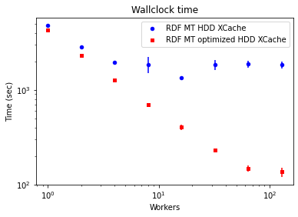
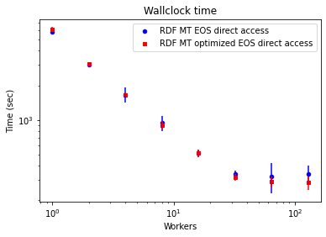
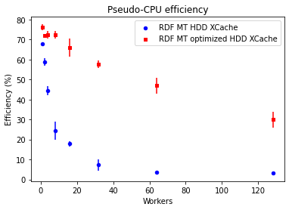
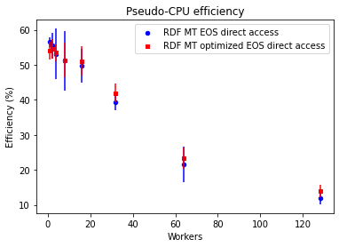
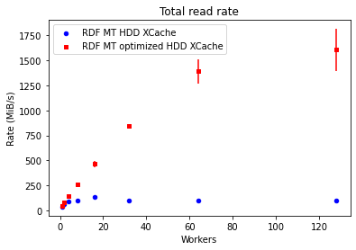
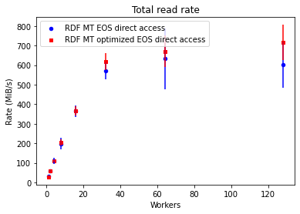
RDF + Xrootd performance optimization
Scalability with ROOT multithreading and XCache can be improved
  XRD_PARALLELEVTLOOP=10 on the client largely improves Xrootd performance
  Prevent the connection multiplexing by adding different client names to the file names
  root://client1@eoscms.cern.ch//eos/myfile.root
Enormous impact when reading from XCache
  Obvious as it is a single server and multiplexing a big bottleneck
Effect negligible when reading from EOS
  Files already spread over hundreds of disk servers, multiplexing irrelevant
XCache
EOS

Slide 13
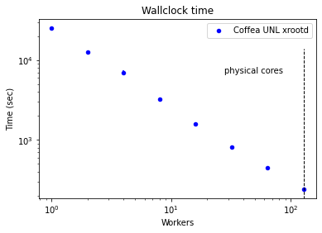
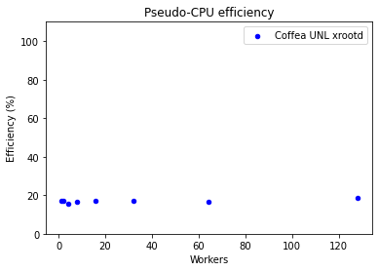
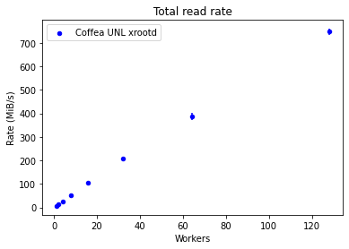
Direct access to UNL via Xrootd (Coffea only)
Perfect scalability and constant (low) CPU efficiency
  Network latency is the only bottleneck
RDF jobs running now, sorry…

Slide 14
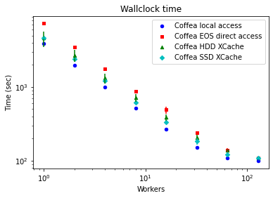
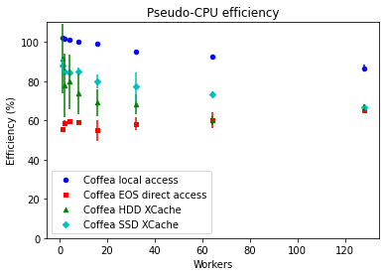
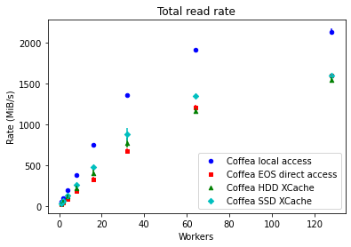
Coffea: all configurations

Slide 15
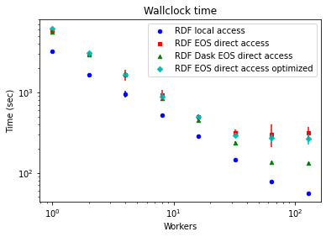
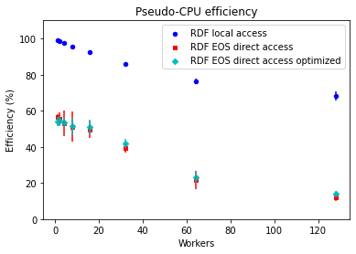
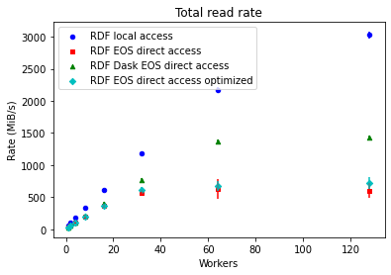
RDF: all non-Xcache configurations

Slide 16
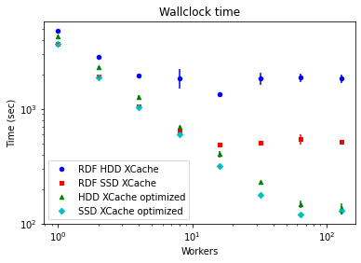
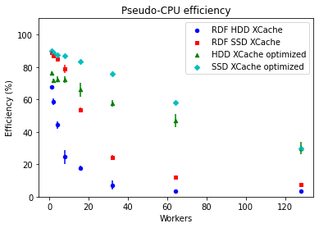
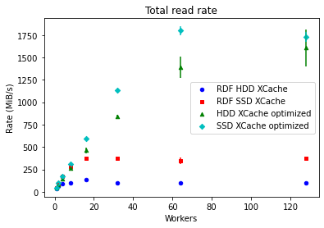
RDF: all XCache configurations

Slide 17
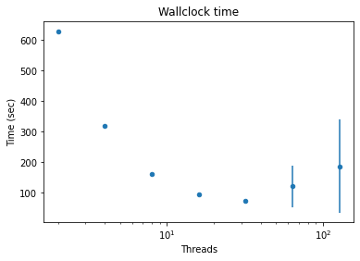
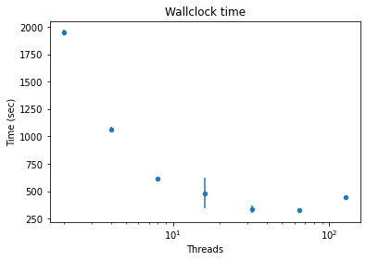
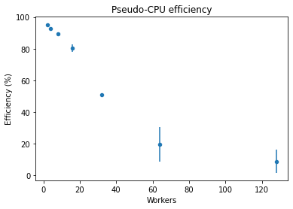
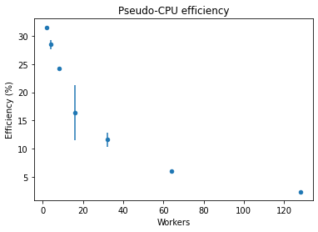
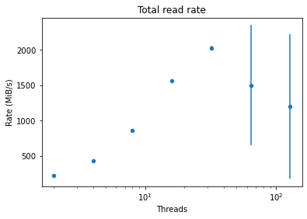
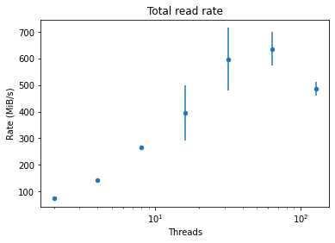
Synthetic ROOT I/O performance
rootreadspeed CLI tool
  Created exactly to identify I/O bottlenecks when reading ROOT files locally or via Xrootd
  Reading only the branches used by the AGC RDF workload for comparison purposes
Excellent performance with HDD XCache
  To be better understood
EOS performance and scalability similar to EOS RDF
  About 1.5 faster as it does only the I/O
XCache
EOS

Slide 18
Conclusions
Compared performance and scalability under different (favorable) scenarios
  A high-performance node with no other users offers the maximum obtainable throughput per core
  Direct access to EOS comparably performant, no server-side bottlenecks observed
    It is a shared facility, busy with other workloads, but performance is rather consistent
  A caching layer (XCache) does not provide additional benefits to direct access to EOS
    SSDs are better but not necessarily much better
    It will be shared in production
More details in the Google slides
  https://docs.google.com/presentation/d/1zRKyI-QupsRHKrju-AoiAupIrfhPA_tBFQTmwUfrKx4/edit?usp=sharing

Slide 19
Backup slides

Slide 20
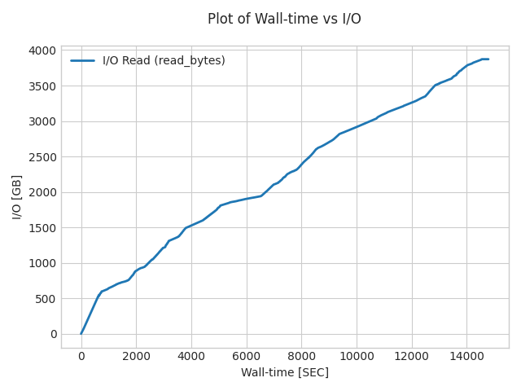
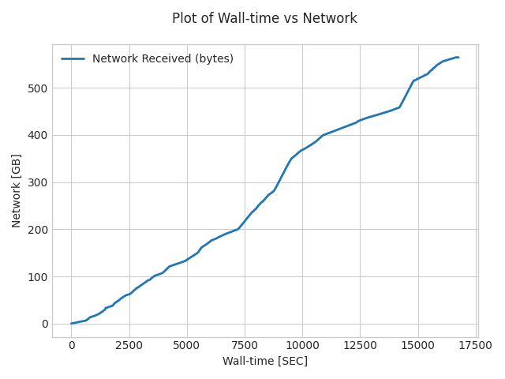
CMS NanoAOD analysis using Coffea
Real world Higgs analysis from A. Novak
  First observation of ggH → cc
  Running on NanoAOD
    Tests using 2017 data, 6 TB, average file size 160 MB
Performance comparison in different scenarios
  Local access
  Direct EOS access
  HDD XCache
Local access
EOS access
Results for 64 workers
  CPU limited
  Caching layer irrelevant
  I/O is modest
 | Wallclock time (h) | CPU efficiency (%) | Read rate (MiB/s)
Local access | 4.1 | 103 | 270
Direct EOS access | 4.7 | 87 | 34.5
Cold HDD XCache | 4.6 | 89 | 34.7
Warm HDD XCache | 4.8 | 82 | 34.1

