Slide 1

DMM-Blender training
F. J. Mangiarotti, 2023.05.09

Slide 2
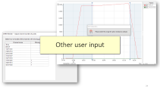
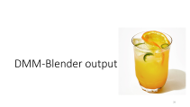
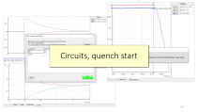
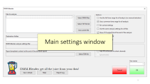
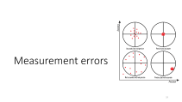
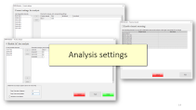
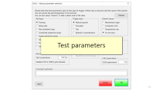
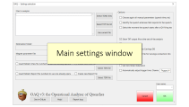
Topics
What is DMM-Blender?
How to use DMM-Blender?
  Main settings
  Analysis settings
    Renaming
    Current
    Resistance
    VI
    Inductance
    AC loss
  Other user input
DMM-Blender output
A short discussion on measurement error

Slide 3
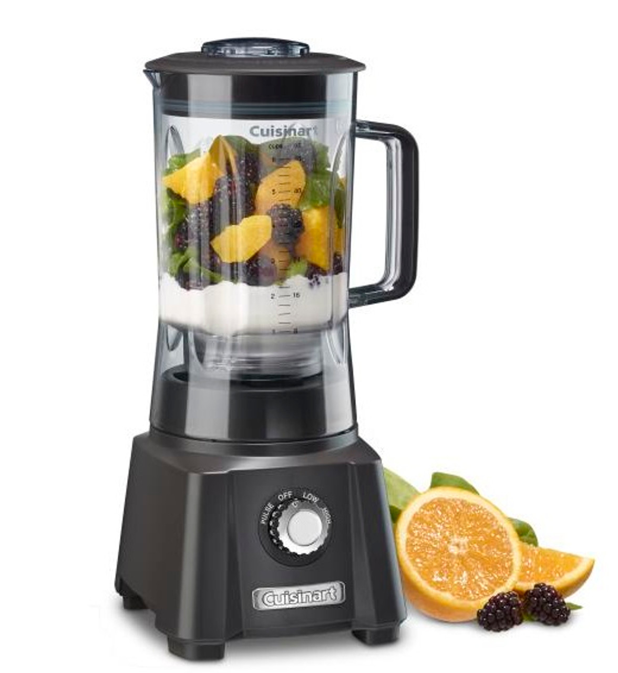
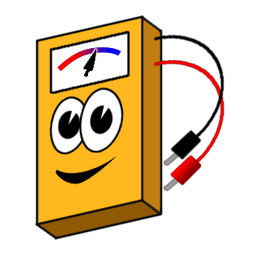
What is DMM-Blender?
It is the spiritual successor of the DMM-Processor
It does a similar analysis, with some improvements:
  Multiple analysis at the same time
  Dedicated VI analysis
  Save settings for later use
  Better error bar treatment

Slide 4
How to use
DMM-Blender?

Slide 5
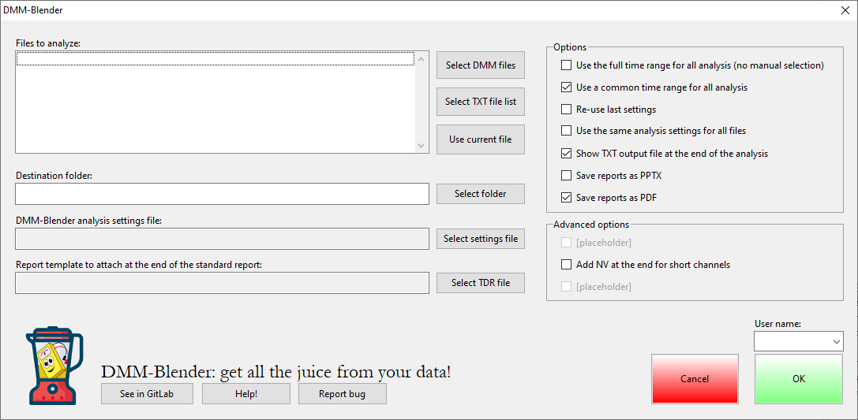
Main settings window

Slide 6
Here you can select the files to analyze.
Options:
Select one or more TDMS files, all in the same folder
Select a text file with a list of files (including file path). You could (if you really want) put files from different magnets
The currently open file

Slide 7
After selecting the files, DMM-Blender will automatically propose a destination folder with the same logic as OAQ:
mtbop/MTB_meas/ANALYSIS/[magnet]/DMM-Blender
If you want a different you can change it.
Best practice: use the same magnet name for DAQ and DMM configuration

Slide 8
You can save the analysis settings (discussed later) and re-use them. This is great for consistency in the analysis and saves a lot of time.
You can also attach a report template to the automatic one, at the end of processing. Useful for example for VI analysis.

Slide 9
You can select some analysis options as well:
Use the full time range for all analysis: by default, DMM-Blender lets you choose the time range to analyze. Choose this to skip this step and use all the data points from the DMM file.
Use a common time range for all analysis: select this option if you want to use the same data points for all analysis (default). If you want to use different parts of the file for different analysis, un-select it.

Slide 10
You can select some analysis options as well:
Re-use last settings: sometimes you want to apply the same analysis settings you just used to another file, or for example you want to re-run the same file but change the time range. Select this option to do it.
Note: if you are not sure, it’s more reliable to use an analysis setting file (two slides before).
Use the same analysis settings for all files: in case you analyze many files at the same time, you can choose the settings one file by one (default) or choose the settings at the start and run all with the same settings.

Slide 11
You can select some analysis options as well:
Show TXT output file at the end: DMM-Blender always produces a TXT file per analysis type and per DMM file. If you don’t want to see them at the end, unselect this option.
Save report as PPTX: The report is always generated (one per DMM file); you can choose to save it as a PowerPoint file if you prefer.
Save report as PDF: the report can be saved as PDF as well; this is enabled by default (one PDF per DMM file).

Slide 12
Advanced analysis options:
Add NV at the end for short channels: Sometimes the DMM misbehaves and creates some channels shorter than others. Most of the time, the channels are shorter by 1 data point. DMM-Blender will see this and ask you to interact with the data or choose some predefined options.
Alternatively, you can select this option before the analysis starts to treat all these channels the same way, adding no-values at the end of the short channels to ensure all are the same size.
[more to come]

Slide 13
Bottom buttons:
See in GitLab: to see the GitLab page of DMM-Blender.
Help!: it will bring you to the “readme” in GitLab. This file has (or should have) the same information as this presentation. I try to update it whenever there is a major change.
Report bug: this will let you report a bug in the GitLab page. It’s useful because that way I remember if I don’t do it right away. I recommend that you also tell me directly ☺
Username: here you must select your name to continue the analysis. If your name does not appear here, please let me know and I’ll fix it.
OK: start the analysis
Cancel: abort the analysis

Slide 14
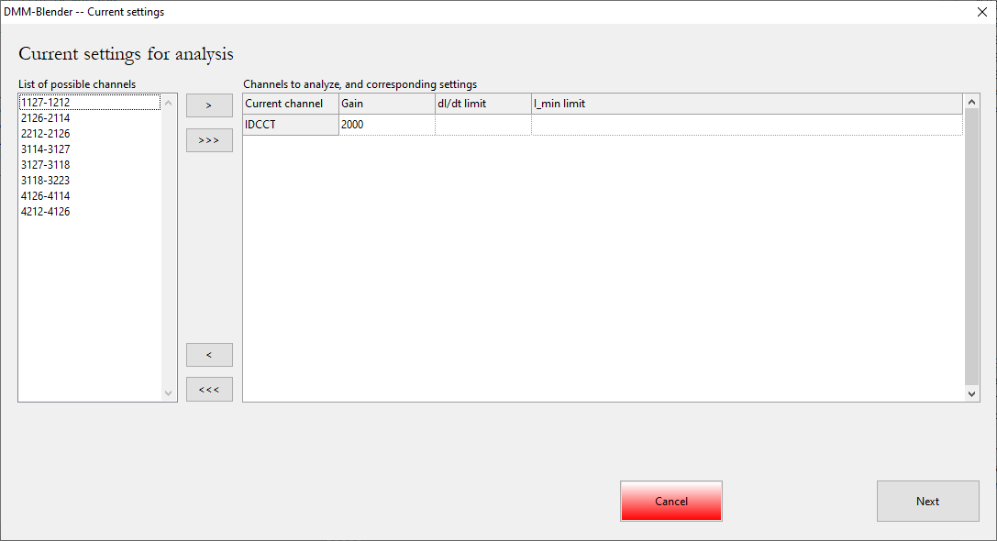
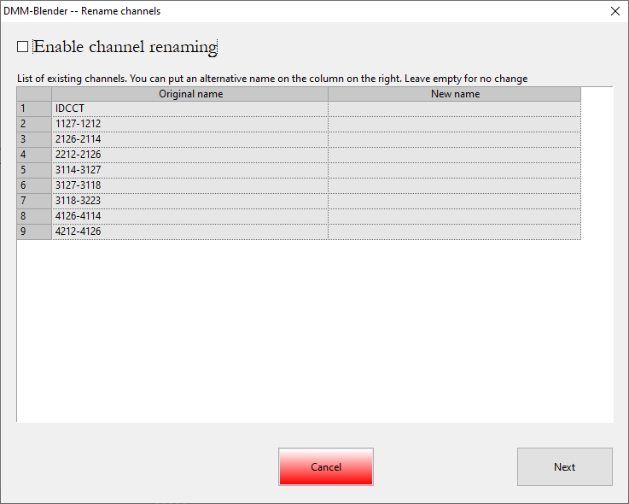
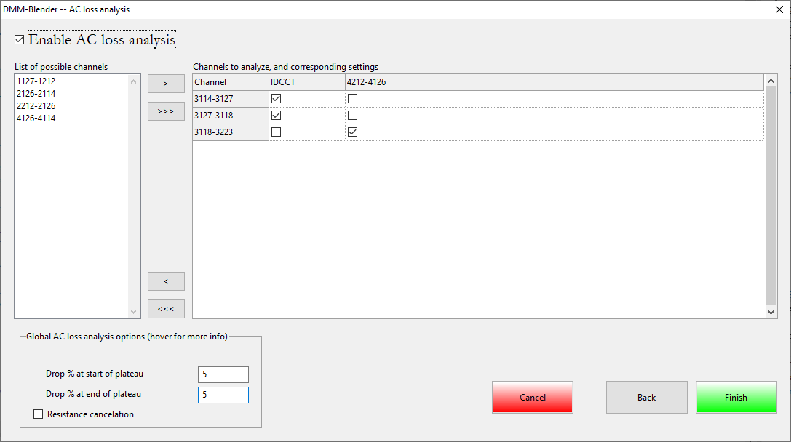
Analysis settings

Slide 15
Rename channels
Here you can change the channel names if you want.
This is useful for analysis settings files, to ensure the analysis is always performed the same, and useful for additional standard report pages.
During the analysis settings input, you can go forward and backwards to adjust things if you made mistakes.

Slide 16
Current settings
DMM-Blender will always
propose the first channel
as a current channel. You can
remove it, add another, etc.
The three numbers are important for the analysis:
Gain: current channel gain. DMM-Blender will automatically propose the DMM setting if it was different than 1. Best practice: put the current gain in the DMM settings
dI/dt limit: below this level (in absolute value) we consider plateau, above we consider ramp.
I_min limit: we will not use datapoints with current below this number. Negative current will be used only if this number is 0.

Slide 17
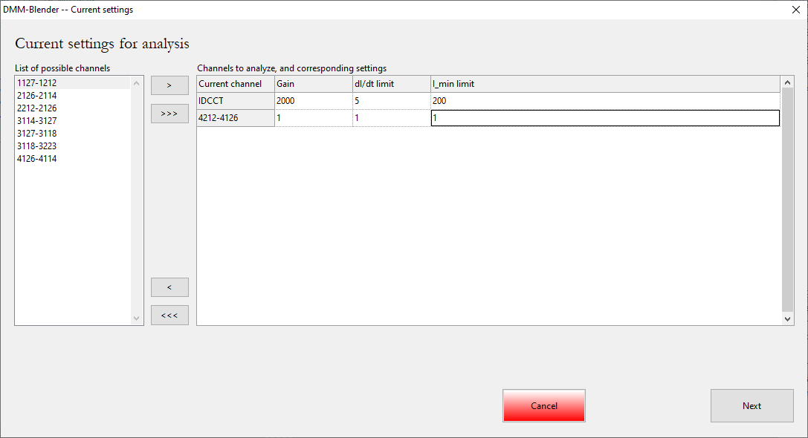
Current settings
This is just an example with two currents defined, only as an example for the next few slides

Slide 18
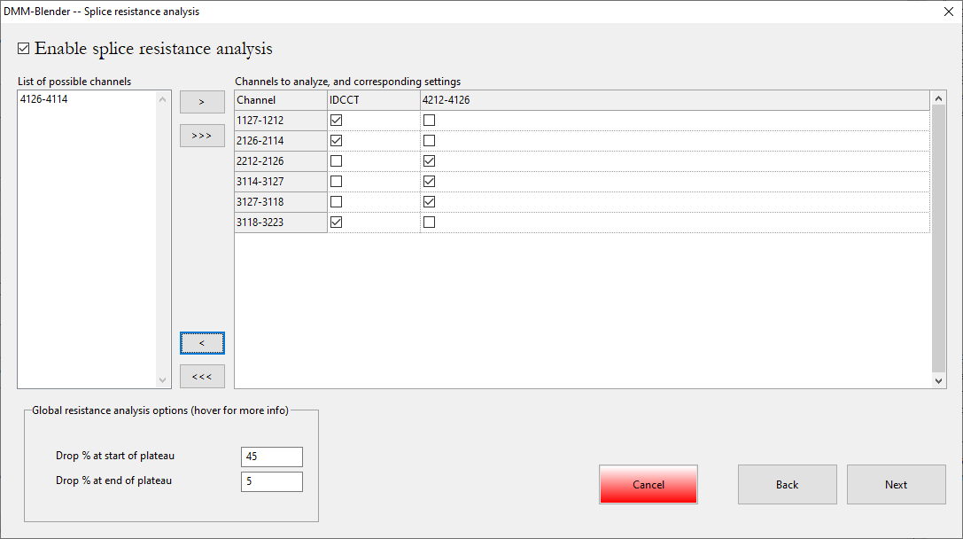
Splice resistance
You can enable or disable
this type of analysis at the top
If you enable it, you can choose
what channels to use. If you
set up many currents, you can also choose which current applies to this segment.
At the bottom you have global options, in this case what portion of the plateaus are dropped to run this analysis.

Slide 19
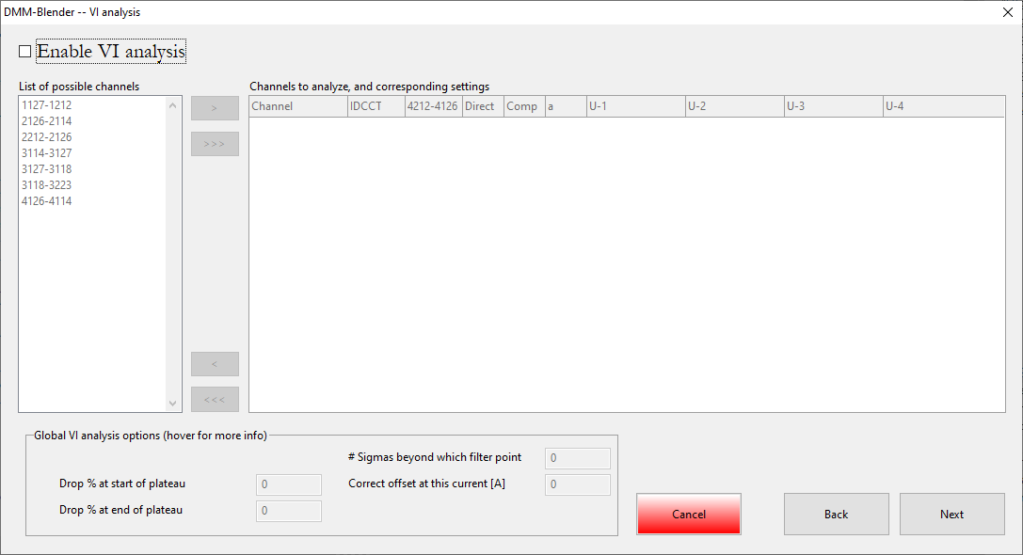
VI analysis
Here you see the analysis
disabled. You can go “next”
if you want

Slide 20
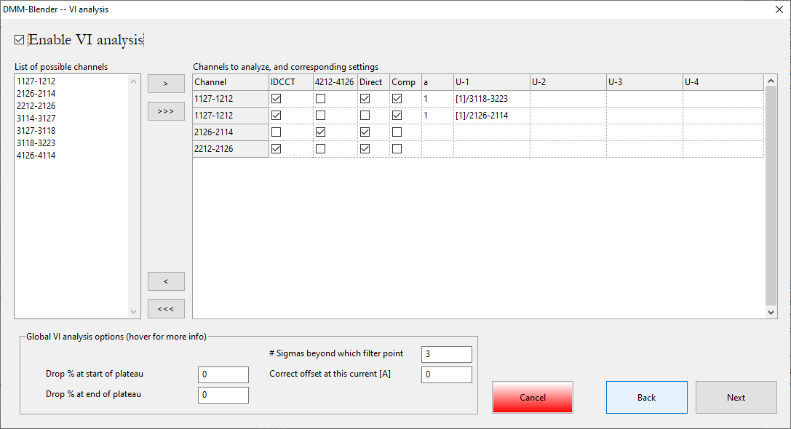
VI analysis
With the analysis enabled, you
can select the channels to
analyze (more than once!), and
their settings:
Direct: do a direct analysis
Comp: compensate before analysis, with equation: U_comp = U_channel – a * (U-1 + U-2 + U-3 + U-4)
Global settings:
# sigmas … is useful to remove spikes on the compensated channels. What it does: it calculates a #-sigma band around the full dataset, then removes points outside, and only then performs VI analysis. Put 0 to disable
Correct offset: offset the VI measurement at this current level. Put 0 to disable

Slide 21
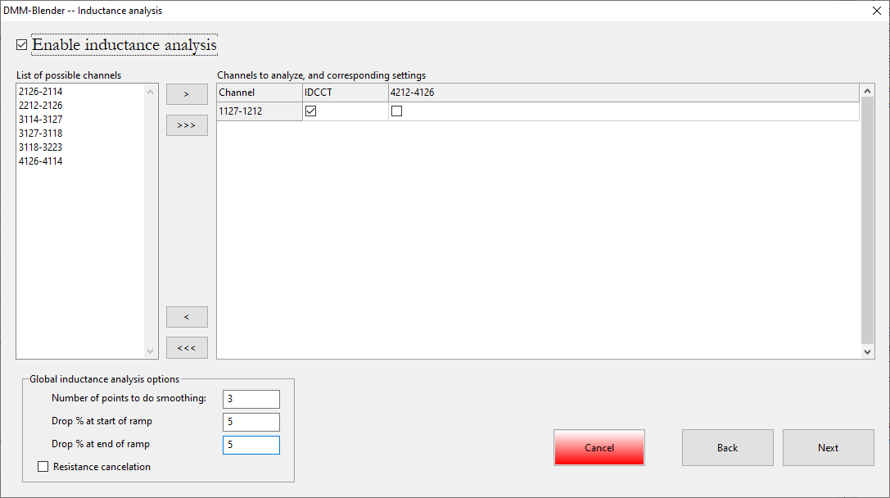
Inductance analysis
As the previous cases, you can
choose the channel (maximum
once) and the corresponding
current.
Points for smoothing are used
for the final plots, and resistance cancelation is useful for segments with significant resistance at low ramp rates (I used this for some MCBY analysis)

Slide 22
AC loss analysis
As the previous cases, you can
choose the channel (maximum
once) and the corresponding
current.
Once you click on “Finish” you won’t be able to go backwards

Slide 23
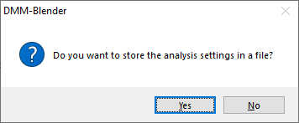
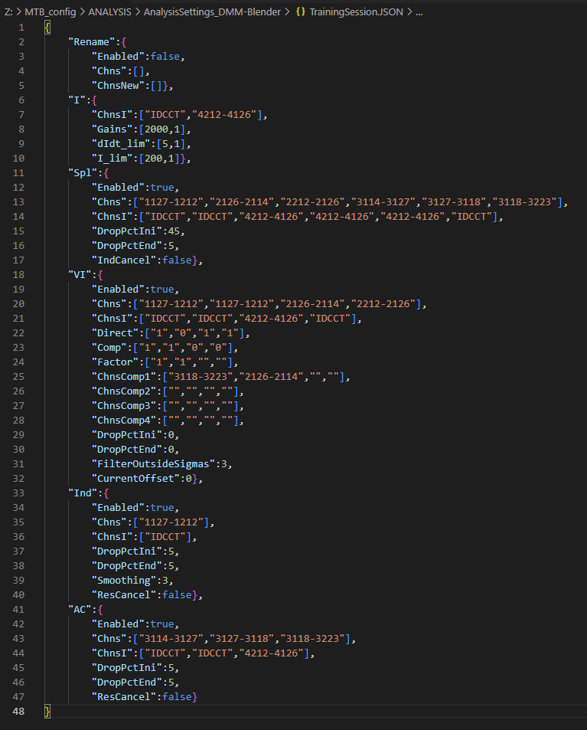
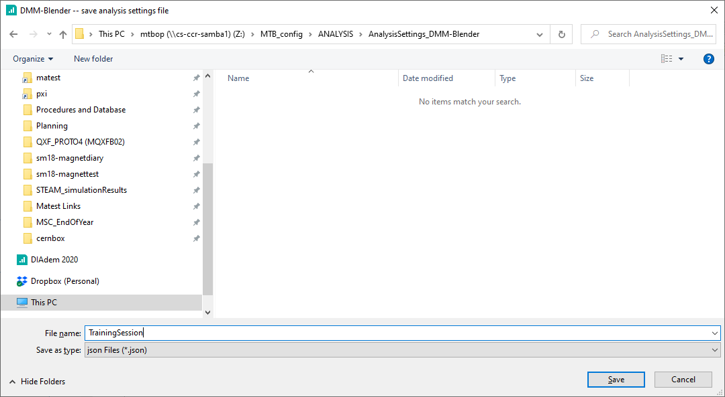
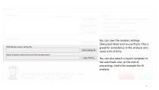
Saving analysis settings
After you click on “Finish” will be prompted if you want to save these settings as a file. If you do, you can use it next time:

Slide 24
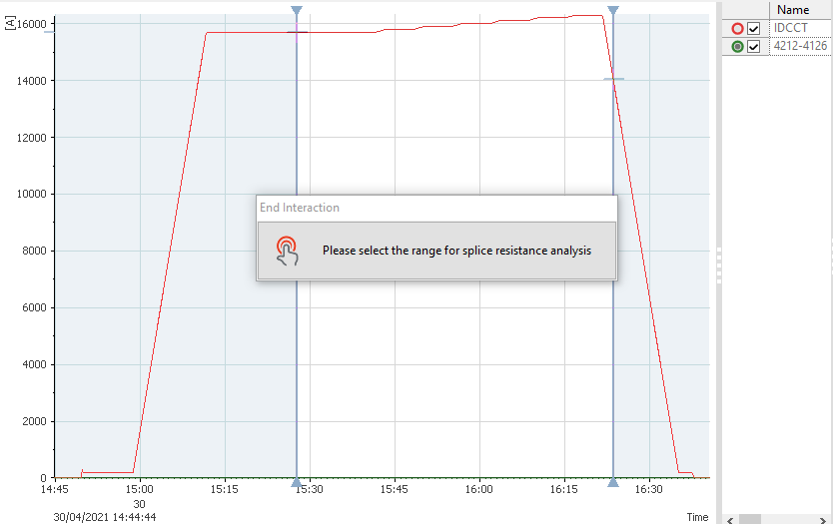
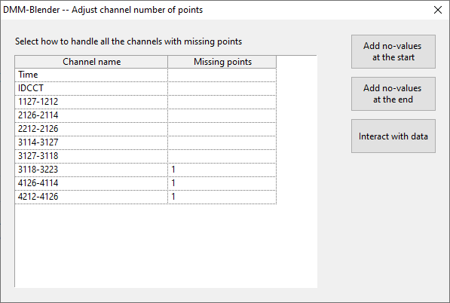
Other user input

Slide 25
Channel length adjustment
DMM-Blender detects if there are shorter channels, tells you how many points they are missing, and asks you what to do about it.
You can first Interact to choose what to do, and then add no-values at the start, at the end, or you can Interact to add the values yourself.
This is important to do right for VI measurements with compensated signals, and less critical for the other analysis (assuming you put at least some % drop at start and end of plateaus/ramps)

Slide 26
Time range selection
DMM-Blender will ask you to select the analysis time range. If you left the default options, it will only ask for one common range. Otherwise, it will ask for a time range per type of analysis.

Slide 27
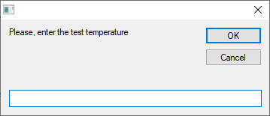
Temperature
DMM-Blender will try to fetch or guess the temperature:
First, from the DMM file “temperature” property
Second, from the file name (“4.5K”, “1.9 “, etc)
If it’s not in any of these, and for VI-measurements only, it will ask the user to provide it

Slide 28

DMM-Blender output

Slide 29
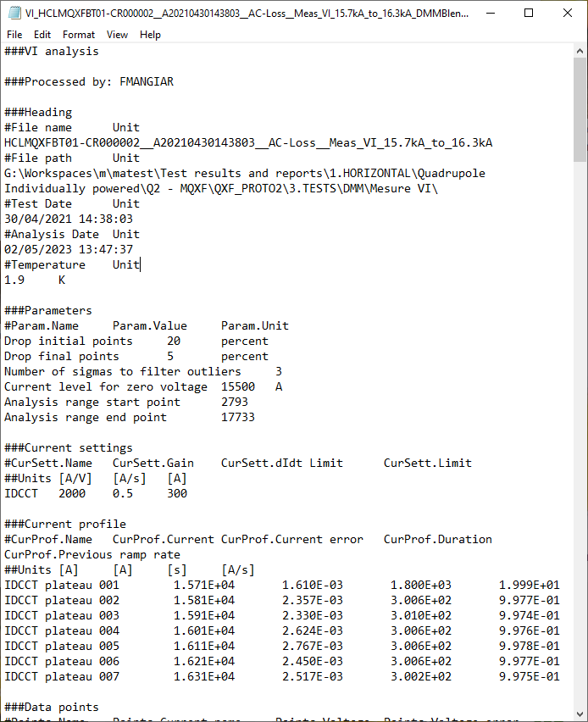
Main output: text file
One text file is produced per analysis type and per DMM file. The structure is very similar to the OAQ output file
Note that file path and analysis parameters are stored
Best practice: keep the DMM files organized in the MTB_meas/DMM folder

Slide 30
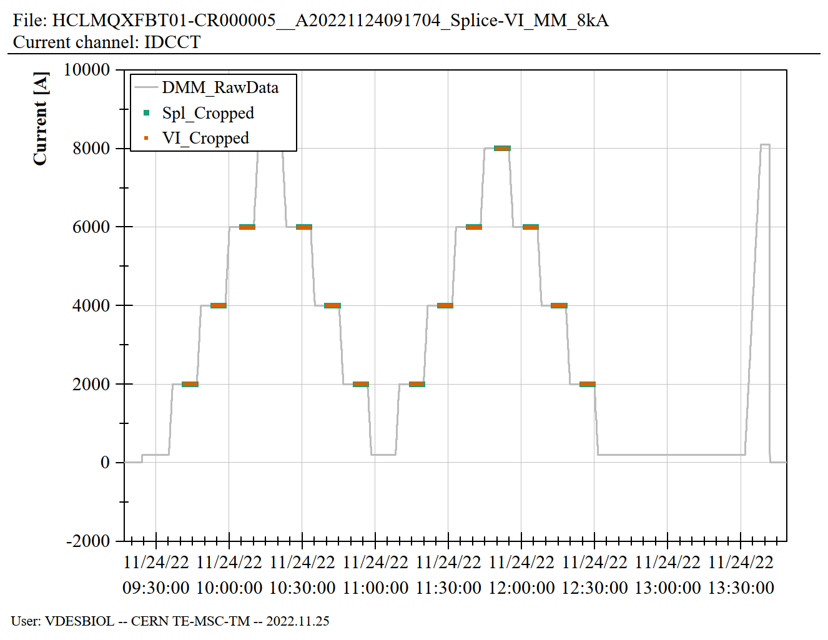
Secondary output: report
The report has some standard plots:
  Current ranges for analysis
  Splice: V vs I and linear regression
  VI: --V and I vs time and decay “estimation”
  --V vs I
  Inductance: L vs I and fitted curve
  AC loss: E vs I, E vs RR, P vs I, P vs RR

Slide 31
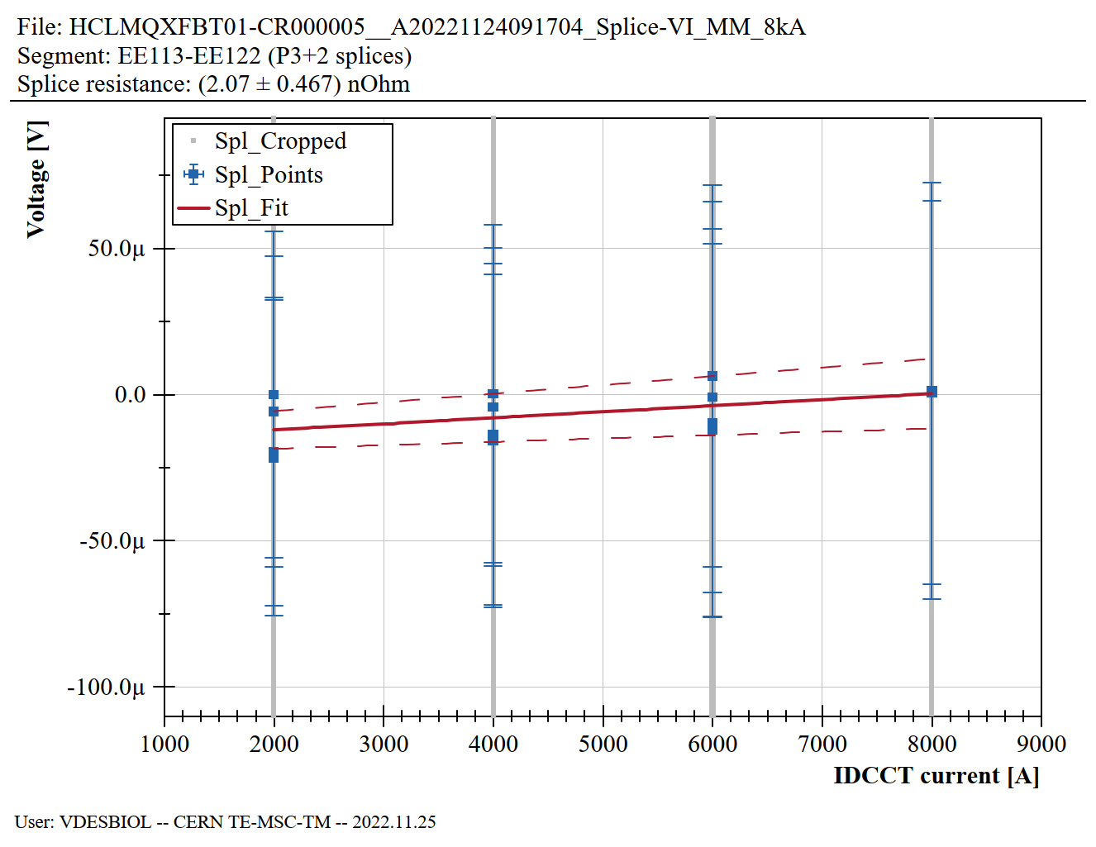
Secondary output: report
The report has some standard plots:
  Current ranges for analysis
  Splice: V vs I and linear regression
  VI: --V and I vs time and decay “estimation”
  --V vs I
  Inductance: L vs I and fitted curve
  AC loss: E vs I, E vs RR, P vs I, P vs RR

Slide 32
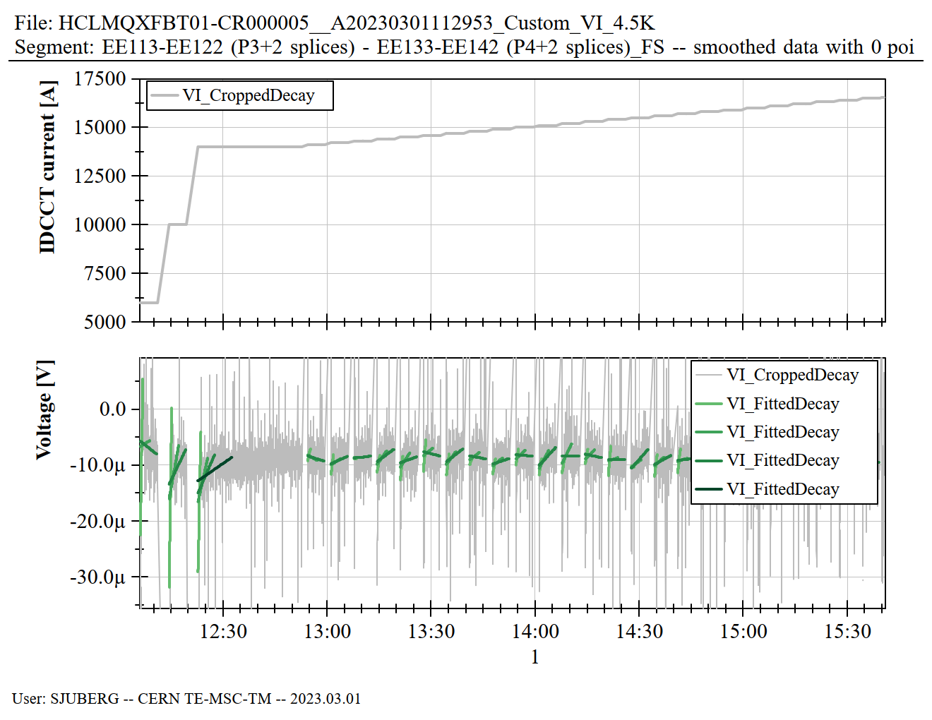
Secondary output: report
The report has some standard plots:
  Current ranges for analysis
  Splice: V vs I and linear regression
  VI: --V and I vs time and decay “estimation”
  --V vs I
  Inductance: L vs I and fitted curve
  AC loss: E vs I, E vs RR, P vs I, P vs RR

Slide 33
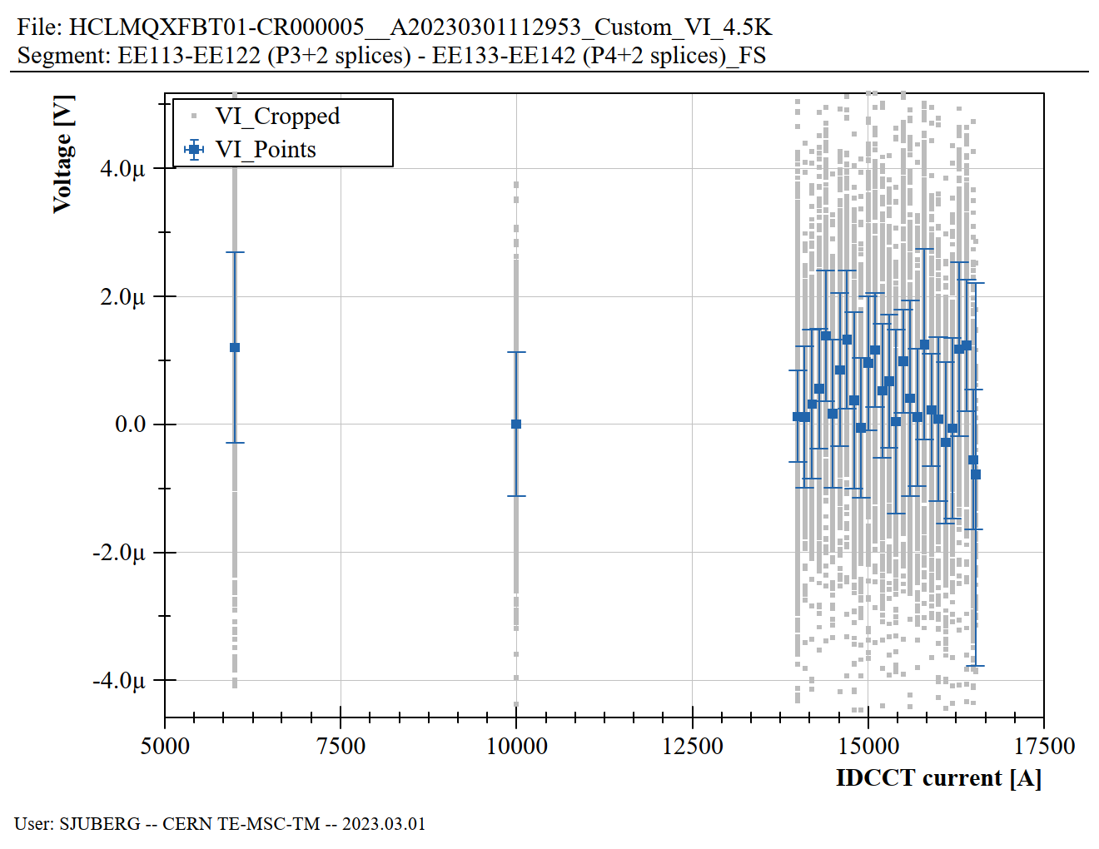
Secondary output: report
The report has some standard plots:
  Current ranges for analysis
  Splice: V vs I and linear regression
  VI: --V and I vs time and decay “estimation”
  --V vs I
  Inductance: L vs I and fitted curve
  AC loss: E vs I, E vs RR, P vs I, P vs RR

Slide 34
Secondary output: report
The report has some standard plots:
  Current ranges for analysis
  Splice: V vs I and linear regression
  VI: --V and I vs time and decay “estimation”
  --V vs I
  Inductance: L vs I and fitted curve
  AC loss: E vs I, E vs RR, P vs I, P vs RR

Slide 35
Secondary output: report
The report has some standard plots:
  Current ranges for analysis
  Splice: V vs I and linear regression
  VI: --V and I vs time and decay “estimation”
  --V vs I
  Inductance: L vs I and fitted curve
  AC loss: E vs I, E vs RR, P vs I, P vs RR

Slide 36

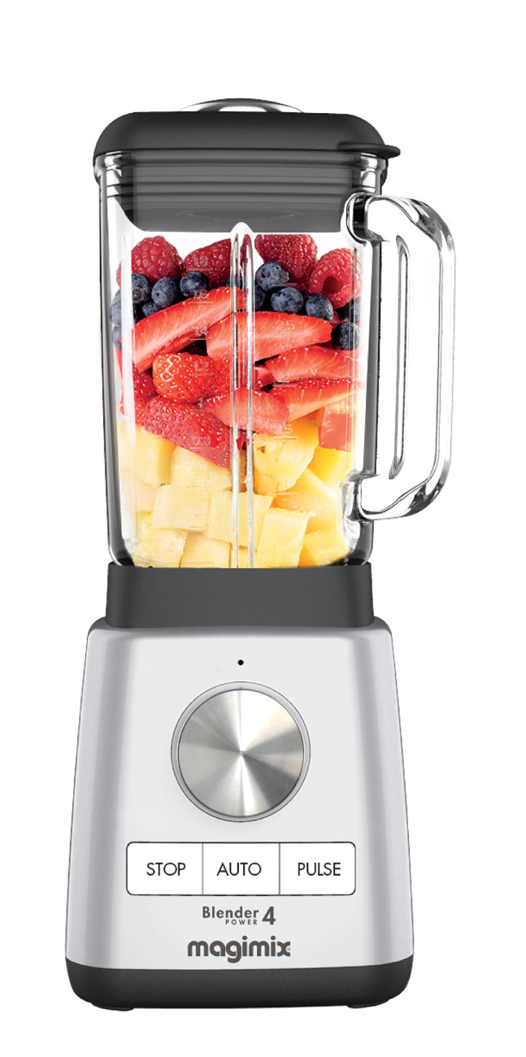
DMM data in Carpenter
The output of DMM-Blender is ready to be put into Carpenter
The only thing that is missing is the proper field definition in Carpenter
  This means: if you try to put the TXT in Carpenter, most of the outputs won’t be stored
I hope to finish this before summer

Slide 37
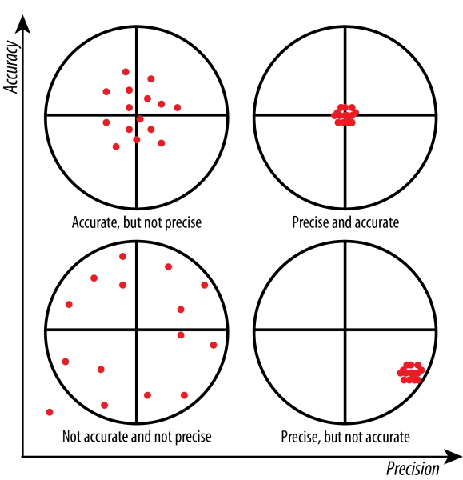
Measurement errors

Slide 38
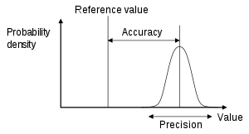
Definitions and how I use them
Accuracy: how close is the measurement with respect of reality
  Important if we want to measure absolute values, not important for relative measurements
Precision: how close are measurements with respect of each other
  It could be interpreted as the DMM noise
Dispersion: how much the test setup noise affects the measurement

Slide 39
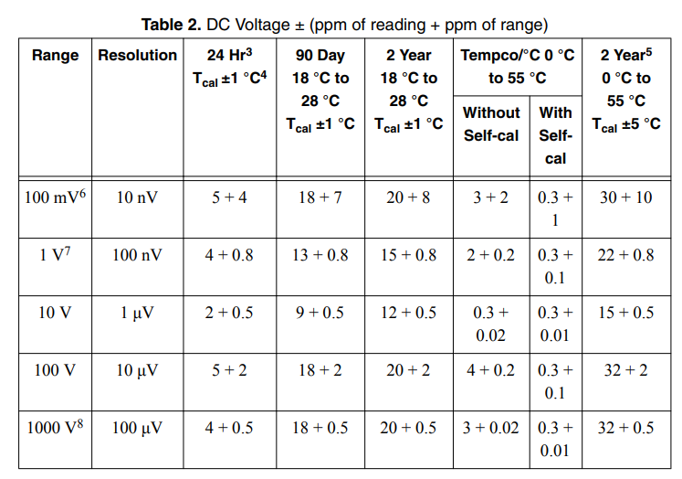
DMM cards accuracy
Example for PXI-4071
Meaning: at 10 V, 2 year calibration, we have as minimum 0.5e-6 * 10V = 5uV of accuracy error
Source: https://www.ni.com/pdf/manuals/371371n.pdf
The other DMM cards have similar numbers

Slide 40
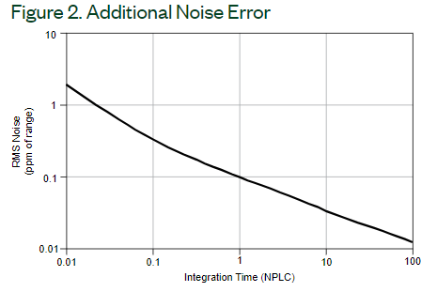
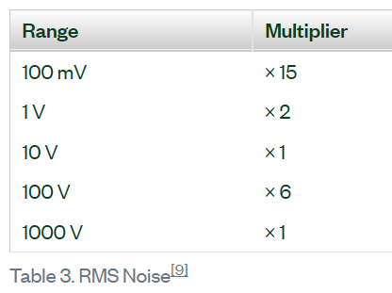
DMM cards precision (additional noise error)
Example for PXI-4071
At 10 V, with 200 ms integration time (10 NPLCs), the additional error is around 0.02e-6 * 10 V = 0.2 uV
At 100 mV range, same integration time: 0.03 uV
Source: https://www.ni.com/pdf/manuals/371371n.pdf
The other DMM cards have similar numbers

Slide 41
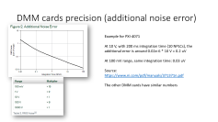
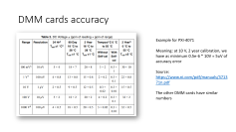
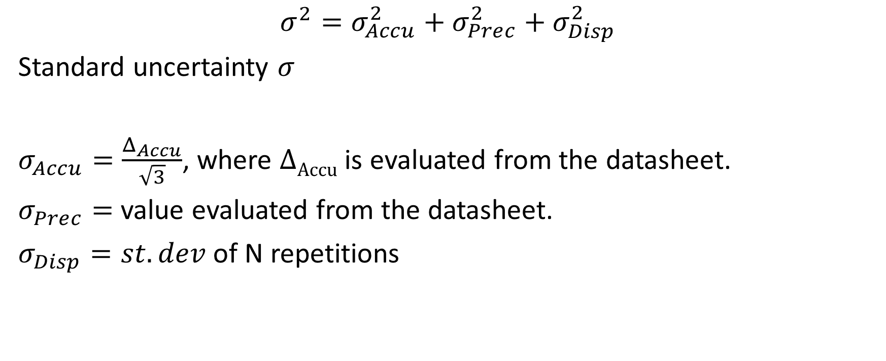
Error treatment – first look
$$σ^{2}=σ_{Accu}^{2}+σ_{Prec}^{2}+σ_{Disp}^{2}$$
Standard uncertainty $σ$
$σ_{Accu}=\frac{Δ_{Accu}}{\sqrt{3}}$, where $ΔAccu$ is evaluated from the datasheet.
$σ_{Prec}=$ value evaluated from the datasheet.
$σ_{Disp}=st.dev$ of N repetitions

Slide 42
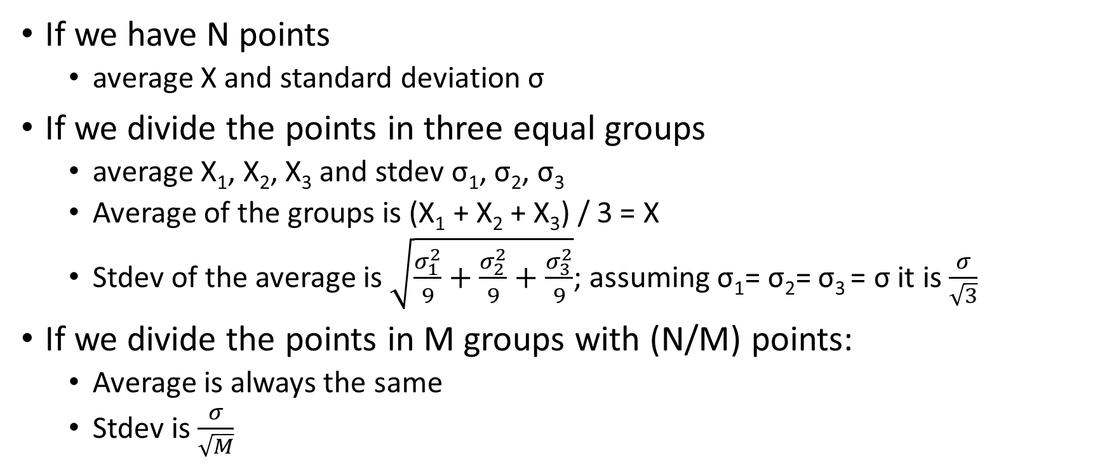
Error treatment – multiple averages
If we have N points
  average X and standard deviation σ
If we divide the points in three equal groups
  average X₁, X₂, X₃ and stdev σ₁, σ₂, σ₃
  Average of the groups is (X₁ + X₂ + X₃) / 3 = X
  Stdev of the average is $\sqrt{\frac{σ_{1}^{2}}{9}+\frac{σ_{2}^{2}}{9}+\frac{σ_{3}^{2}}{9}}$; assuming σ₁= σ₂= σ₃ = σ it is $\frac{σ}{\sqrt{3}}$
If we divide the points in M groups with (N/M) points:
  Average is always the same
  Stdev is $\frac{σ}{\sqrt{M}}$

Slide 43
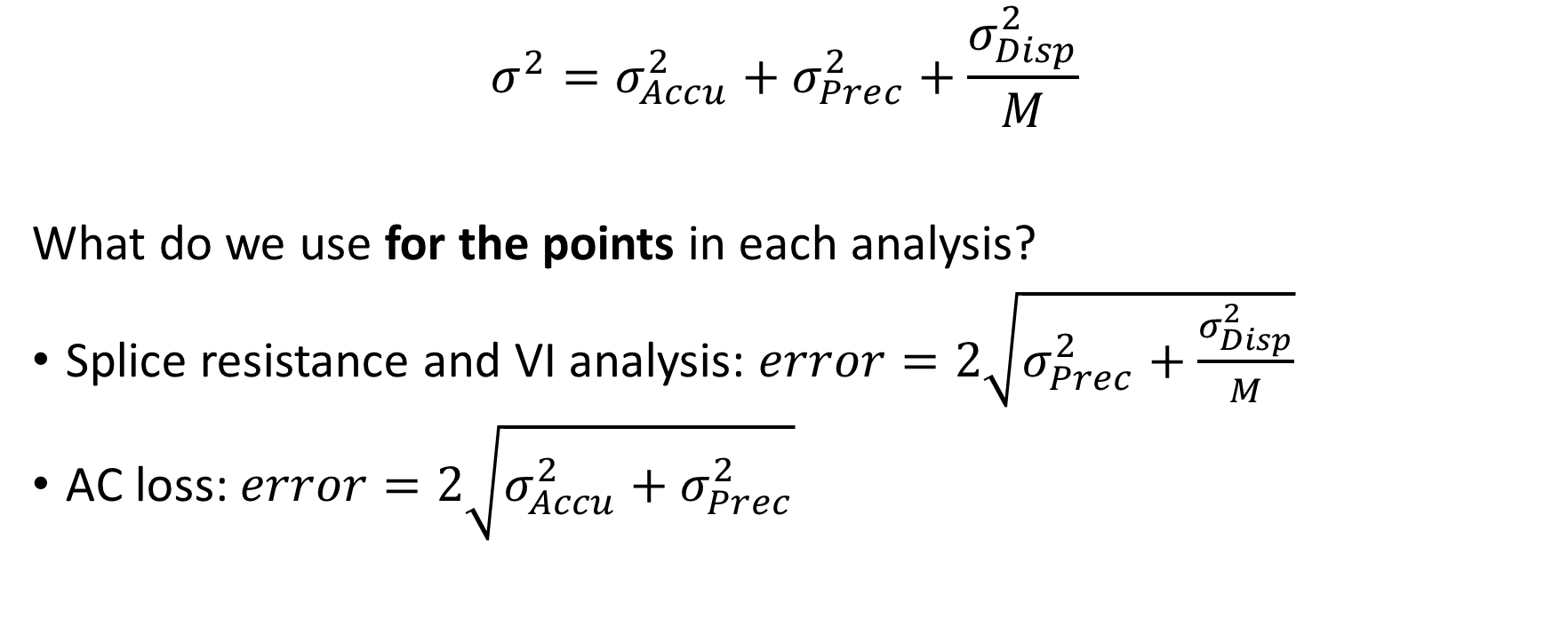
Error treatment with multiple averages
$$σ^{2}=σ_{Accu}^{2}+σ_{Prec}^{2}+\frac{σ_{Disp}^{2}}{M}$$
What do we use for the points in each analysis?
Splice resistance and VI analysis: $error=2\sqrt{σ_{Prec}^{2}+\frac{σ_{Disp}^{2}}{M}}$
AC loss: $error=2\sqrt{σ_{Accu}^{2}+σ_{Prec}^{2}}$
Note: factor 2 for the 2-sigma approach (95% confidence)

Slide 44
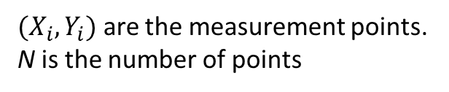
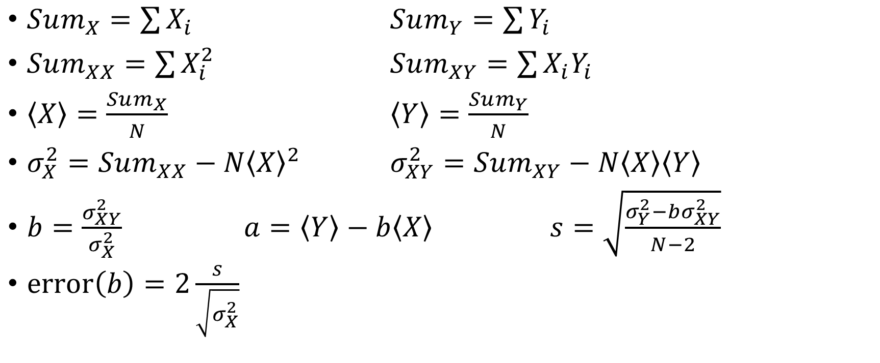
What about the splices’ resistance error?
$(X_{i},Y_{i})$ are the measurement points.
N is the number of points
$Sum_{X}=\sum{X_{i}}$ $Sum_{Y}=\sum{Y_{i}}$
$Sum_{XX}=\sum{X_{i}^{2}}$ $Sum_{XY}=\sum{X_{i}Y_{i}}$
$\left\langle X\right\rangle =\frac{Sum_{X}}{N}$ $\left\langle Y\right\rangle =\frac{Sum_{Y}}{N}$
$σ_{X}^{2}=Sum_{XX}−N{\left\langle X\right\rangle }^{2}$ $σ_{XY}^{2}=Sum_{XY}−N\left\langle X\right\rangle \left\langle Y\right\rangle$
$b=\frac{σ_{XY}^{2}}{σ_{X}^{2}}$ $a=\left\langle Y\right\rangle −b\left\langle X\right\rangle$ $s=\sqrt{\frac{σ_{Y}^{2}−bσ_{XY}^{2}}{N−2}}$
$error\left(b\right)=2\frac{s}{\sqrt{σ_{X}^{2}}}$
Resistance and its error
Note: factor 2 for the 2-sigma approach (95% confidence)

Slide 45

Confidence bars equations
$Y=bX+a$
$Y_{up}=Y+2s\sqrt{\frac{{\left(X−\left\langle X\right\rangle \right)}^{2}}{Sum_{XY}−N\left\langle X\right\rangle \left\langle Y\right\rangle }−\frac{1}{N}}$
$Y_{low}=Y−2s\sqrt{\frac{{\left(X−\left\langle X\right\rangle \right)}^{2}}{Sum_{XY}−N\left\langle X\right\rangle \left\langle Y\right\rangle }−\frac{1}{N}}$
Note: factor 2 for the 2-sigma approach (95% confidence)

