Slide 1
Situation of spare for IT magnets and cold D1s
LHC IT Task Force,
S. Le Naour, 08/06/2023

Slide 2
LHC IT Spare
Three cryo-magnets are stored
  HCLQXA_001-FL000008 (Q1 – LQXA-08)
  HCLQXB_001-FL000001 (Q2 – LQXB-01)
  NCR 555602 : During reception tests performed at CERN, strip heater YT1142 was found open, but this problem was already detected in FERMILAB. It can not be repaired
  HCLQXC_001-FL000009 (Q3 – LQXC-09)
Two main magnets for Q1 or Q3
  HCMQXA_001-FL000011
  HCMQXA_001-FL000020
Correctors
  2* MCBX (HCMCBX_001-SP000032, HCMCBX_001-SP000035)
  1* MCBXA (HCMCBXA001-SP000033, but MCSTX not attached in MTF !?)
  2* MCSTX (HCMCSTX001-CR000005, HCMCSTX001-CR000012)
  5* MCSOX (MCSOX009, MCSOX010, MCSOX011, MCSOX020, MCSOX021
  3* MQSX (MQSX009, MQSX010, MQSX011)
Tested at KEK in 2003 : 21 training quenches to reach 7720 A
No quench data found
Trained individually : 13 quenches on each magnet to reach 700A
No quench data found on the other magnets

Slide 3
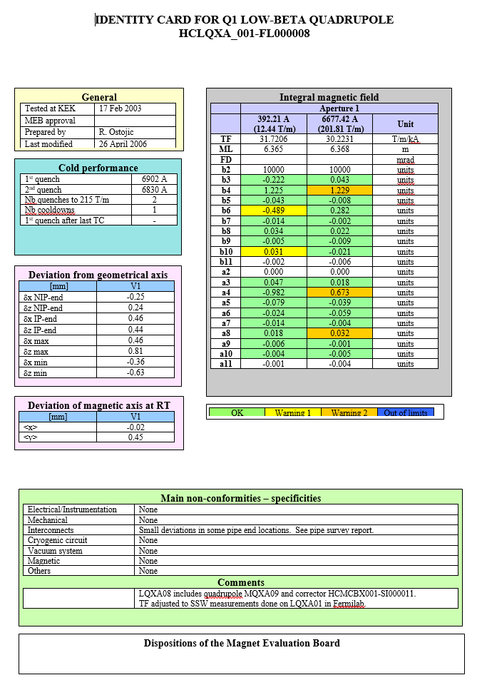
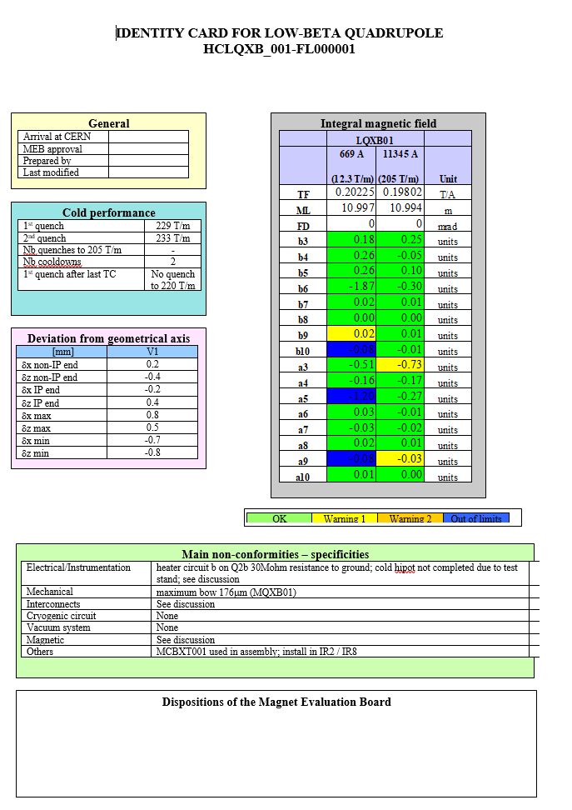
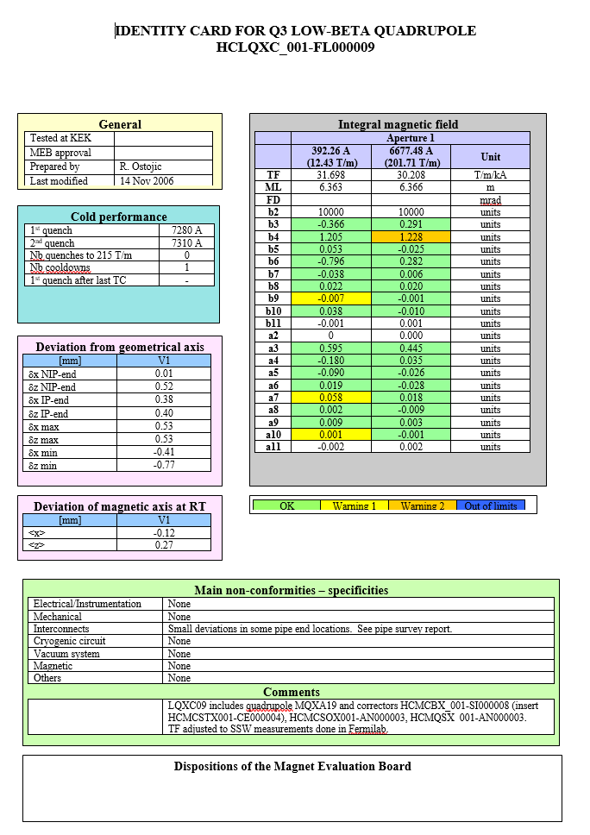
LHC IT Spare – ID cards

Slide 4
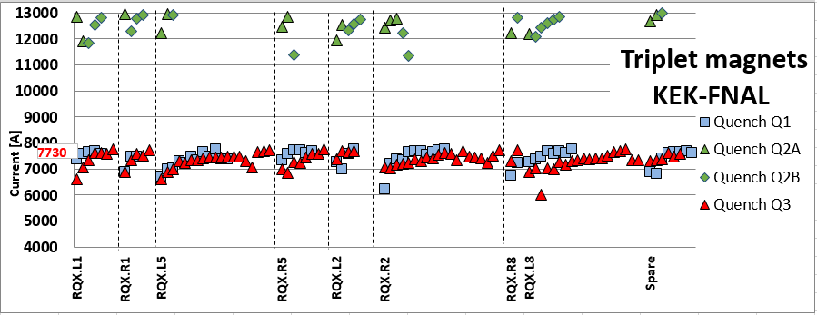
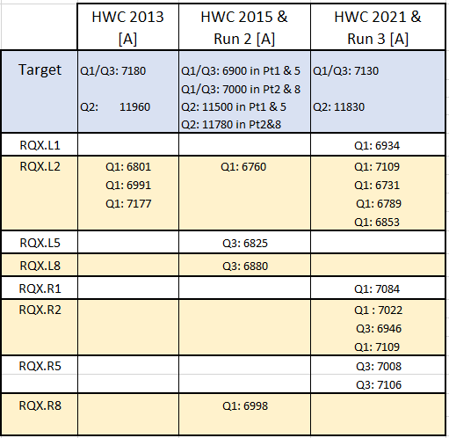
LHC IT Spare – Cryo-magnets performance
Training performance at KEK-FNAL
Training Performance
  in the LHC (see table)
NCR 555602: Strip heater YT1142 circuit open
NCR 1017174 : Reduced heater discharge on Q1

Slide 5
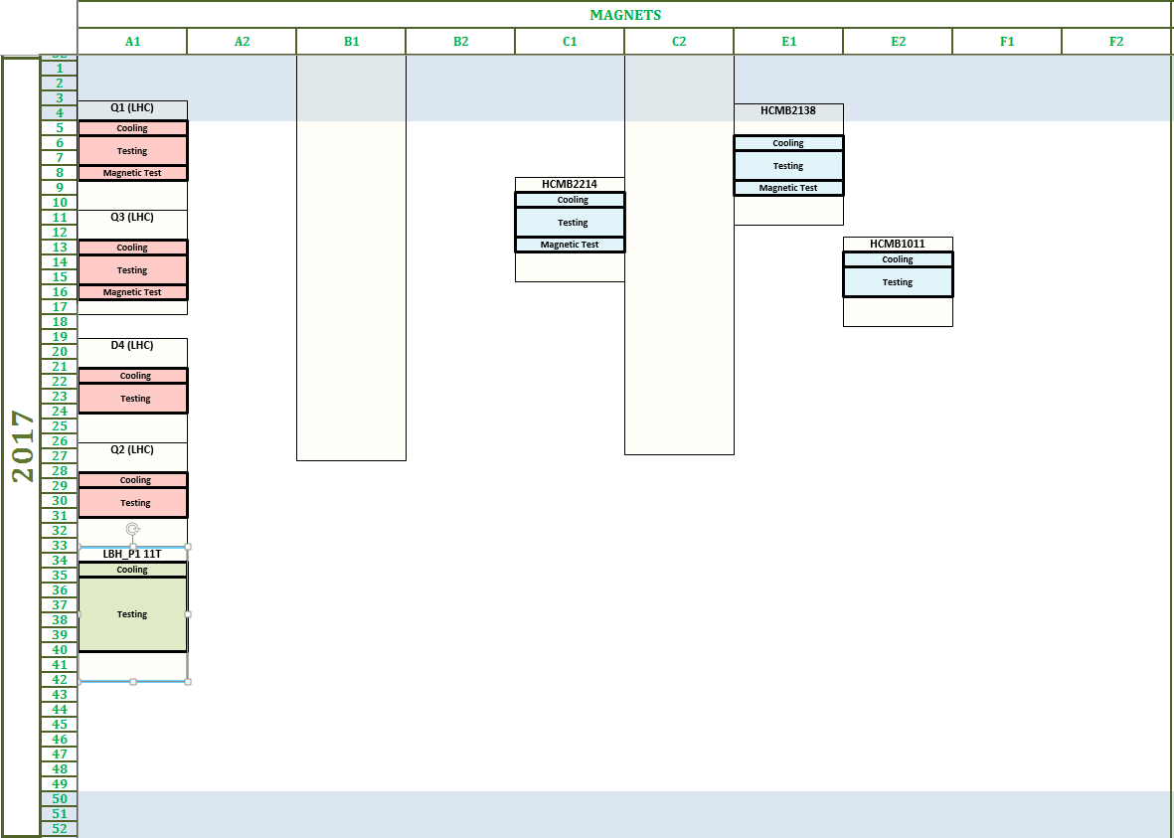
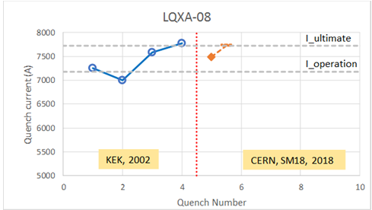
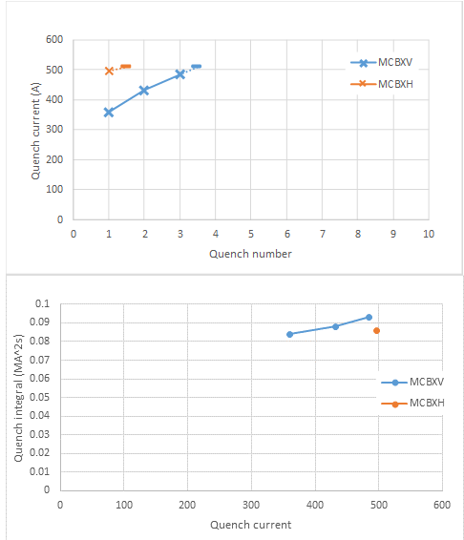
LHC IT Spare – Test at CERN
Usually, we try to test at CERN, the spare magnet before replacing a faulty one. Planned to be tested in 2017, but always consider as second priority, only the Q1 (LQXA-08) was tested in May 2018 (specific toolings needed for cold test).
Trained 4h at ultimate current

Slide 6
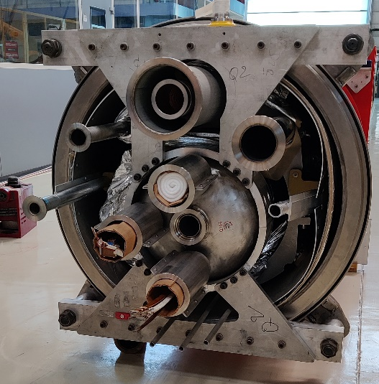
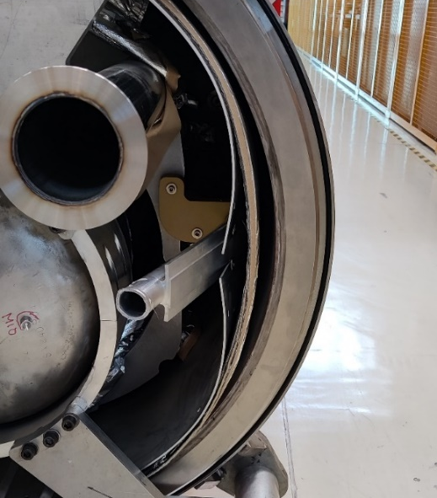
LHC IT Spare – LQXB-01 consolidation
Disconnected from the tunnel in 2007 (L5), after a pressure test failure, LQXB-01 needs some consolidation work
  Transport the cryo-magnet to Blg 180 ✓
  Exchange of the heat exchanger tube ✓
  Change of flanges (LHC type)
  Repair of ff line (thermal shield cooling)
Plan to perform the consolidation work by the end of summer. The work is followed by new (young) staff member.
This consolidation will be done in parallel with the consolidation of the MQ magnet from Q7R3. If repaired it will be the only MQ spare magnet available.

Slide 7
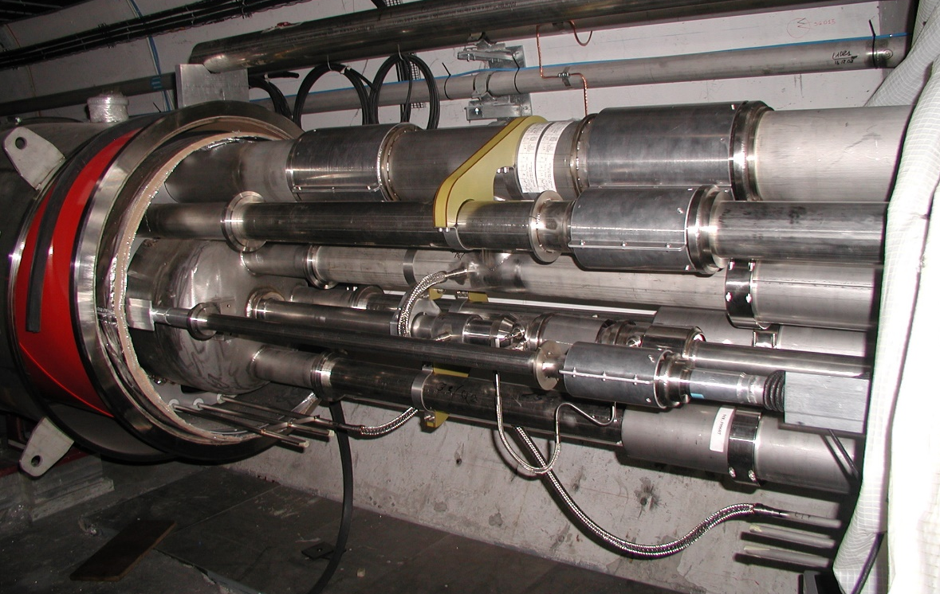
Exchange of IT cryo-magnet in the LHC
Due to the radiation level in IP1 and 5, the disconnection of the magnets must follow the ALARA rules (DIMR).
The study of the disconnection of an IT magnet in the LHC is not yet done (procedures, toolings…)
After the consolidation of the Q2 (LQXB-01), the Q3 (LQXC-09) will be transferred to bld 180, to propose some solutions for the disconnection.
Heat exchanger line (L)
Cold mass/heat exchanger line (M4)
Pumping line 2 (Xbt)
Instrumentation line (M2)
Q3
Thermal shield return line (FF)
Beam line (V)
Q2
Main bus bar line (M1)
Beam screen line (K)
4.5 K heat intercept line (C’)

Slide 8
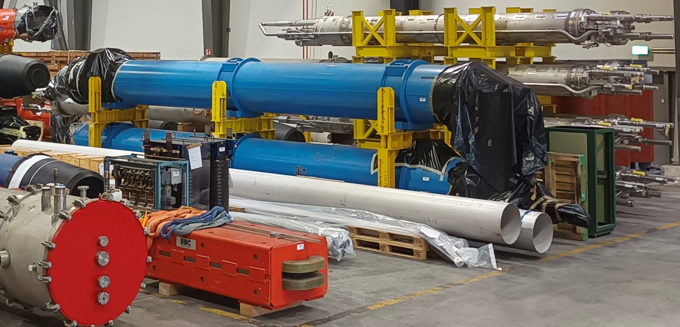
LHC LBX (D1) spare
2 LBX spare are available at CERN (for 4 units in the LHC). Both units were tested at CERN (SM18)
  HCLBX__001-BL000006 (Cold power test report : EDMS 1709956)
  HCLBX__001-BL000007 (Cold power test report : EDMS 2038642)
  The two magnets reached 6100A without quenching.

Slide 10
