Slide 1
Skew magnet installation scenarios
M. Perez Ornedo (EN-HE)
A. Herty, J.-F. Fuchs, H. Mainaud Durand, M. Sosin, K. Widuch (BE-GM) EDMS 2892773
P. A. Thonet (TE-MSC)
E. Page, G. Bregliozzi, J. Sestak (TE-VSC)
A. Infantino, S. Roesler HSE-RP
P. Fessia ATS-DO

Slide 2
Outline
Installation scenario
List of changes and information from the various stakeholders
  Vacuum system
  Transport
  Survey system
  Magnet system
  Vacuum system
  RP considerations
  Very very preliminary sequence

Slide 3
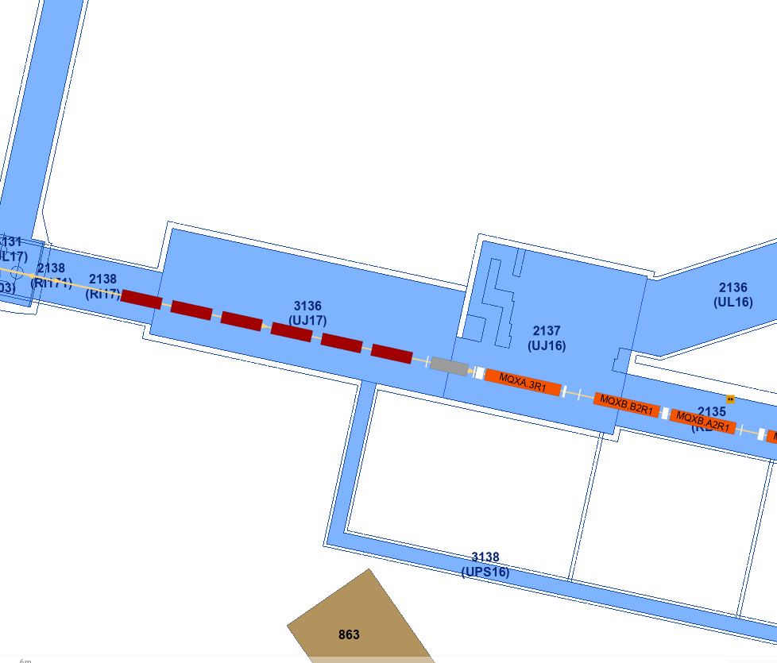
Installation scenario
option II
insert skew magnet here
less efficient
baseline
insert skew magnet here
option I
insert skew magnet here
move first D1 here

Slide 4
Vacuum lay-out preliminary layout for corrector skew Q3-D1

Slide 5
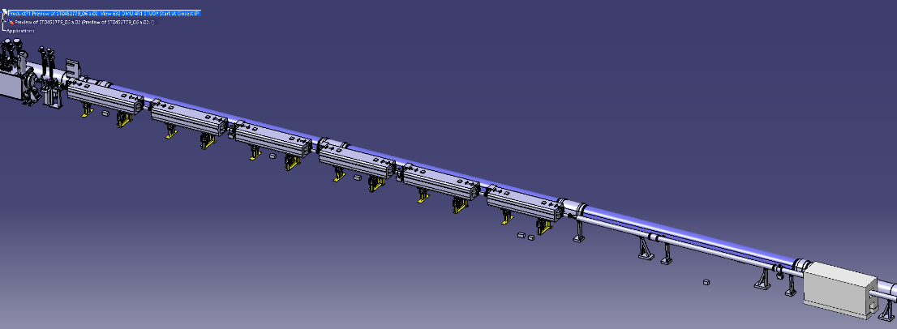
Current situation in 4R1
2 impacted areas for the installation of a new Skew quad warm magnet:
  ARC side of D1
  IP side of D1

Slide 6
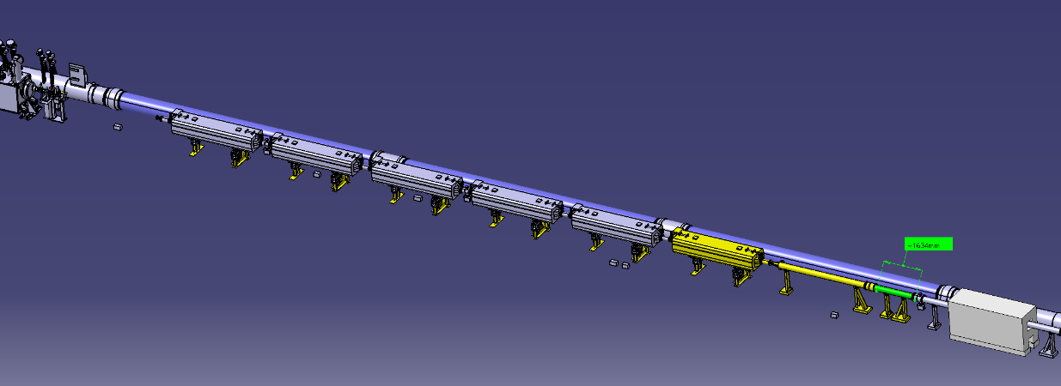
Proposition Arc side of D1
MBXW #1 goes in position #7 (new slot)
Moved equipment in yellow, already in the tunnel
New equipment in green: chamber ID212.7 L=1634mm

Slide 7
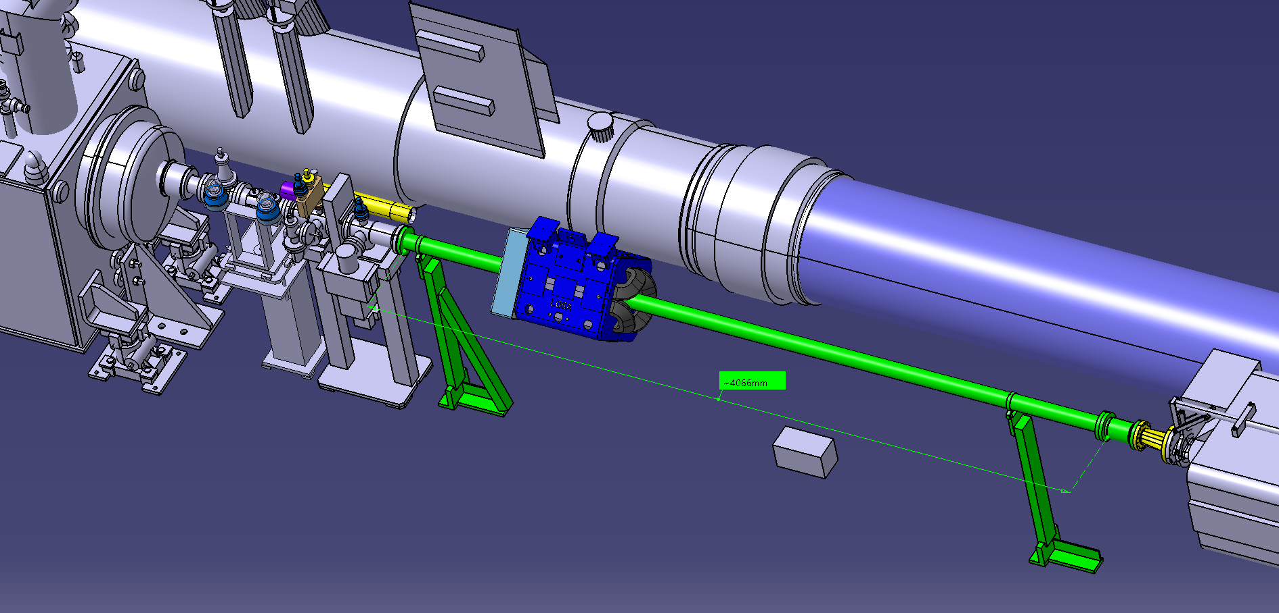
Proposition IP side of D1
Standard ID80 NEG chamber L=4066mm inserted in Skew quad: one sleeve/flange to be welded after insertion
Re-used VCTNC elliptical – circular transition chamber
Standard ID80
L= 200mm module to replace the elliptical module

Slide 8
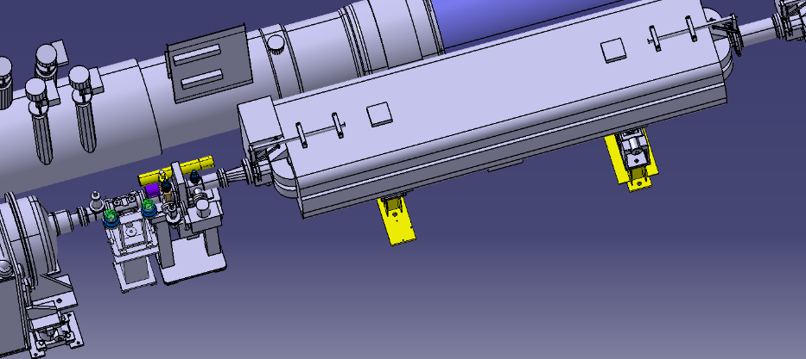
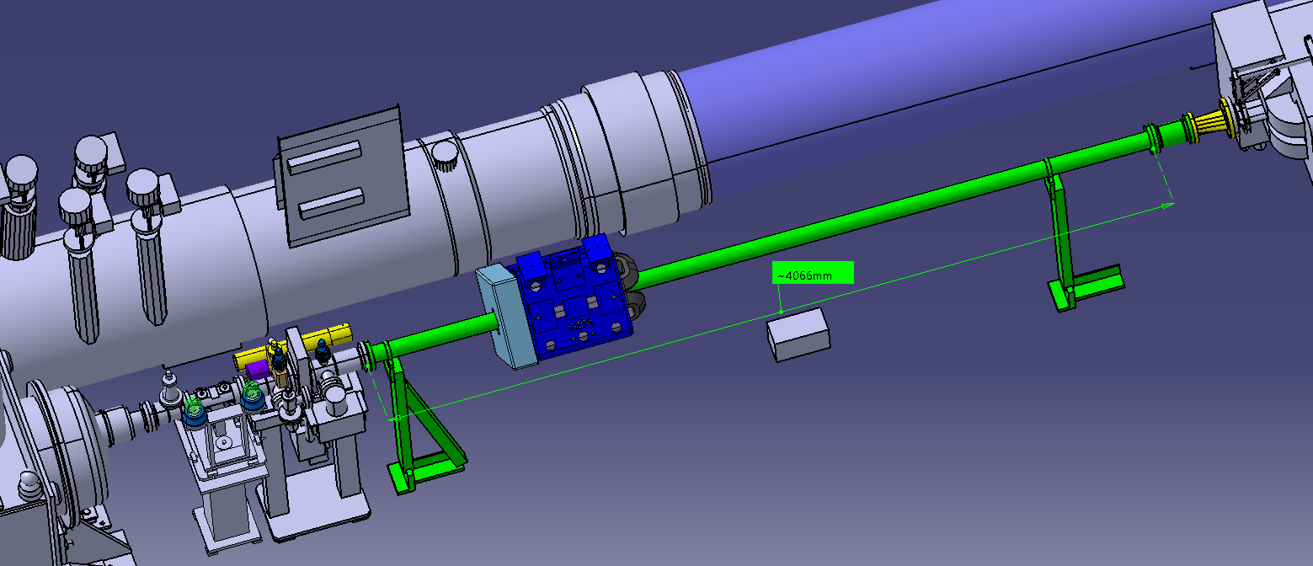
Aperture changes IP side 1/2

Slide 9
Aperture changes IP side 2/2

Slide 10
Preliminary proposition and open points
Re-used VCTNC elliptical – circular transition chamber
NEW Standard Copper Chamber Ø 80/84 (ID80) with NEG coating L=4066 mm
NEW ID212.7 chamber L=1634mm
Elliptical module 128/53 replaced by NEW ID80 standard module L=200mm
BO available space is 3 mm thickness for a Ø 80/84 chamber
Supporting of VCD Skew chamber and alignment to be checked
Cost around 10 kCHF if no new support developed (alignment)
Solution around 50 kCHF for all 4 concerned areas of the LHC
For each area:
  2 weeks mechanical intervention (including floor drilling)
  10 days of Bakeout cabling and preparation
  10 days of vacuum reconditioning - NEG activation (TAN)

Slide 11
Transport

Slide 12
Transport I
Installation (hence de-installation procedure) exists, but not yet loaded in EDMS
So far, no showstopper has been identified. If all the equipment around the magnet are removed and there are not obstacles left in the floor, it should be possible. WPS system will need to be removed while invar bar from the UPS shall stay in place and temporarily supported
The sequence would as it follows
  Once all the equipment around the magnet have been removed, install safety wedges and supplementary jacks
  Lift the magnet and place it on the wedges
  Remove the double jack
  Introduce de bogies (prepared with wedges)
  Place the magnet on the bogies and lash it
  Remove the magnet from its position towards the transport side
  Transport it to the new position
  Follow the installation sequence
In point 1 it is needed to remove the shielding next to the magnets.
The estimated time of the operation is 1 week/per IP side. No parallelism possible among IP sides

Slide 13
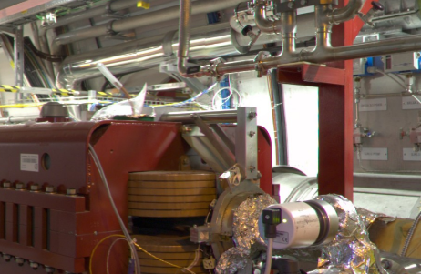
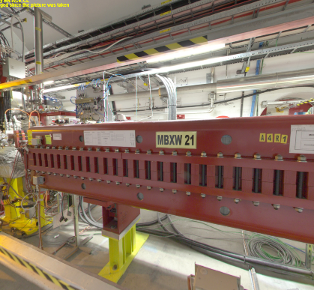
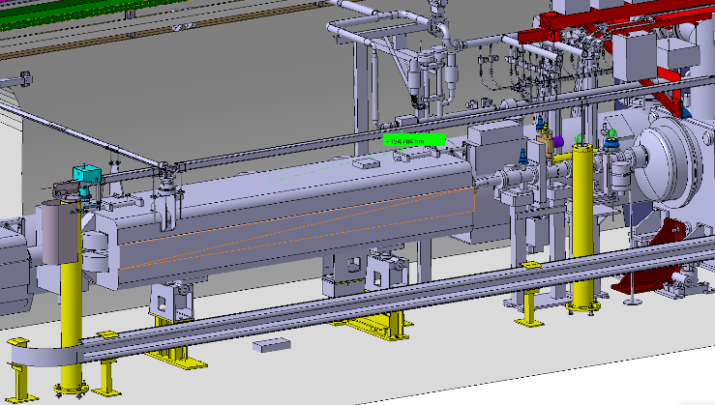
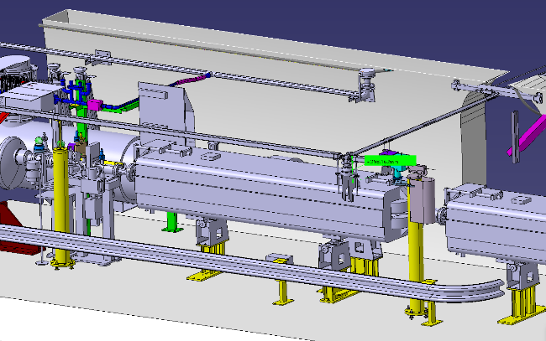
Transport II Other checks needed
P1 Left
P1 Right
Limiting element in height the survey line from the UPS.
Limiting element in height the DFBX ancillary pipe. If 15 cm it should be possible, but measurement in real is required

Slide 14
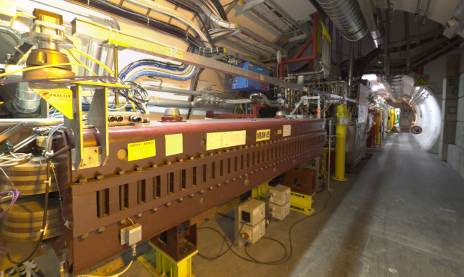
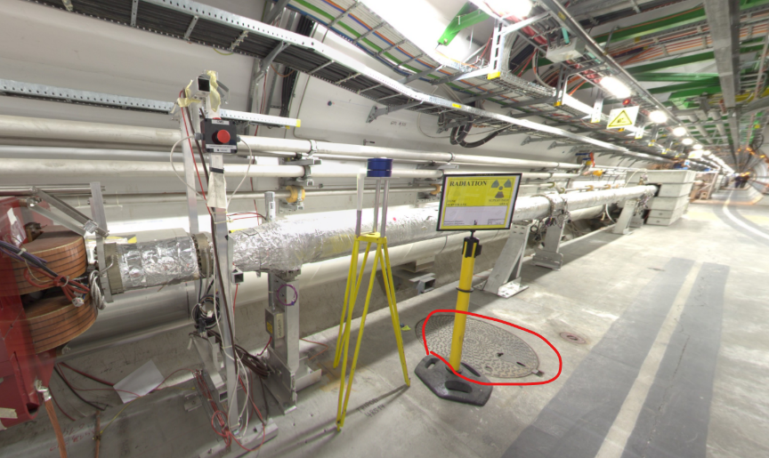
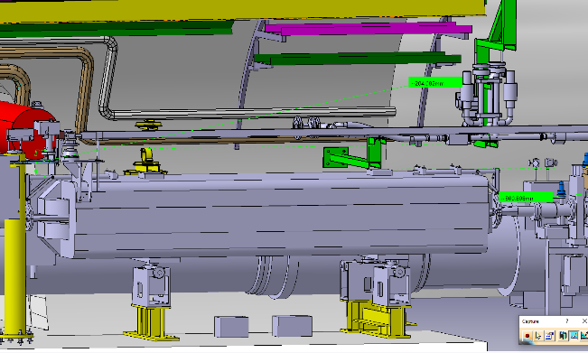
Transport III Other checks needed
P5 Left
P5 Right
Possible interference of the manhole with the new jack position need to be verified

Slide 15
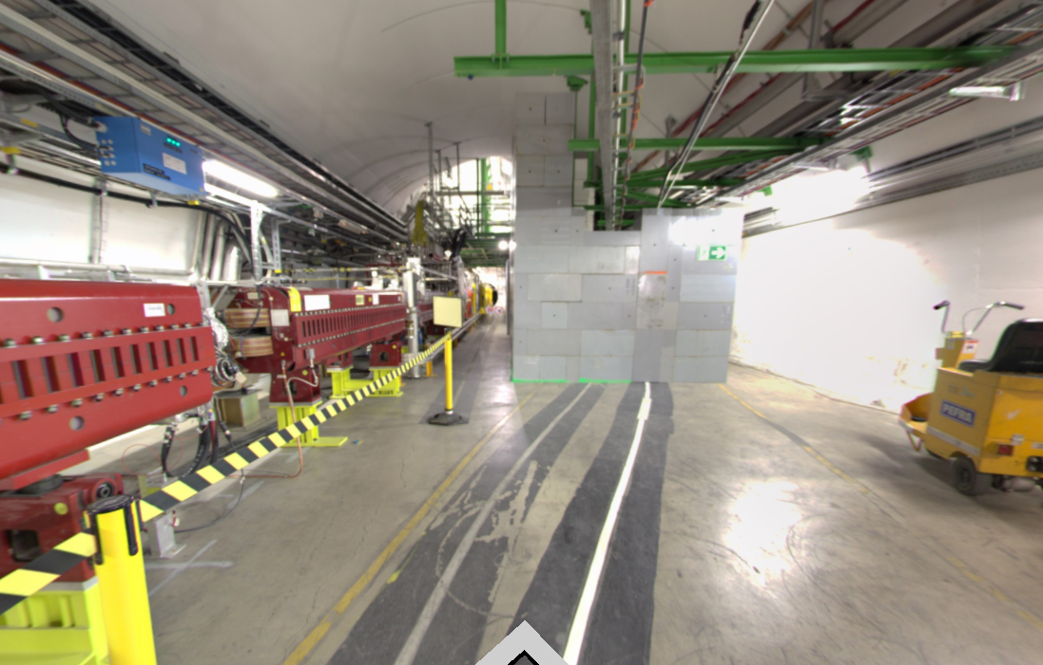
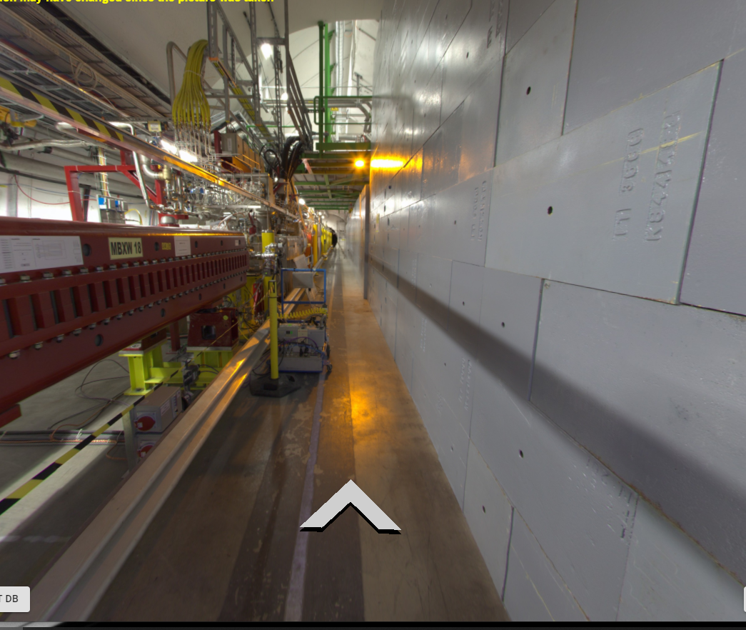
Shielding to be removed in P1

Slide 16
Magnet intervention

Slide 17
Displacement of the MBXW from IP side to non IP side
The compatibility of existing networks have been checked with respect to available photos in GIS portal. The following tables summarize the actions to be done for each point.
All the assumptions shall be confirmed by an inspection on site. This is planned to be done in June during the Technical Stop.

Slide 18
DC cables
 | Actions required
Point 1 left | Make an extension of 2 cables (last magnet on the left). | Re-use 2 existing cables taken from the displaced magnet.
Point 1 right | Make an extension of 2 cables (last magnet on the right). | Re-use 2 existing cables taken from the displaced magnet.
Point 5 left | Difficult to see from the picture. we would probably have to make an extension of 2 cables (last magnet on the left). | Re-use 2 existing cables taken from the displaced magnet.
Point 5 right | Not possible to see from the picture. In worse case we would have to make an extension of 4 cables (last magnet on the left and right). | Re-use 2 existing cables taken from the displaced magnet.

Slide 19
Interlock cable
 | Actions required
Point 1 left | Make an extension of 1 interlock cable | Re-name the magnets in WIC system
Point 1 right | From picture the interlock cable may be long enough. It shall be confirmed during inspection. Otherwise we will need to make an extension of 1 interlock cable. | Re-name the magnets in WIC system only if a cable extension is required.
Point 5 left | Make an extension of 1 interlock cable | Re-name the magnets in WIC system
Point 5 right | Make an extension of 1 interlock cable | Re-name the magnets in WIC system

Slide 20
Demineralized water
 | Actions required
Point 1 left | 2 options: Make a new piquage for the last magnet on the left. Install new hoses for all the 6 magnets
Point 1 right | Install new hoses for the last magnet on the right
Point 5 left | 2 options: Make a new piquage for the last magnet on the left. Install new hoses for all the 6 magnets
Point 5 right | 2 options: Make a new piquage for the last magnet on the right. Install new hoses for all the 6 magnets

Slide 21
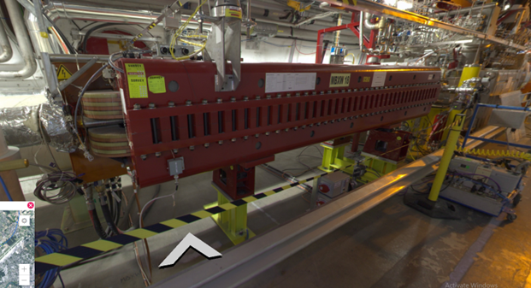
Temporally storage of the magnets and moving of the supporting structure
The magnet could be removed form its present location, and then temporarily stored in the tunnel few meters away from its future location. This temporarily storage should not affect any access or transport which would need to be done in the area.
The new position of magnet supports shall be marked by survey on the floor.
The existing supports and jacks would be dismantled from present location and re-installed at the new location.
New supports holes shall be drilled (I think by EN-ACE)
The jaks shall be re-aligned by survey.
The magnet is re-installed at the new location.
Jack
Support

Slide 22
Survey system

Slide 23
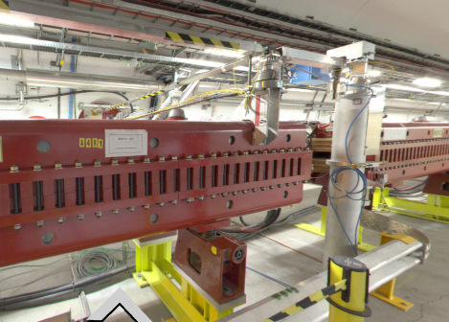
Consequences for LSS alignment
This baseline has a major impact as
During the (E)YETS of the installation, a full measurement for the alignment of the LSS and the experiments shall be carried out before any intervention on the magnet.
The impact on the smoothing strategy of the concerned LSS has to be studied during the definition of the installation timeline
Part of the invar radial measurement system is hosted on the MBXW module to be moved. The removal would lead to an interruption of the continuous position determination between tunnel and cavern
The reference wire along the triplet has to be unstretched (and potentially replaced) which will result in the need to perform the calibration of all WPS sensors
A temporary fixation system has to be installed for the invar radial system during the handling. It cannot be dismounted and a limited vertical clearance for removing the magnet is imposed (seen with EN-HE)
New mechanical structures have to be designed, built and installed to support the invar radial system and the WPS reference sensor

Slide 24
Contribution BE-GM-ASG
activity | days per side | personnel | location
preparation | 4.0 | 1 | surface
alignment steps | 3.5 | 2 | LHC
documentation | 0.5 | 1 | surface
SUM | 11.5 man.days per side
Reminder
For the modification of the installation, the survey guidelines apply EDMS 2708664

Slide 25
Contribution BE-GM-HPA
activity | days per side | personnel | location
preparation | 3.5 | 1 | surface
contribution mechanical workshop BE-GM | 2.0 | 1 | surface
data quality assurance of measurement system before dismounting | 0.5 | 1 | surface
dismounting / securing of measurement system | 0.5 | 2 | LHC
installation and recommissioning of sensors and measurement system | 1.5 | 2 | LHC
WPS sensor calibration | 2.0 | 2 | LHC
documentation | 0.5 | 1 | surface
SUM | 14.5 man.days per side
Cost estimation
modification of measurement system: 2500 CHF per side (first estimation). At this level of study it is not excluded that it could raise to 10,000 CHF per side
Intervention time in the tunnel:
Presently 6 working days are estimated, but this is the minimum intervention time required
Remarks
The 150 mm available between top of magnet and the invar radial system are sufficient for EN-HE
The calibration of the sensors has to be carefully studied or concessions with respect to an absolute calibration of
≤ 50 μm for the WPS sensors can be accepted by BE-OP
no radial measurements and link left-cavern-right for the time of intervention (wire dismounting to wire installation)

Slide 26
Other activities
The support of the present magnet shall be removed, it could be possible that some small interventions on the floor would be needed. This requires in situ inspection and detailed analysis
The same applies for smaller signal cables and other ancillaries in the area
Other supports will require in situ verification

Slide 27
RP considerations

Slide 28
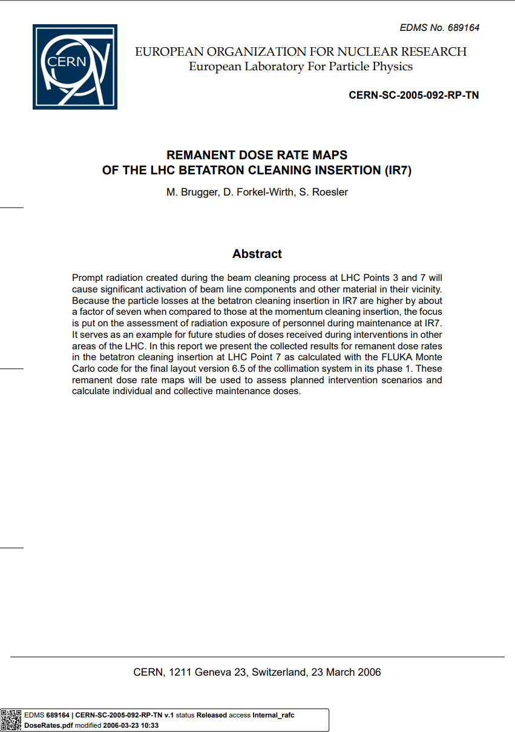
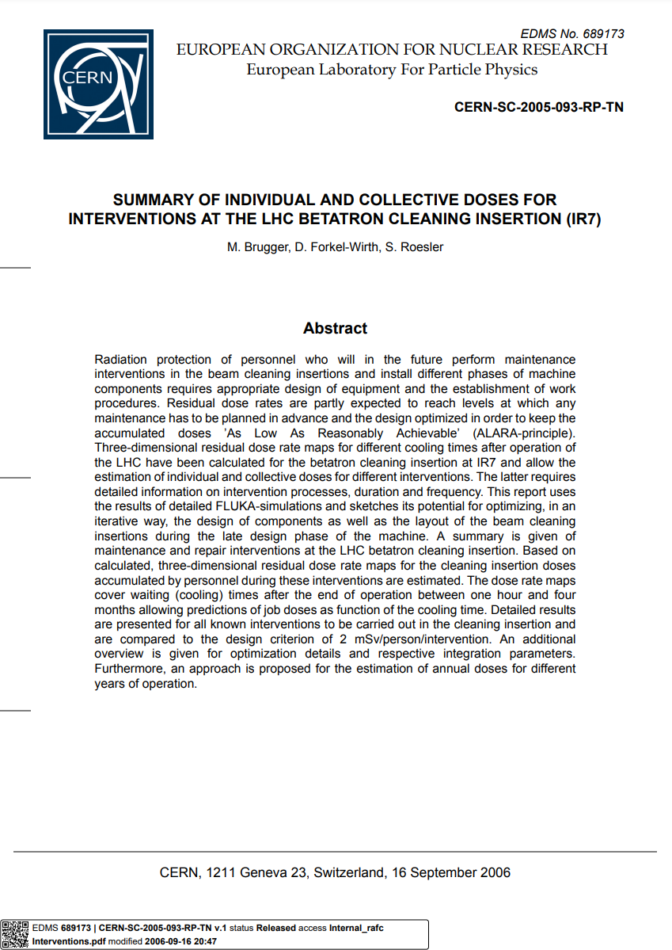
The RP implications in the exchange of warm magnets were studied for IR7 (D3/4, Q4/5)
Dose rate maps
Intervention scenarios and job doses

Slide 29
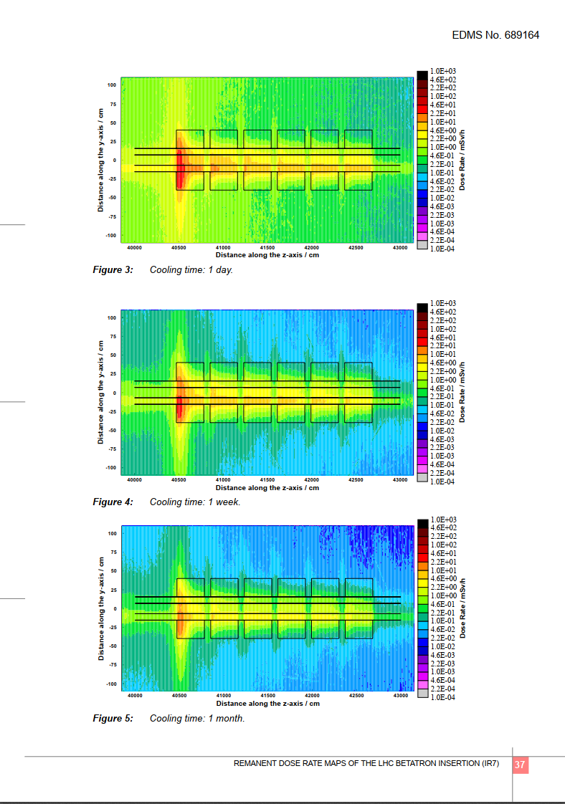
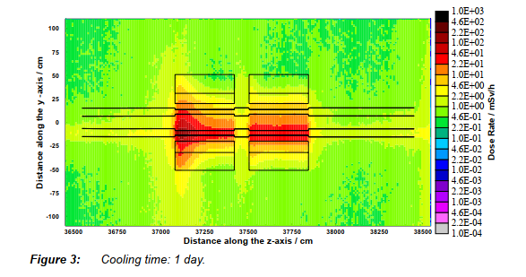
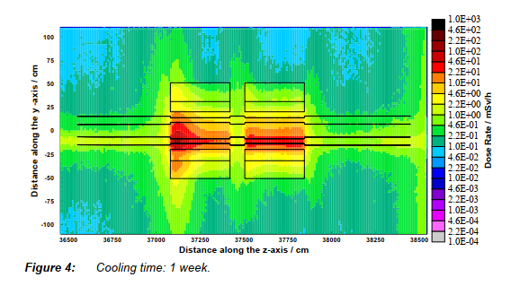
EDMS 689164
D3
Q5

Slide 30
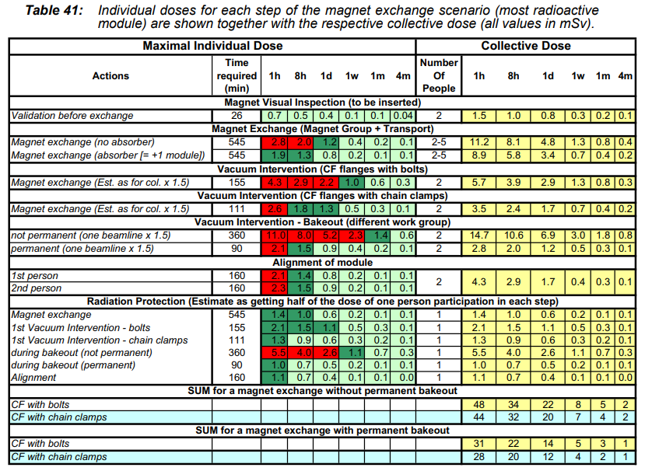
EDMS 689173
Exchange of most radioactive module of Q5
~1 week cooling
Individual dose: <1mSv
Collective dose: 2-8 mSv

Slide 31
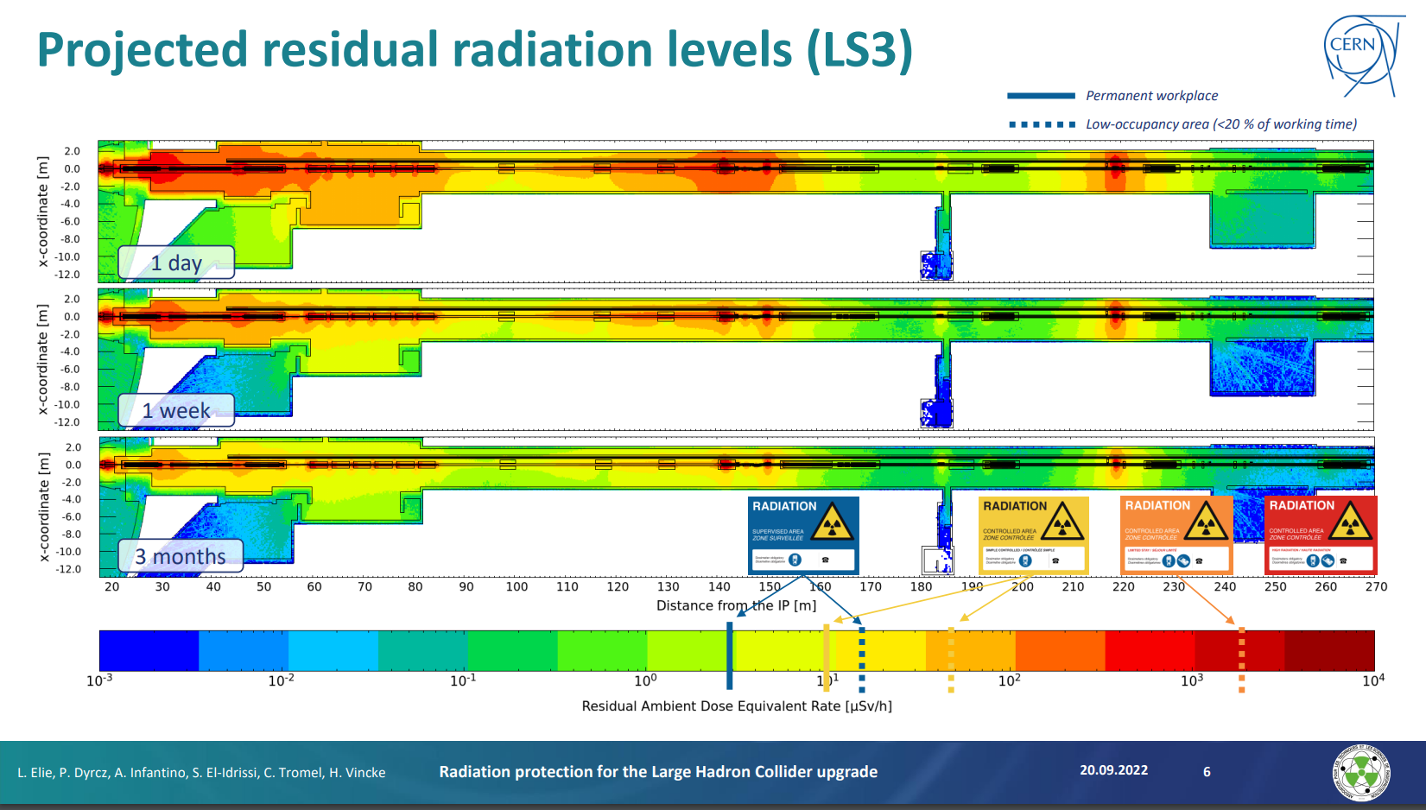

Slide 32
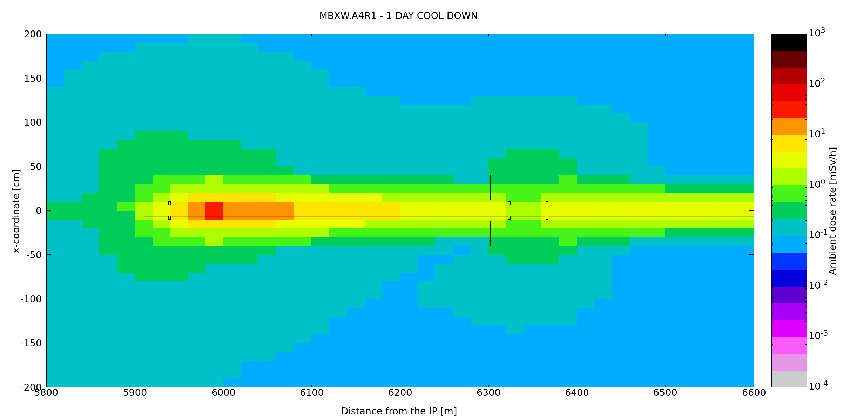
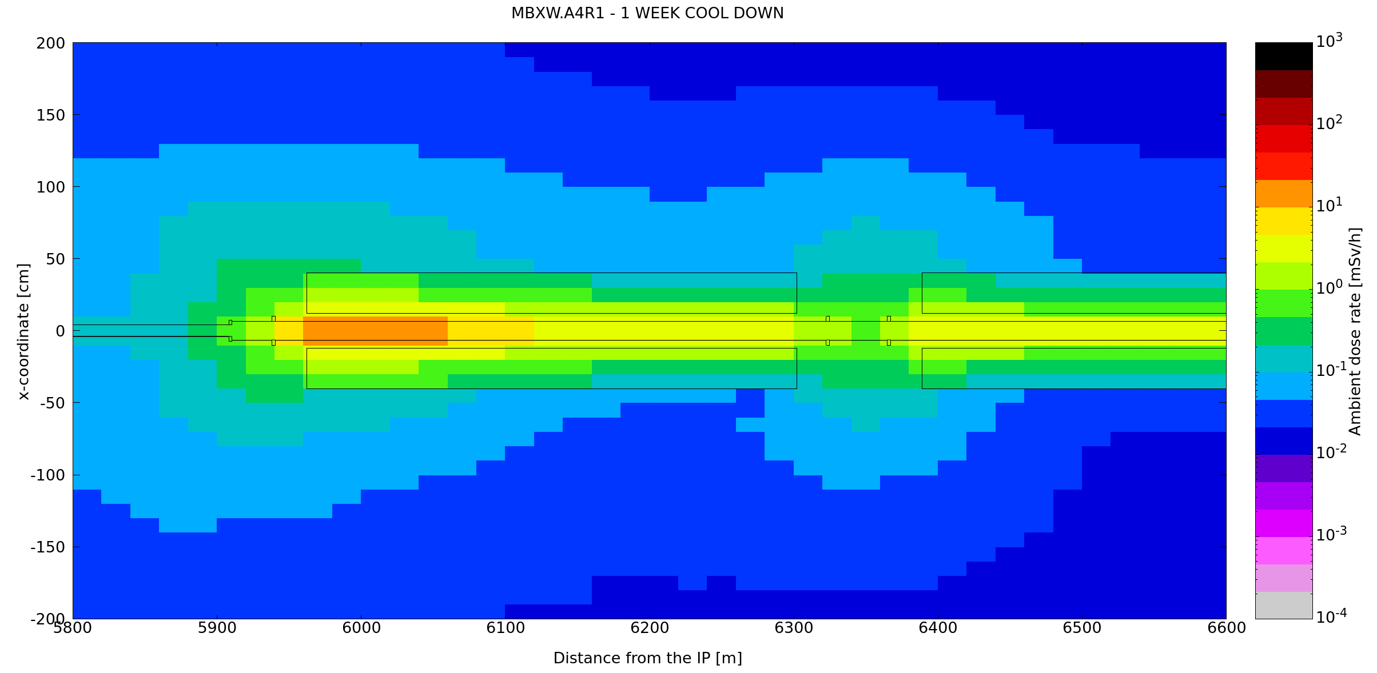
Q5
MBXW.A4R1

Slide 33
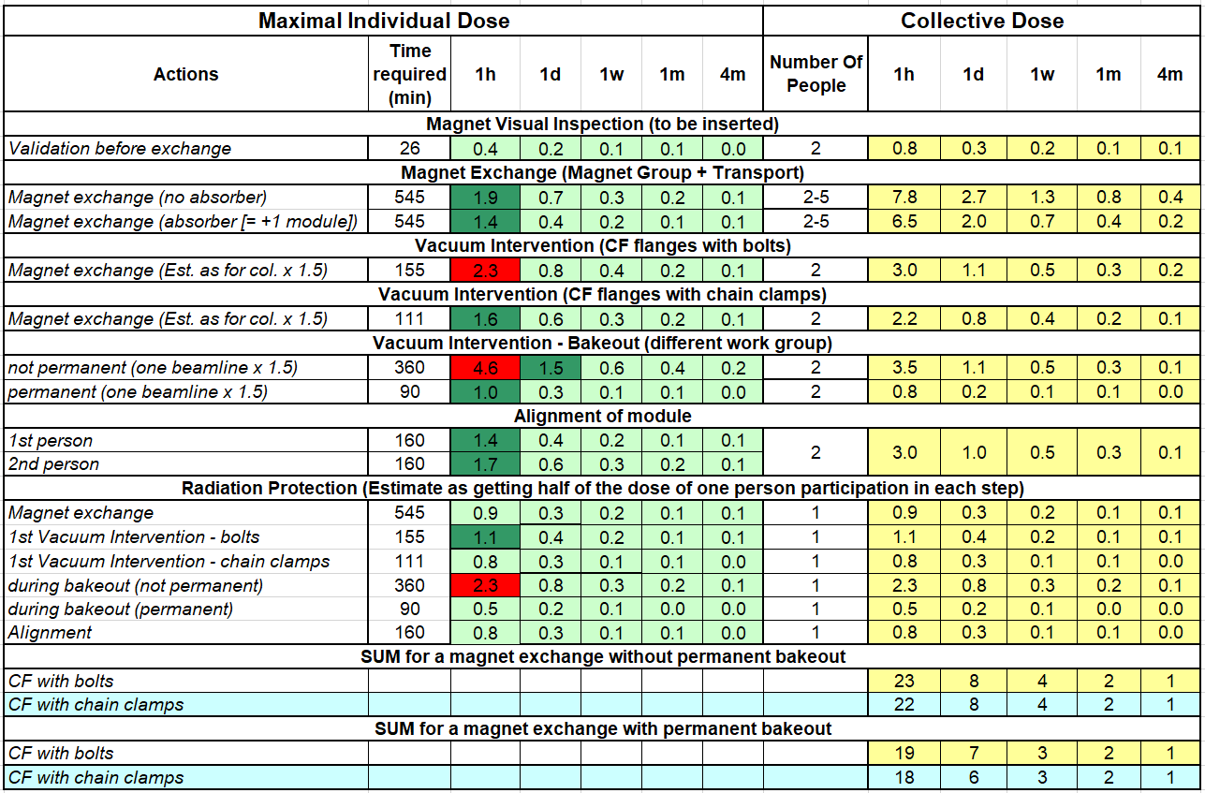
Q5
MBXW.A4R1
~1 week cooling
Individual dose: <1 mSv
Collective dose: 2-8 mSv
~1 week cooling
Individual dose: <0.5 mSv
Collective dose: <5 mSv
ALARA Level 2

Slide 34
Very very preliminary summary of time needed per IP side (de-installation and re-installation)
Observation: the listed activities will not be transparent vs resource allocation in (E)YETS and even for other running projects (HL) DFBX- 1st MBXW, MBXW chain, 6th MBXW-TAN
1.5 week for in parallel
    Removing equipment around 1st MBXW (MPE, BE-GM, … ?)
    Vacuum de-interconnection (TE-VSC)
    MBXW disconnection (water and cables) (TE-MSC)
    Cable elongations (E-EL)
    tracing of new equipment on the floor for MBXW (BE-GM-ASG)
    Preparation of vacuum system on the non-IP side of the 6th MBXW (TE-VSC)
    Installation of new supports on the non-IP side of the MBXW (EN-ACE)
    New water connections (EN-CV)
1 week (+1 week in IP1) for
  Disassembly shielding wall (IP1 EN-HE)
  Displacement of the MBXW module (EN-HE)
  Tracing of new equipment on the floor (BE-GM-ASG)
  RE-assembly shielding wall IP1 EN-HE)
  Pulling new EN-EL cables for the skew quadrupole
2 weeks in parallel
  Installation on new supports on the newly freed area on between DFBX and MBXW (EN-ACE,TE-VSC, BE-GM) . Re assembly and recalibration WPS
  Installation of the skew quadrupole (EN-HE)
  Mechanical installation after last MBXW (TE-VSC)
  Preparation of bakeout cabling and bakeout preparation on the vacuum area D1-TAN (TE-VSC)
  Cable and water hoses connections (TE-MSC)
1-1.5 week in parallel
  Closure of the vacuum (TE-VSC) . Possible needs of BE-GM
  Bakeout preparation on the area between DFBX and MBXW
  MBXW purge (TE-MSC)
10 days bake-out
3 days re-installation ancillaries DFBX (MPE, BE-GM, … ?)
TOTAL 9.5 (+1 IP1 ) weeks.
Some optimization possible,
More technical analysis needed
Some incompressible time without overlap, i.e. EN-HE for the 4 IP minimum 5 weeks

Slide 35
Useful data from TE-VSC

Slide 36
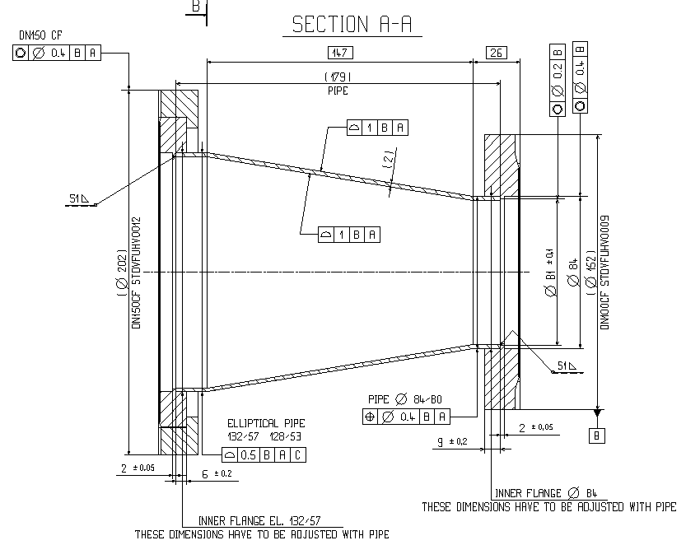
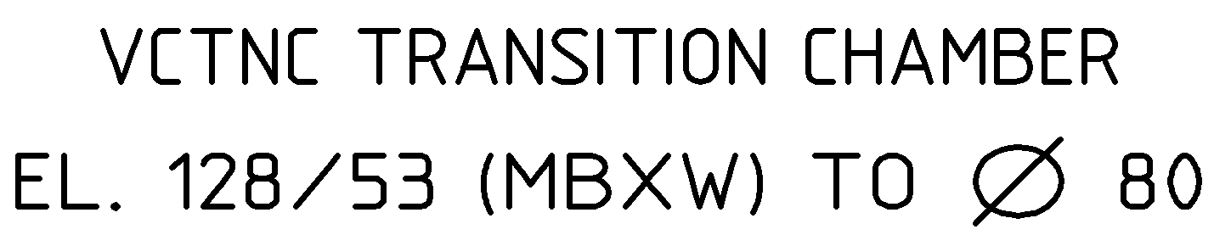
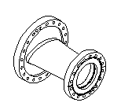
Transition part VCTNC –

Slide 37
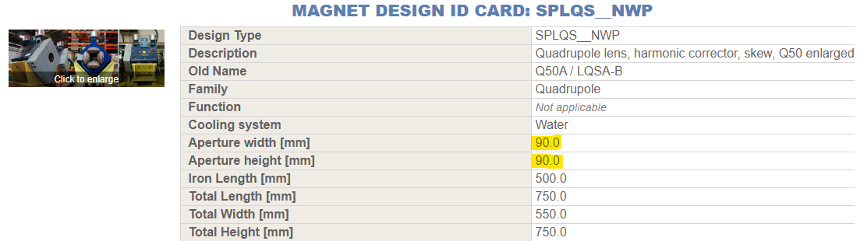
Aperture check between Skew magnet coils

Slide 38
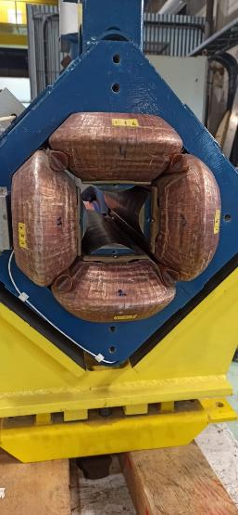
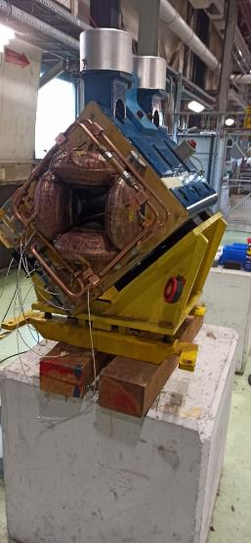
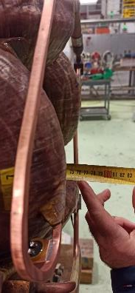
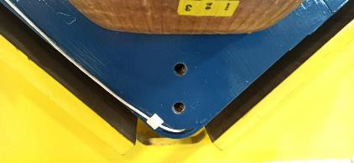
Visit at 867 with P. Thonex on 06.02.2023
Minimum chamber length with flanges would be around 800 mm
Possibility to fix supports for the vacuum chamber on the magnet
Mechanical Drawings of the magnet and/or 3D reference → TE-MSC?

